Slide 1
monopile
All Monopile Pipeline
Add 3 WTIV

Slide 2
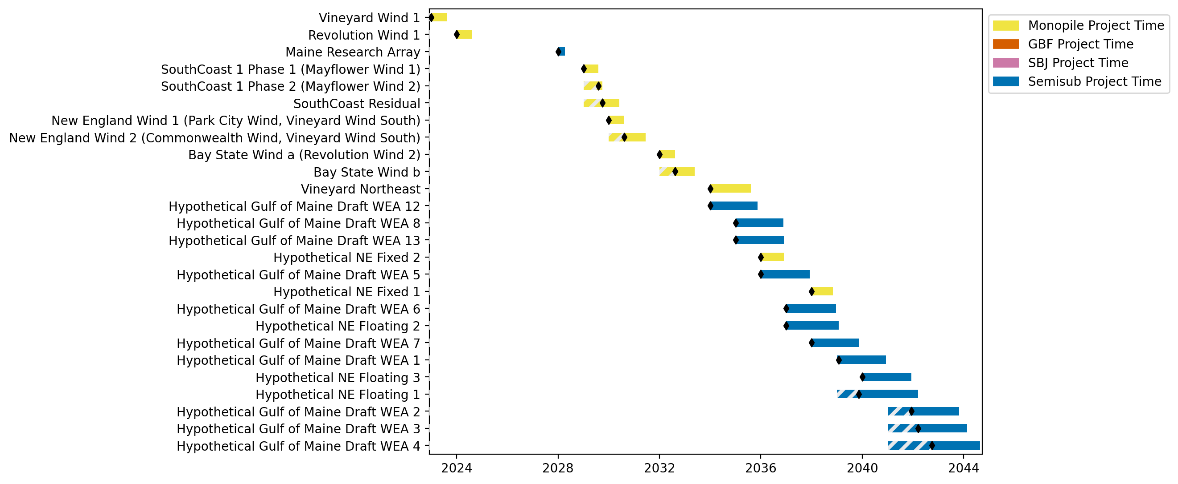
New England Gantt

Slide 3
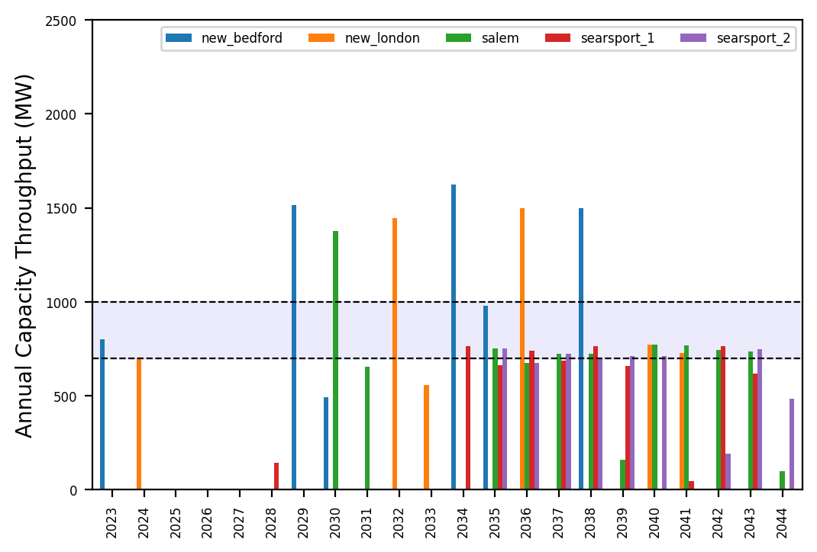
Port Throughput

Slide 4
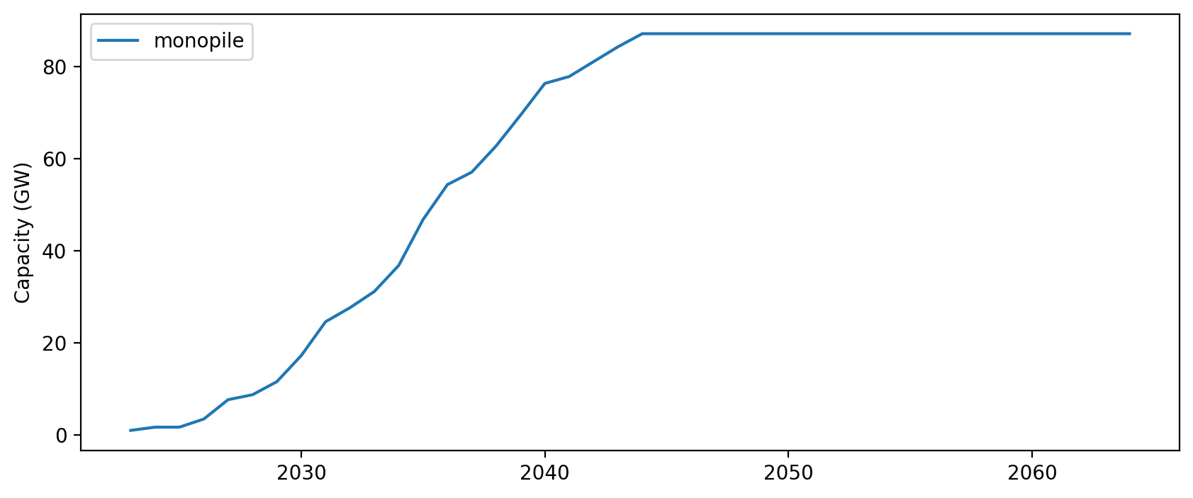
Installed Capacity

