Slide 1
natl_gaps_2us
t
e
x
t

Slide 2
natl_gaps_3us
t
e
x
t

Slide 3
natl_gaps_4us
t
e
x
t

Slide 4
natl_gaps_4us_infp
t
e
x
t

Slide 5
natl_gaps_infv
t
e
x
t

Slide 6
natl_gaps_no_action
t
e
x
t

Slide 7
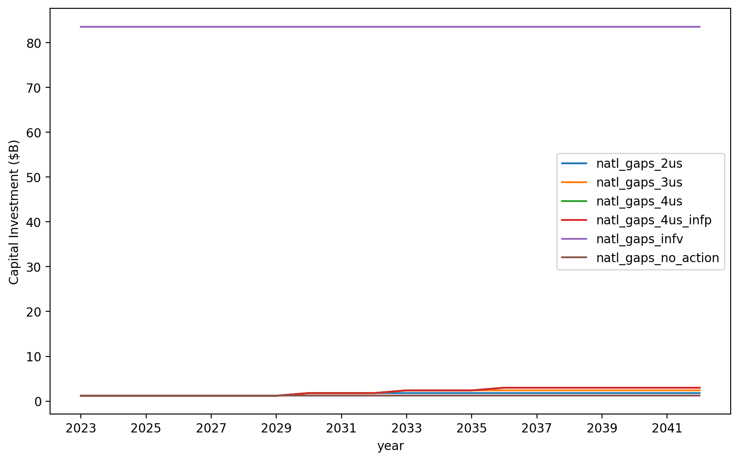
Vessel Investment

Slide 8
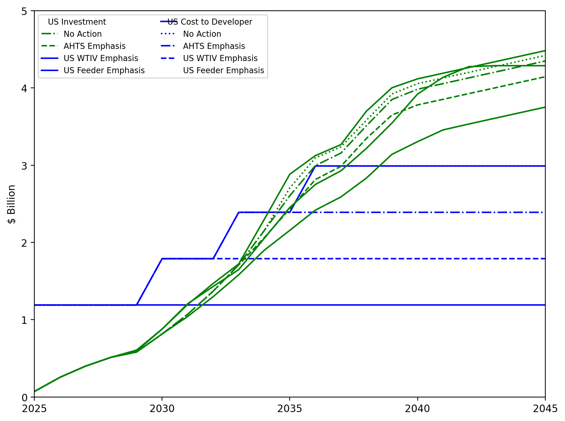
US Investment Summary

Slide 9
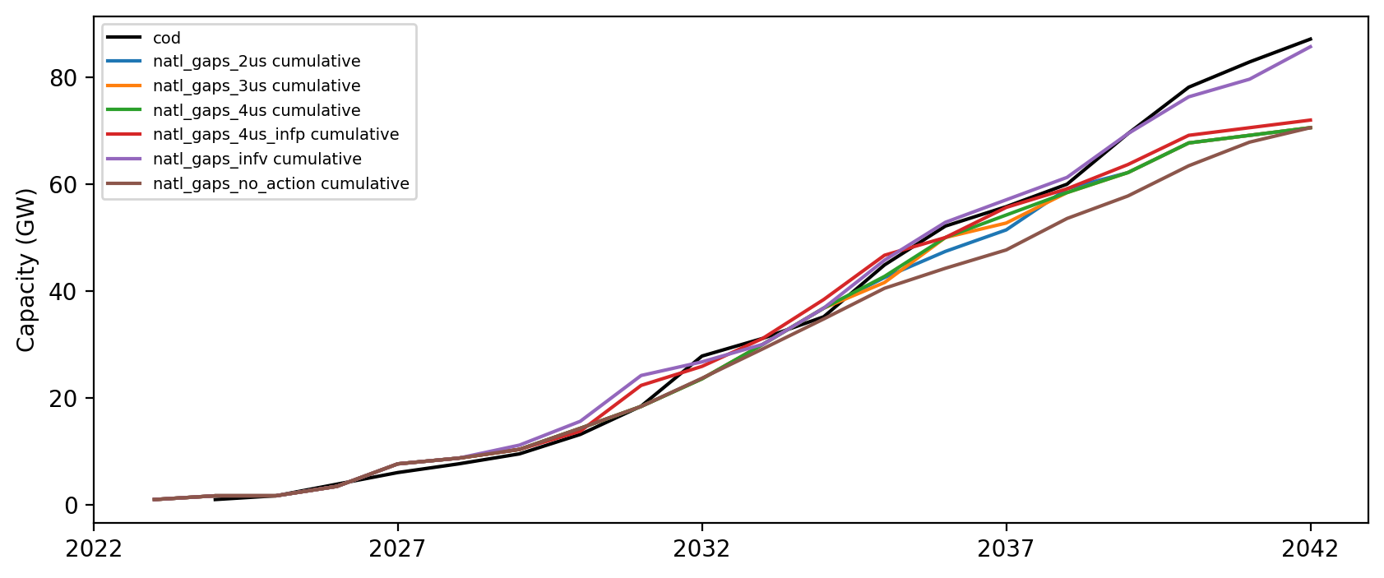
Installed Capacity

Slide 10
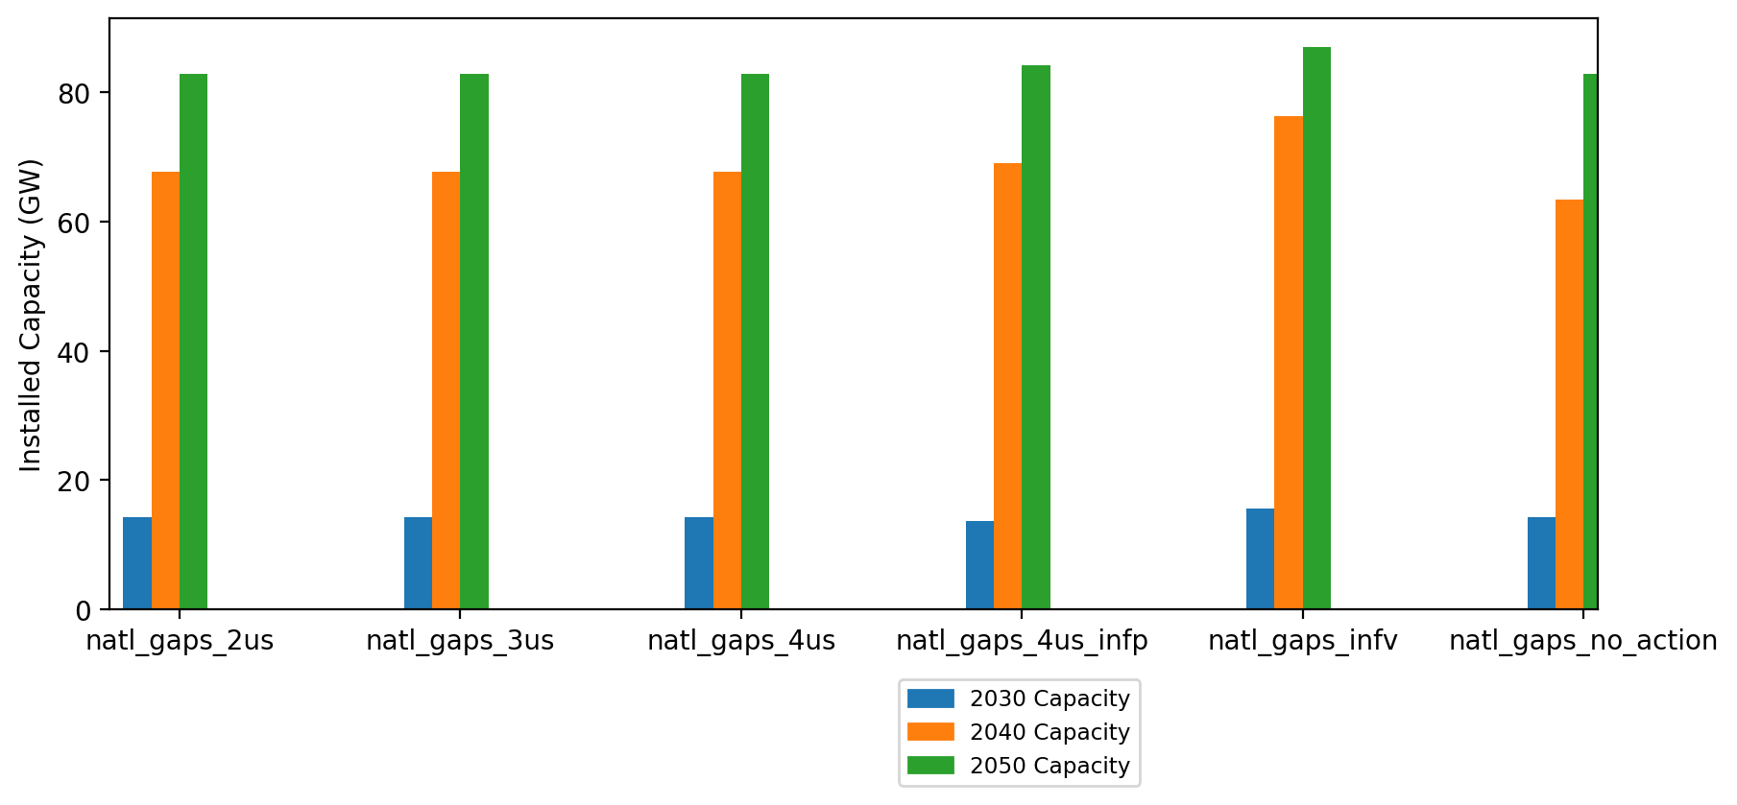
Summary Installed Cap

