Slide 1
1 WTIV
t
e
x
t

Slide 2
2 WTIV
t
e
x
t

Slide 3
3 WTIV
t
e
x
t

Slide 4
4 WTIV
t
e
x
t

Slide 5
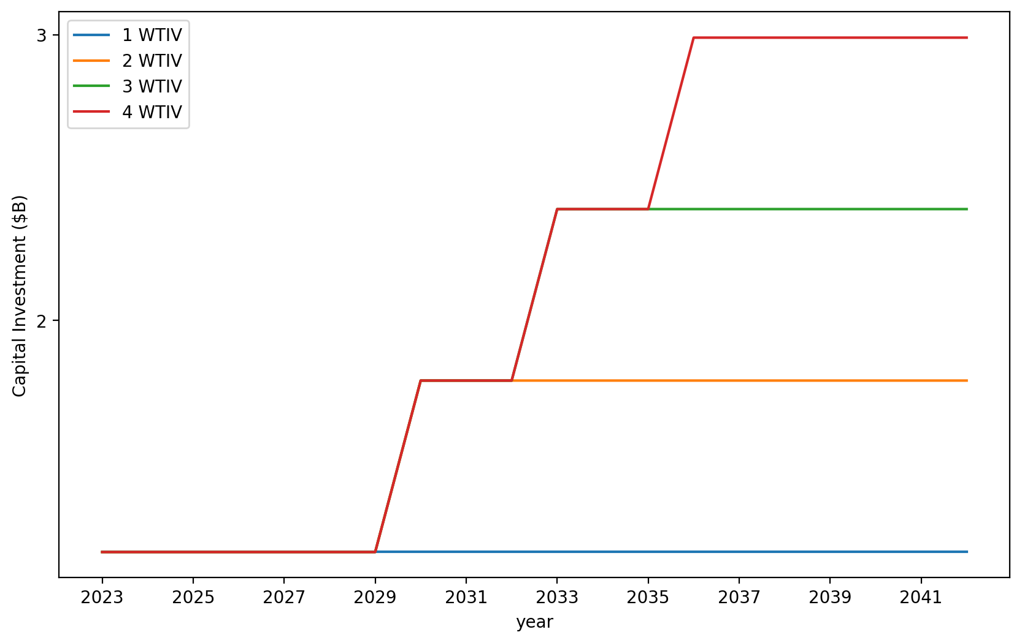
Vessel Investment

Slide 6
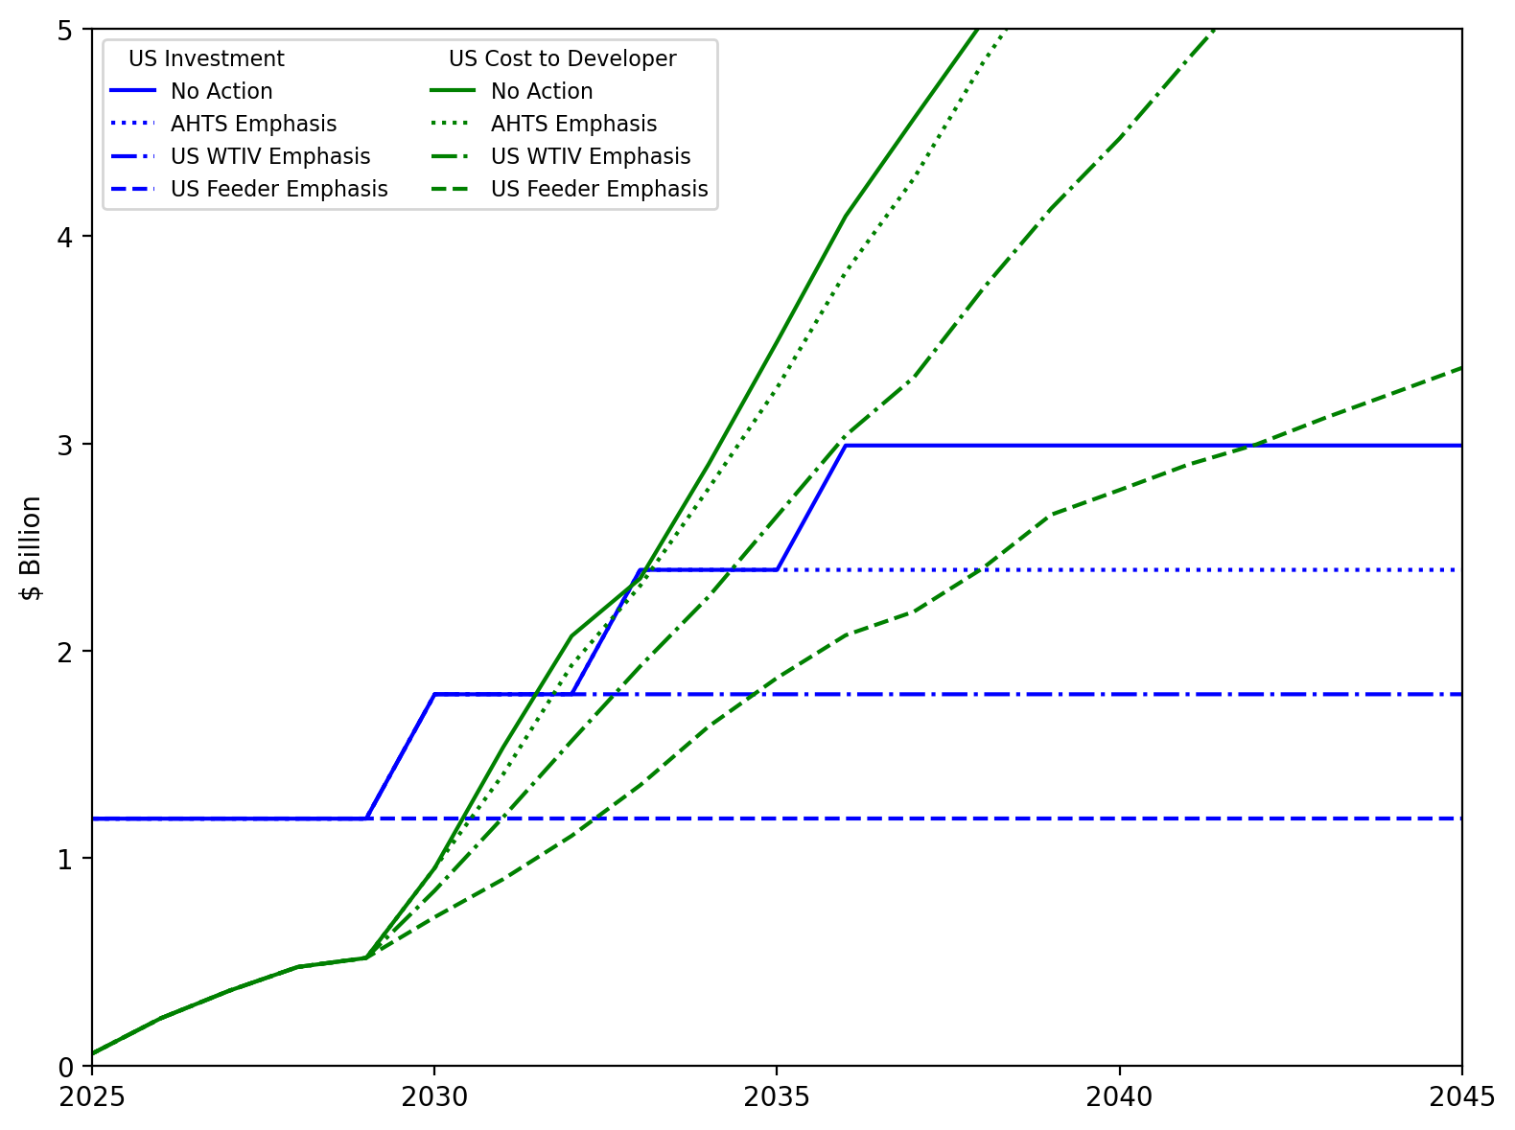
US Investment Summary

Slide 7
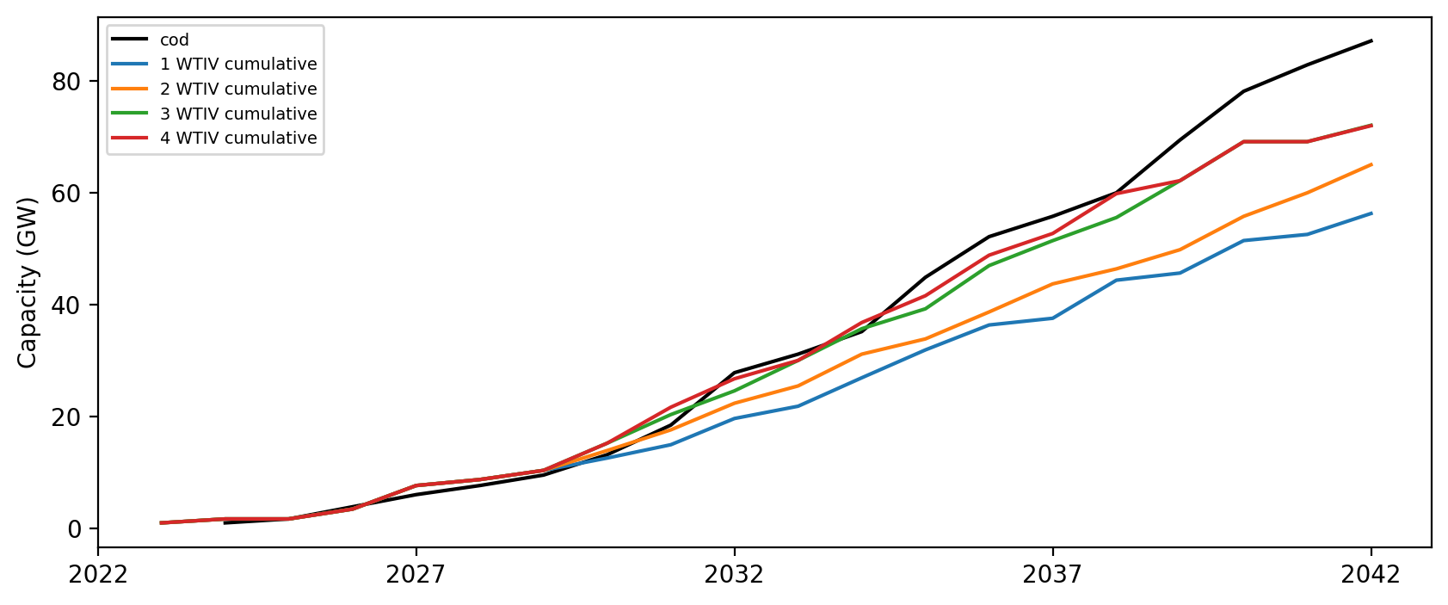
Installed Capacity

Slide 8
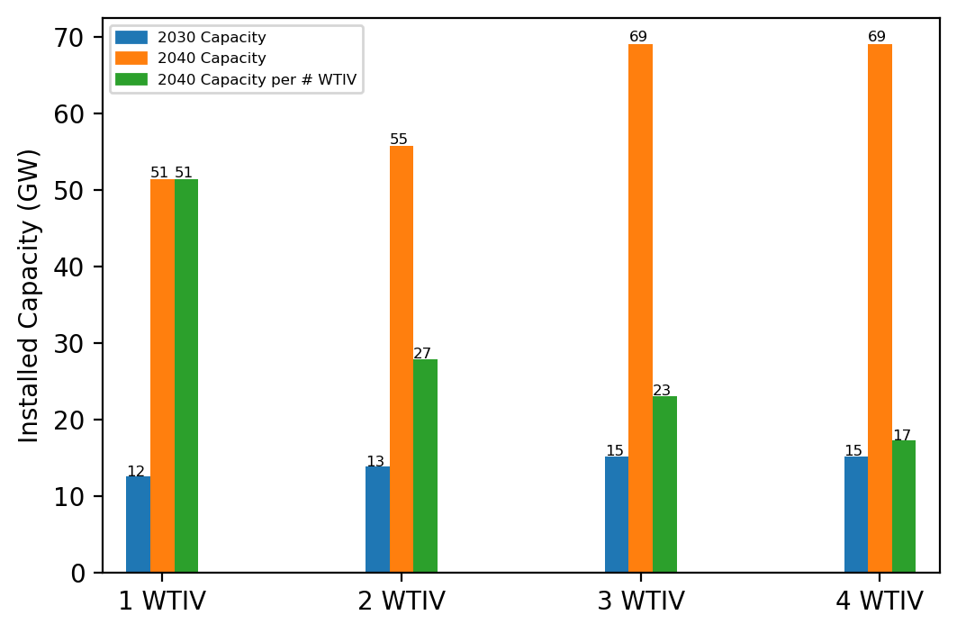
Summary Installed Cap

Slide 9
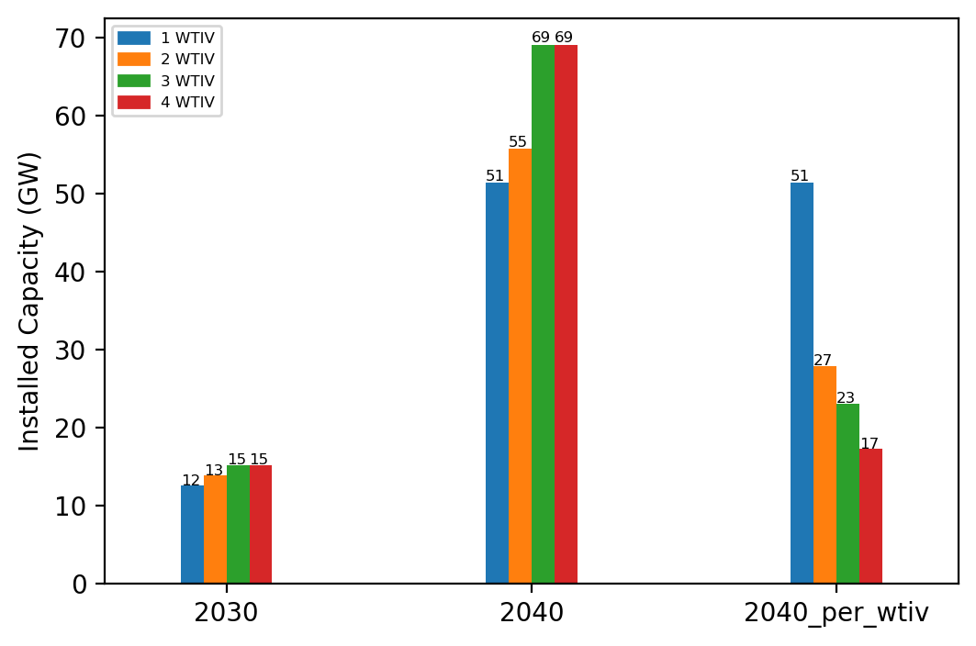
Summary Installed Cap T

