Slide 1
natl_gaps_no_action
1 US WTIV starting with CVOW

Slide 2
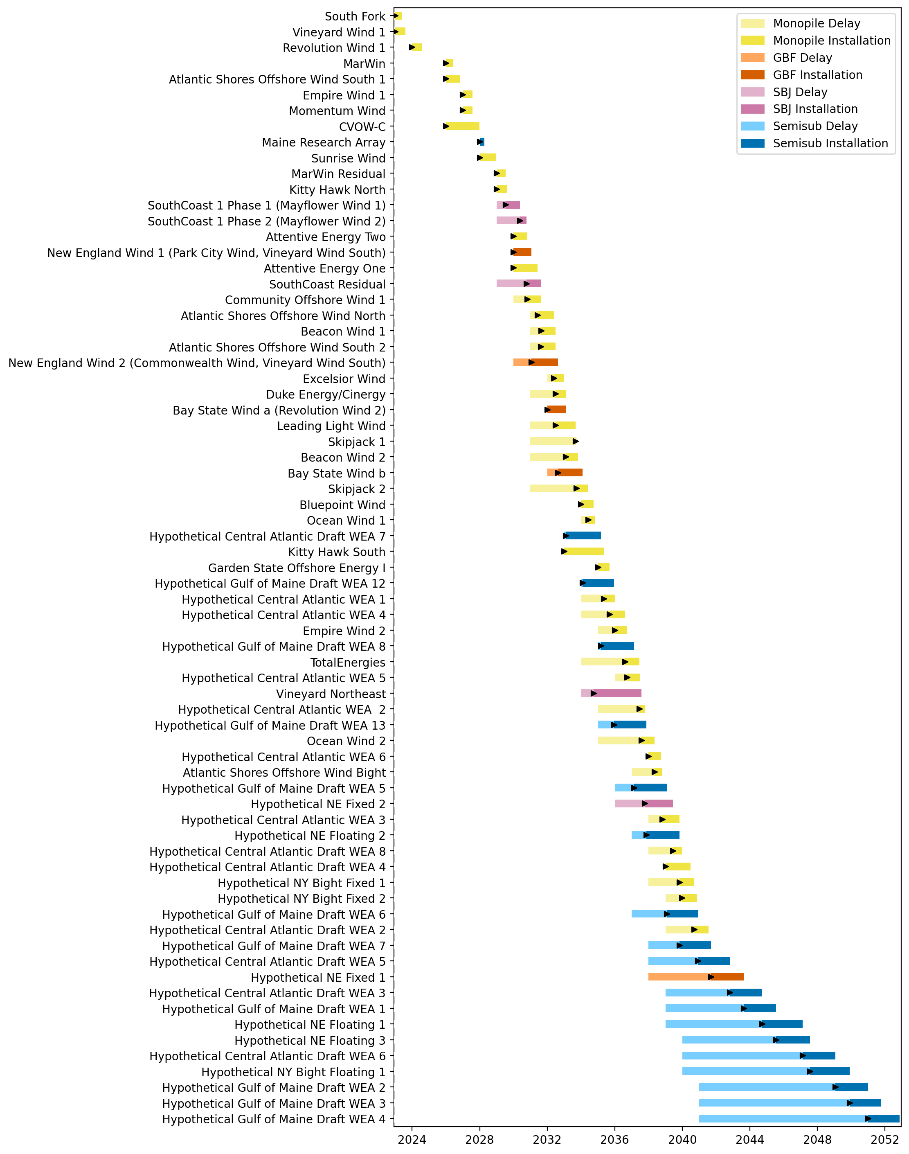
Full Gantt

Slide 3
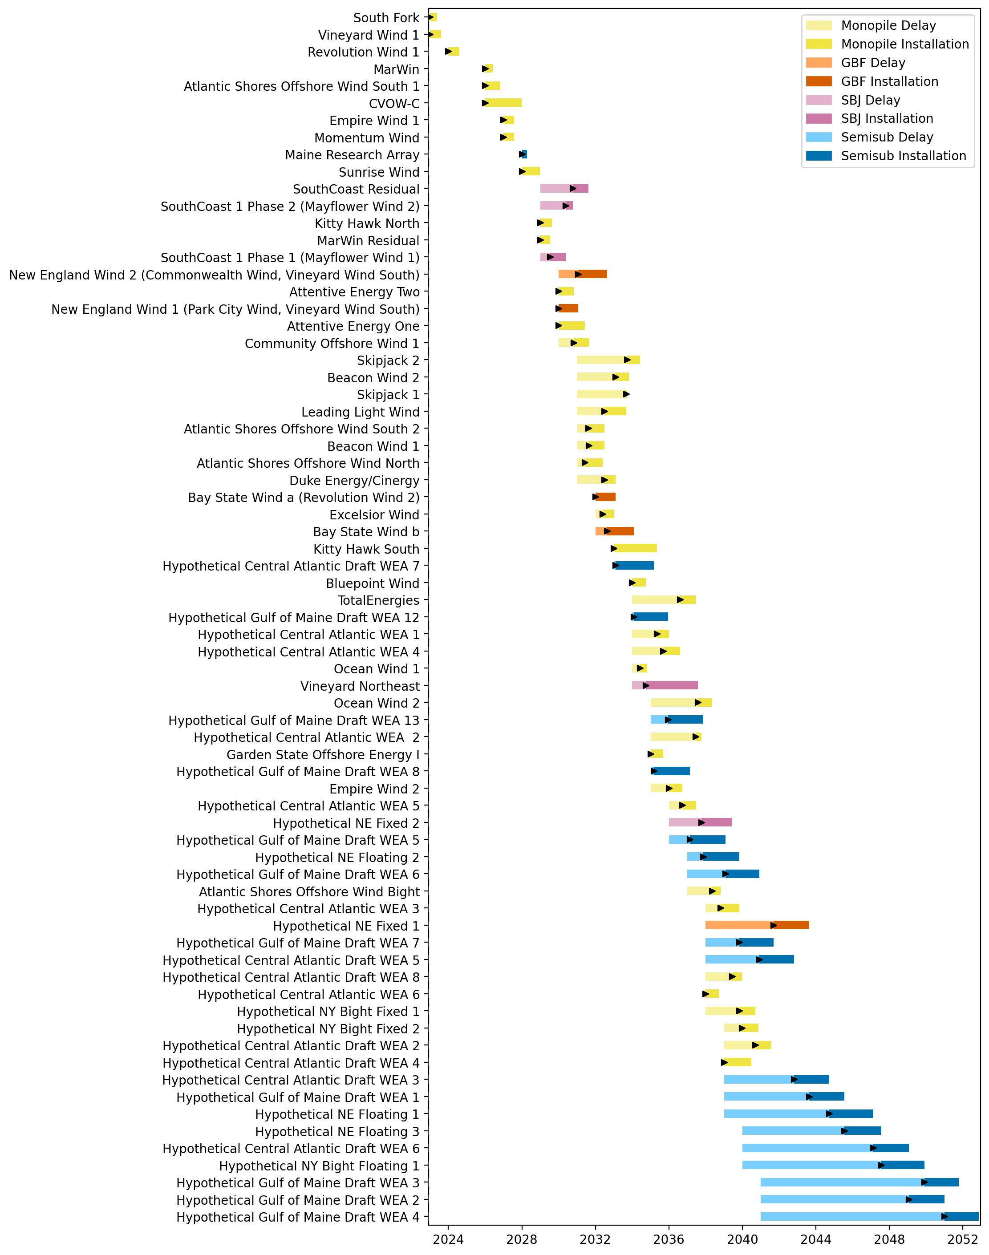
Sorted Full Gantt

Slide 4
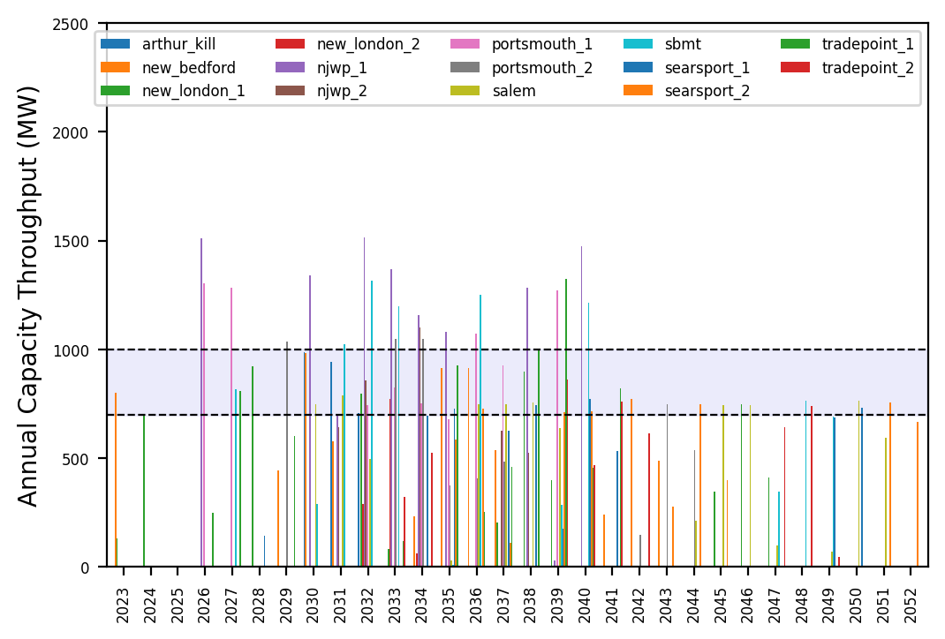
Port Throughput

Slide 5
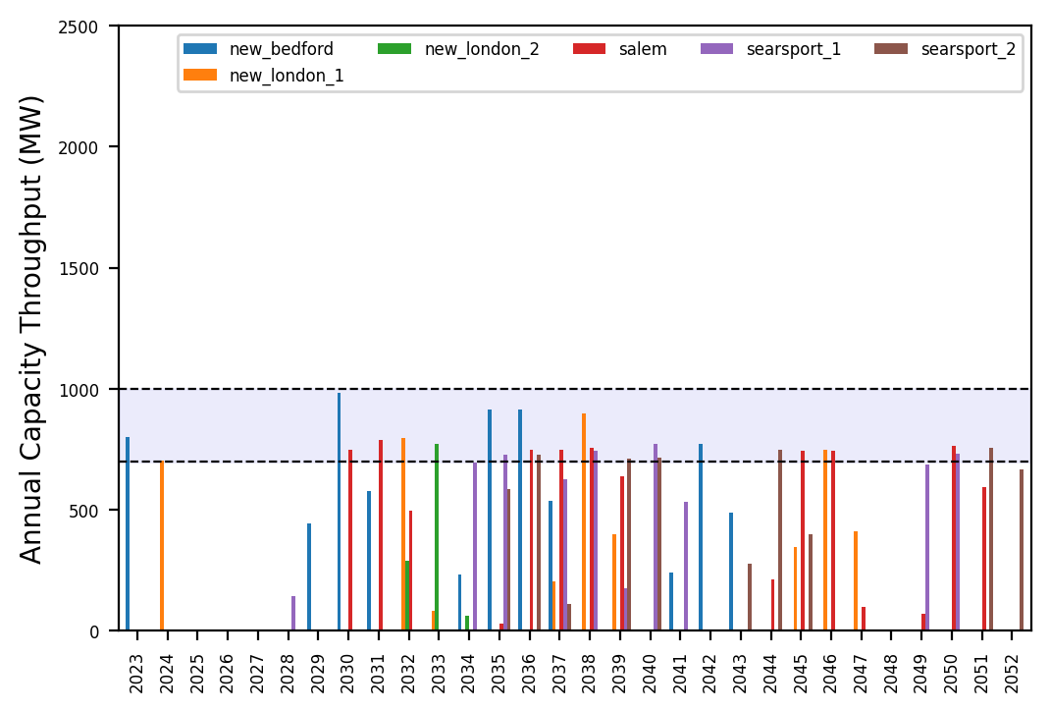
Port Throughput

Slide 6
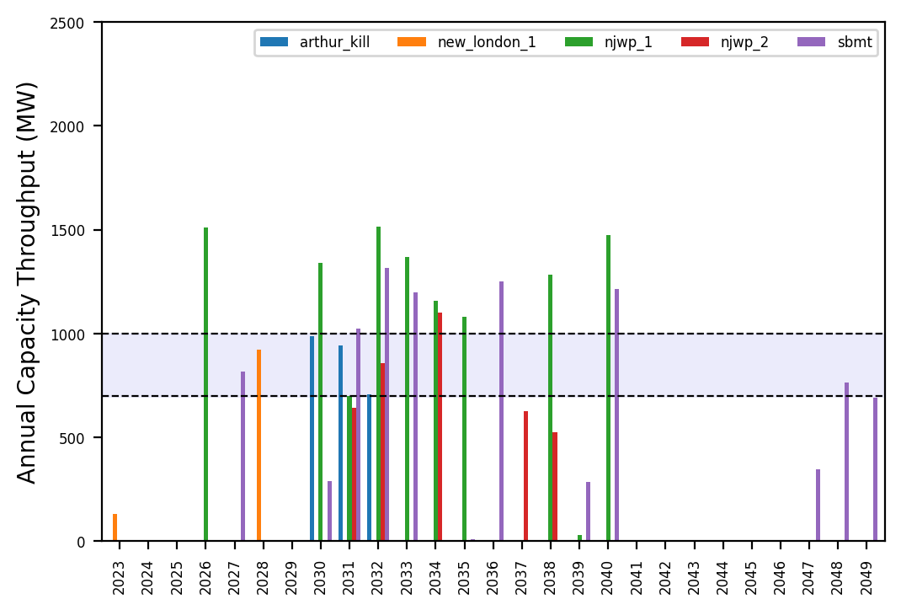
Port Throughput

Slide 7
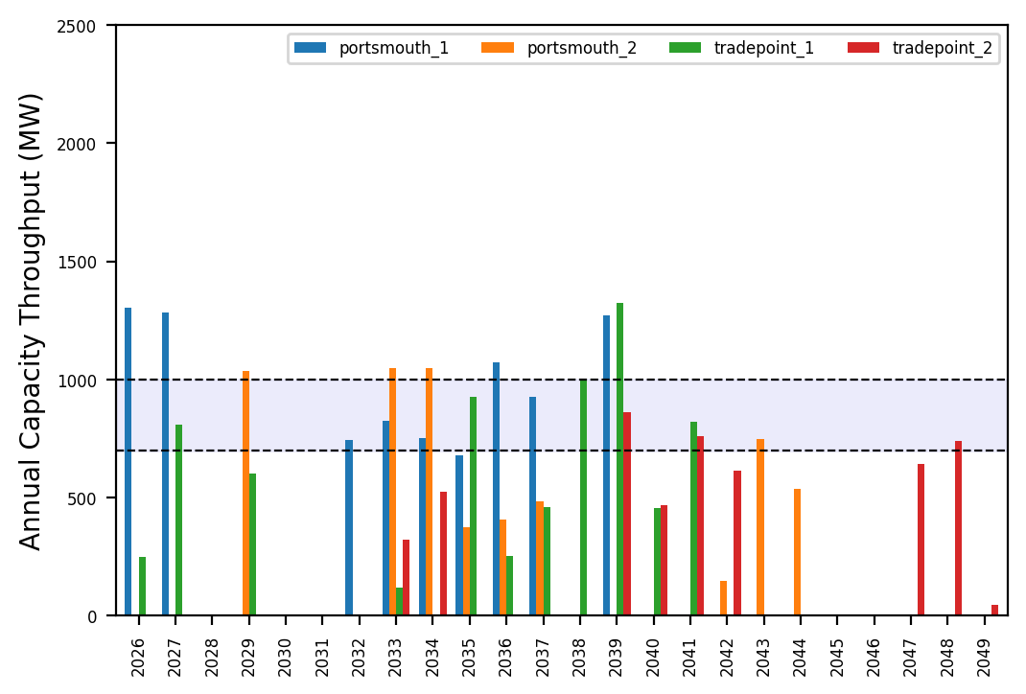
Port Throughput

Slide 8
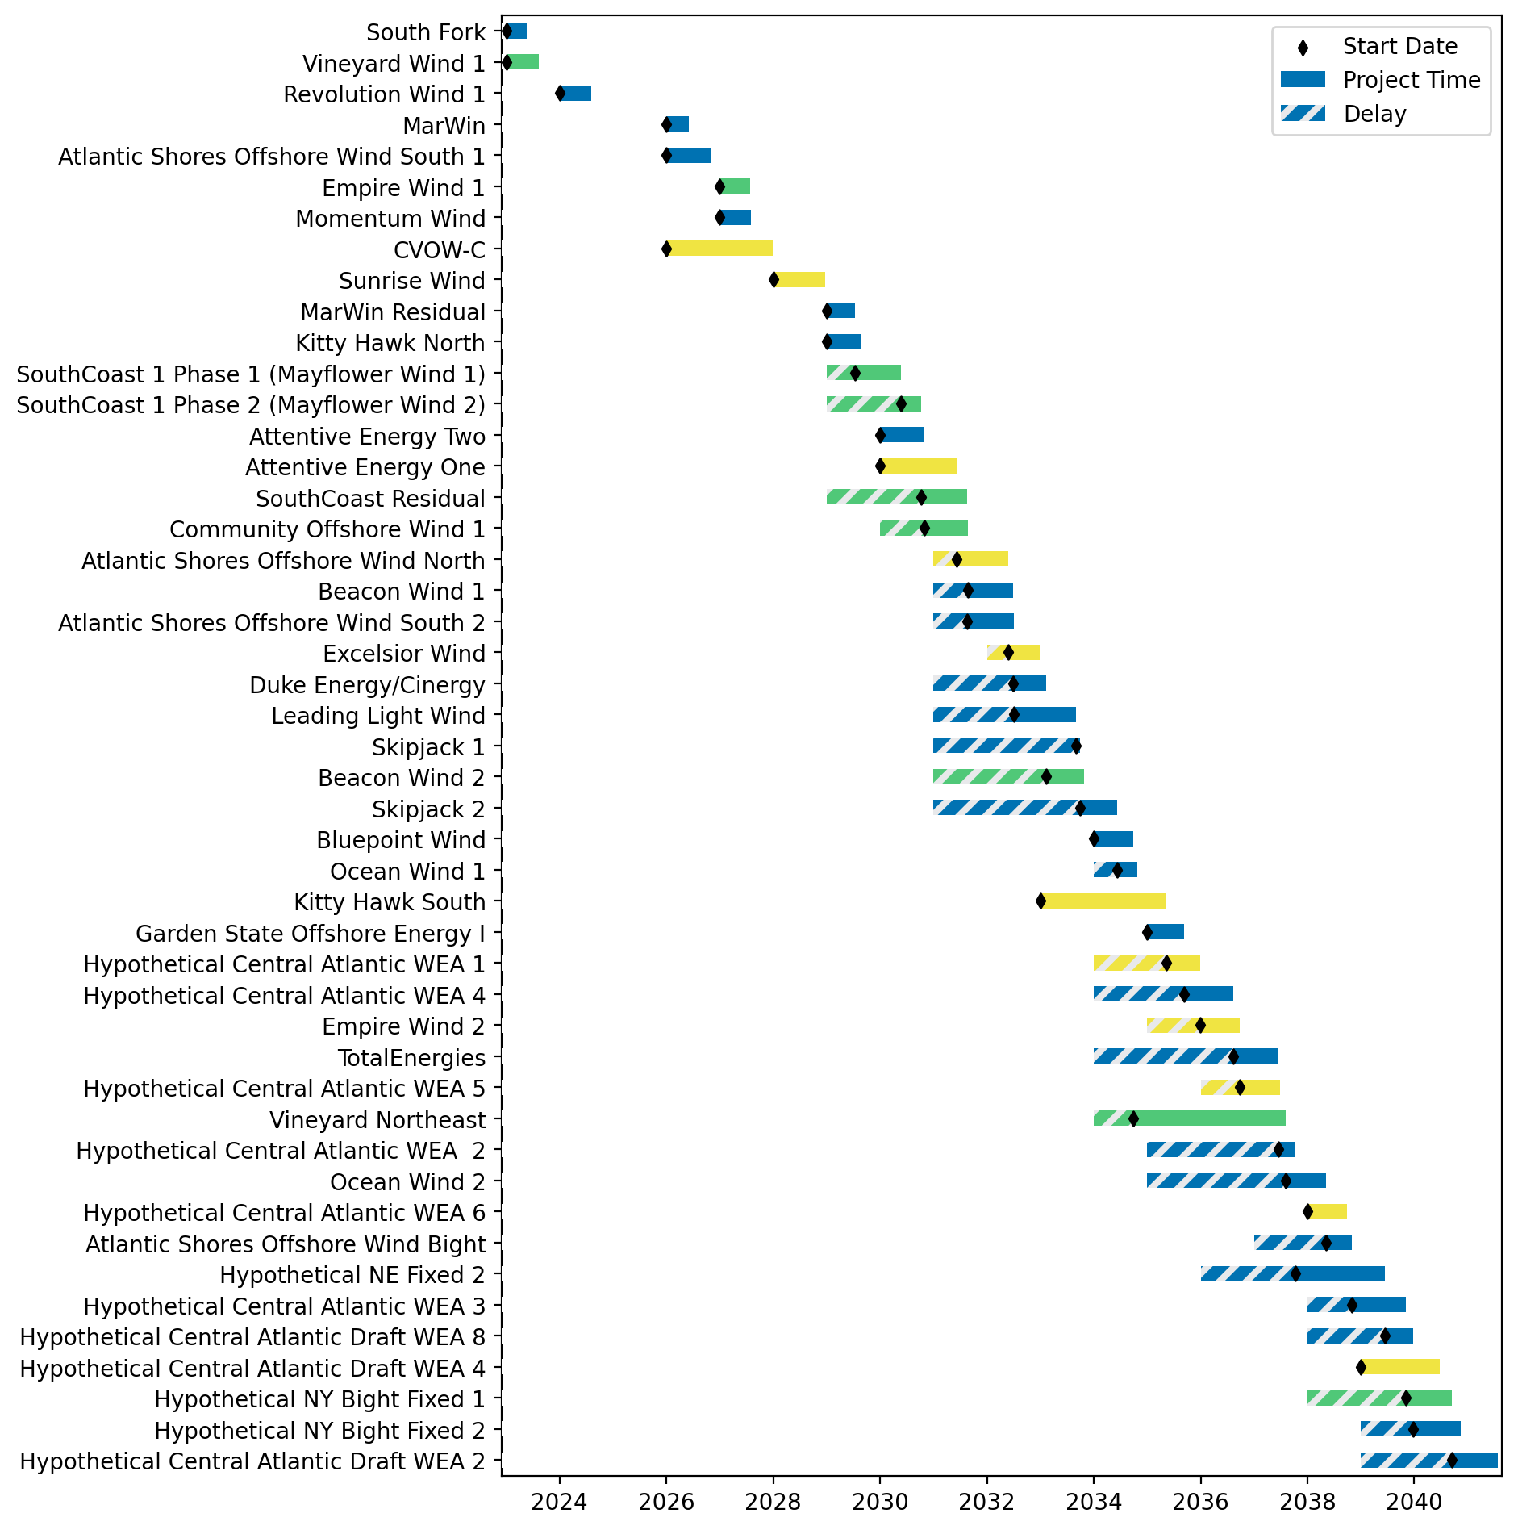
Fixed Gantt

Slide 9
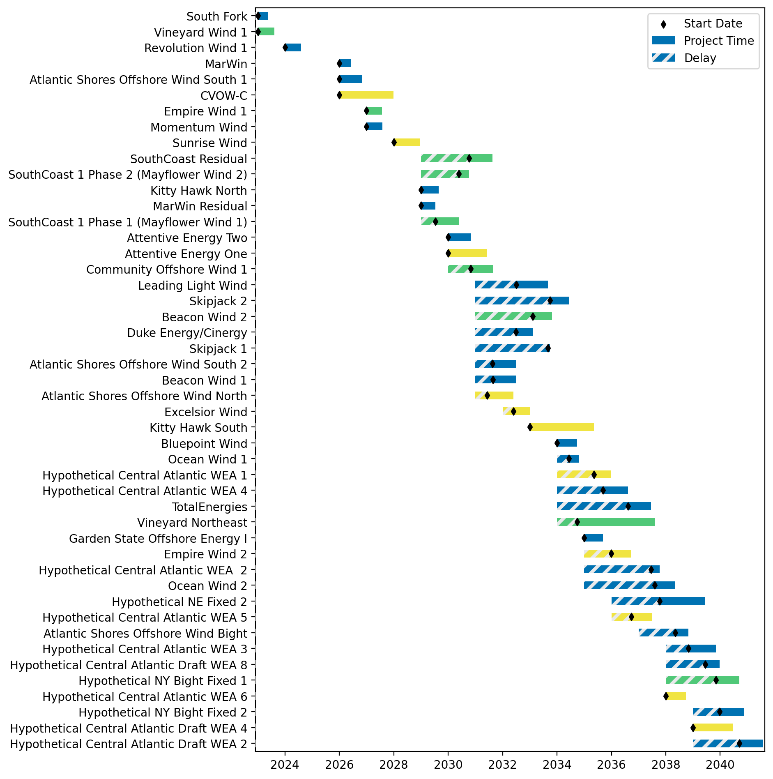
Sorted Fixed Gantt

Slide 10
natl_gaps_3us
1 US WTIV starting with CVOW, then 1 in 2030, 2033

Slide 11
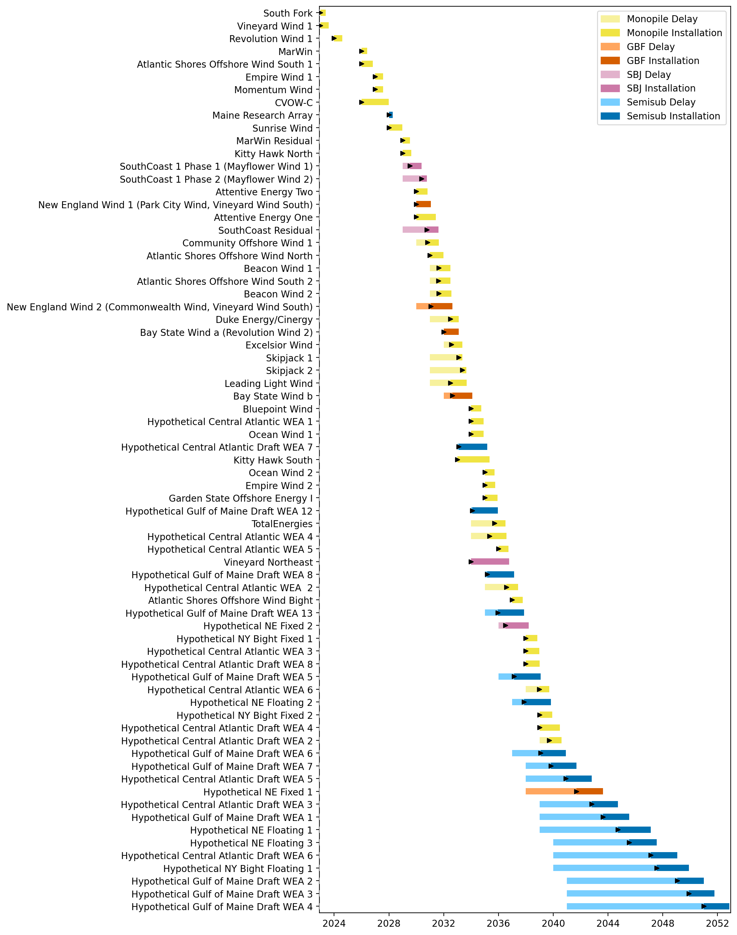
Full Gantt

Slide 12
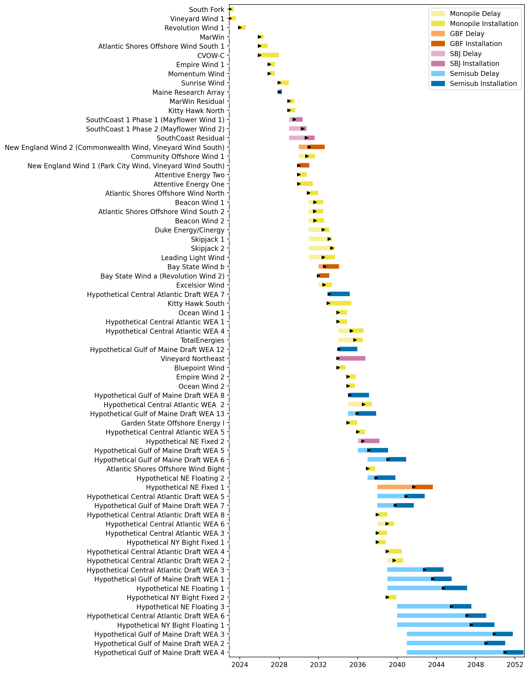
Sorted Full Gantt

Slide 13
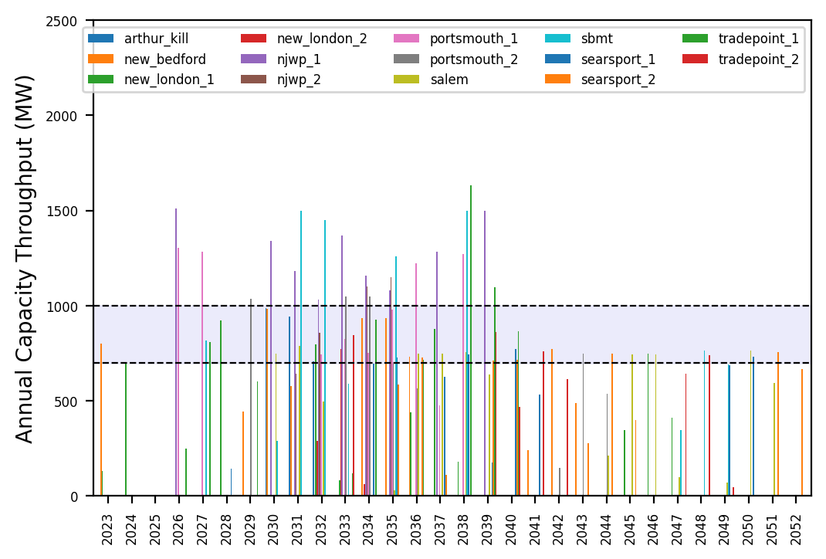
Port Throughput

Slide 14
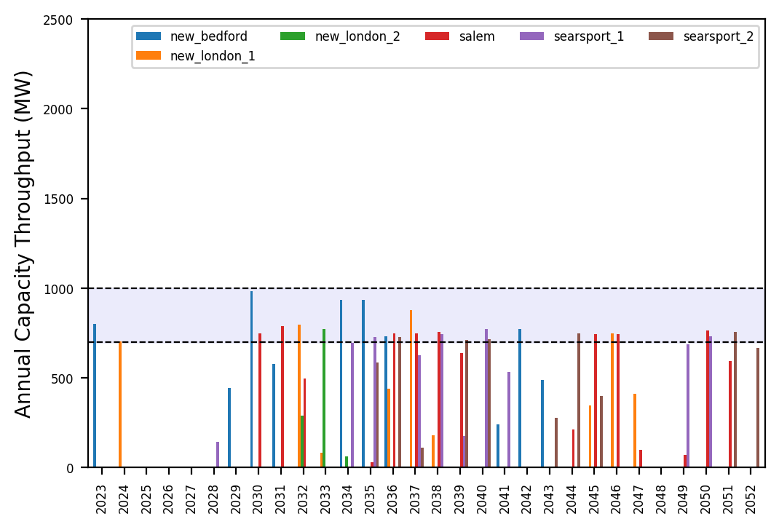
Port Throughput

Slide 15
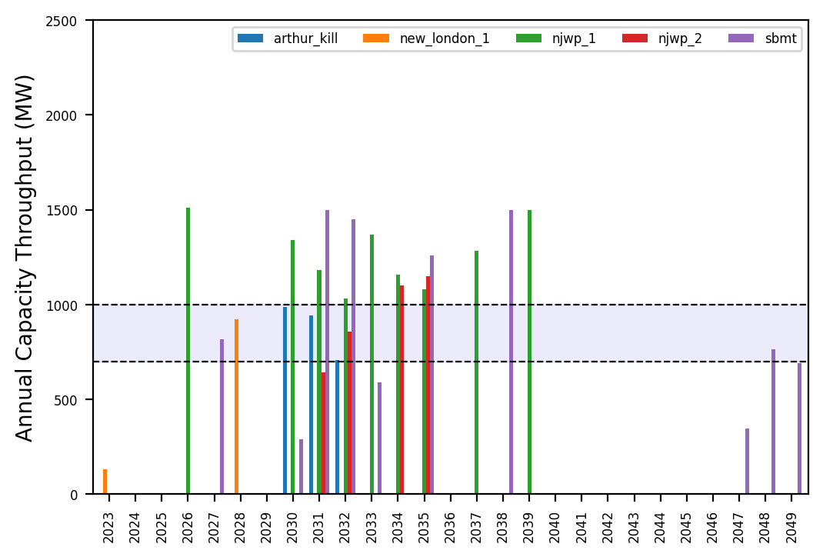
Port Throughput

Slide 16
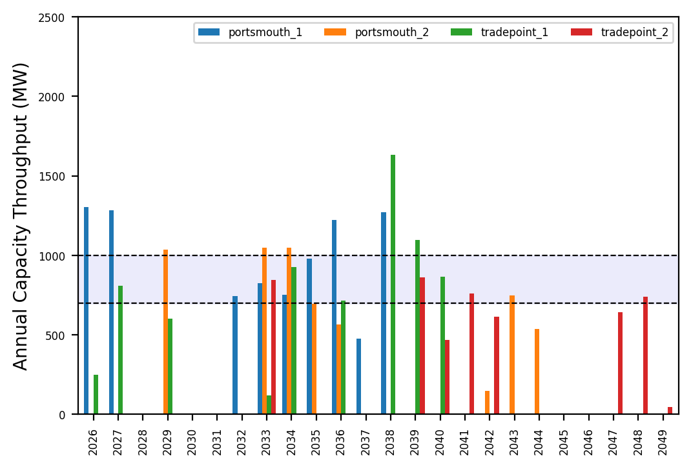
Port Throughput

Slide 17
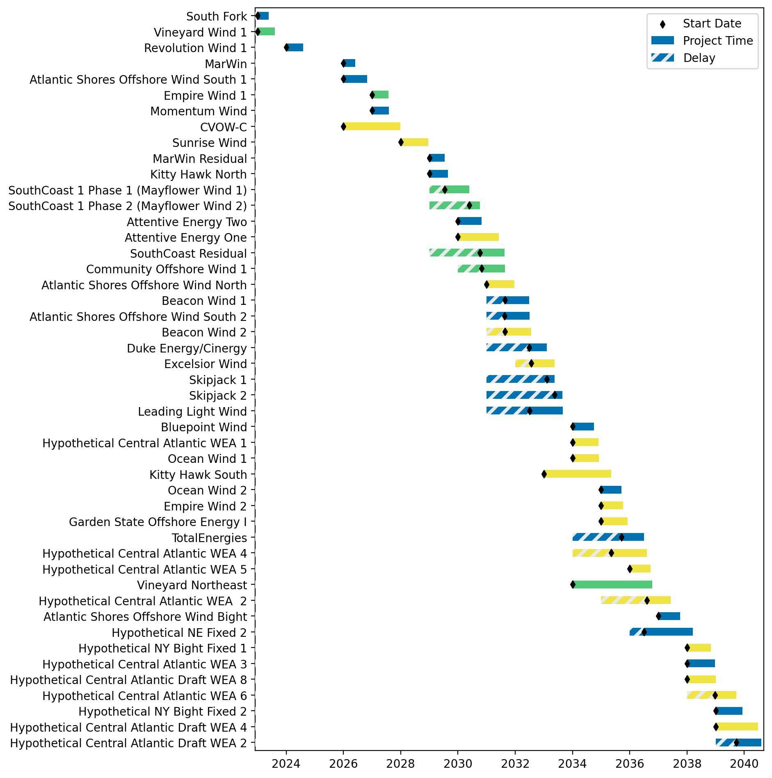
Fixed Gantt

Slide 18
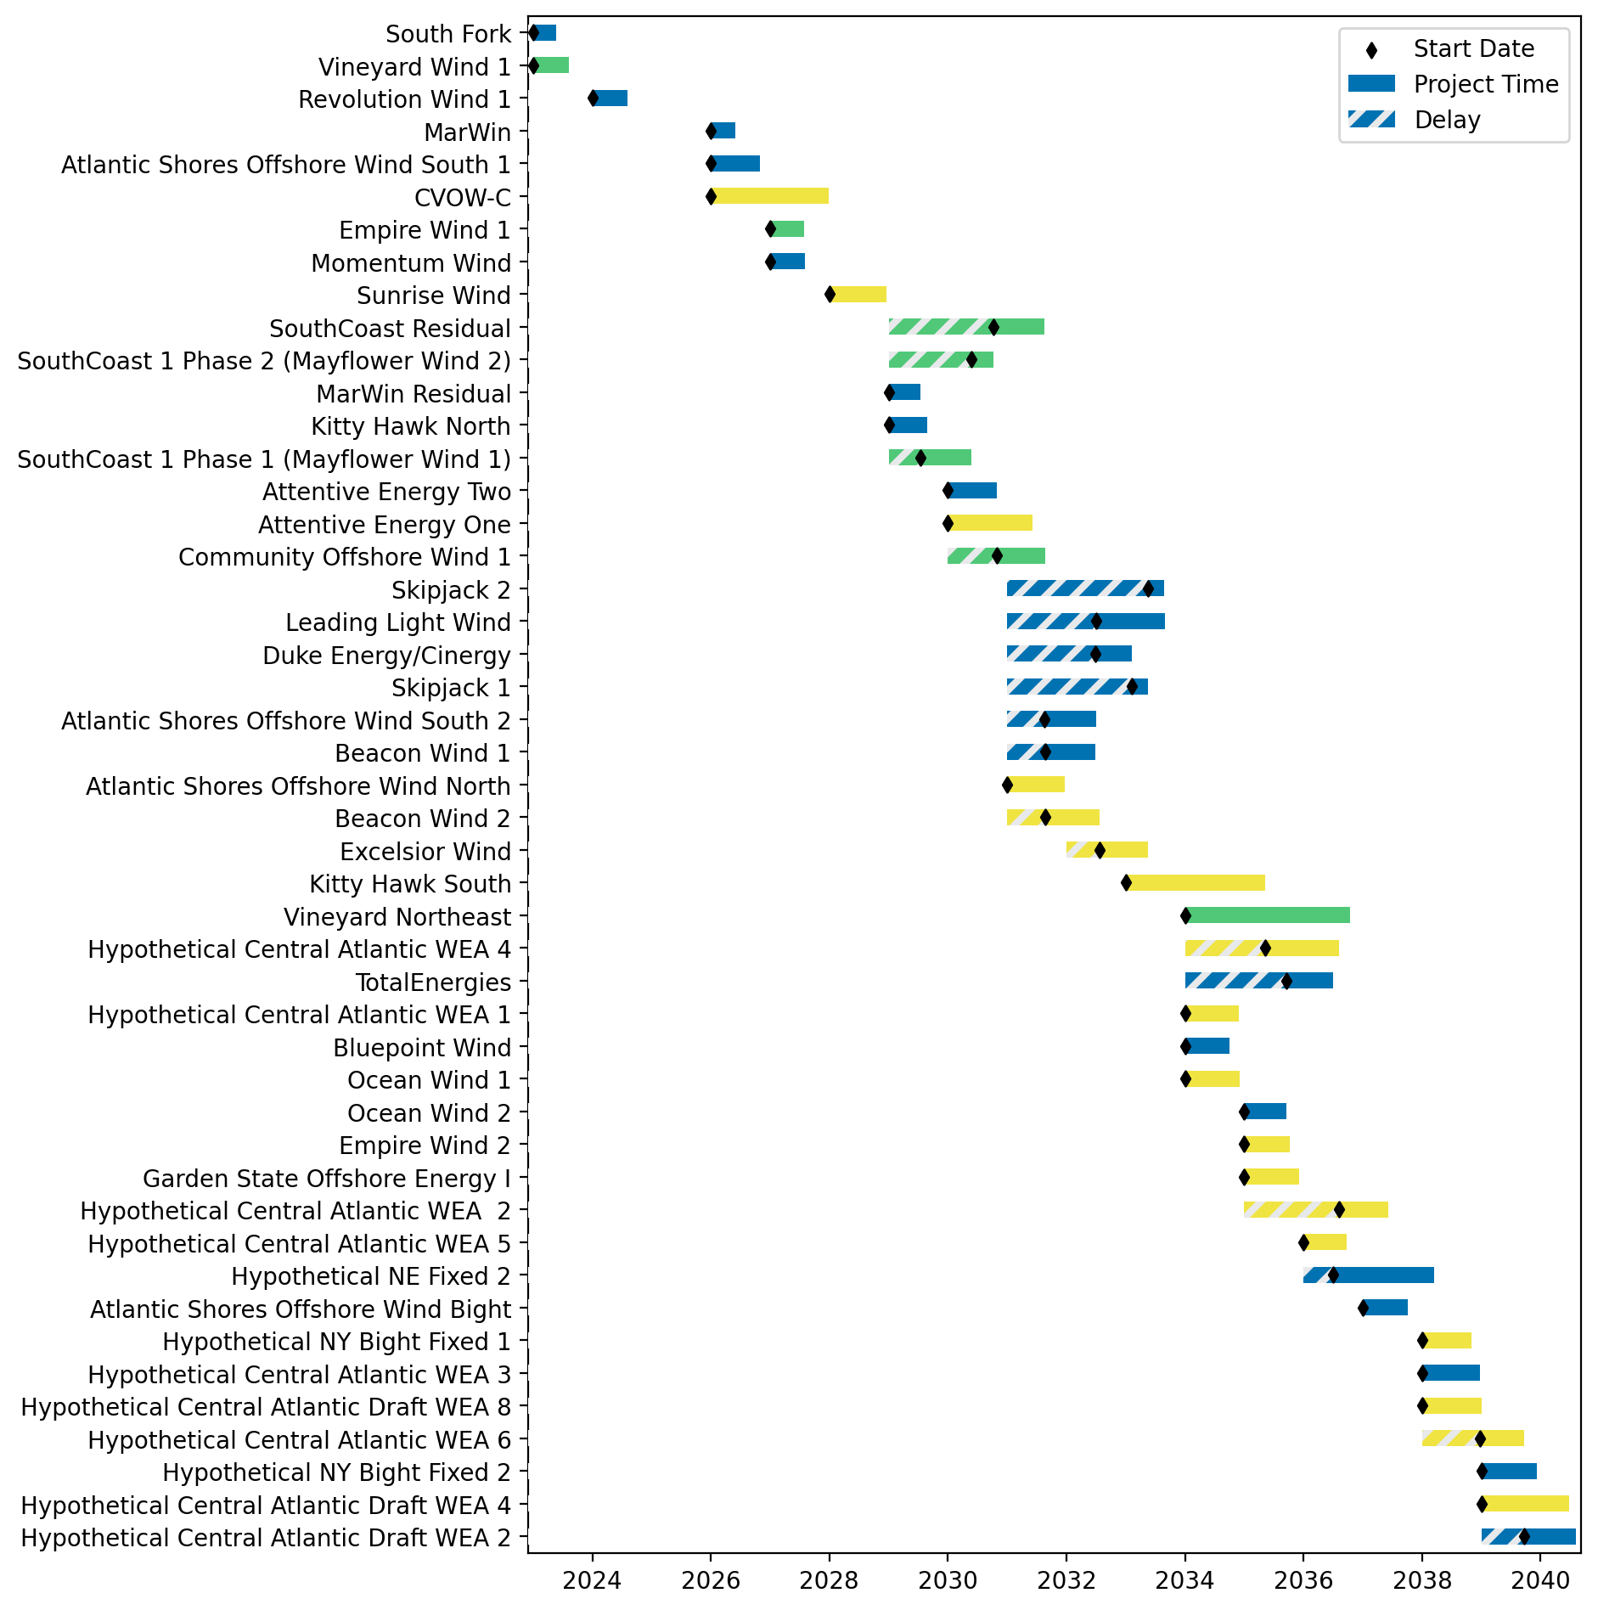
Sorted Fixed Gantt

Slide 19
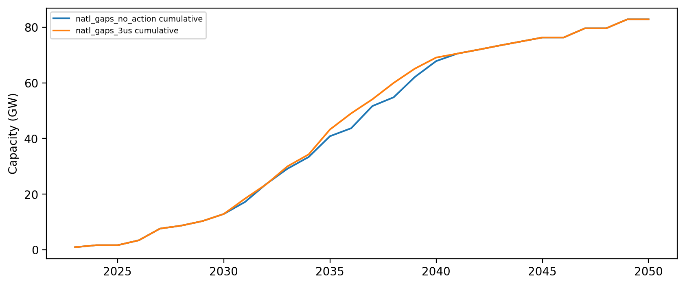
Installed Capacity

