Slide 1
natl_gaps_no_action
1 US WTIV starting with CVOW

Slide 2
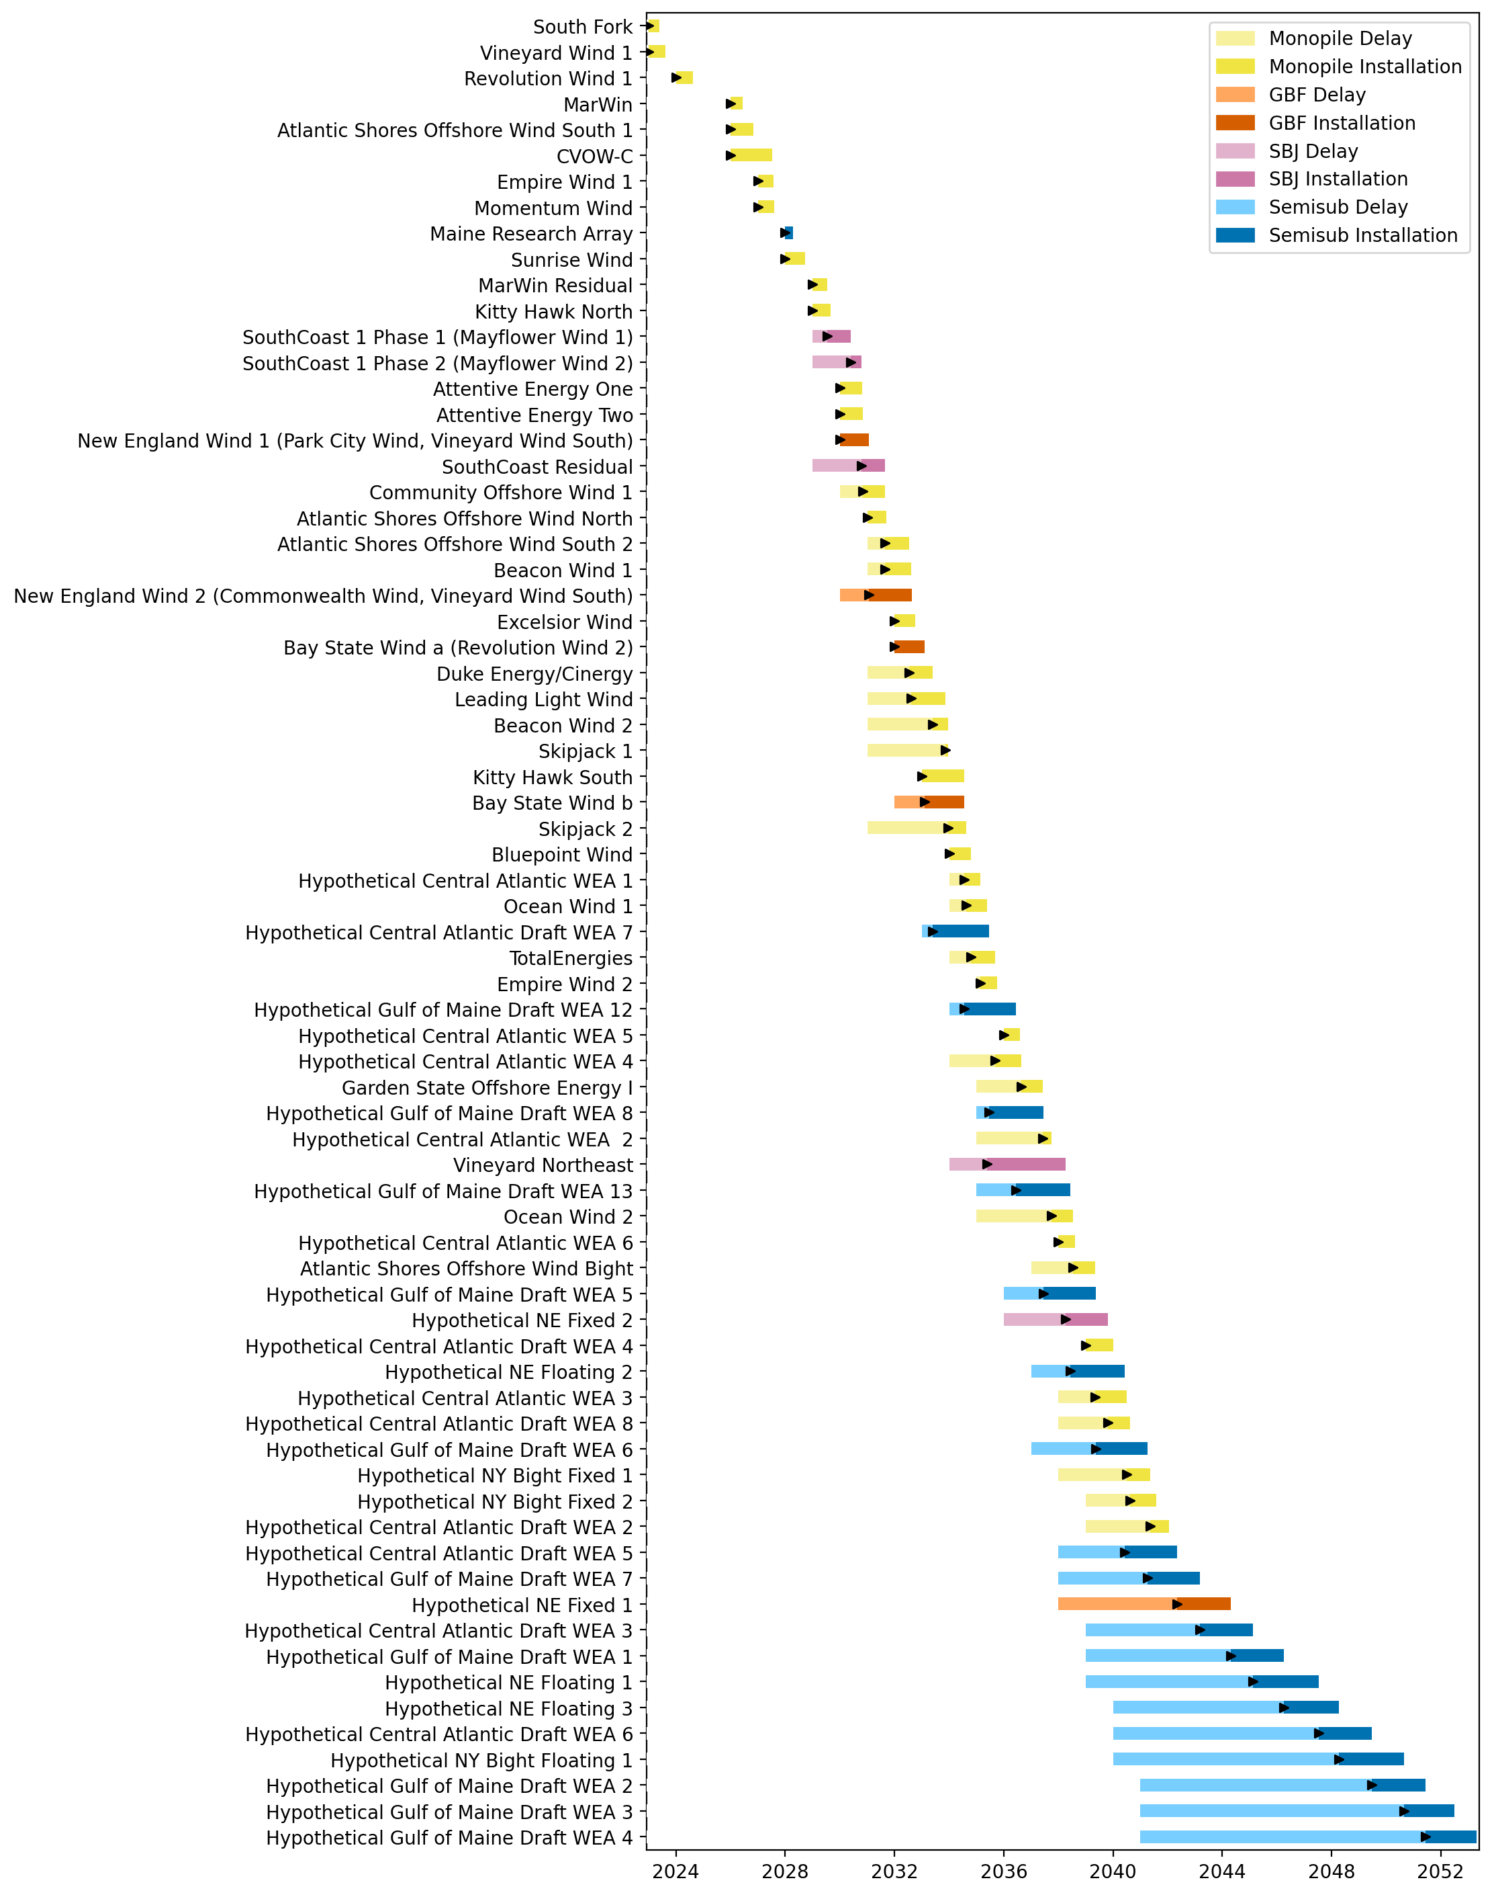
Full Gantt

Slide 3
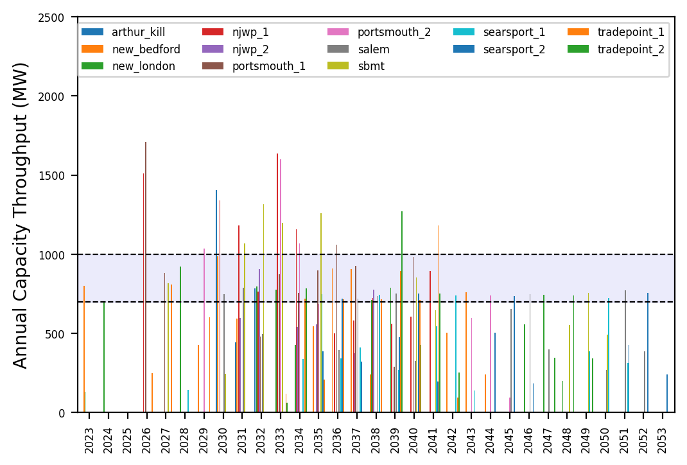
Port Throughput

Slide 4
natl_gaps_1AHTS
1 AHTS built in 2027

Slide 5
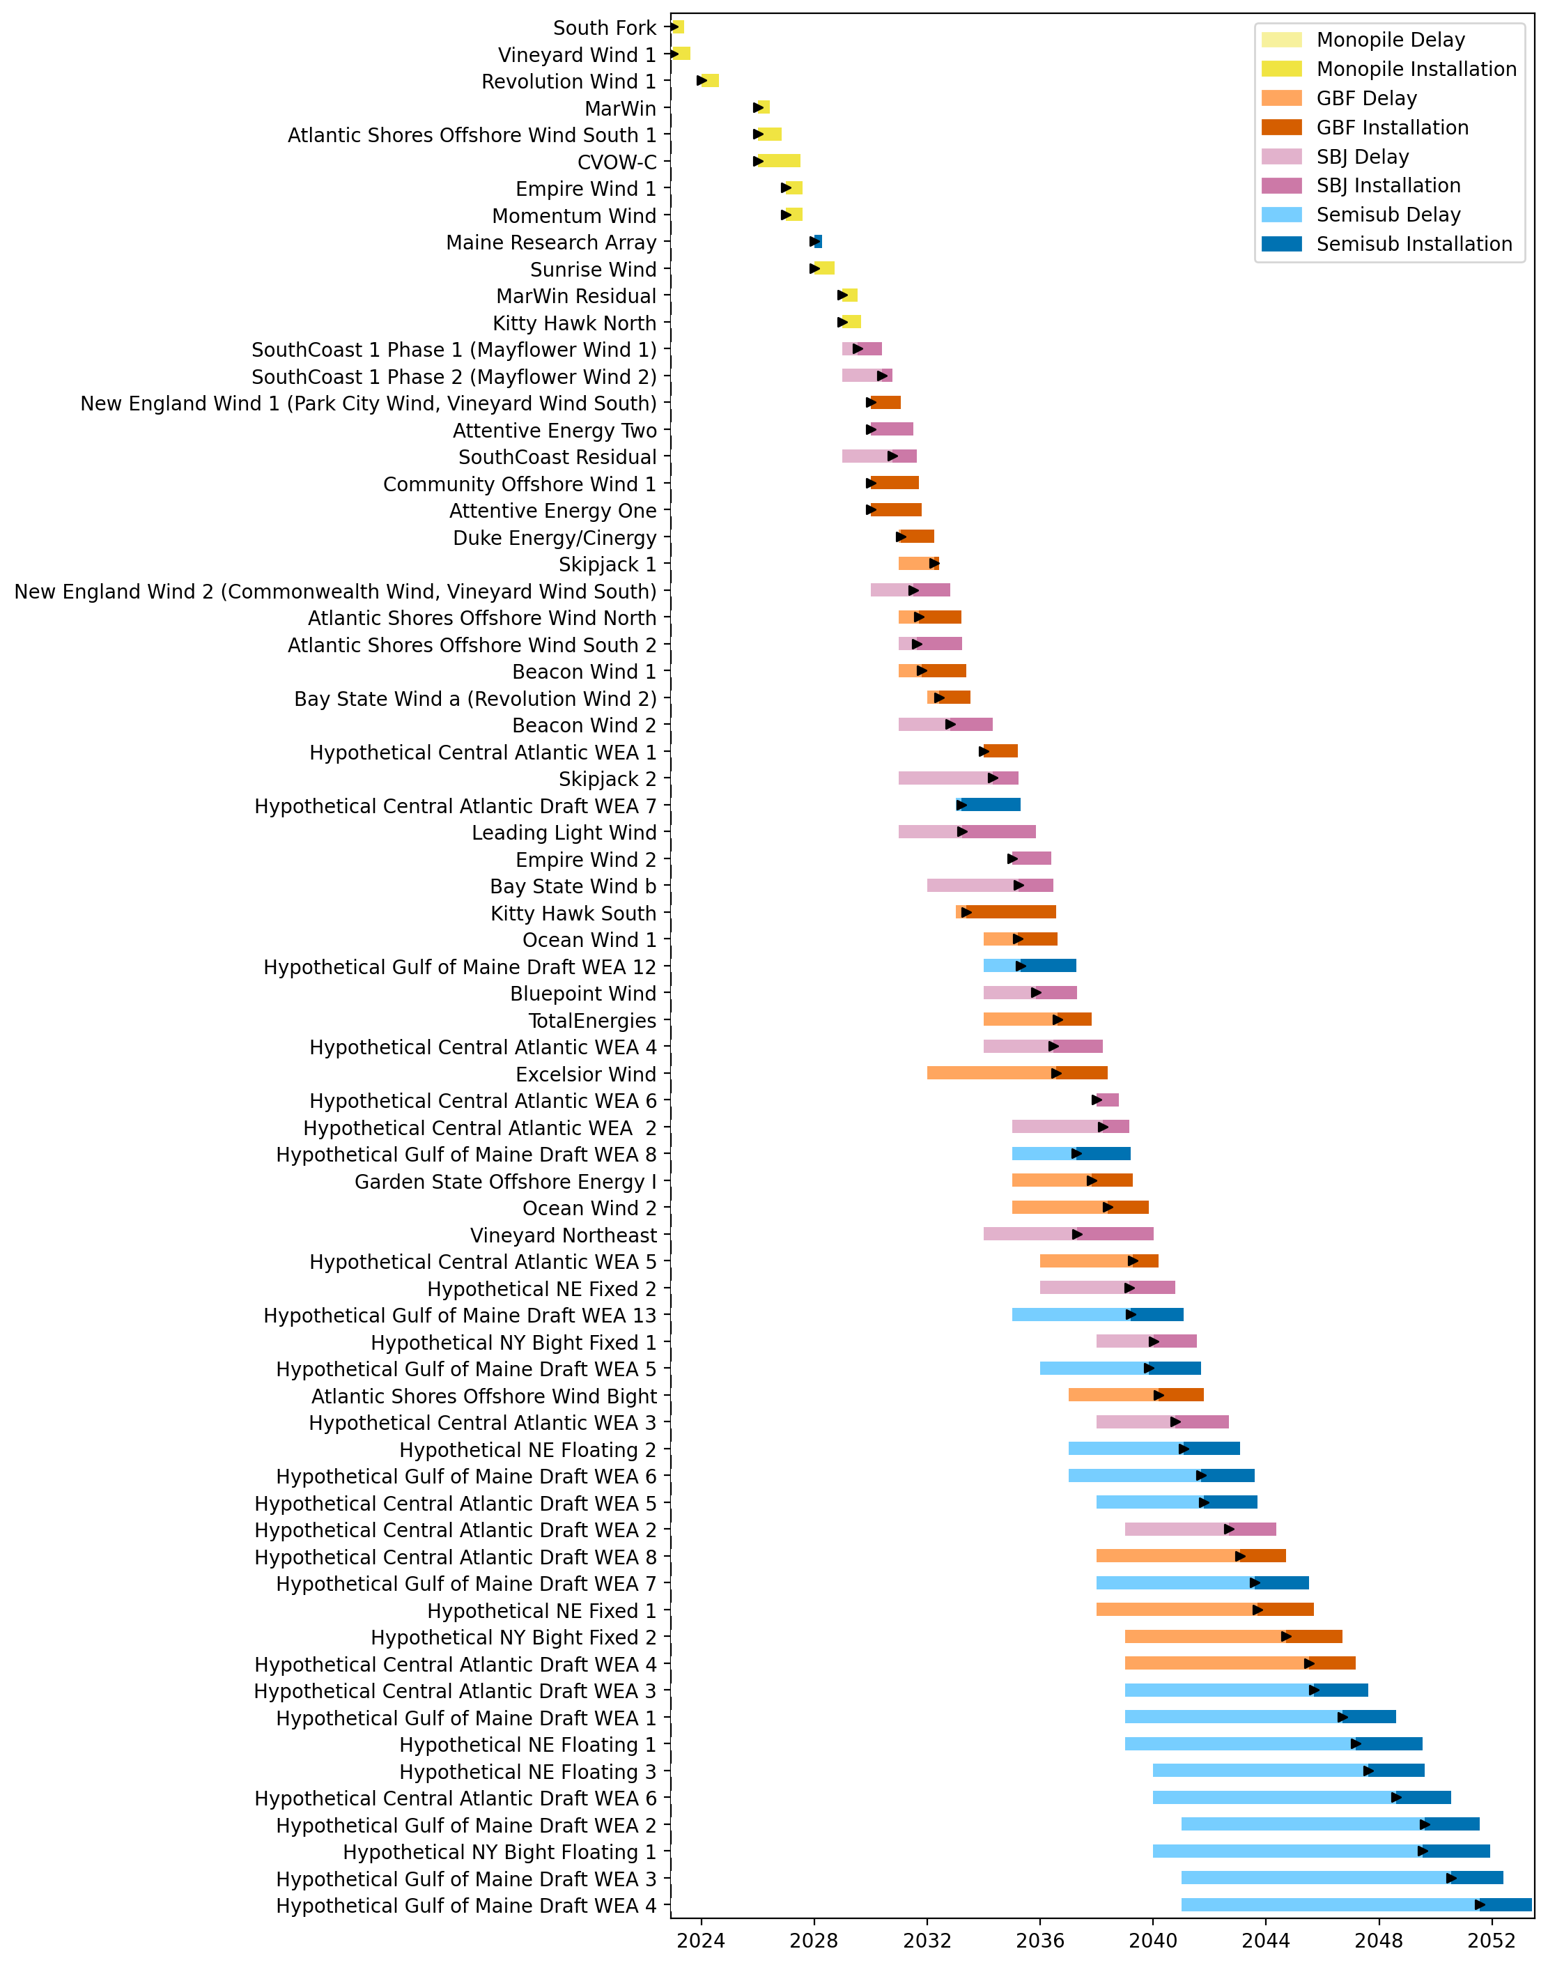
Full Gantt

Slide 6
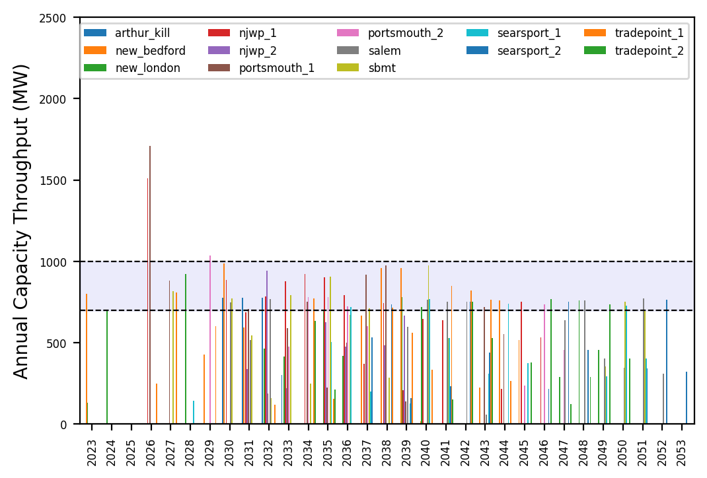
Port Throughput

Slide 7
natl_gaps_2AHTS
2 total AHTS vessels, built every 4 years starting in 2027

Slide 8
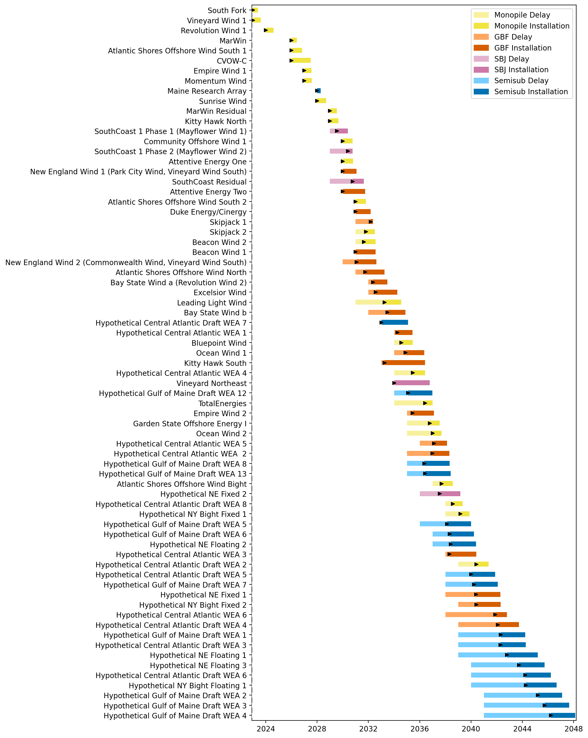
Full Gantt

Slide 9
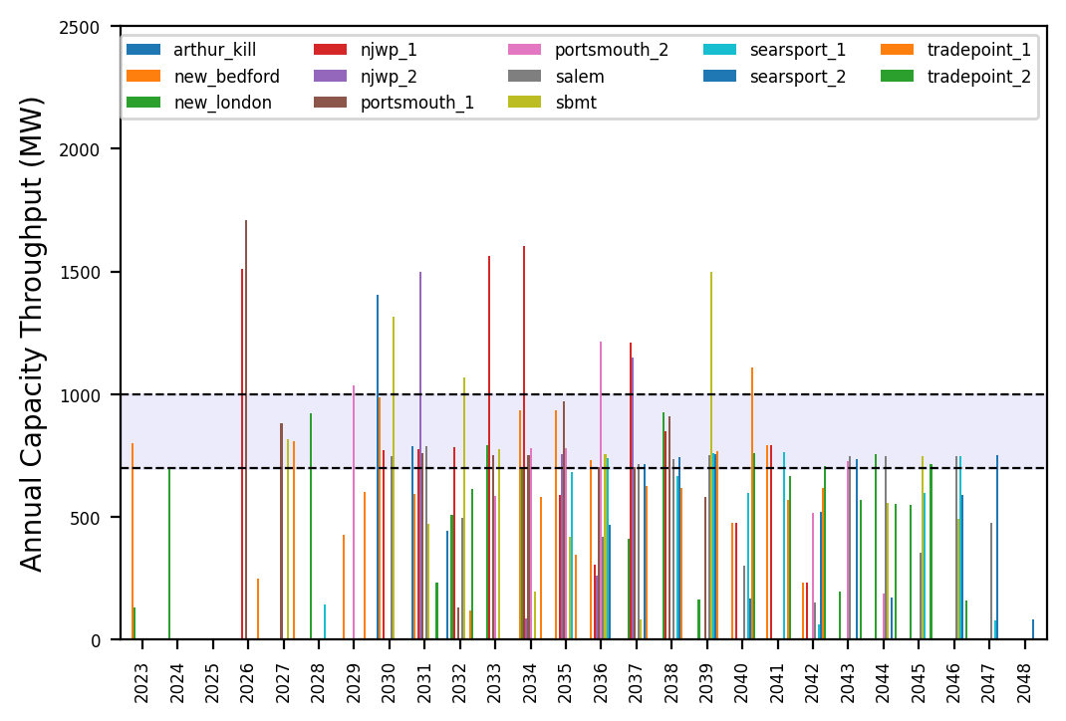
Port Throughput

Slide 10
natl_gaps_3AHTS
3 total AHTS vessels, built every 4 years starting in 2027

Slide 11
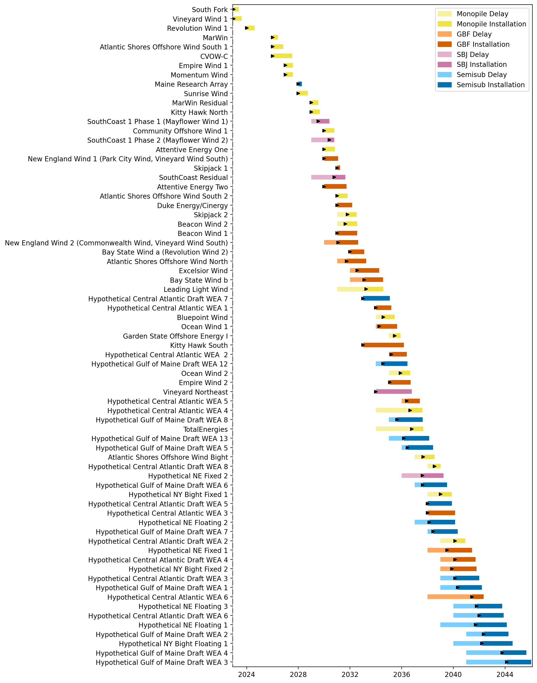
Full Gantt

Slide 12
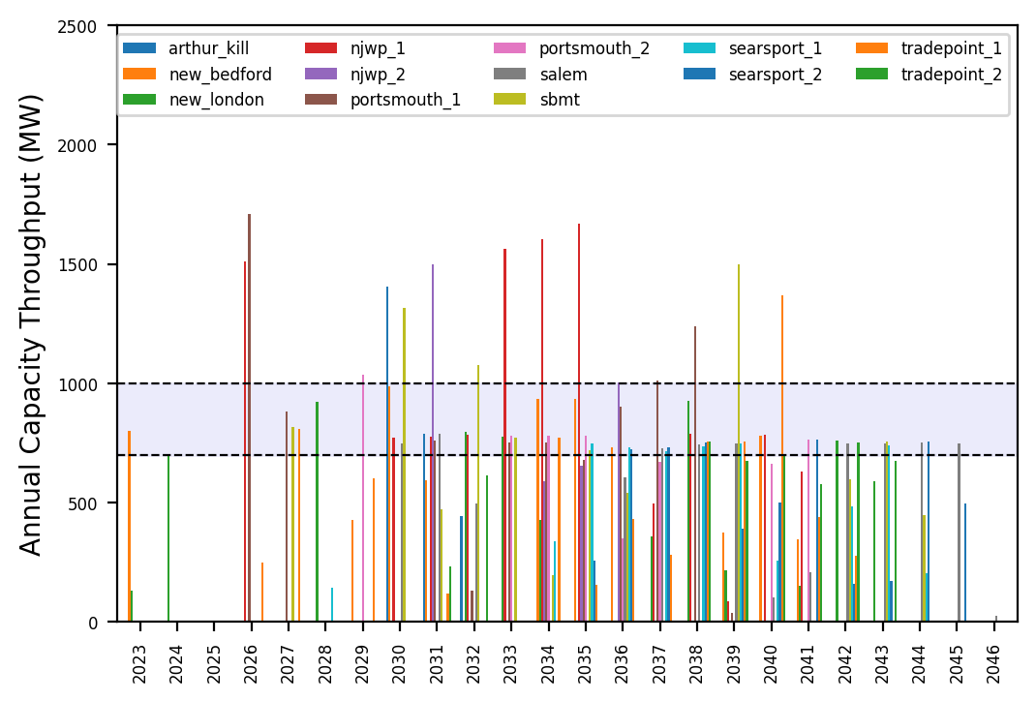
Port Throughput

Slide 13
natl_gaps_4AHTS
4 total AHTS vessels, built every 4 years starting in 2027

Slide 14
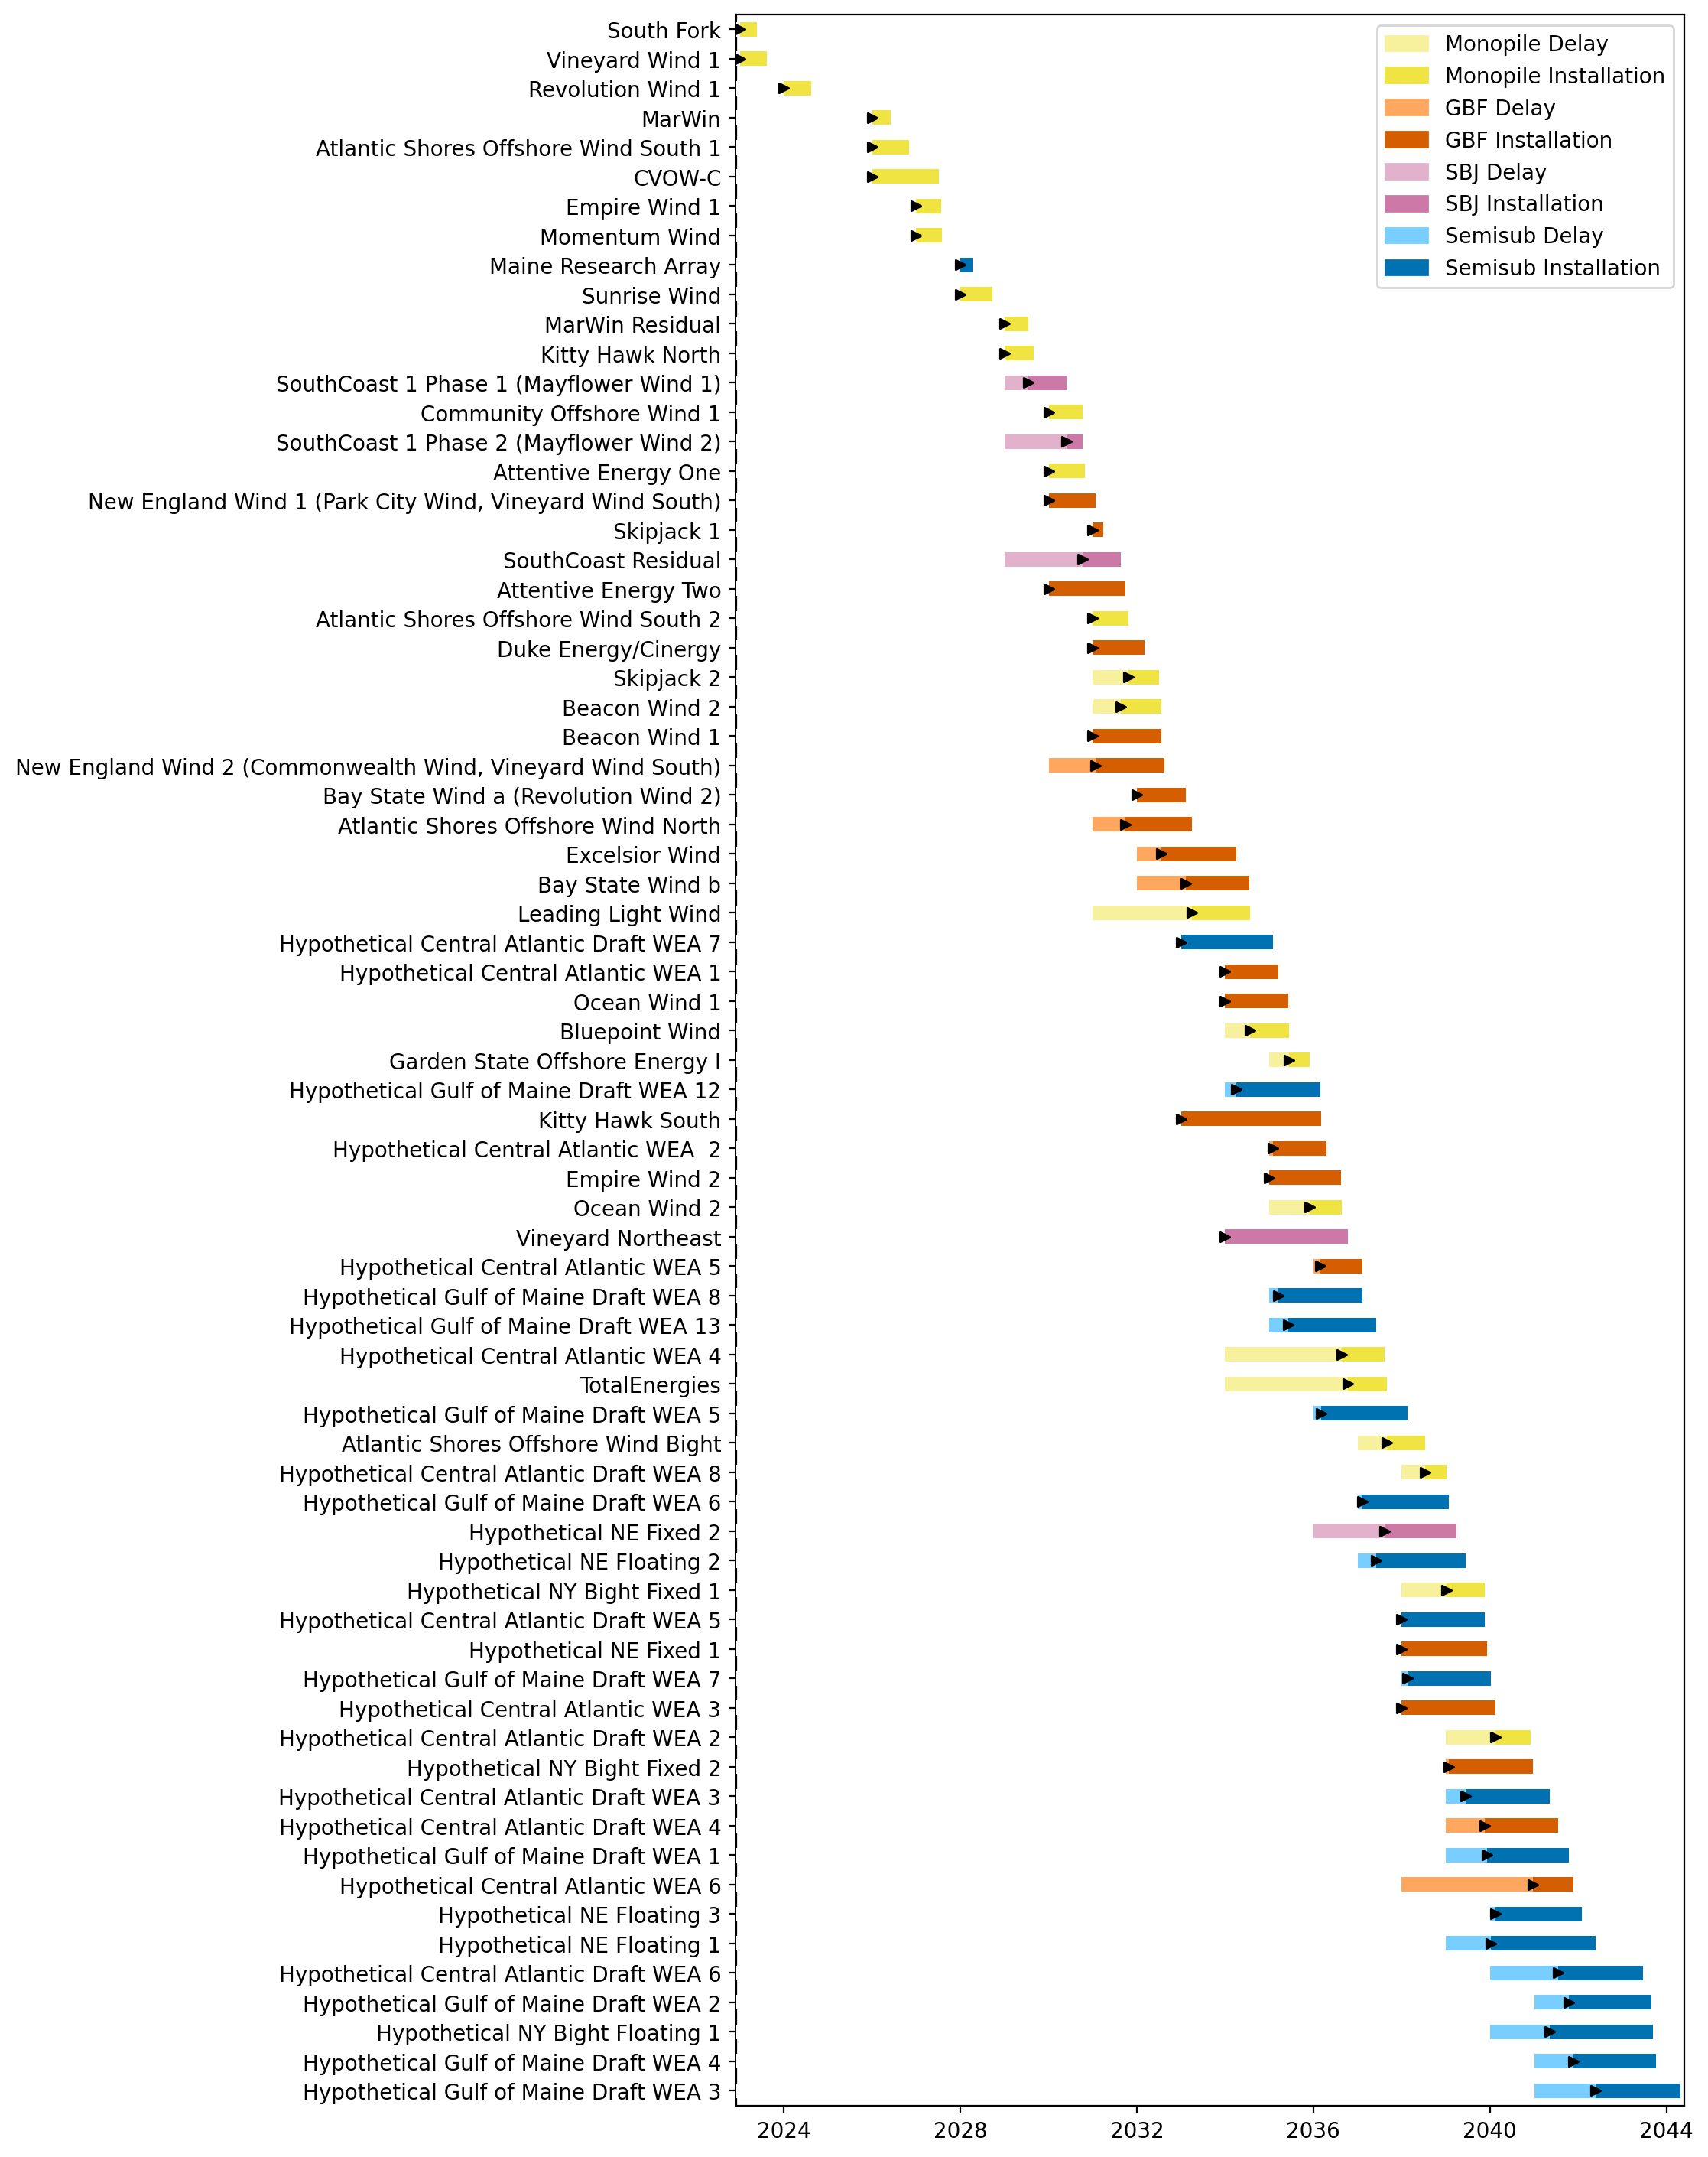
Full Gantt

Slide 15
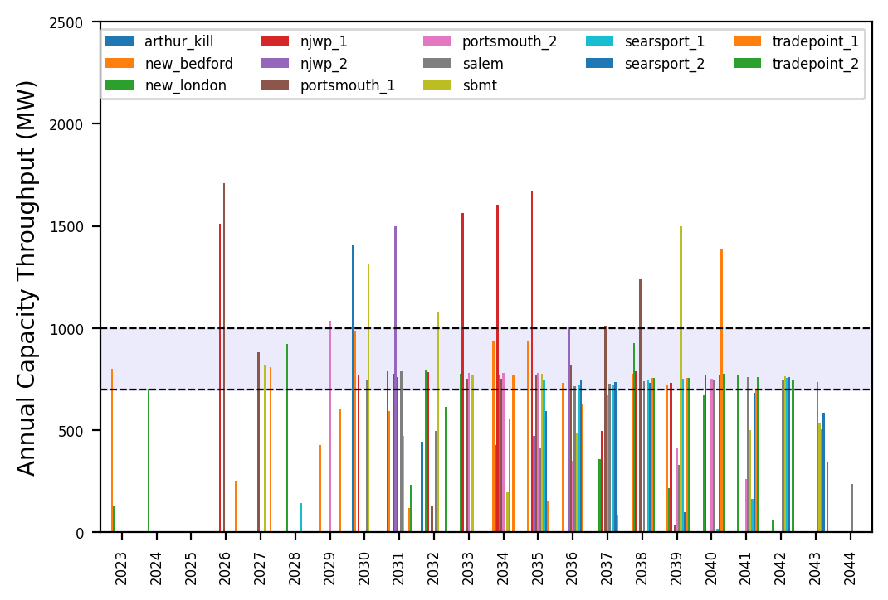
Port Throughput

Slide 16
natl_gaps_4AHTS_infp
4 total AHTS vessels, built every 4 years starting in 2027, unconstrained ports

Slide 17
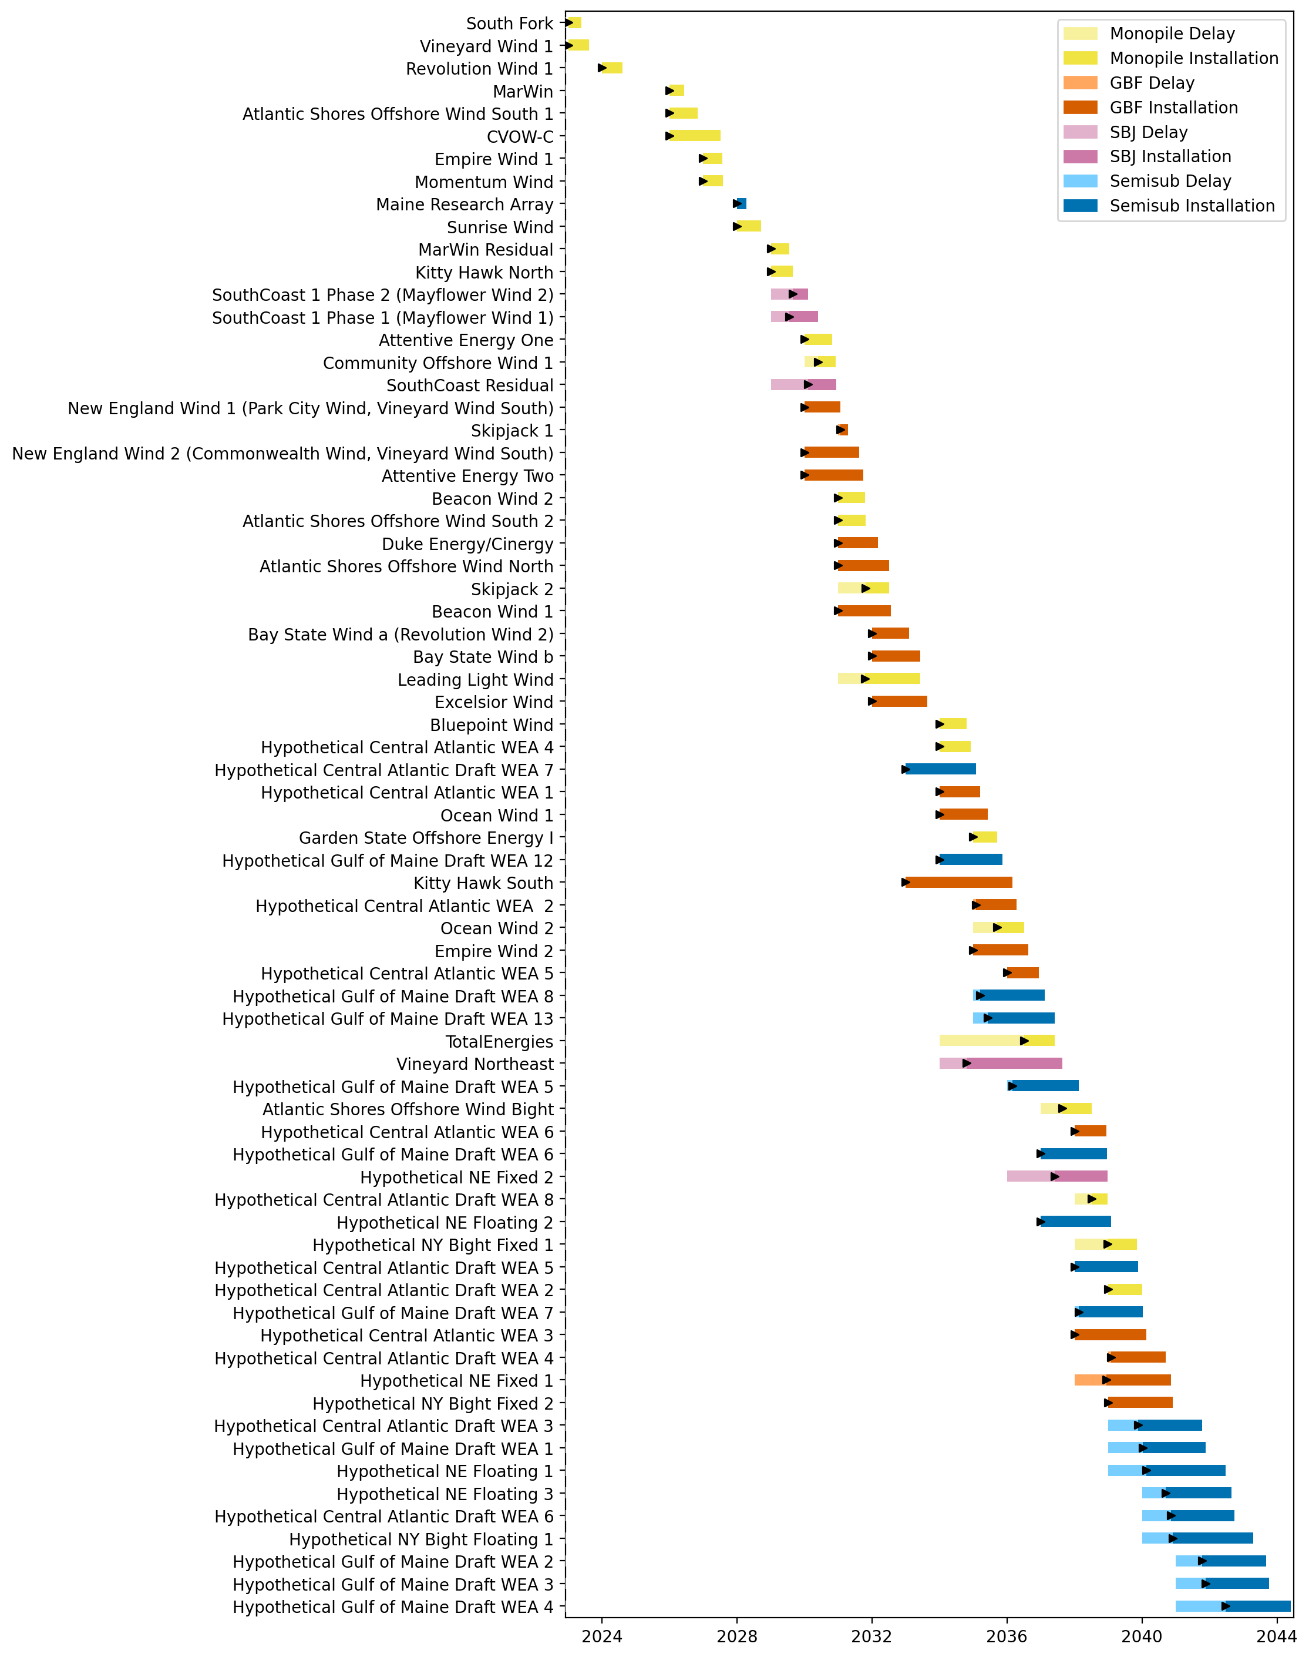
Full Gantt

Slide 18
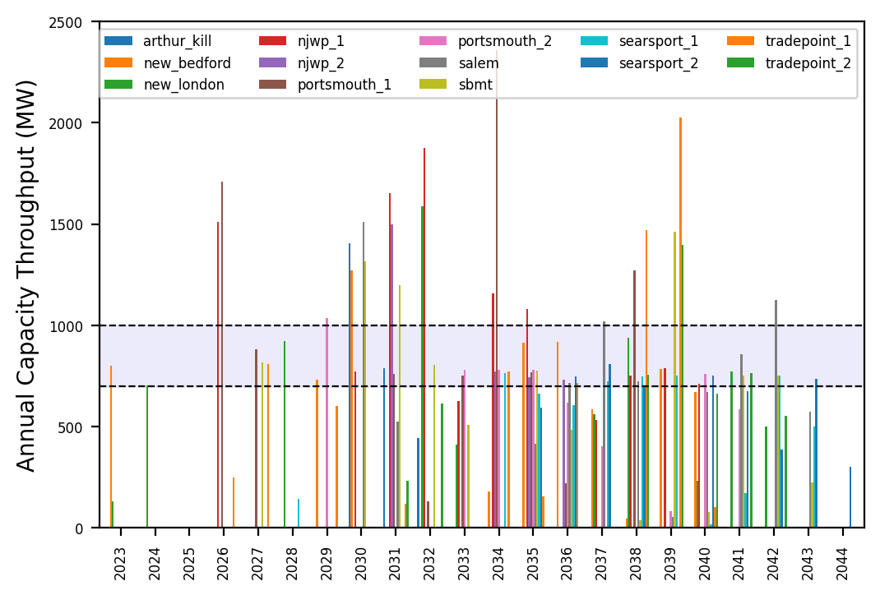
Port Throughput

Slide 19
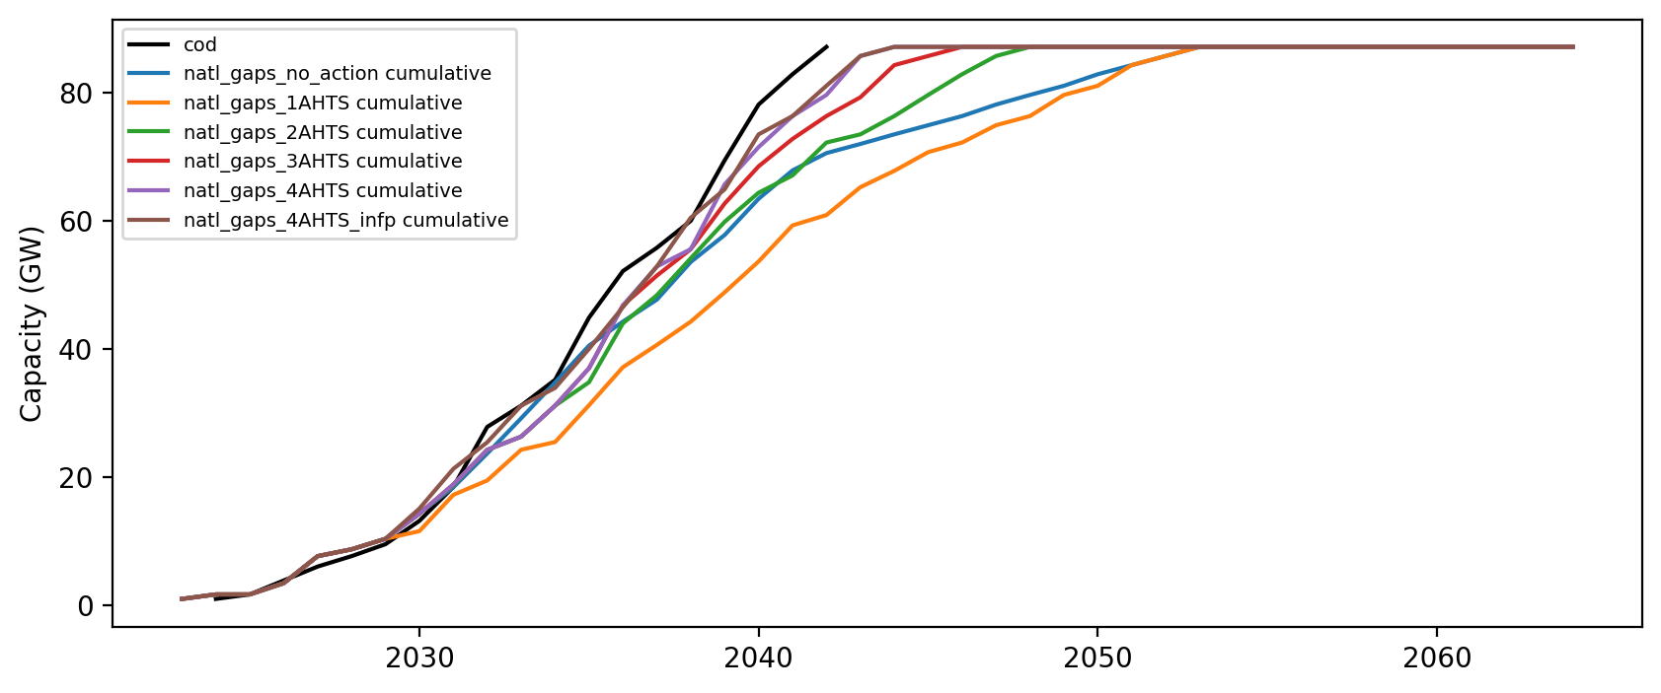
Installed Capacity

