Slide 1
natl_gaps_no_action_doubled_vessels
1 US WTIV starting with CVOW

Slide 2
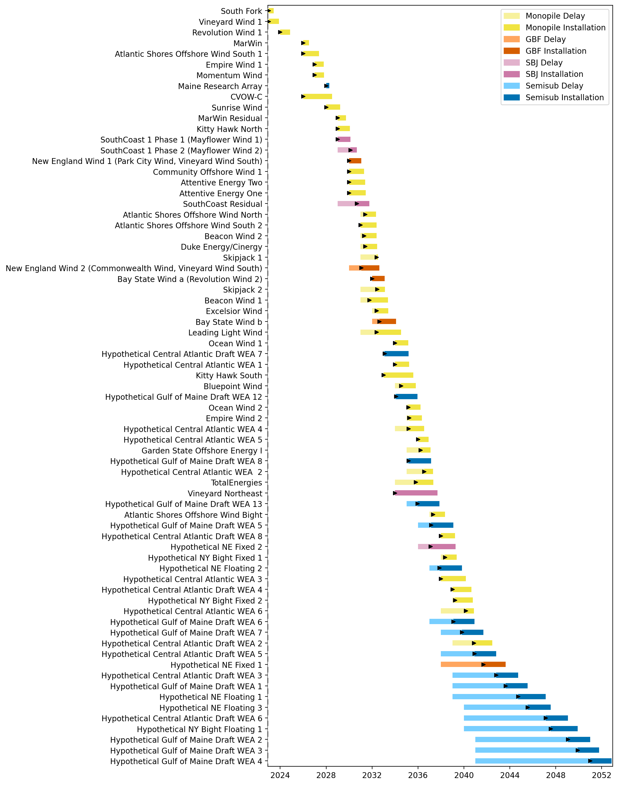
Full Gantt

Slide 3
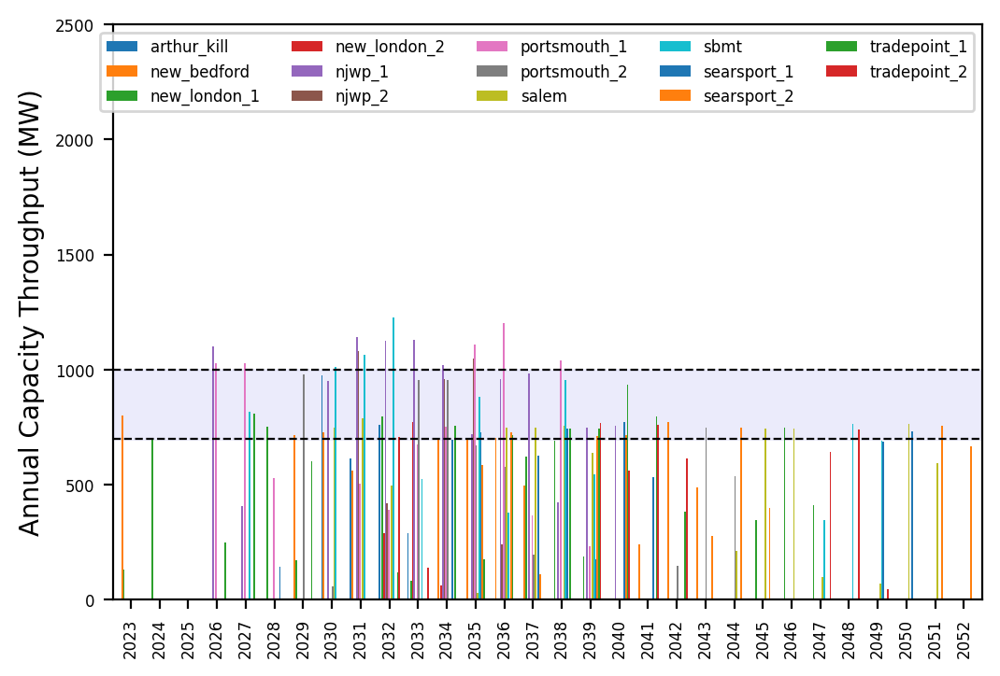
Port Throughput

Slide 4
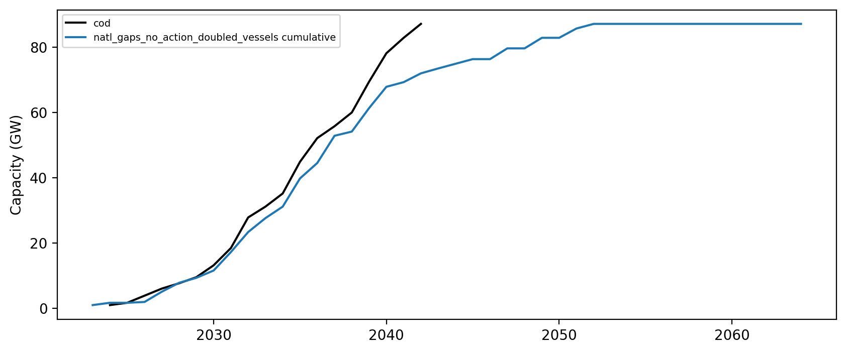
Installed Capacity

