Slide 1
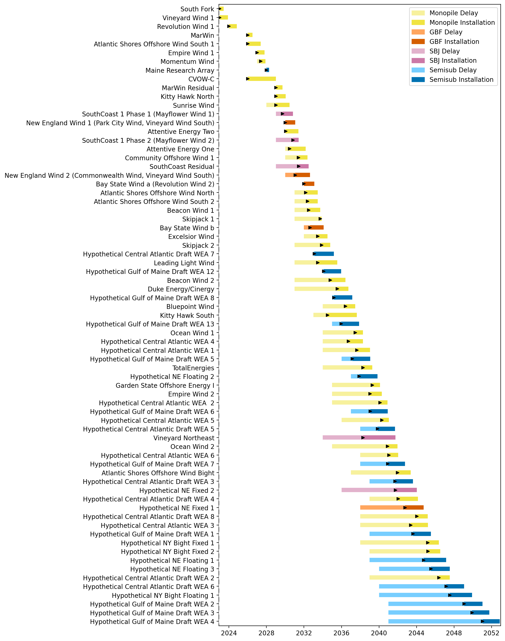
Full Gantt

Slide 2
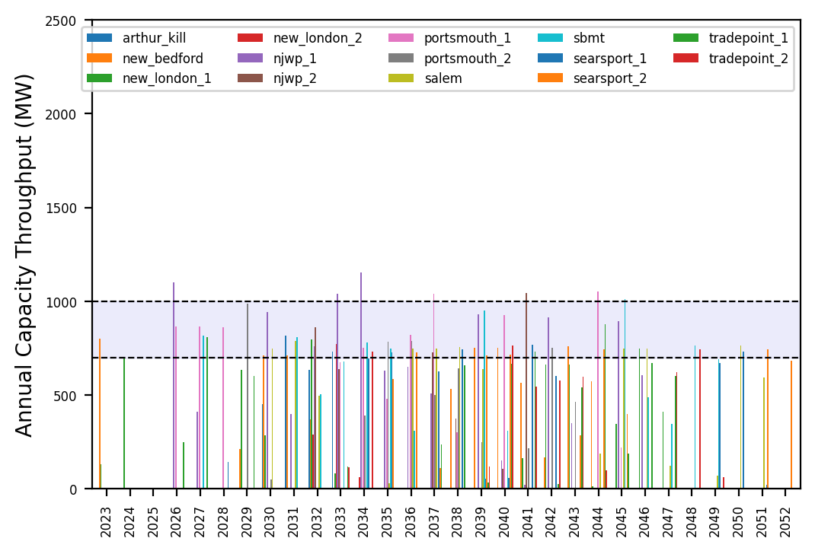
Port Throughput

Slide 3
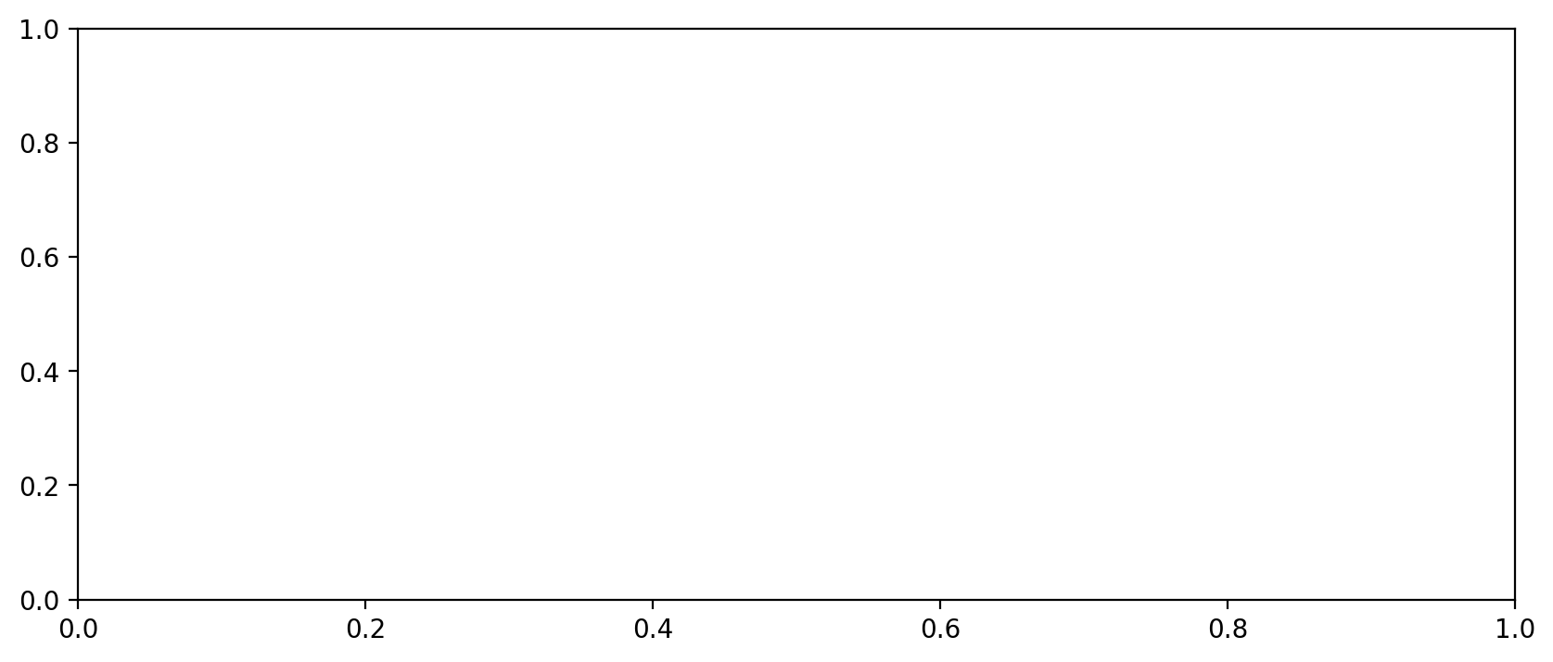
Vessel Utilization

Slide 4
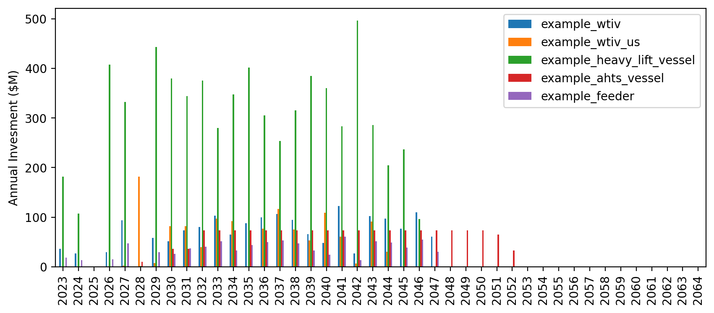
Vessel Investment

Slide 5
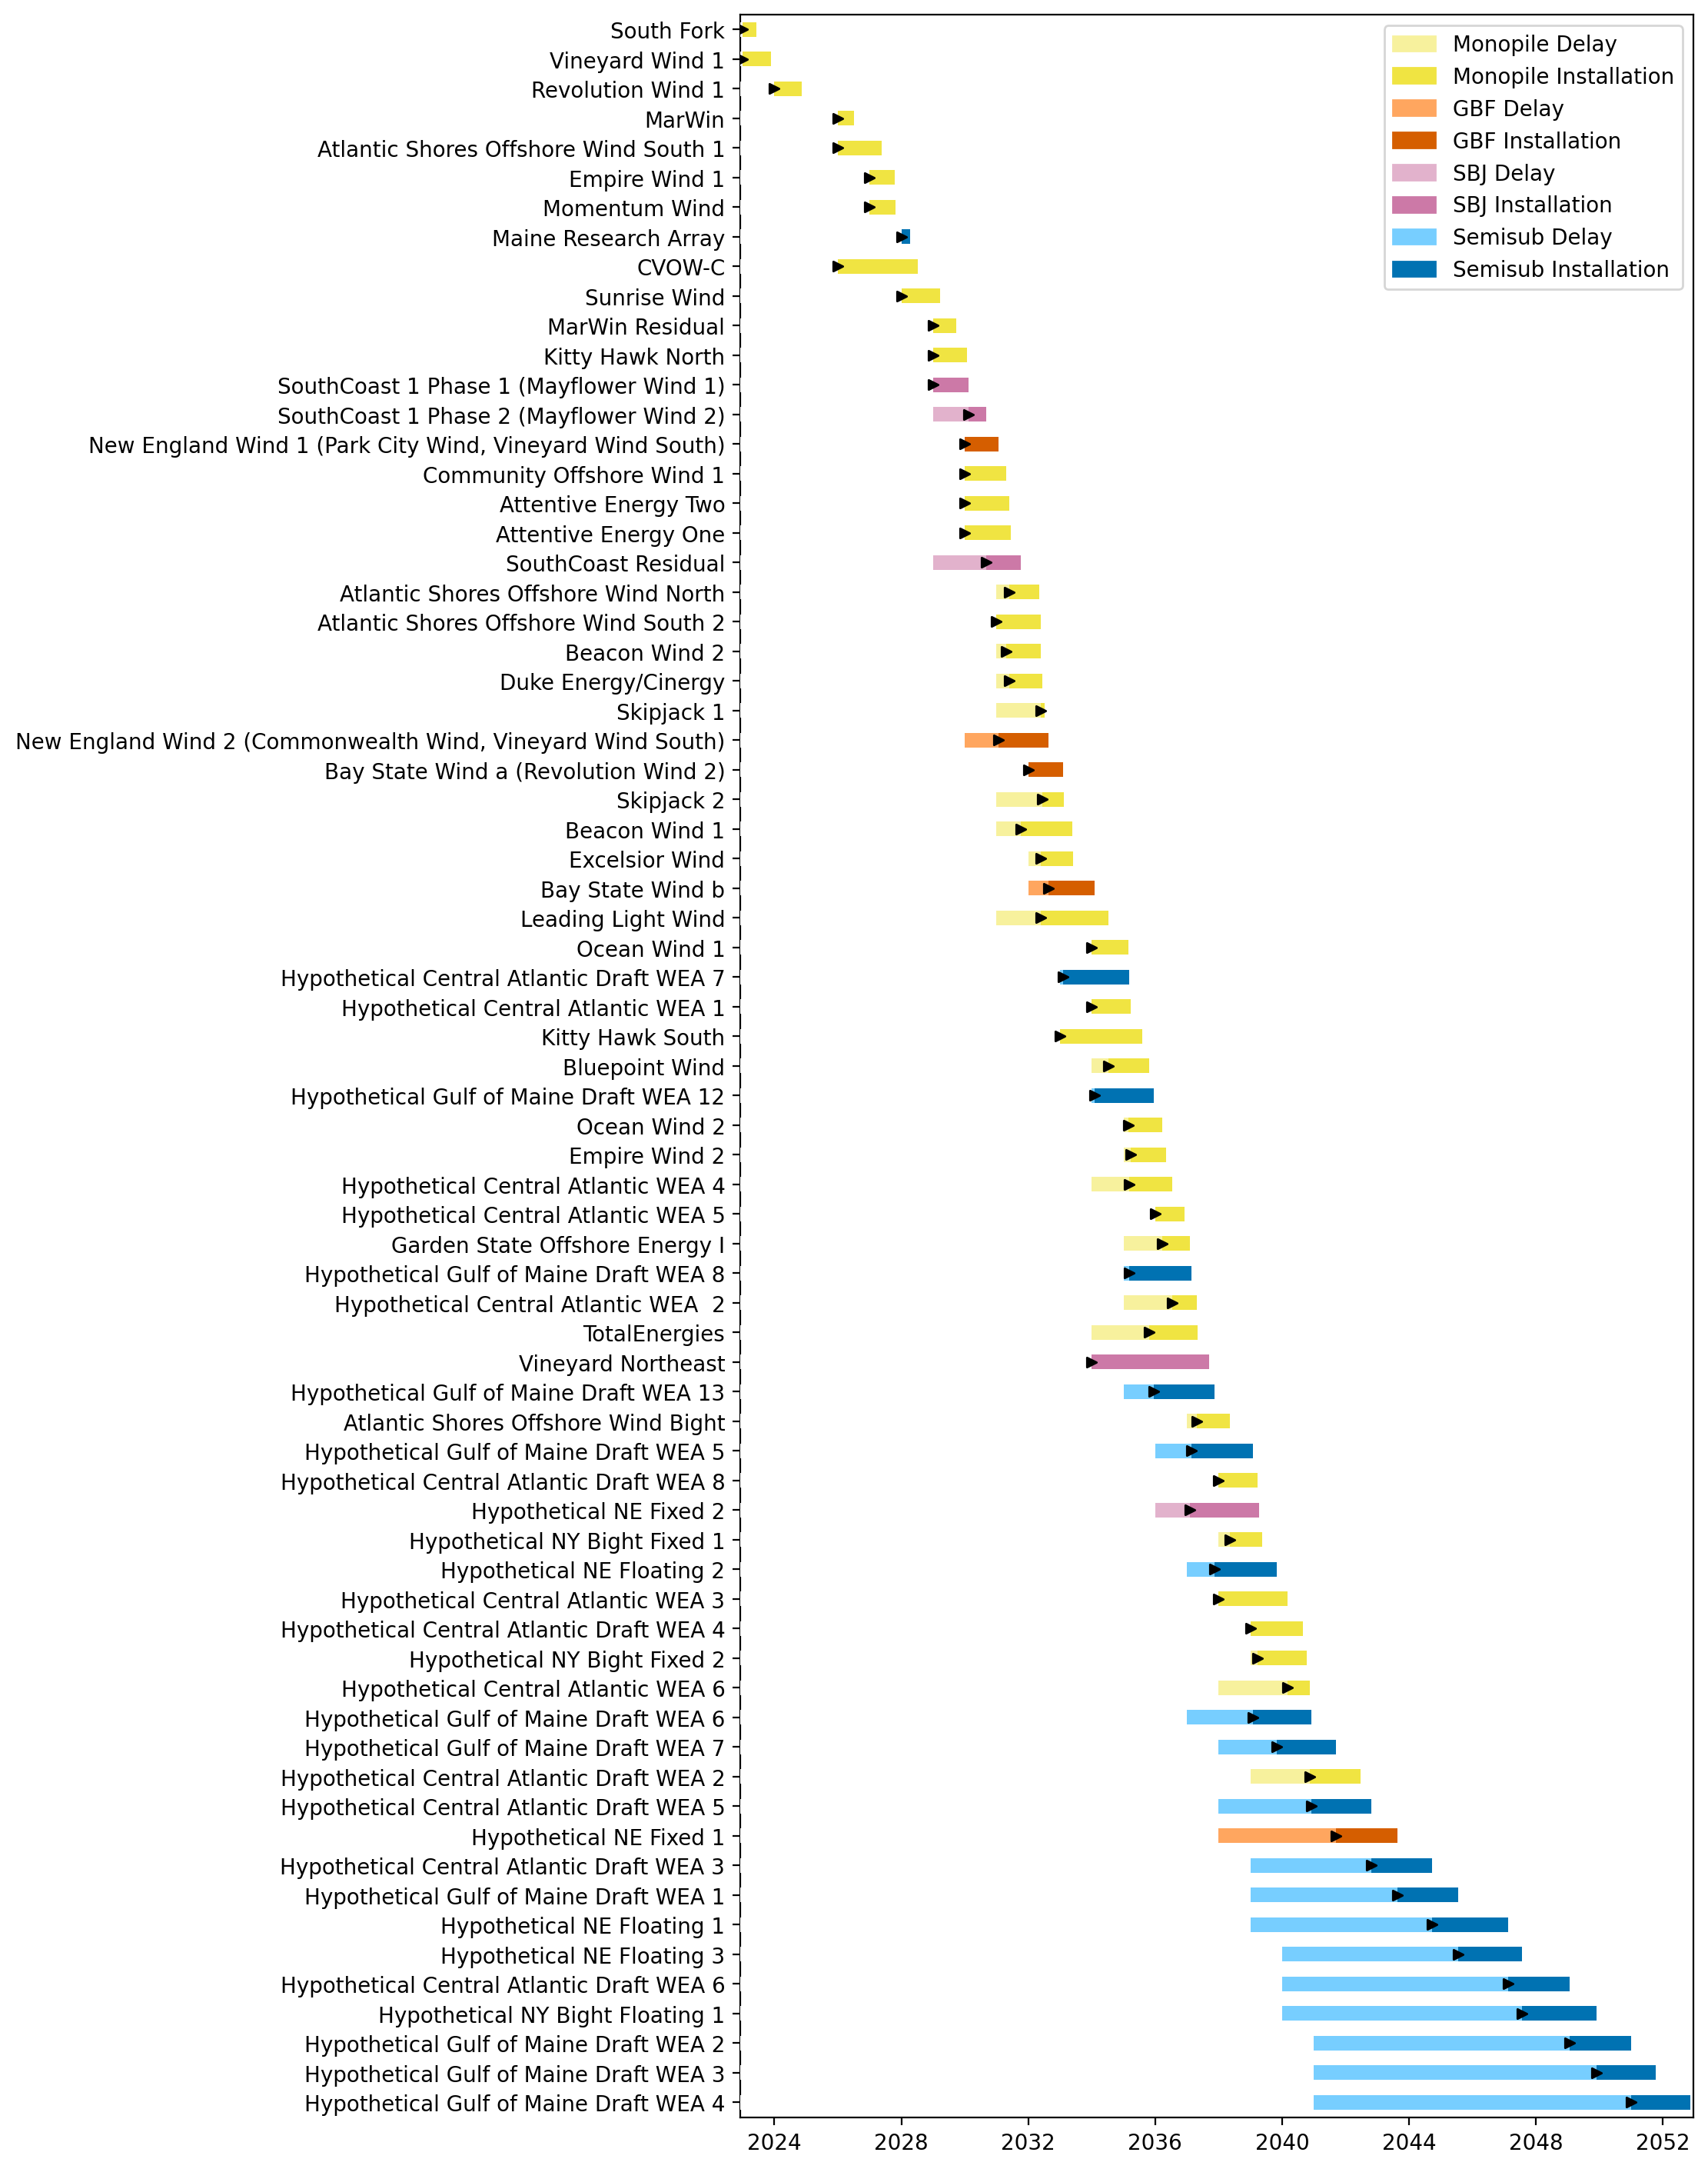
Full Gantt

Slide 6
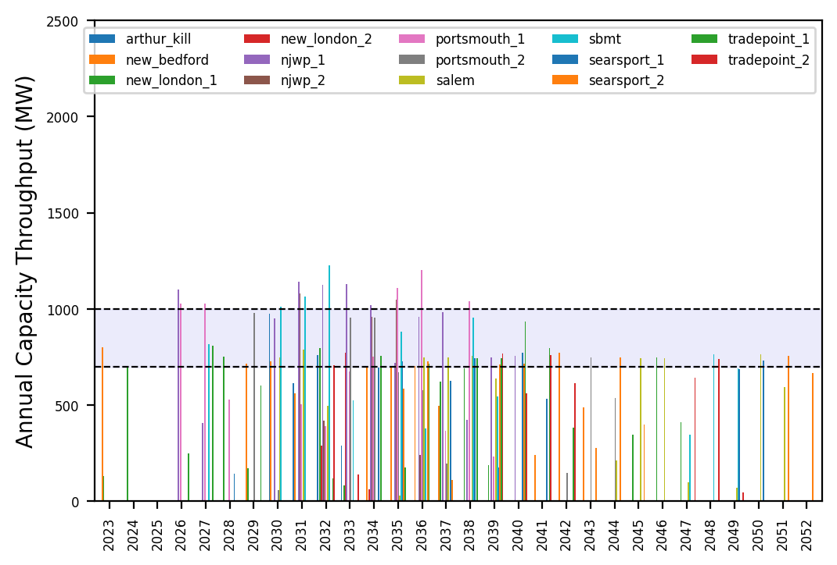
Port Throughput

Slide 7
Vessel Utilization

Slide 8
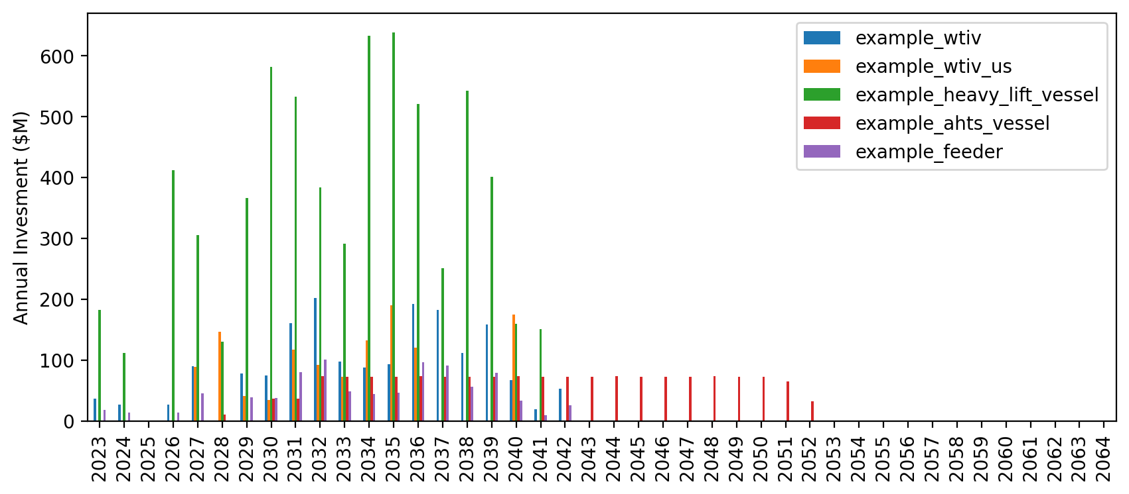
Vessel Investment

Slide 9
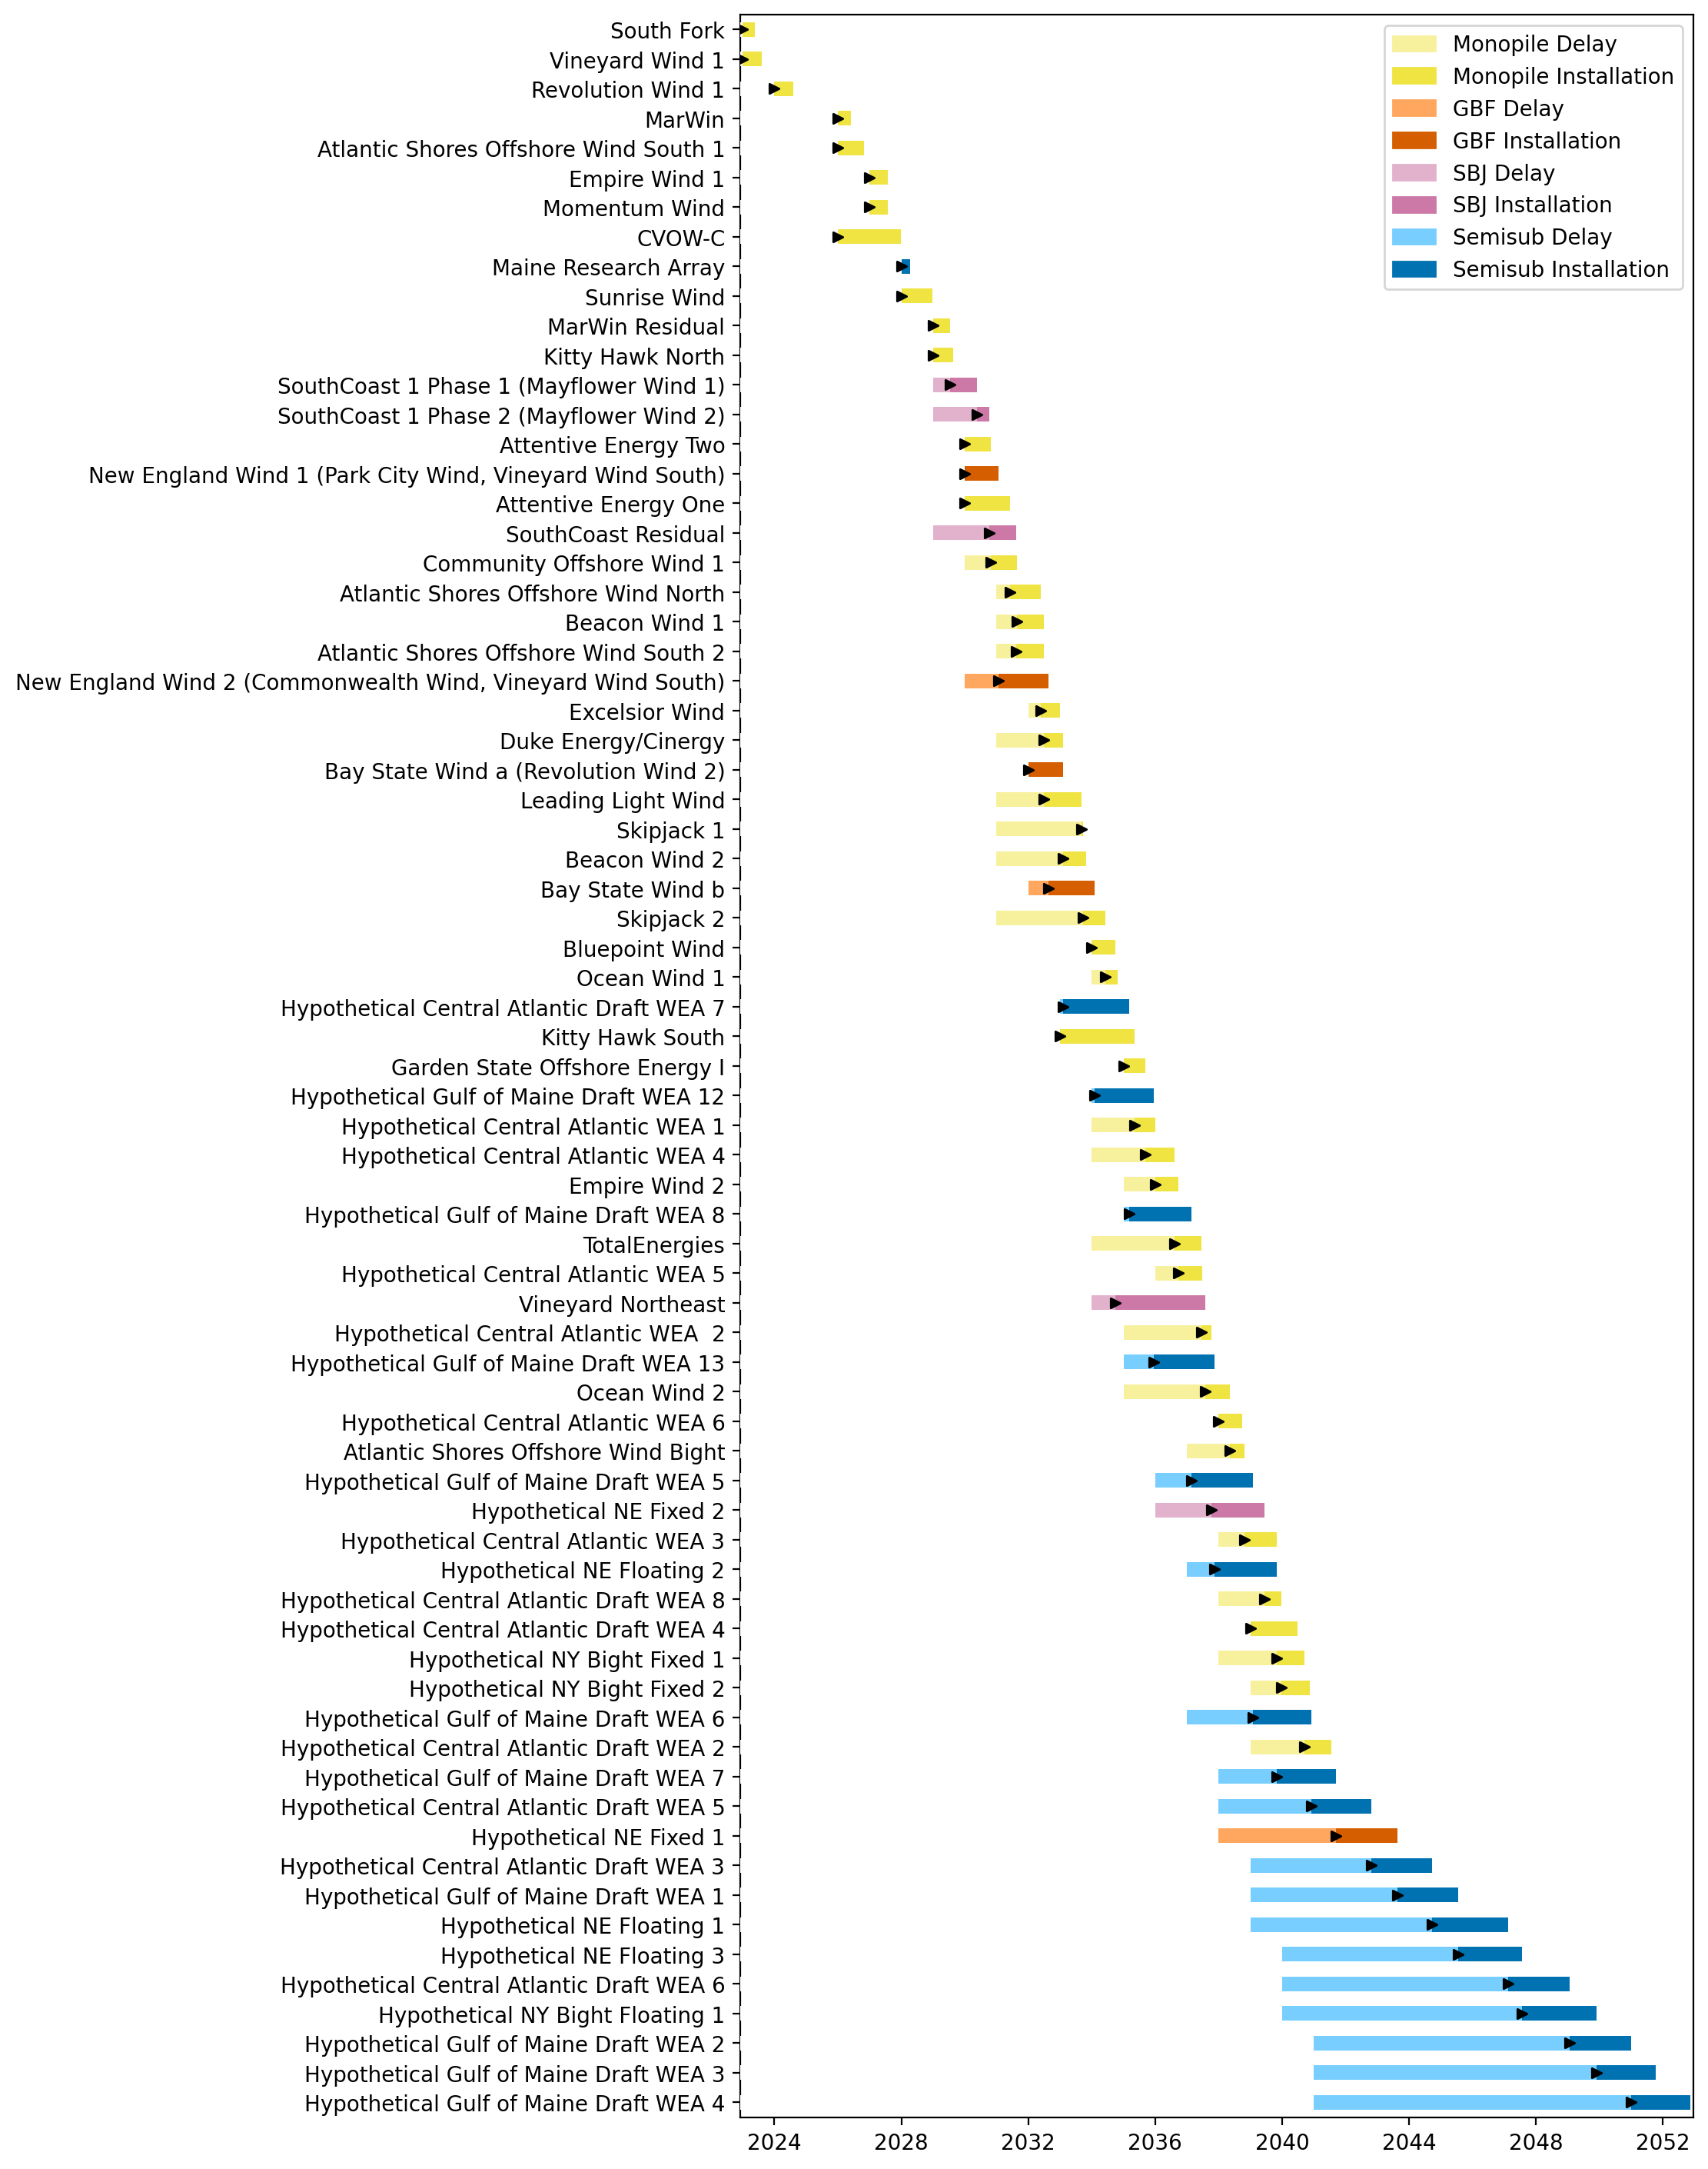
Full Gantt

Slide 10
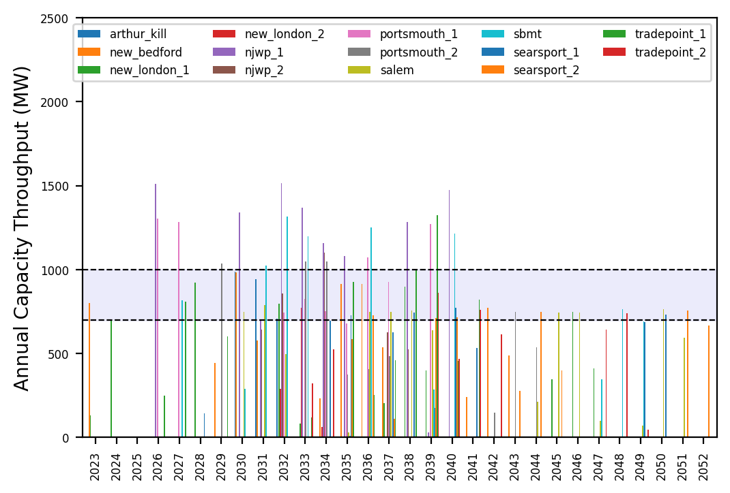
Port Throughput

Slide 11
Vessel Utilization

Slide 12
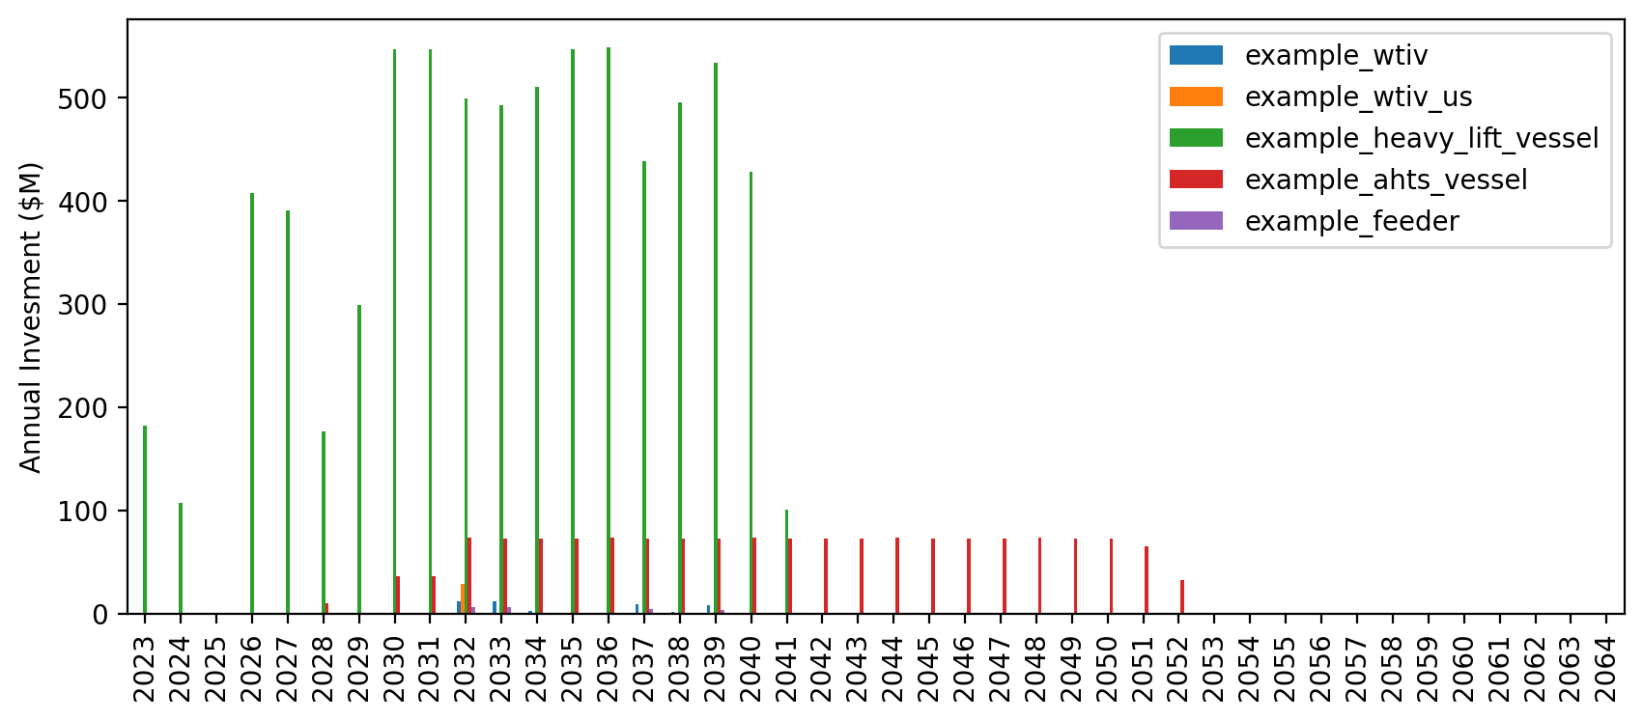
Vessel Investment

Slide 13
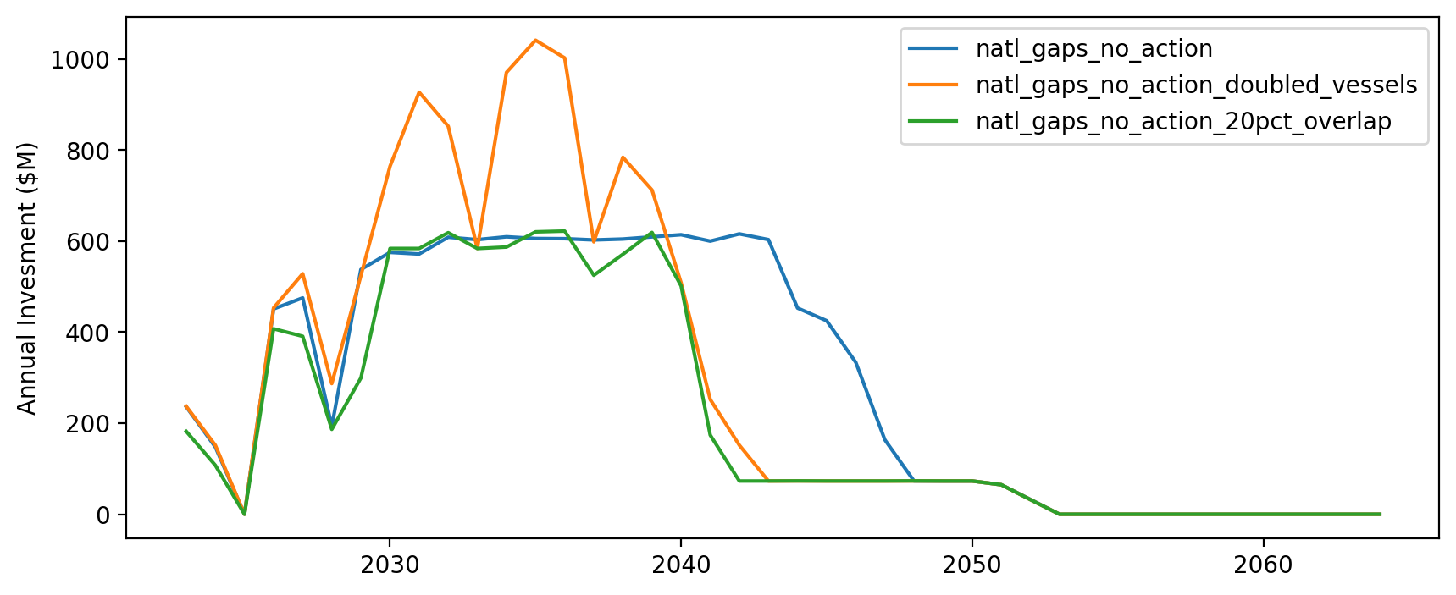
Vessel Investment by Scenario

Slide 14
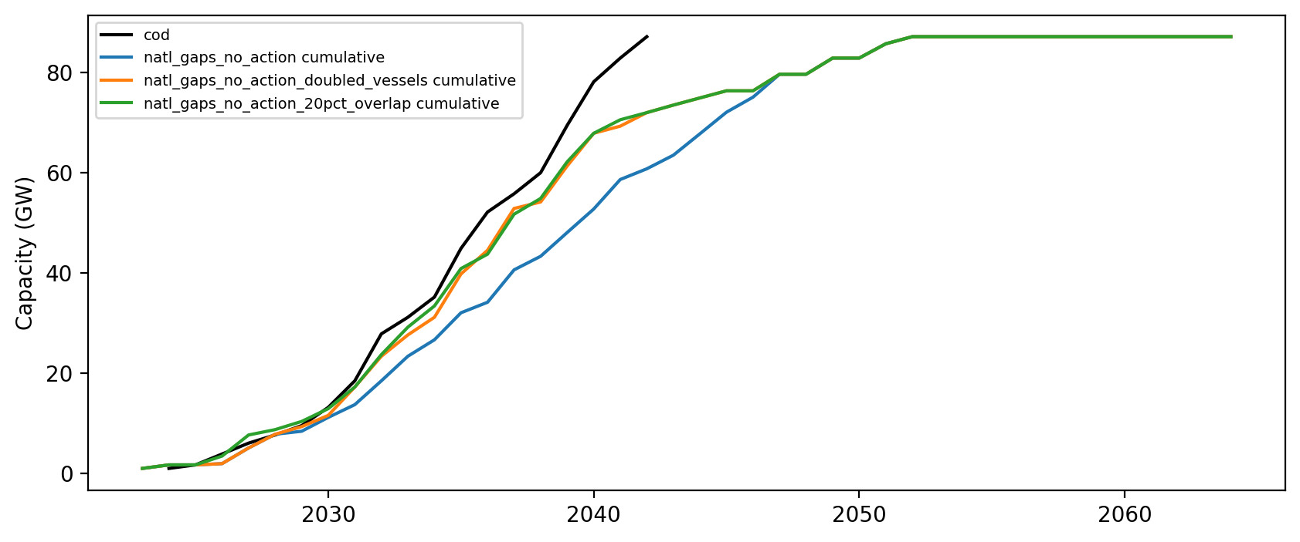
Installed Capacity

