Slide 1
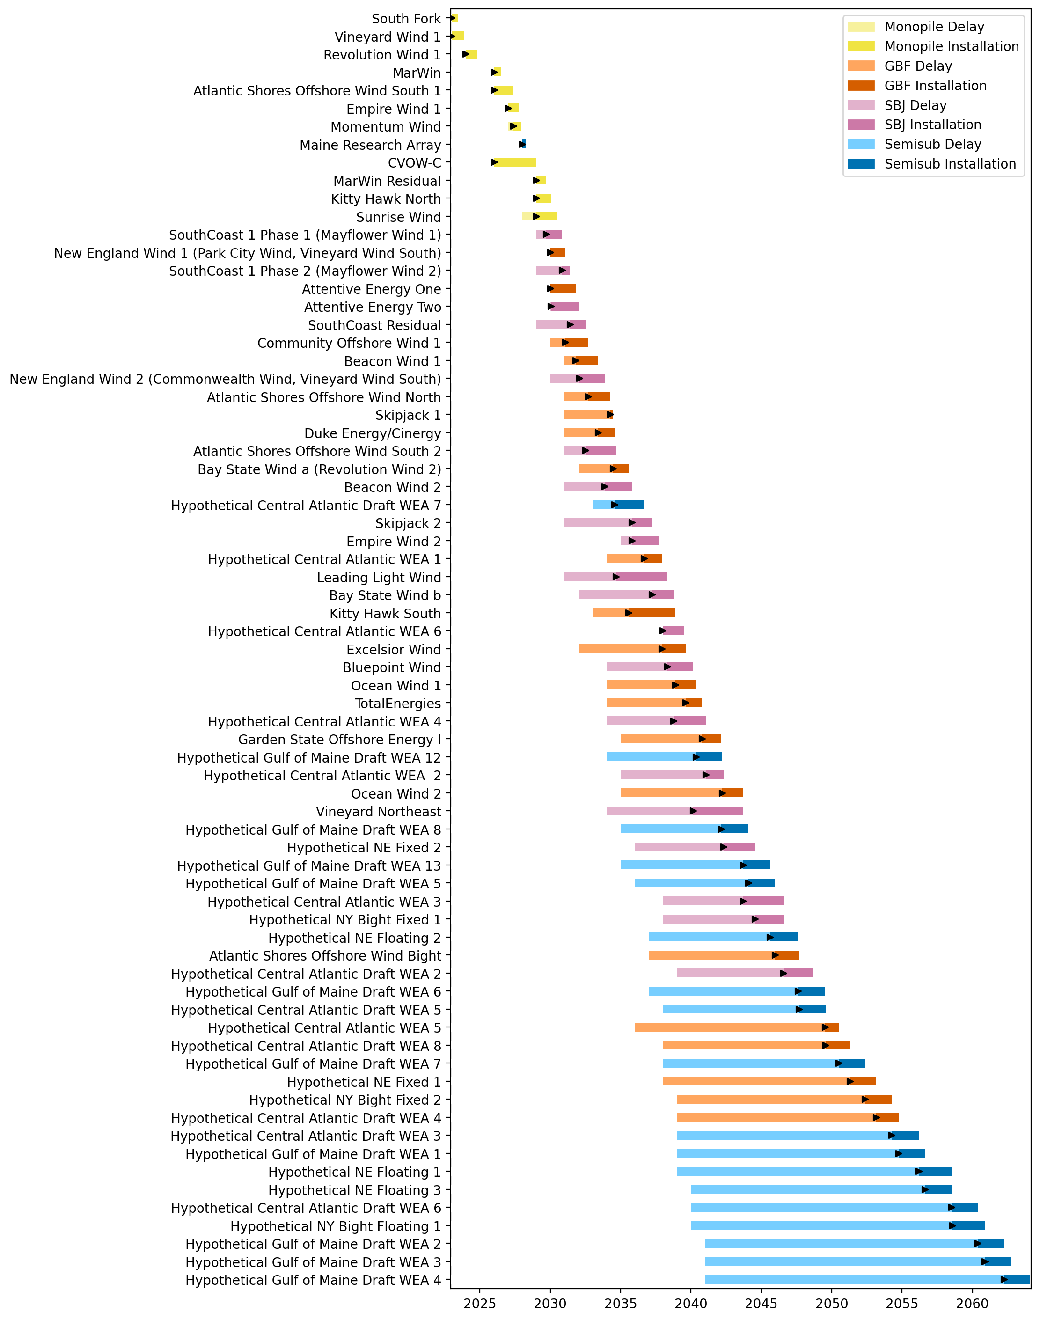
Full Gantt

Slide 2
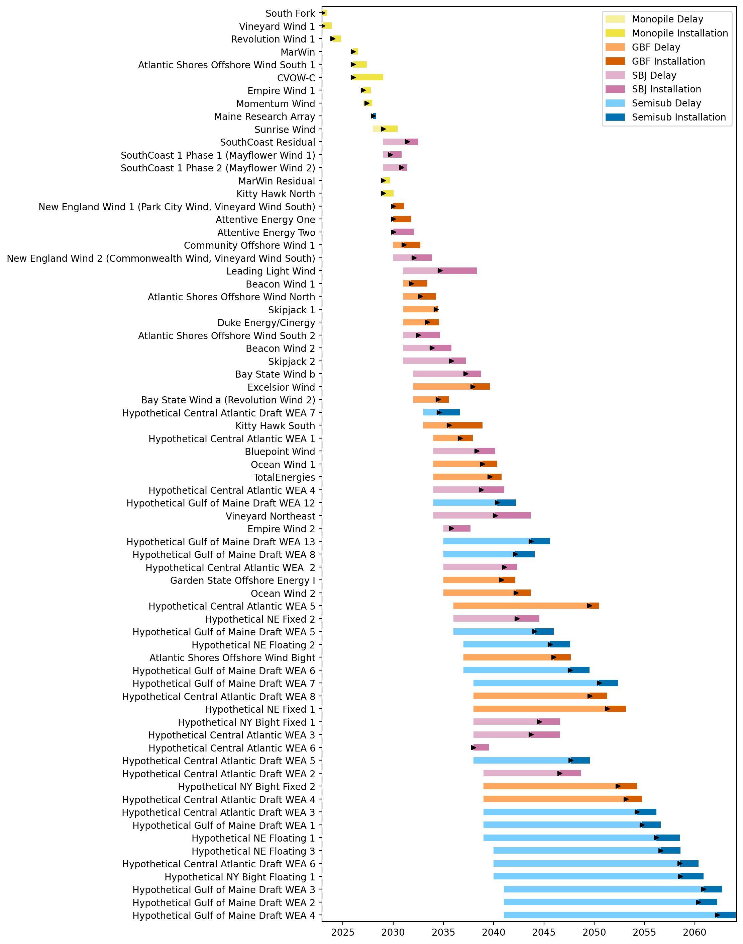
Sorted Full Gantt

Slide 3
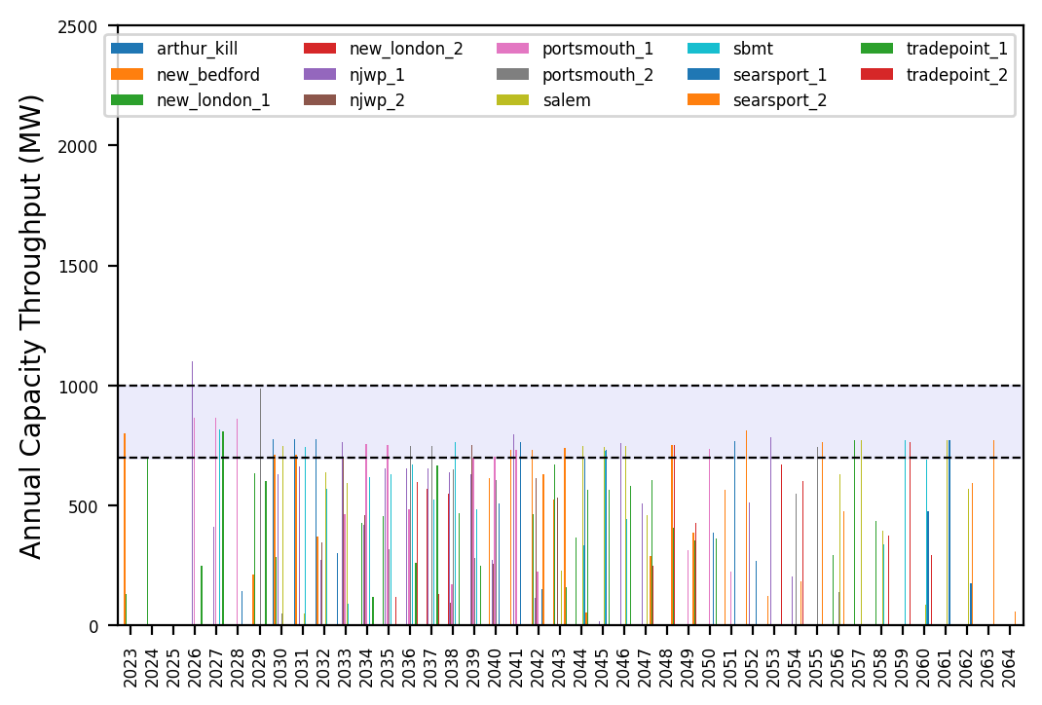
Port Throughput

Slide 4
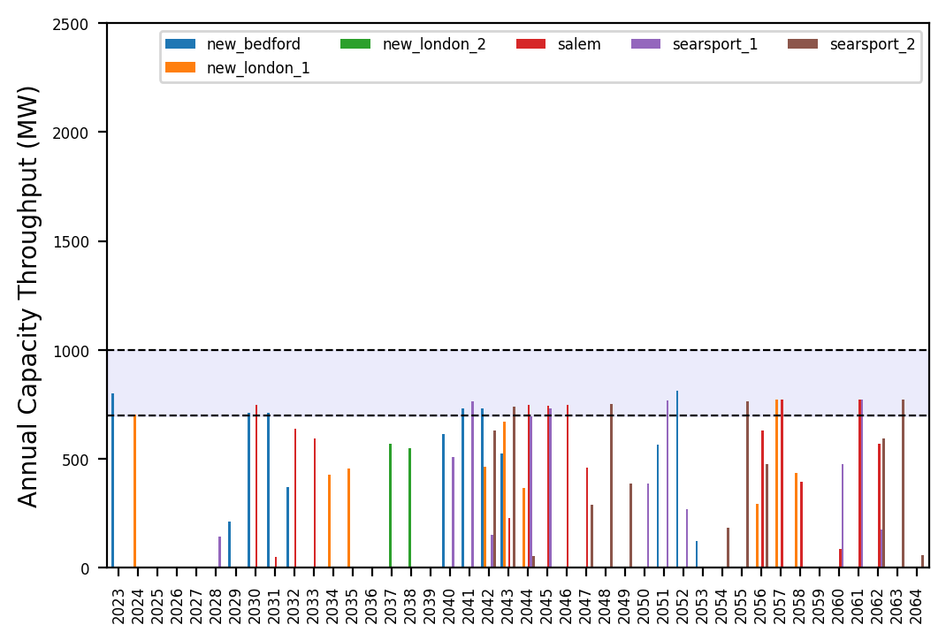
Port Throughput

Slide 5
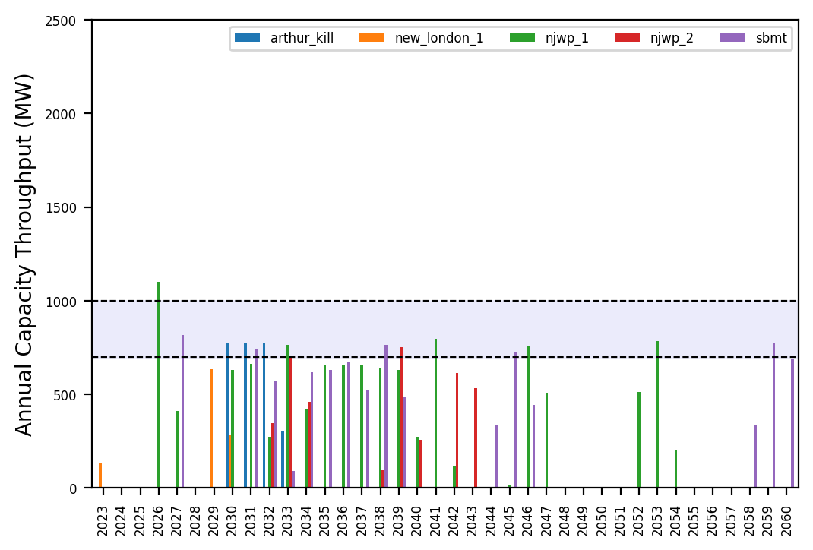
Port Throughput

Slide 6
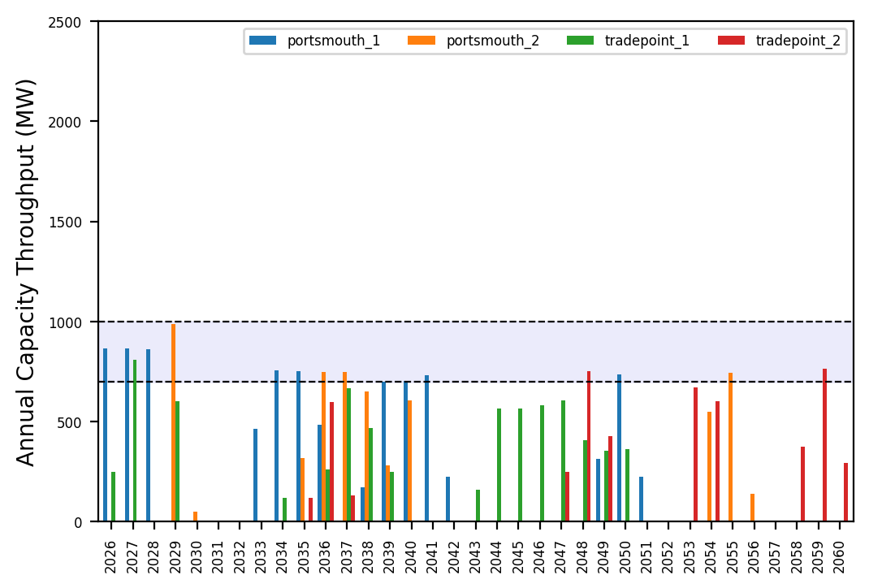
Port Throughput

Slide 7
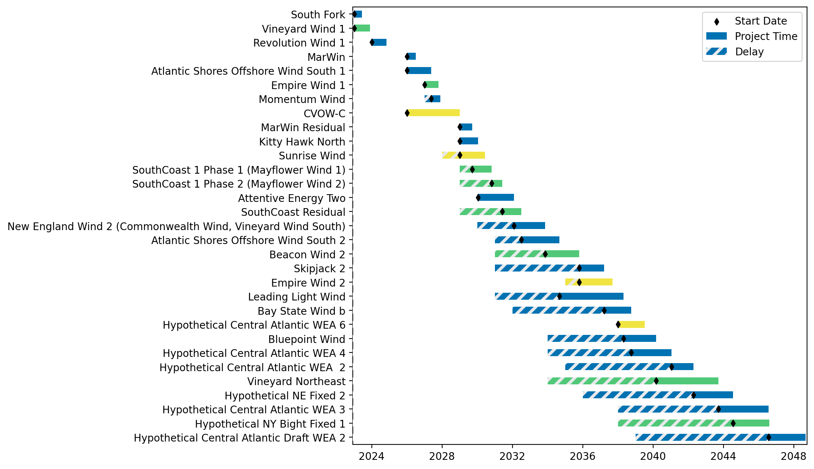
Fixed Gantt

Slide 8
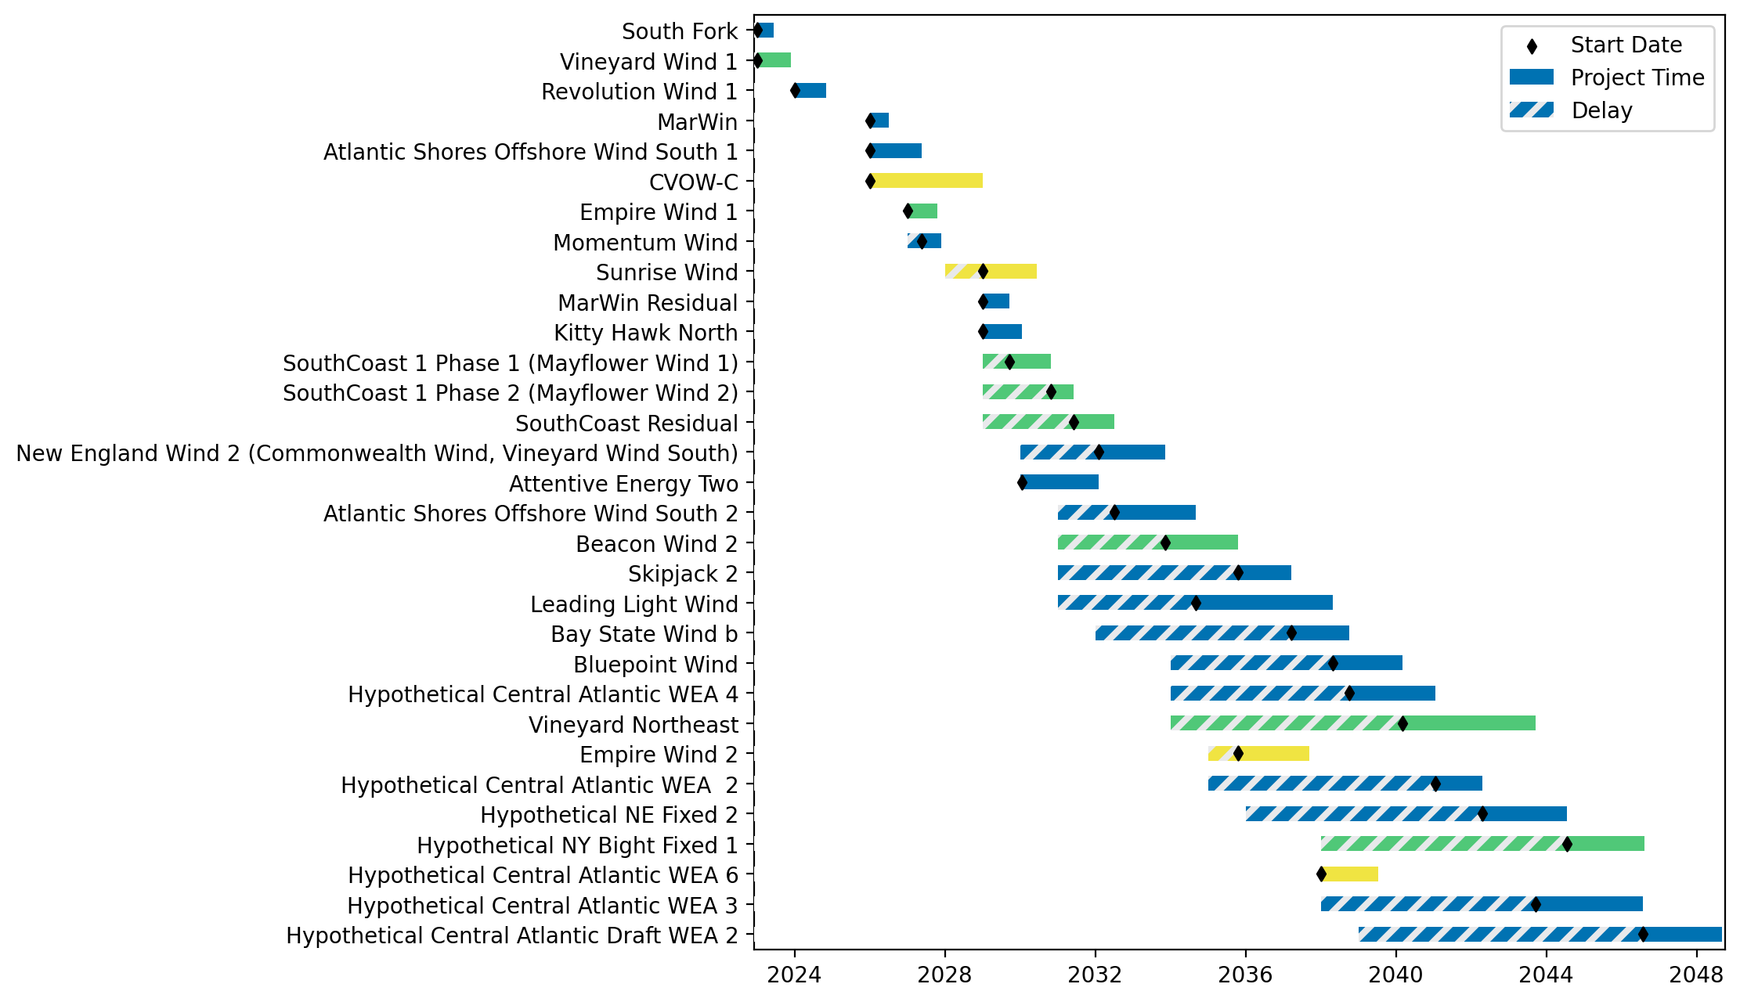
Sorted Fixed Gantt

Slide 9
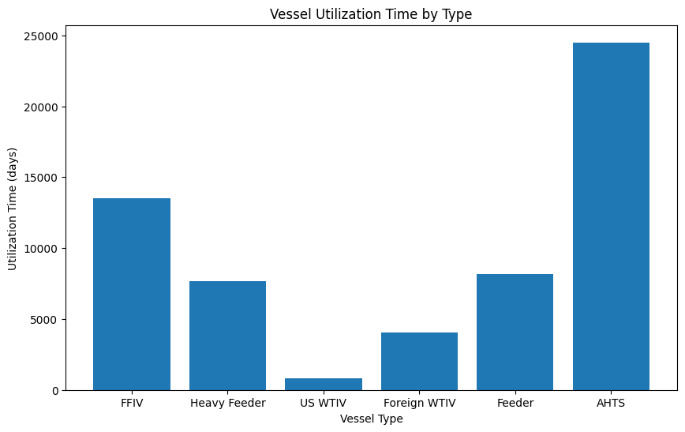
Vessel Utilization Time by Type

Slide 10
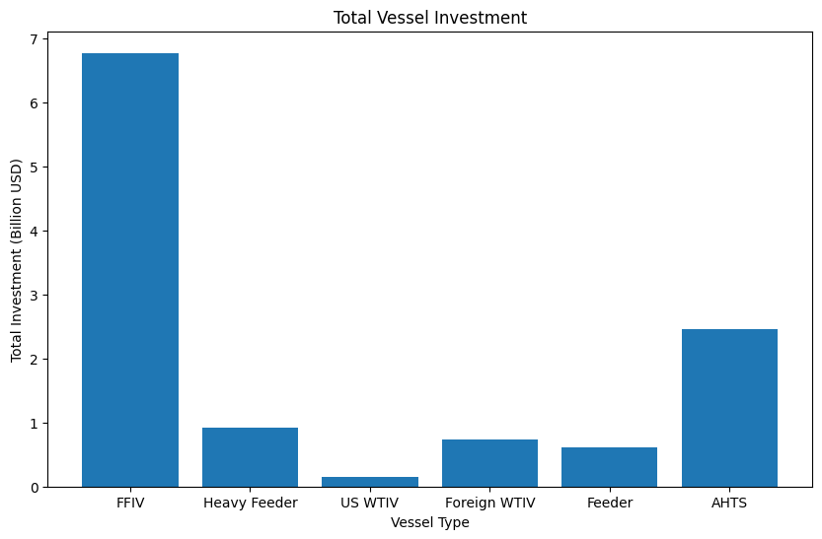
Total Vessel Investments

Slide 11
Total Vessel Investments

Slide 12
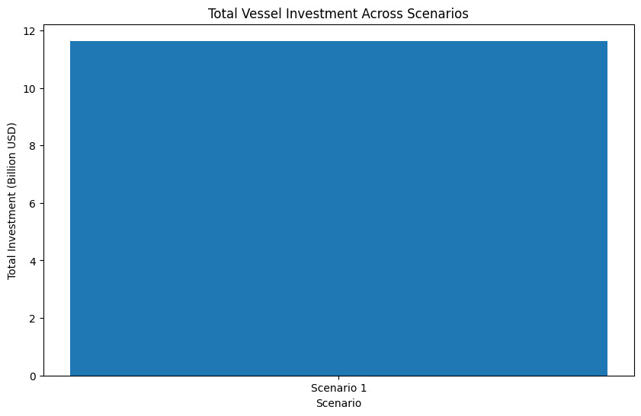
Total Vessel Investments Across Scenarios

