Slide 1
base_0225
1 US WTIV starting with CVOW

Slide 2
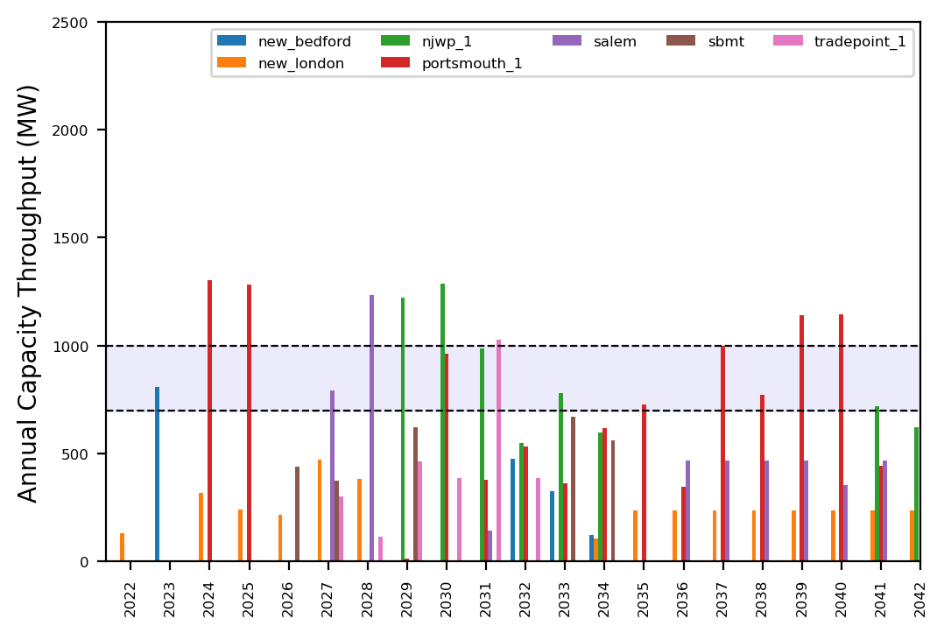
Port Throughput

Slide 3
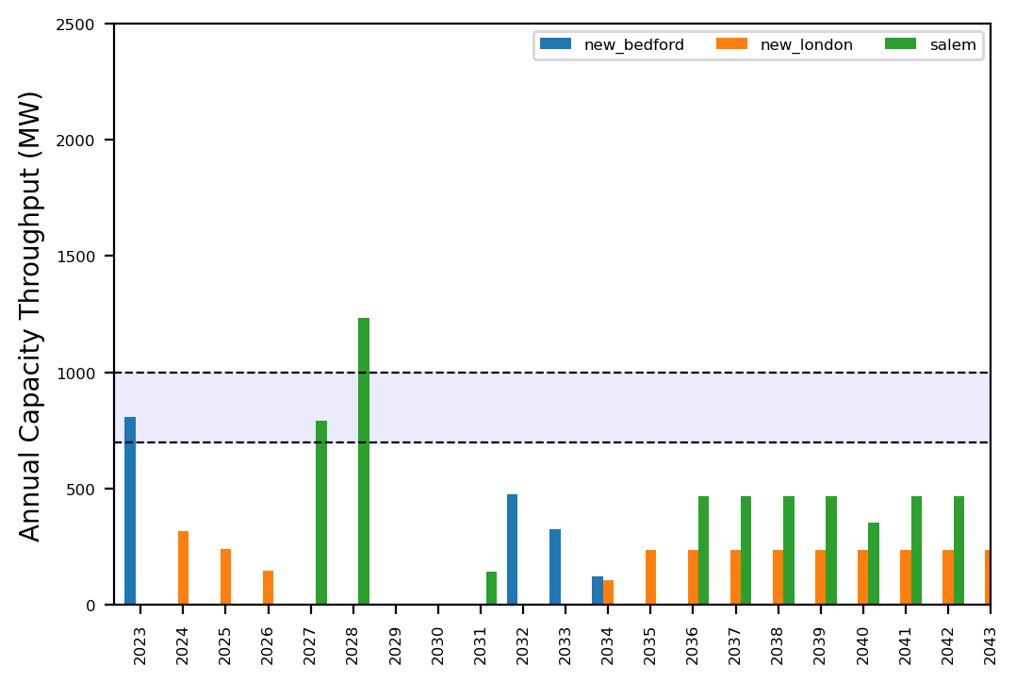
Port Throughput

Slide 4
base_0225_inf
1 US WTIV starting with CVOW

Slide 5
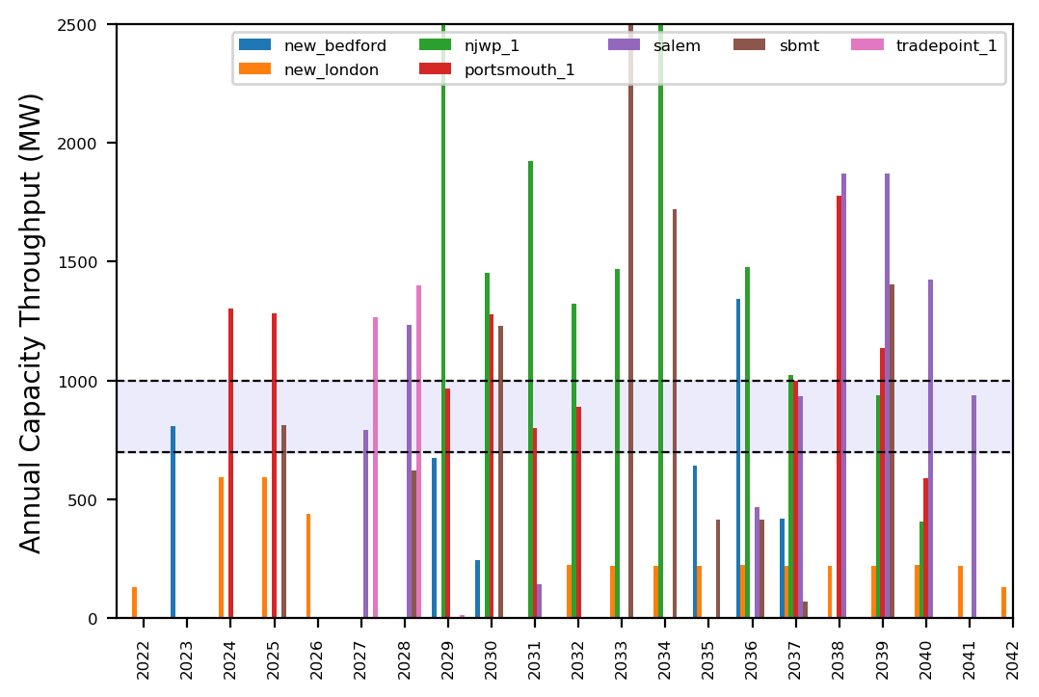
Port Throughput

Slide 6
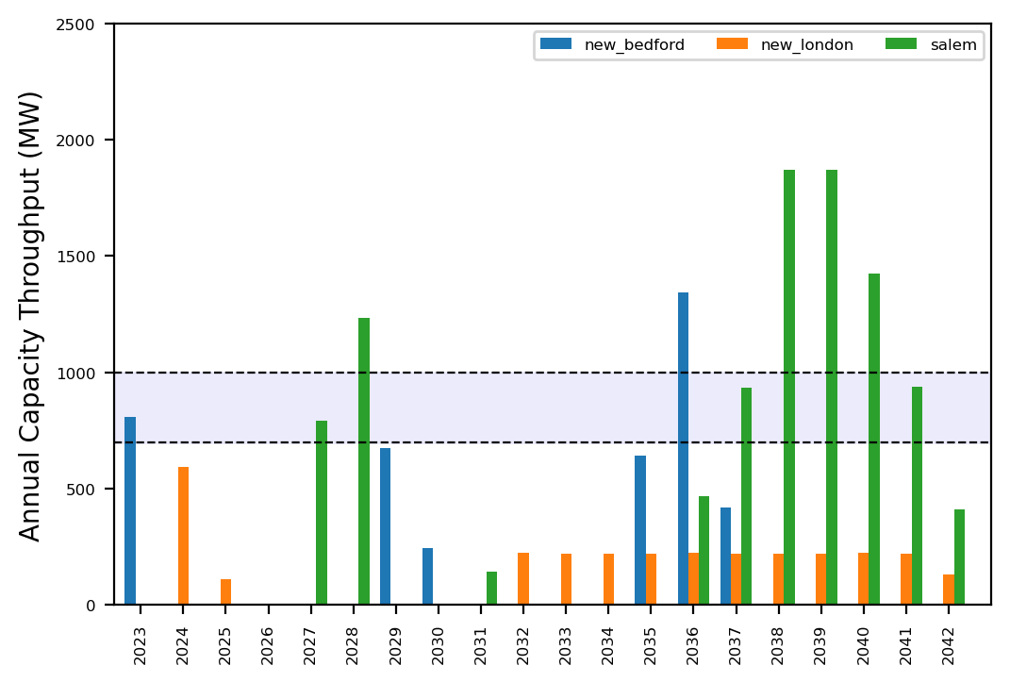
Port Throughput

Slide 7
congested_0225
No action with base pipeline

Slide 8
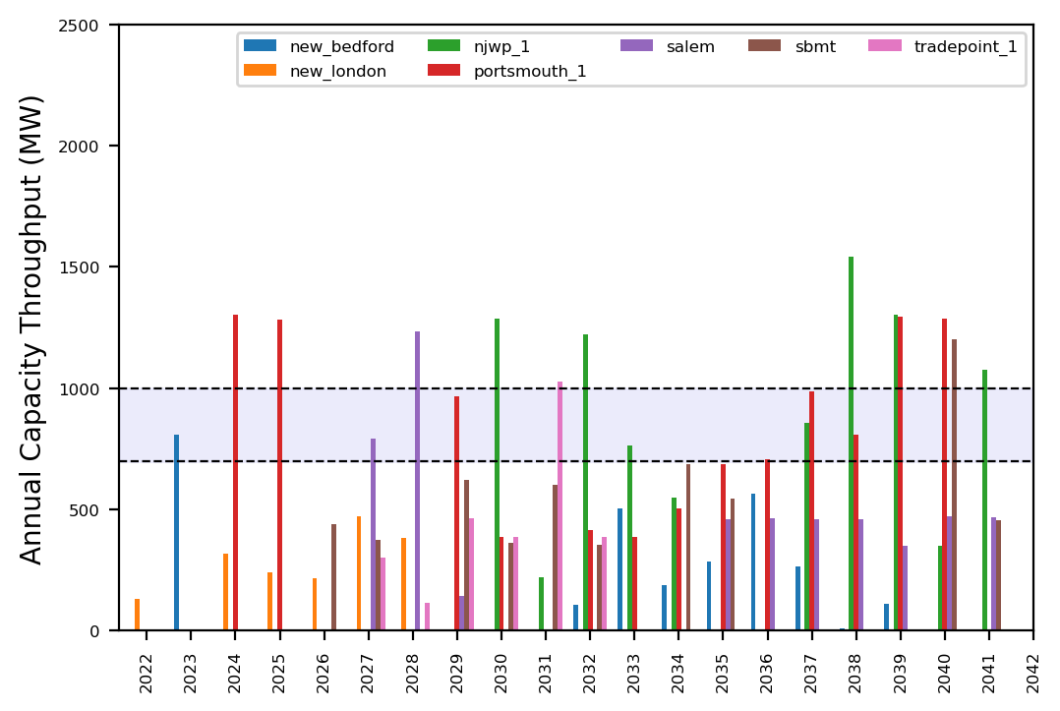
Port Throughput

Slide 9
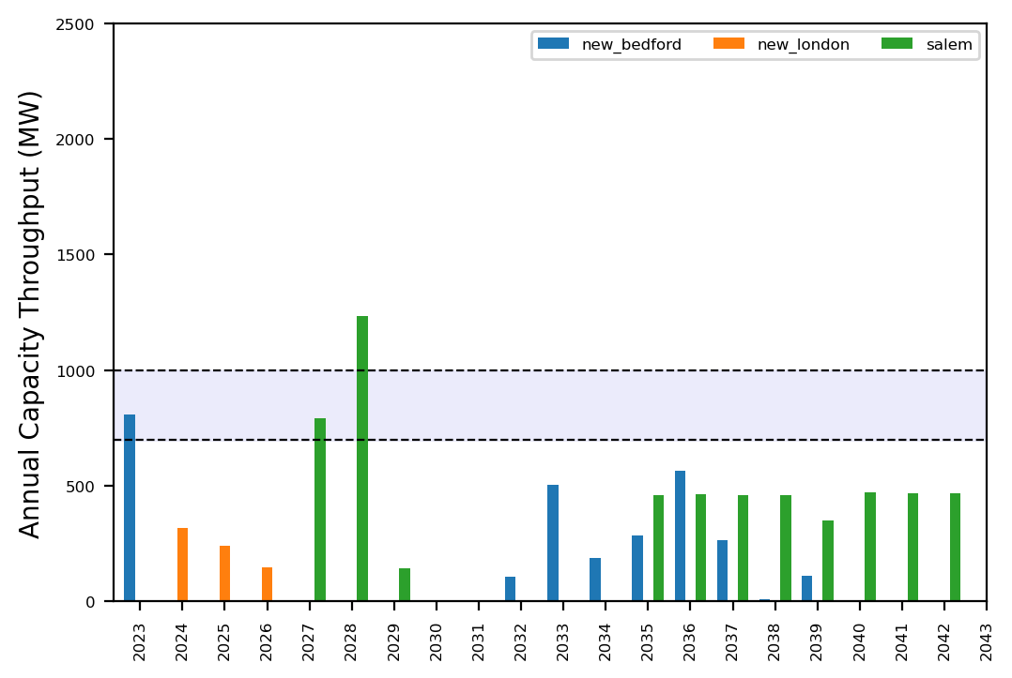
Port Throughput

Slide 10
congested_0225_inf
No action with base pipeline

Slide 11
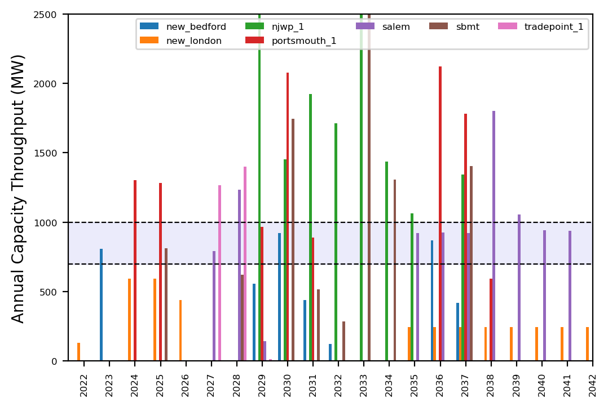
Port Throughput

Slide 12
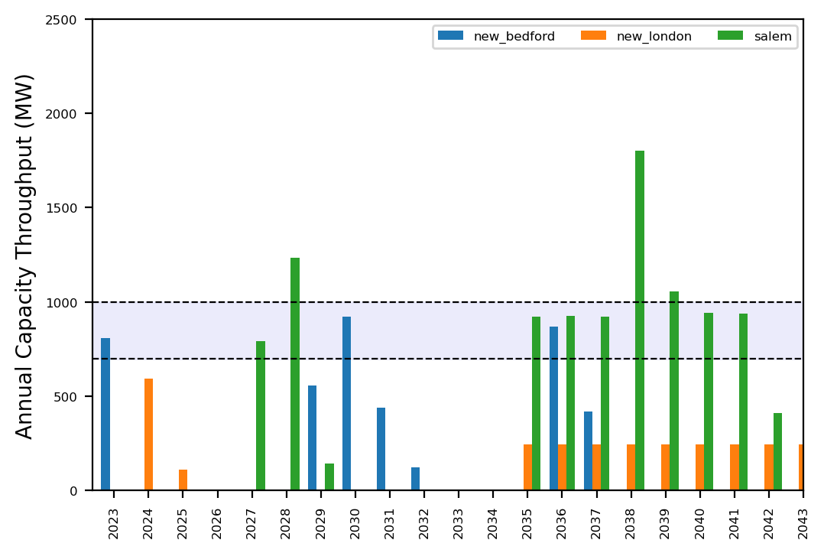
Port Throughput

Slide 13
expanded_0225
No action with base pipeline

Slide 14
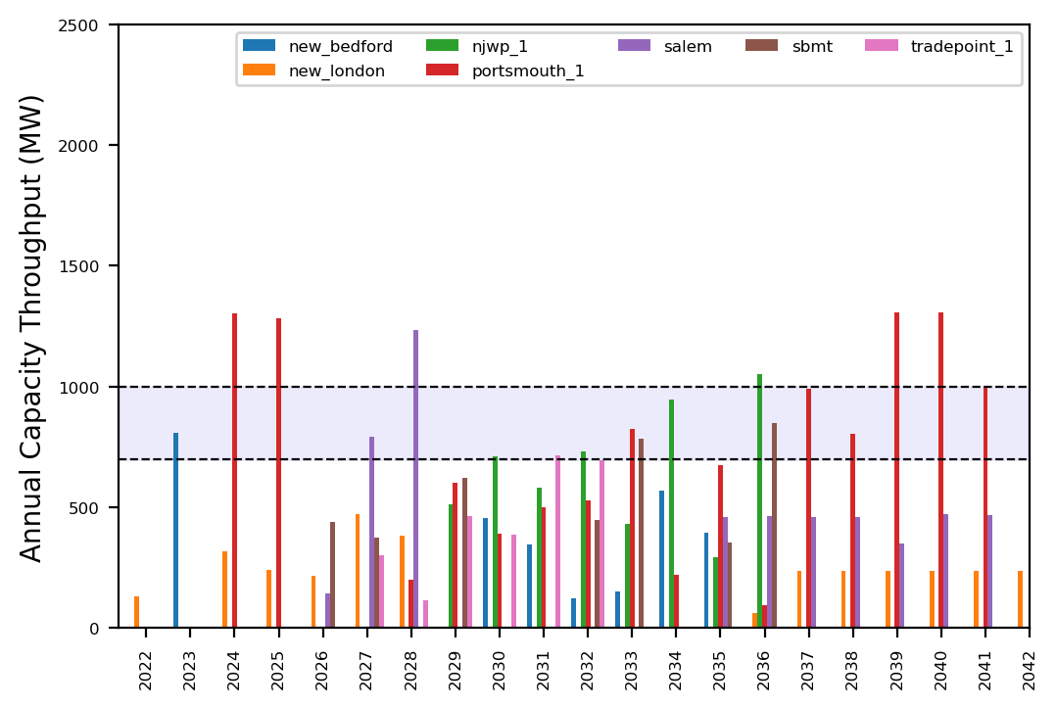
Port Throughput

Slide 15
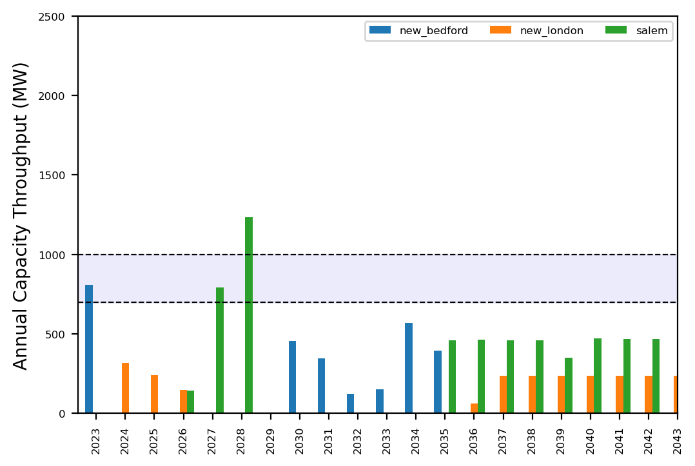
Port Throughput

Slide 16
expanded_0225_inf
No action with base pipeline

Slide 17
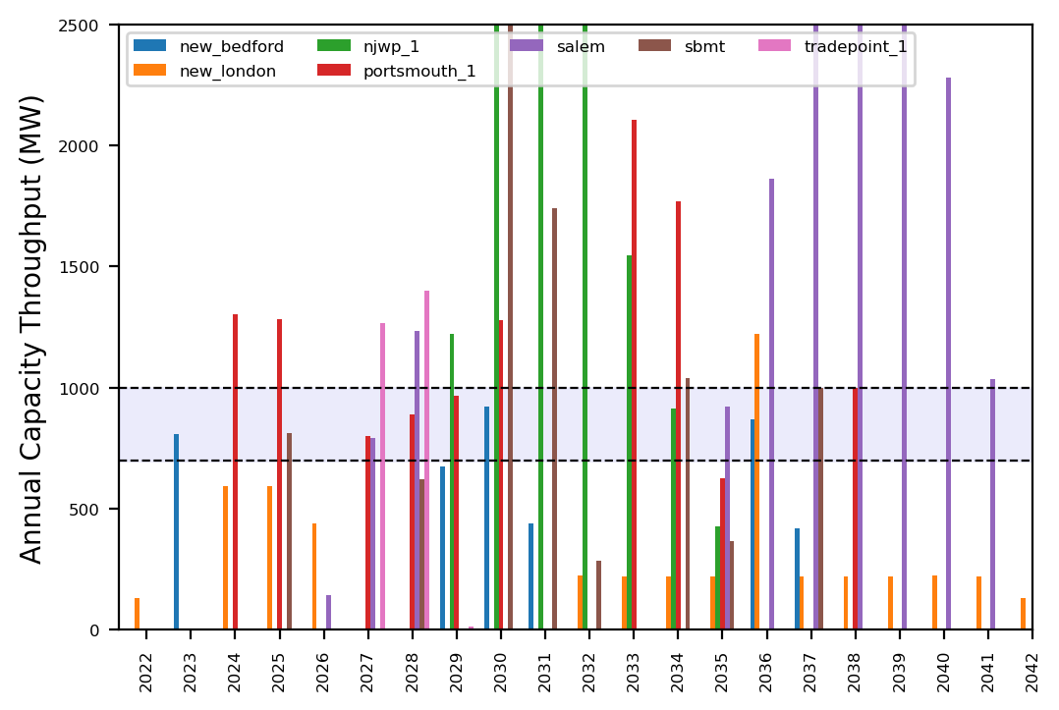
Port Throughput

Slide 18
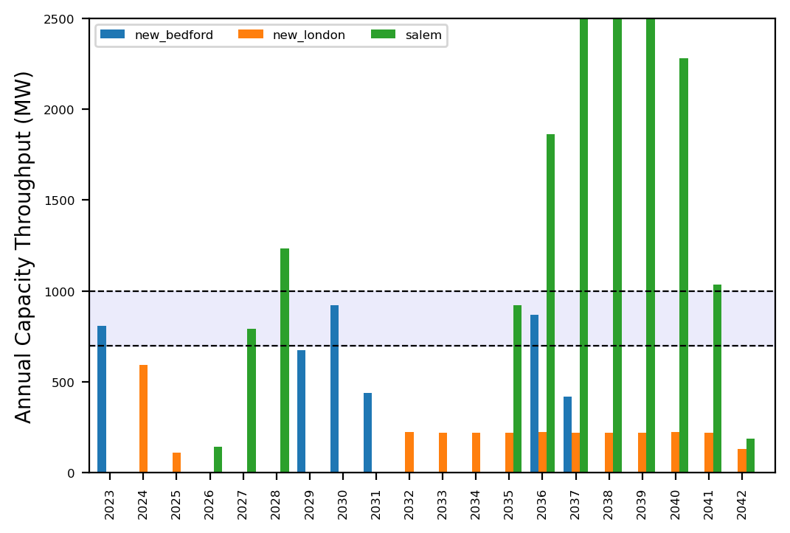
Port Throughput

Slide 19
reduced_0225
No action with base pipeline

Slide 20
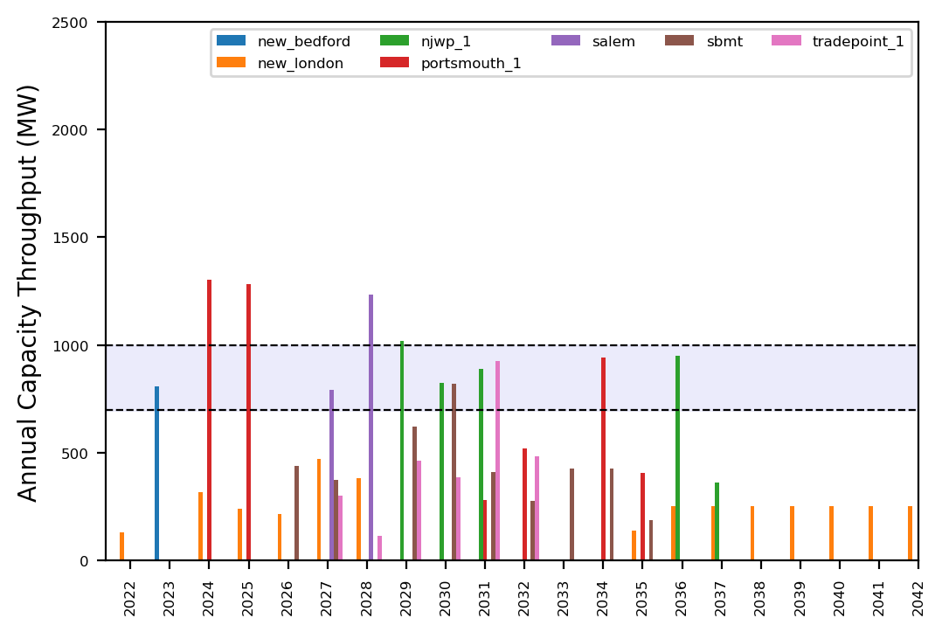
Port Throughput

Slide 21
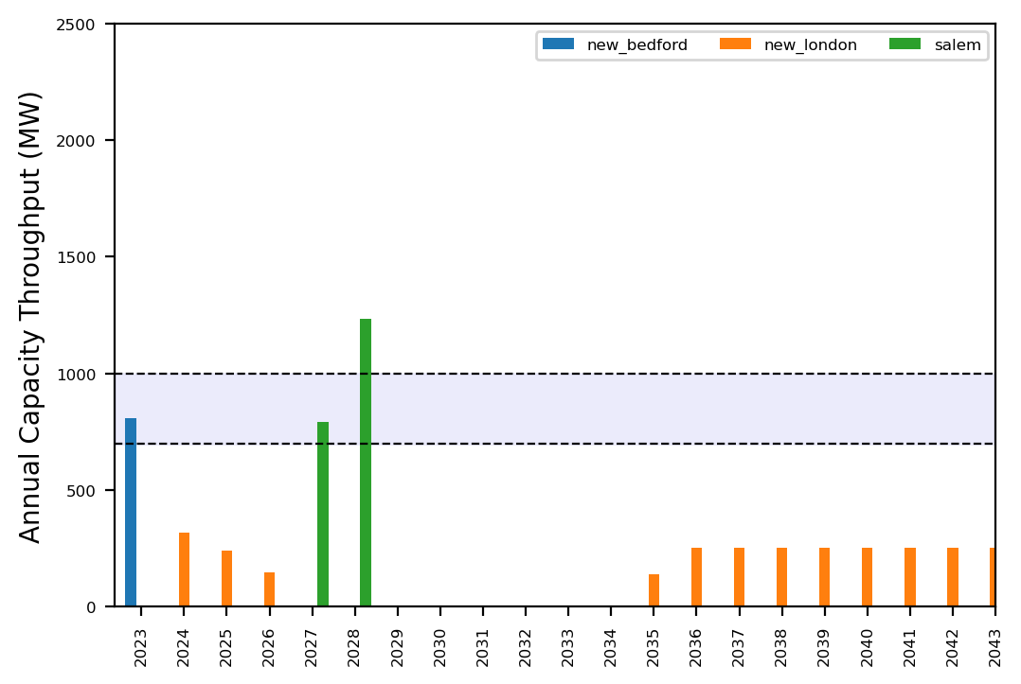
Port Throughput

Slide 22
reduced_0225_inf
No action with base pipeline

Slide 23
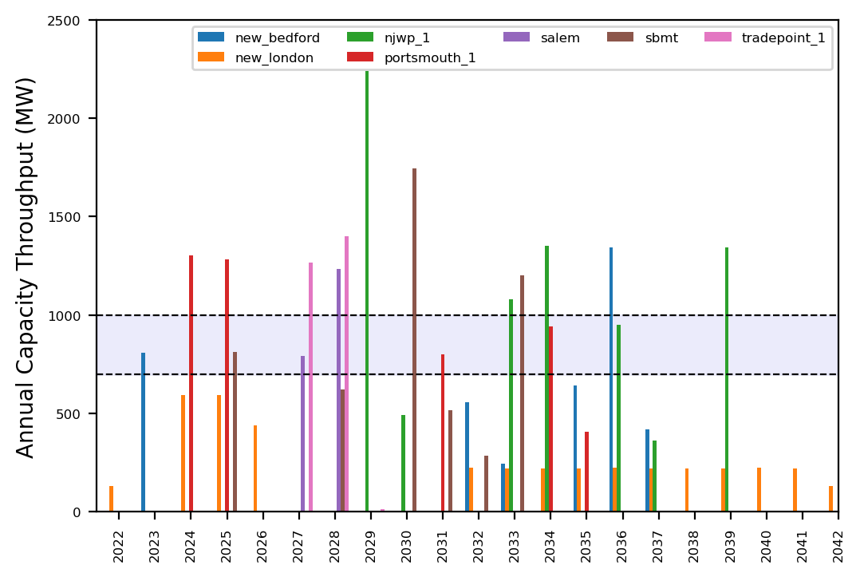
Port Throughput

Slide 24
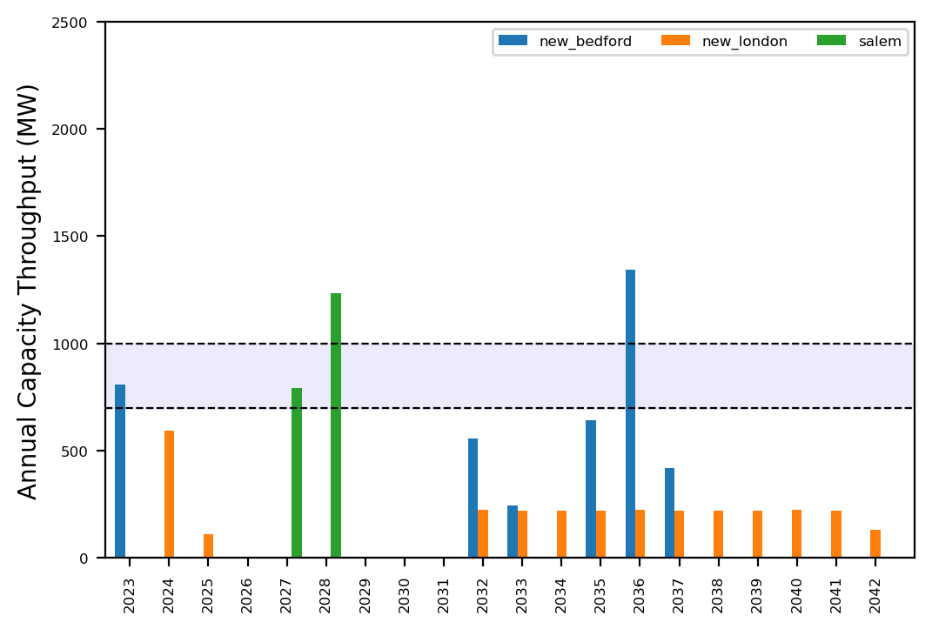
Port Throughput

Slide 25
uniform_0225
No action with base pipeline

Slide 26
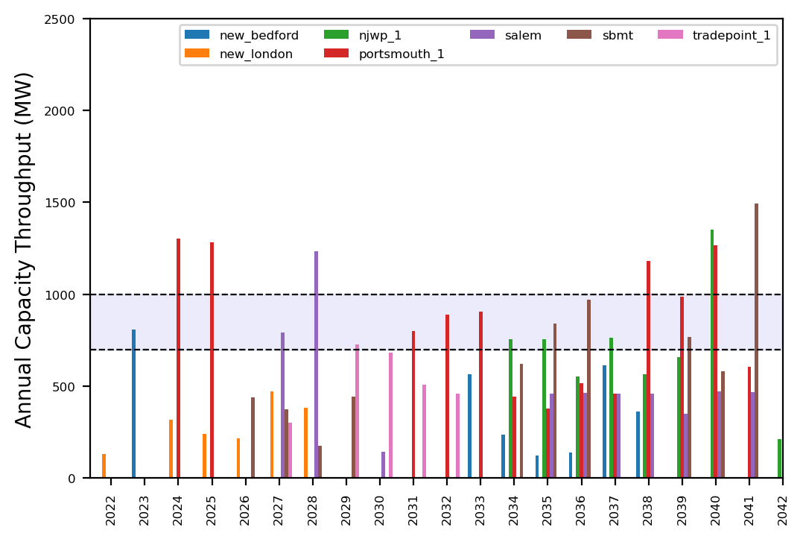
Port Throughput

Slide 27
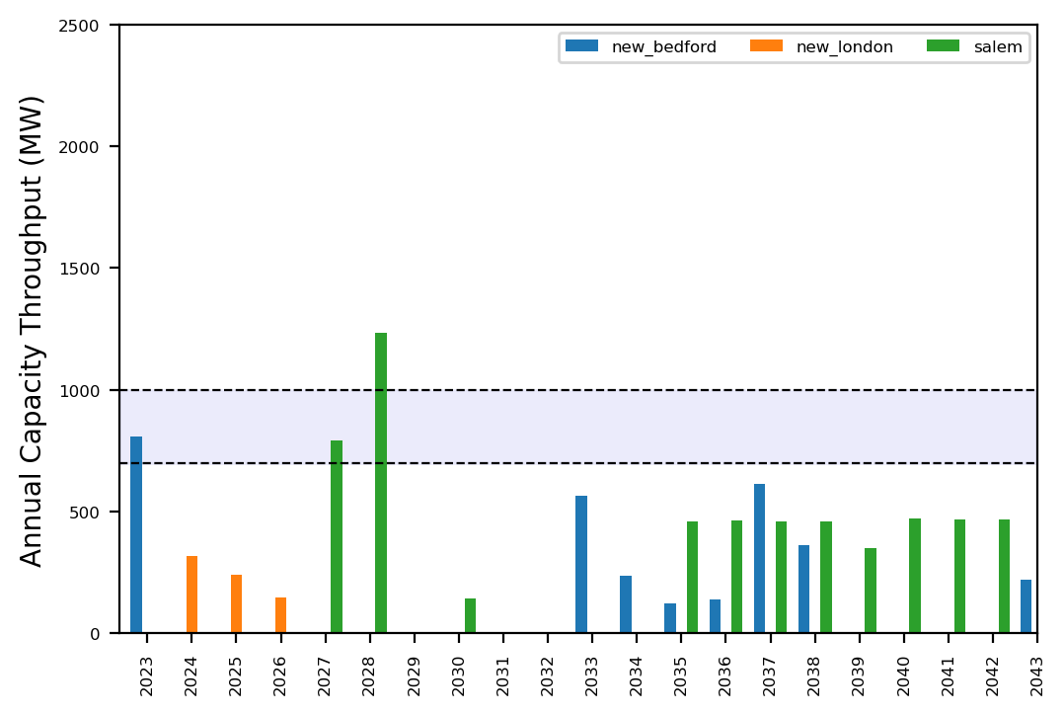
Port Throughput

Slide 28
uniform_0225_inf
No action with base pipeline

Slide 29
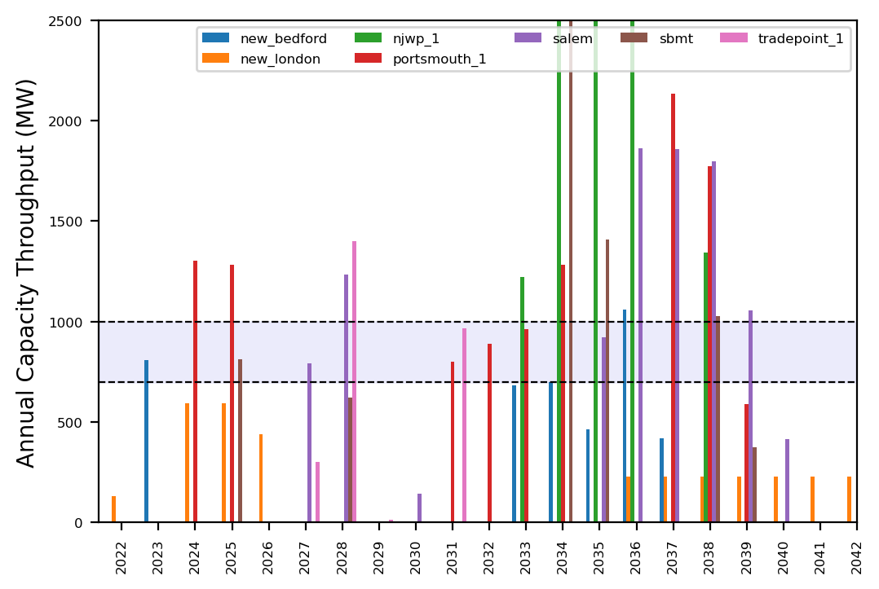
Port Throughput

Slide 30
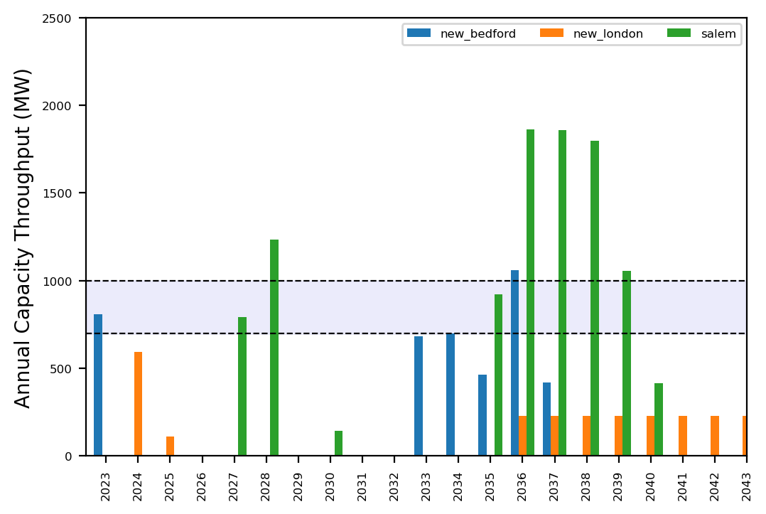
Port Throughput

Slide 31
Summary Plots
Plots comparing runs

Slide 32
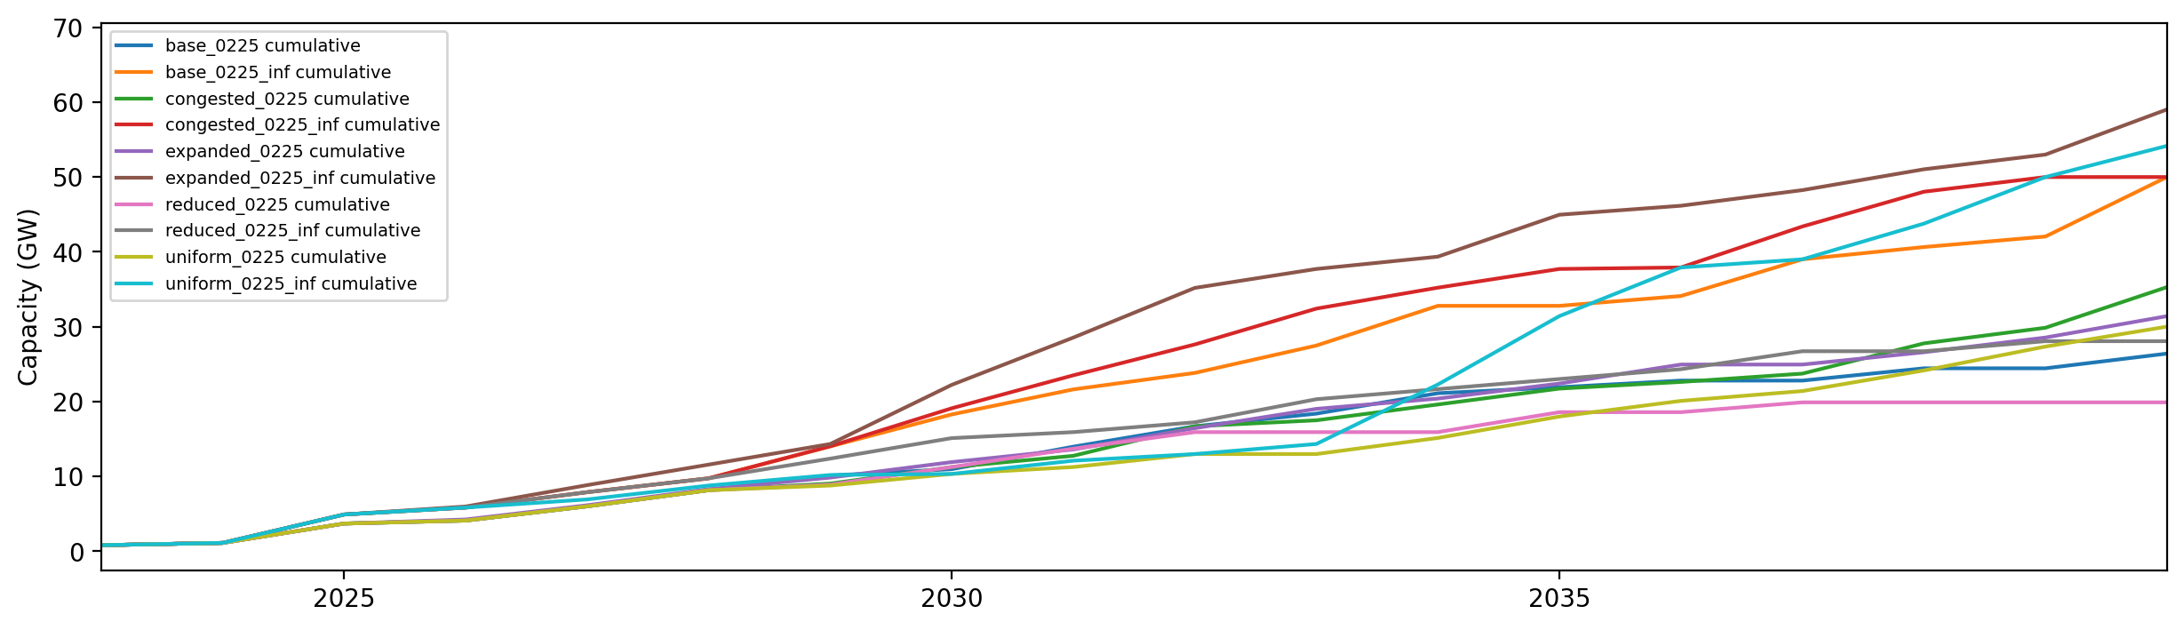
Installed Capacity

Slide 33
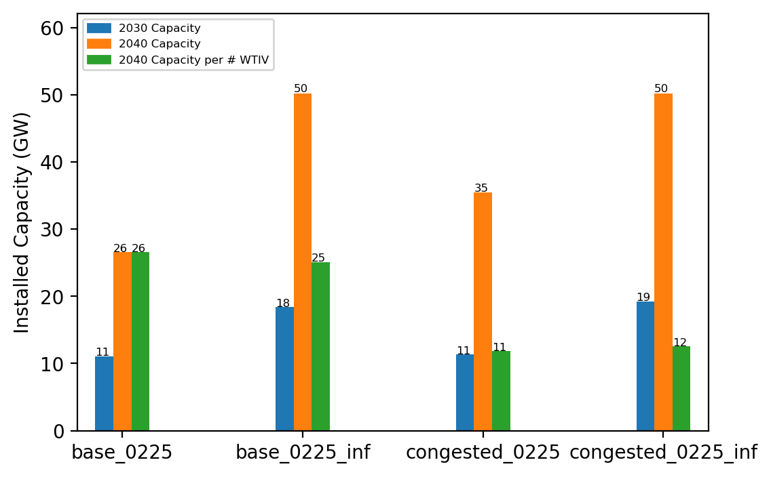
Summary Installed Cap

Slide 34
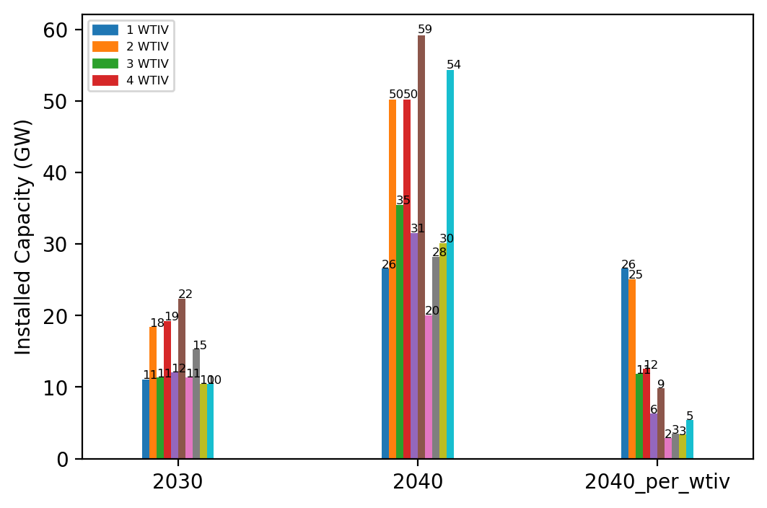
Summary Installed Cap T

Slide 35
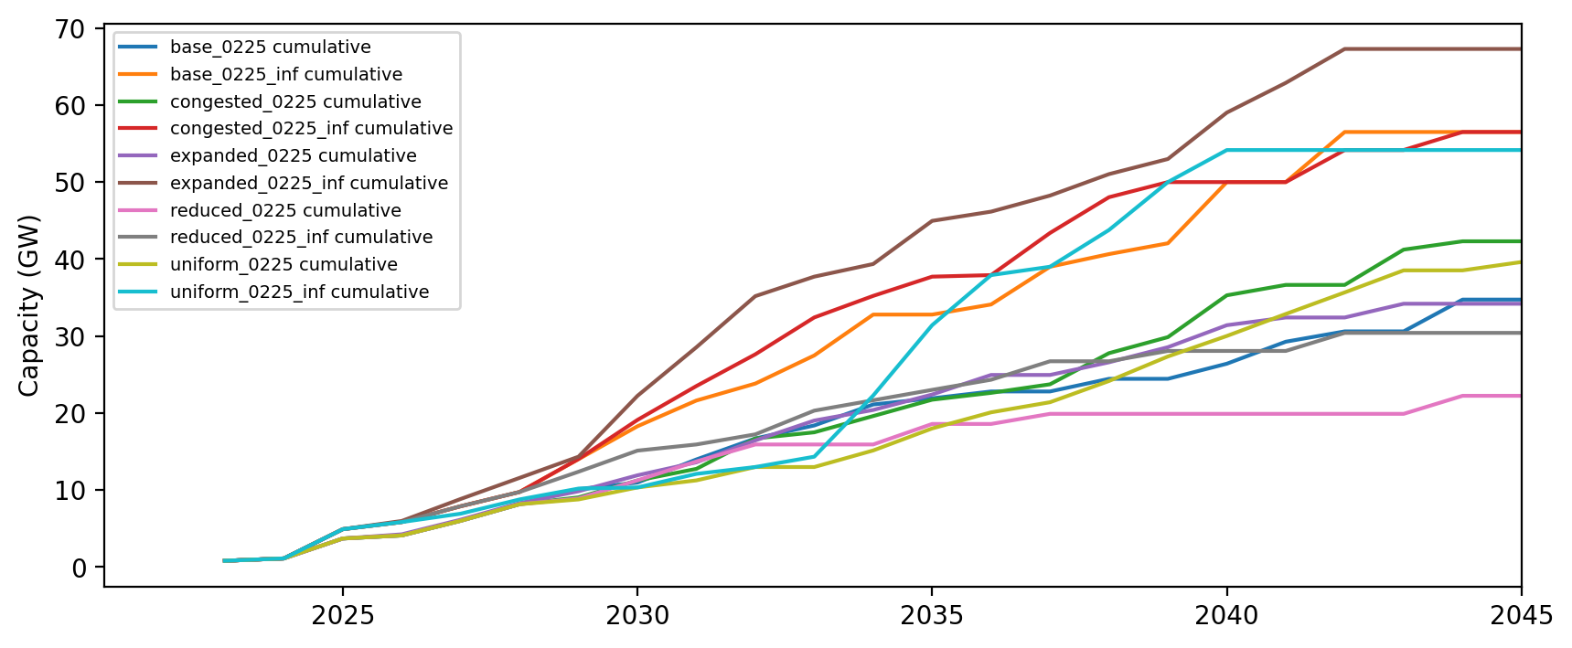
Installed Capacity - All Regions

Slide 36
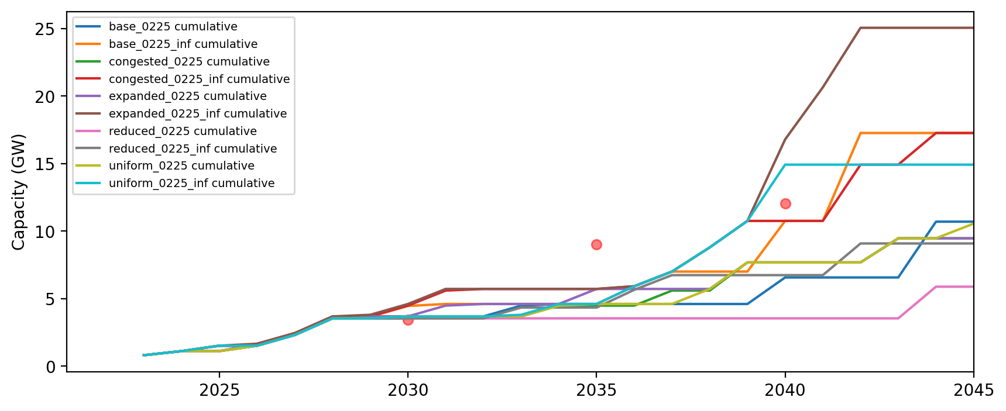
Installed Capacity - NE

Slide 37
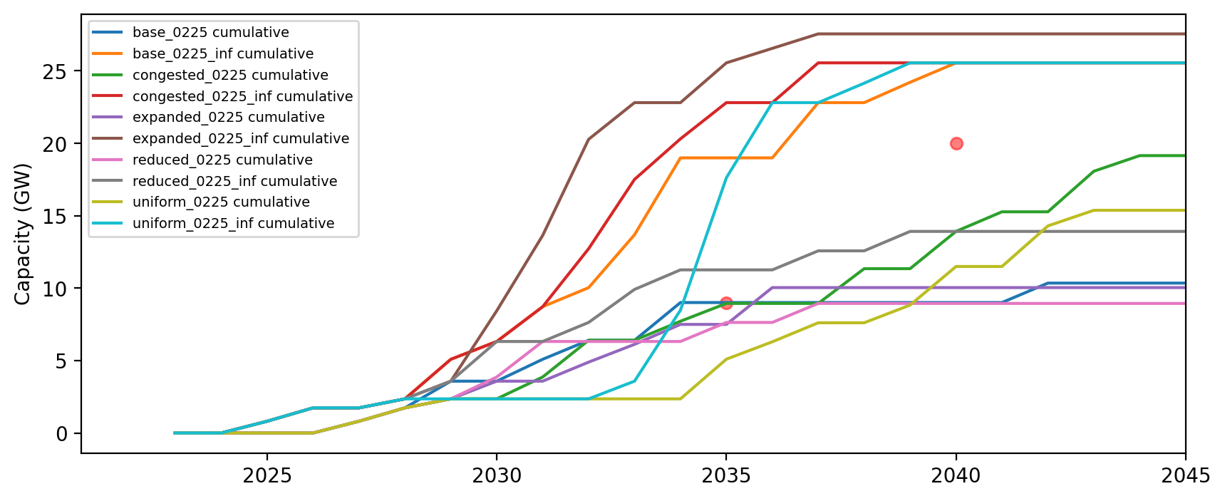
Installed Capacity - NY/NJ

Slide 38
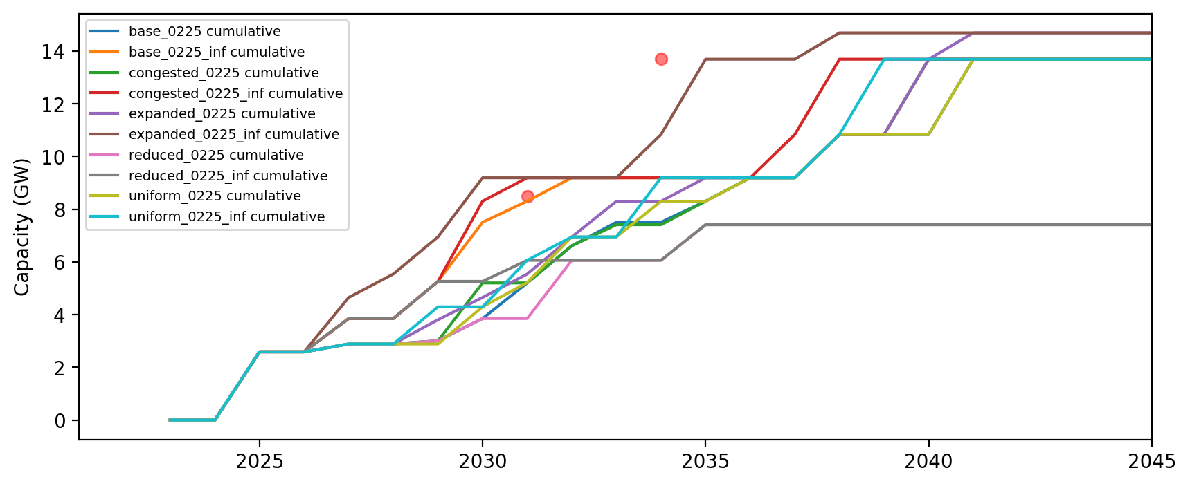
Installed Capacity - Mid-Atlantic

Slide 39
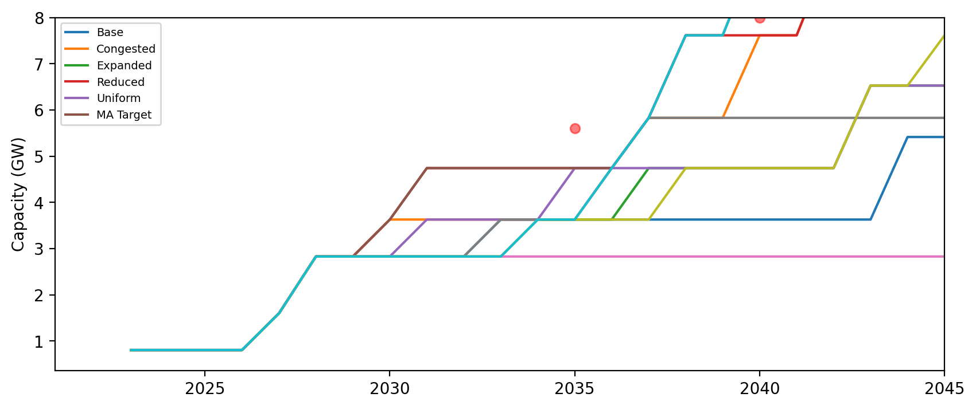
Installed Capacity - MA

Slide 40
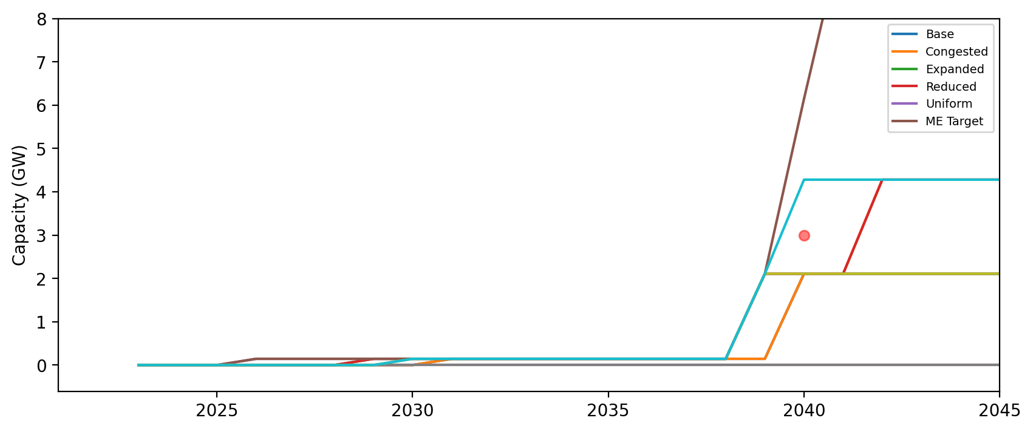
Installed Capacity - ME

Slide 41
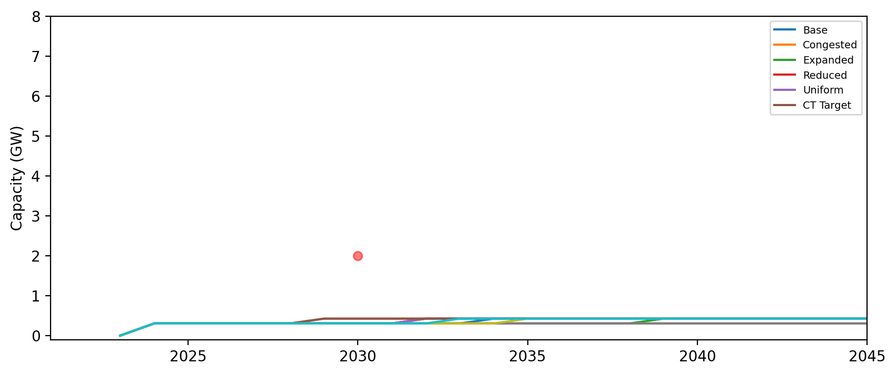
Installed Capacity - CT

Slide 42
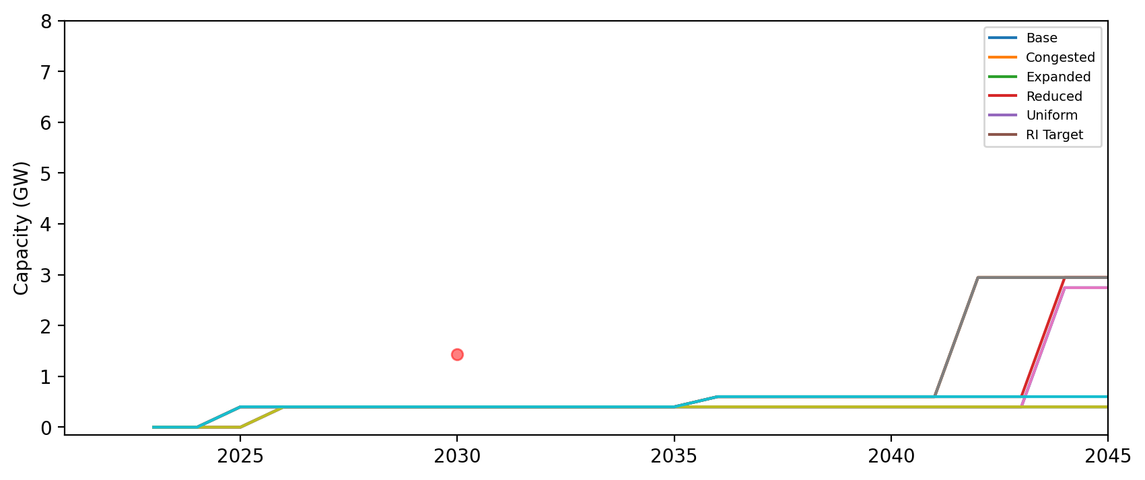
Installed Capacity - RI

Slide 43
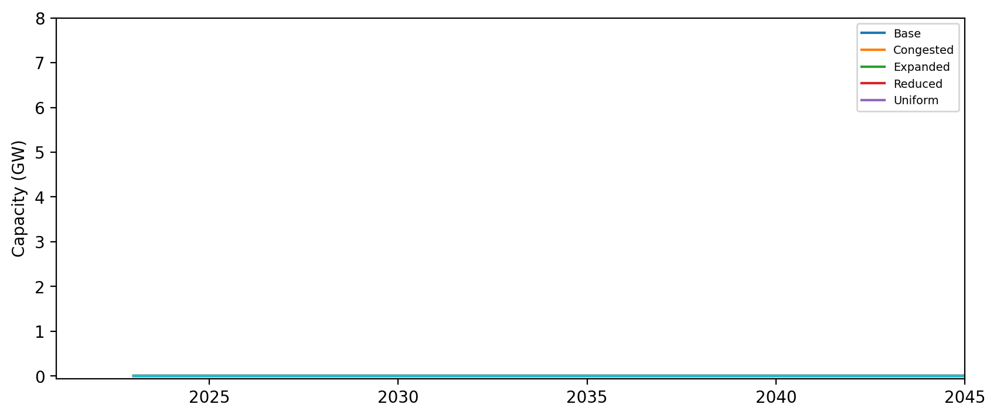
Installed Capacity - NH

Slide 44
Installed Capacity - RI/CT

Slide 45
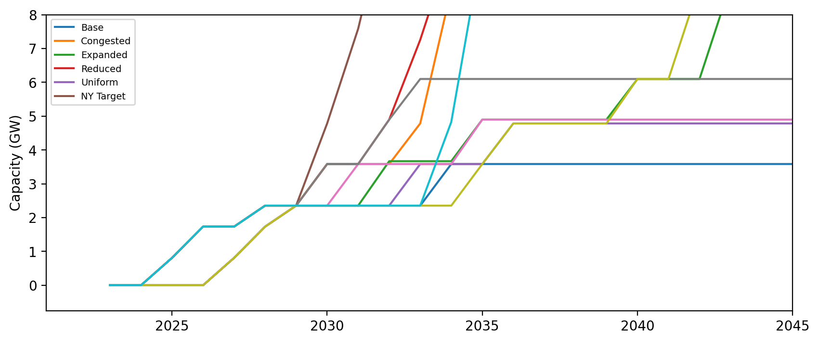
Installed Capacity - NY

Slide 46
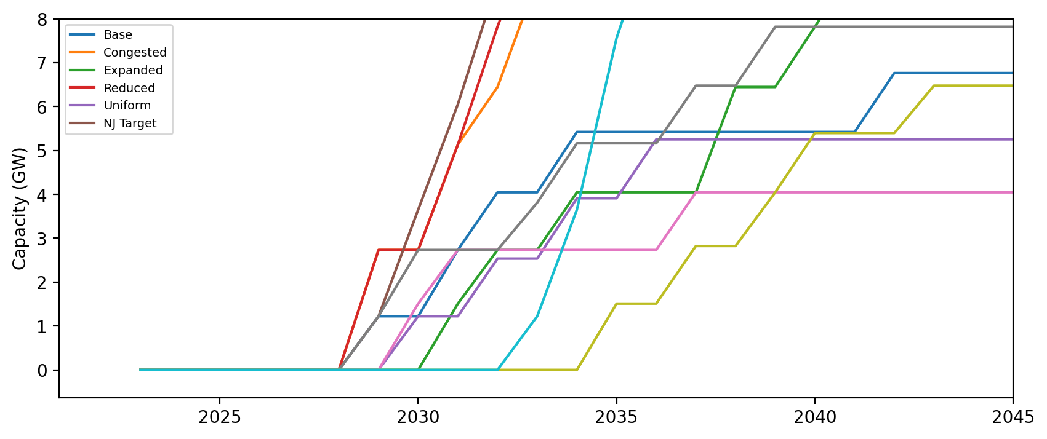
Installed Capacity - NJ

Slide 47
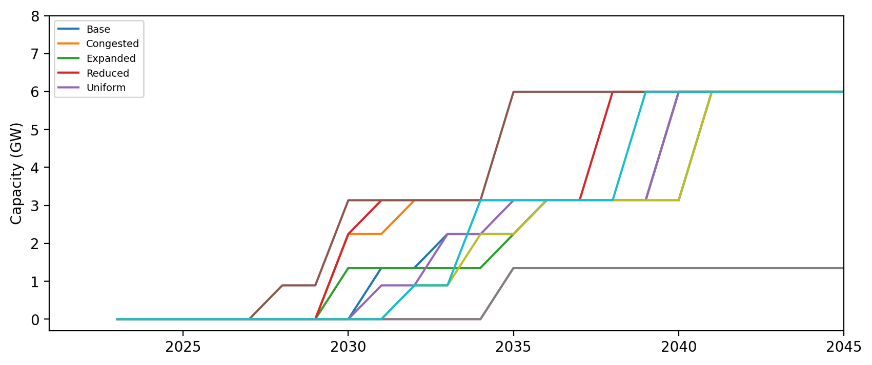
Installed Capacity - NC

Slide 48
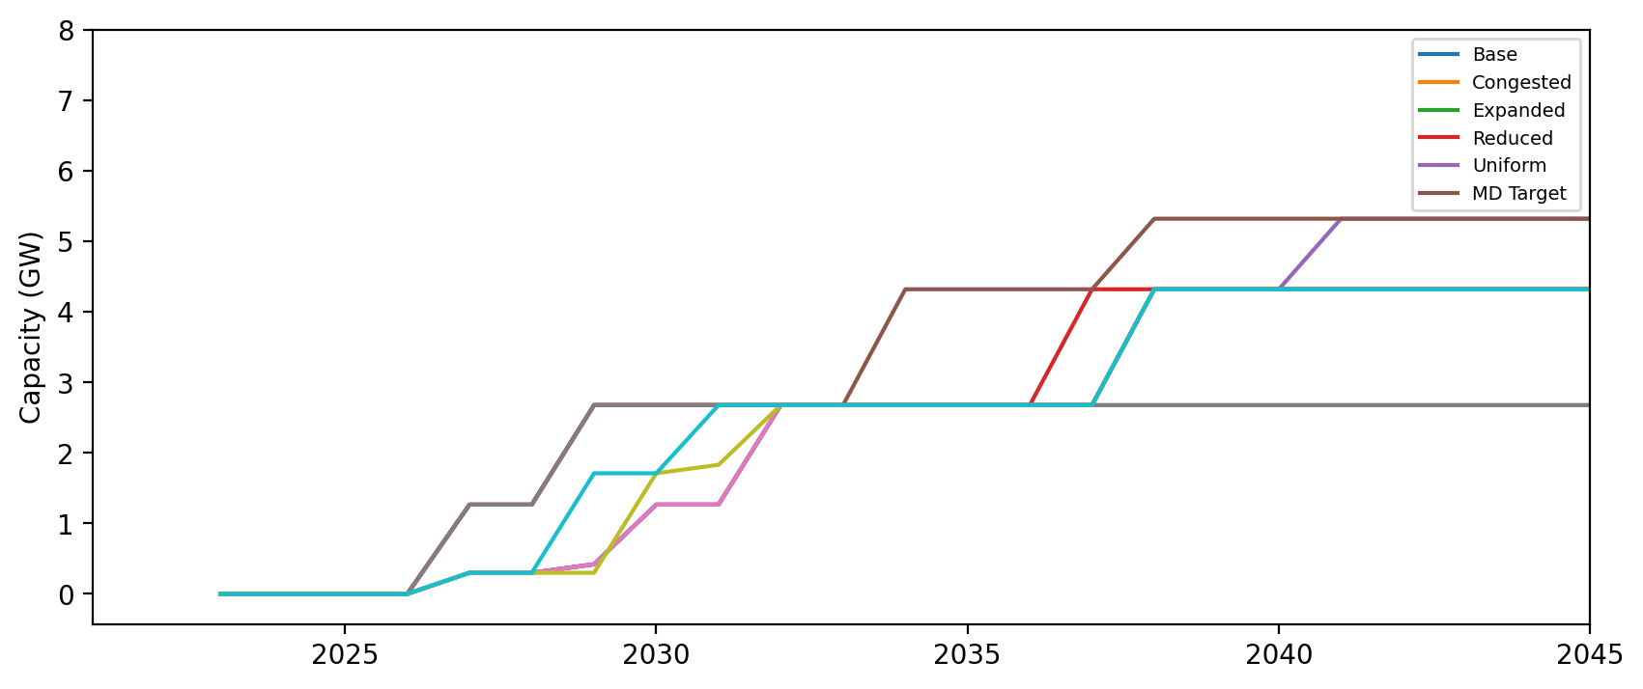
Installed Capacity - MD

Slide 49
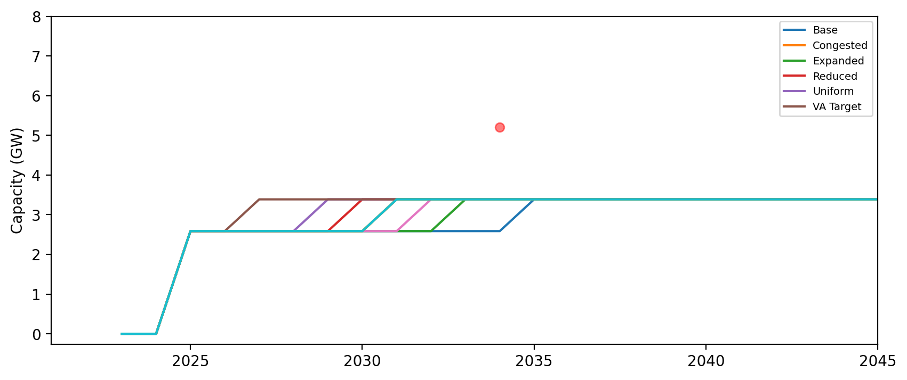
Installed Capacity - VA

Slide 50
Installed Capacity - DE

Slide 51
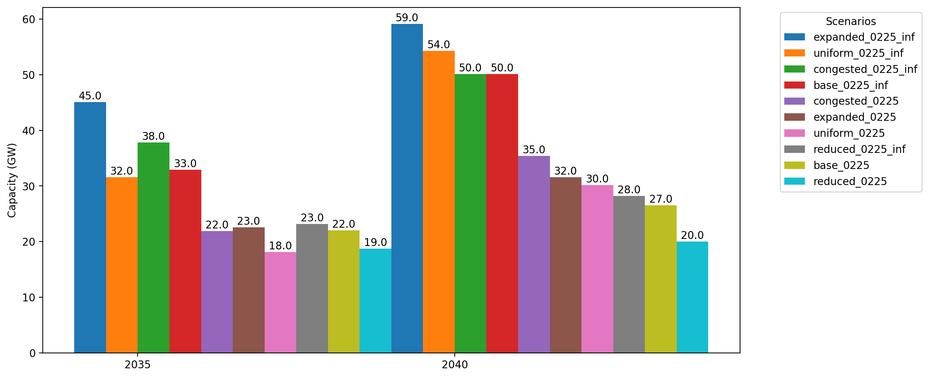
Cumulative Capacity by 2035 and 2040

Slide 52
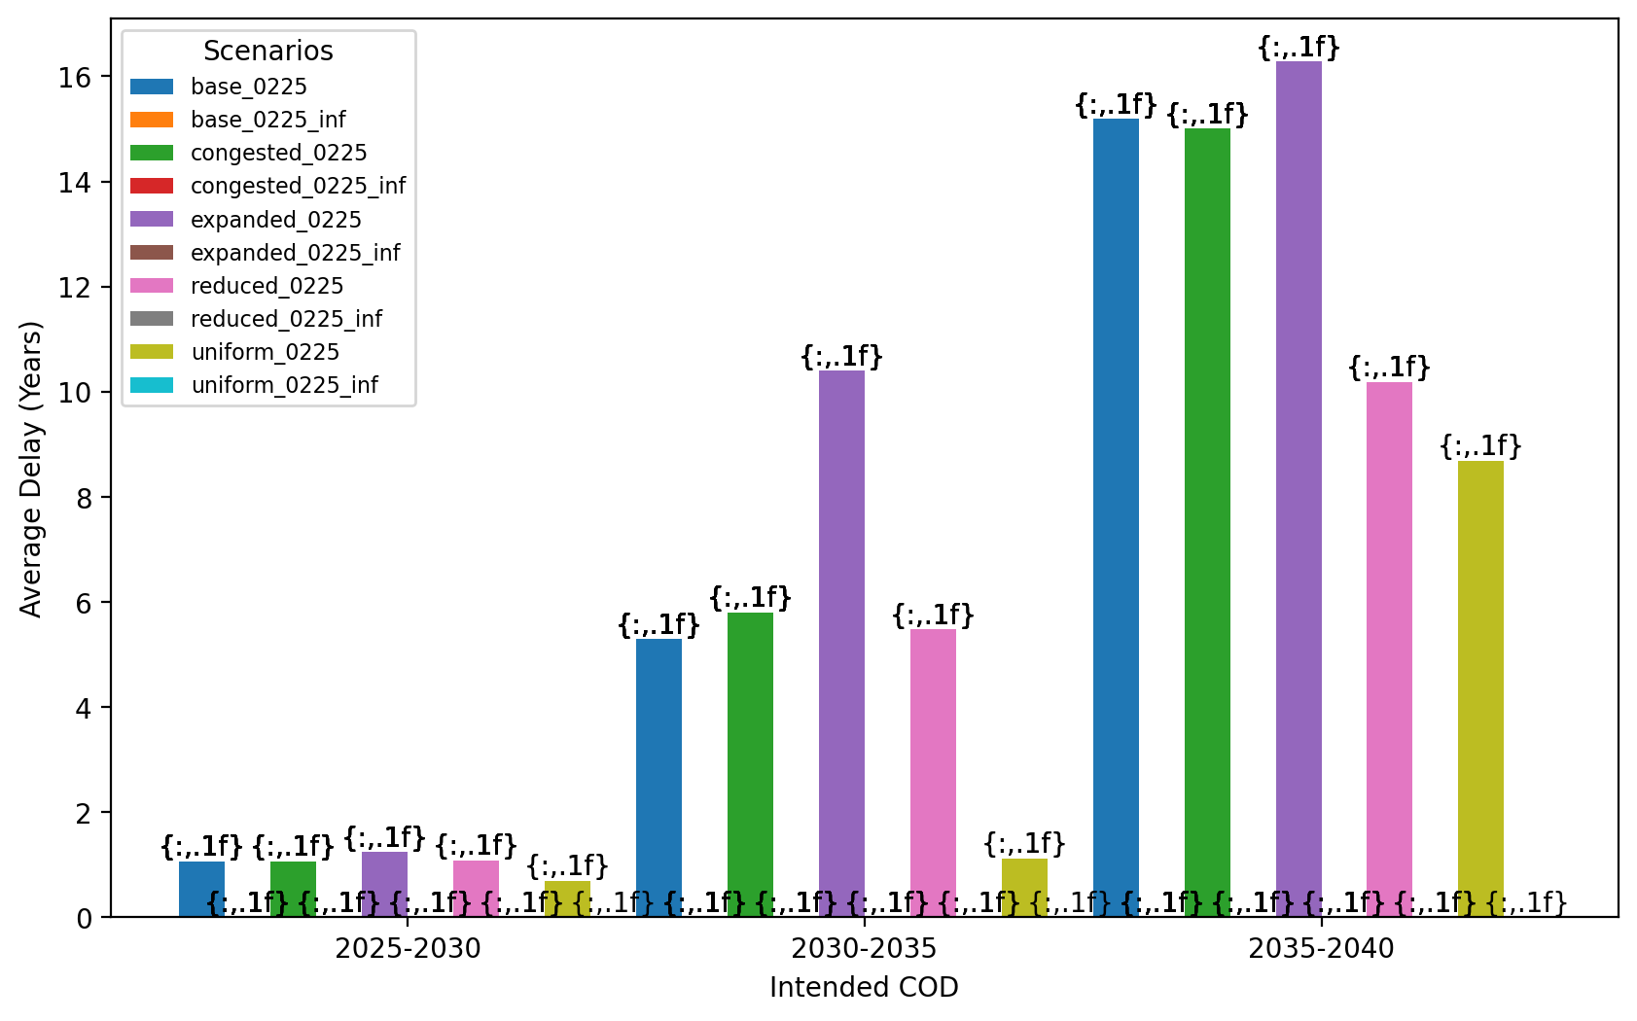
Average Delay Per Project by COD - All Regions

Slide 53
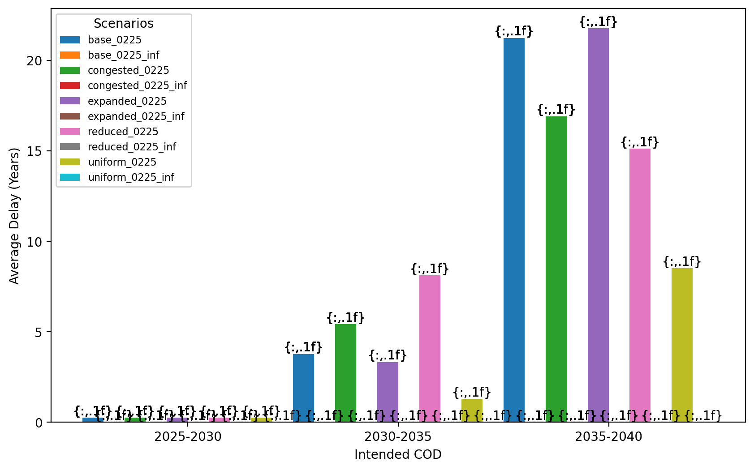
Average Delay Per Project by COD - NE

Slide 54
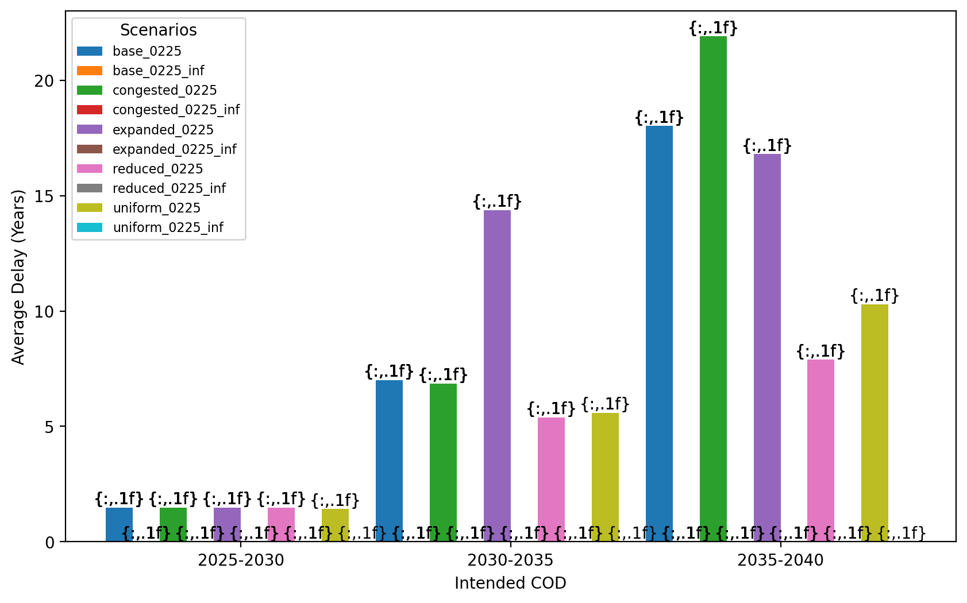
Average Delay Per Project by COD - NY/NJ

Slide 55
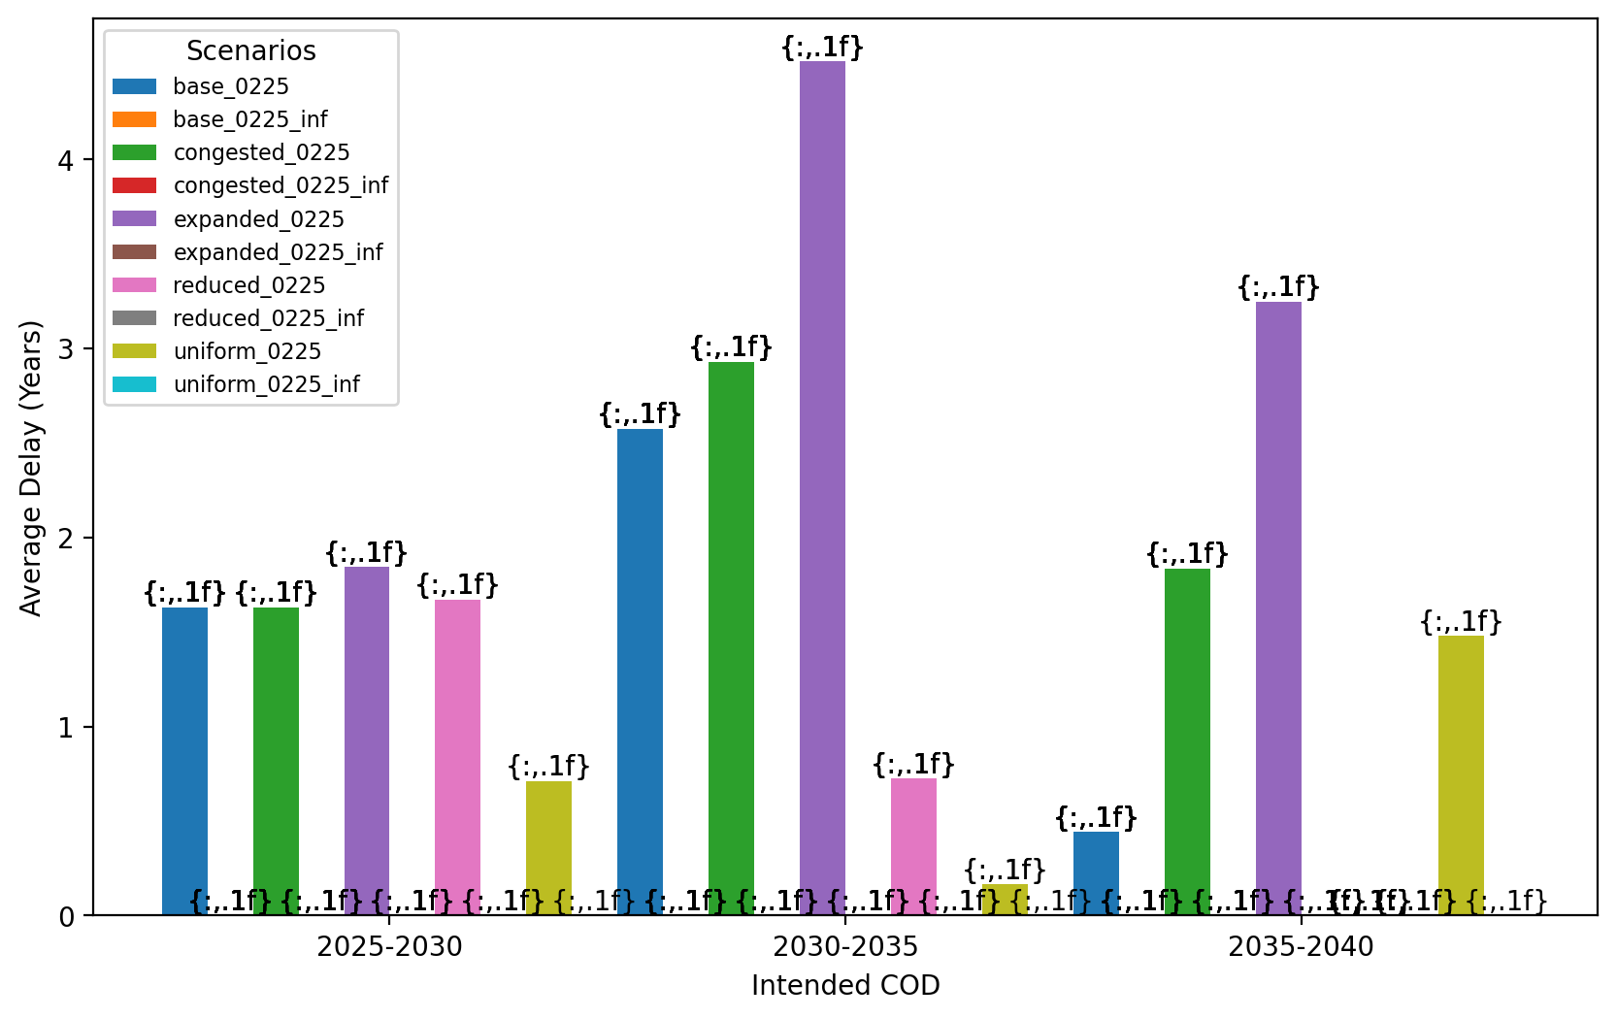
Average Delay Per Project by COD - Mid-Atlantic

Slide 56
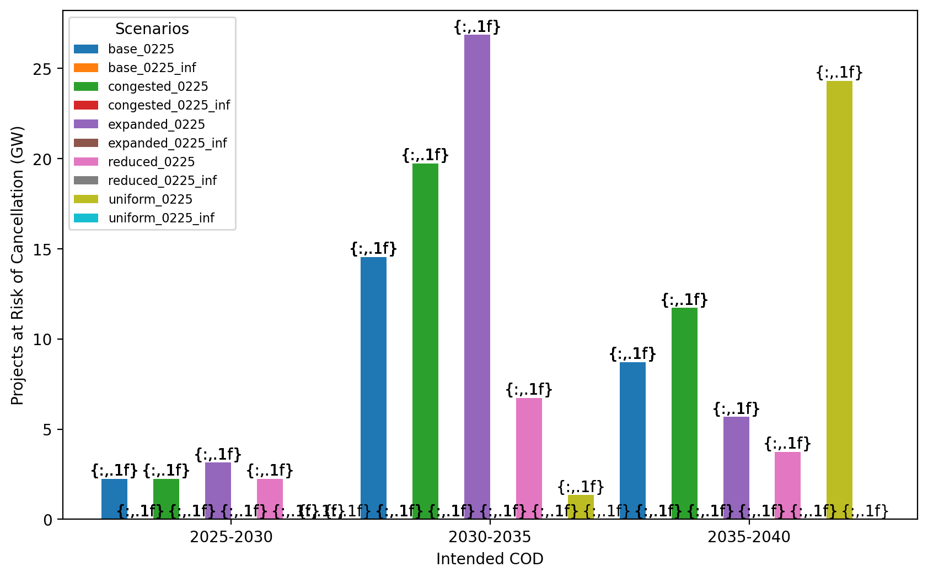
Total Capacity at Risk by COD - All Regions

Slide 57
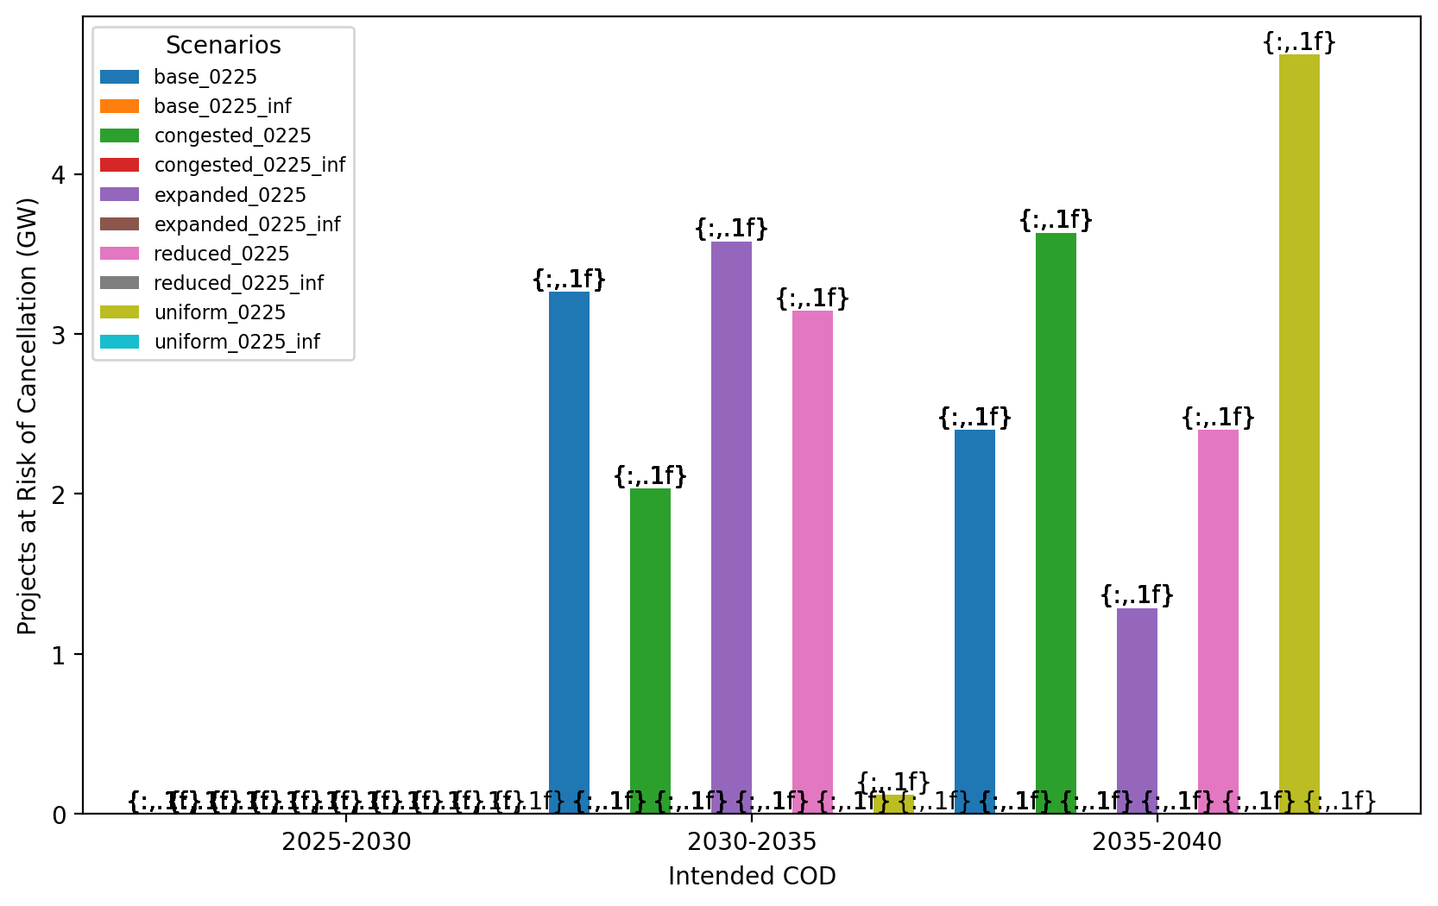
Total Capacity at Risk by COD - NE

Slide 58
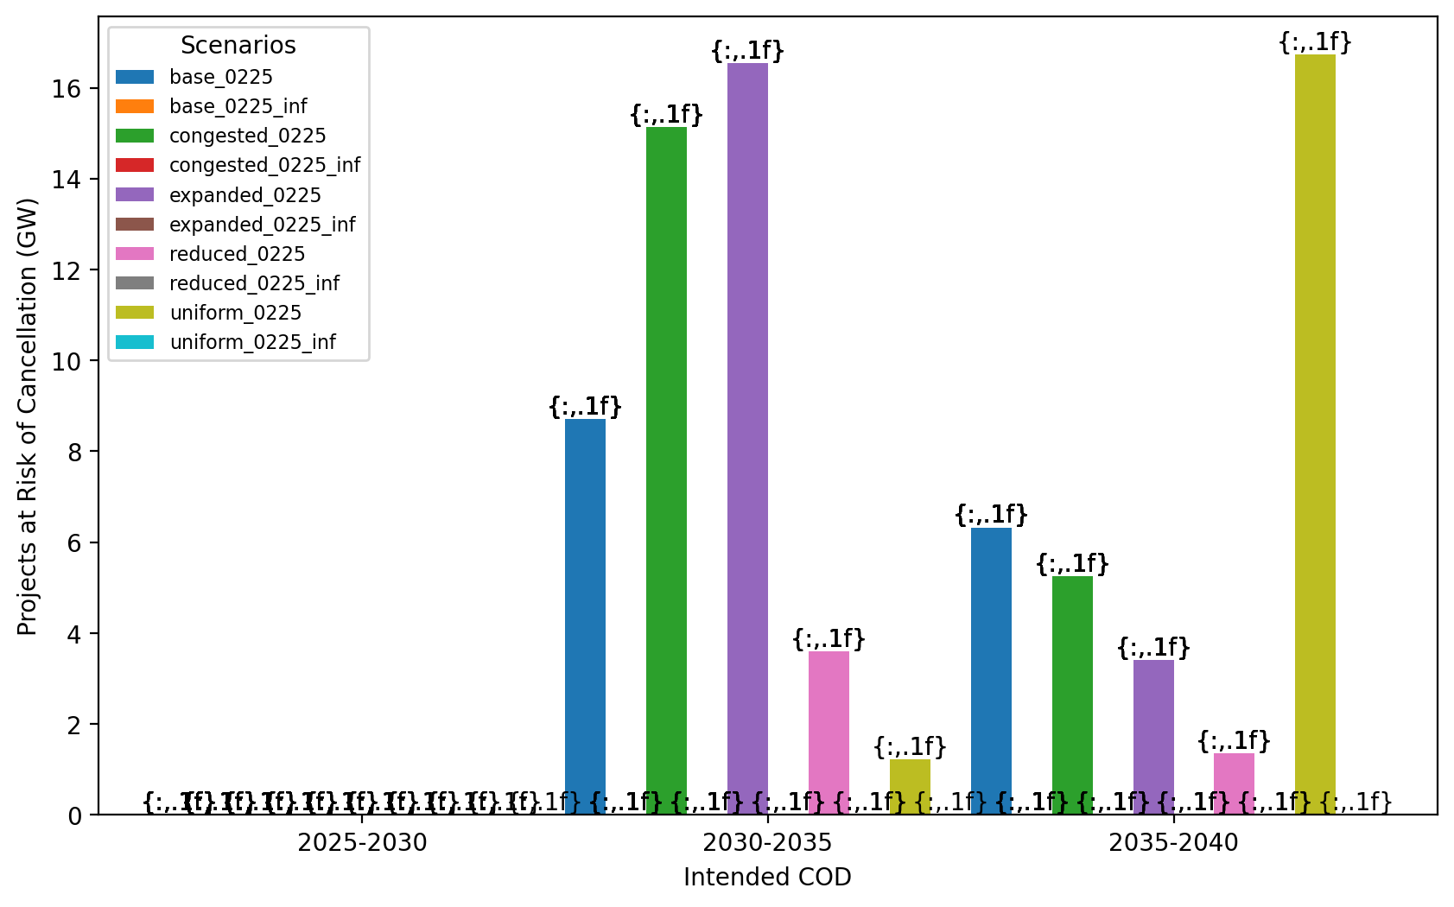
Total Capacity at Risk by COD - NY/NJ

Slide 59
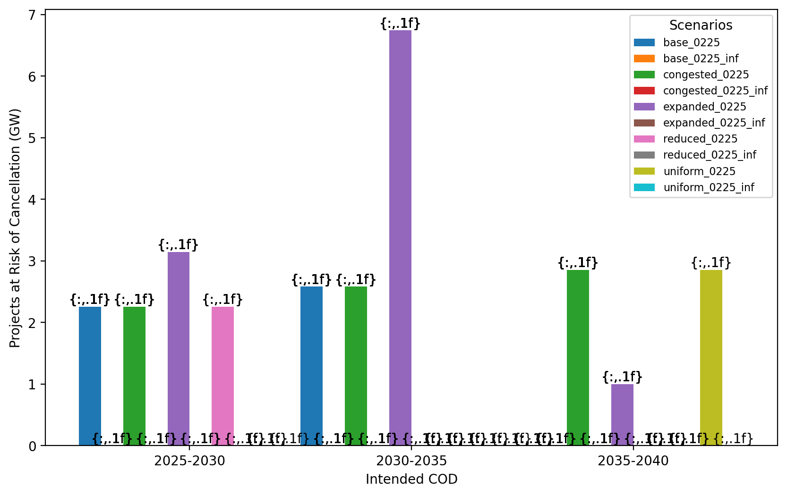
Total Capacity at Risk by COD - Mid-Atlantic

Slide 60
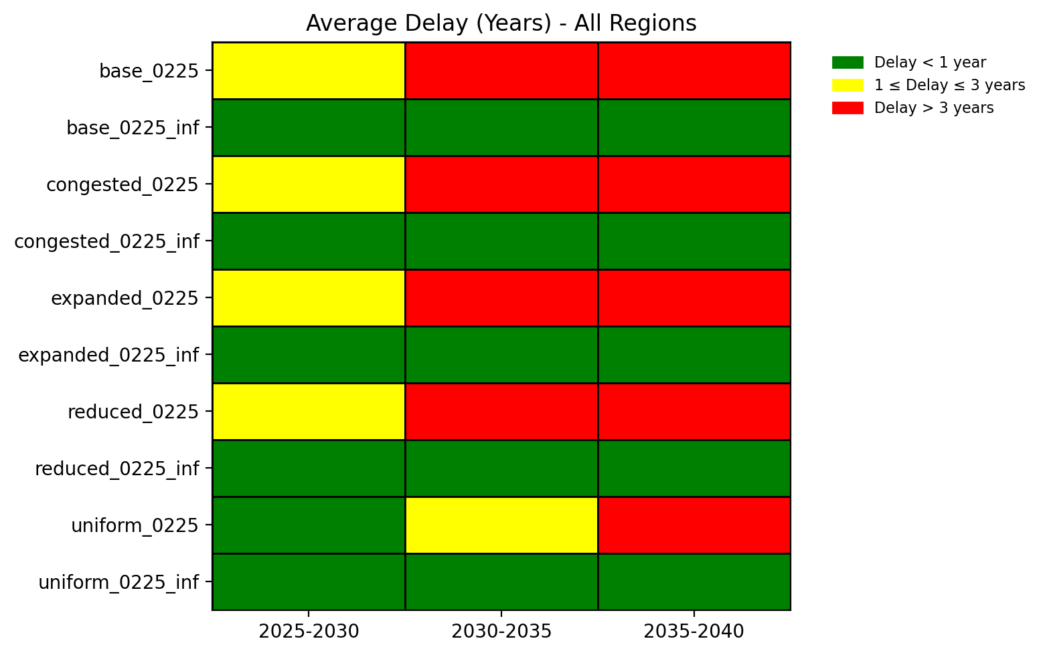
Average Delay Heat Map - All Regions

Slide 61
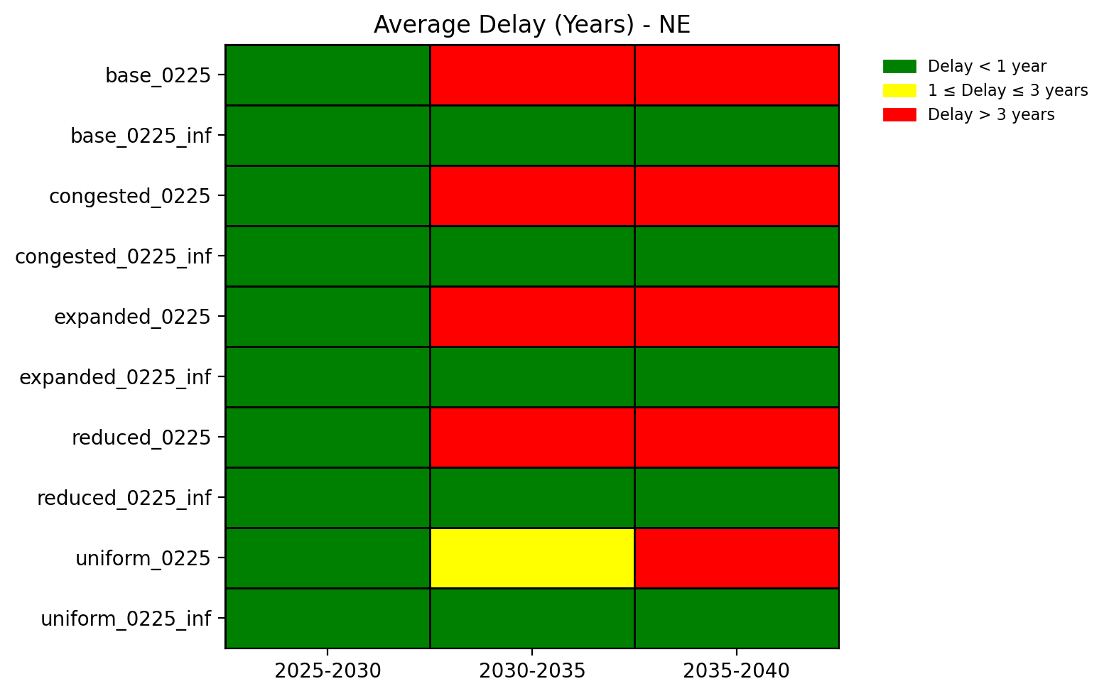
Average Delay Heat Map - NE

Slide 62
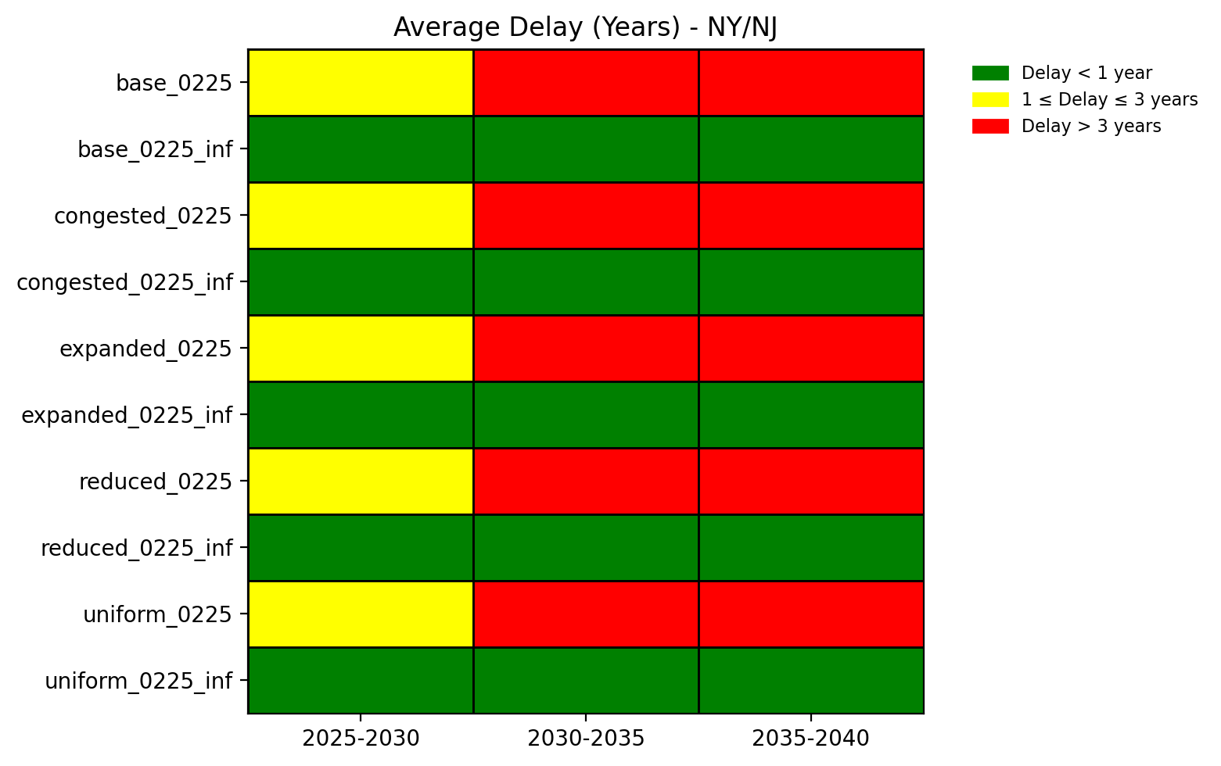
Average Delay Heat Map - NY/NJ

Slide 63
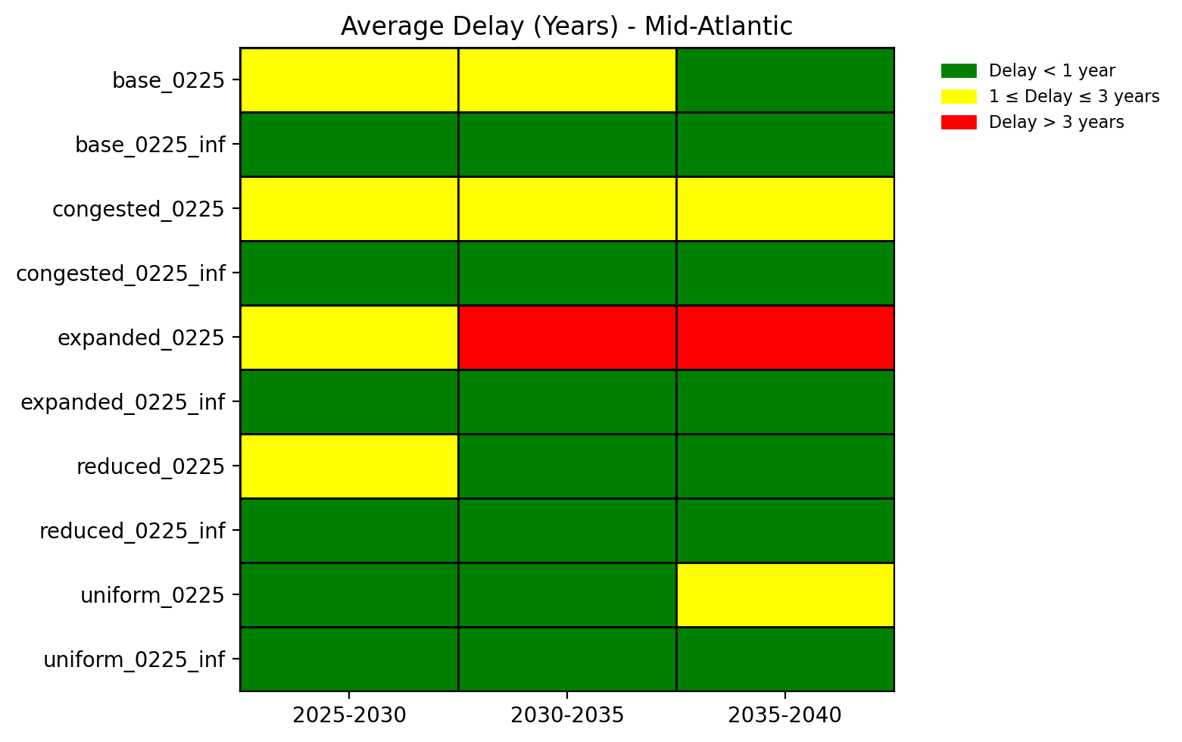
Average Delay Heat Map - Mid-Atlantic

