Slide 1
congested_0225
No action with base pipeline

Slide 2
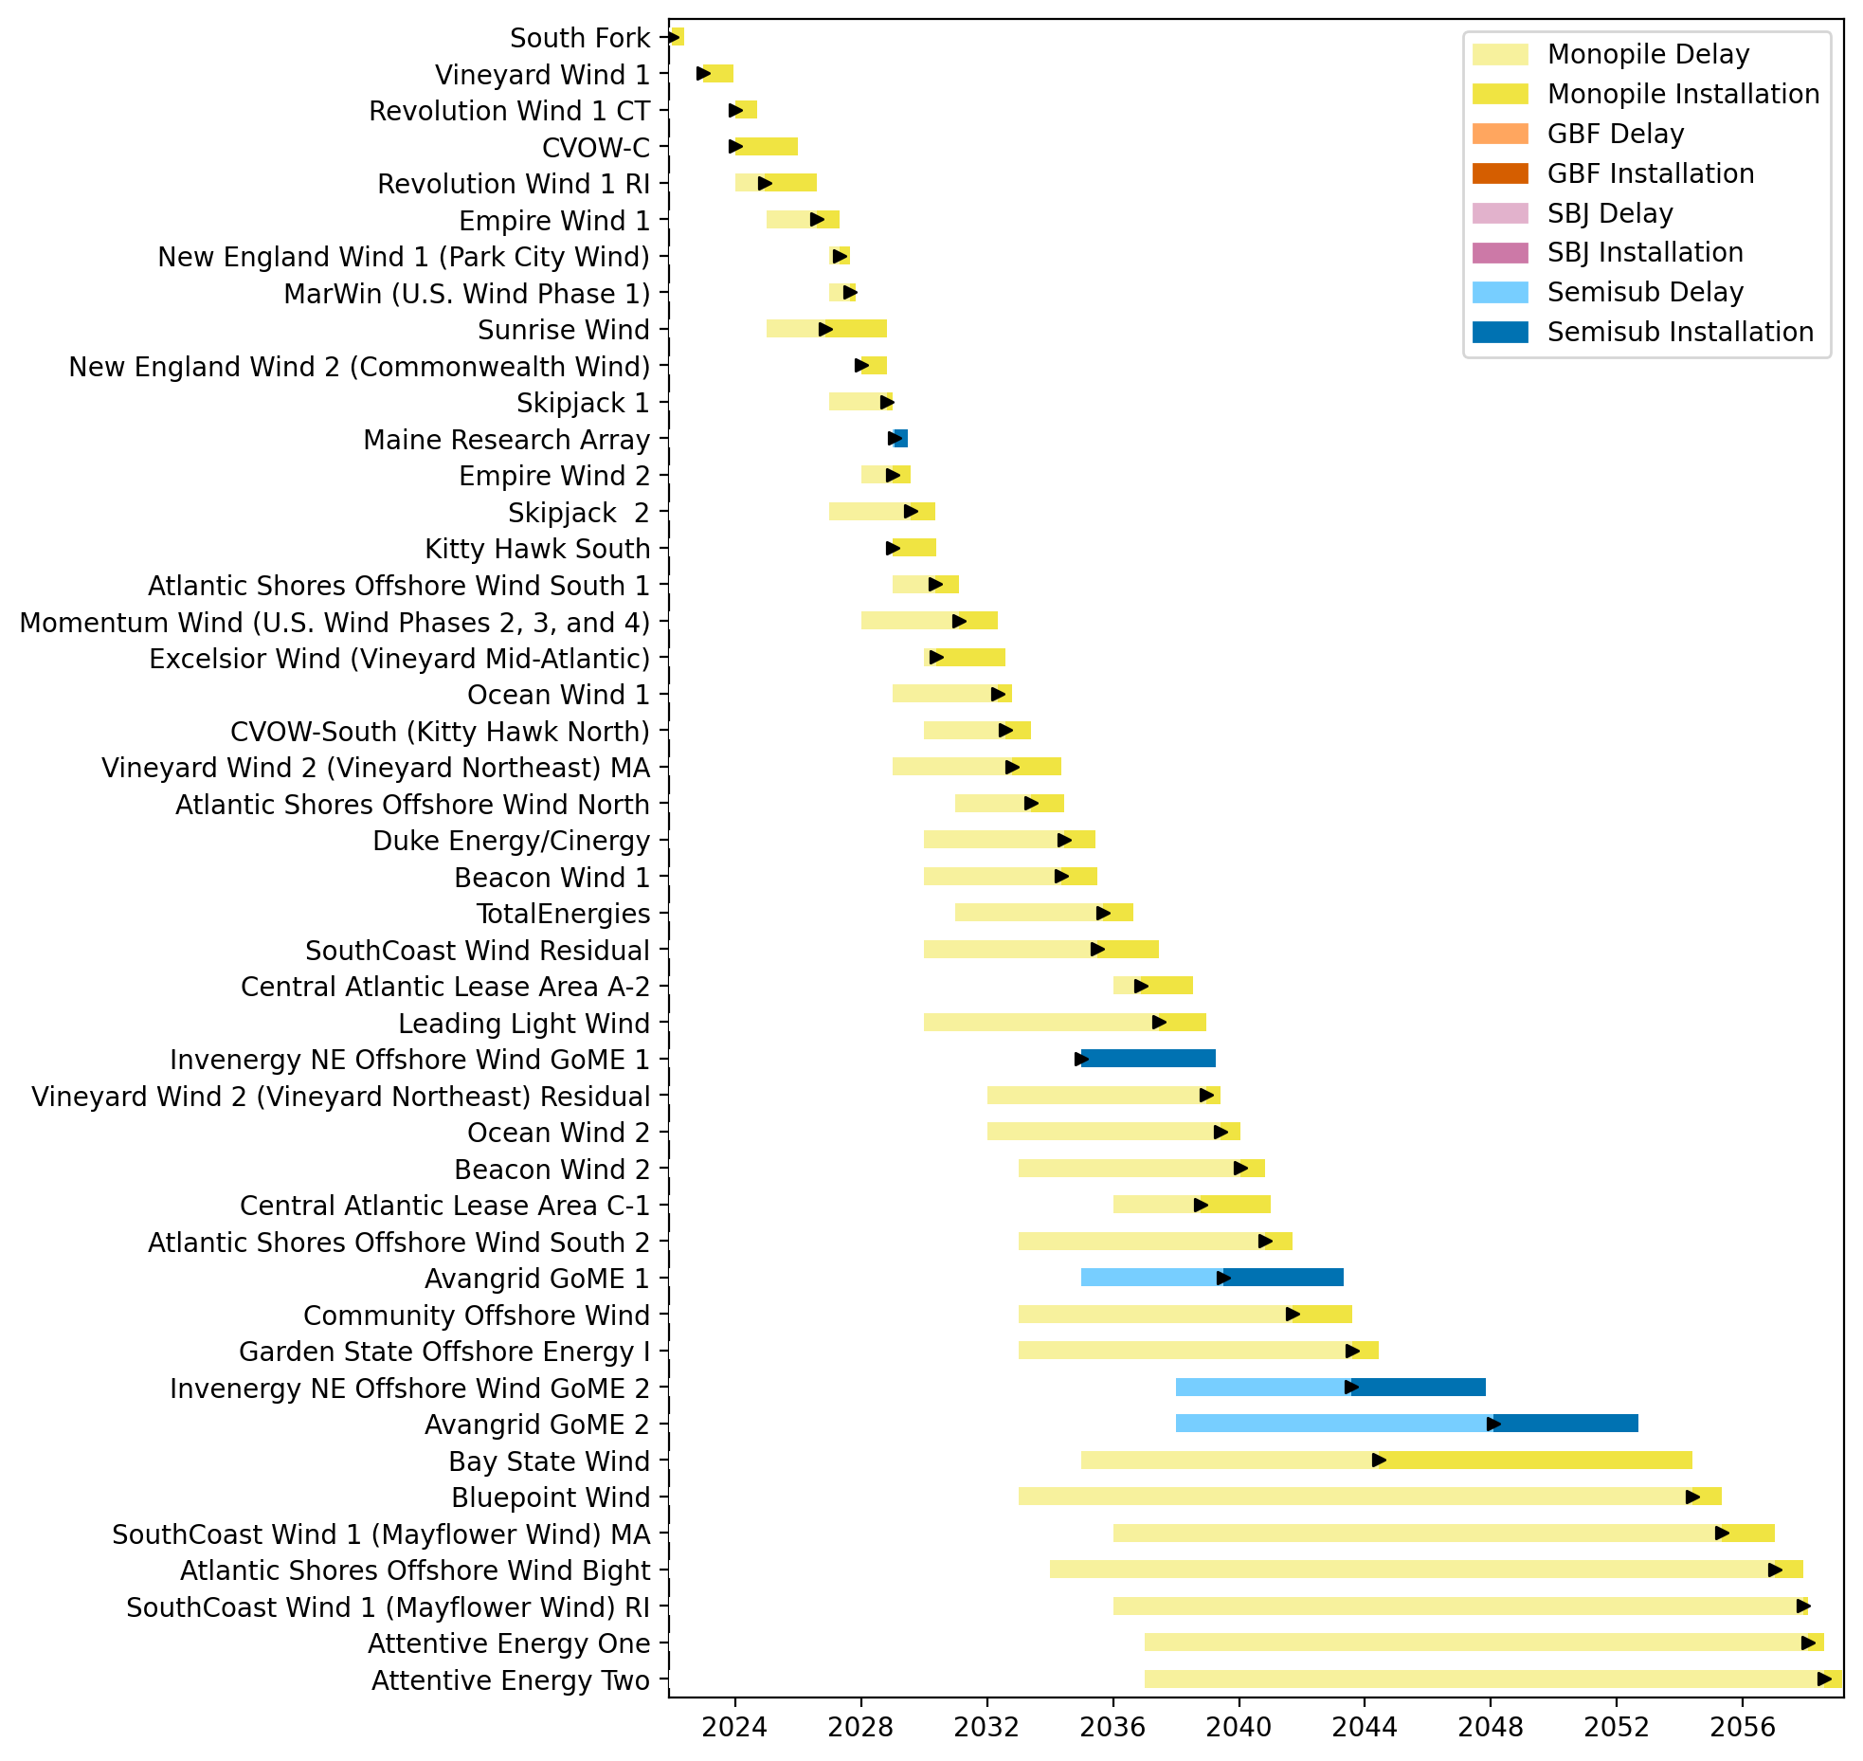
Full Gantt

Slide 3
congested_0225_inf
No action with base pipeline

Slide 4
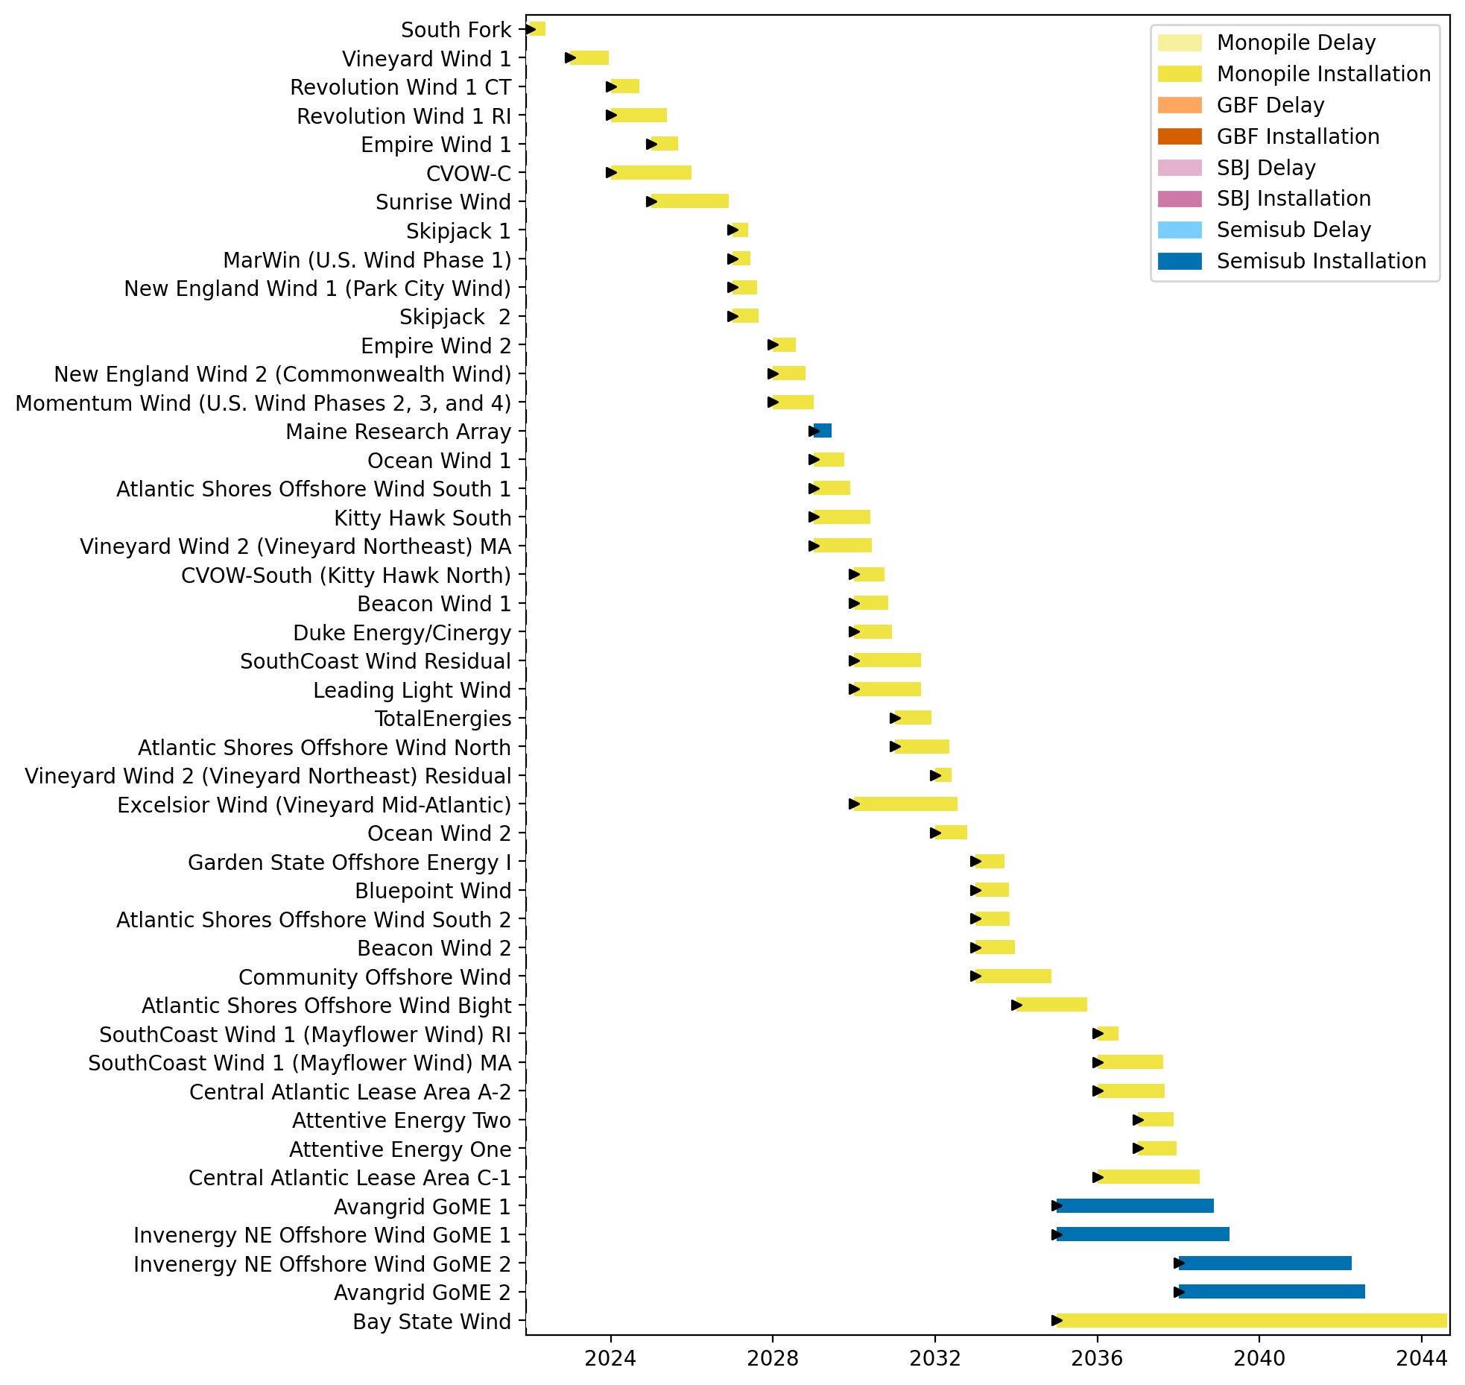
Full Gantt

Slide 5
Summary Plots
Plots comparing runs

Slide 6
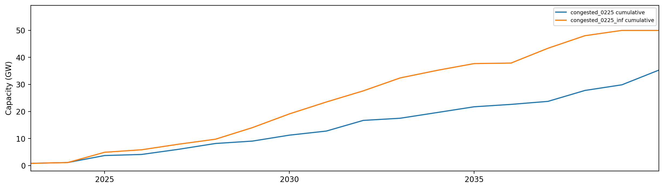
Installed Capacity

Slide 7
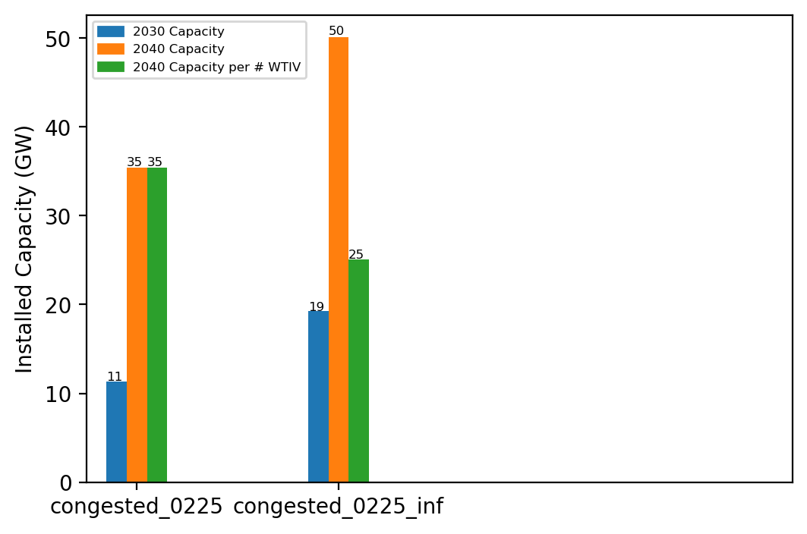
Summary Installed Cap

Slide 8
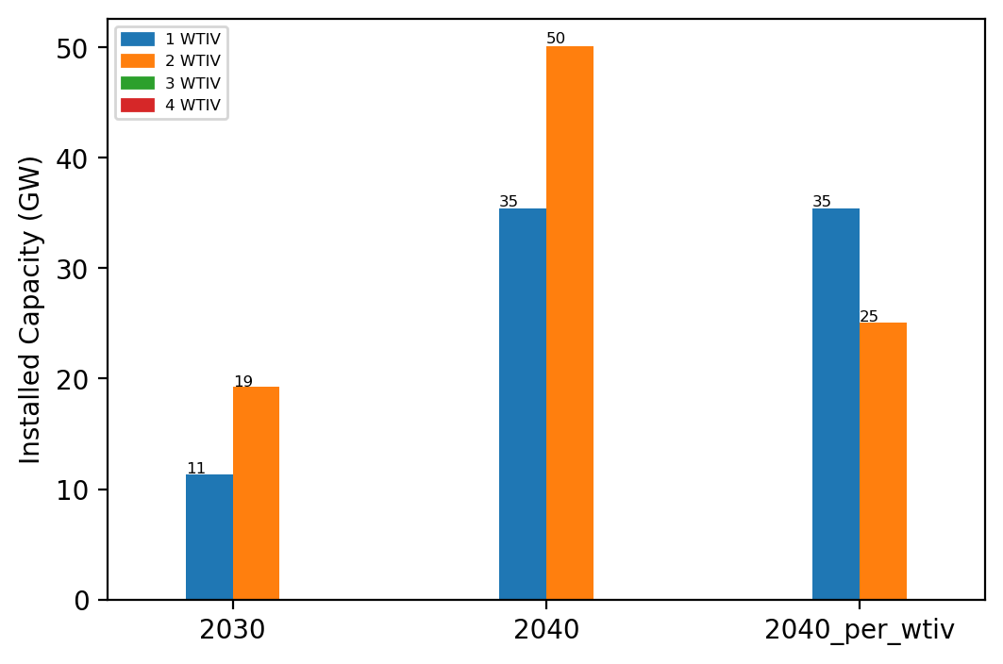
Summary Installed Cap T

Slide 9
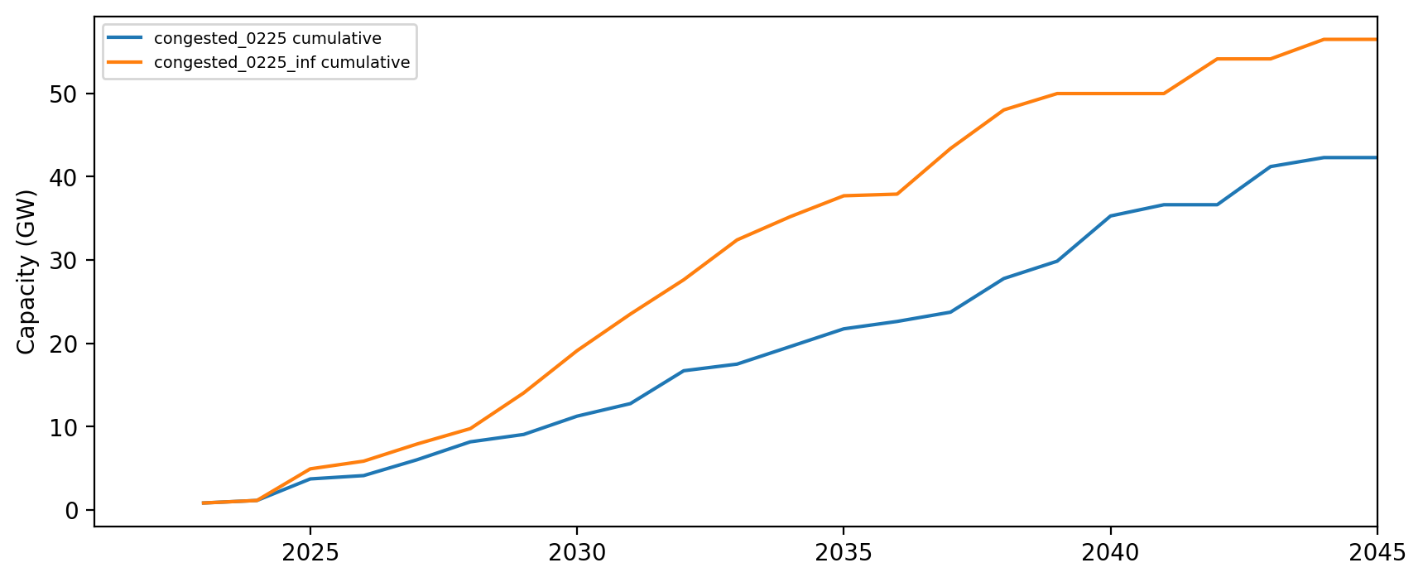
Installed Capacity - All Regions

Slide 10
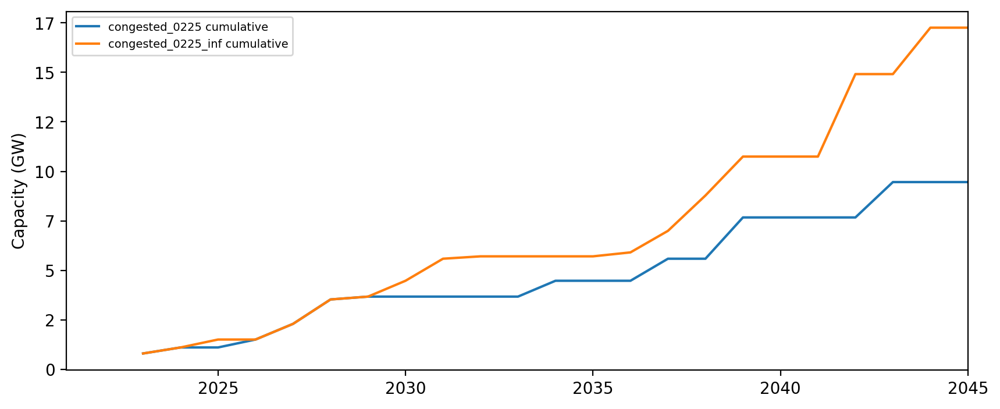
Installed Capacity - NE

Slide 11
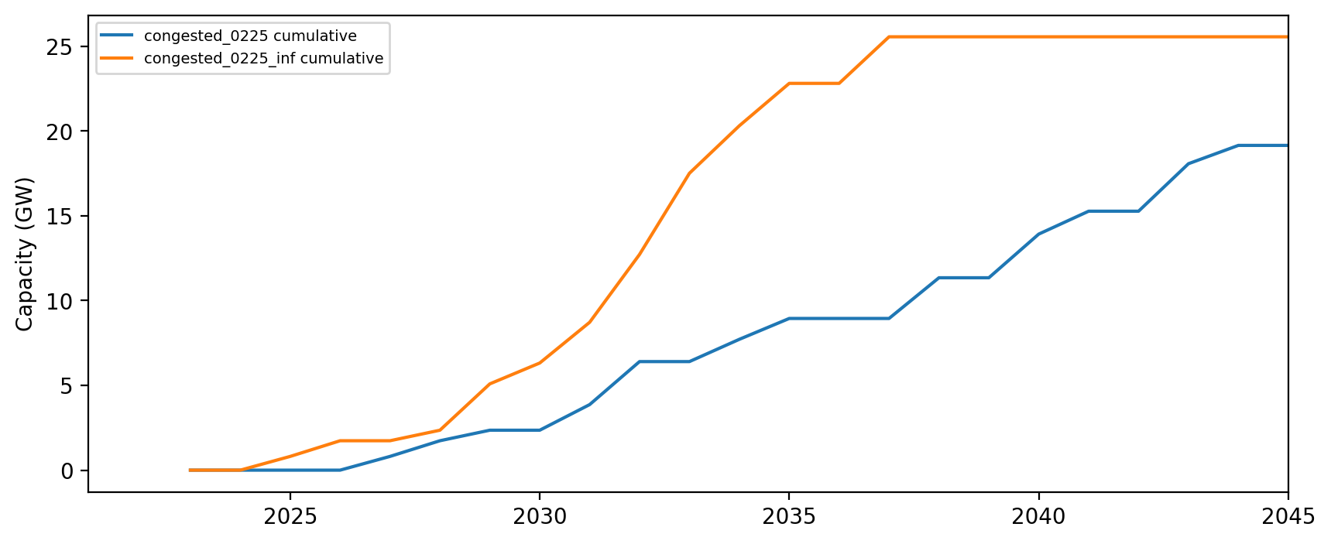
Installed Capacity - NY/NJ

Slide 12
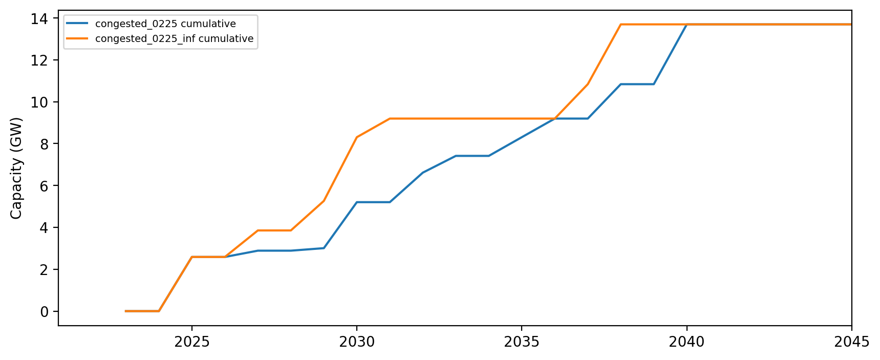
Installed Capacity - Mid-Atlantic

Slide 13
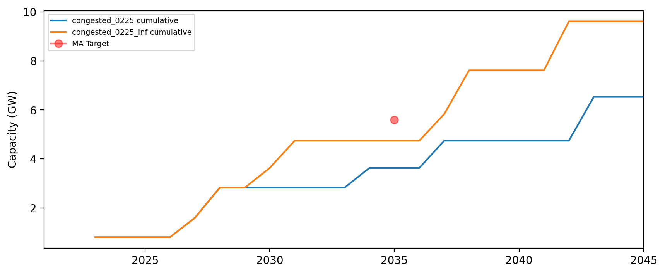
Installed Capacity - MA

Slide 14
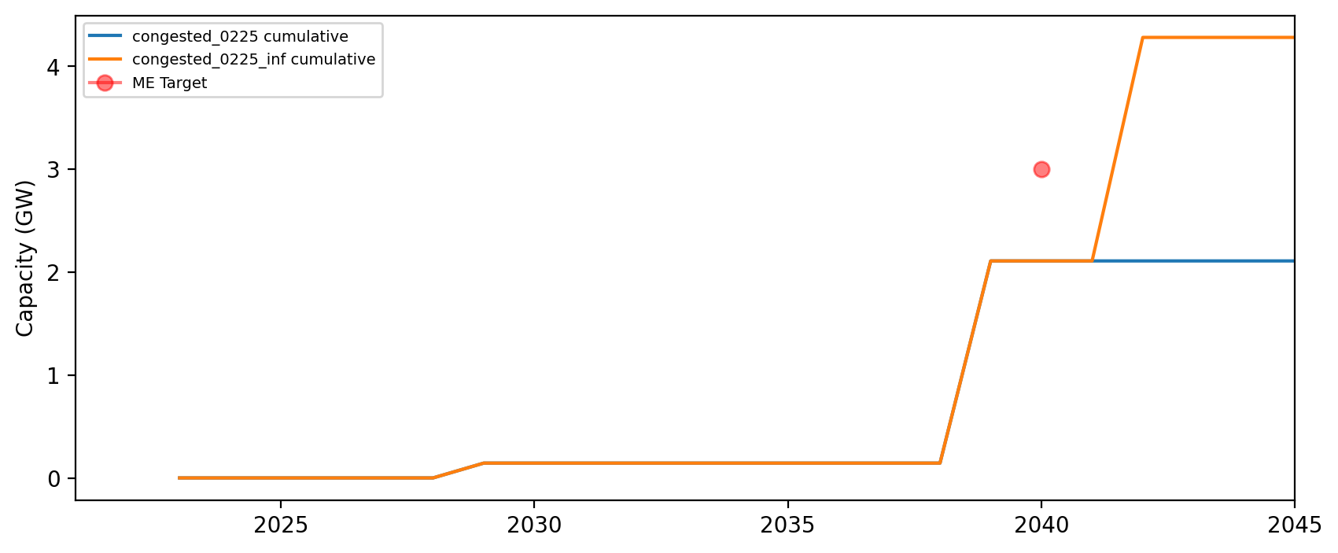
Installed Capacity - ME

Slide 15
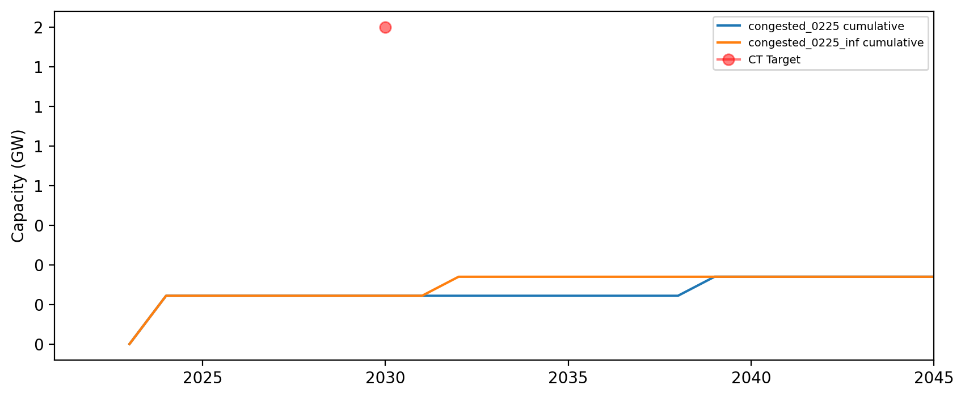
Installed Capacity - CT

Slide 16
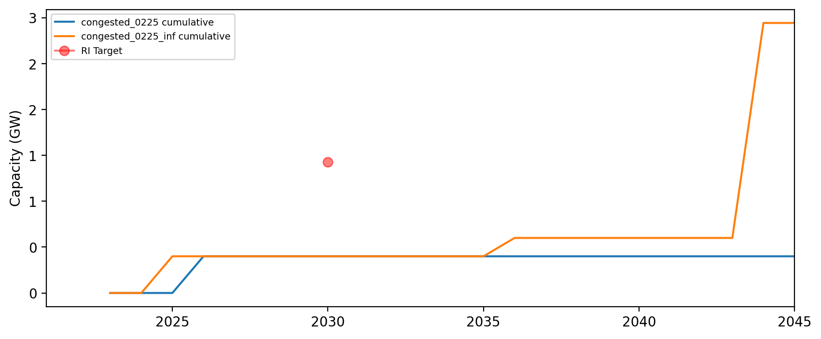
Installed Capacity - RI

Slide 17
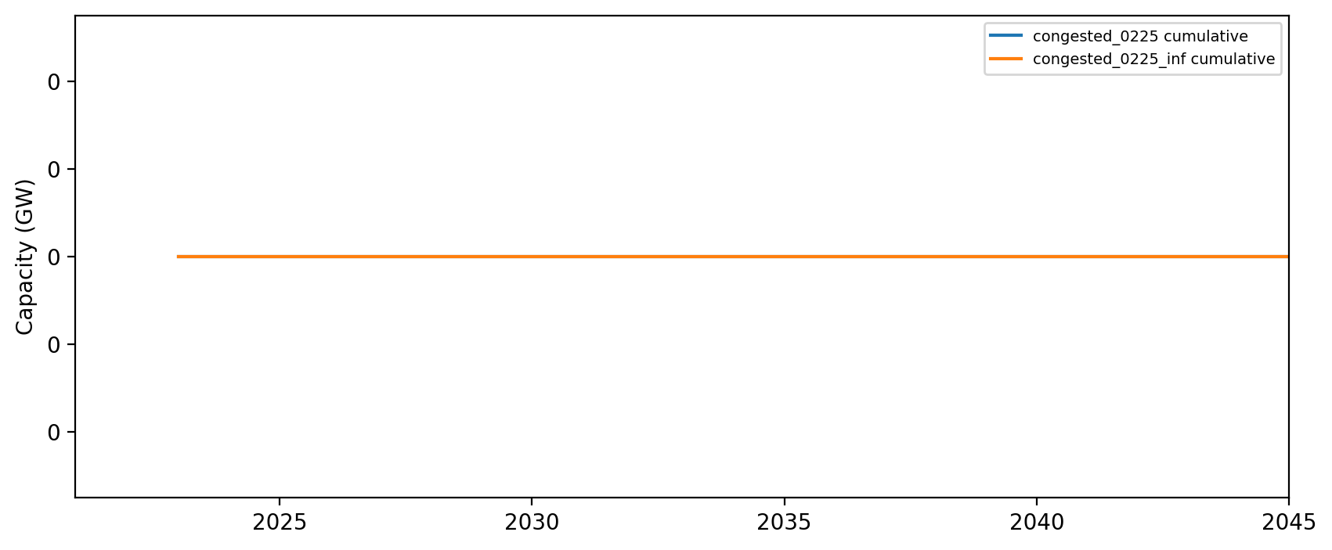
Installed Capacity - NH

Slide 18
Installed Capacity - RI/CT

Slide 19
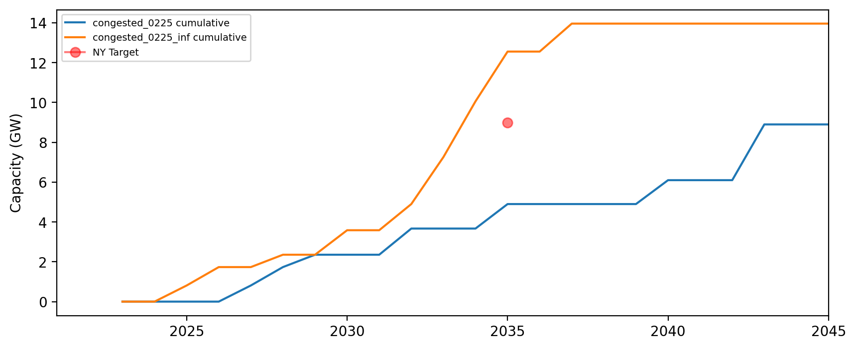
Installed Capacity - NY

Slide 20
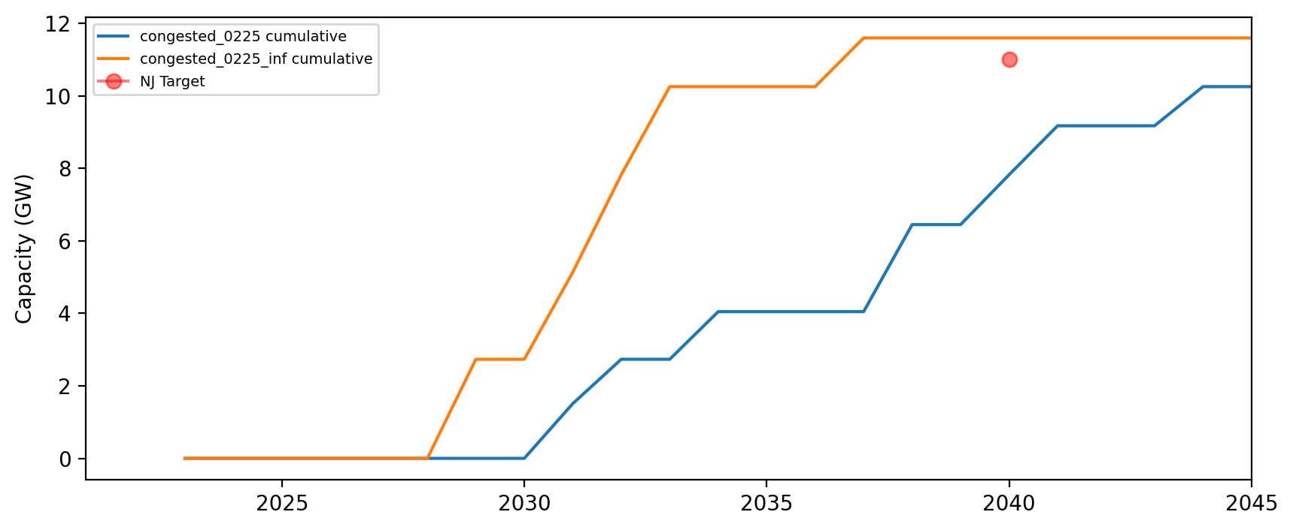
Installed Capacity - NJ

Slide 21
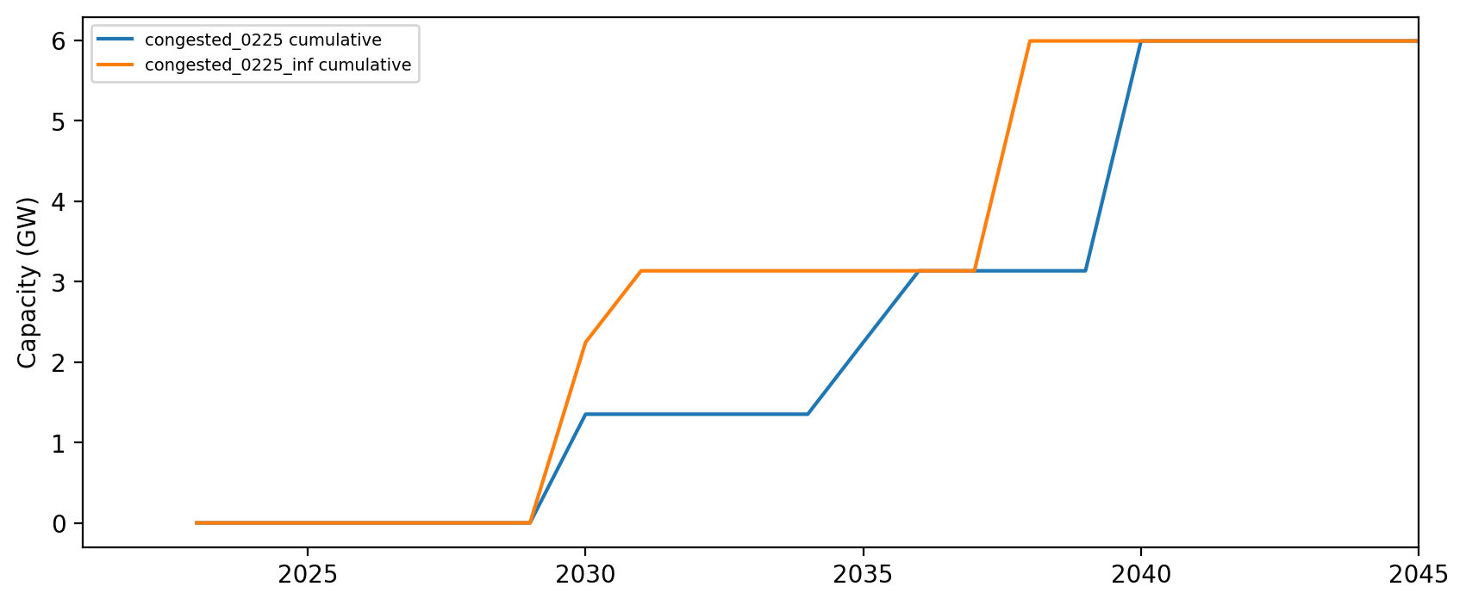
Installed Capacity - NC

Slide 22
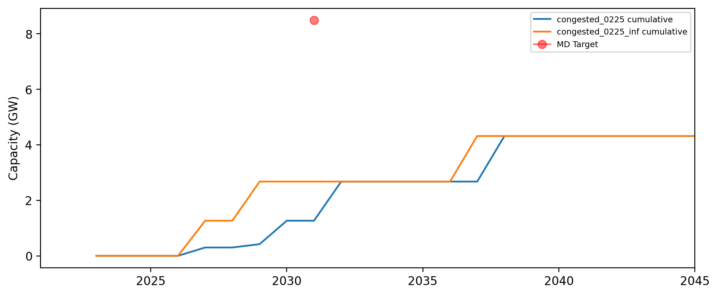
Installed Capacity - MD

Slide 23
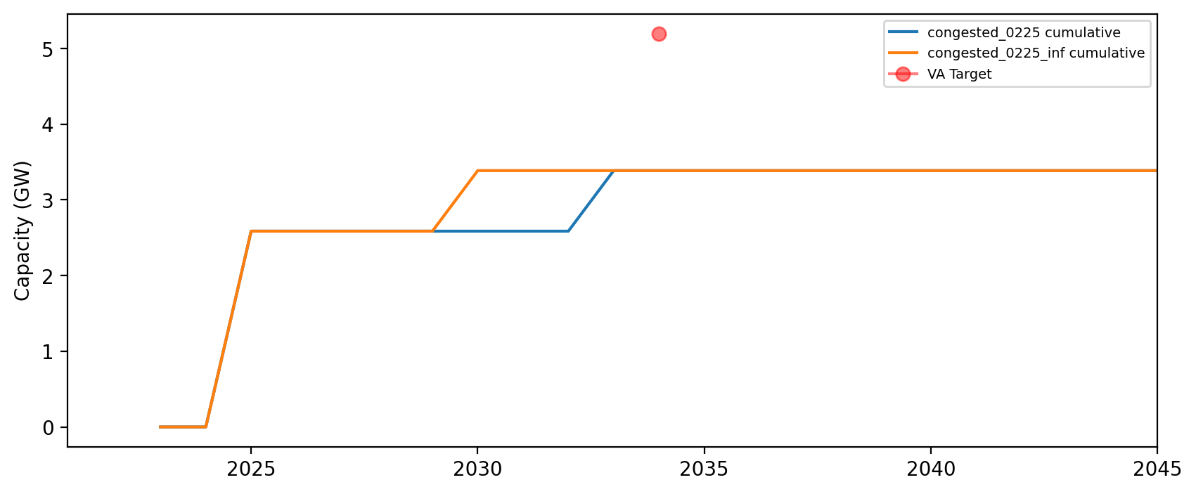
Installed Capacity - VA

Slide 24
Installed Capacity - DE

Slide 25
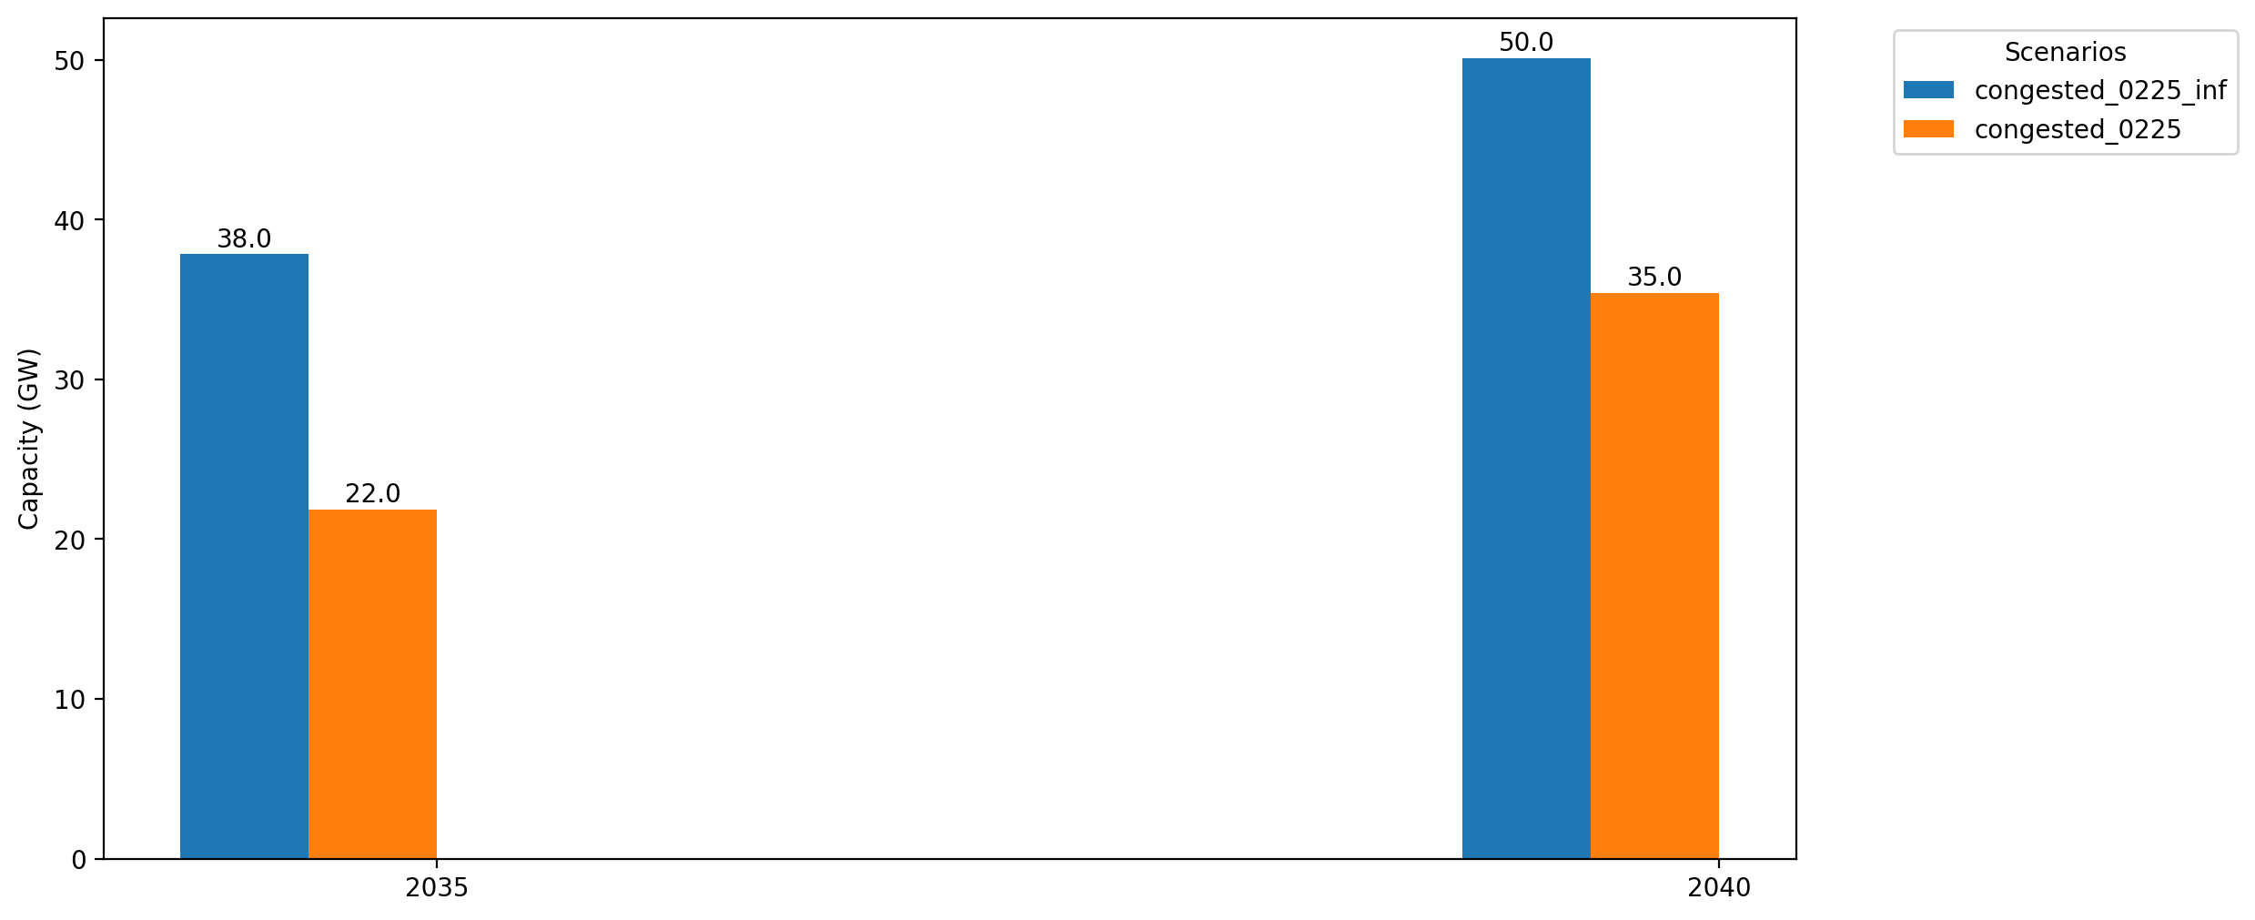
Cumulative Capacity by 2035 and 2040

Slide 26
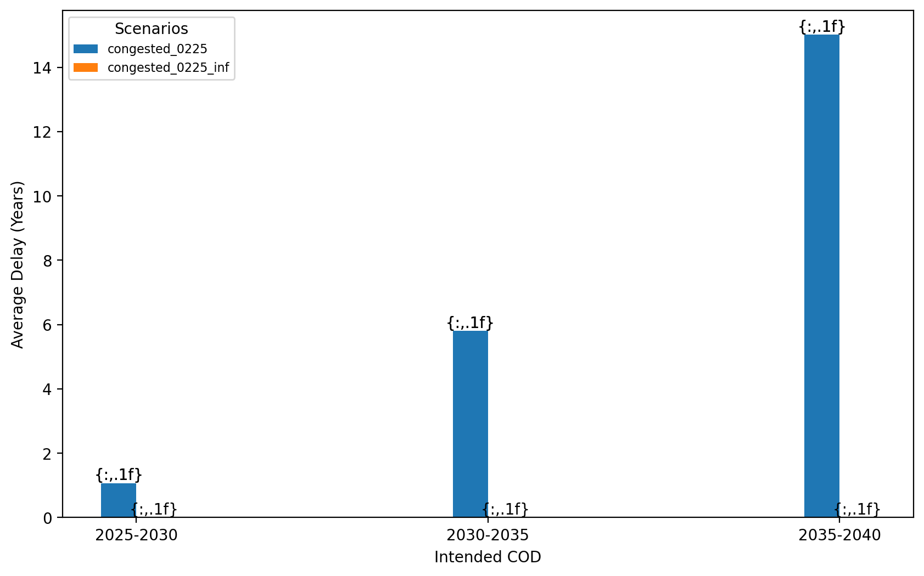
Average Delay Per Project by COD - All Regions

Slide 27
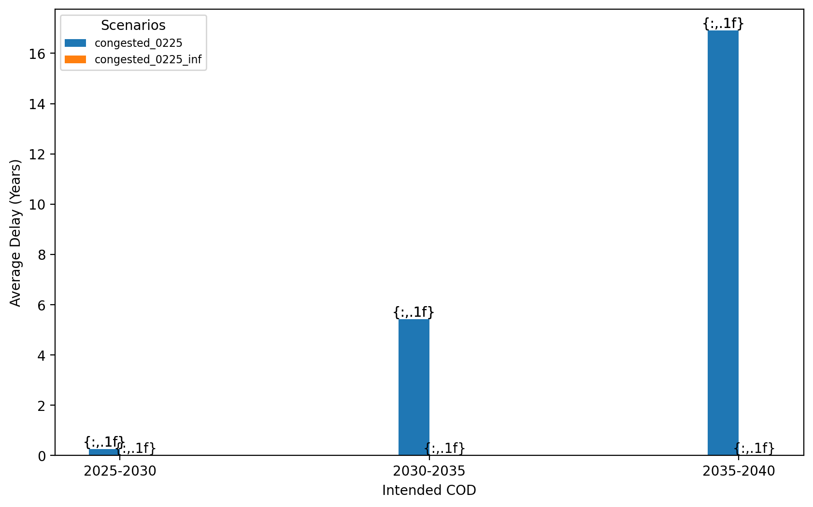
Average Delay Per Project by COD - NE

Slide 28
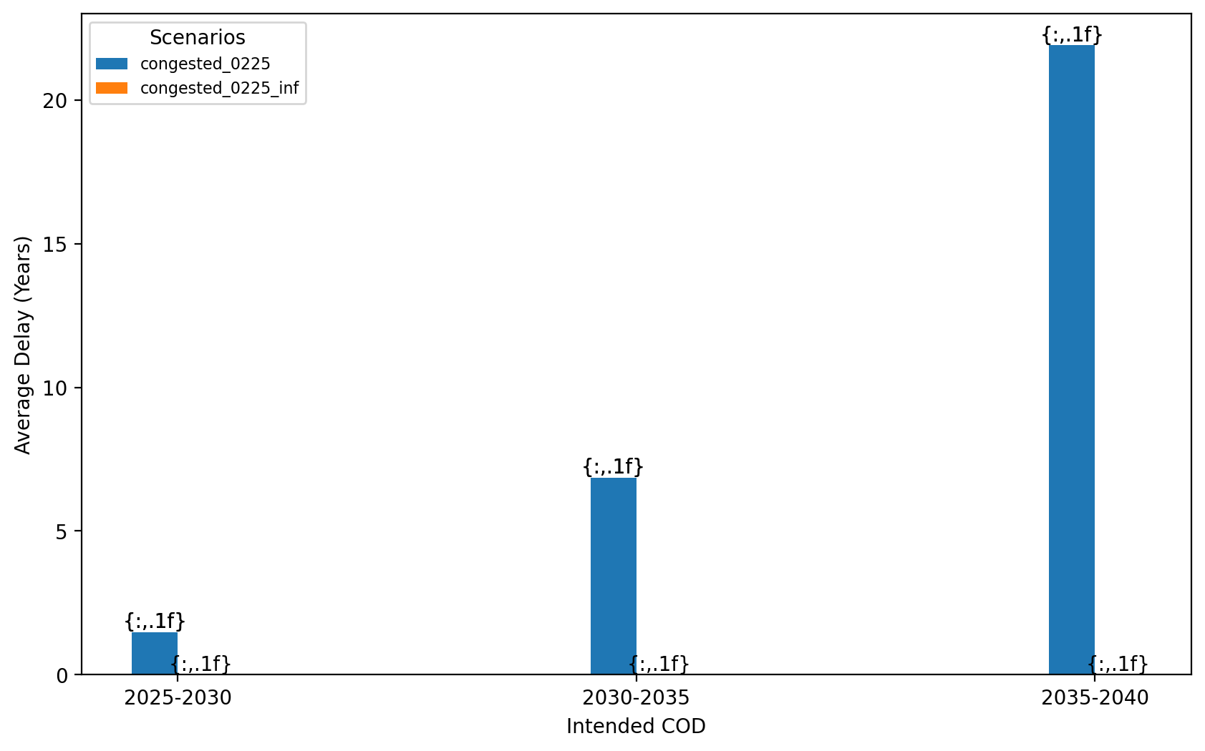
Average Delay Per Project by COD - NY/NJ

Slide 29
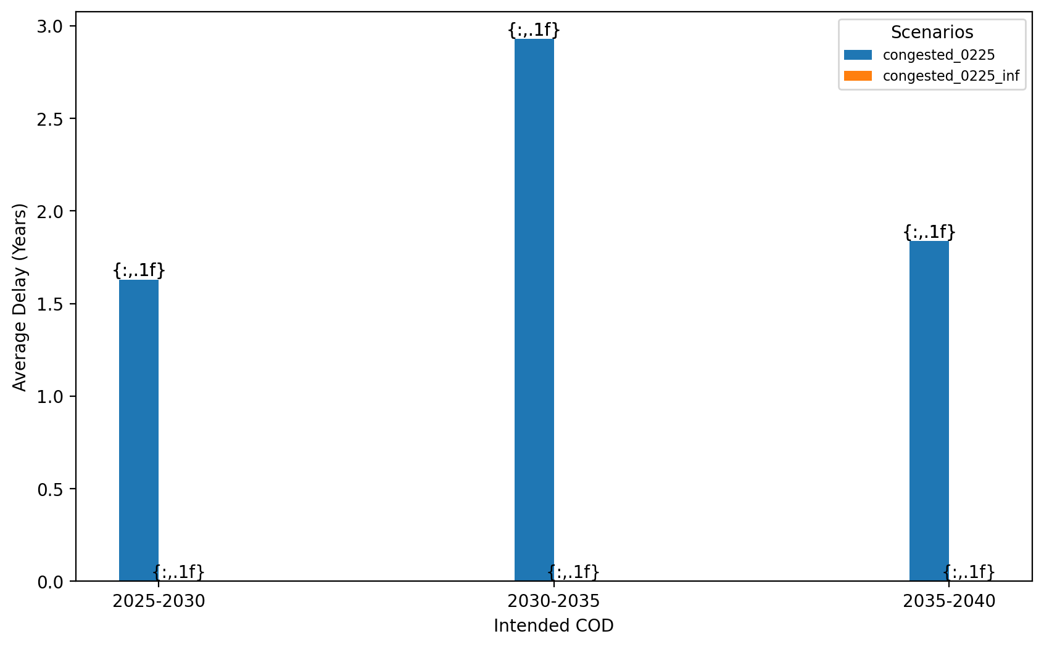
Average Delay Per Project by COD - Mid-Atlantic

Slide 30
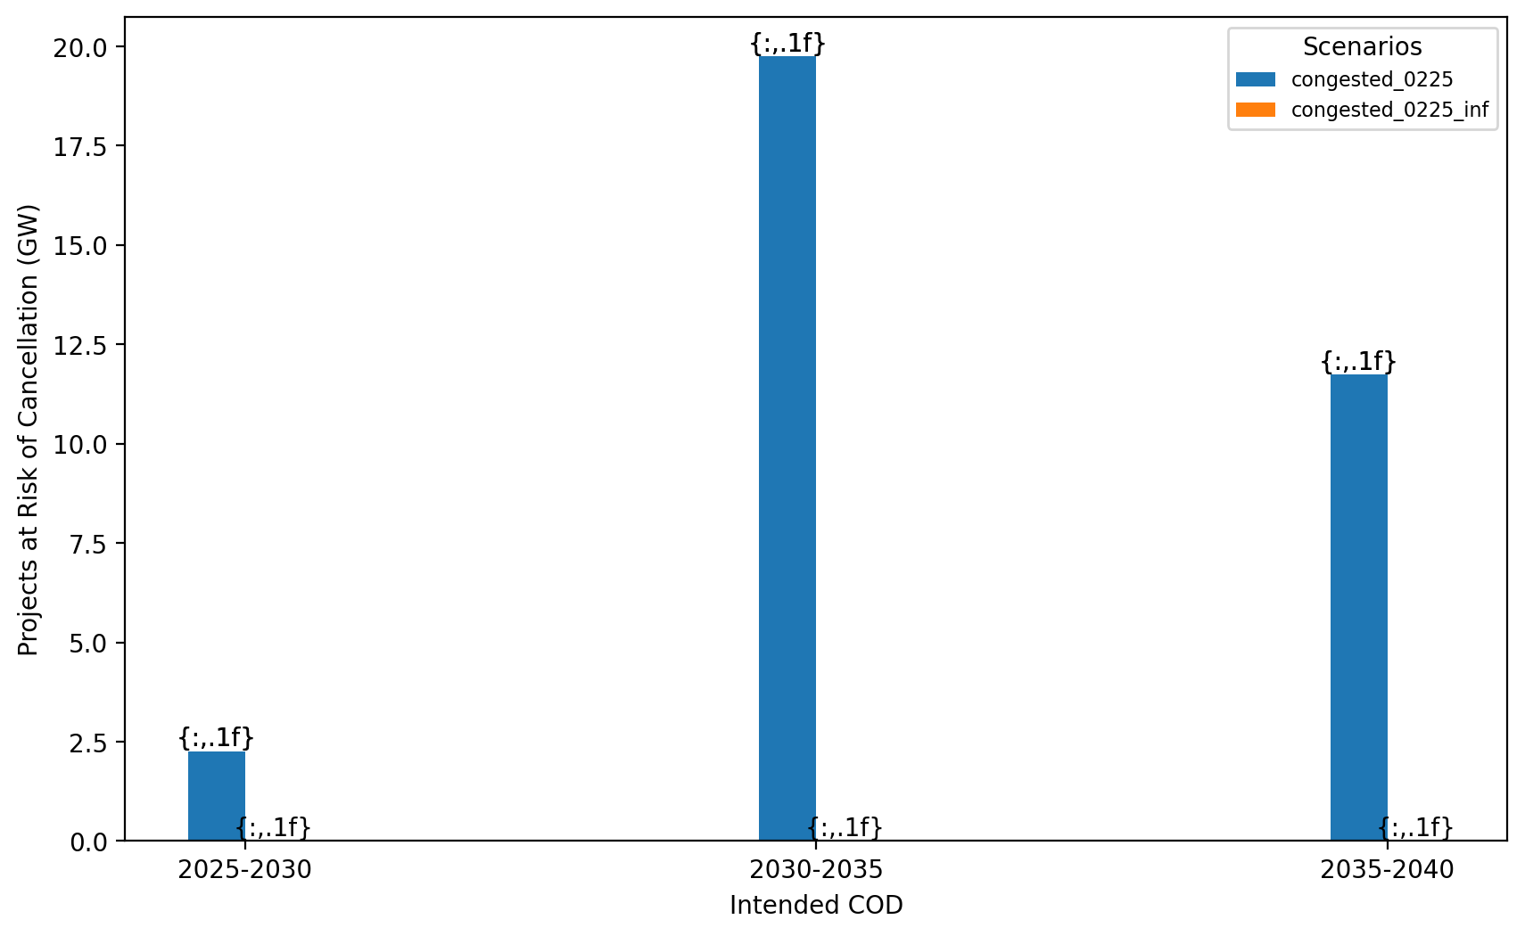
Total Capacity at Risk by COD - All Regions

Slide 31
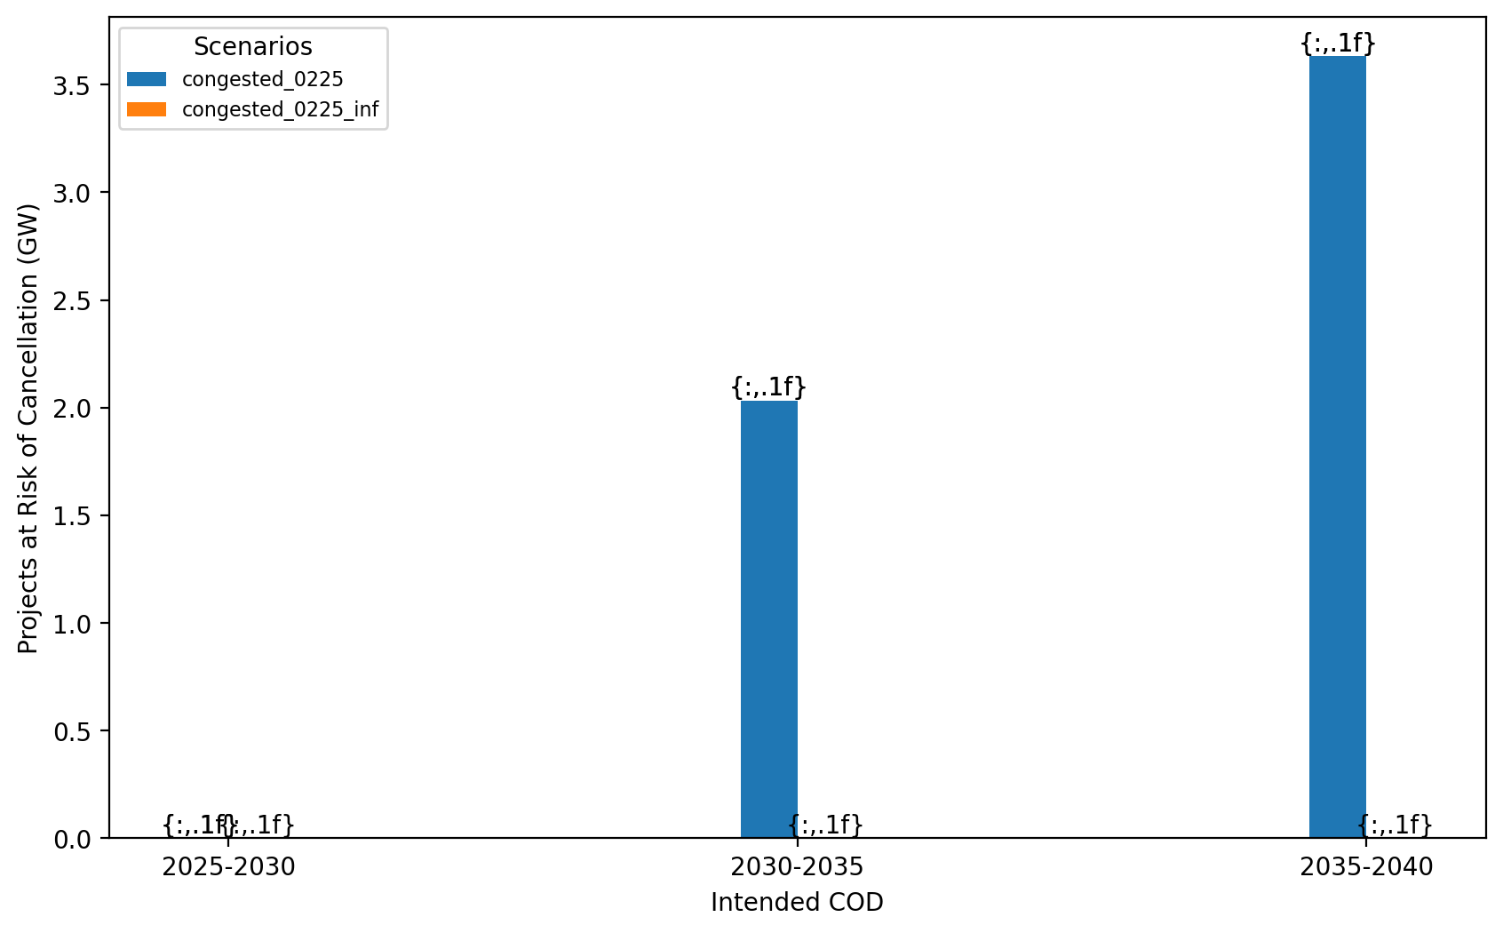
Total Capacity at Risk by COD - NE

Slide 32
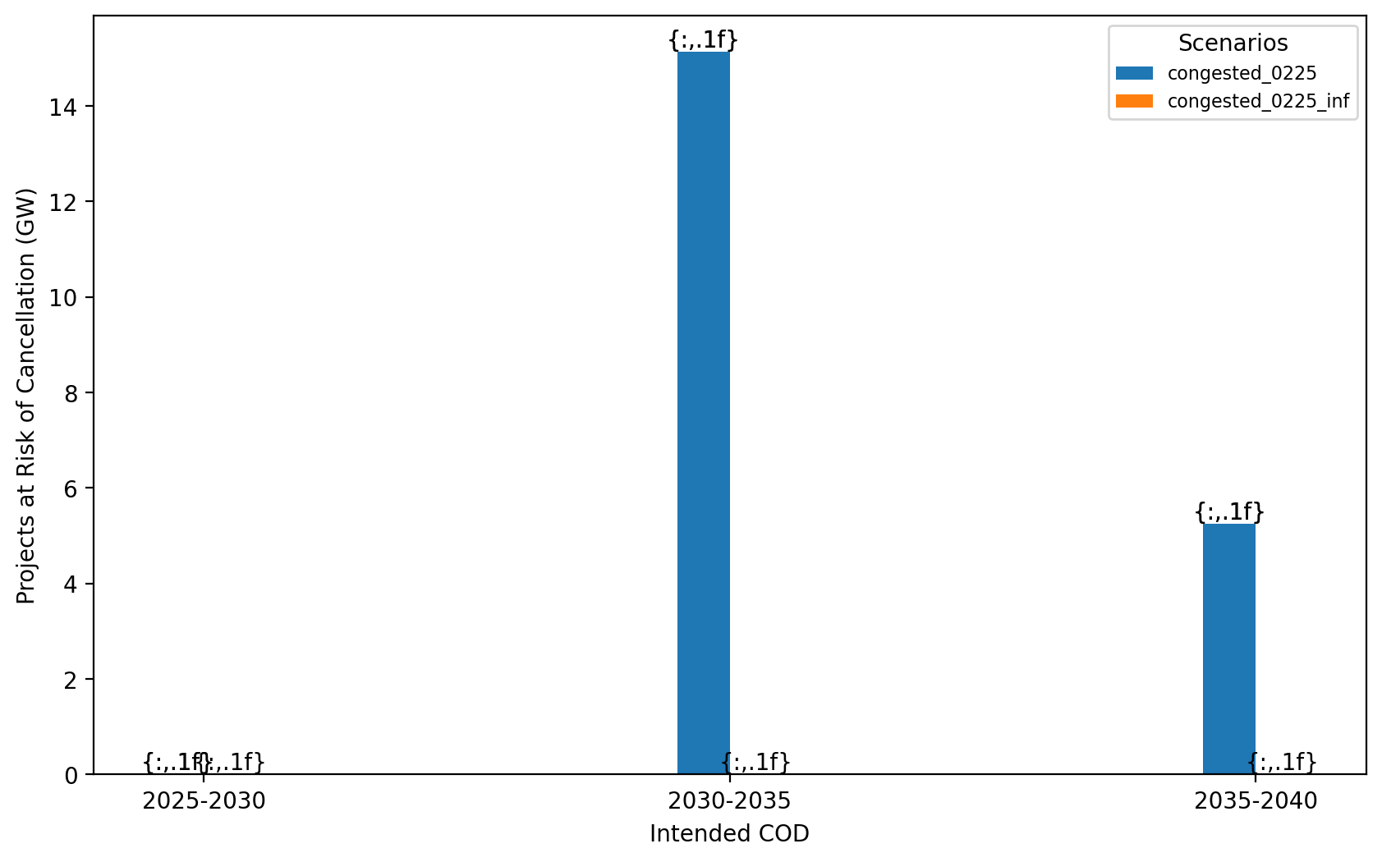
Total Capacity at Risk by COD - NY/NJ

Slide 33
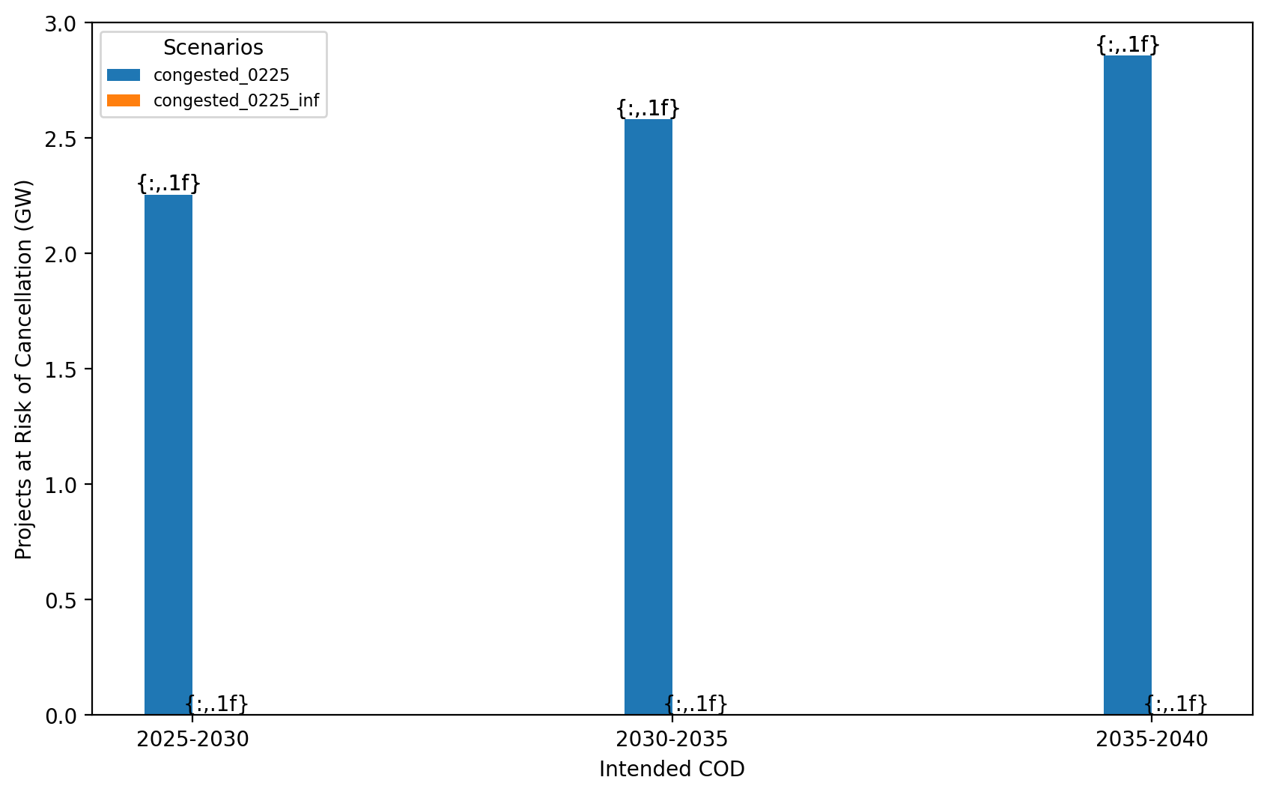
Total Capacity at Risk by COD - Mid-Atlantic

Slide 34
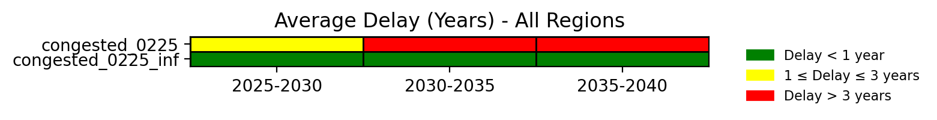
Average Delay Heat Map - All Regions

Slide 35
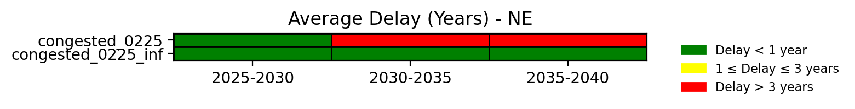
Average Delay Heat Map - NE

Slide 36
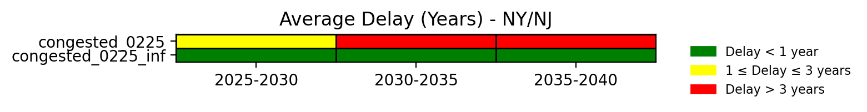
Average Delay Heat Map - NY/NJ

Slide 37
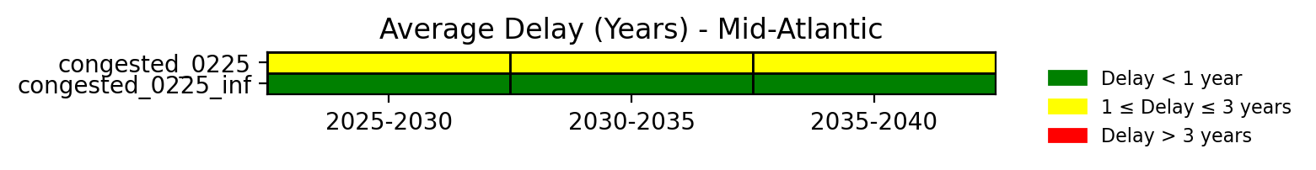
Average Delay Heat Map - Mid-Atlantic

