Slide 1
base_0225
1 US WTIV starting with CVOW

Slide 2
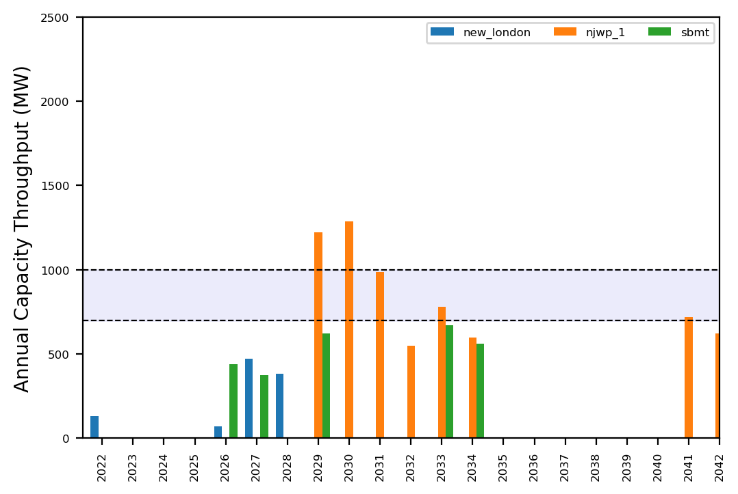
Port Throughput

Slide 3
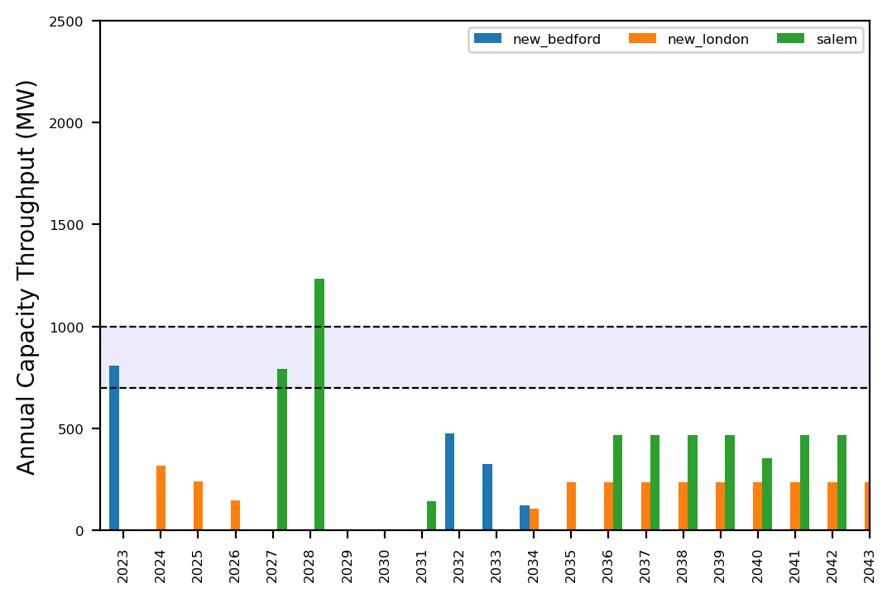
Port Throughput

Slide 4
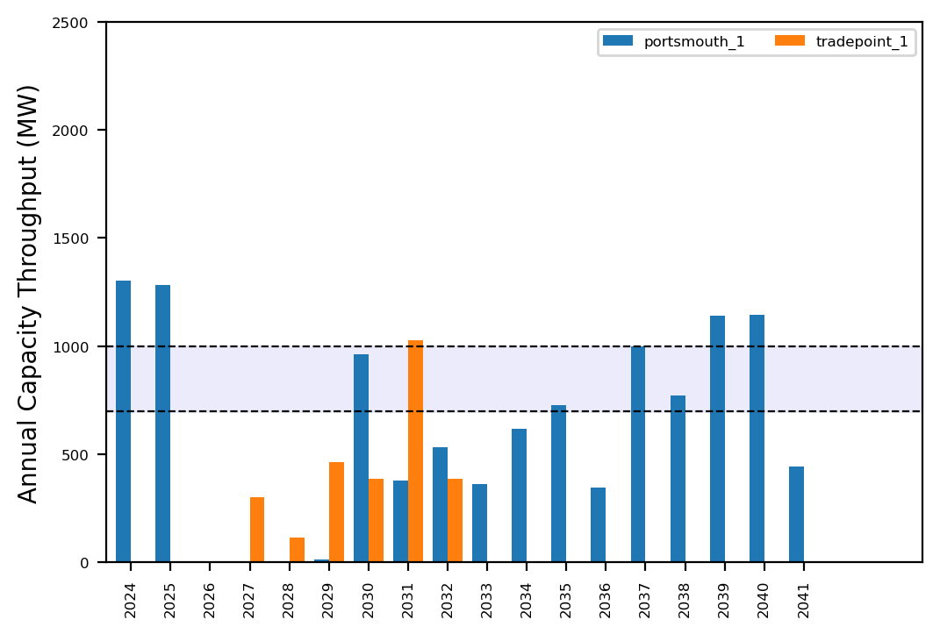
Port Throughput

Slide 5
congested_0225
No action with base pipeline

Slide 6
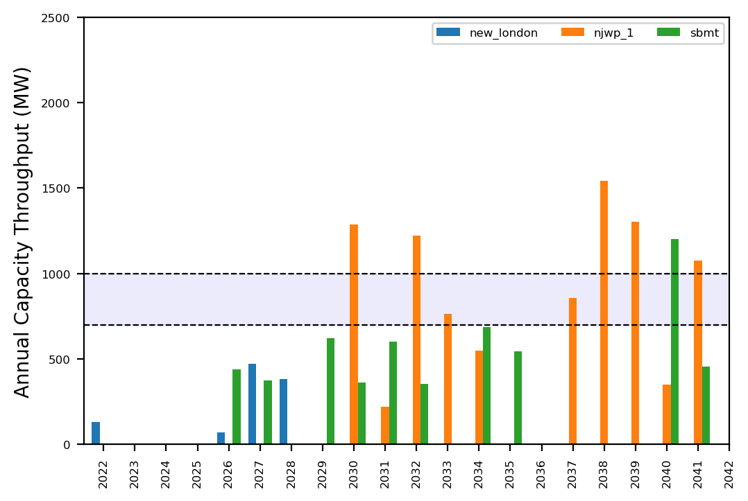
Port Throughput

Slide 7
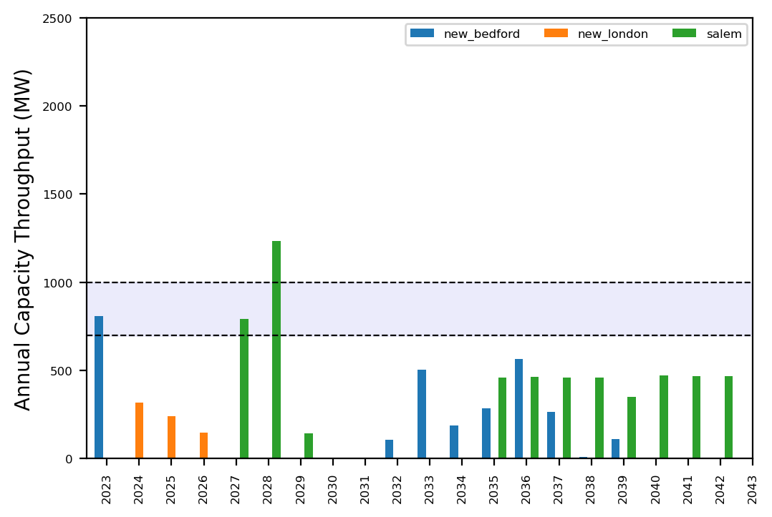
Port Throughput

Slide 8
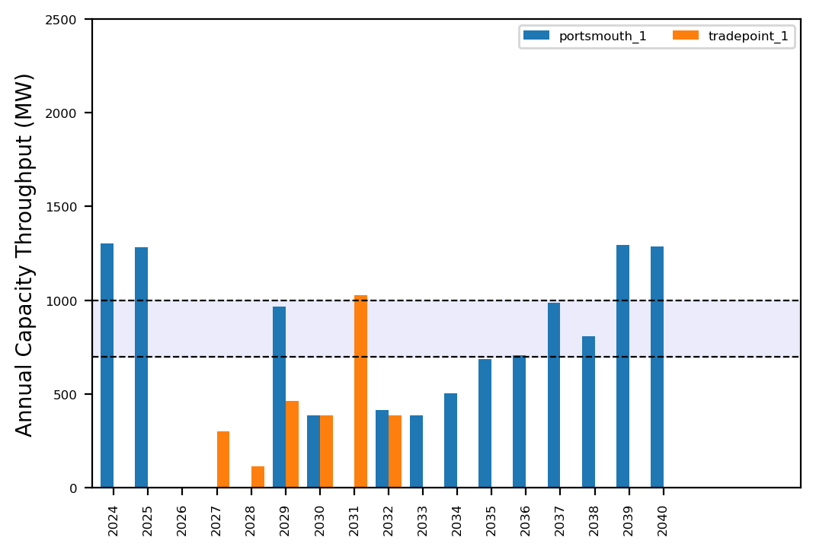
Port Throughput

Slide 9
expanded_0225
No action with base pipeline

Slide 10
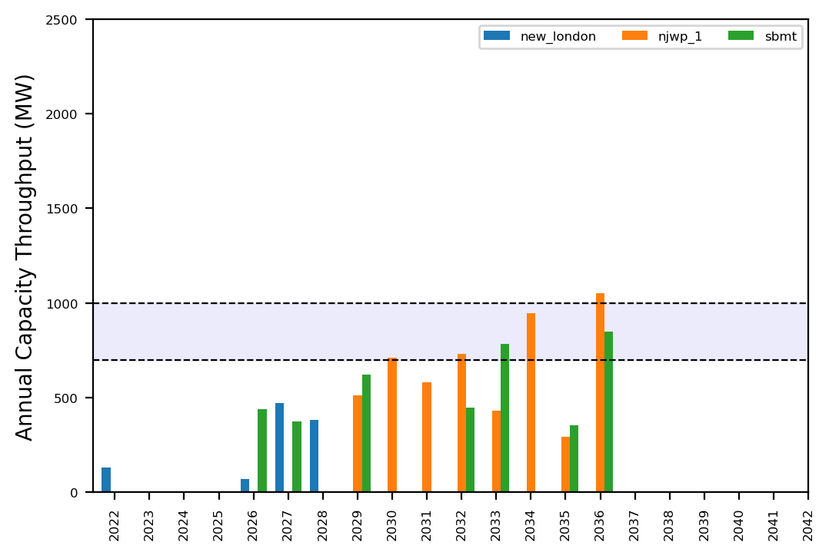
Port Throughput

Slide 11
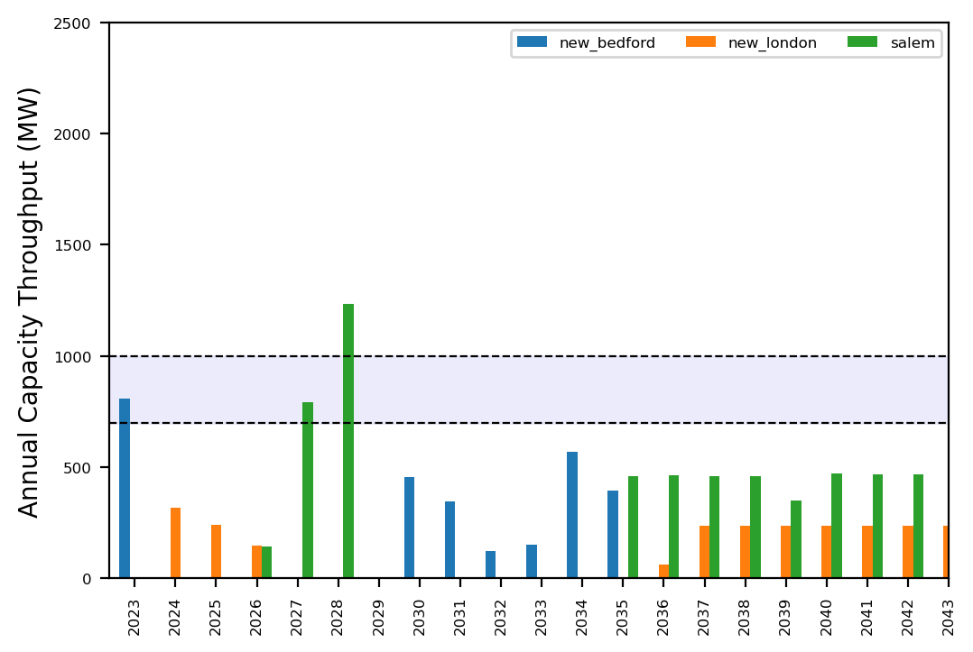
Port Throughput

Slide 12
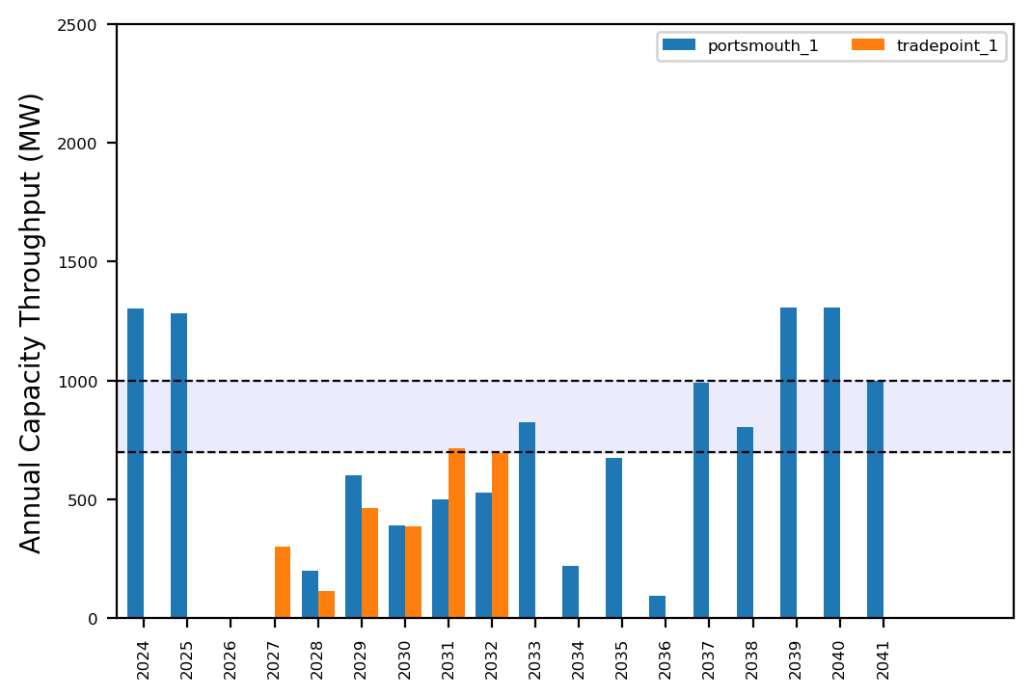
Port Throughput

Slide 13
reduced_0225
No action with base pipeline

Slide 14
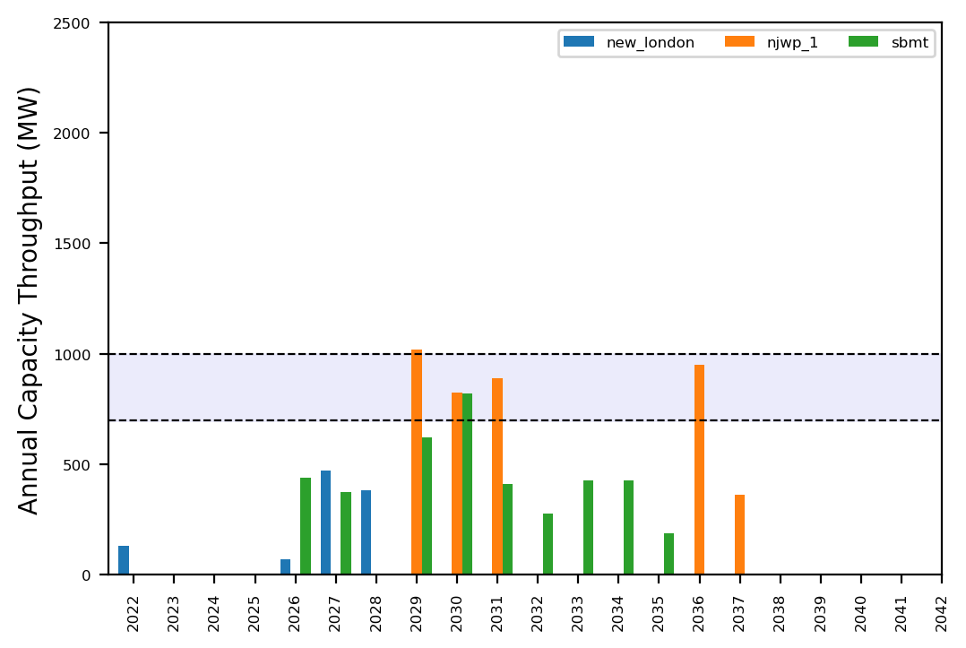
Port Throughput

Slide 15
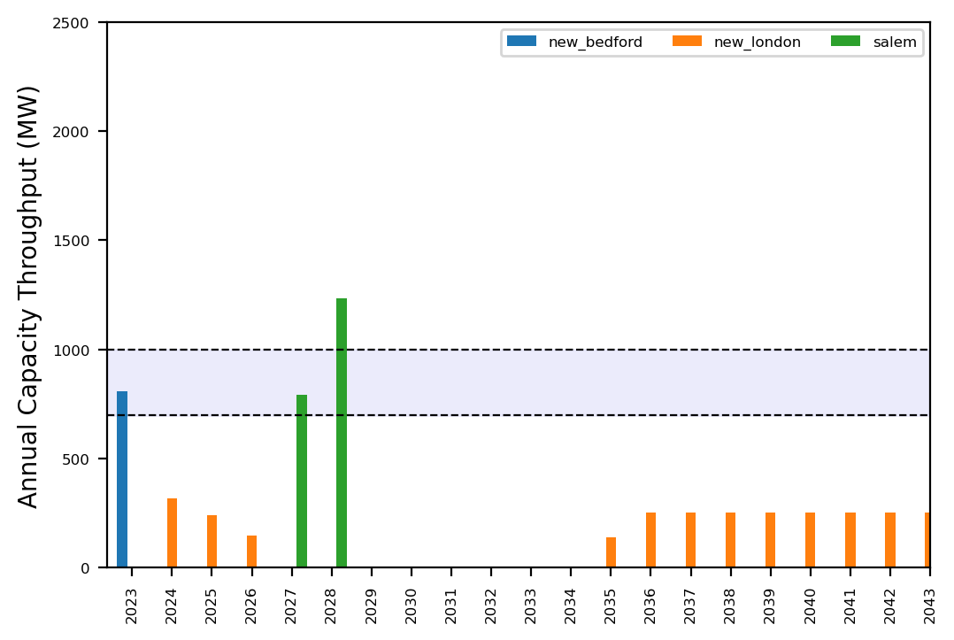
Port Throughput

Slide 16
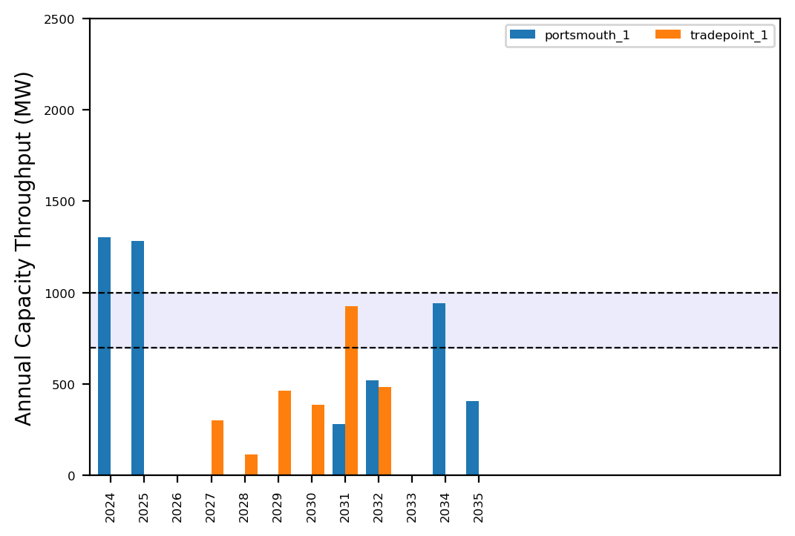
Port Throughput

Slide 17
uniform_0225
No action with base pipeline

Slide 18
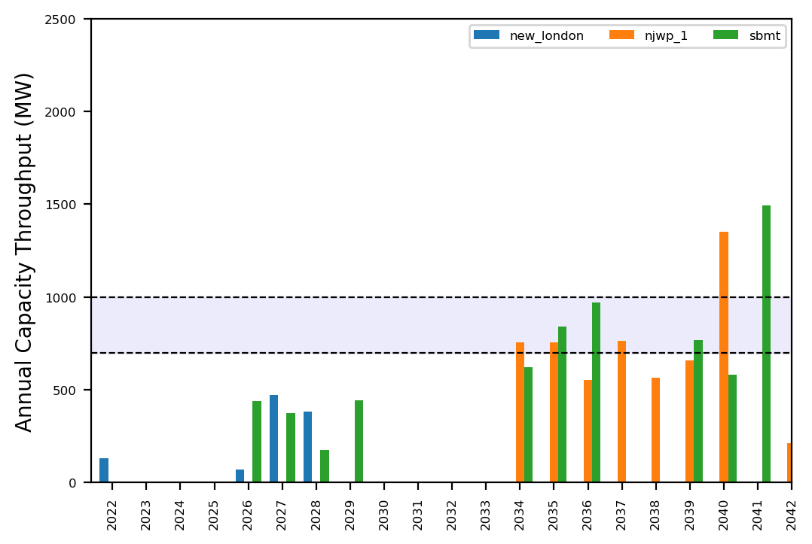
Port Throughput

Slide 19
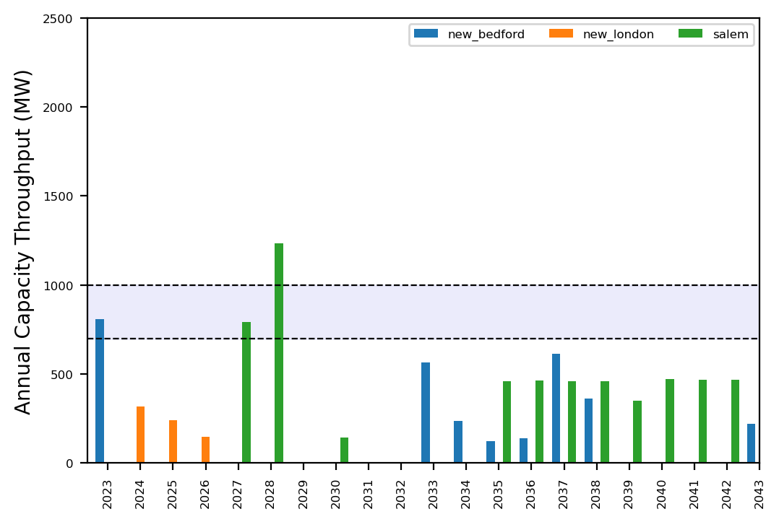
Port Throughput

Slide 20
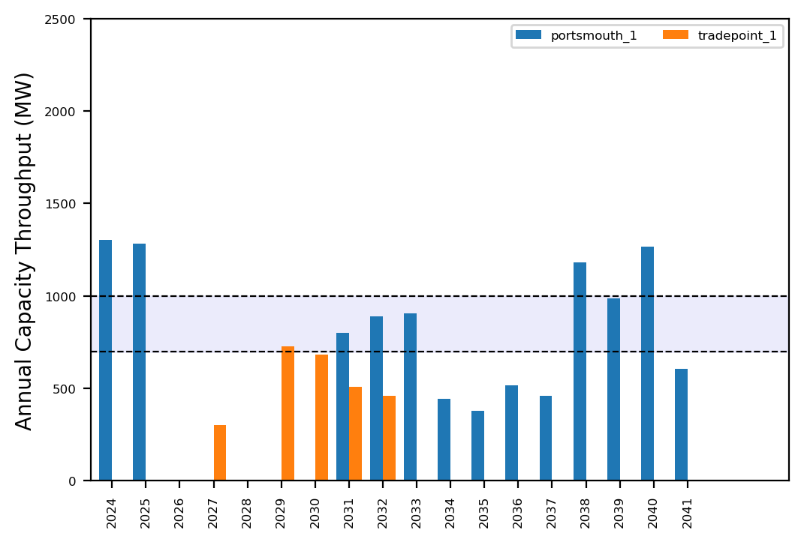
Port Throughput

Slide 21
Summary Plots
Plots comparing runs

Slide 22
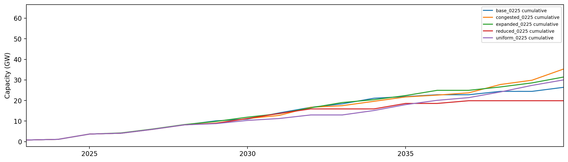
Installed Capacity

Slide 23
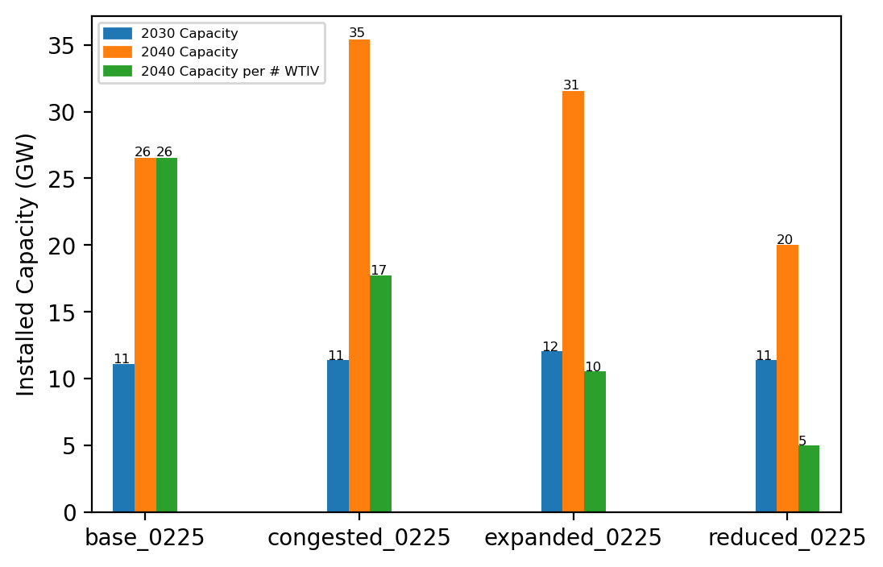
Summary Installed Cap

Slide 24
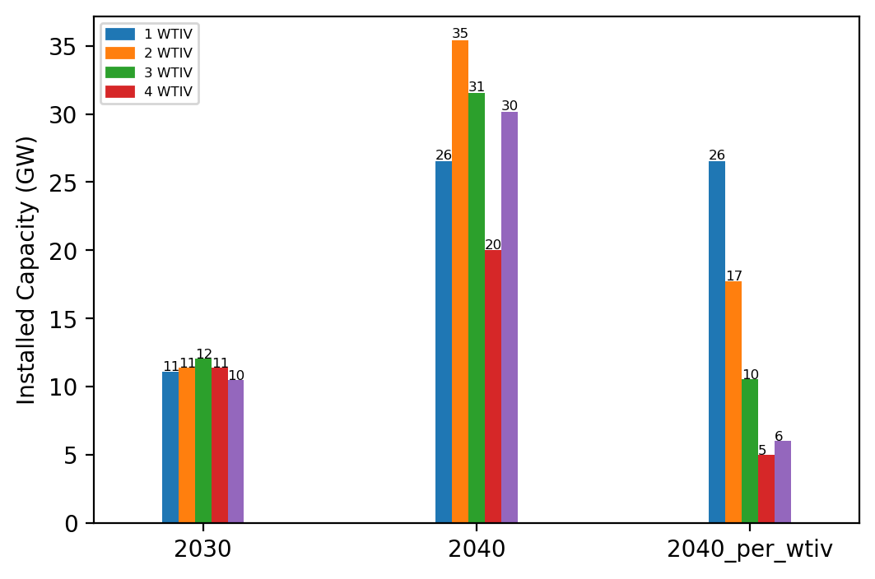
Summary Installed Cap T

Slide 25
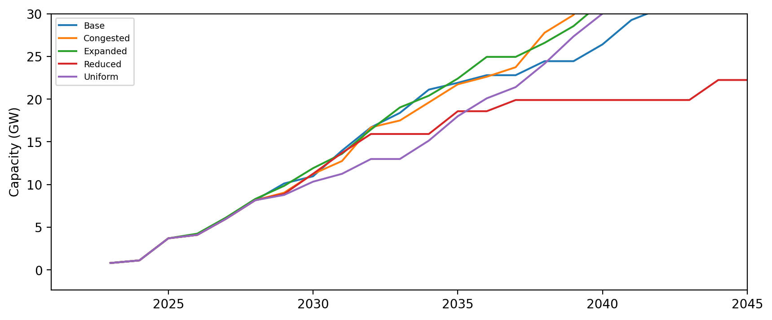
Installed Capacity - All Regions

Slide 26
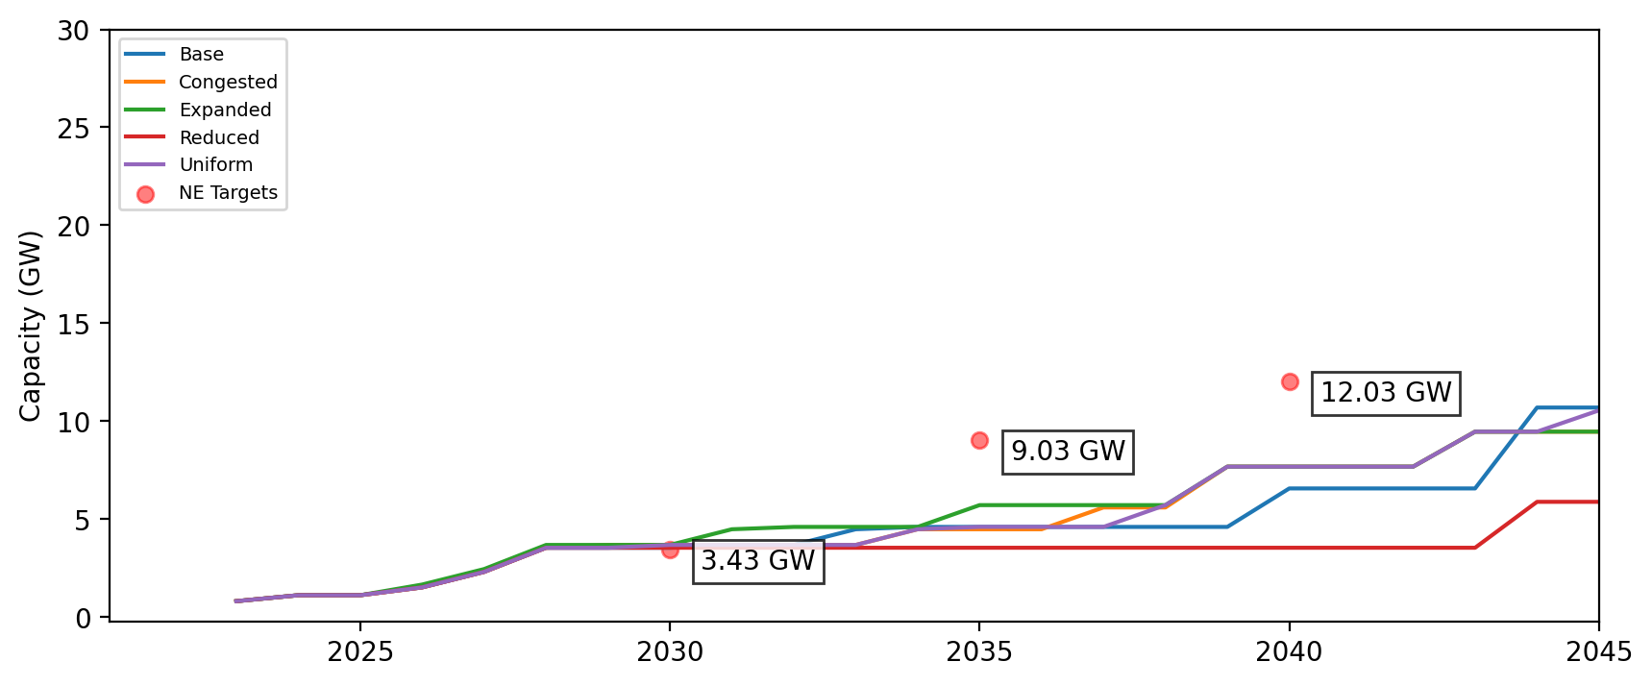
Installed Capacity - NE

Slide 27
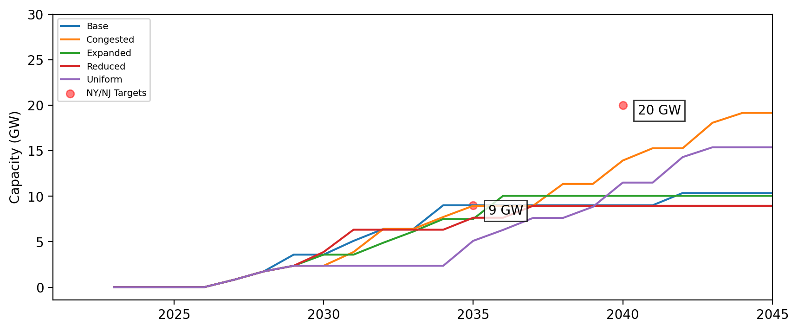
Installed Capacity - NY/NJ

Slide 28
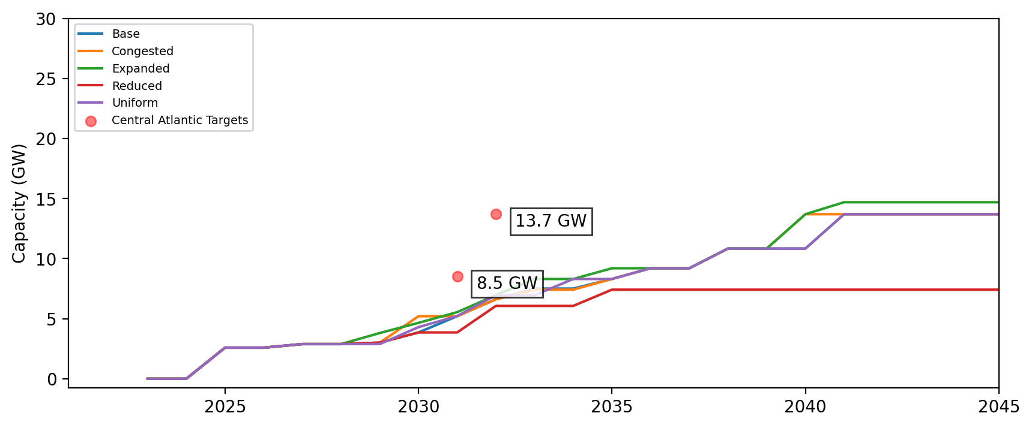
Installed Capacity - Central Atlantic

Slide 29
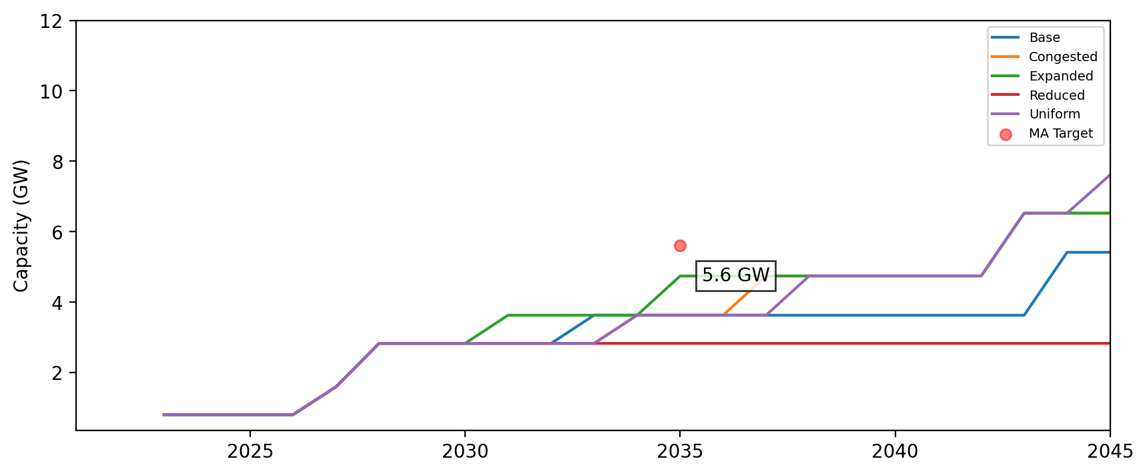
Cumulative Installed Capacity - MA

Slide 30
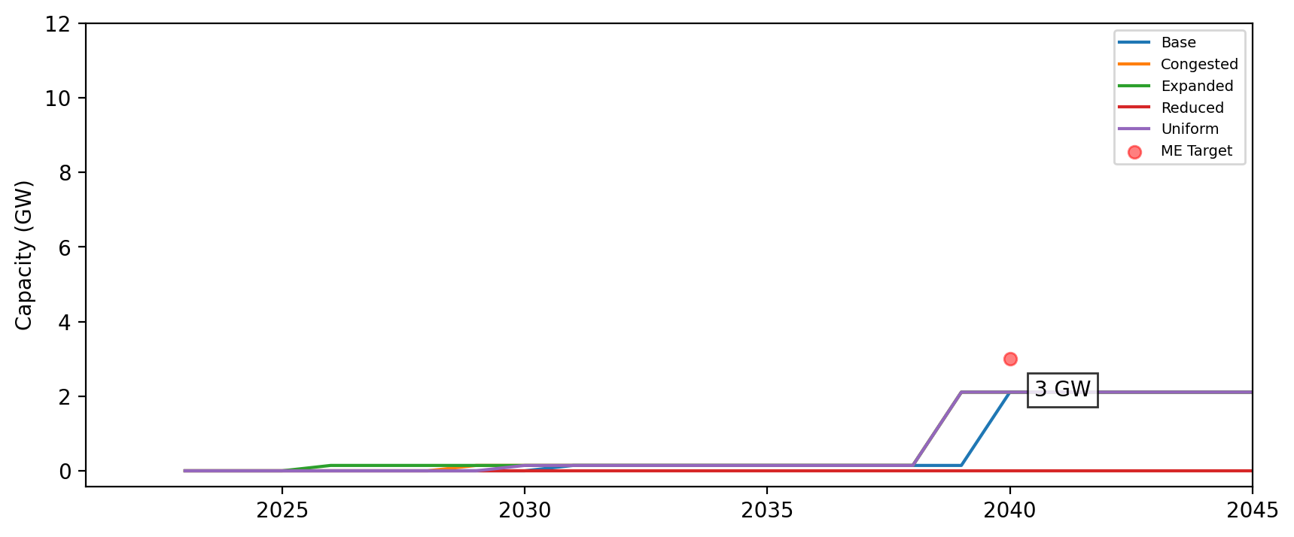
Cumulative Installed Capacity - ME

Slide 31
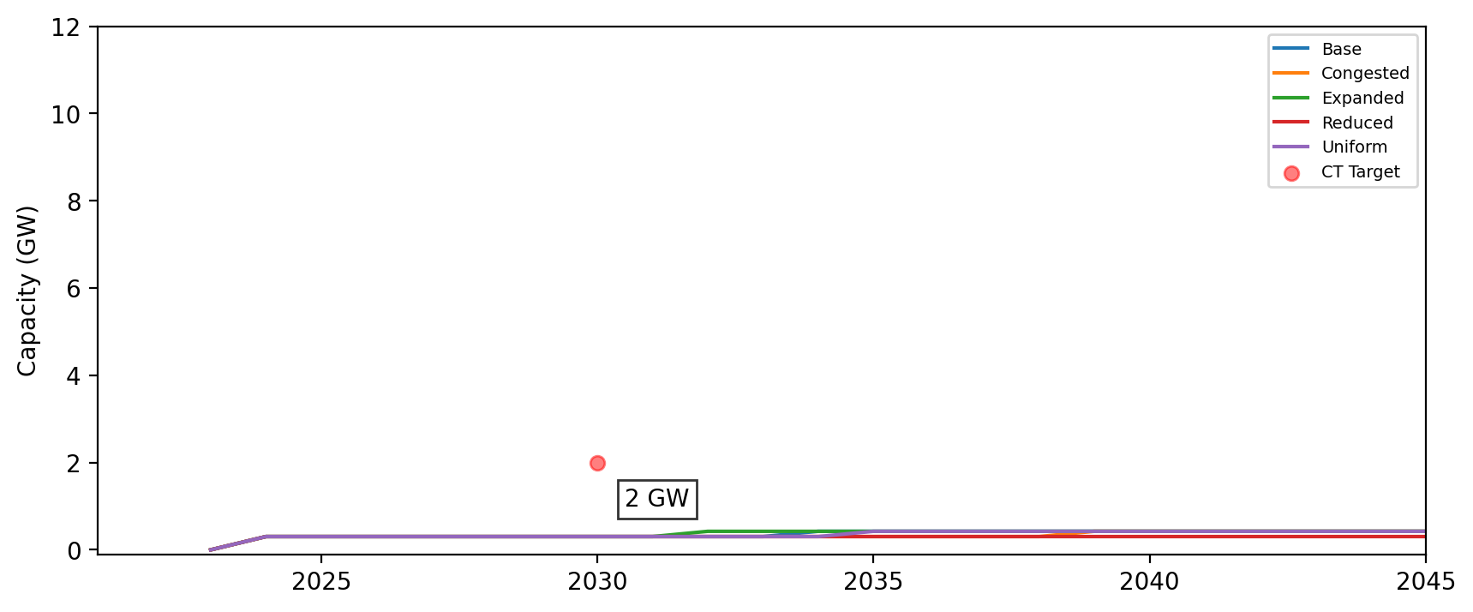
Cumulative Installed Capacity - CT

Slide 32
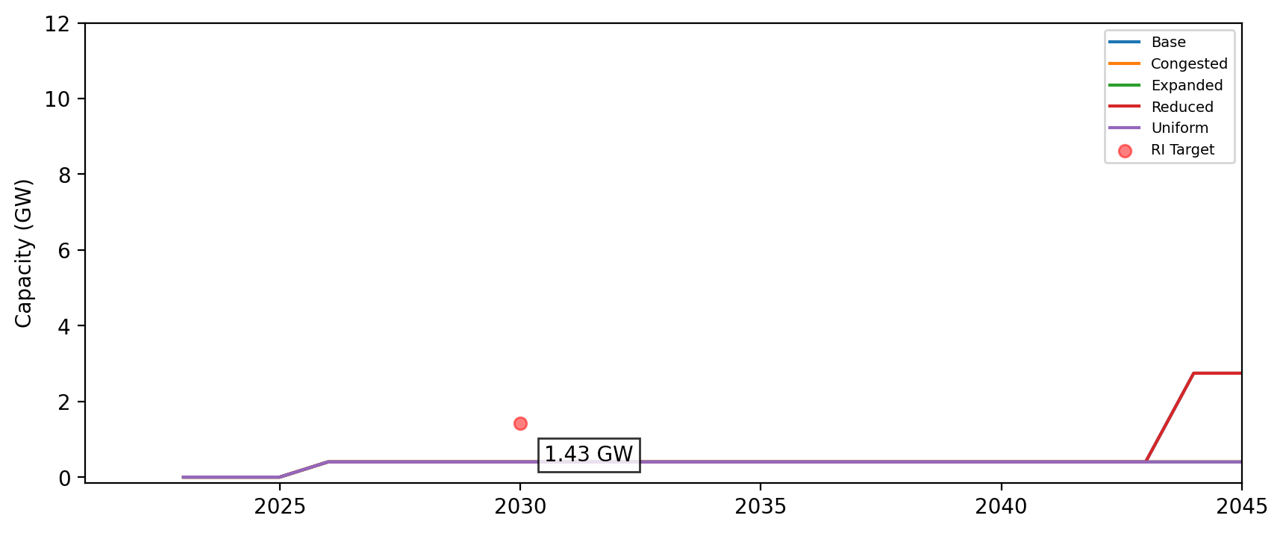
Cumulative Installed Capacity - RI

Slide 33
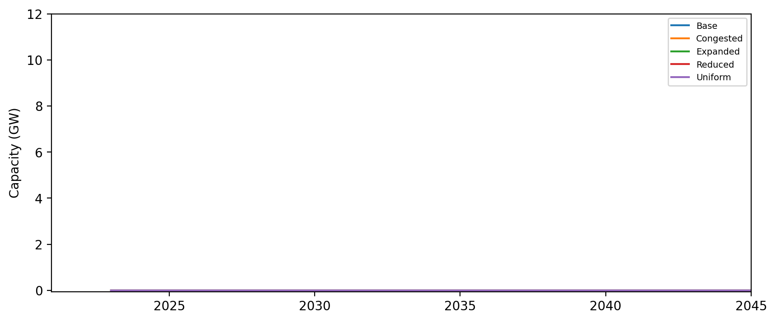
Cumulative Installed Capacity - NH

Slide 34
Cumulative Installed Capacity - RI/CT

Slide 35
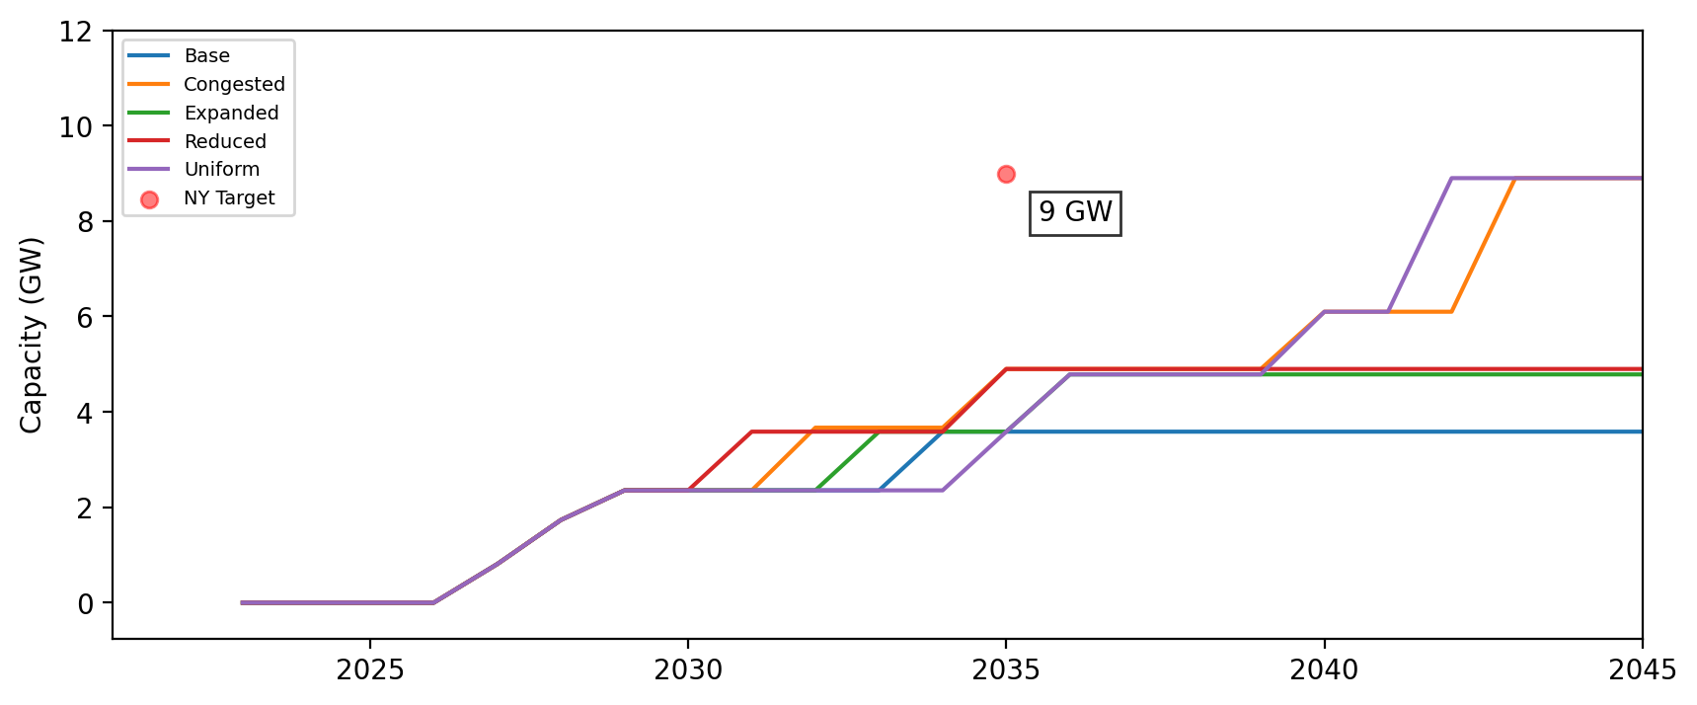
Cumulative Installed Capacity - NY

Slide 36
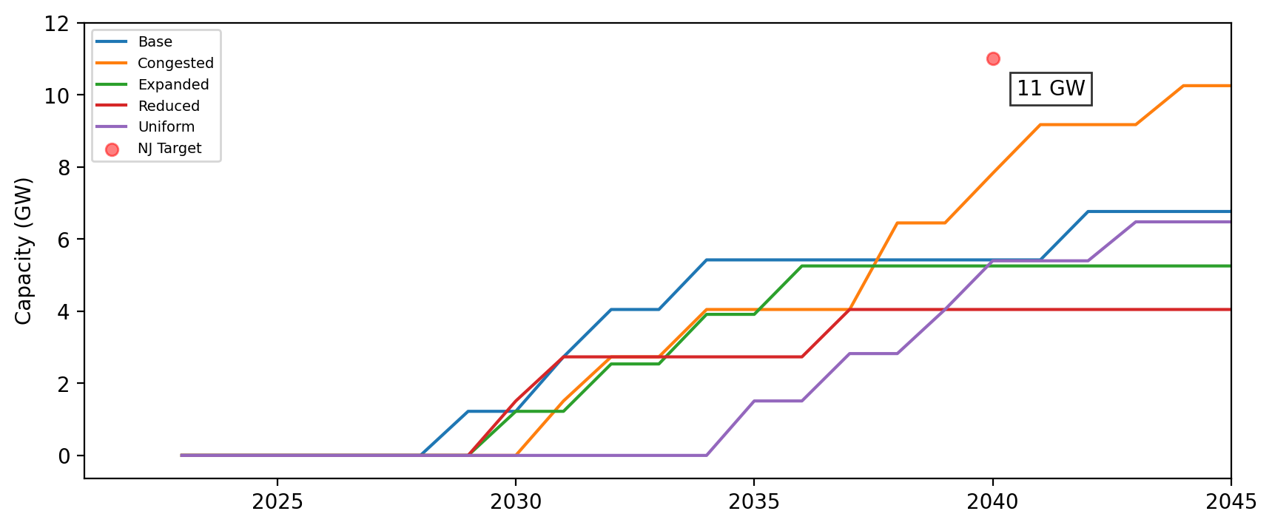
Cumulative Installed Capacity - NJ

Slide 37
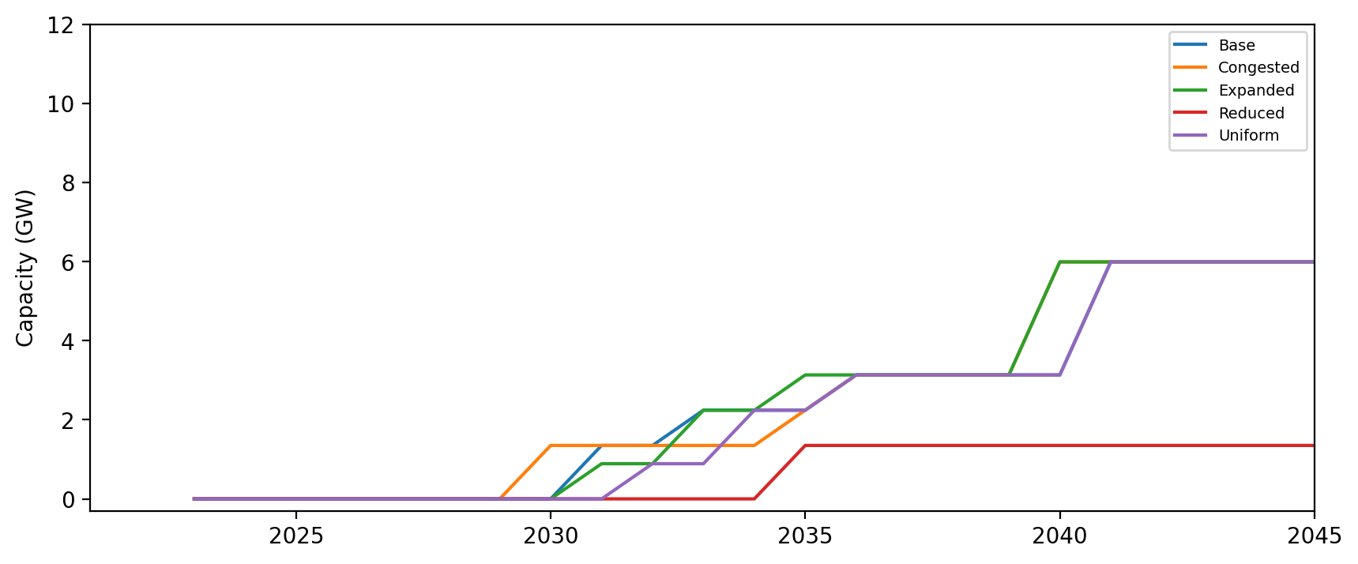
Cumulative Installed Capacity - NC

Slide 38
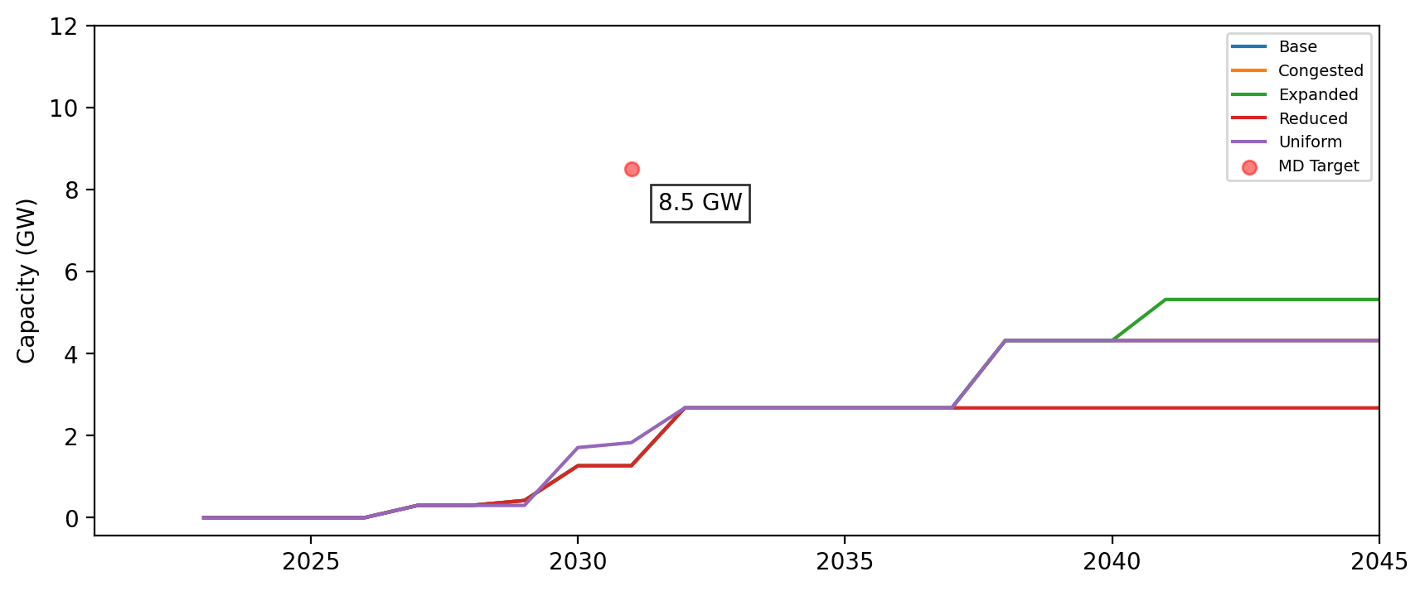
Cumulative Installed Capacity - MD

Slide 39
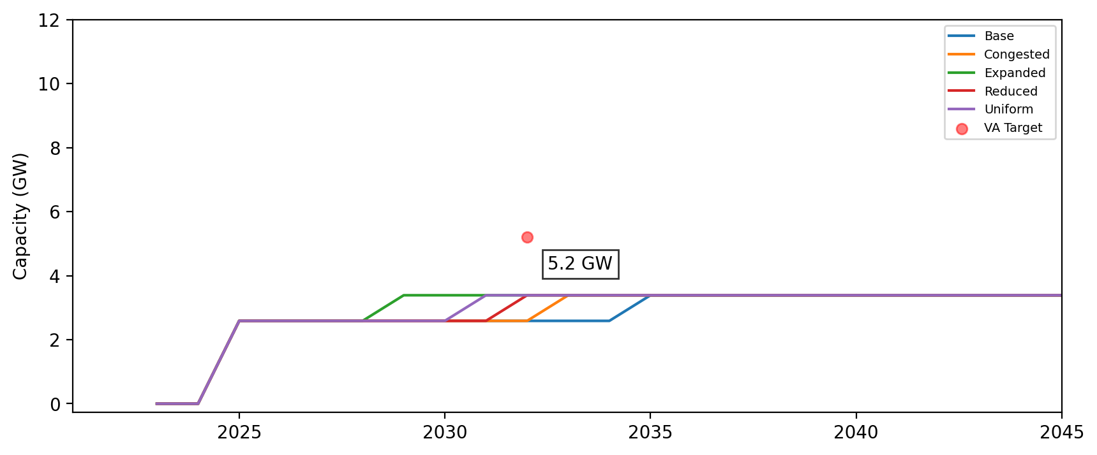
Cumulative Installed Capacity - VA

Slide 40
Cumulative Installed Capacity - DE

Slide 41
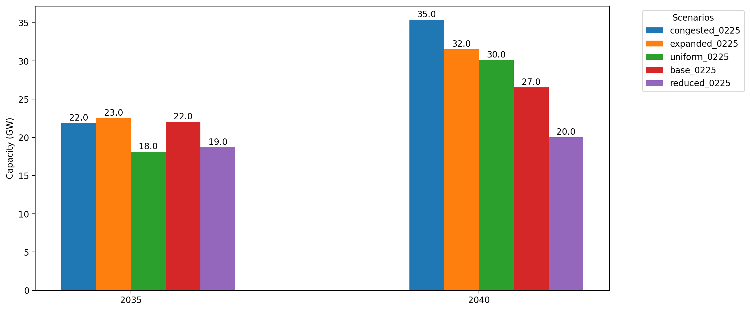
Cumulative Capacity by 2035 and 2040

Slide 42
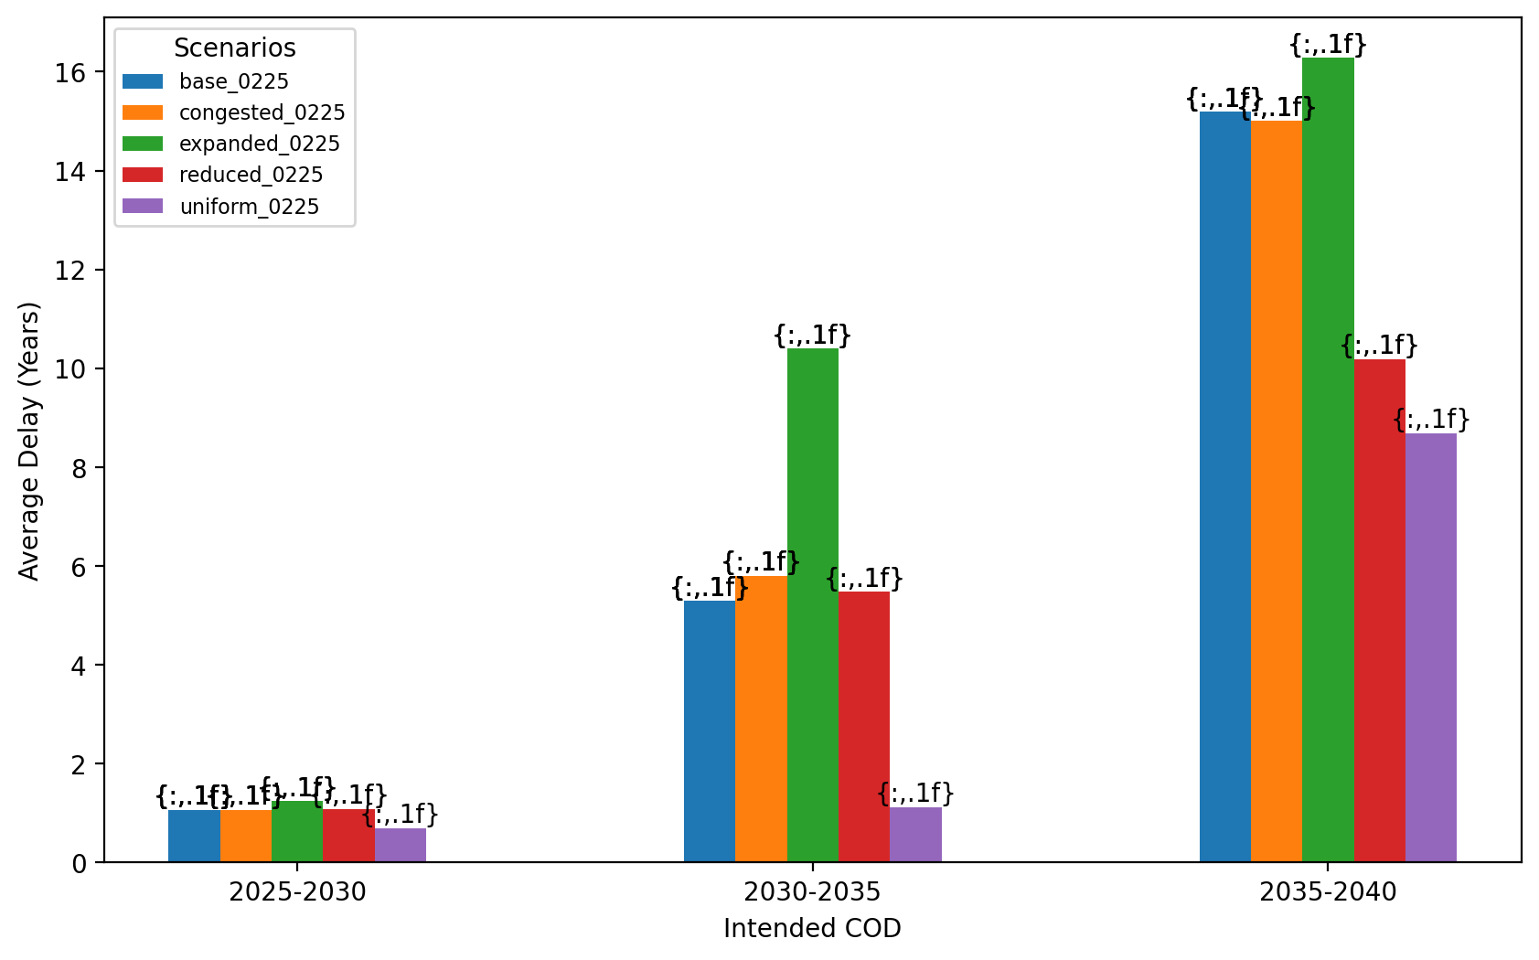
Average Delay Per Project by COD - All Regions

Slide 43
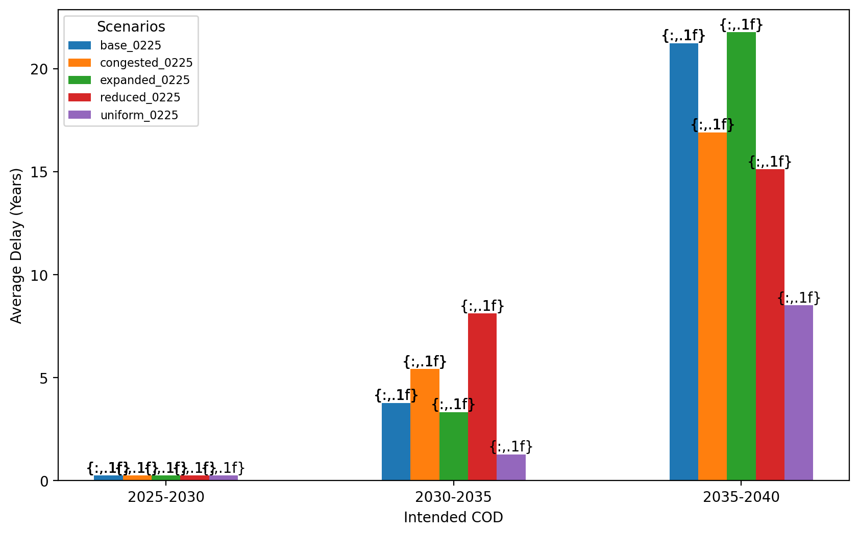
Average Delay Per Project by COD - NE

Slide 44
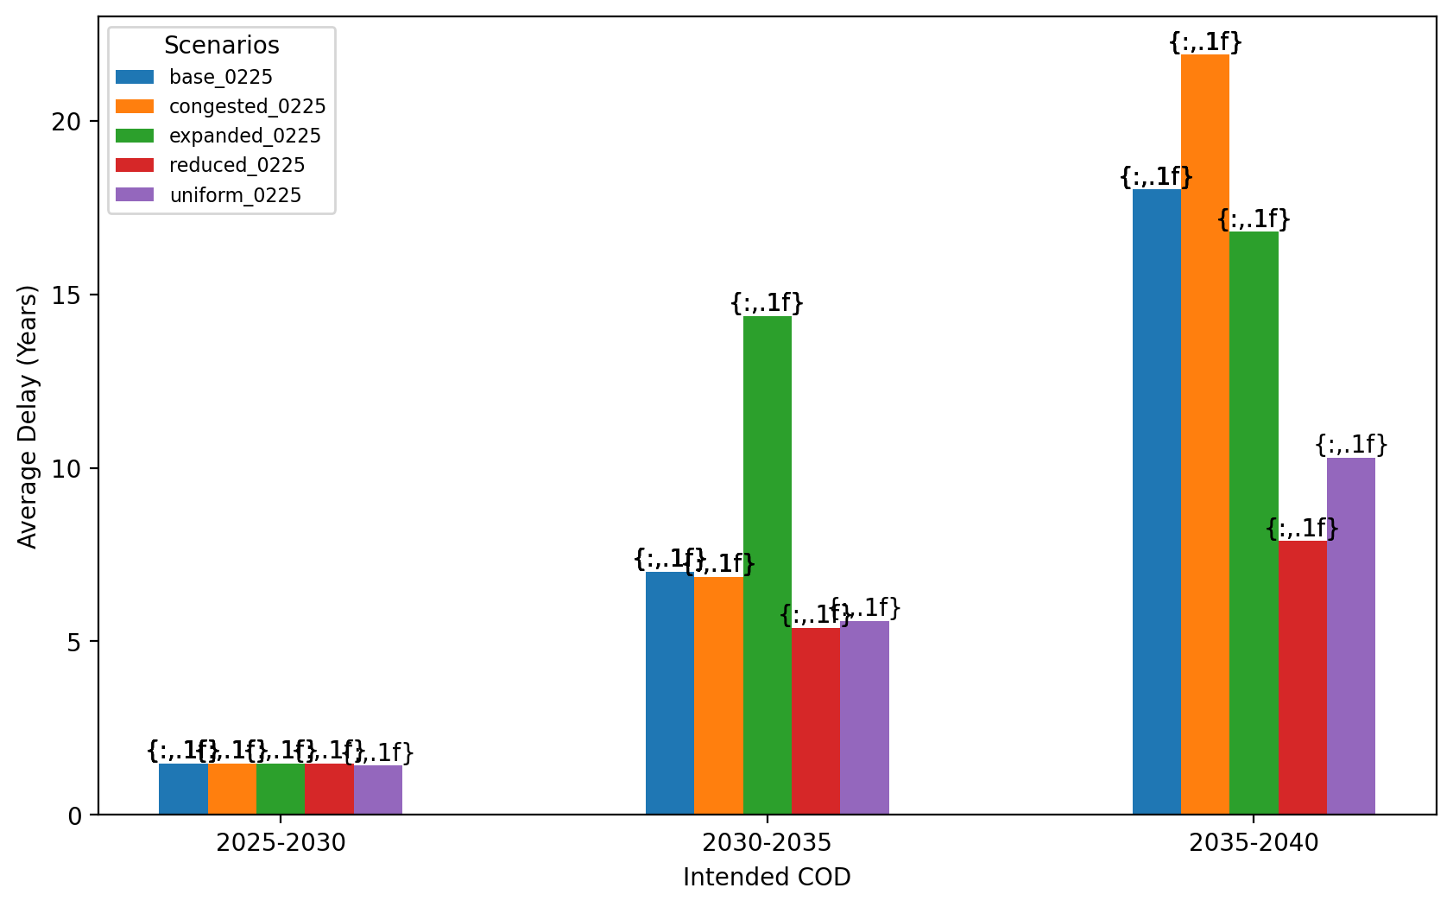
Average Delay Per Project by COD - NY/NJ

Slide 45
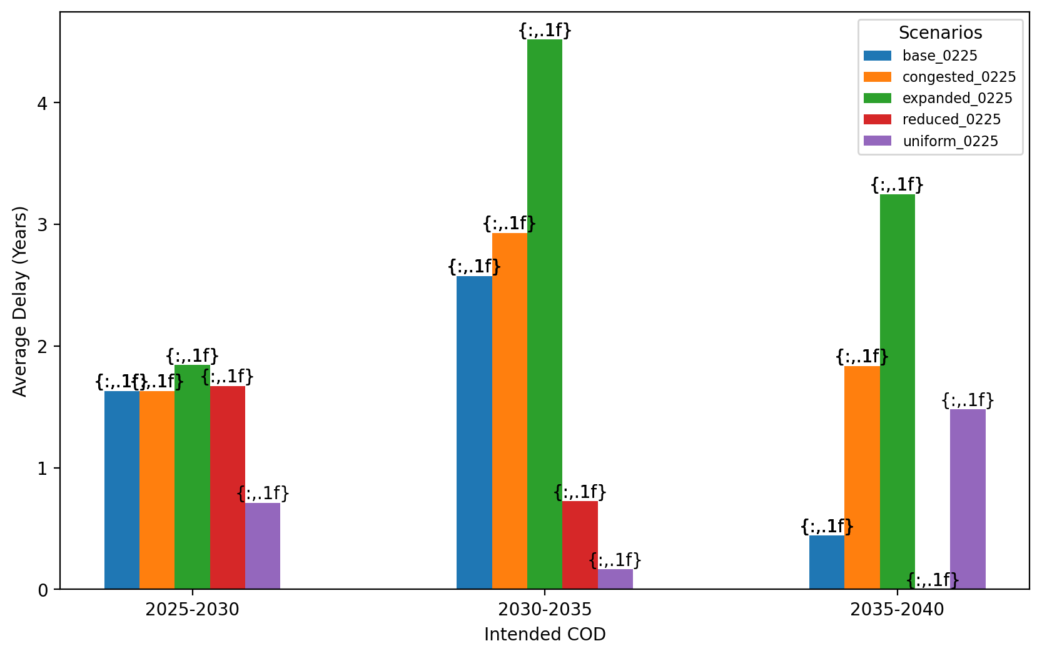
Average Delay Per Project by COD - Mid-Atlantic

Slide 46
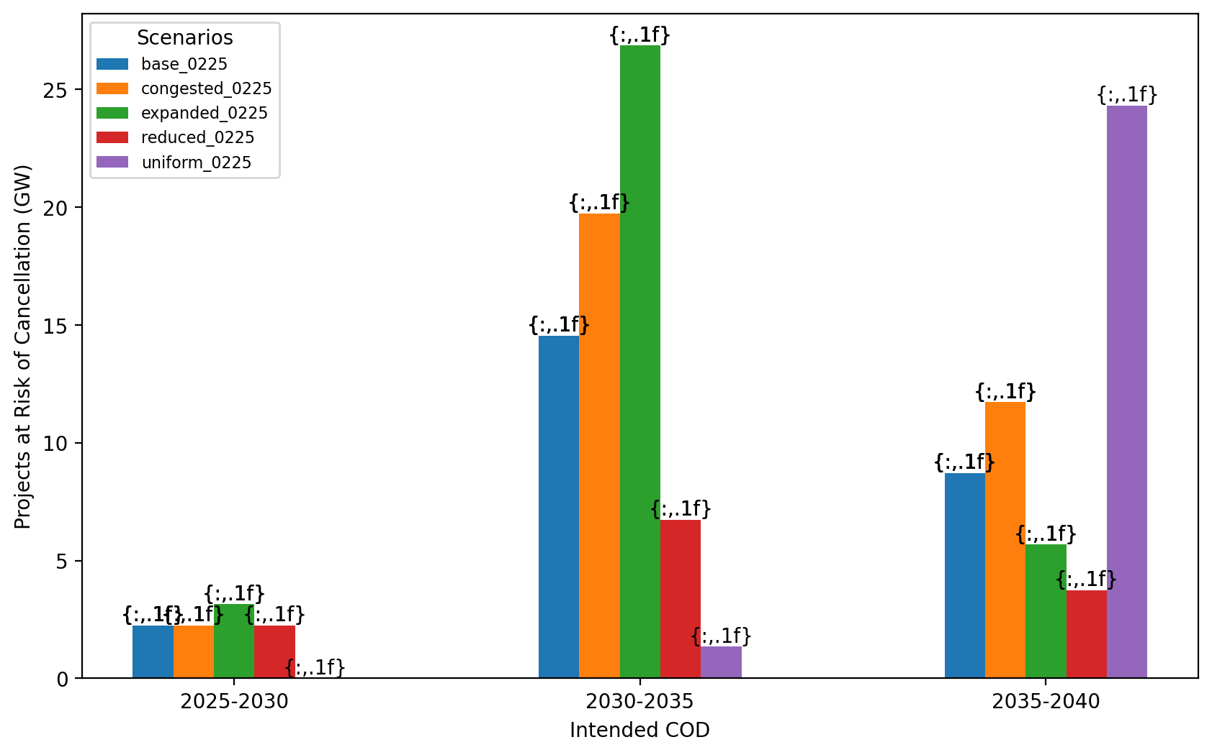
Total Capacity at Risk by COD - All Regions

Slide 47
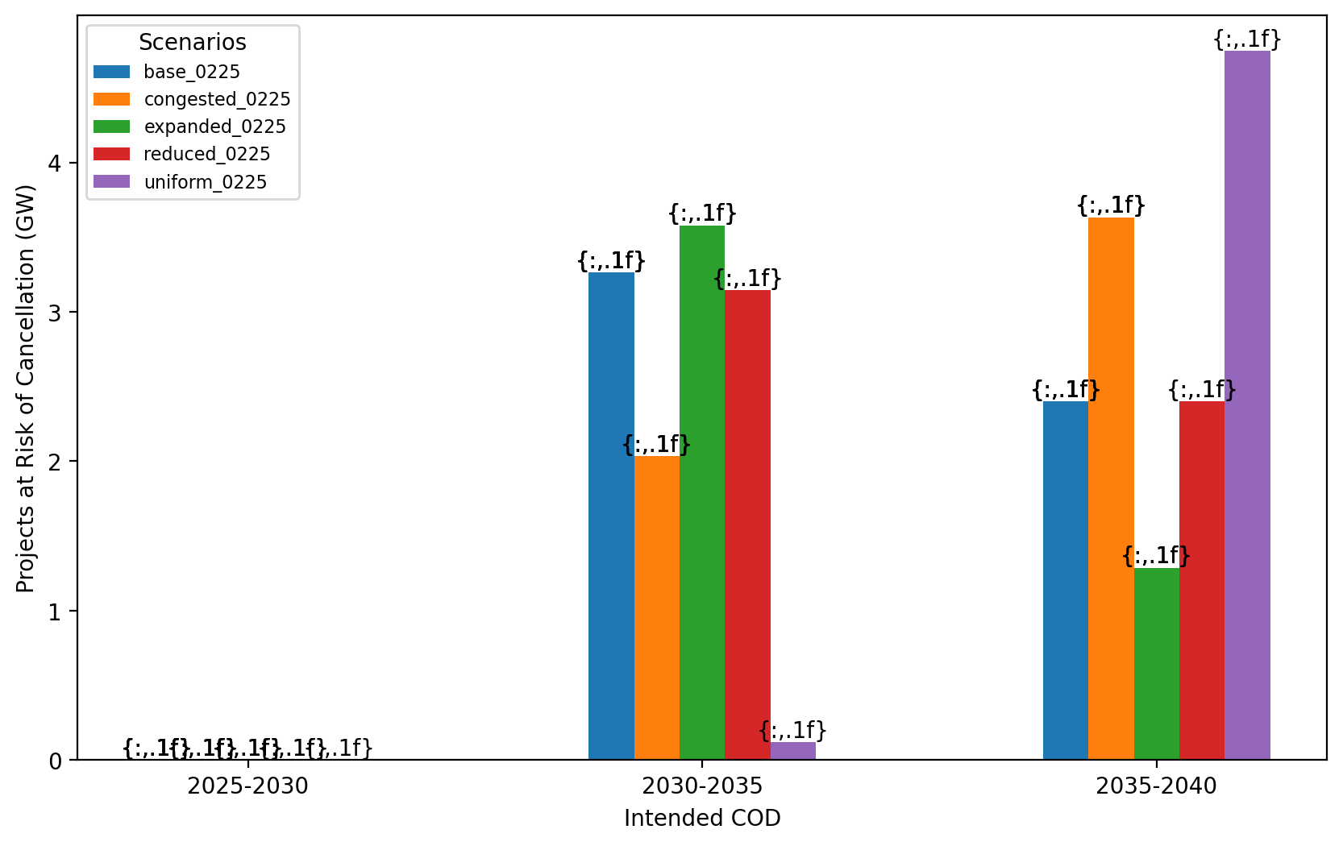
Total Capacity at Risk by COD - NE

Slide 48
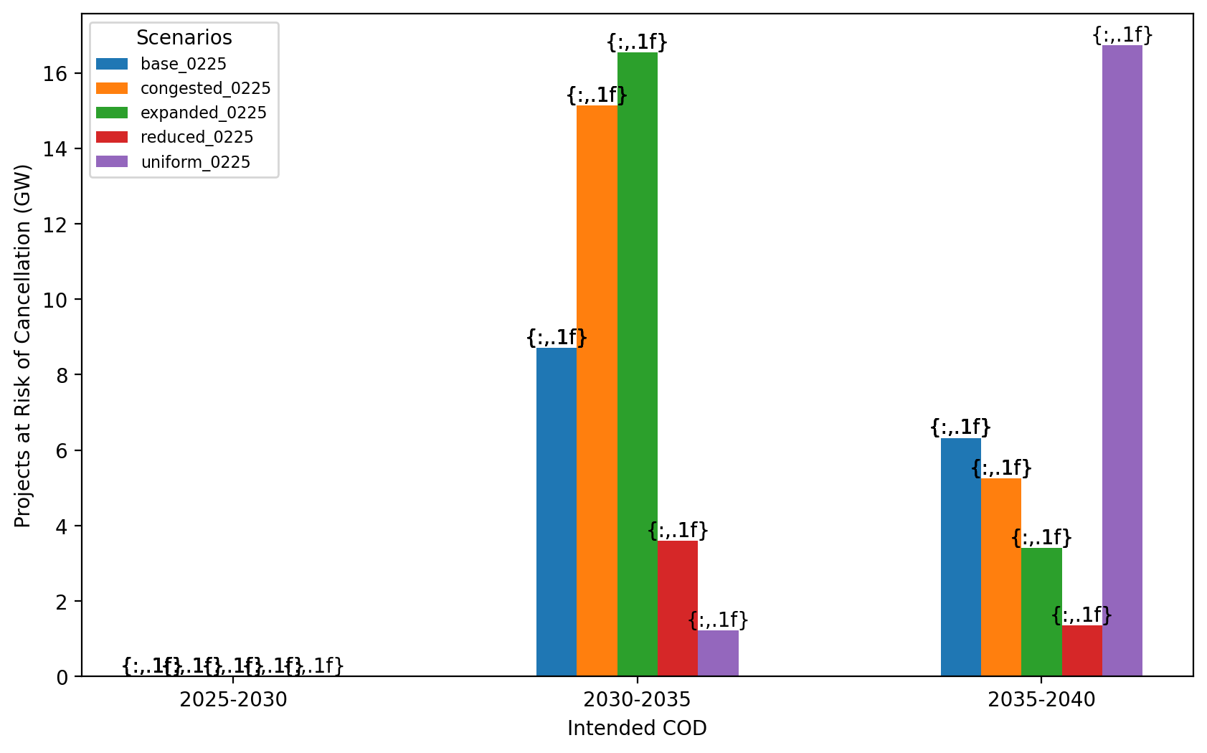
Total Capacity at Risk by COD - NY/NJ

Slide 49
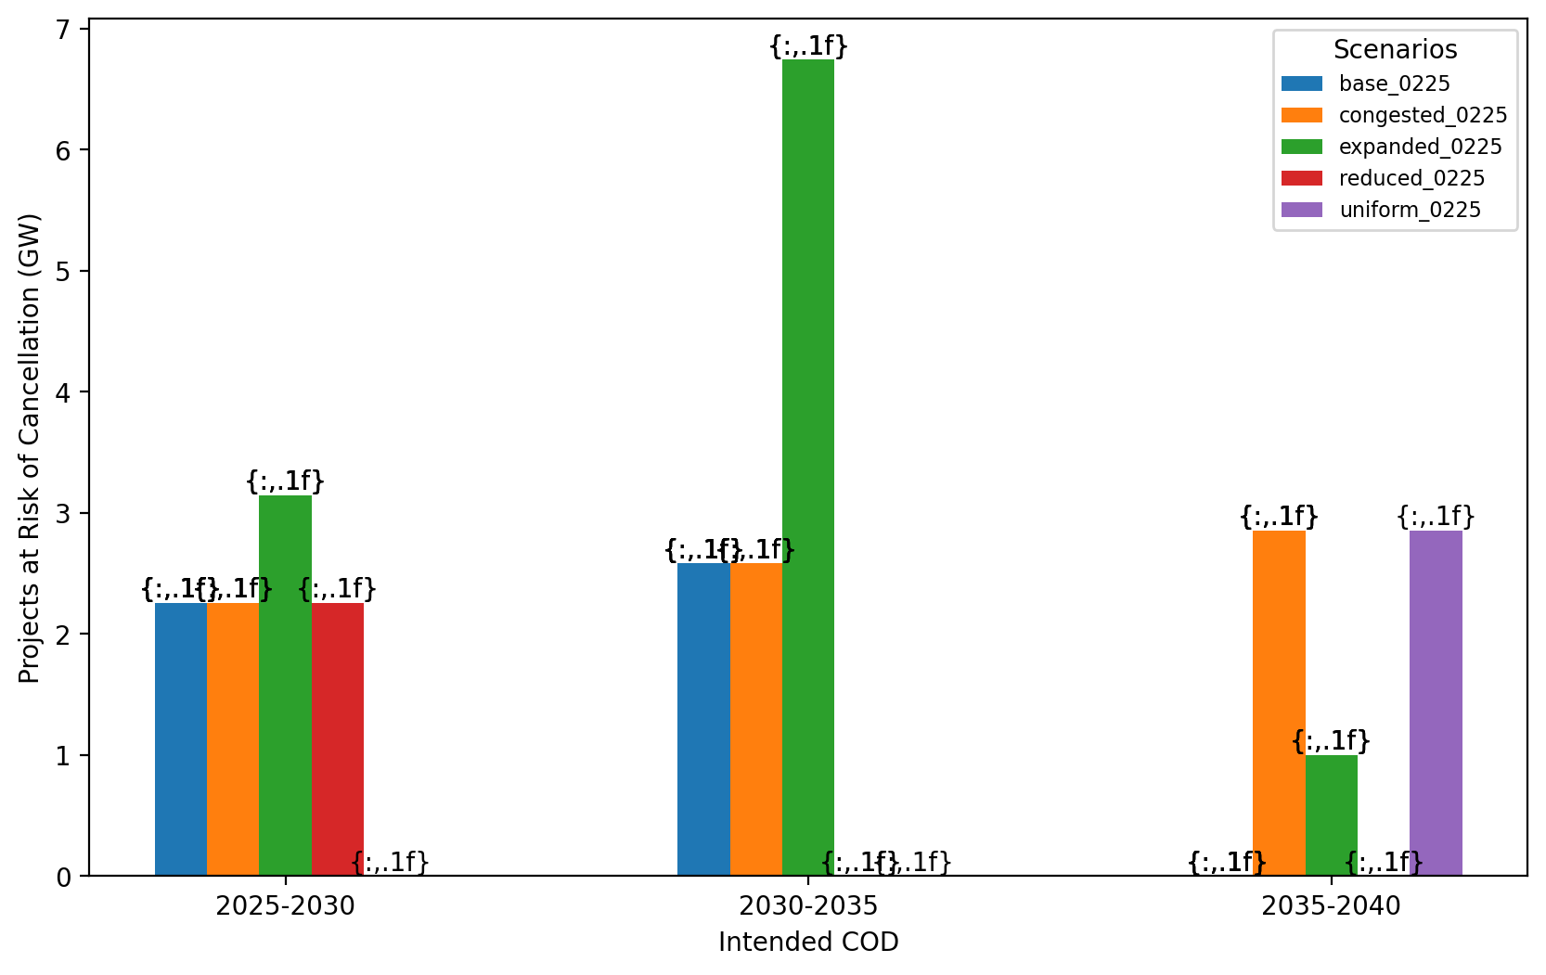
Total Capacity at Risk by COD - Mid-Atlantic

Slide 50
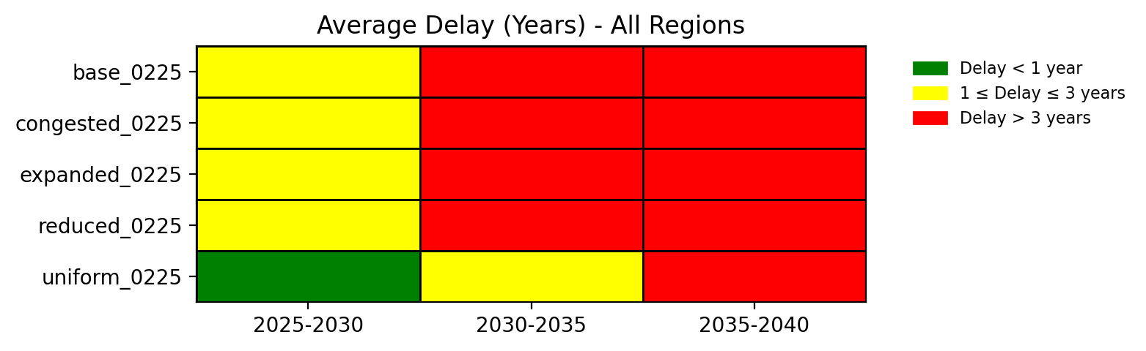
Average Delay Heat Map - All Regions

Slide 51
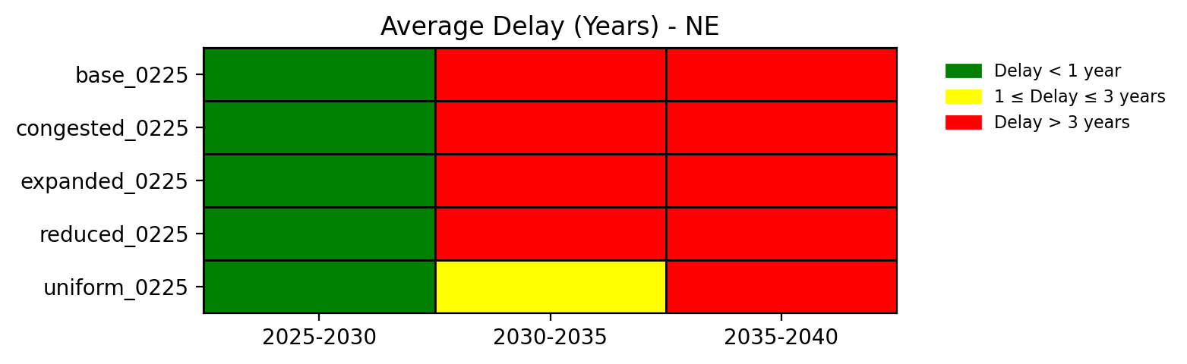
Average Delay Heat Map - NE

Slide 52
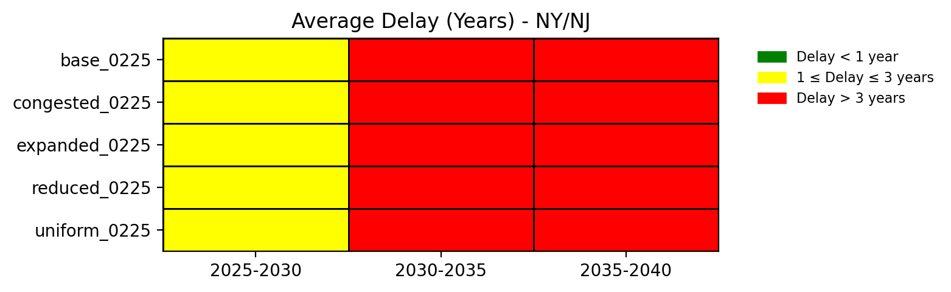
Average Delay Heat Map - NY/NJ

Slide 53
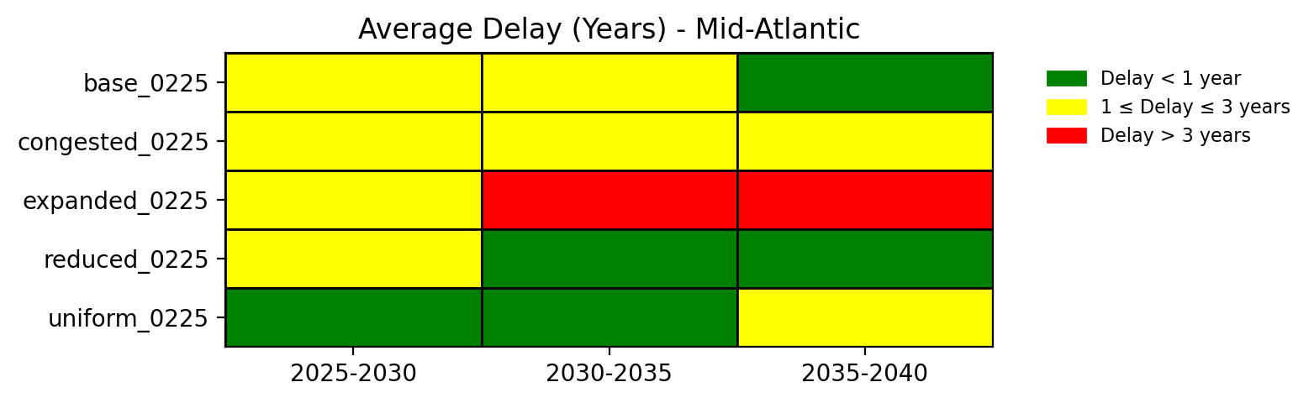
Average Delay Heat Map - Mid-Atlantic

