Slide 1
reduced_0225
No action with base pipeline

Slide 2
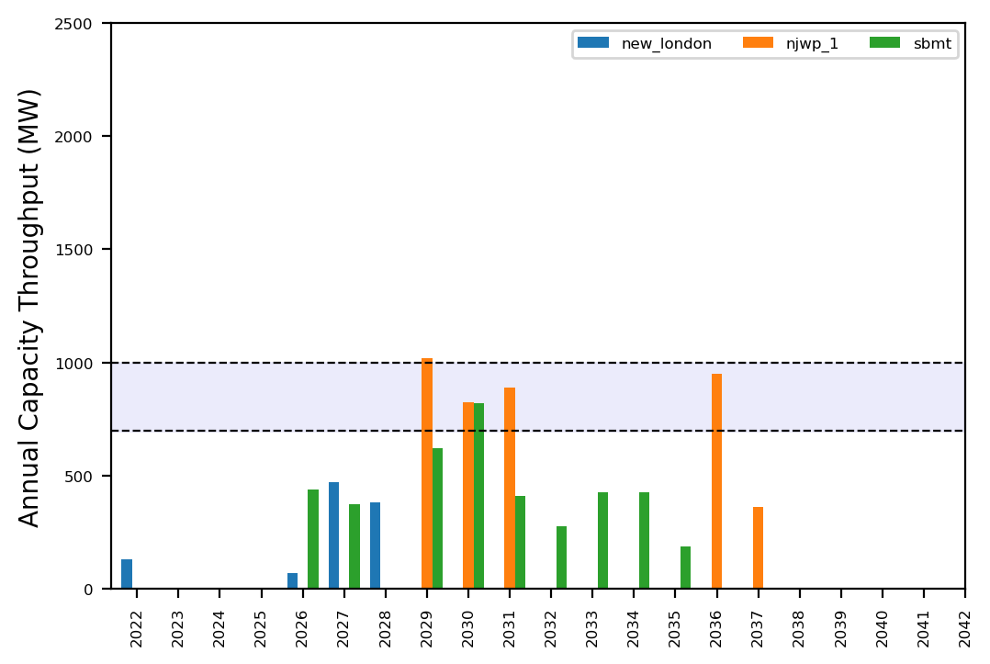
Port Throughput

Slide 3
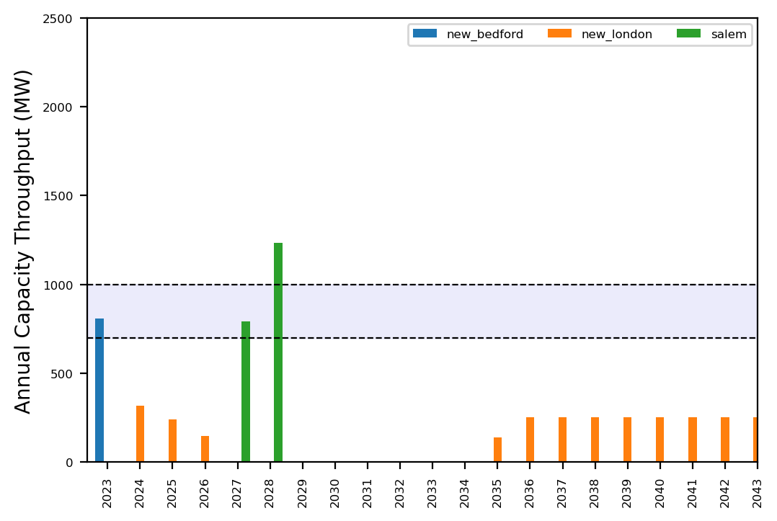
Port Throughput

Slide 4
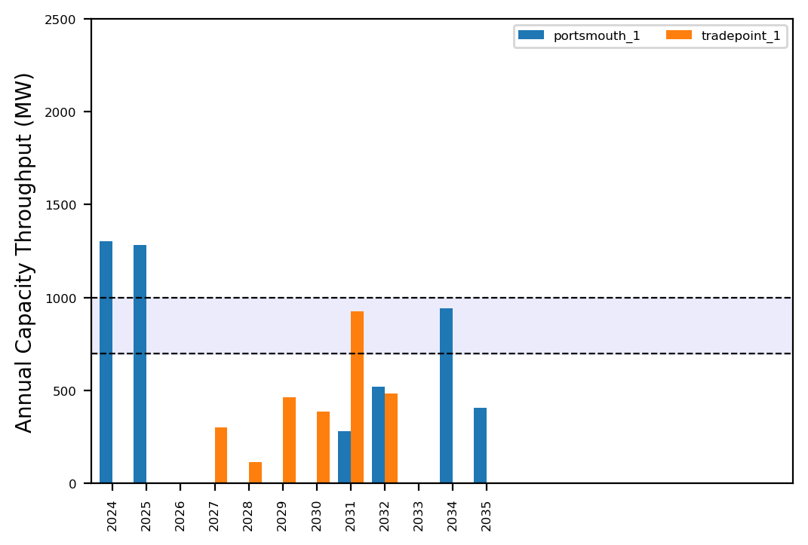
Port Throughput

Slide 5
reduced_0225_inf
No action with base pipeline

Slide 6
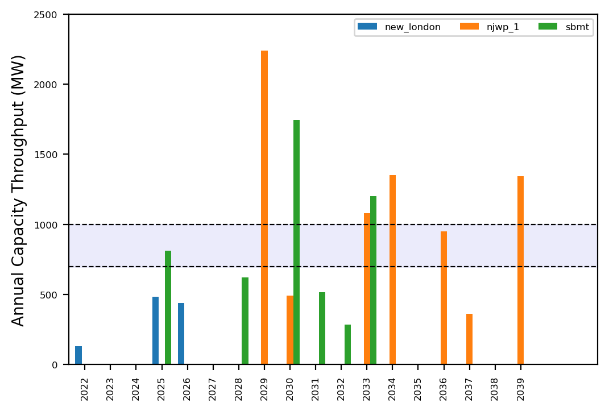
Port Throughput

Slide 7
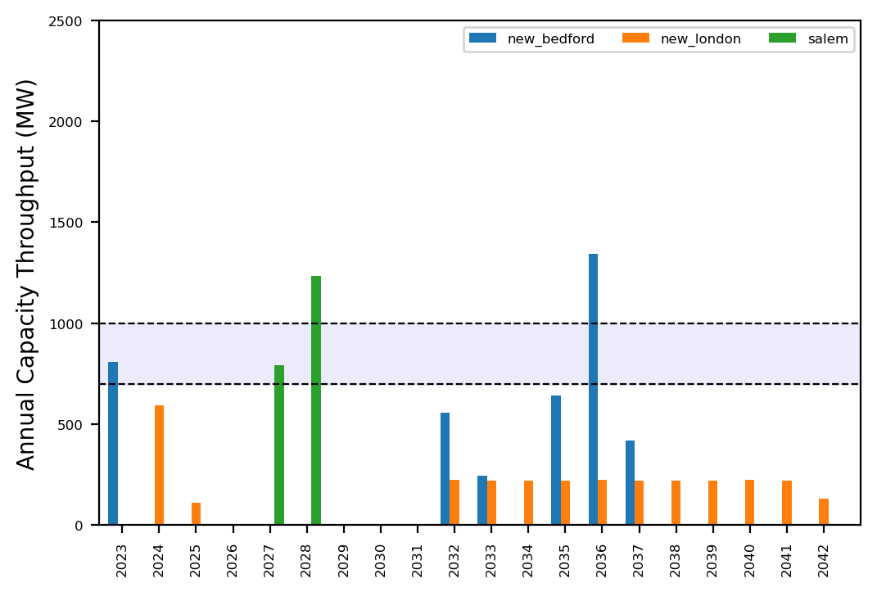
Port Throughput

Slide 8
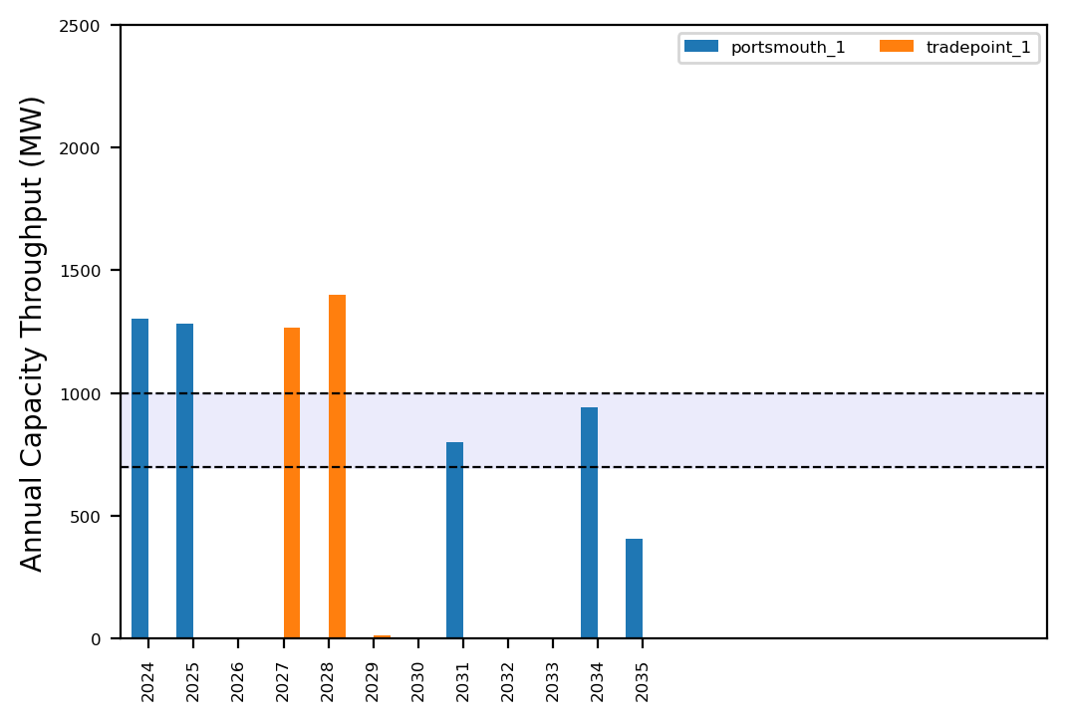
Port Throughput

Slide 9
Summary Plots
Plots comparing runs

Slide 10
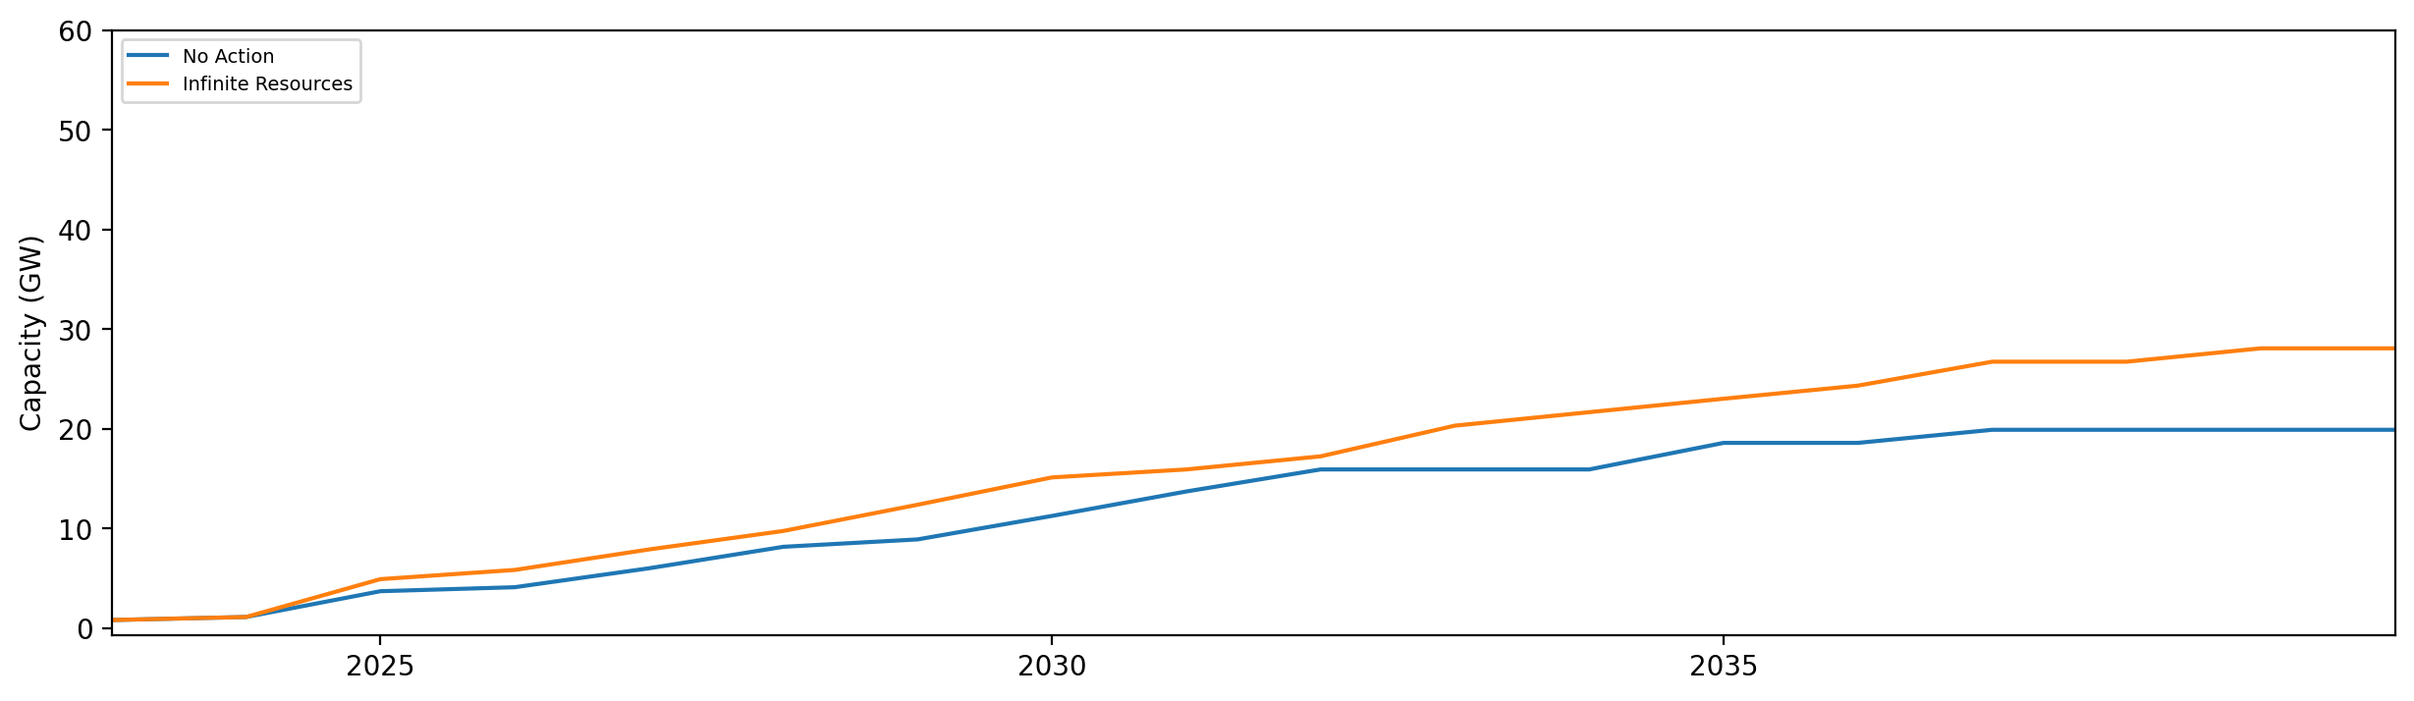
Installed Capacity

Slide 11
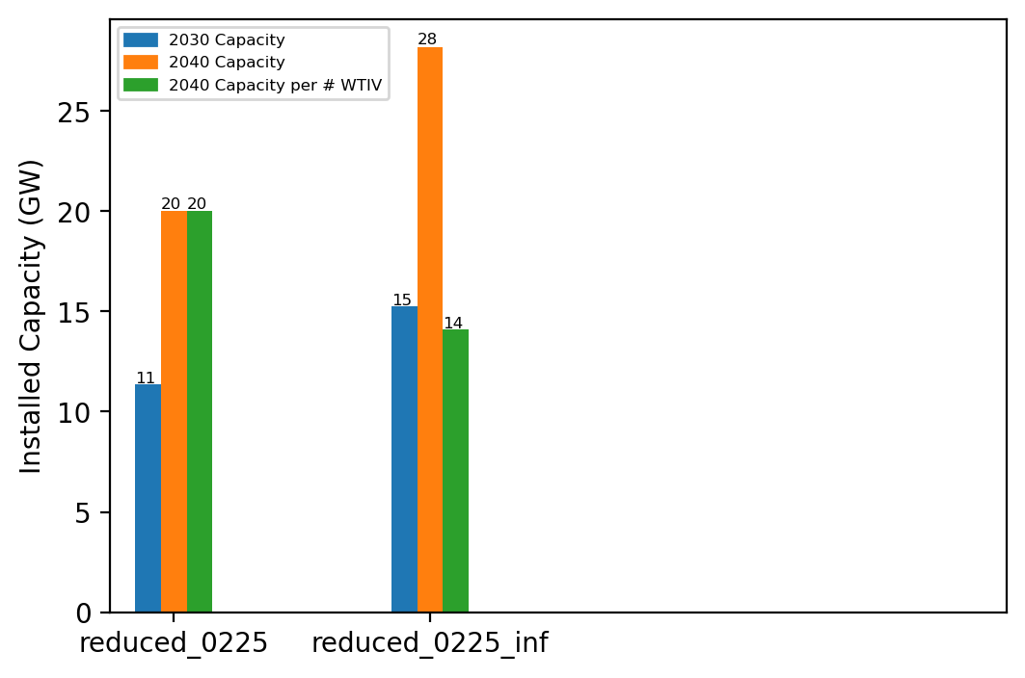
Summary Installed Cap

Slide 12
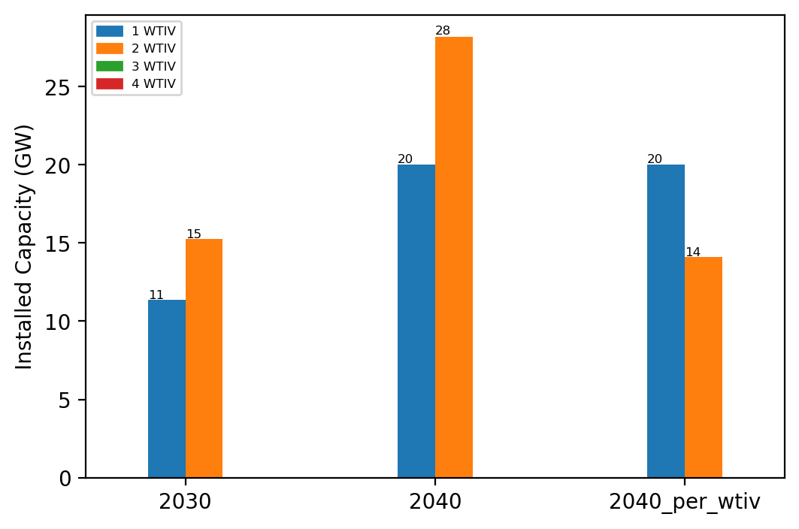
Summary Installed Cap T

Slide 13
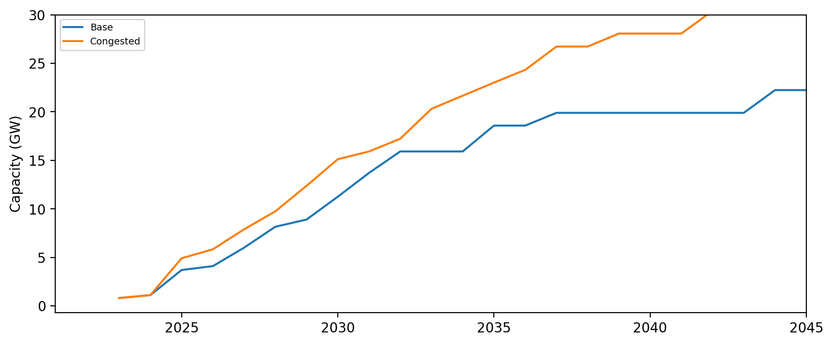
Installed Capacity - All Regions

Slide 14
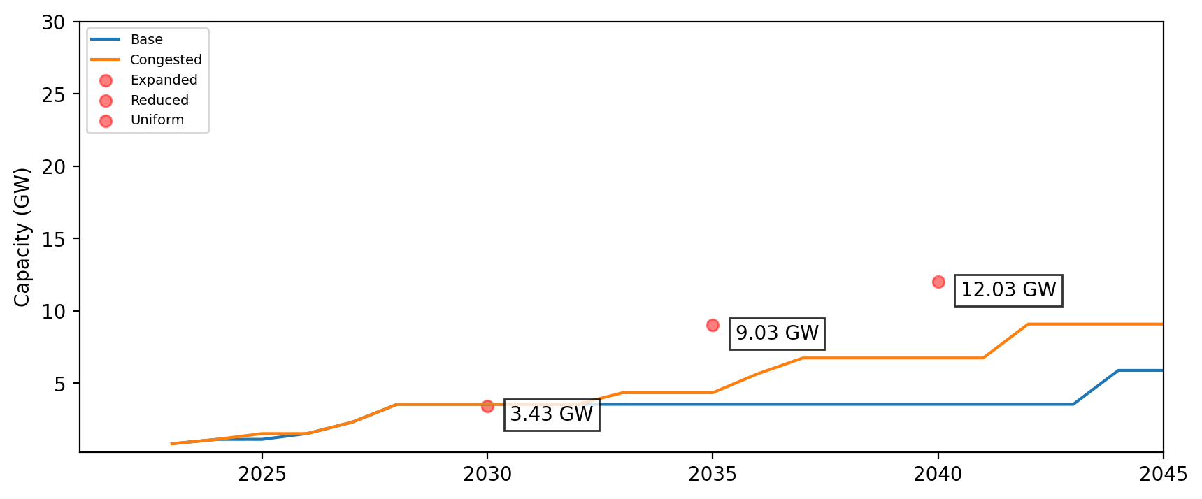
Installed Capacity - NE

Slide 15
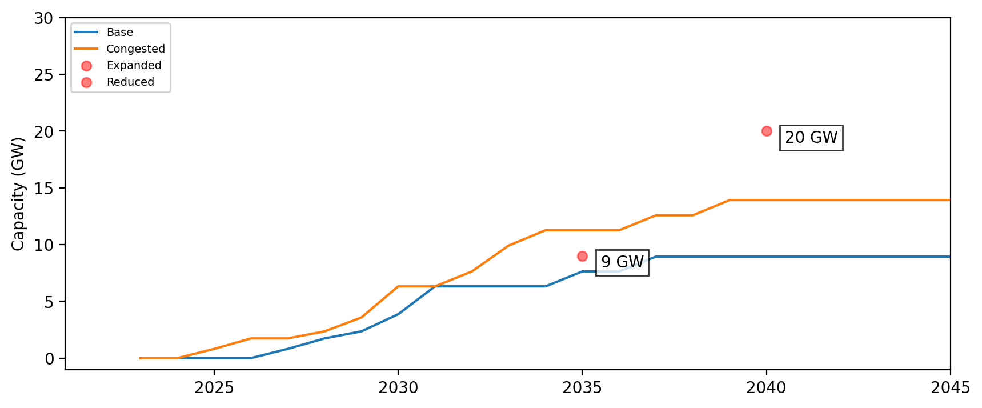
Installed Capacity - NY/NJ

Slide 16
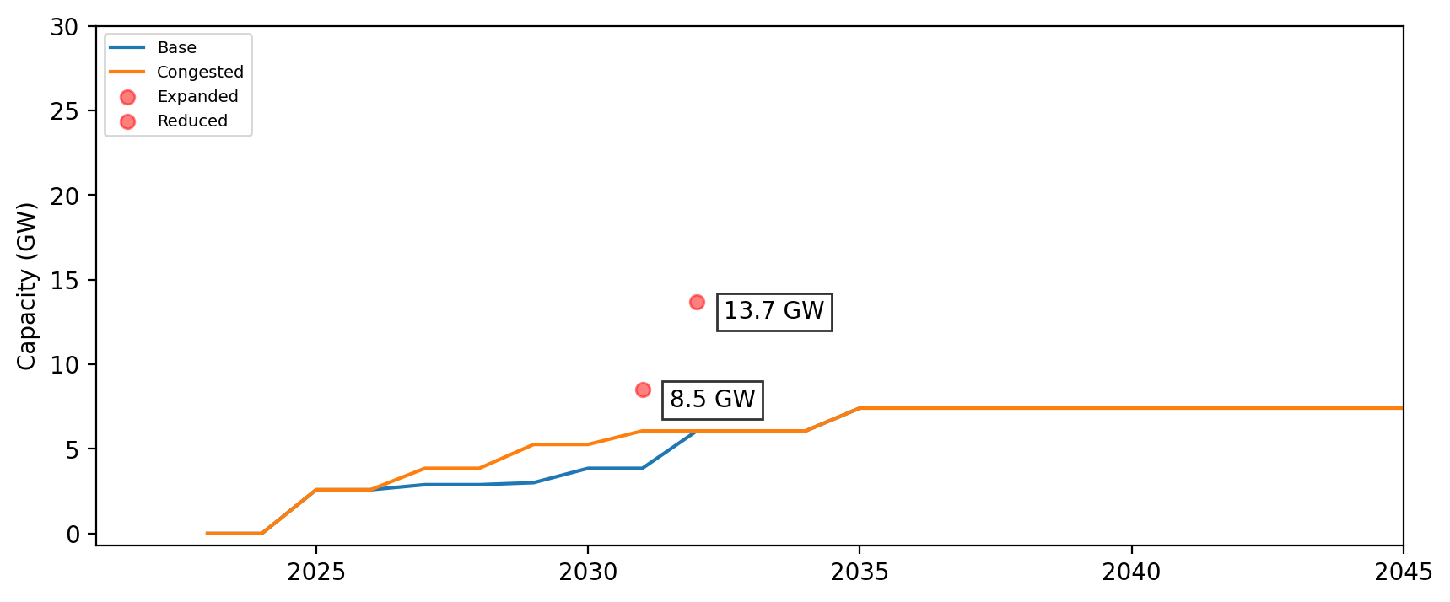
Installed Capacity - Central Atlantic

Slide 17
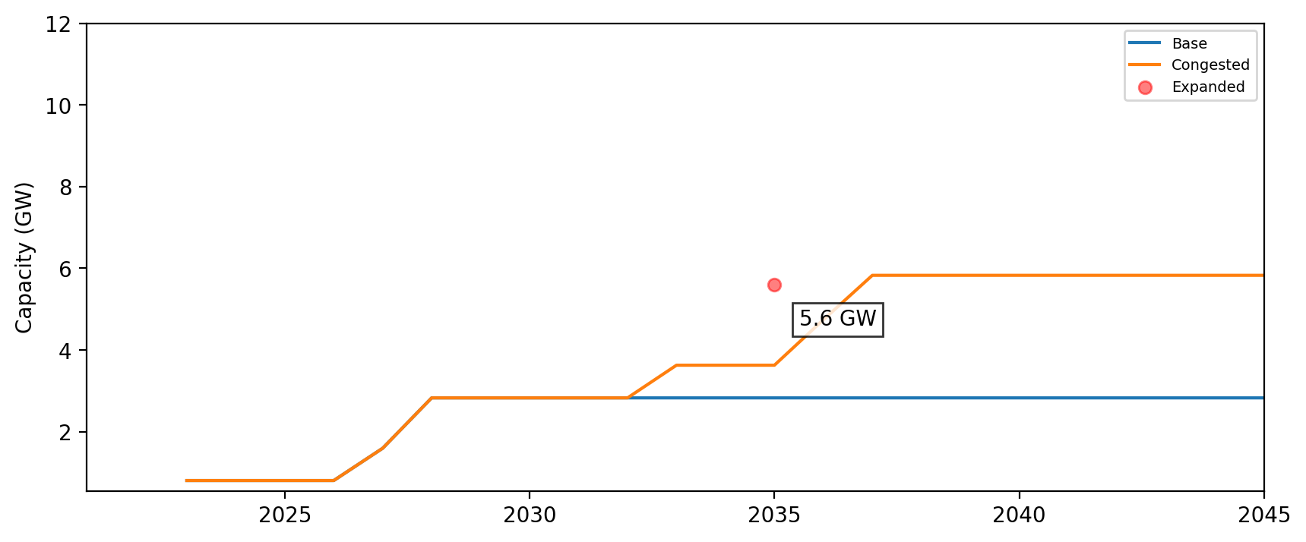
Cumulative Installed Capacity - MA

Slide 18
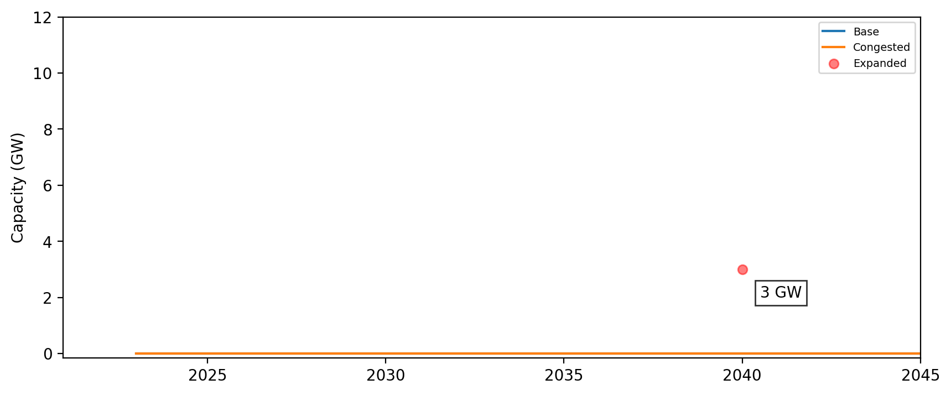
Cumulative Installed Capacity - ME

Slide 19
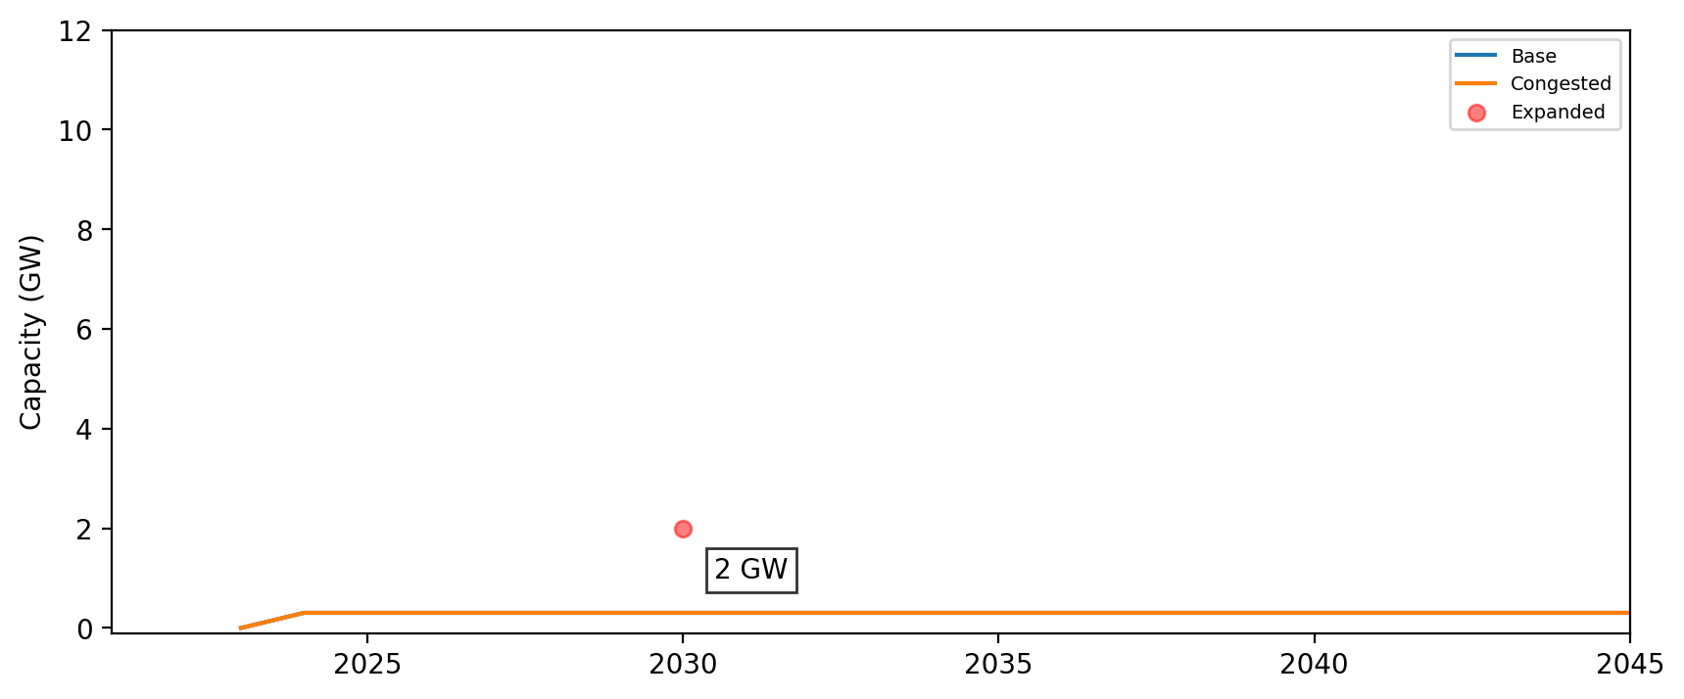
Cumulative Installed Capacity - CT

Slide 20
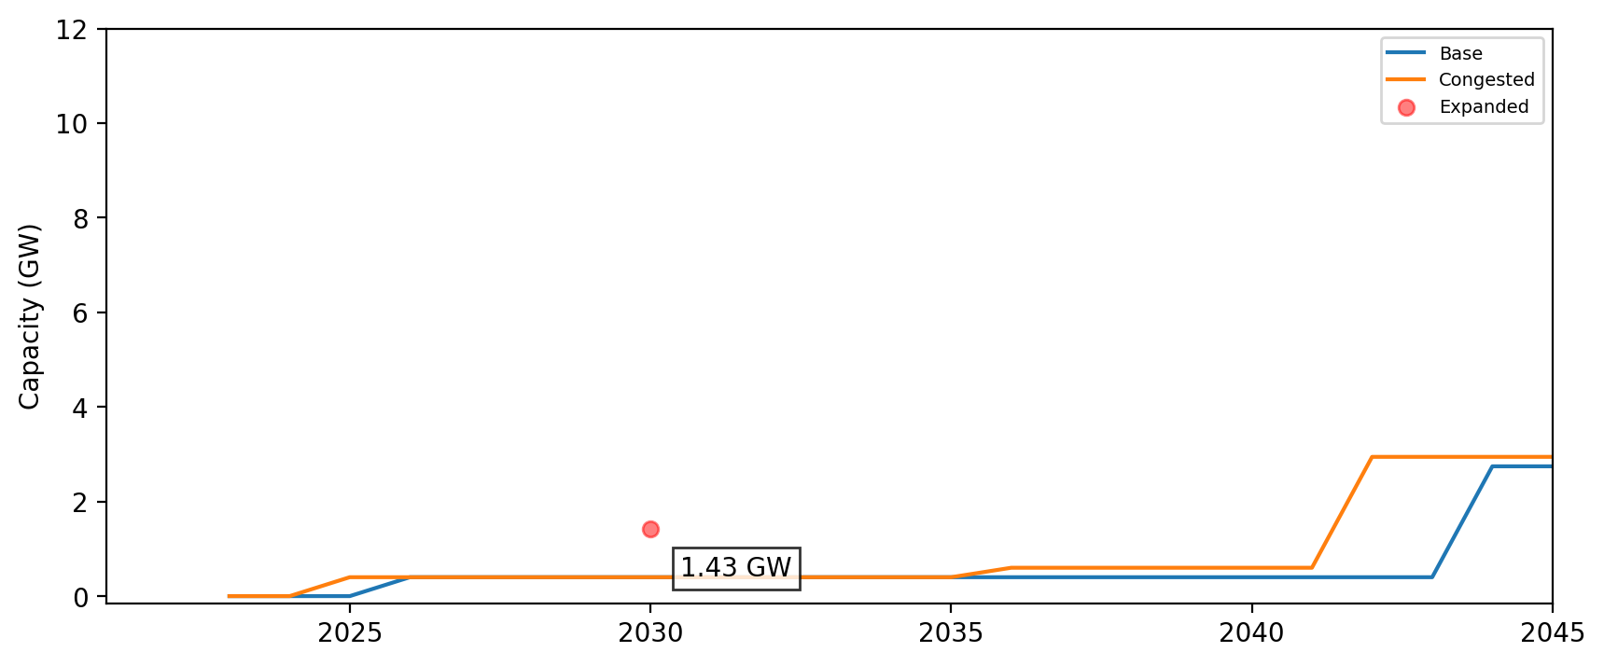
Cumulative Installed Capacity - RI

Slide 21
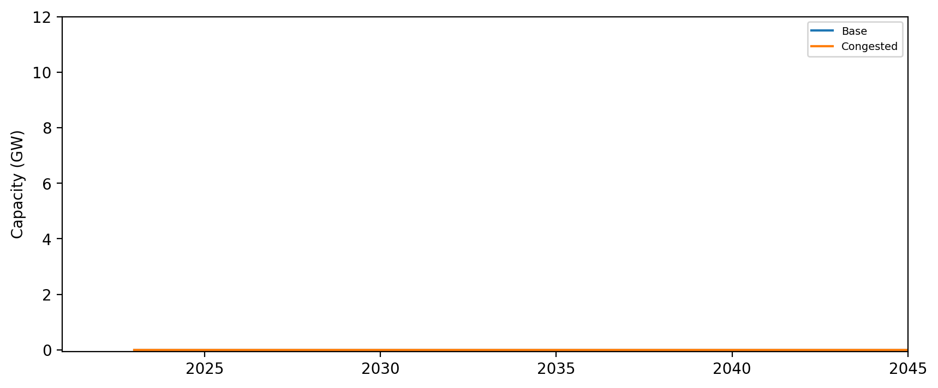
Cumulative Installed Capacity - NH

Slide 22
Cumulative Installed Capacity - RI/CT

Slide 23
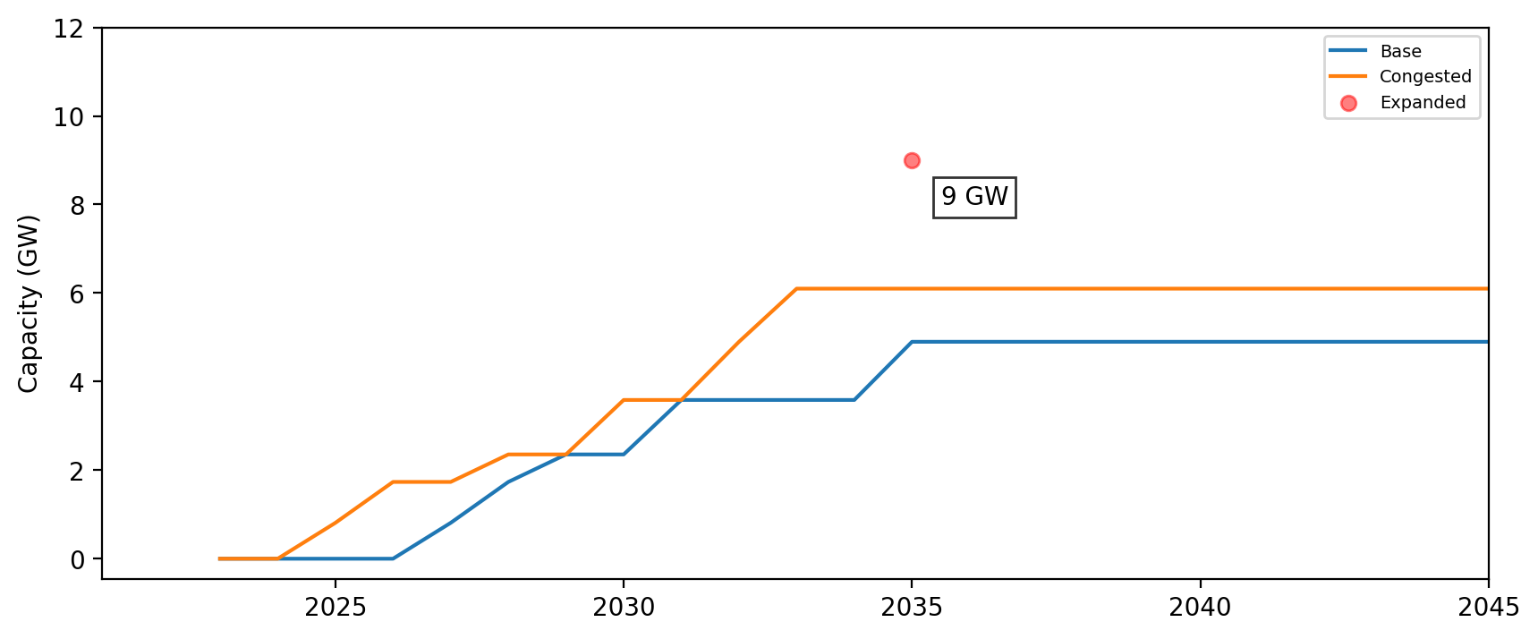
Cumulative Installed Capacity - NY

Slide 24
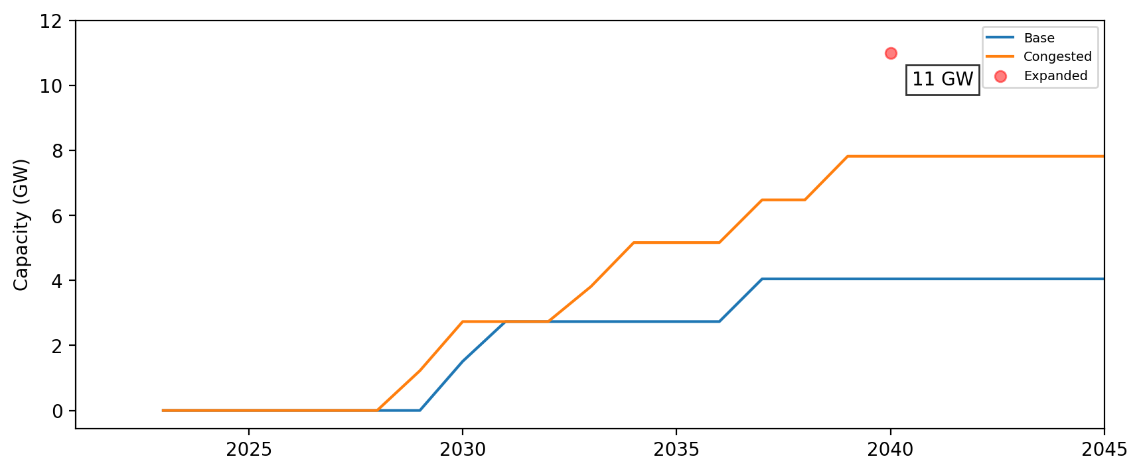
Cumulative Installed Capacity - NJ

Slide 25
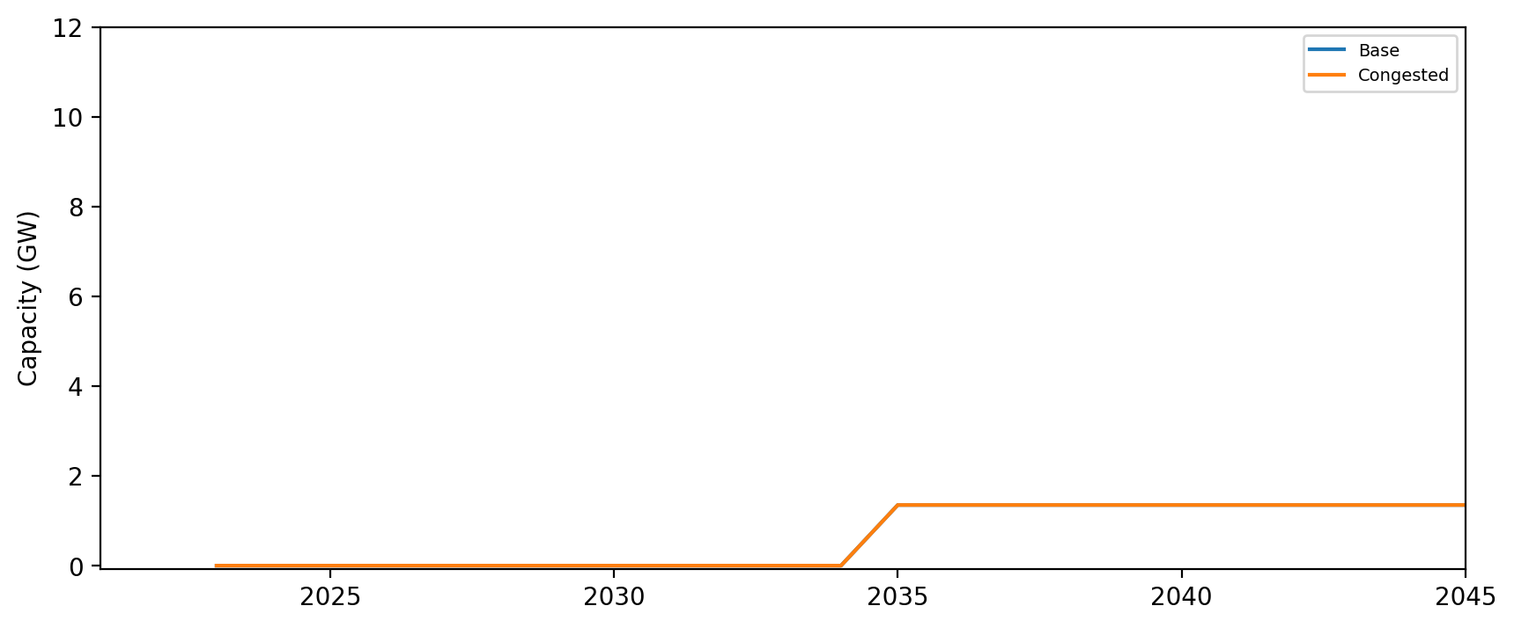
Cumulative Installed Capacity - NC

Slide 26
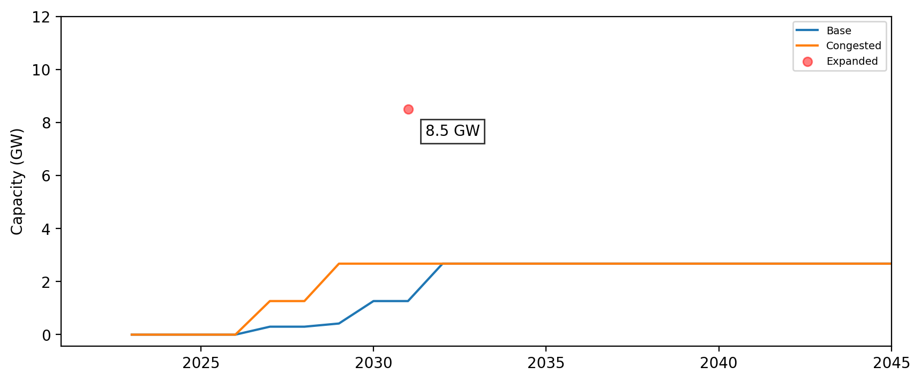
Cumulative Installed Capacity - MD

Slide 27
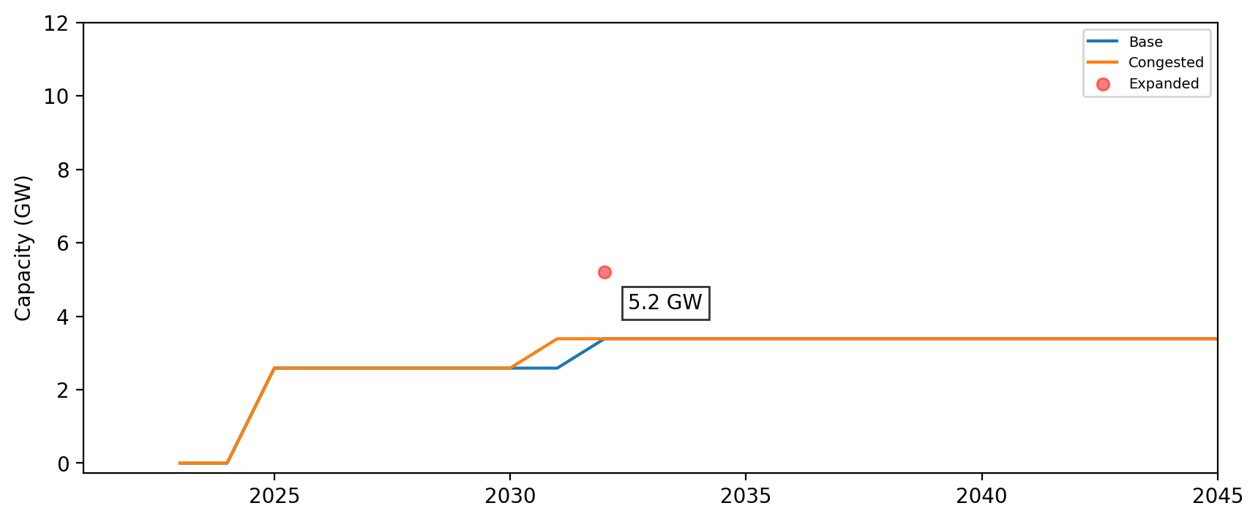
Cumulative Installed Capacity - VA

Slide 28
Cumulative Installed Capacity - DE

Slide 29
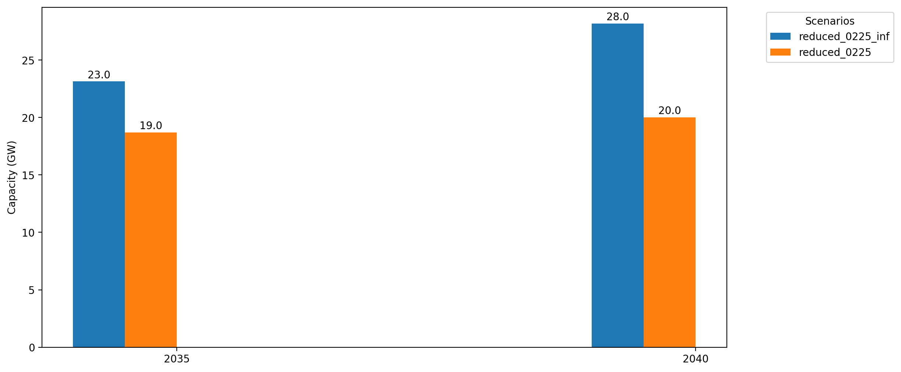
Cumulative Capacity by 2035 and 2040

Slide 30
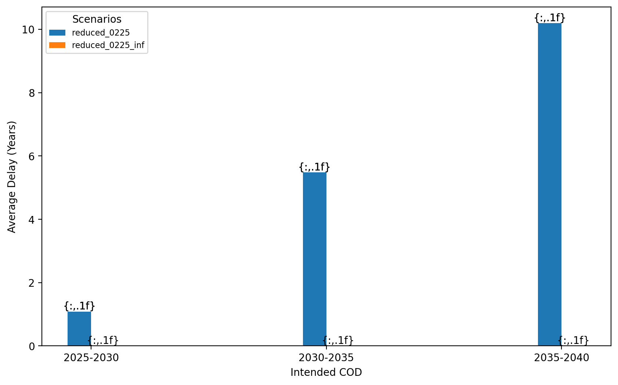
Average Delay Per Project by COD - All Regions

Slide 31
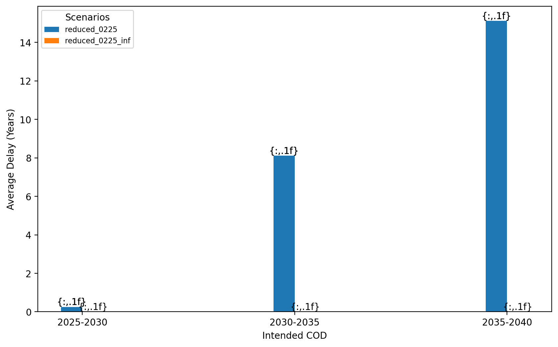
Average Delay Per Project by COD - NE

Slide 32
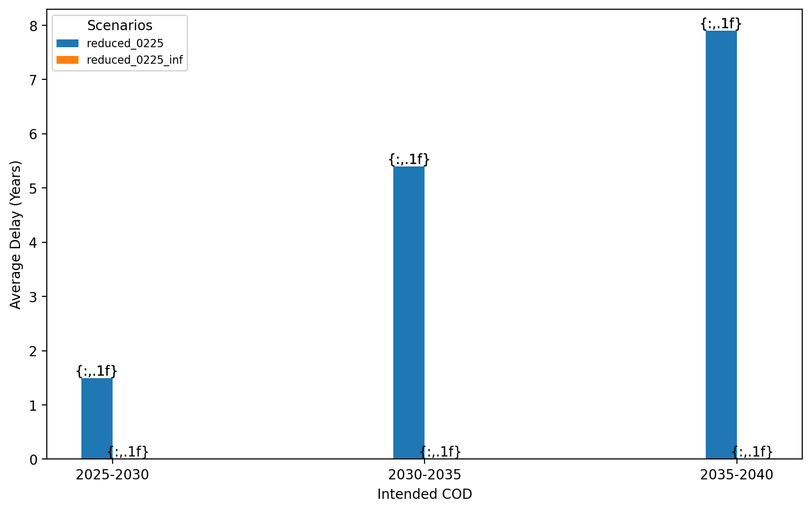
Average Delay Per Project by COD - NY/NJ

Slide 33
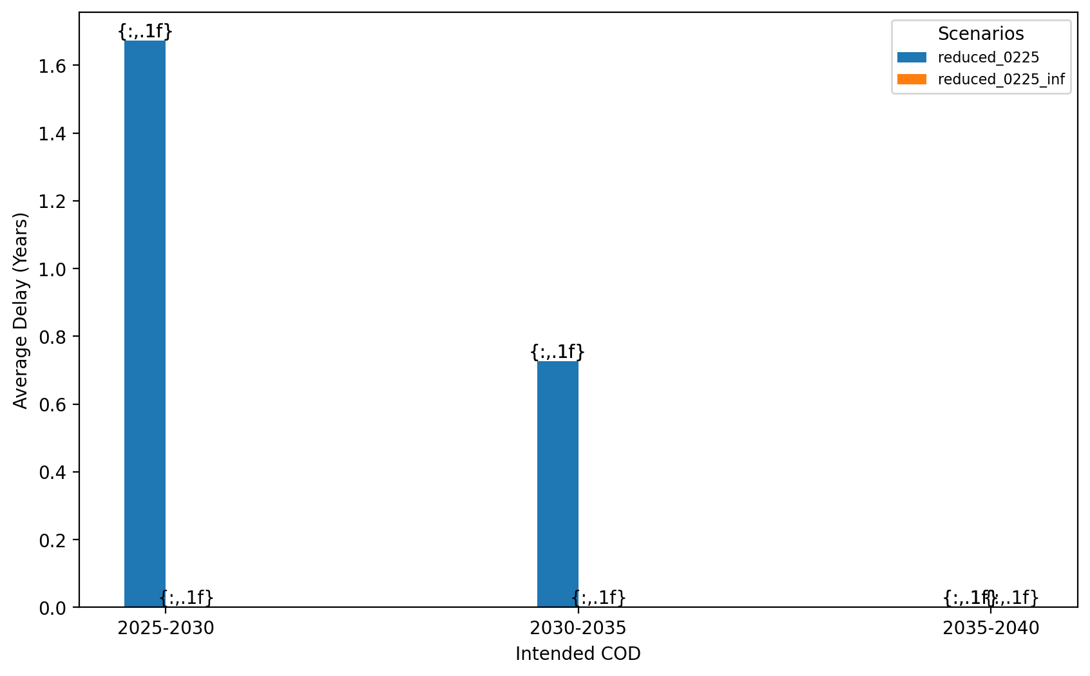
Average Delay Per Project by COD - Mid-Atlantic

Slide 34
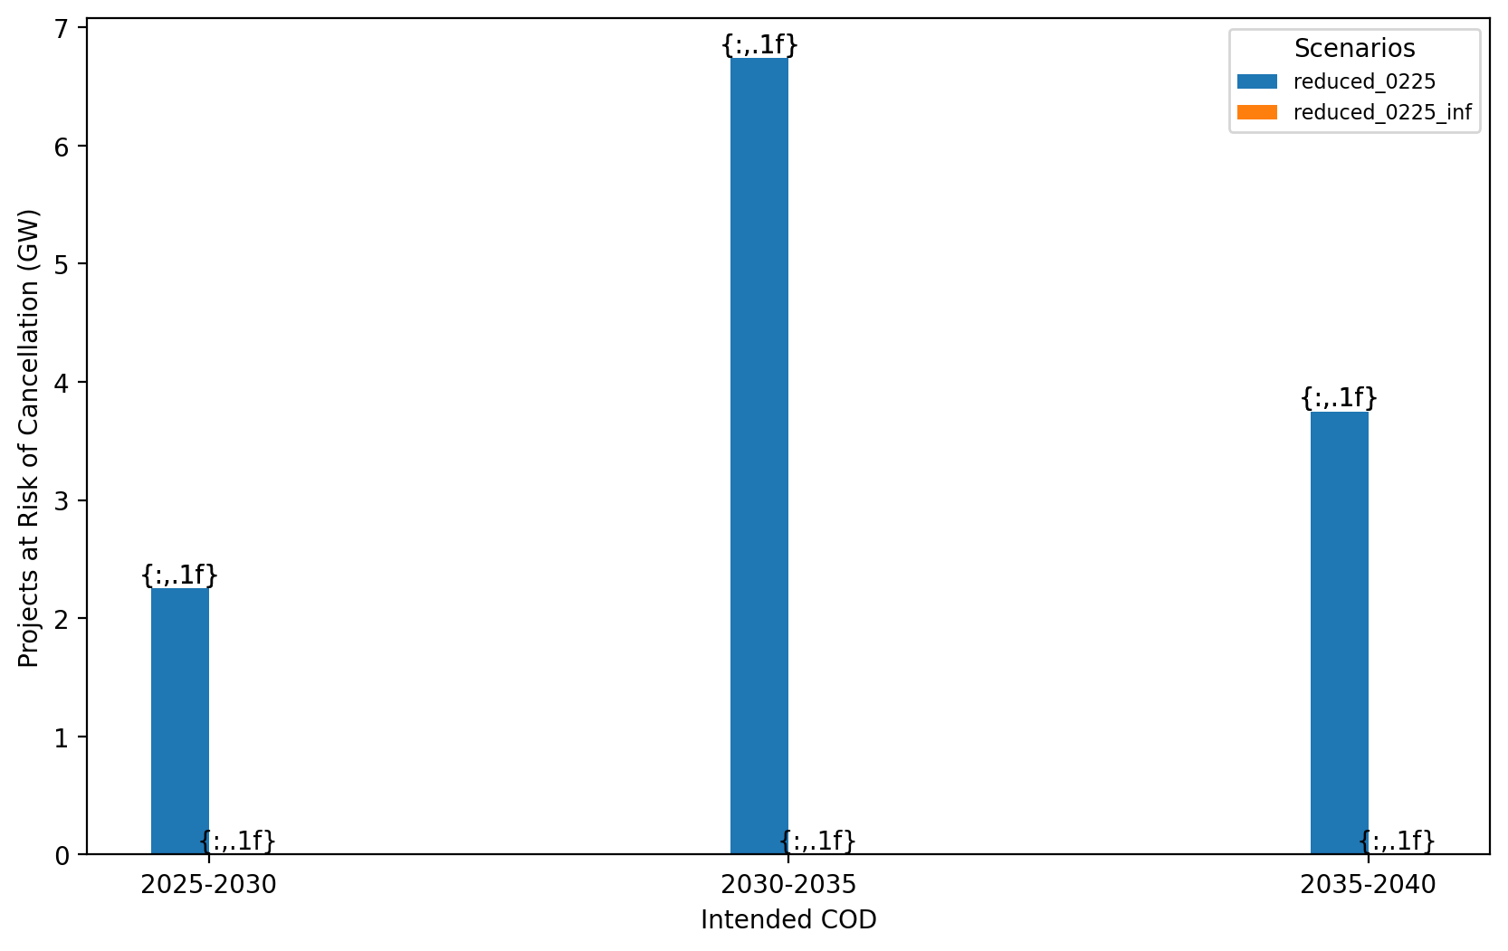
Total Capacity at Risk by COD - All Regions

Slide 35
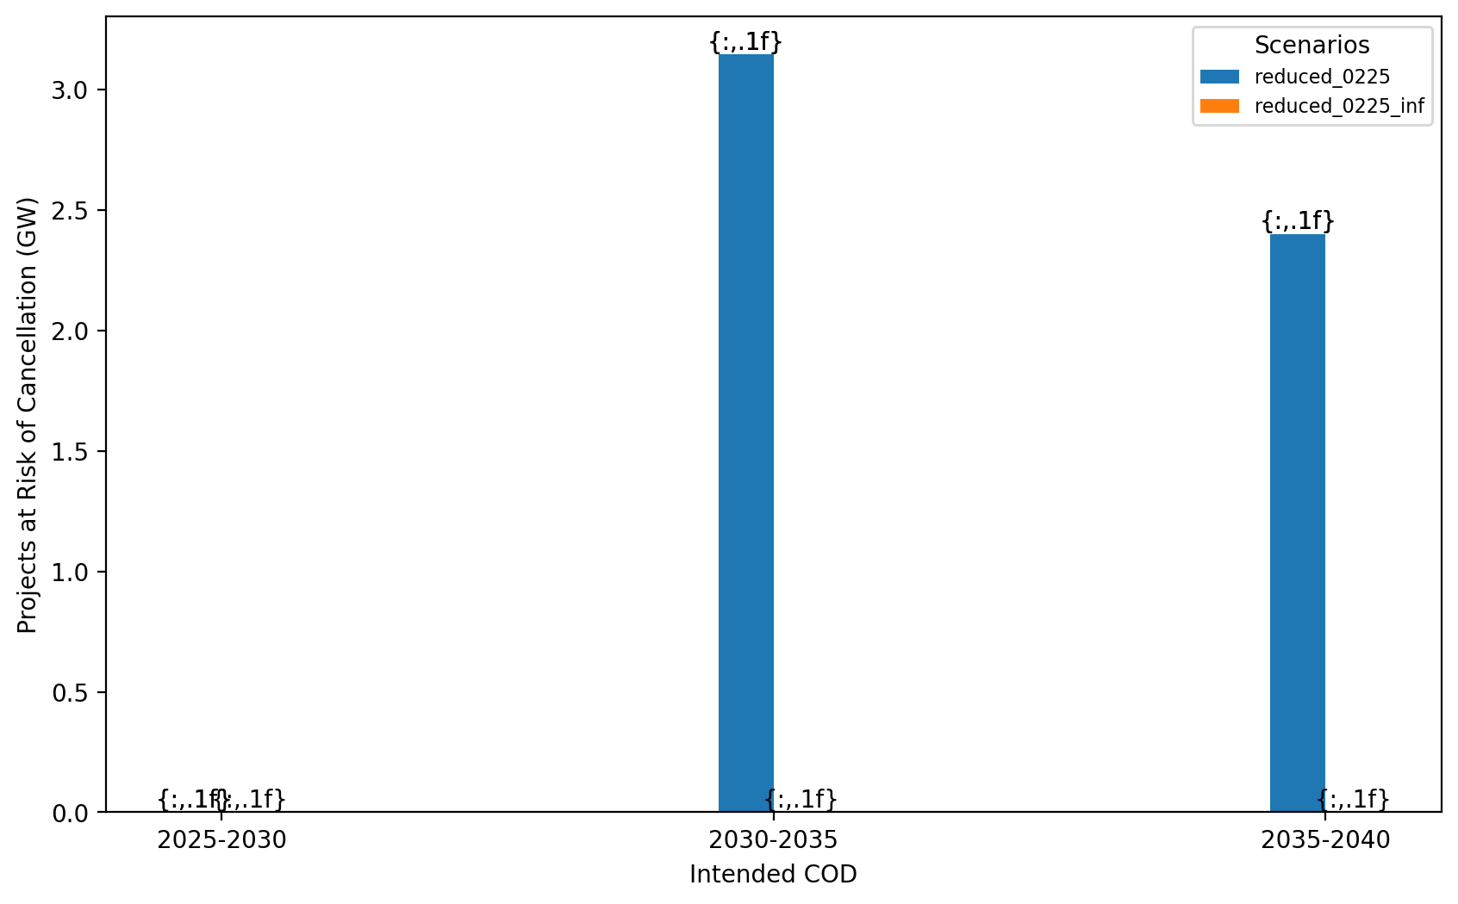
Total Capacity at Risk by COD - NE

Slide 36
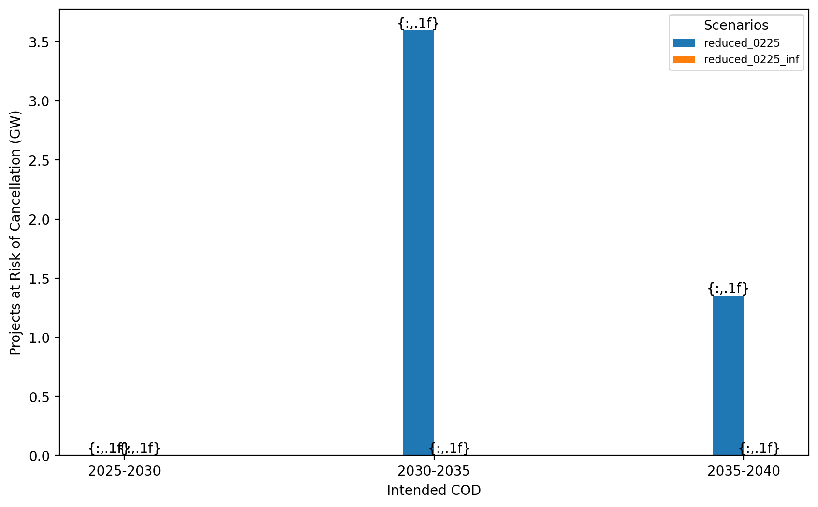
Total Capacity at Risk by COD - NY/NJ

Slide 37
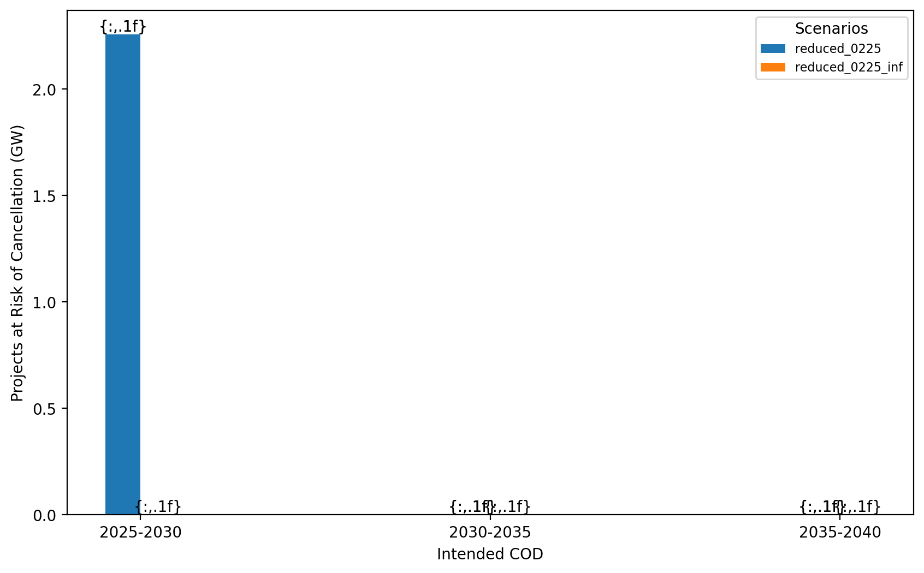
Total Capacity at Risk by COD - Mid-Atlantic

Slide 38
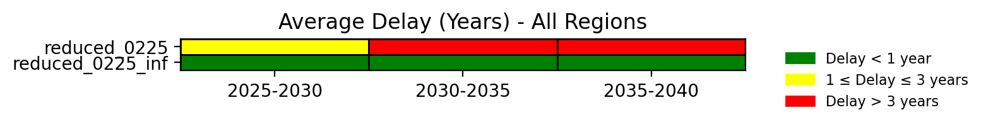
Average Delay Heat Map - All Regions

Slide 39
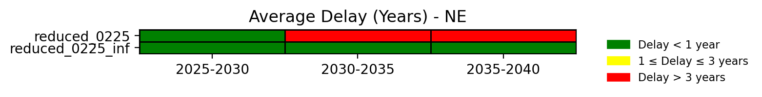
Average Delay Heat Map - NE

Slide 40
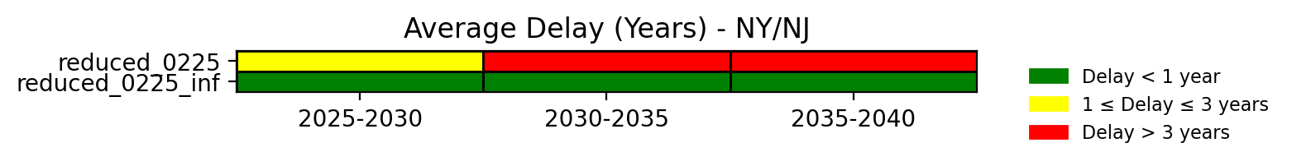
Average Delay Heat Map - NY/NJ

Slide 41
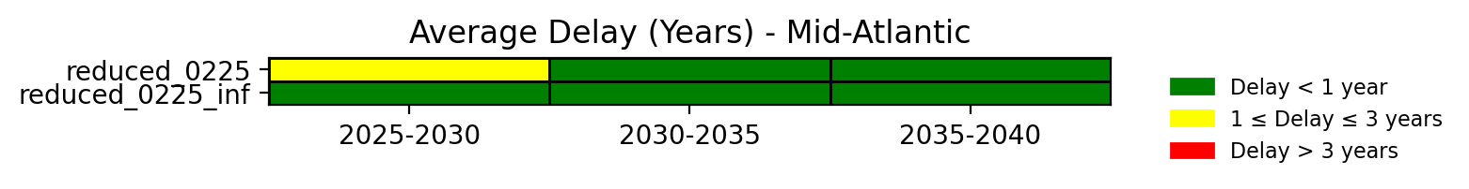
Average Delay Heat Map - Mid-Atlantic

