Slide 1
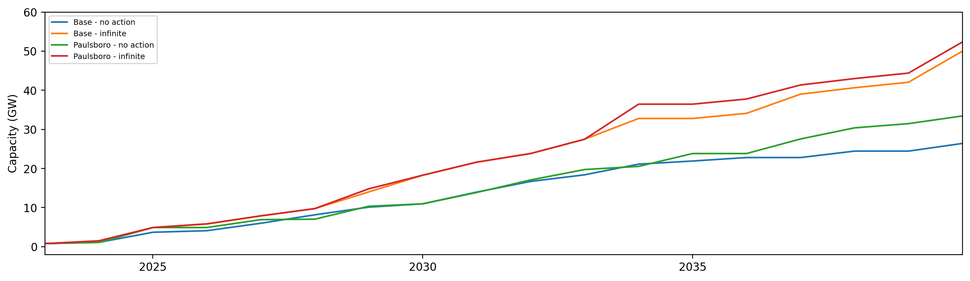
Installed Capacity

Slide 2
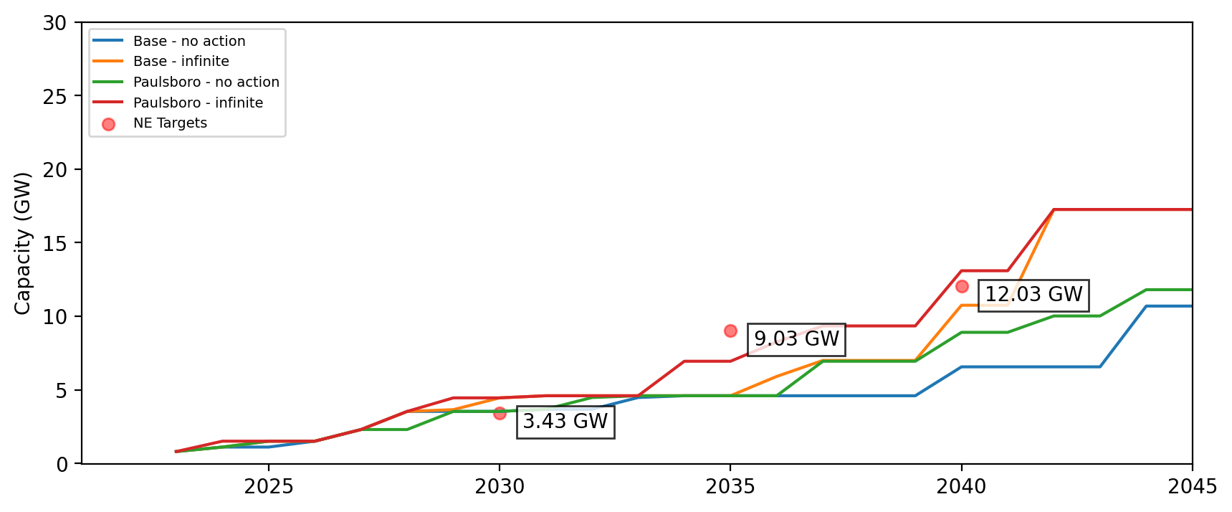
Installed Capacity - NE

Slide 3
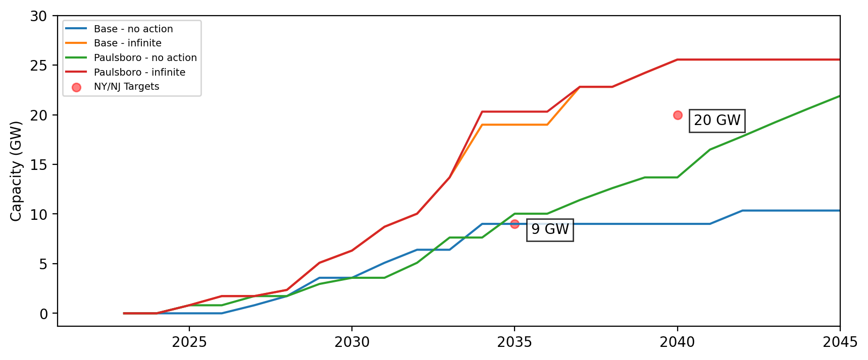
Installed Capacity - NY/NJ

Slide 4
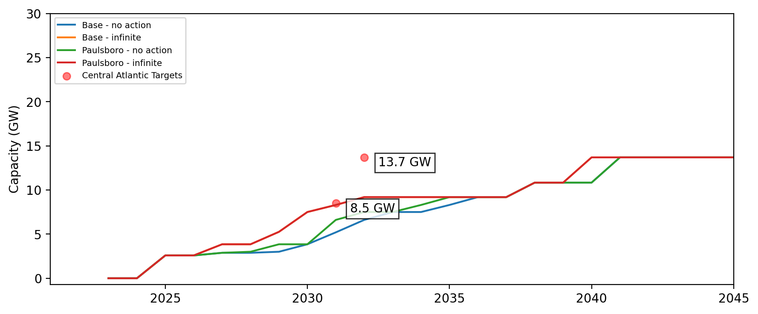
Installed Capacity - Central Atlantic

Slide 5
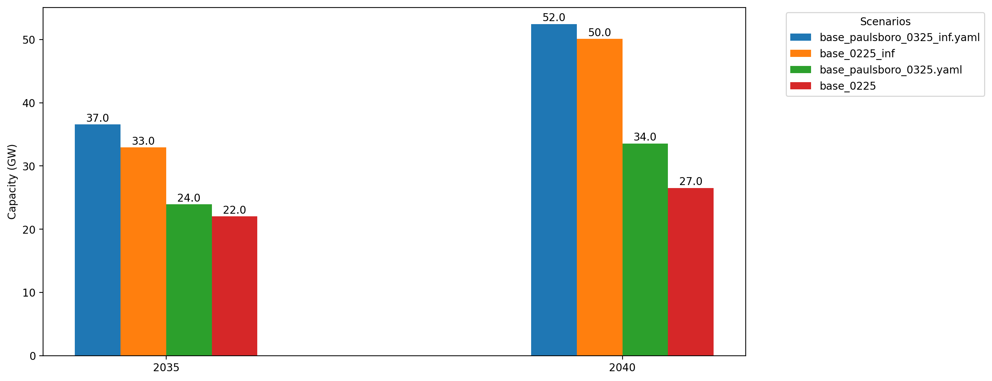
Cumulative Capacity by 2035 and 2040

Slide 6
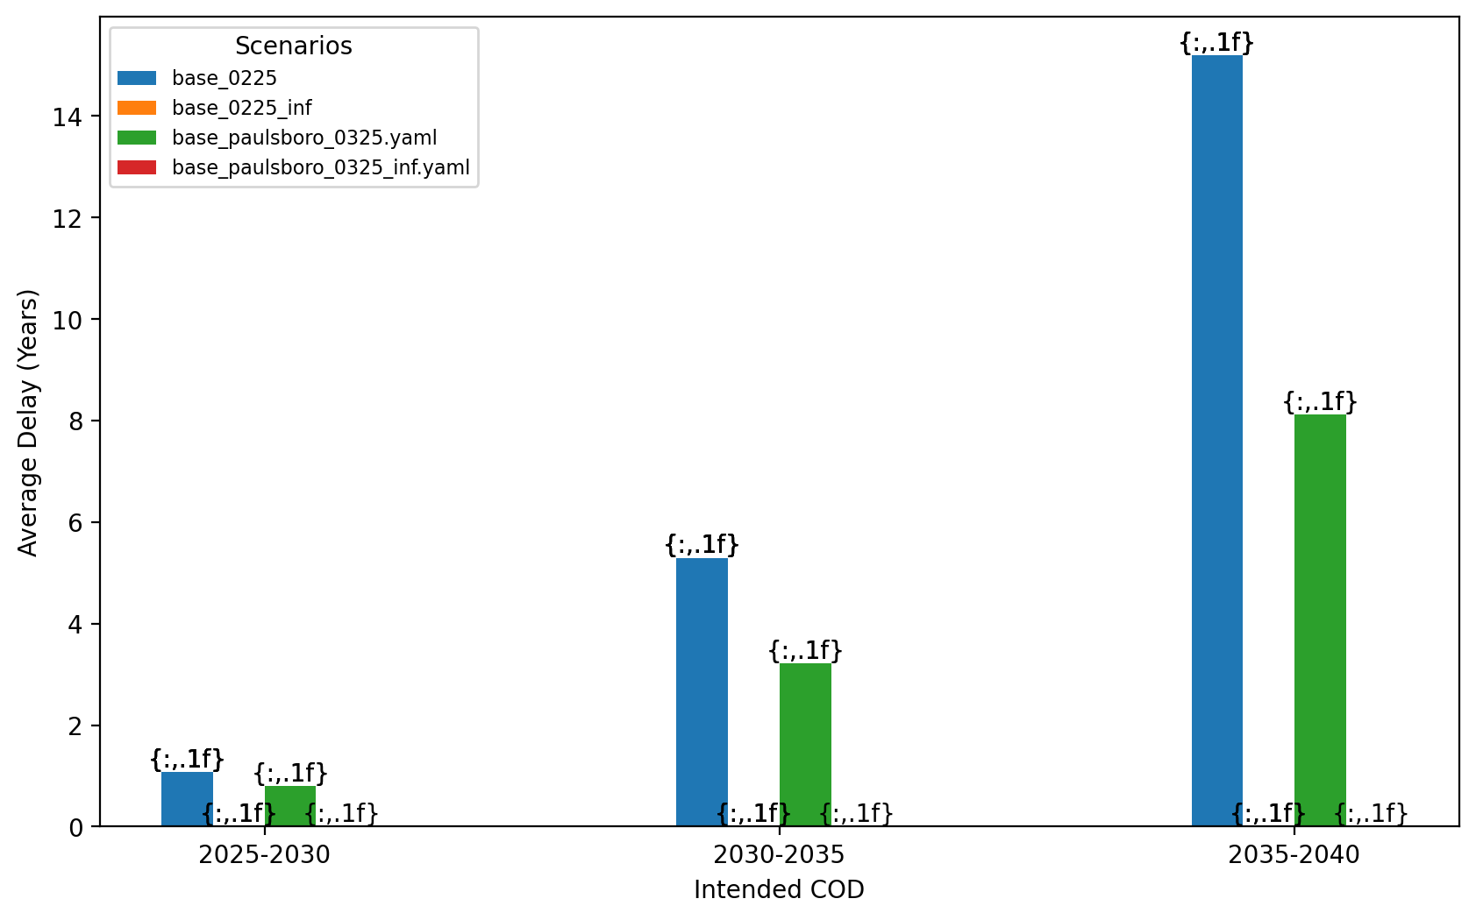
Average Delay Per Project by COD - All Regions

Slide 7
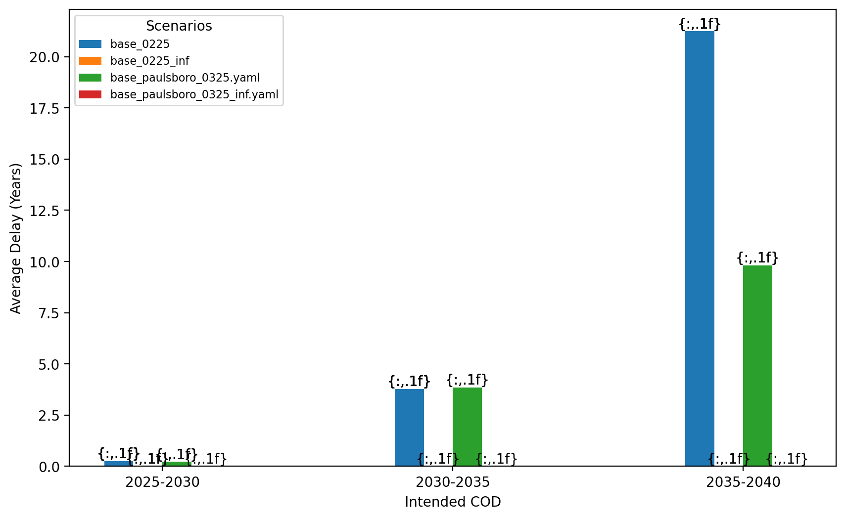
Average Delay Per Project by COD - NE

Slide 8
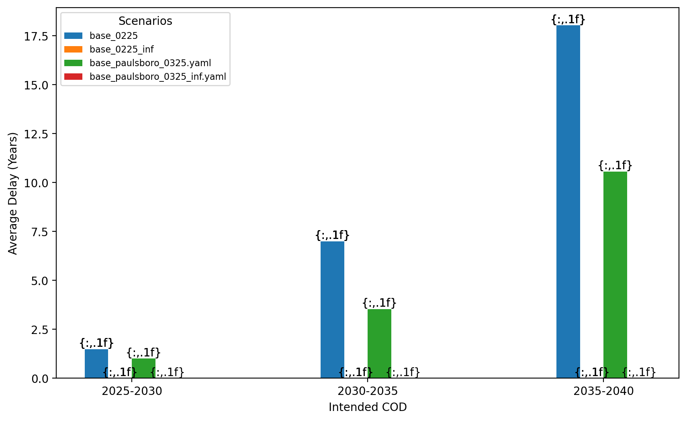
Average Delay Per Project by COD - NY/NJ

Slide 9
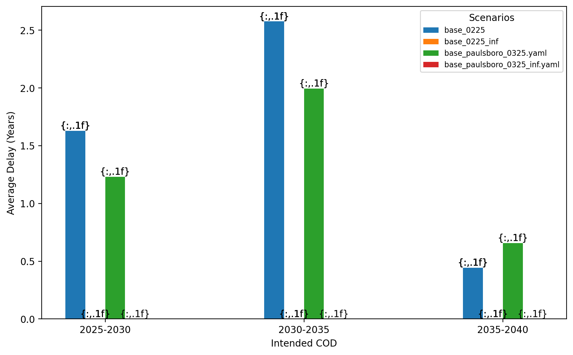
Average Delay Per Project by COD - Mid-Atlantic

