Slide 1
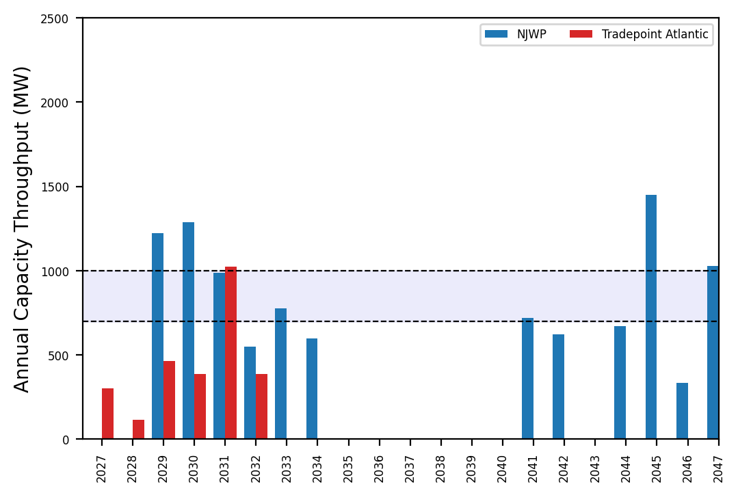
Port Throughput

Slide 2
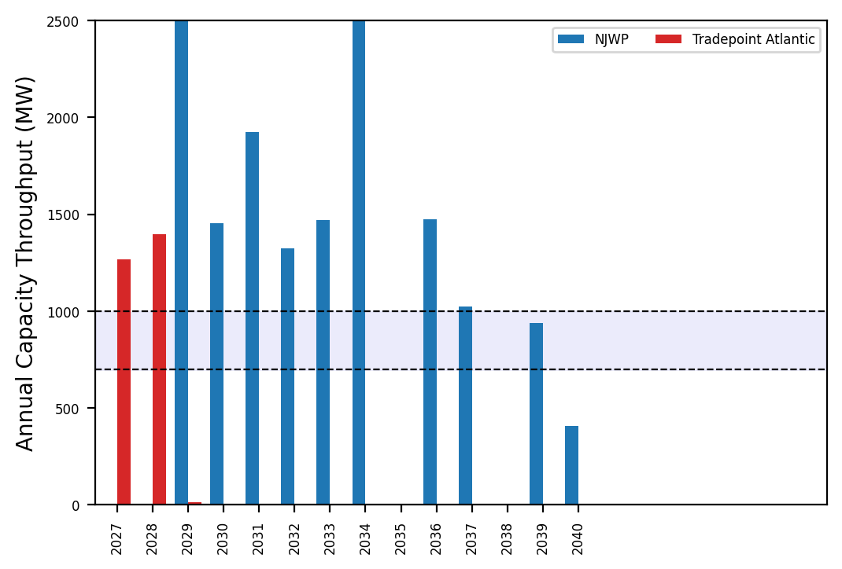
Port Throughput

Slide 3
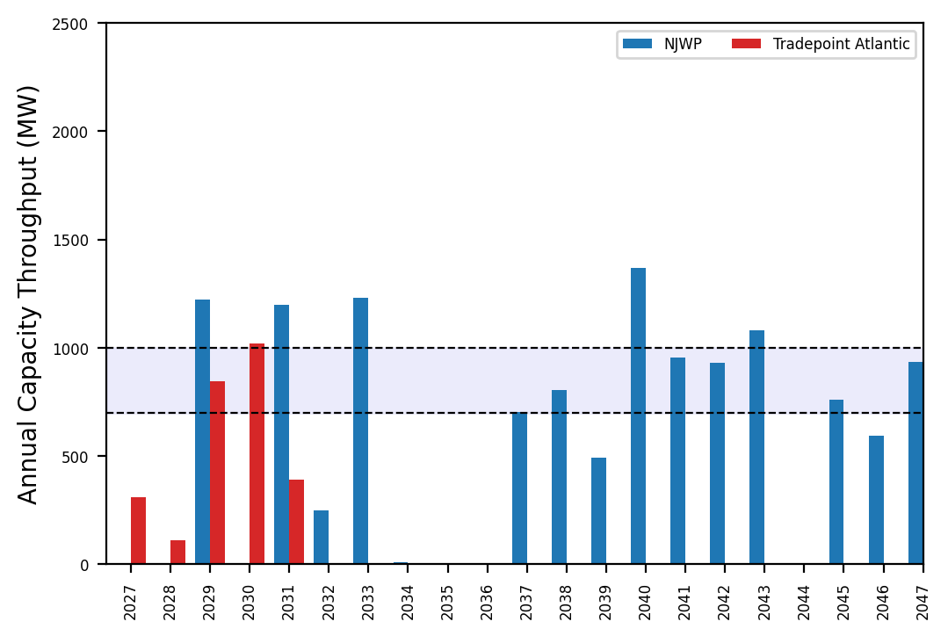
Port Throughput

Slide 4
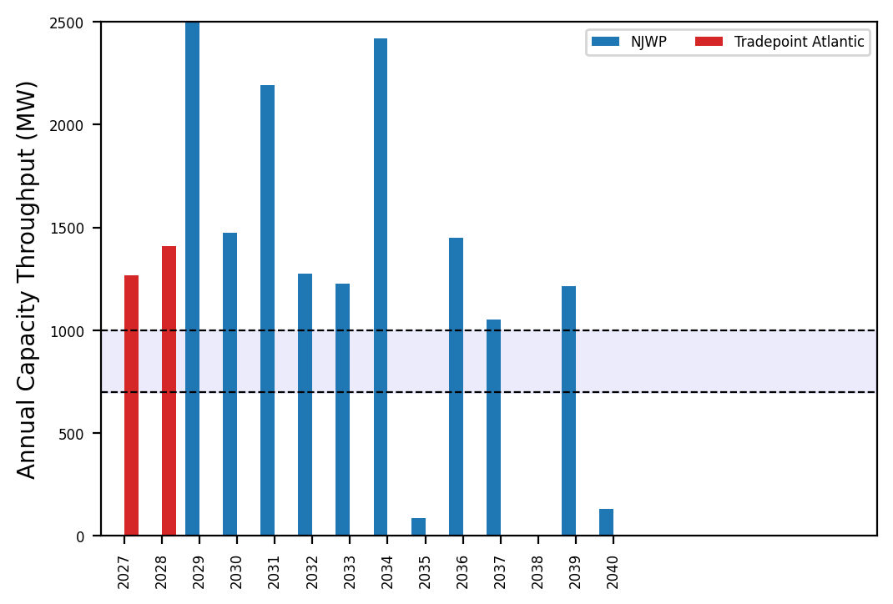
Port Throughput

Slide 5
Summary Plots
Plots comparing runs

Slide 6
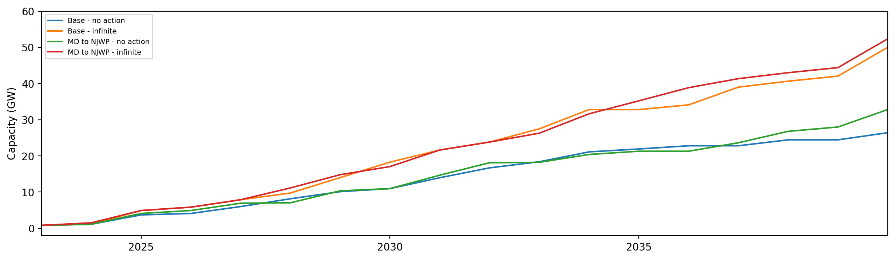
Installed Capacity

Slide 7
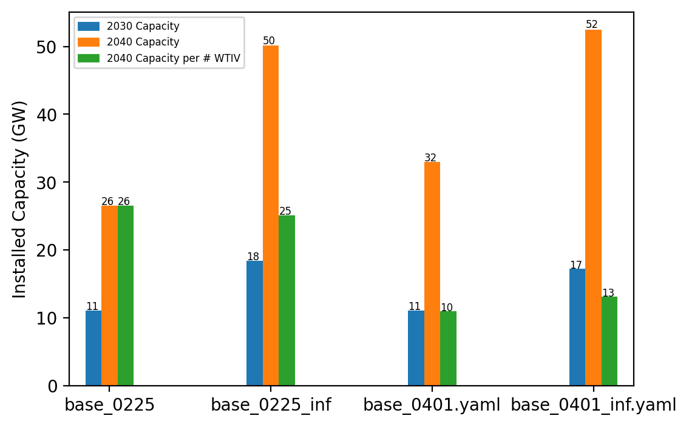
Summary Installed Cap

Slide 8
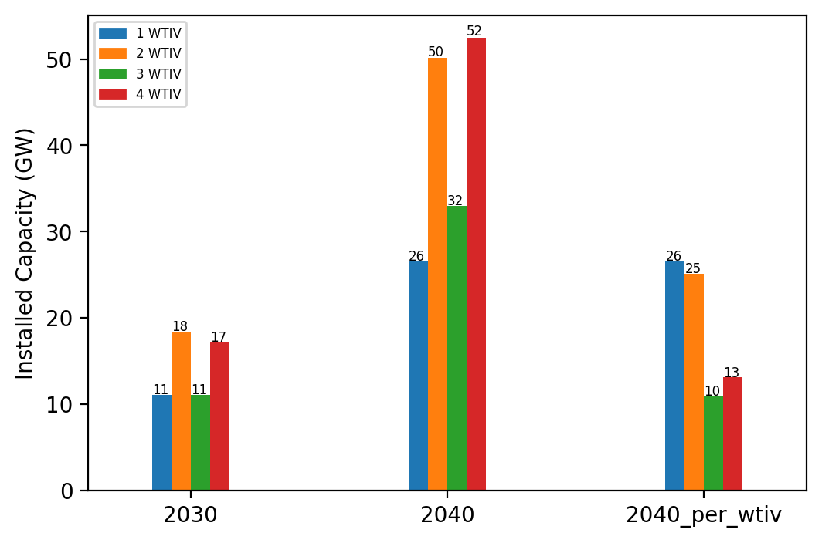
Summary Installed Cap T

Slide 9
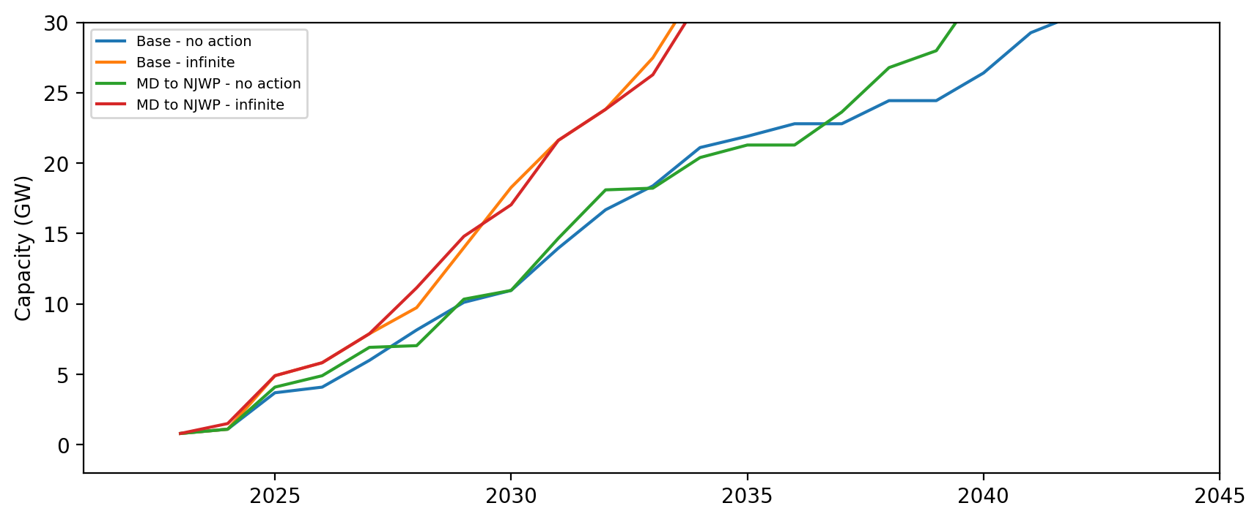
Installed Capacity - All Regions

Slide 10
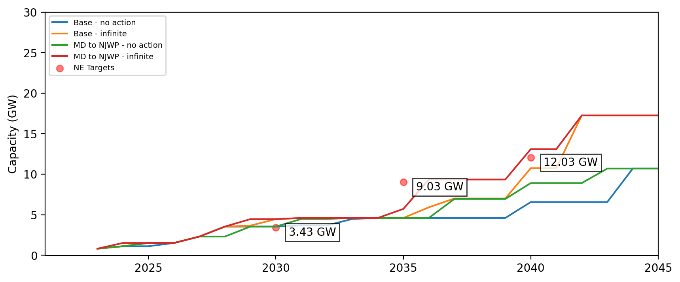
Installed Capacity - NE

Slide 11
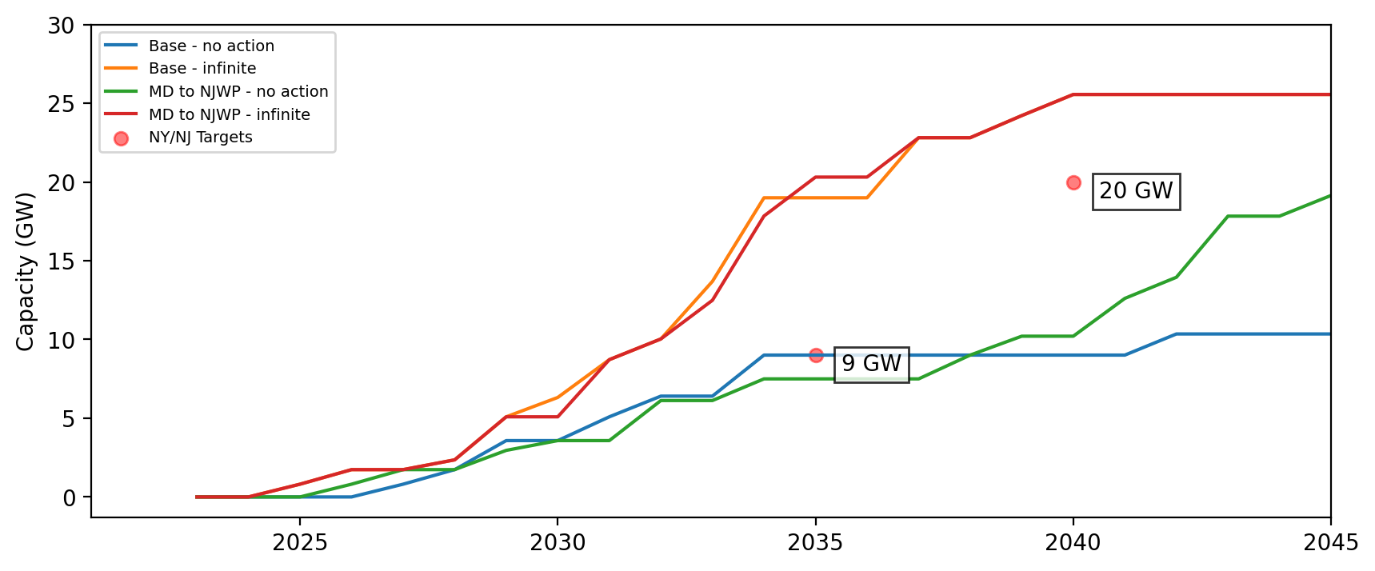
Installed Capacity - NY/NJ

Slide 12
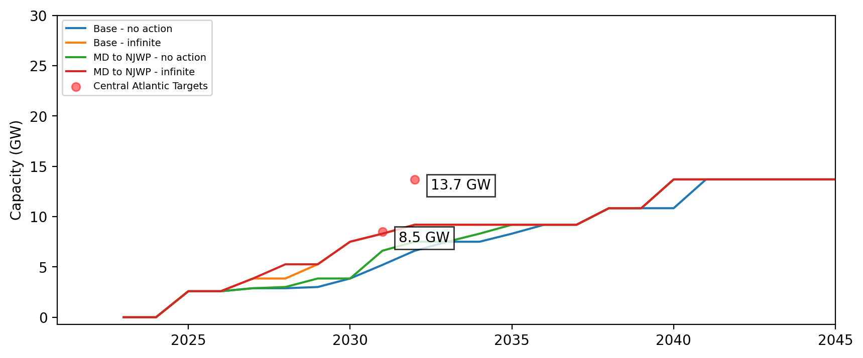
Installed Capacity - Central Atlantic

Slide 13
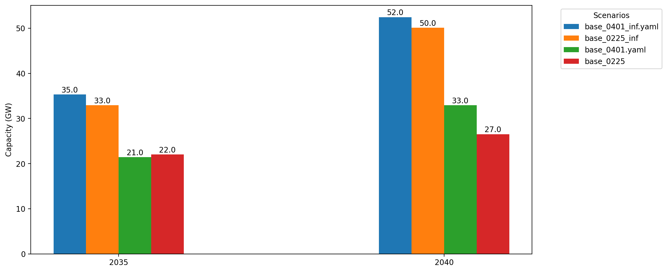
Cumulative Capacity by 2035 and 2040

Slide 14
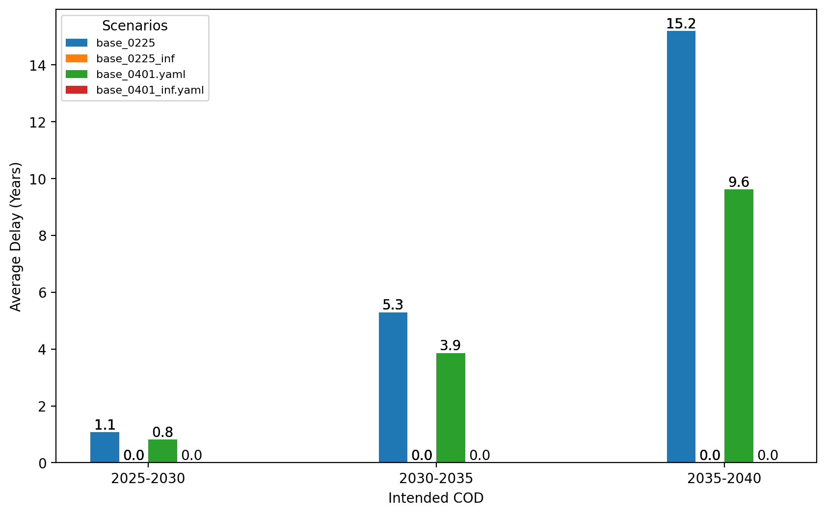
Average Delay Per Project by COD - All Regions

Slide 15
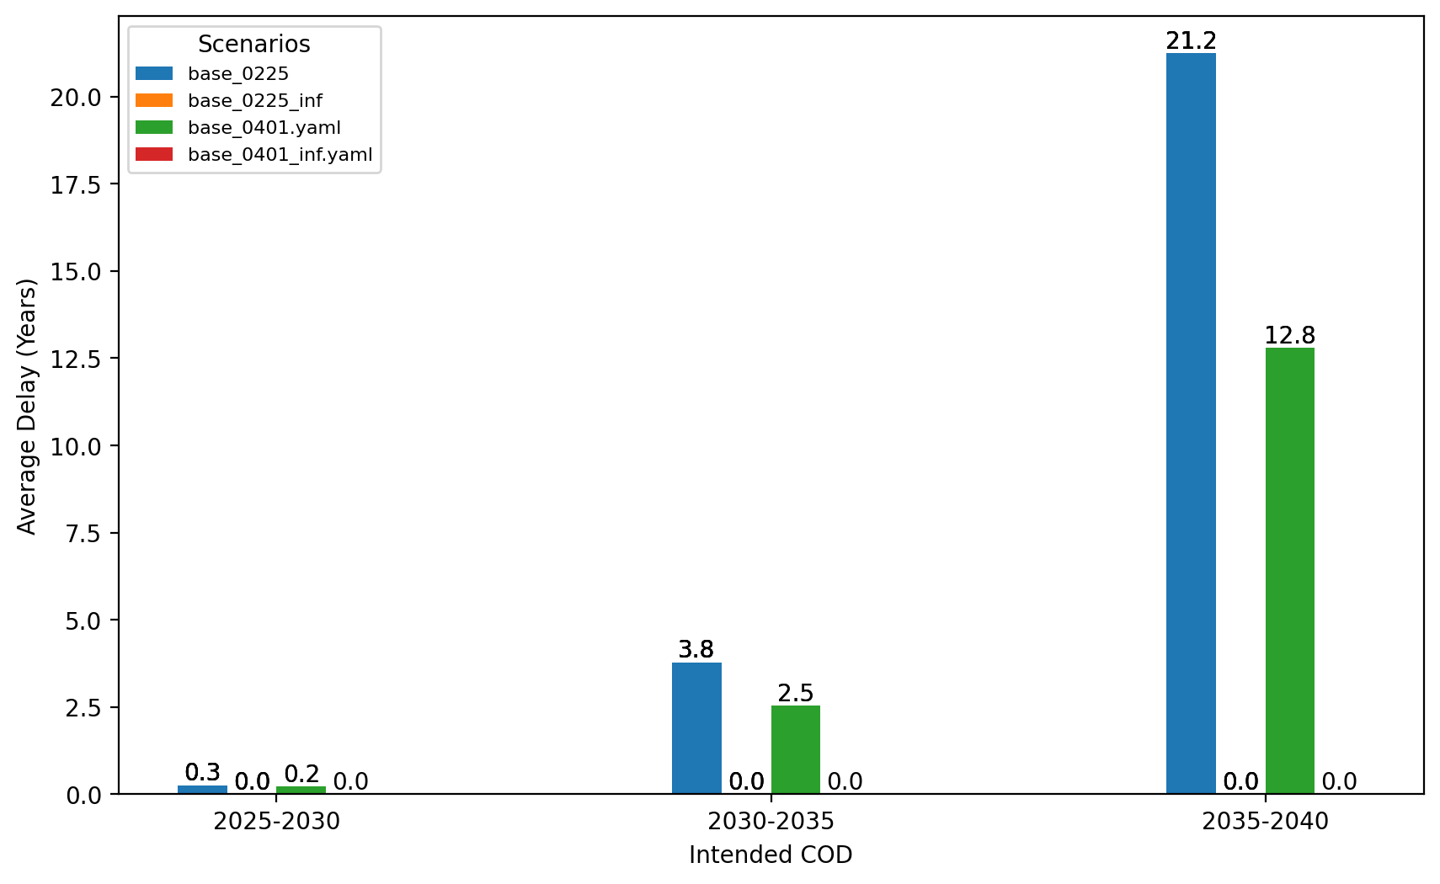
Average Delay Per Project by COD - NE

Slide 16
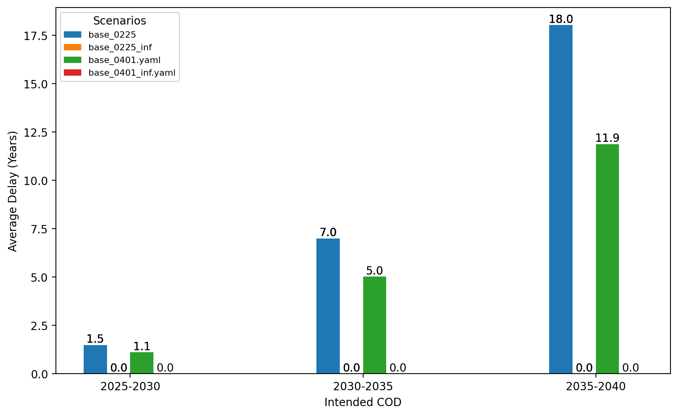
Average Delay Per Project by COD - NY-NJ

Slide 17
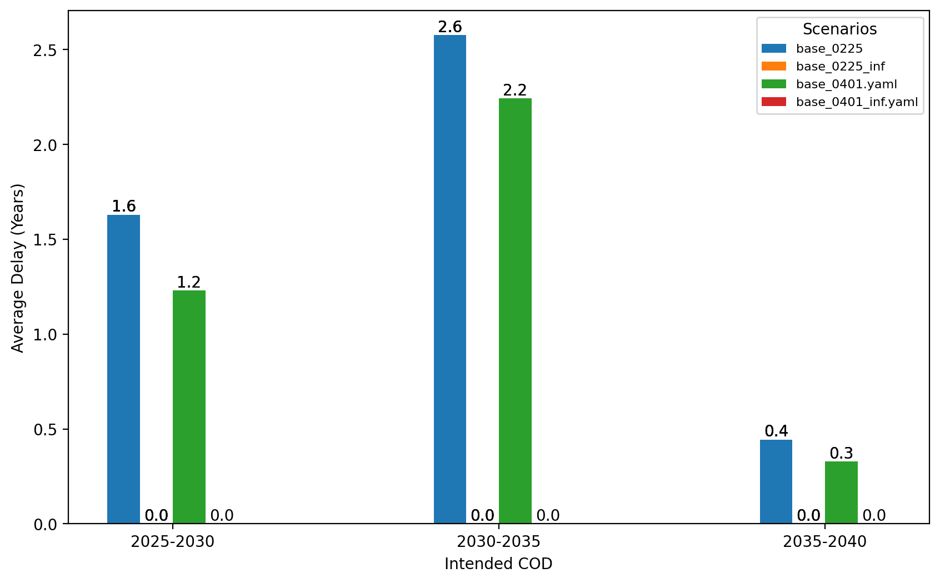
Average Delay Per Project by COD - Mid-Atlantic

Slide 18
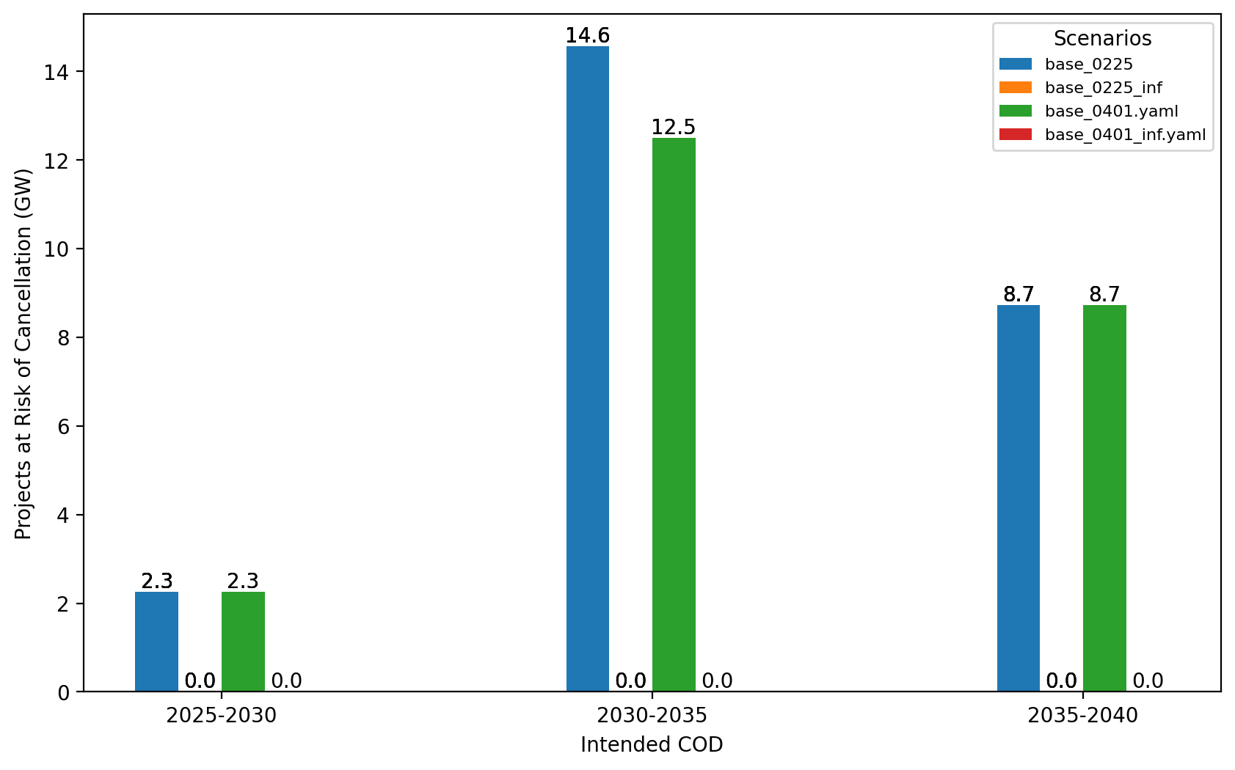
Total Capacity at Risk by COD - All Regions

Slide 19
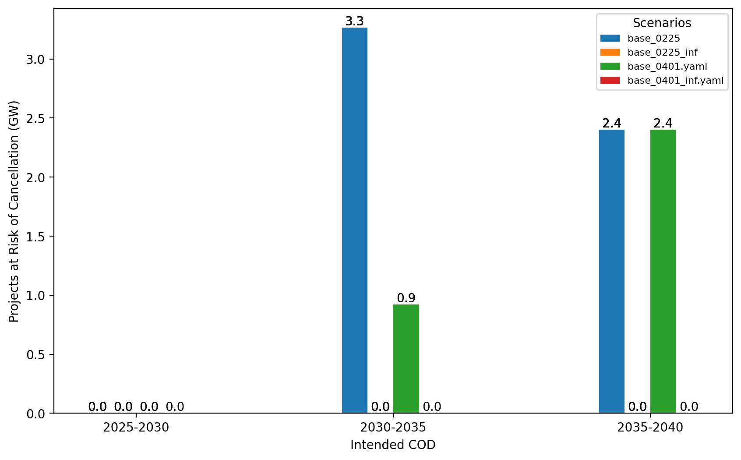
Total Capacity at Risk by COD - NE

Slide 20
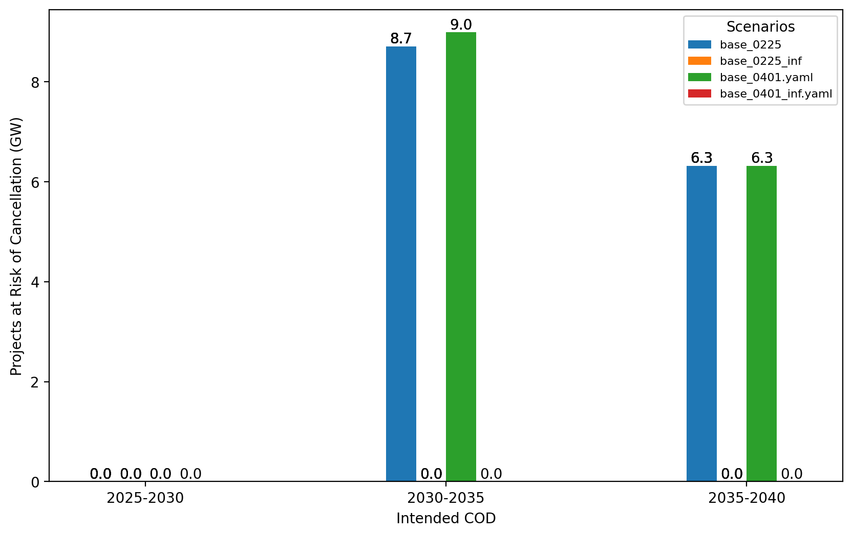
Total Capacity at Risk by COD - NY/NJ

Slide 21
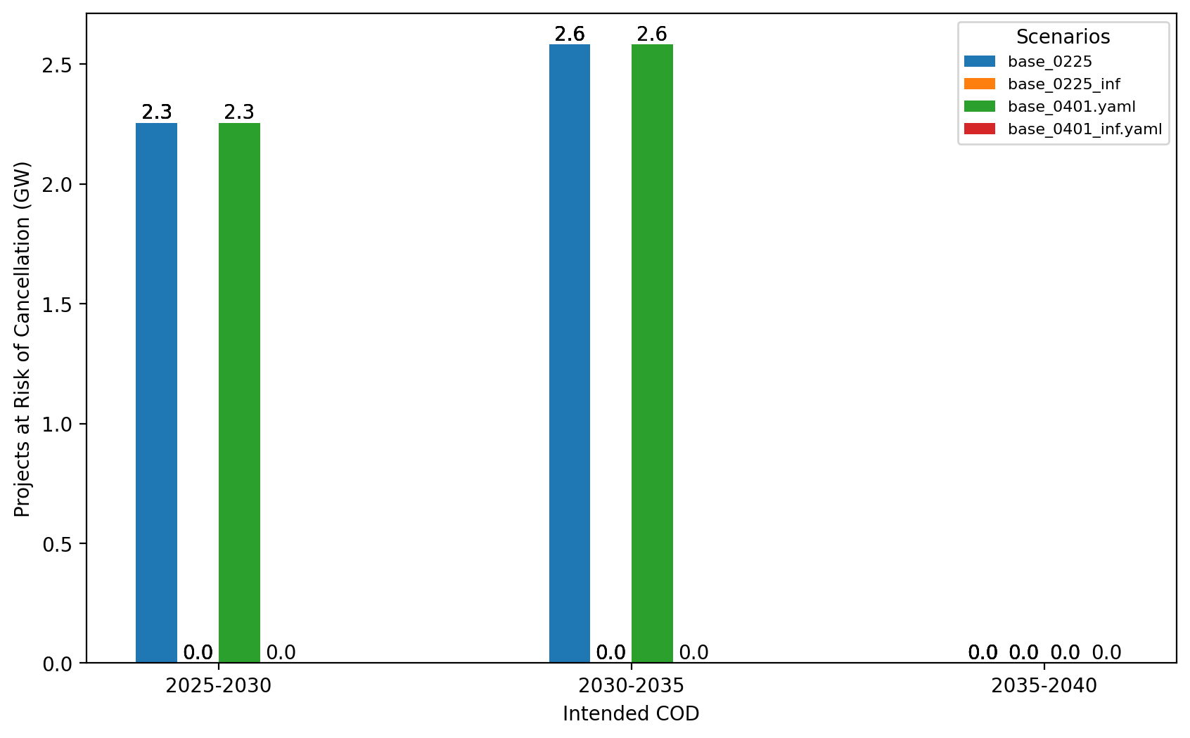
Total Capacity at Risk by COD - Mid-Atlantic

Slide 22
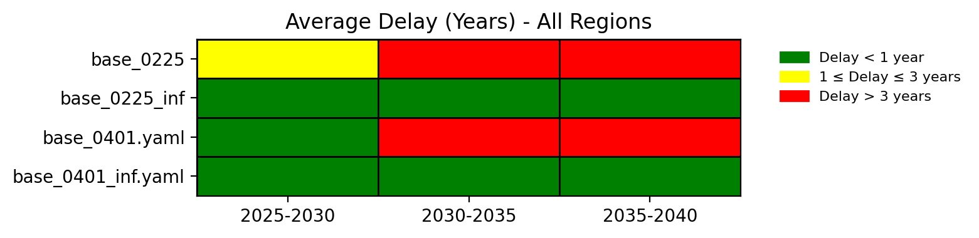
Average Delay Heat Map - All Regions

Slide 23
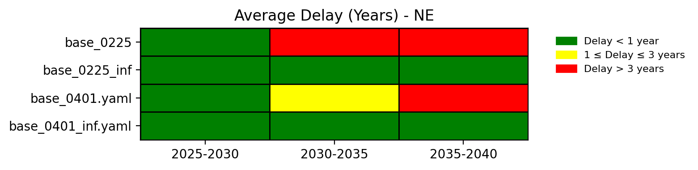
Average Delay Heat Map - NE

Slide 24
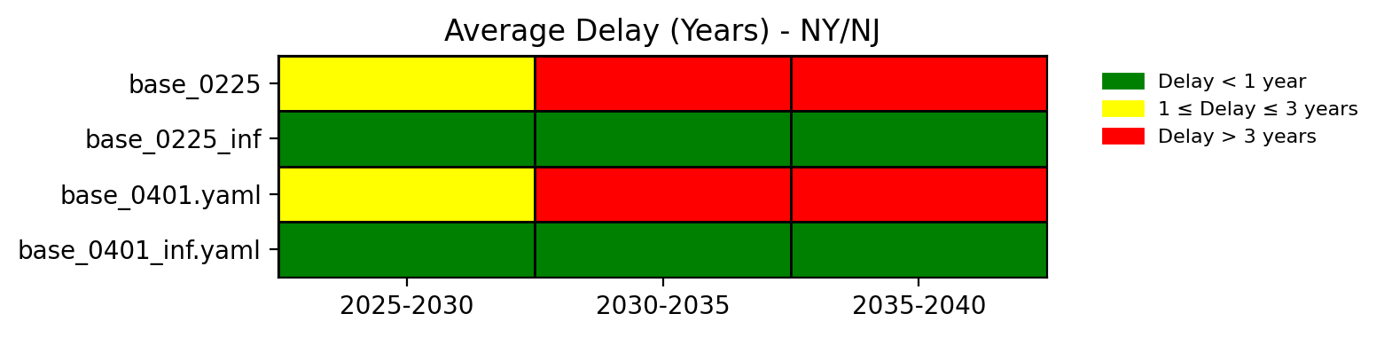
Average Delay Heat Map - NY/NJ

Slide 25
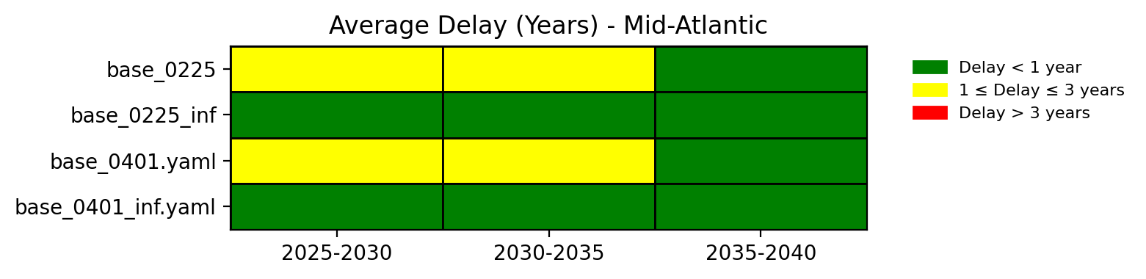
Average Delay Heat Map - Mid-Atlantic

