Slide 1
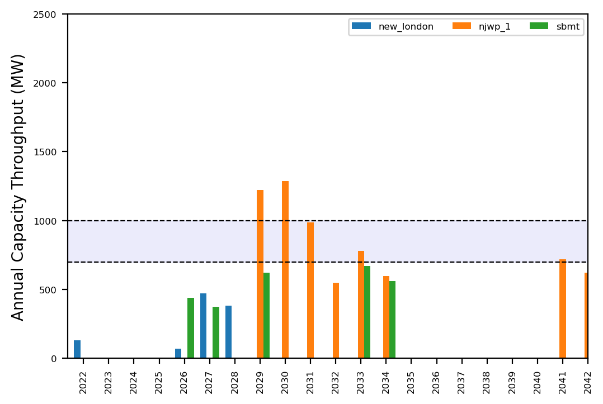
Port Throughput

Slide 2
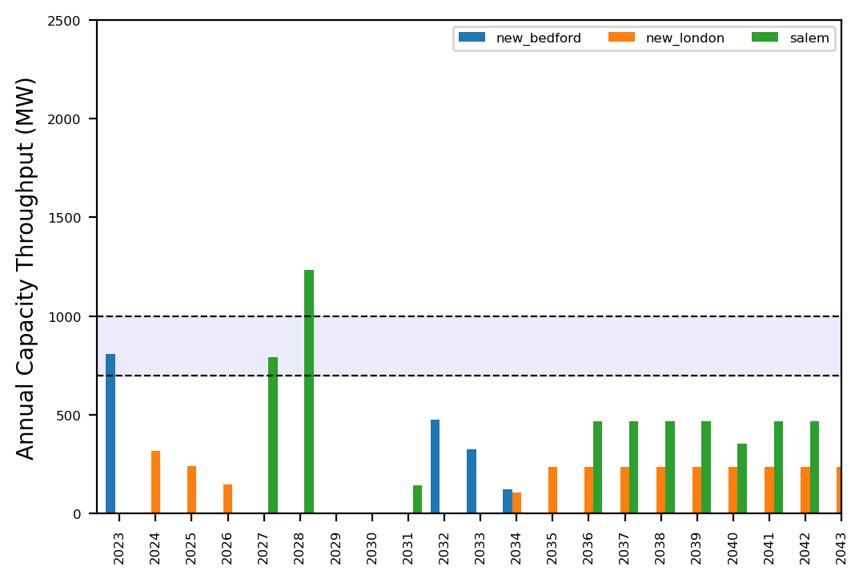
Port Throughput

Slide 3
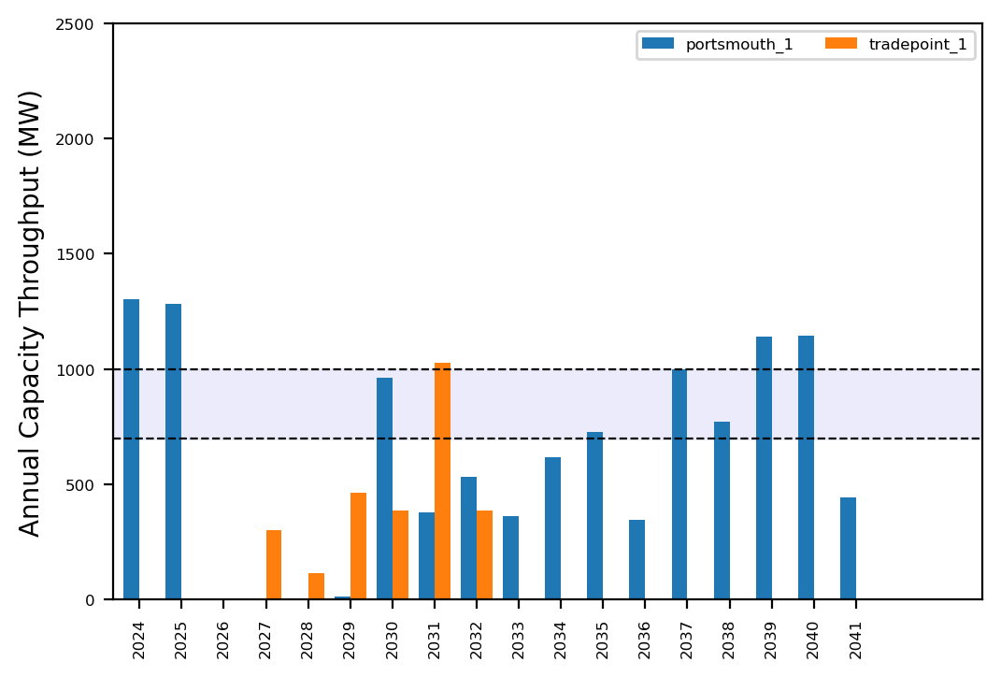
Port Throughput

Slide 4
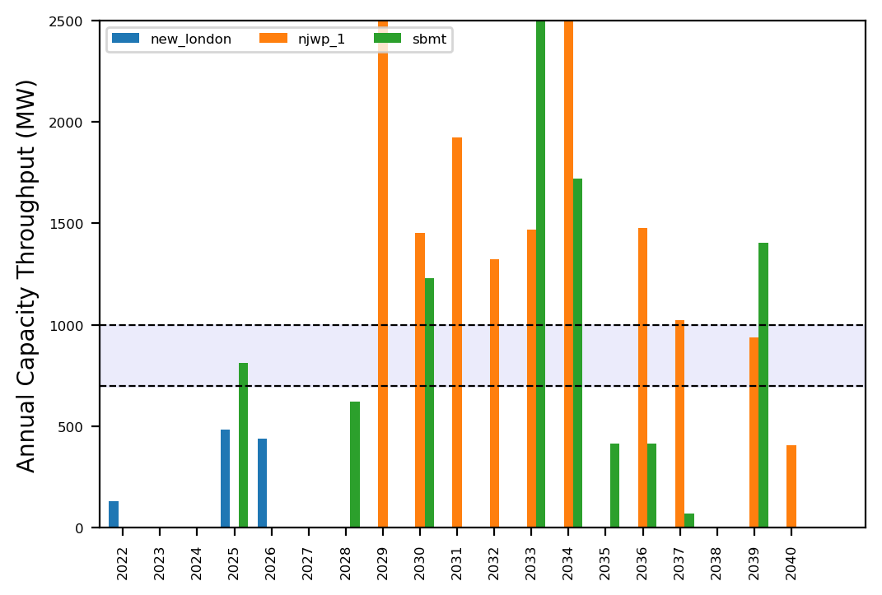
Port Throughput

Slide 5
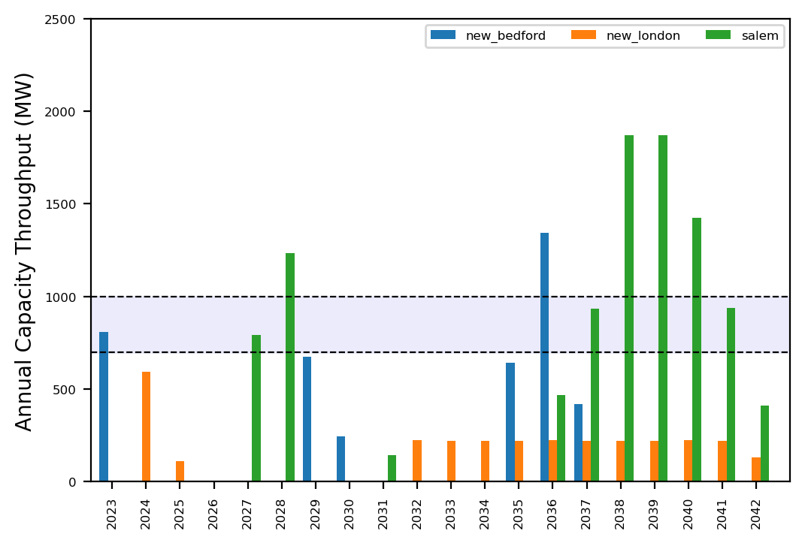
Port Throughput

Slide 6
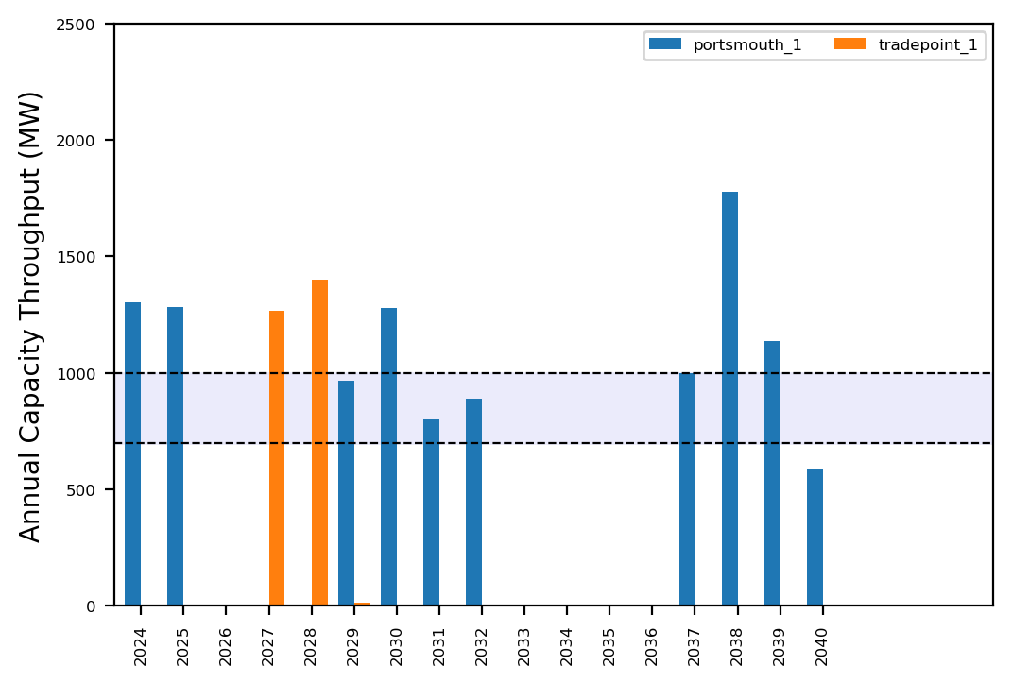
Port Throughput

Slide 7
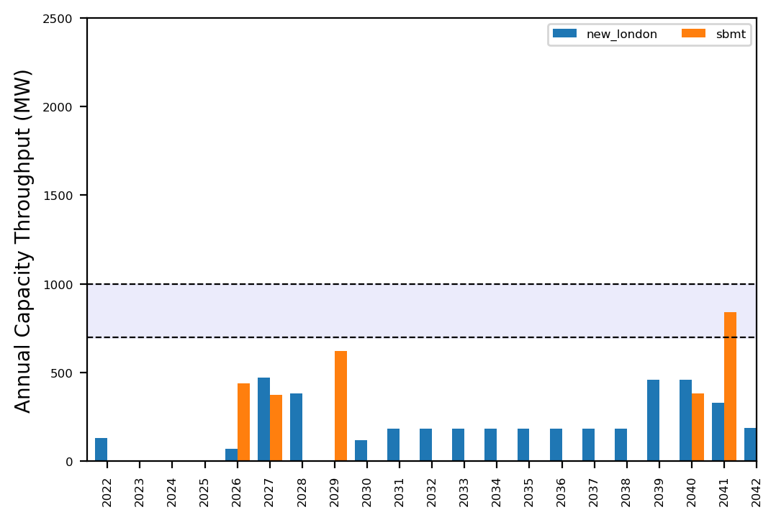
Port Throughput

Slide 8
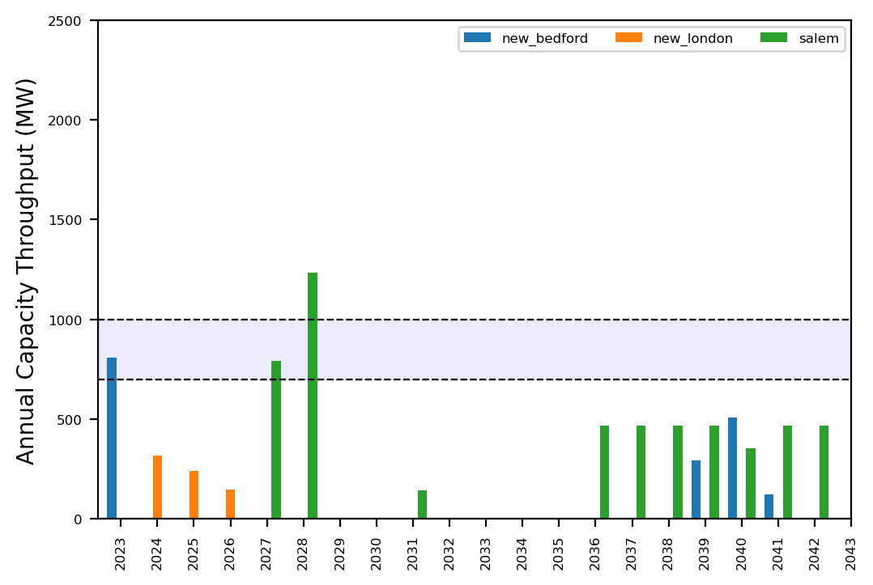
Port Throughput

Slide 9
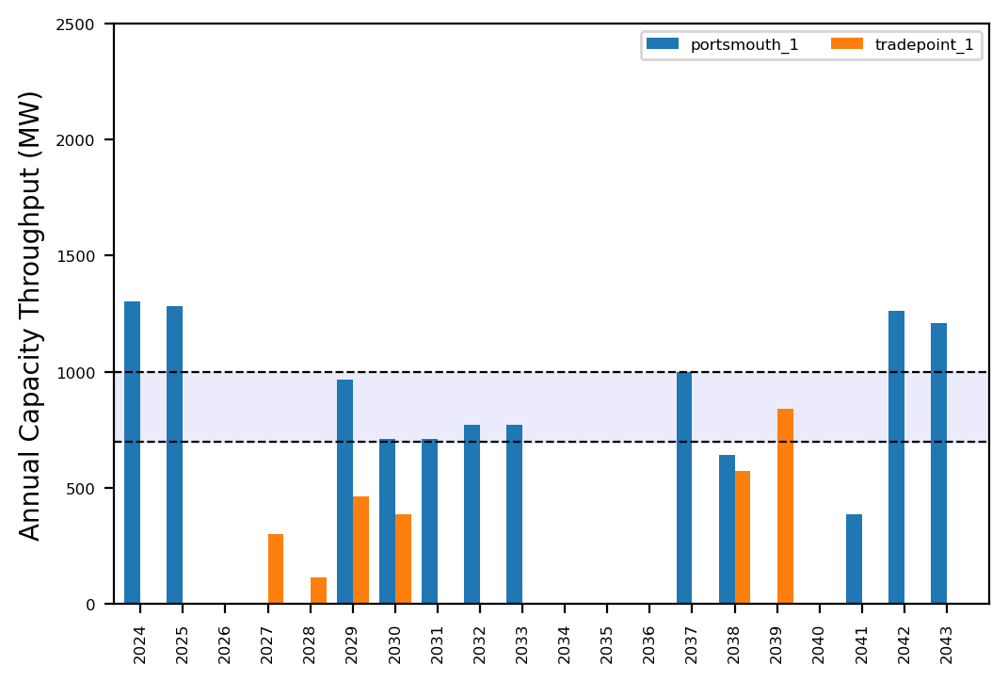
Port Throughput

Slide 10
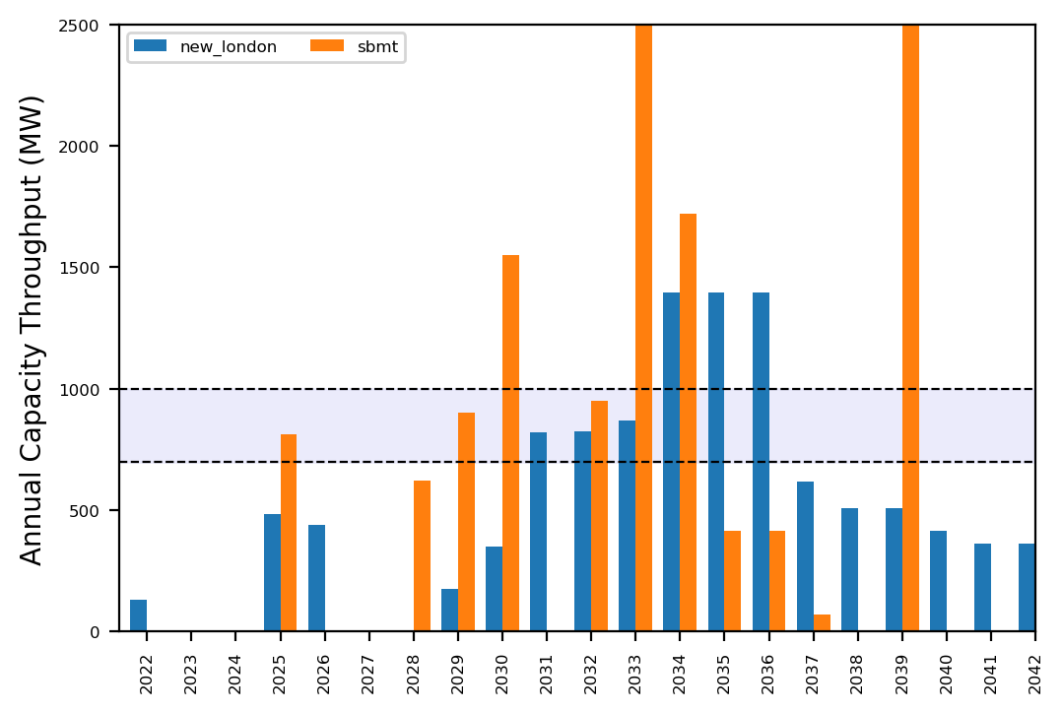
Port Throughput

Slide 11
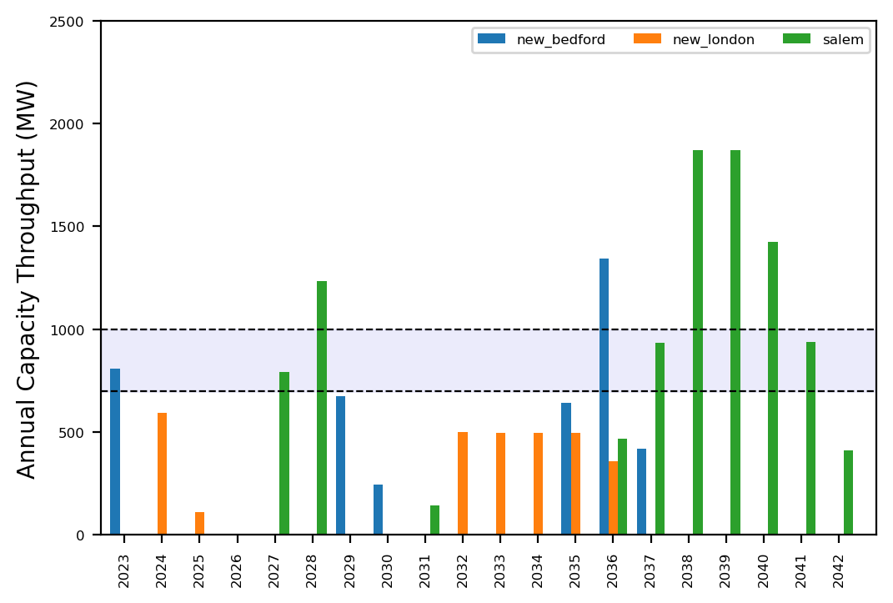
Port Throughput

Slide 12
Port Throughput

Slide 13
Summary Plots
Plots comparing runs

Slide 14
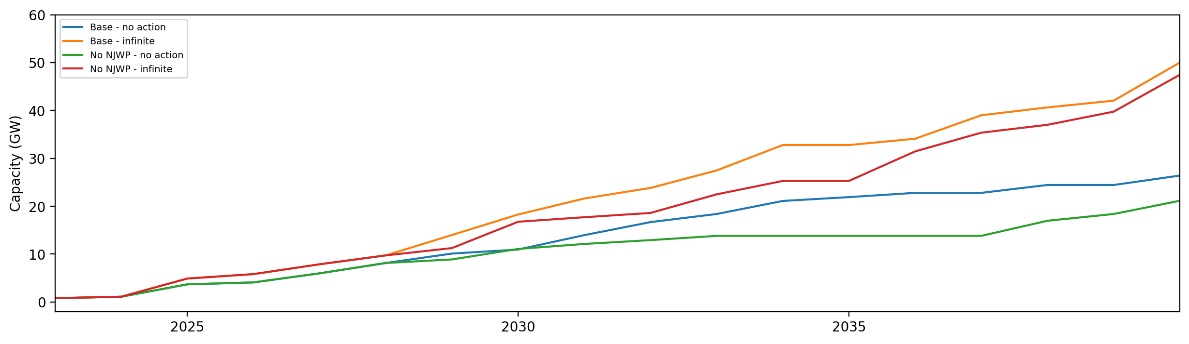
Installed Capacity

Slide 15
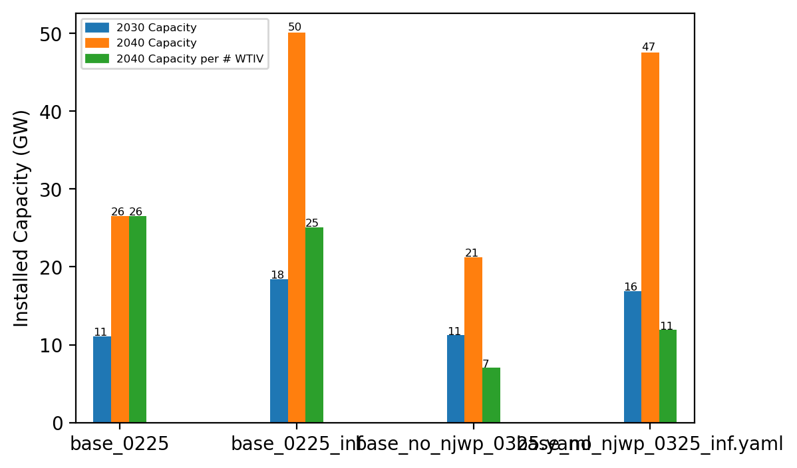
Summary Installed Cap

Slide 16
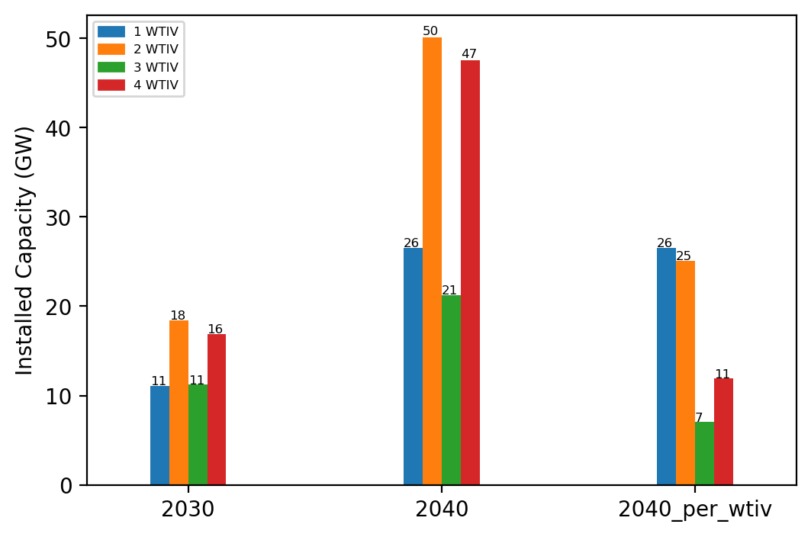
Summary Installed Cap T

Slide 17
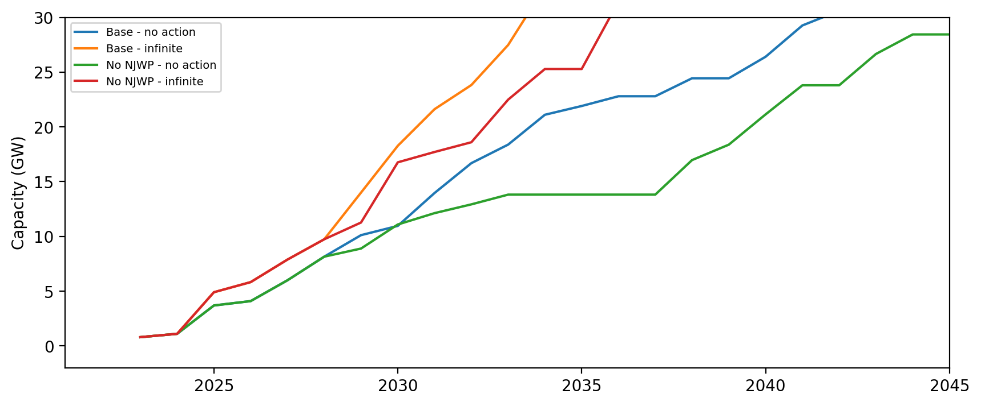
Installed Capacity - All Regions

Slide 18
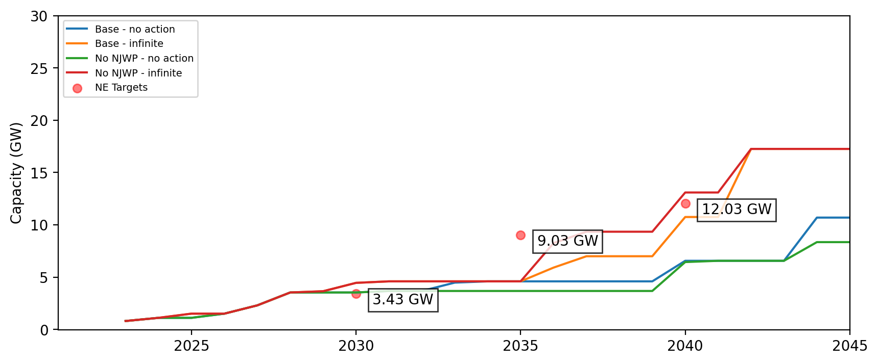
Installed Capacity - NE

Slide 19
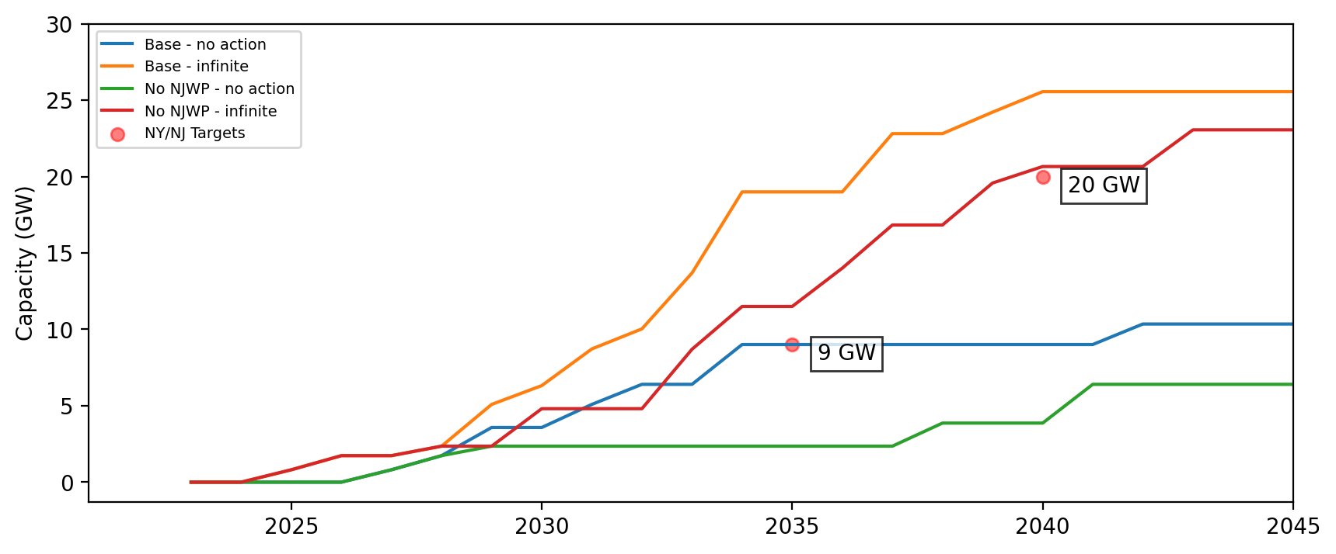
Installed Capacity - NY/NJ

Slide 20
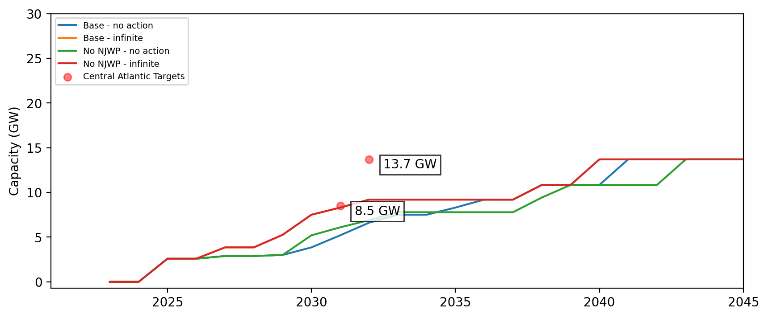
Installed Capacity - Central Atlantic

Slide 21
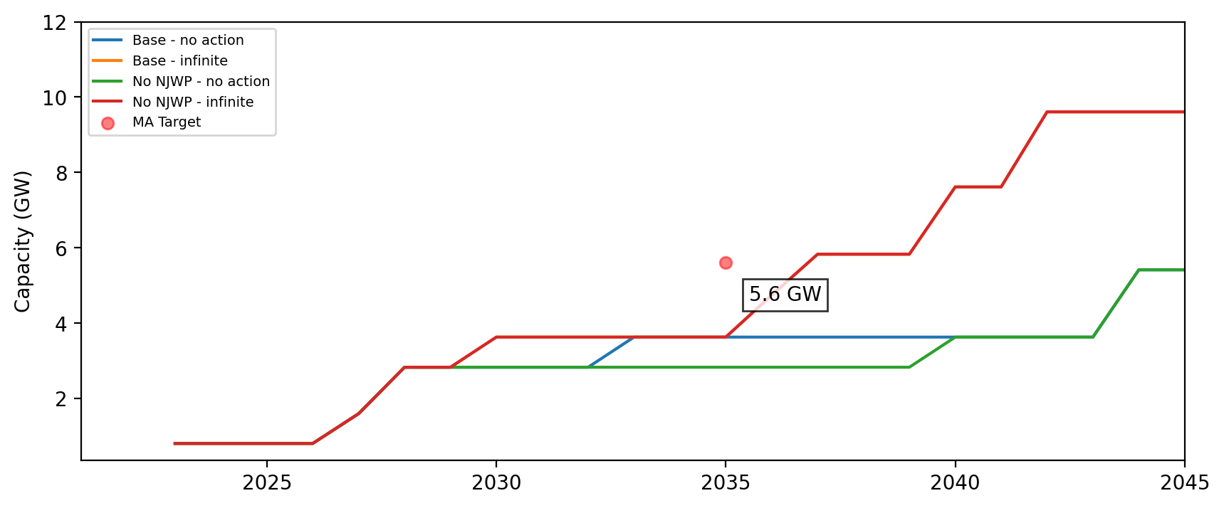
Cumulative Installed Capacity - MA

Slide 22
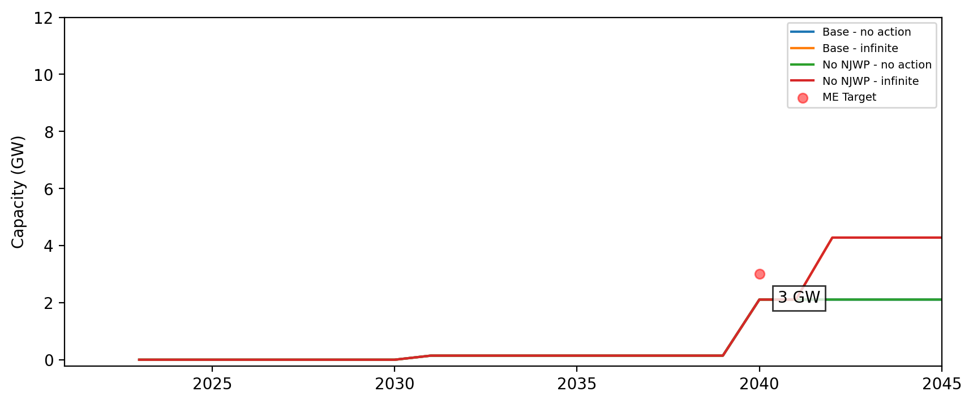
Cumulative Installed Capacity - ME

Slide 23
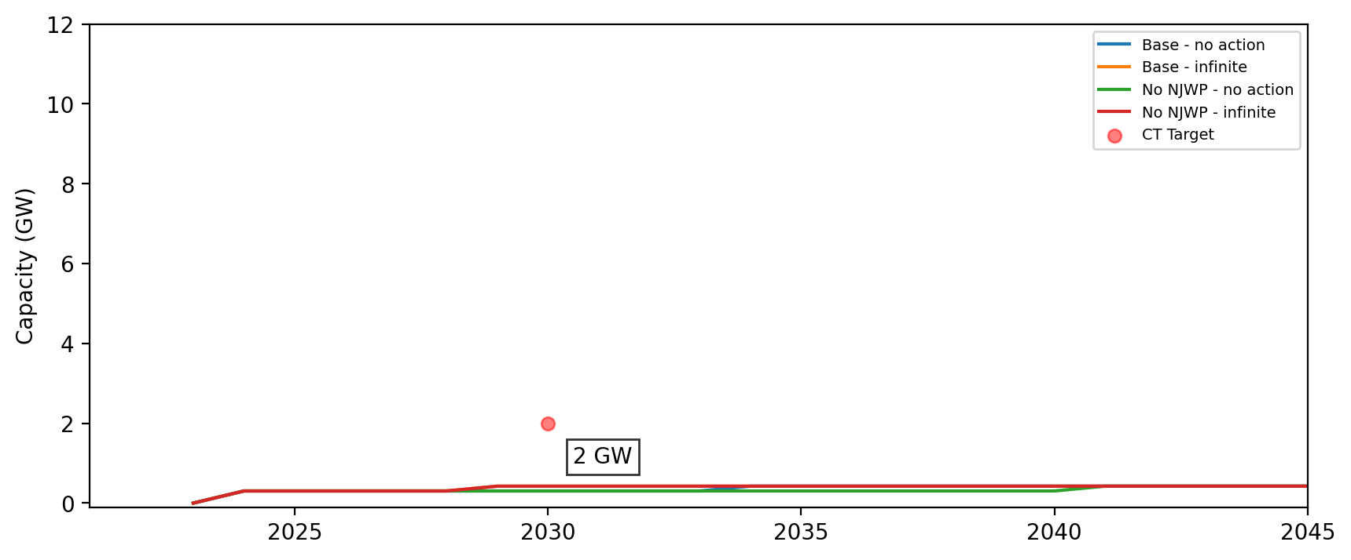
Cumulative Installed Capacity - CT

Slide 24
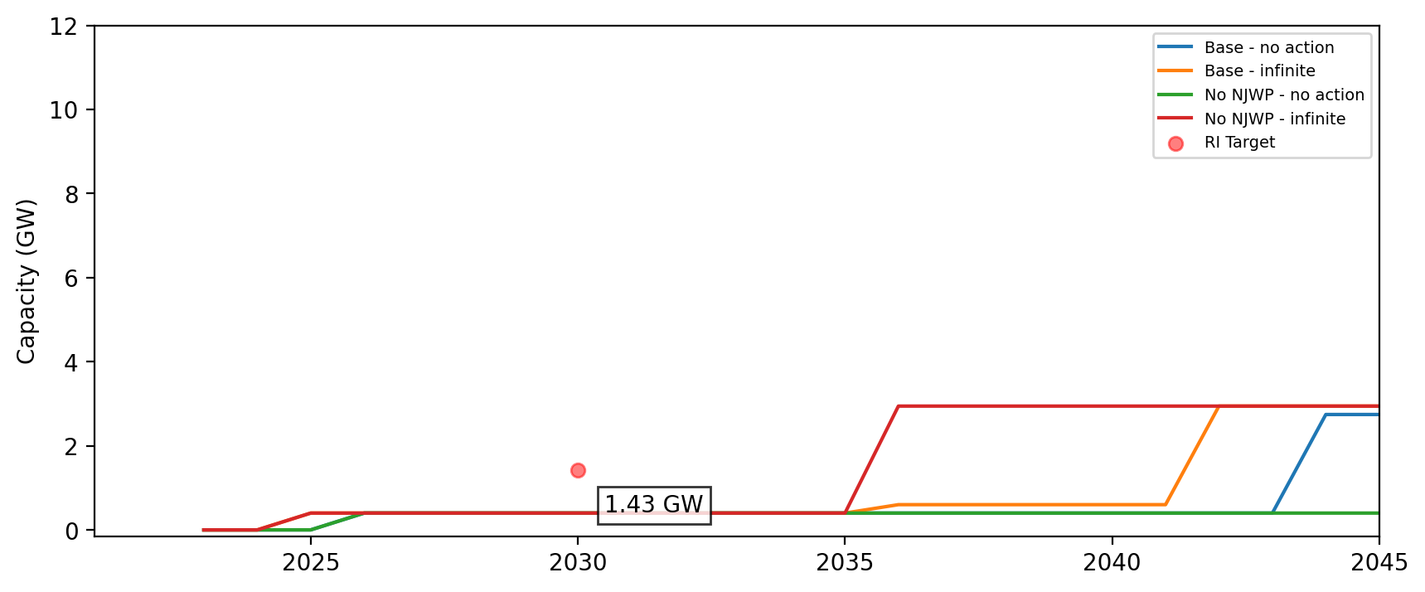
Cumulative Installed Capacity - RI

Slide 25
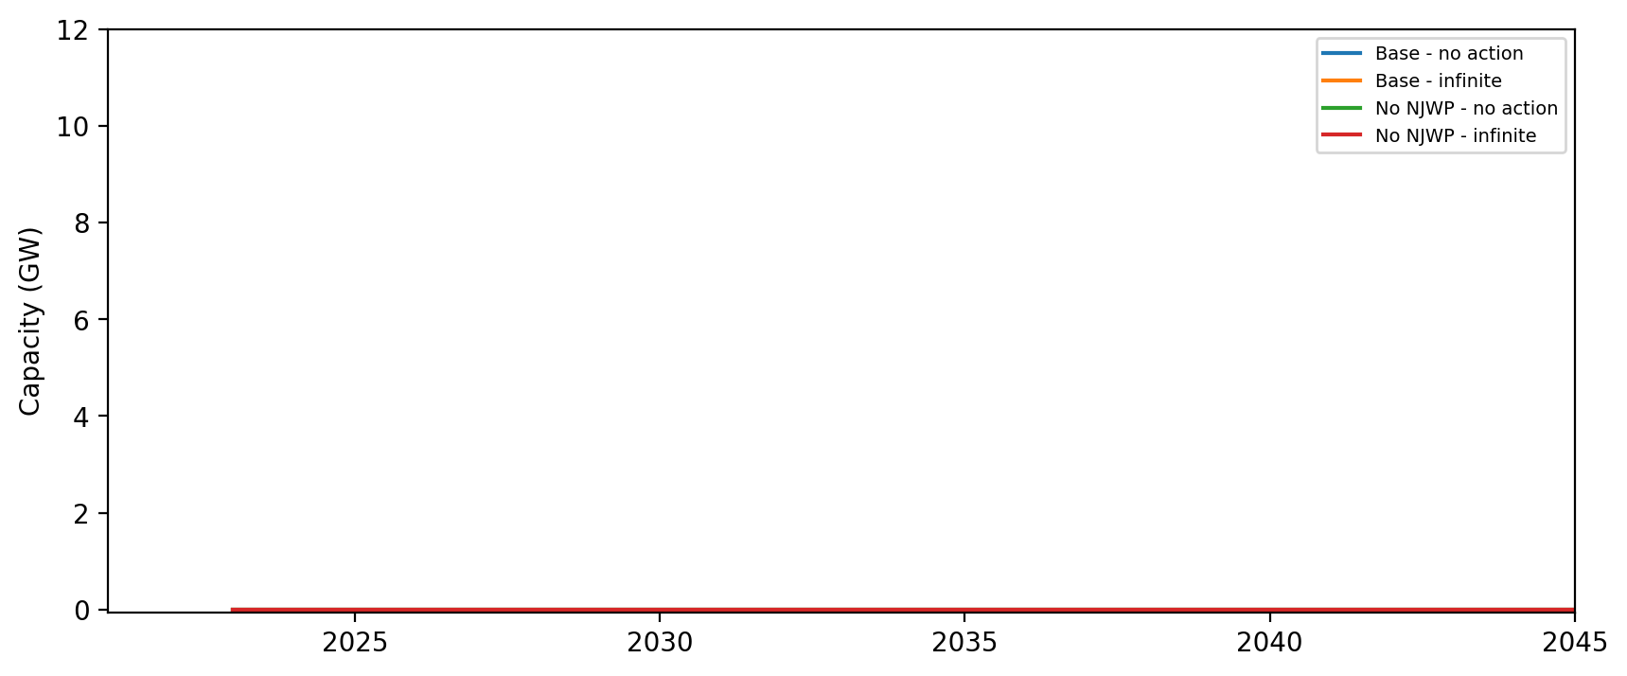
Cumulative Installed Capacity - NH

Slide 26
Cumulative Installed Capacity - RI/CT

Slide 27
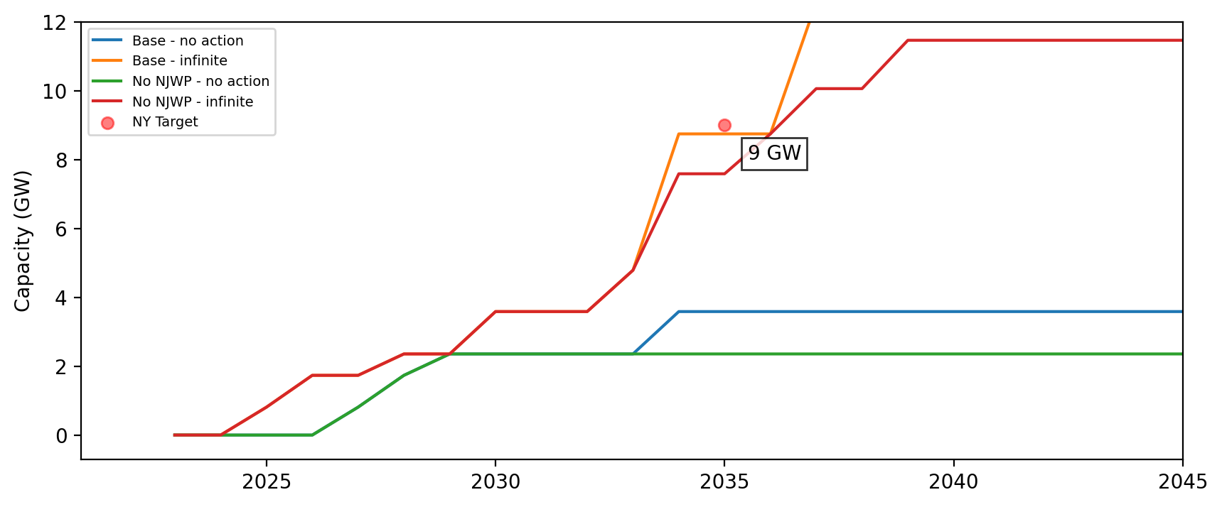
Cumulative Installed Capacity - NY

Slide 28
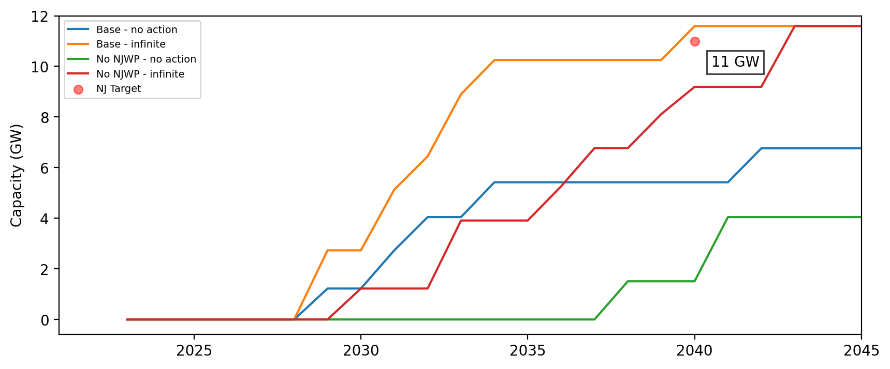
Cumulative Installed Capacity - NJ

Slide 29
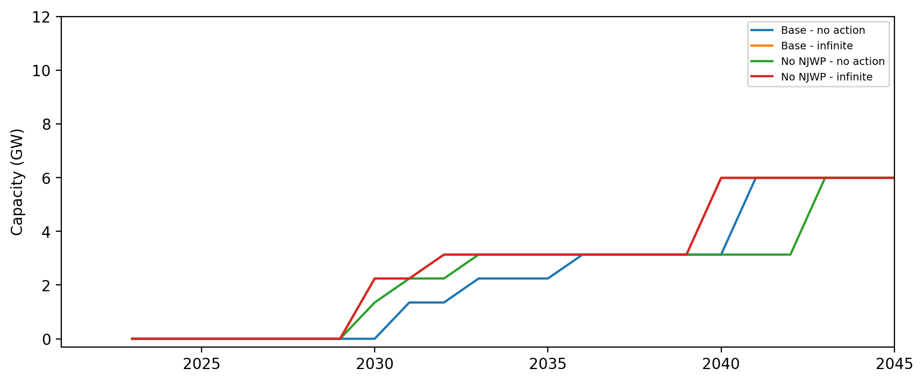
Cumulative Installed Capacity - NC

Slide 30
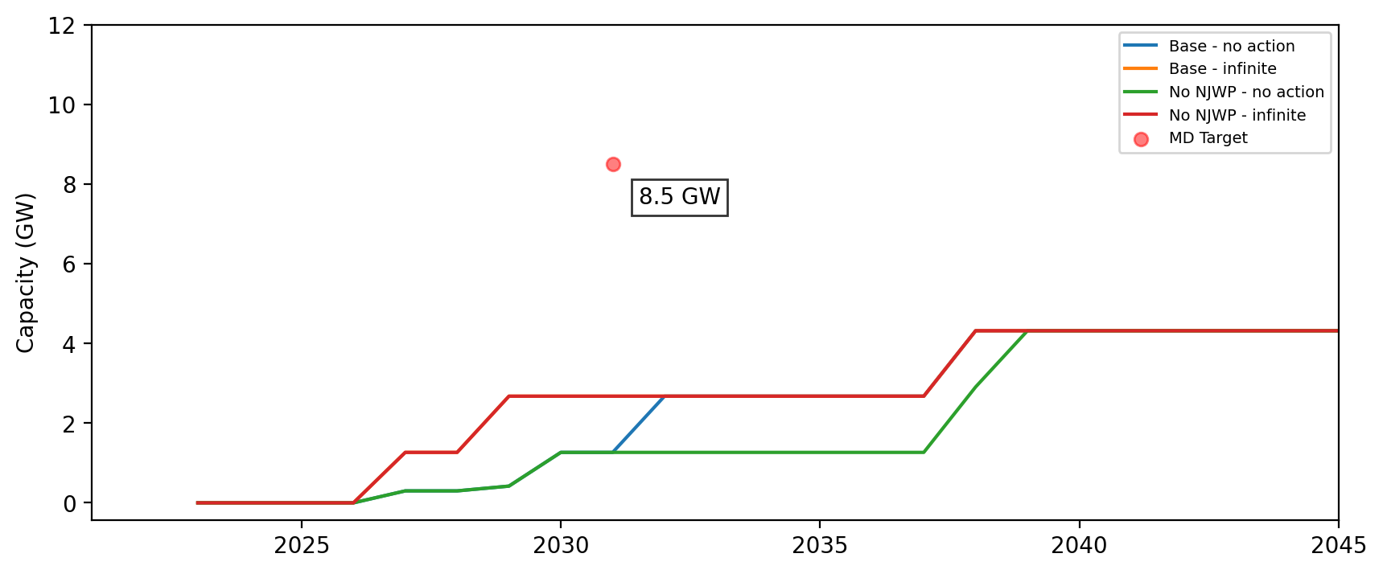
Cumulative Installed Capacity - MD

Slide 31
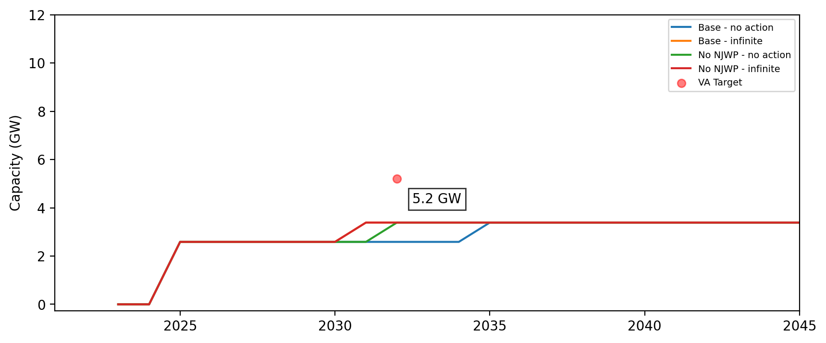
Cumulative Installed Capacity - VA

Slide 32
Cumulative Installed Capacity - DE

Slide 33
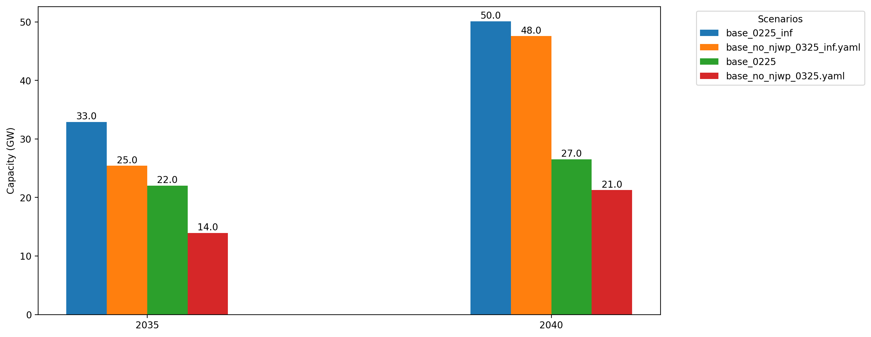
Cumulative Capacity by 2035 and 2040

Slide 34
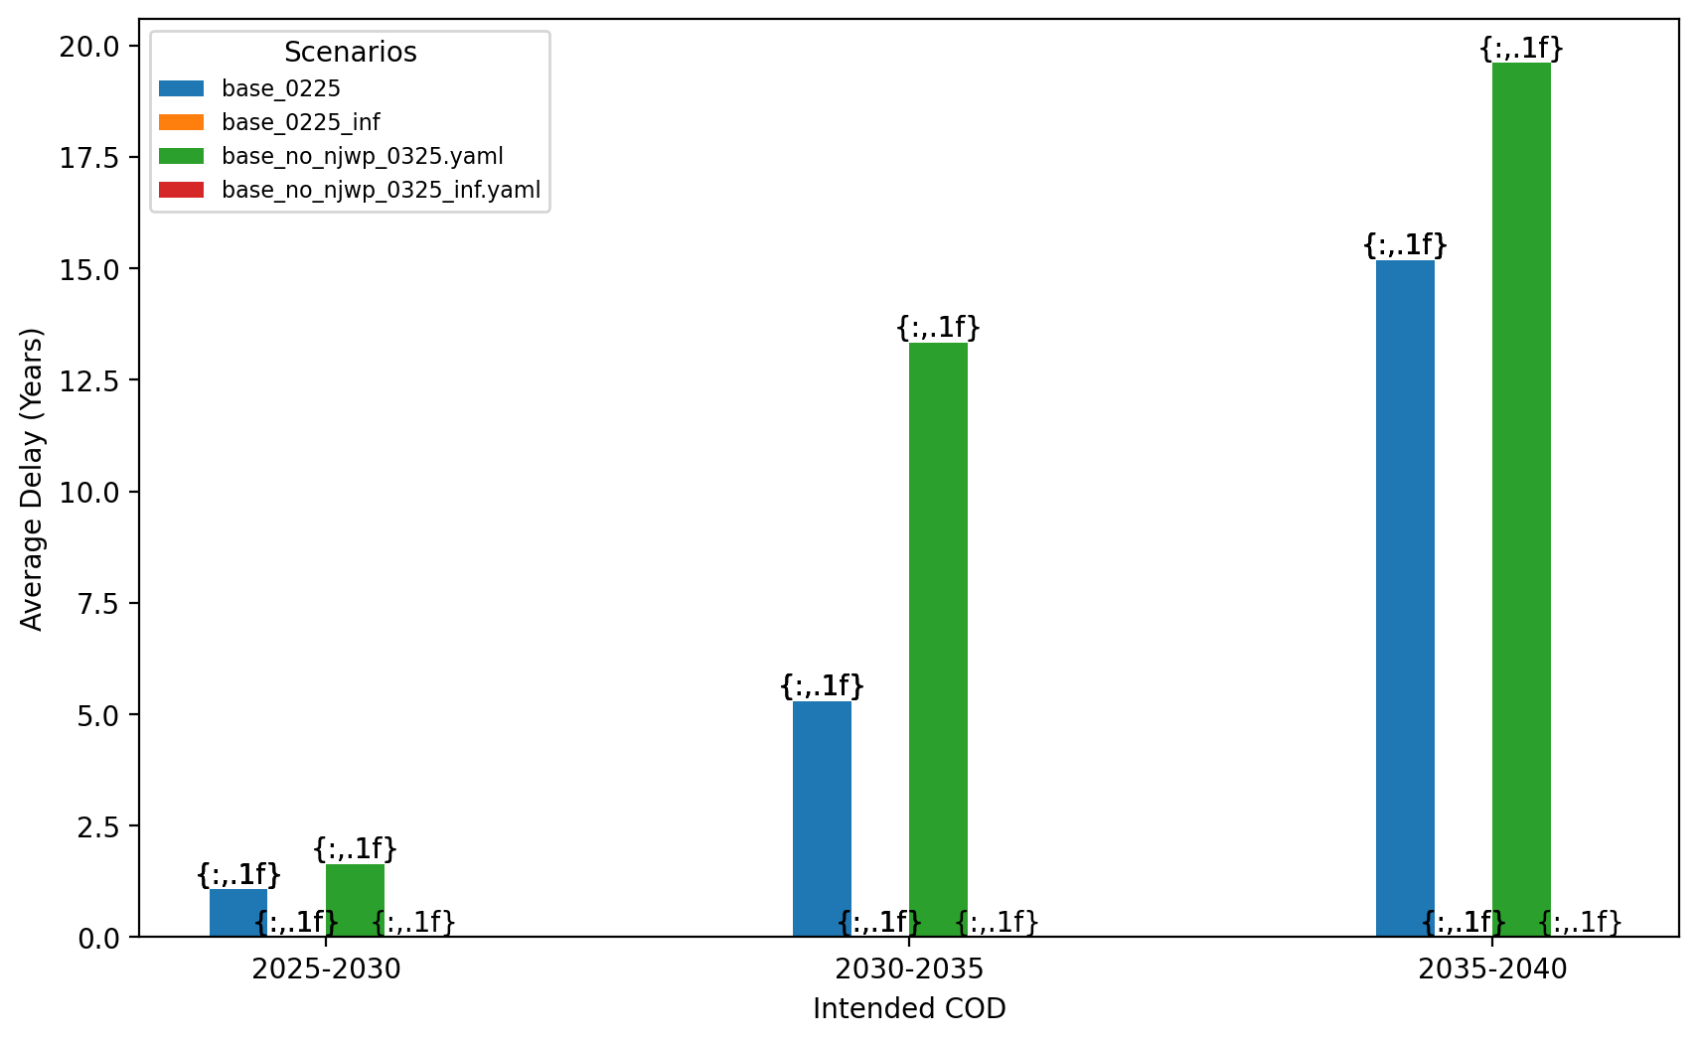
Average Delay Per Project by COD - All Regions

Slide 35
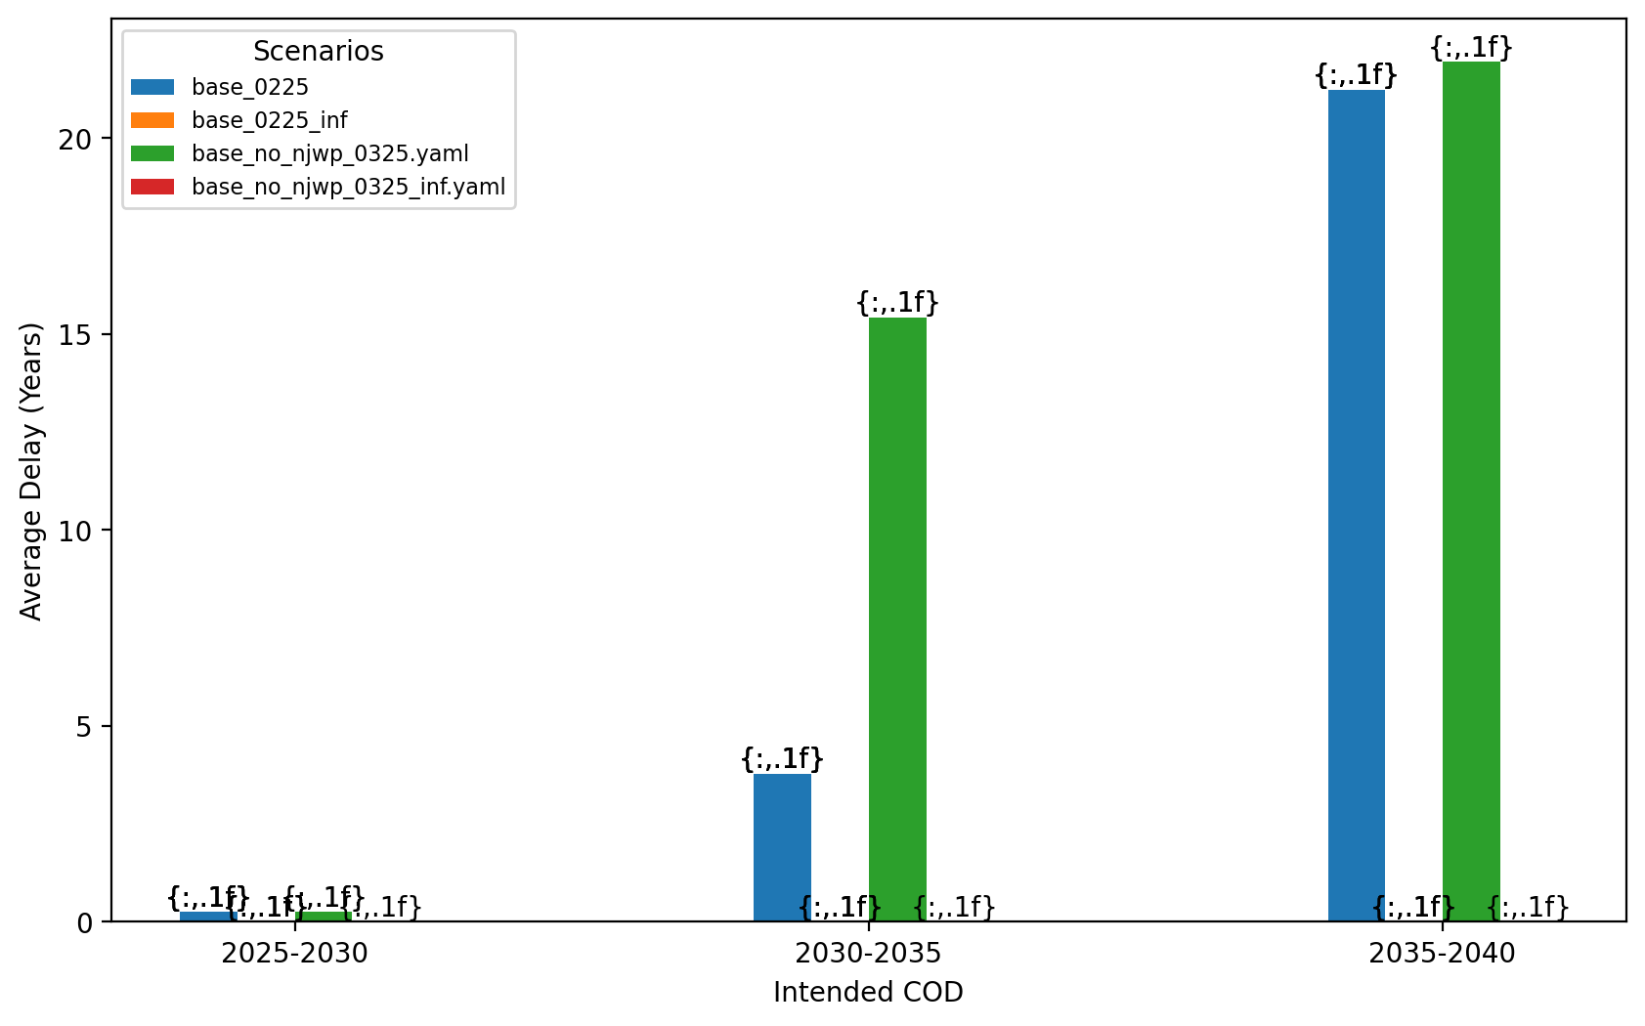
Average Delay Per Project by COD - NE

Slide 36
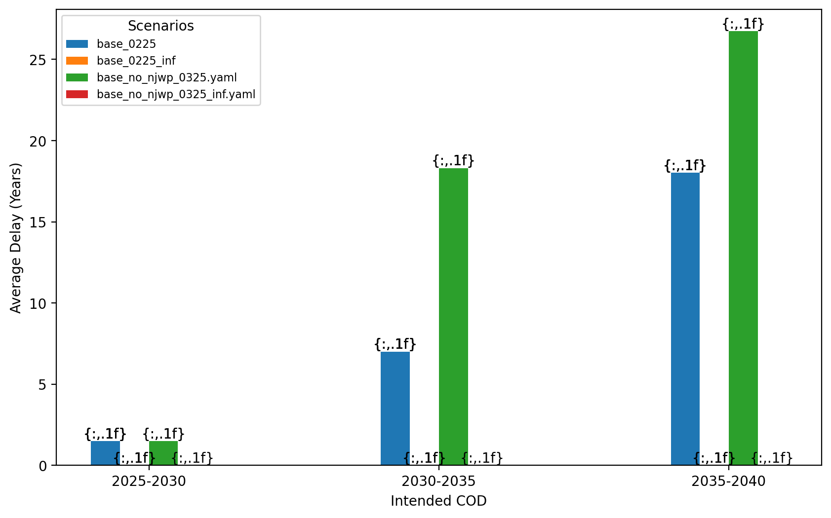
Average Delay Per Project by COD - NY/NJ

Slide 37
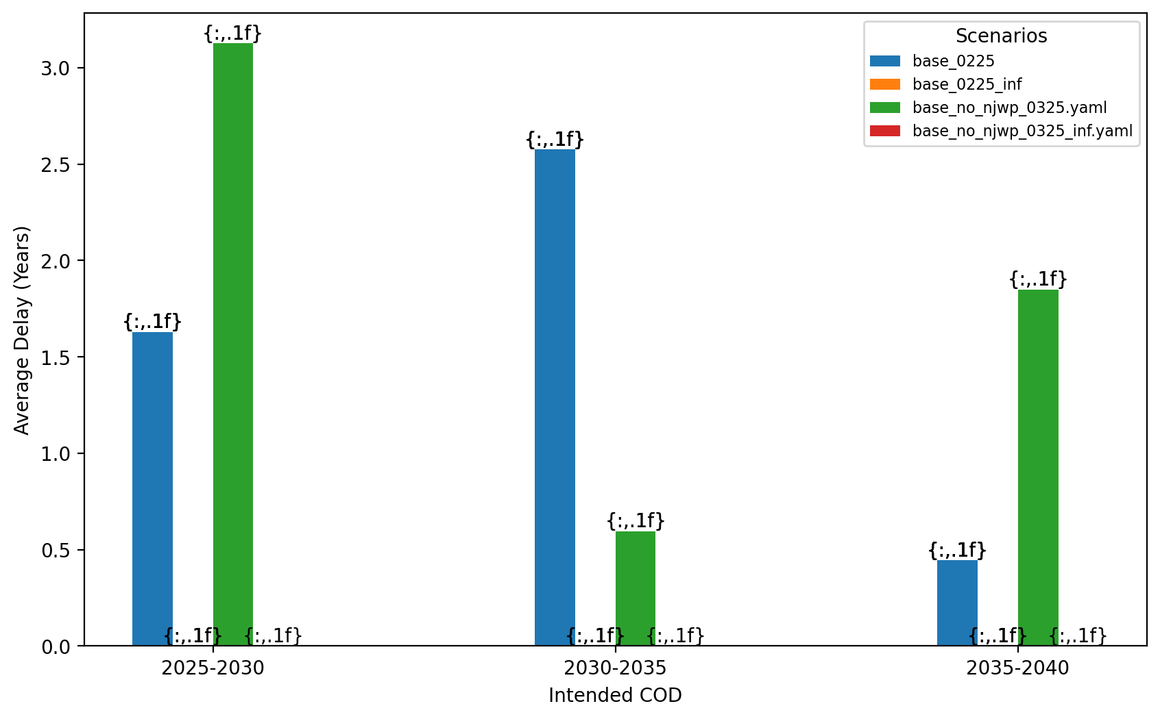
Average Delay Per Project by COD - Mid-Atlantic

Slide 38
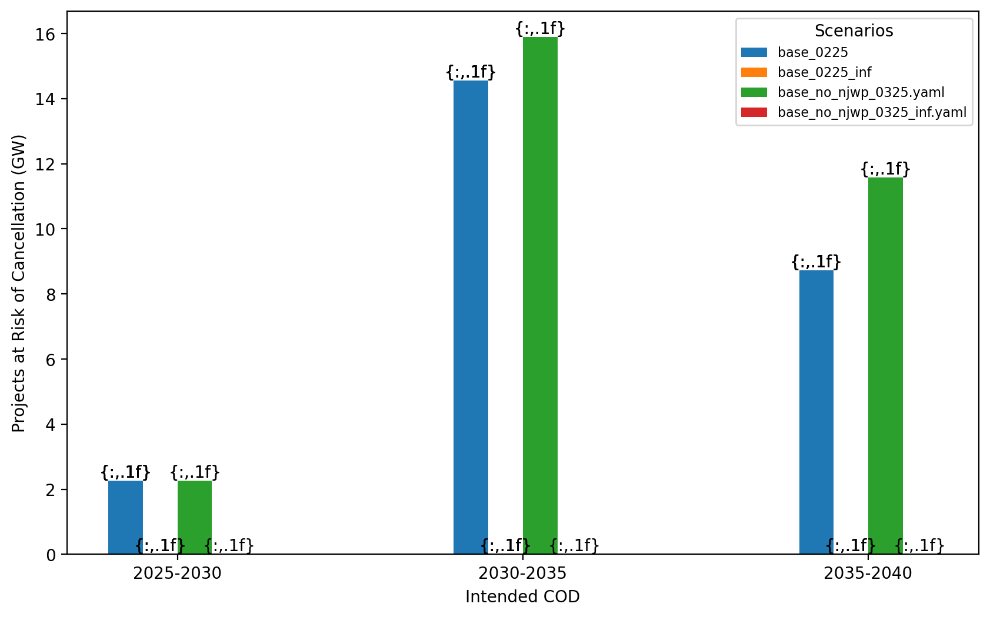
Total Capacity at Risk by COD - All Regions

Slide 39
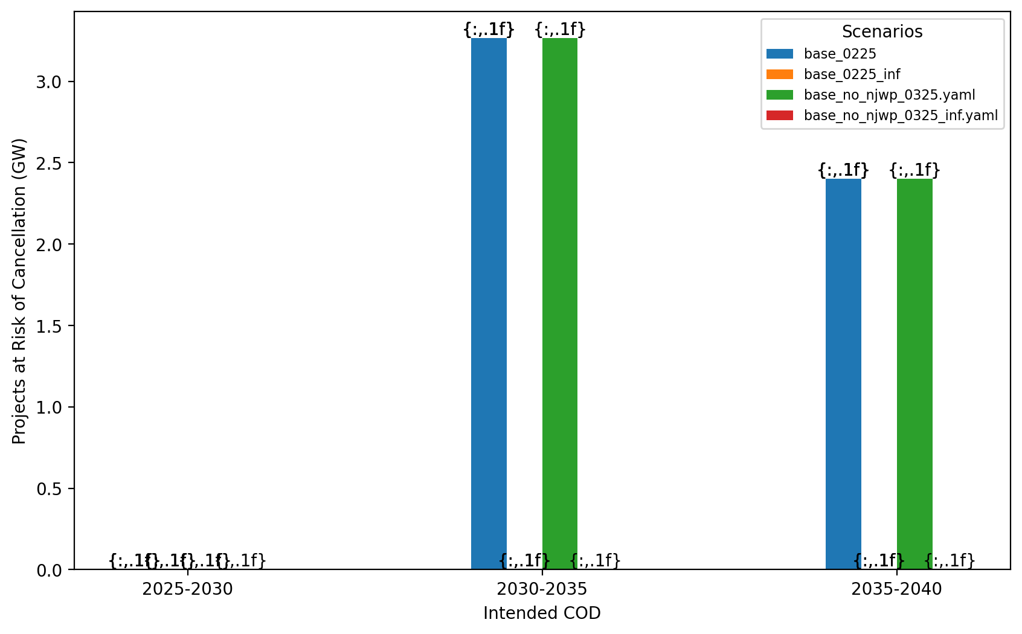
Total Capacity at Risk by COD - NE

Slide 40
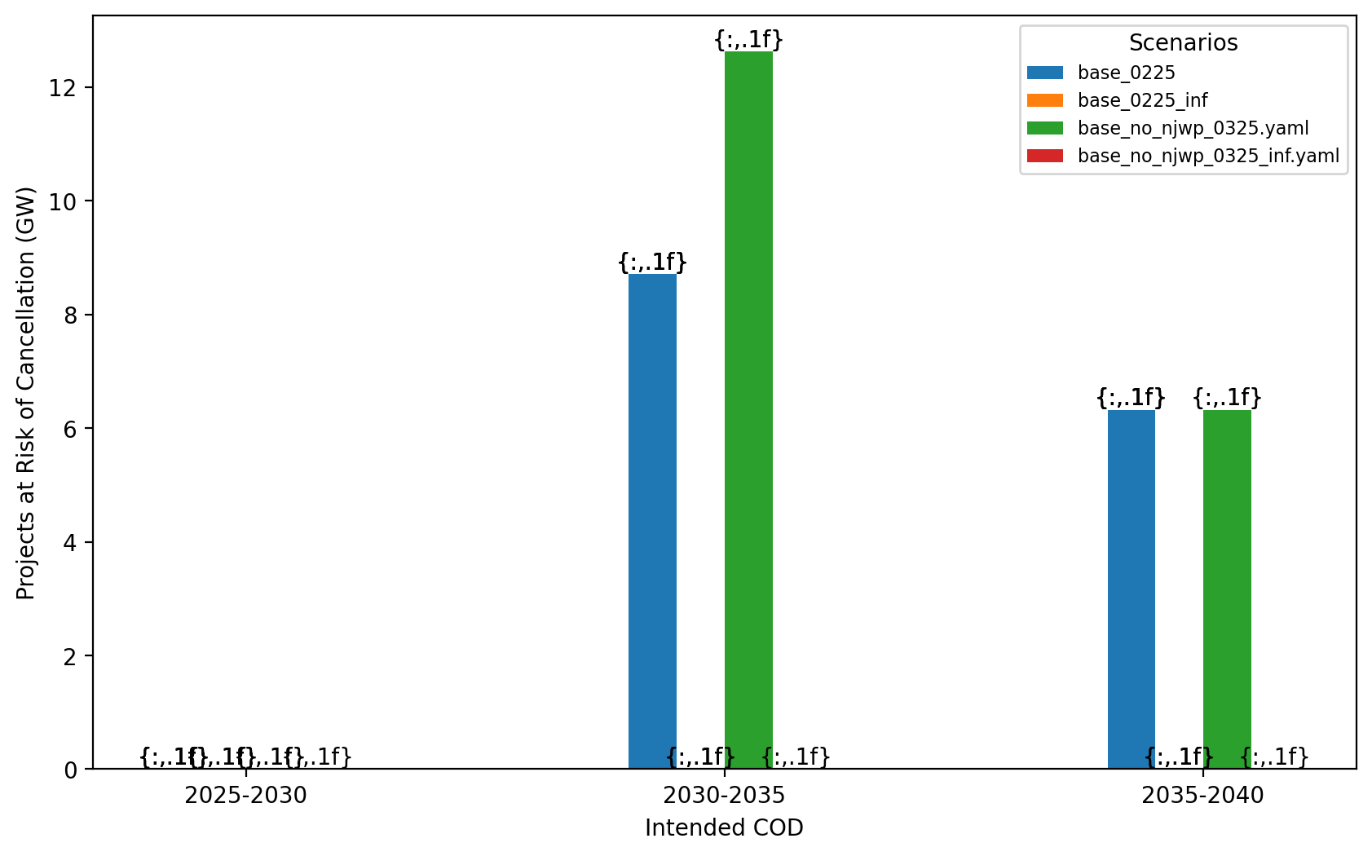
Total Capacity at Risk by COD - NY/NJ

Slide 41
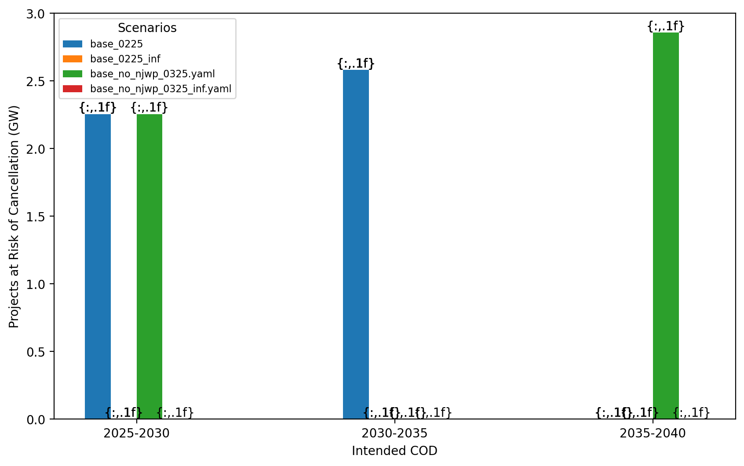
Total Capacity at Risk by COD - Mid-Atlantic

Slide 42
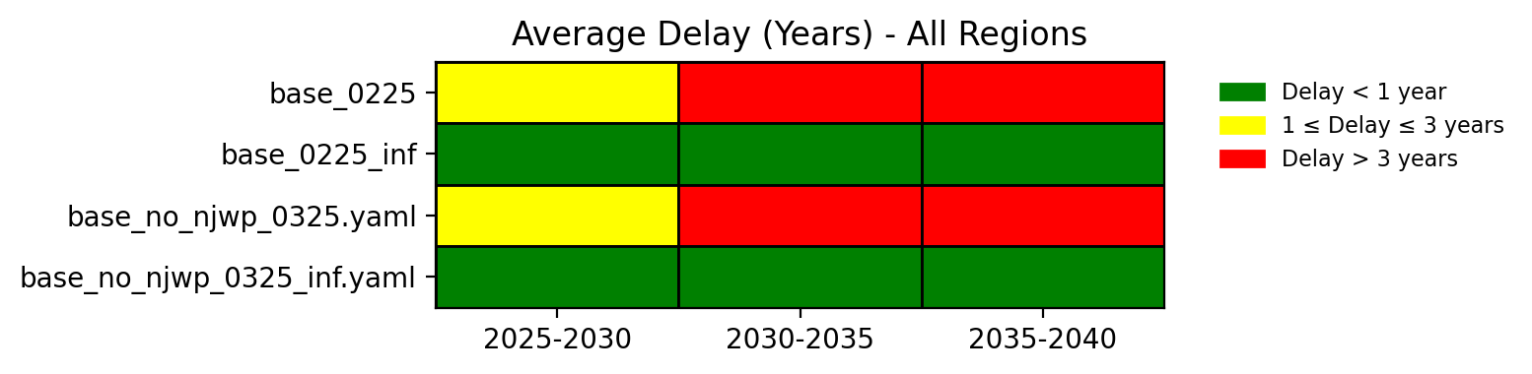
Average Delay Heat Map - All Regions

Slide 43
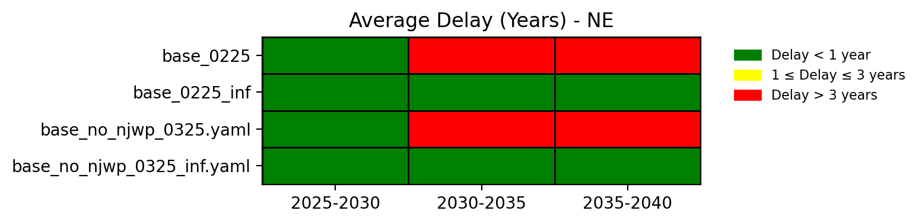
Average Delay Heat Map - NE

Slide 44
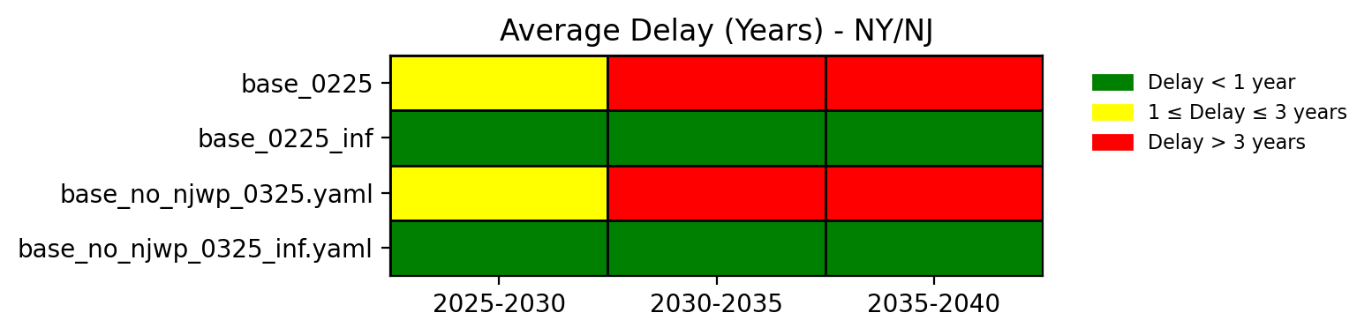
Average Delay Heat Map - NY/NJ

Slide 45
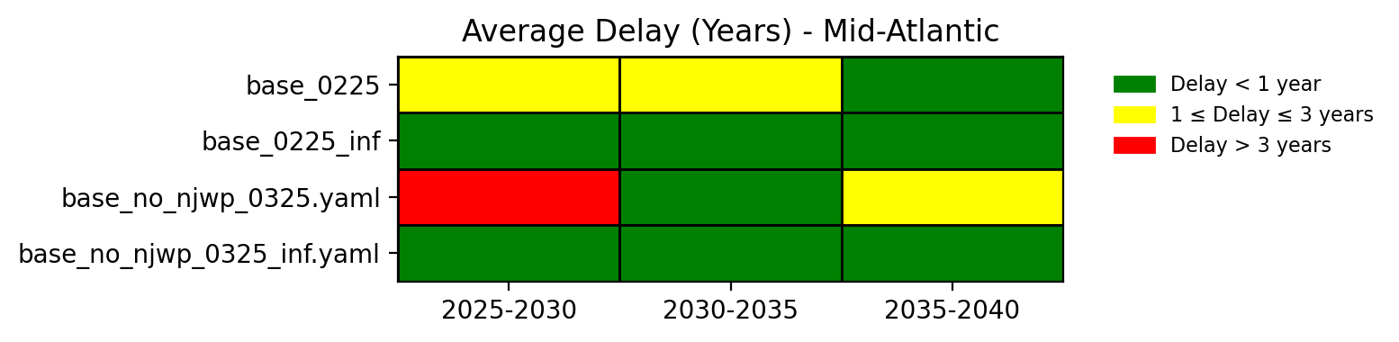
Average Delay Heat Map - Mid-Atlantic

