Slide 1
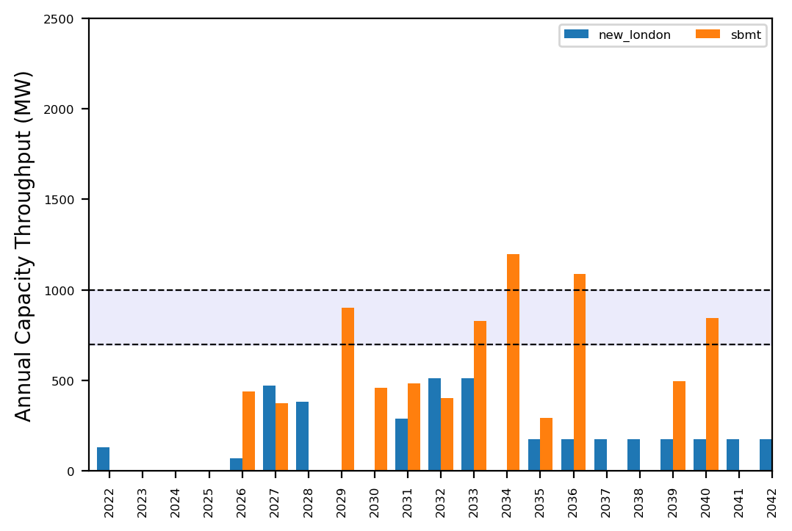
Port Throughput

Slide 2
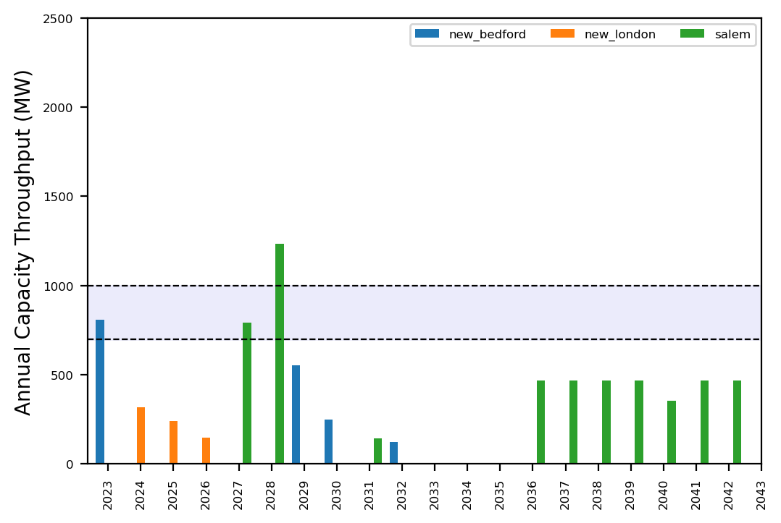
Port Throughput

Slide 3
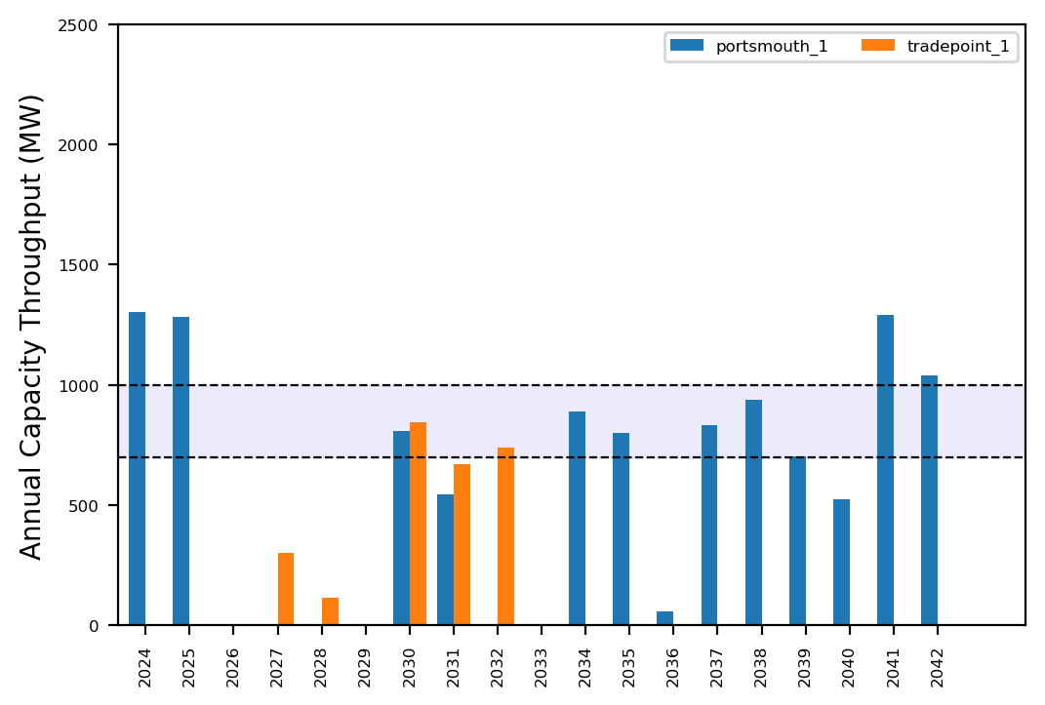
Port Throughput

Slide 4
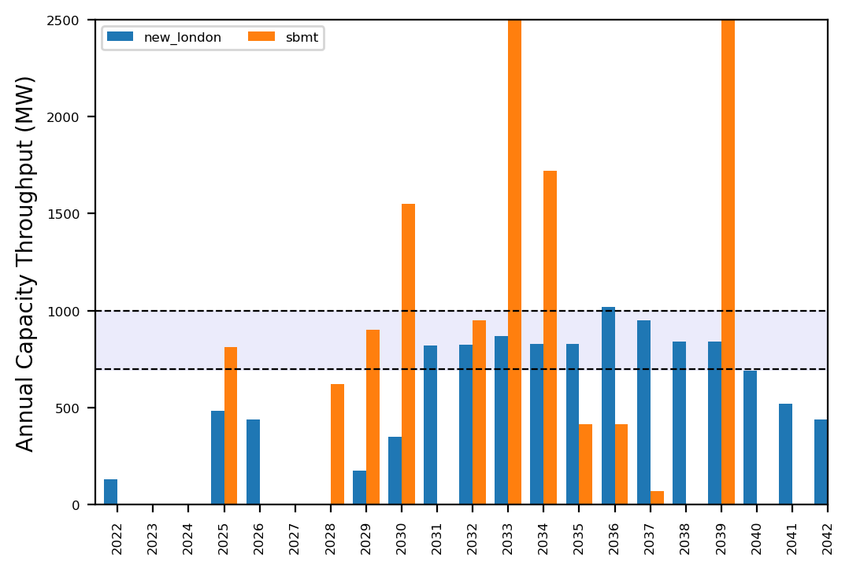
Port Throughput

Slide 5
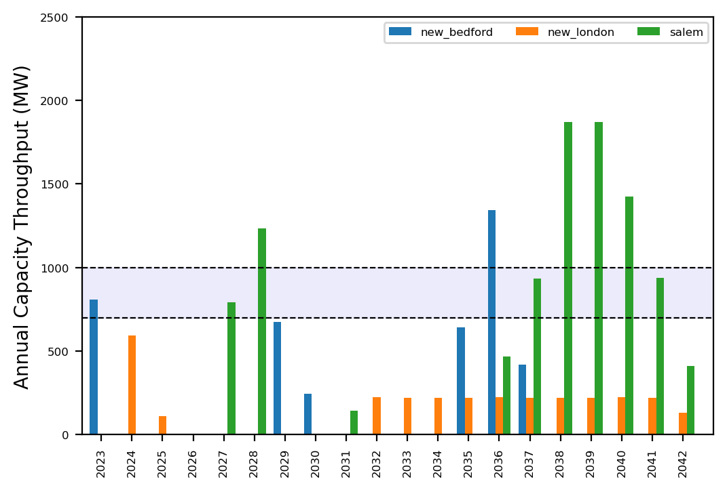
Port Throughput

Slide 6
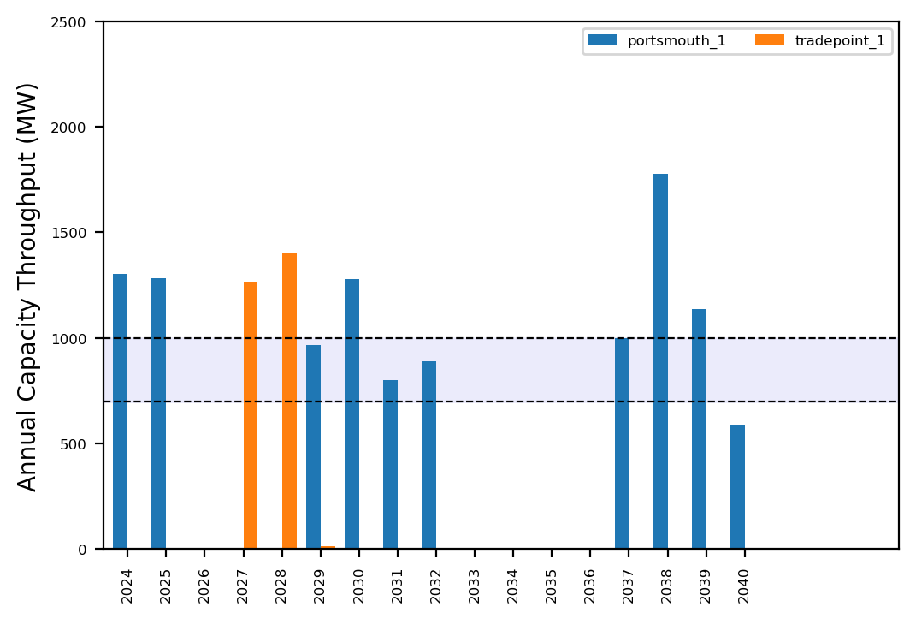
Port Throughput

Slide 7
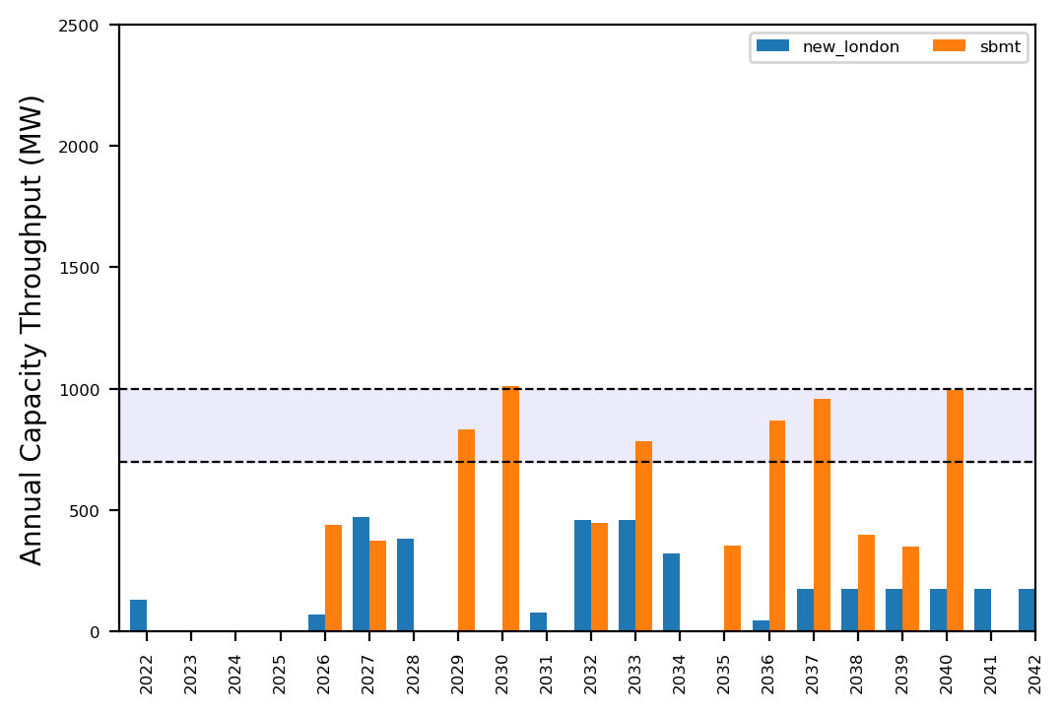
Port Throughput

Slide 8
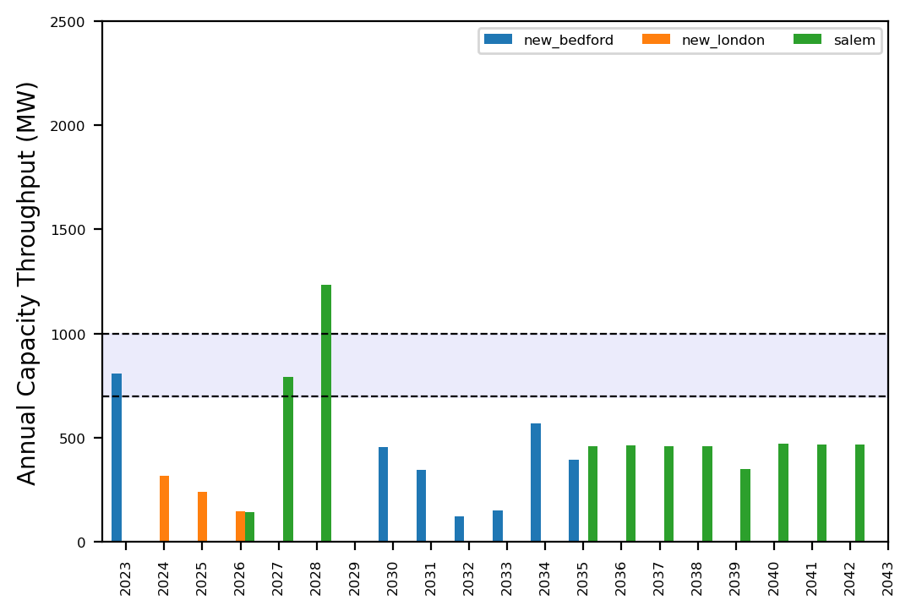
Port Throughput

Slide 9
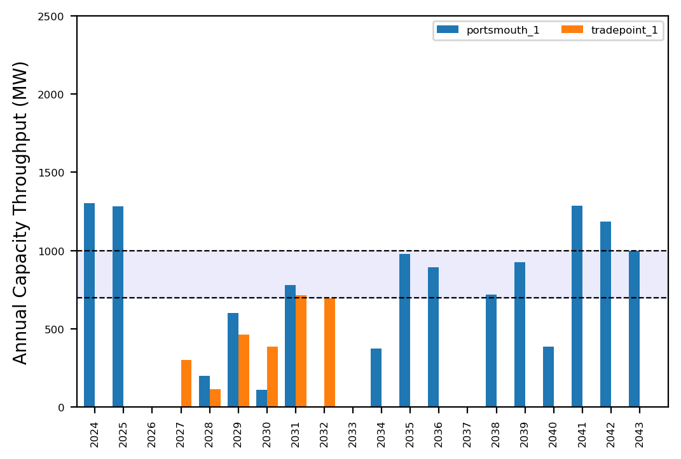
Port Throughput

Slide 10
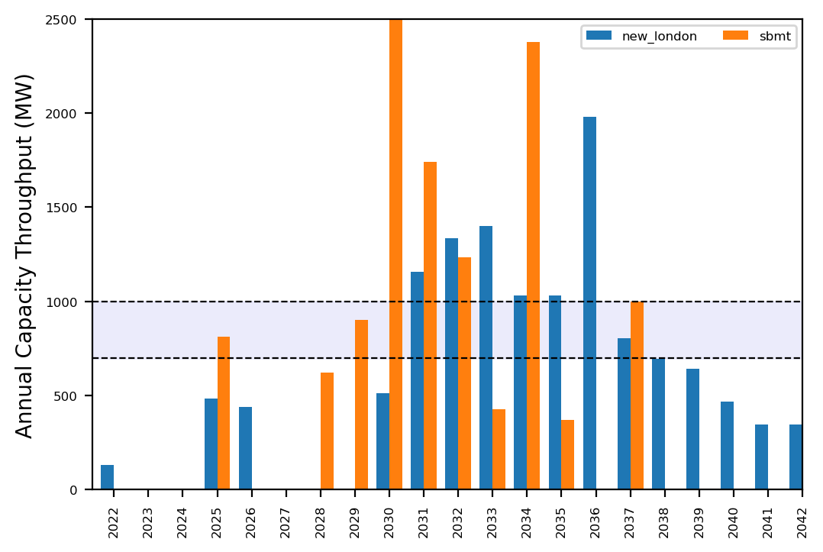
Port Throughput

Slide 11
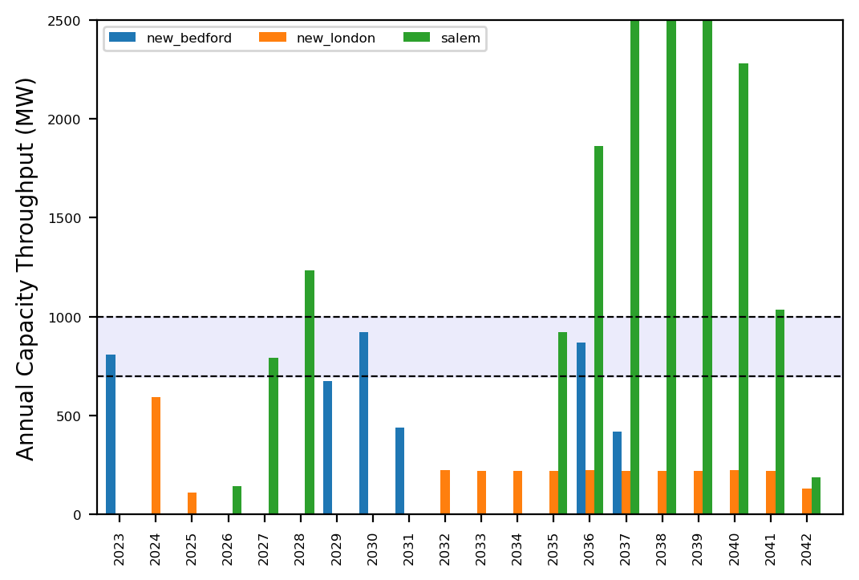
Port Throughput

Slide 12
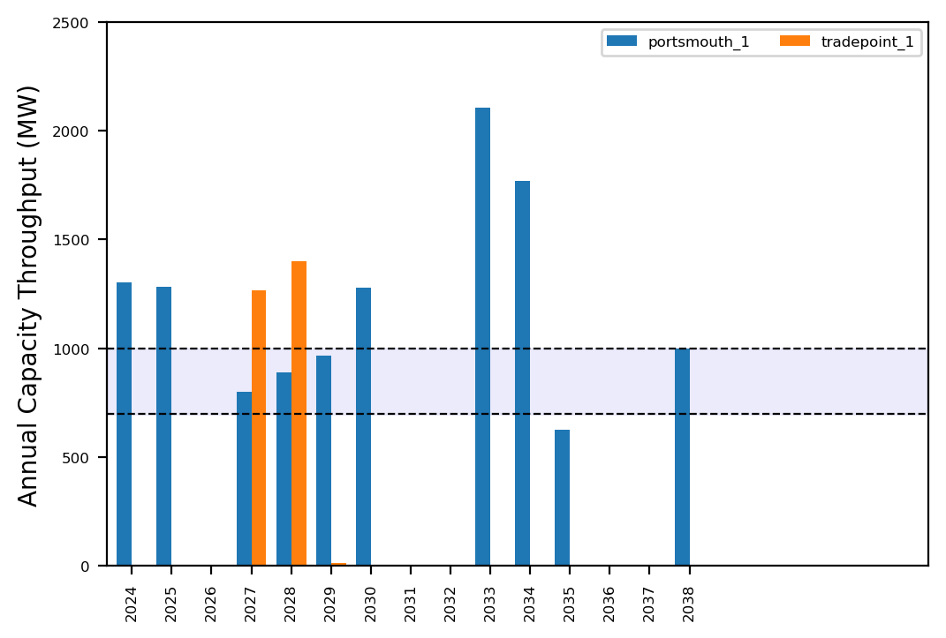
Port Throughput

Slide 13
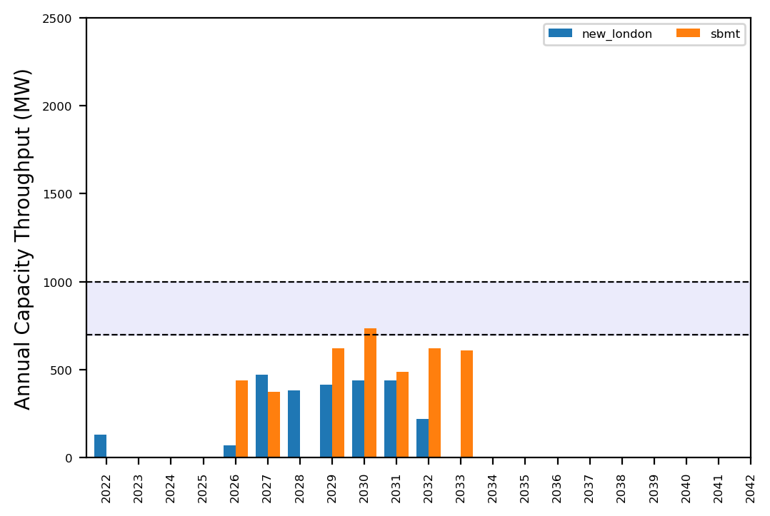
Port Throughput

Slide 14
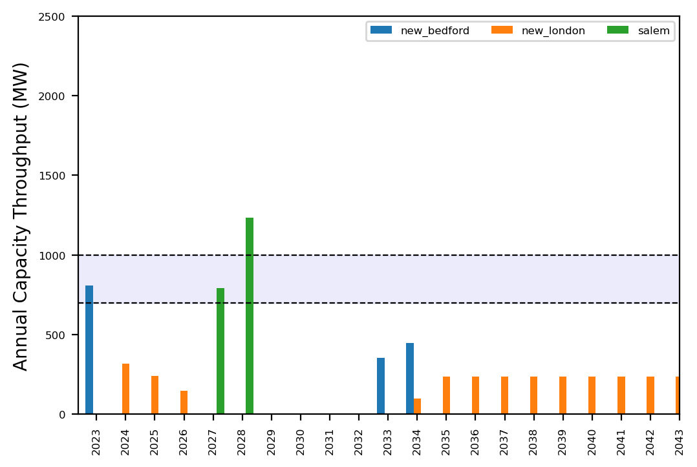
Port Throughput

Slide 15
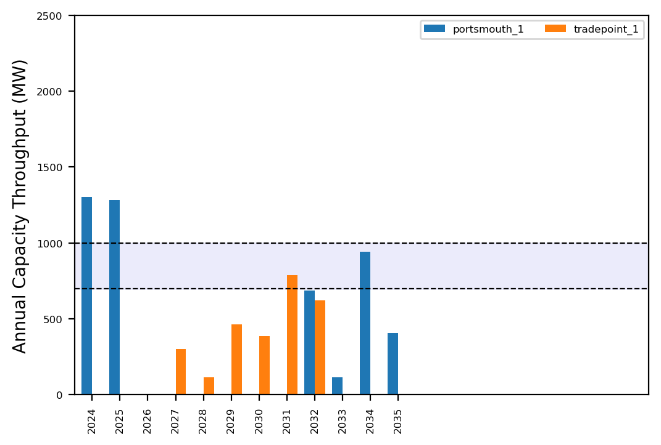
Port Throughput

Slide 16
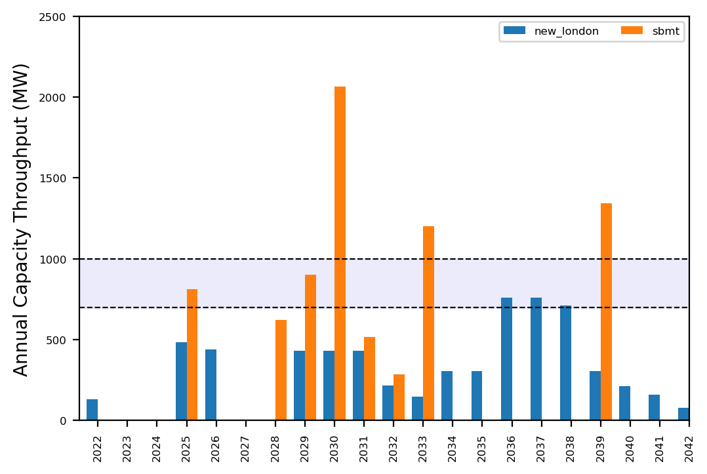
Port Throughput

Slide 17
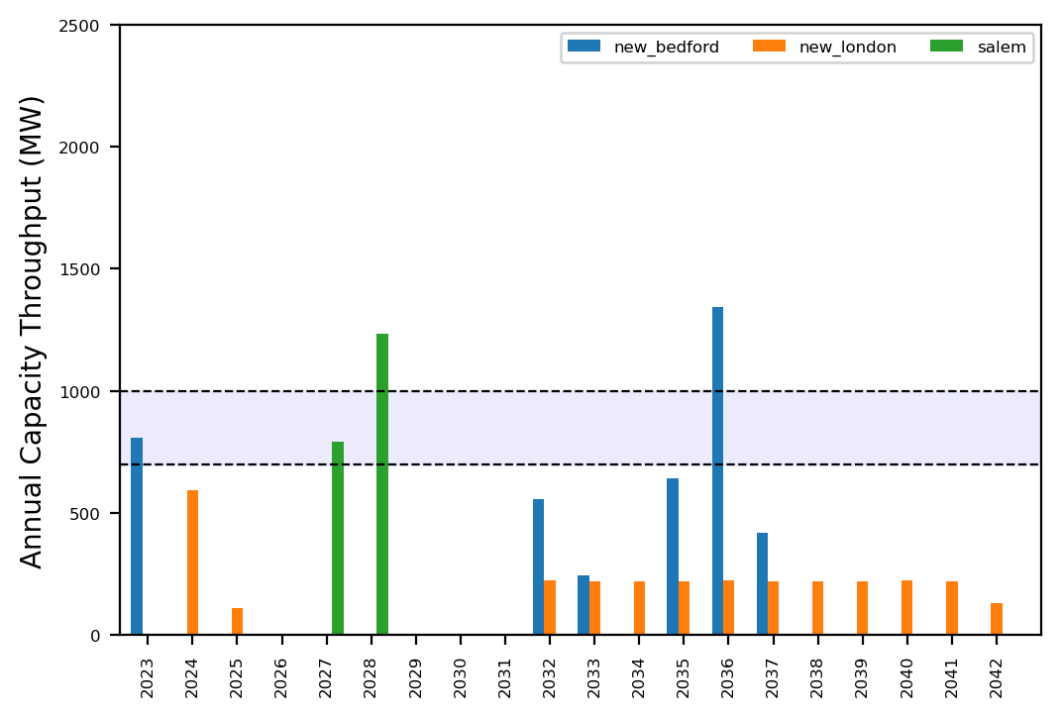
Port Throughput

Slide 18
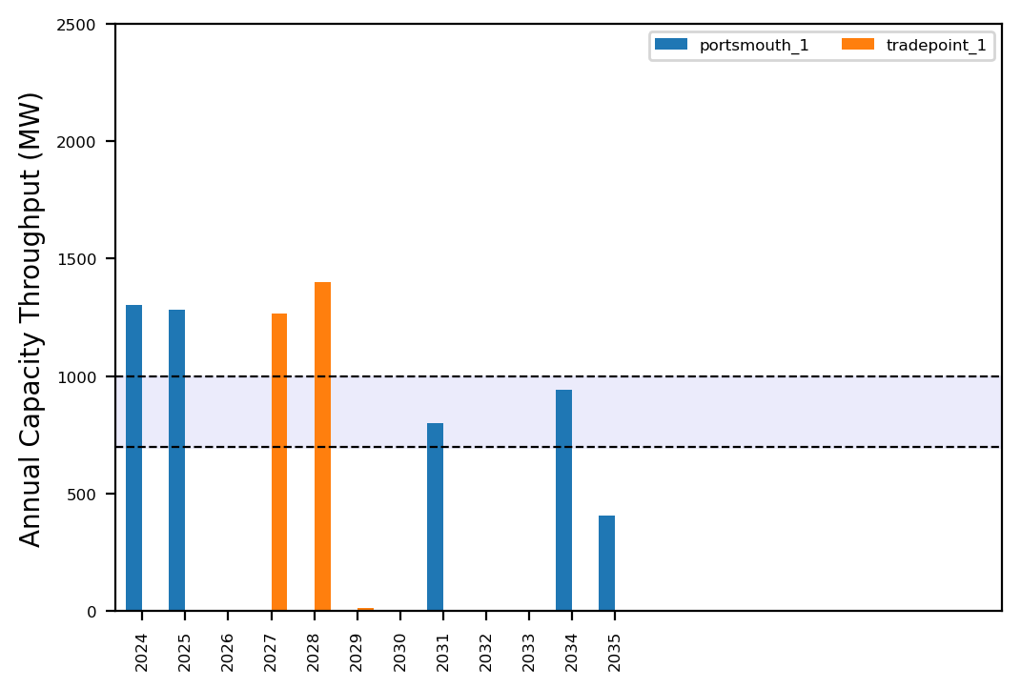
Port Throughput

Slide 19
Summary Plots
Plots comparing runs

Slide 20
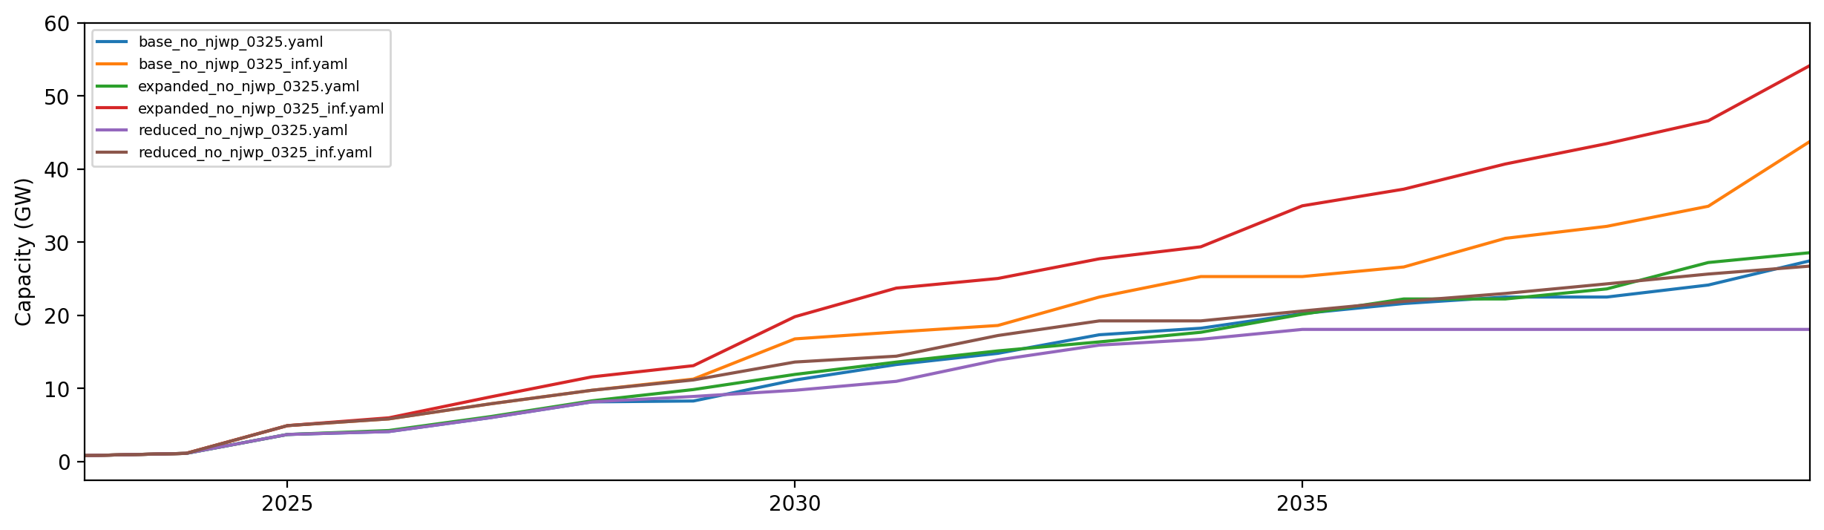
Installed Capacity

Slide 21
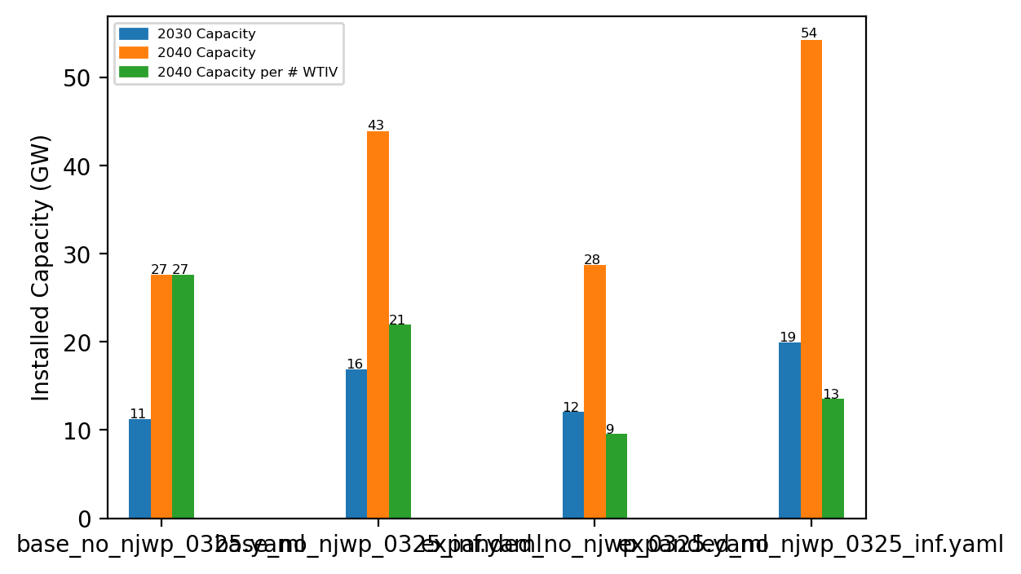
Summary Installed Cap

Slide 22
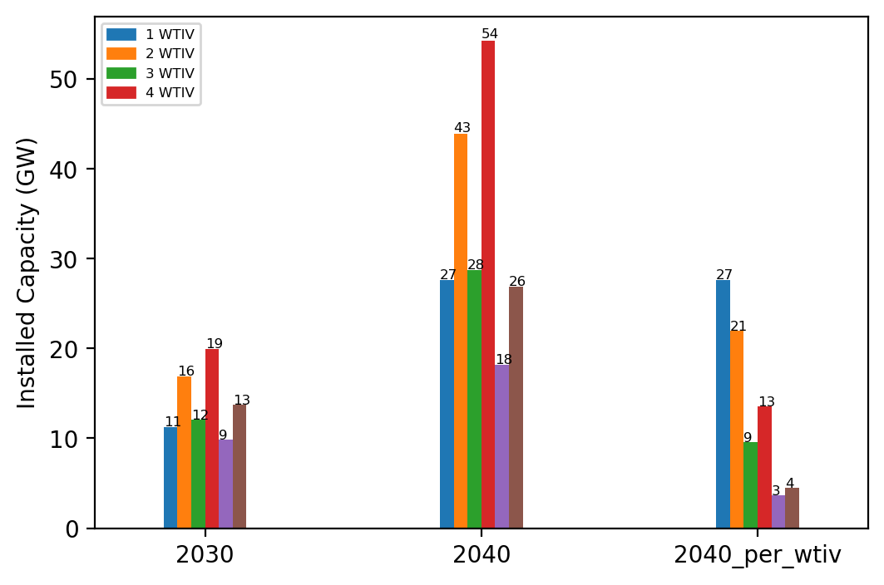
Summary Installed Cap T

Slide 23
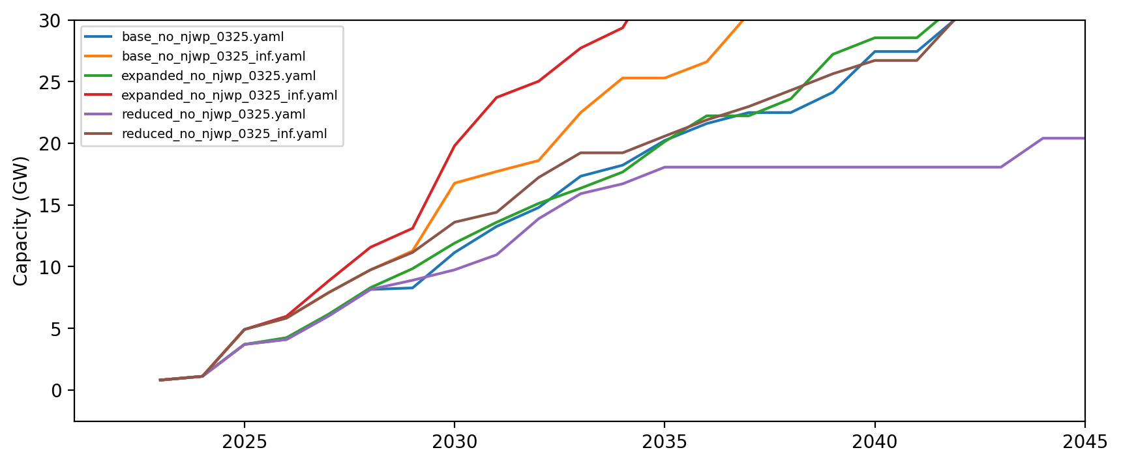
Installed Capacity - All Regions

Slide 24
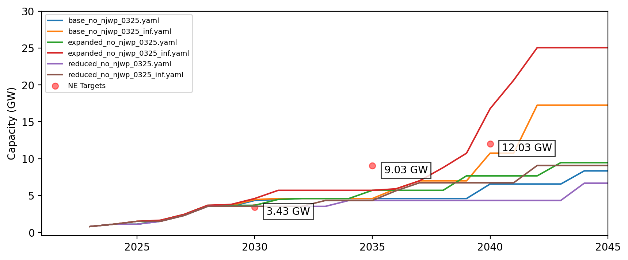
Installed Capacity - NE

Slide 25
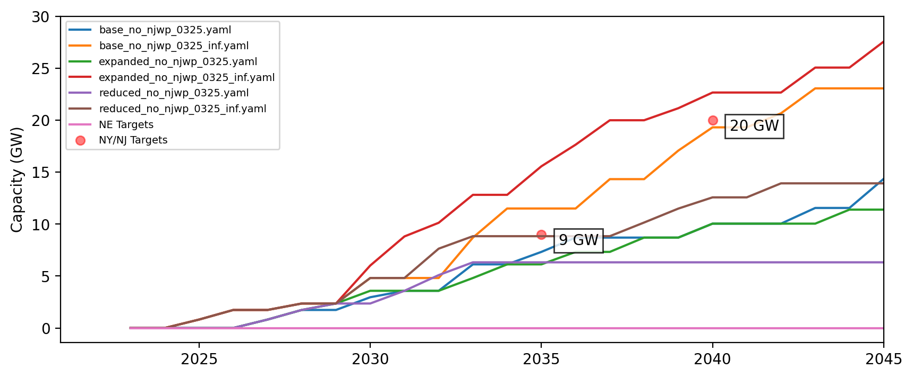
Installed Capacity - NY/NJ

Slide 26
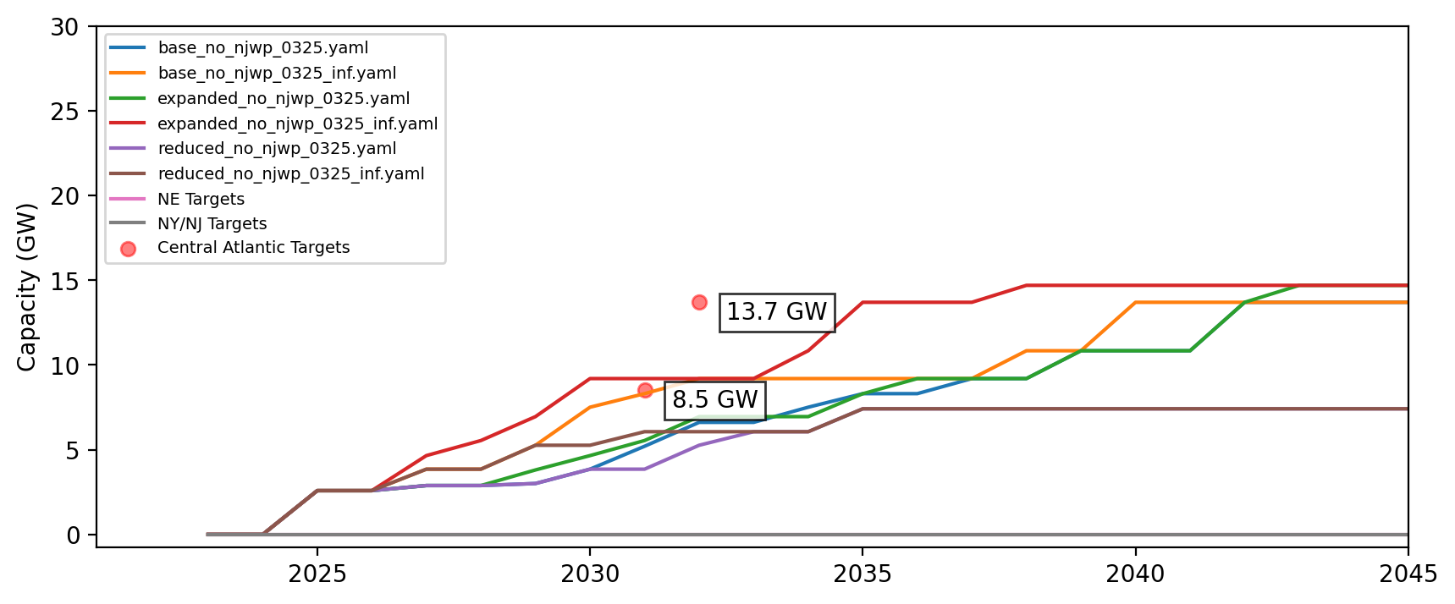
Installed Capacity - Central Atlantic

Slide 27
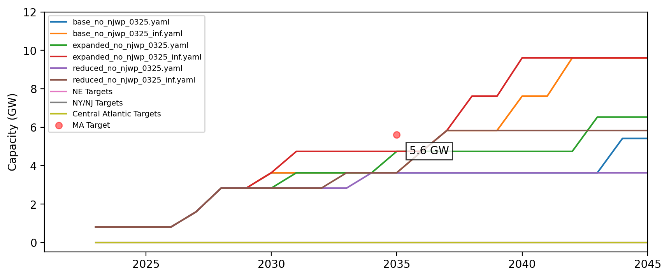
Cumulative Installed Capacity - MA

Slide 28
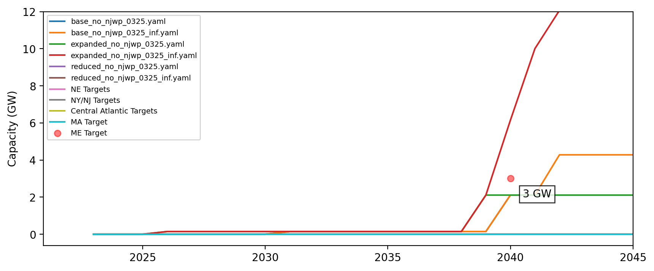
Cumulative Installed Capacity - ME

Slide 29
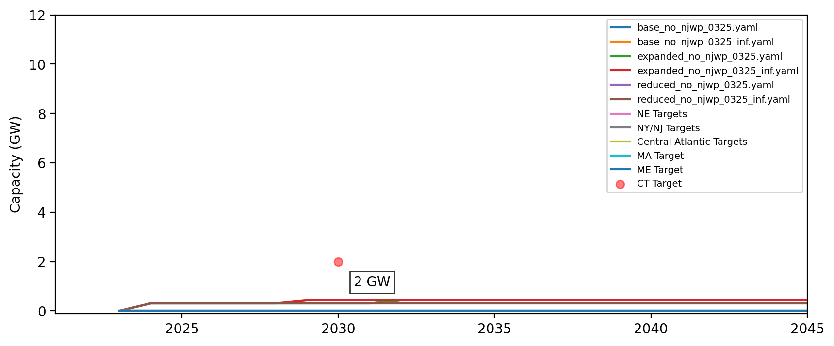
Cumulative Installed Capacity - CT

Slide 30
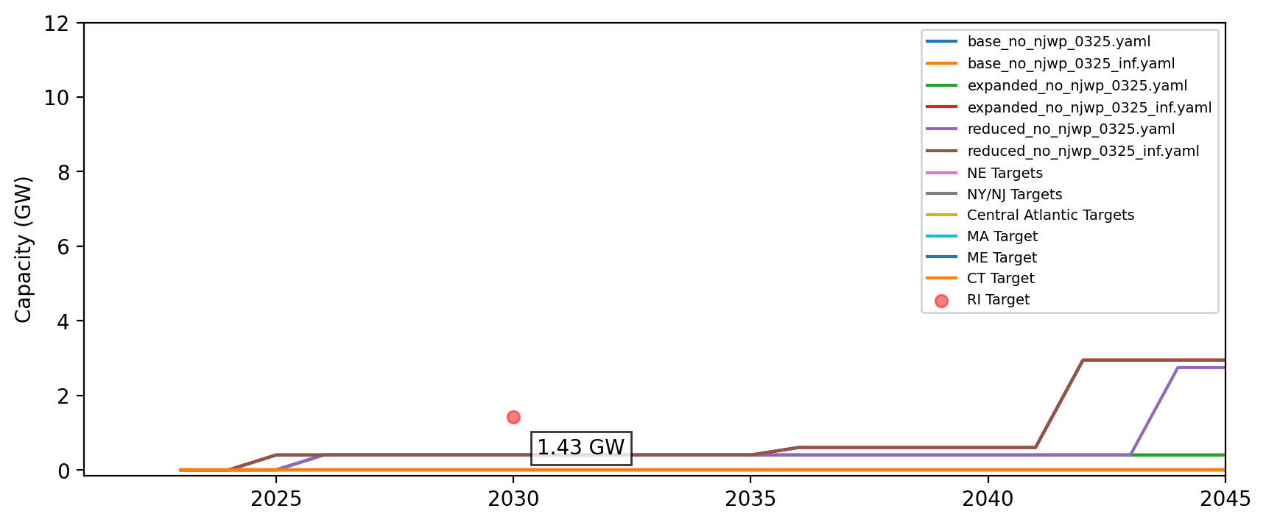
Cumulative Installed Capacity - RI

Slide 31
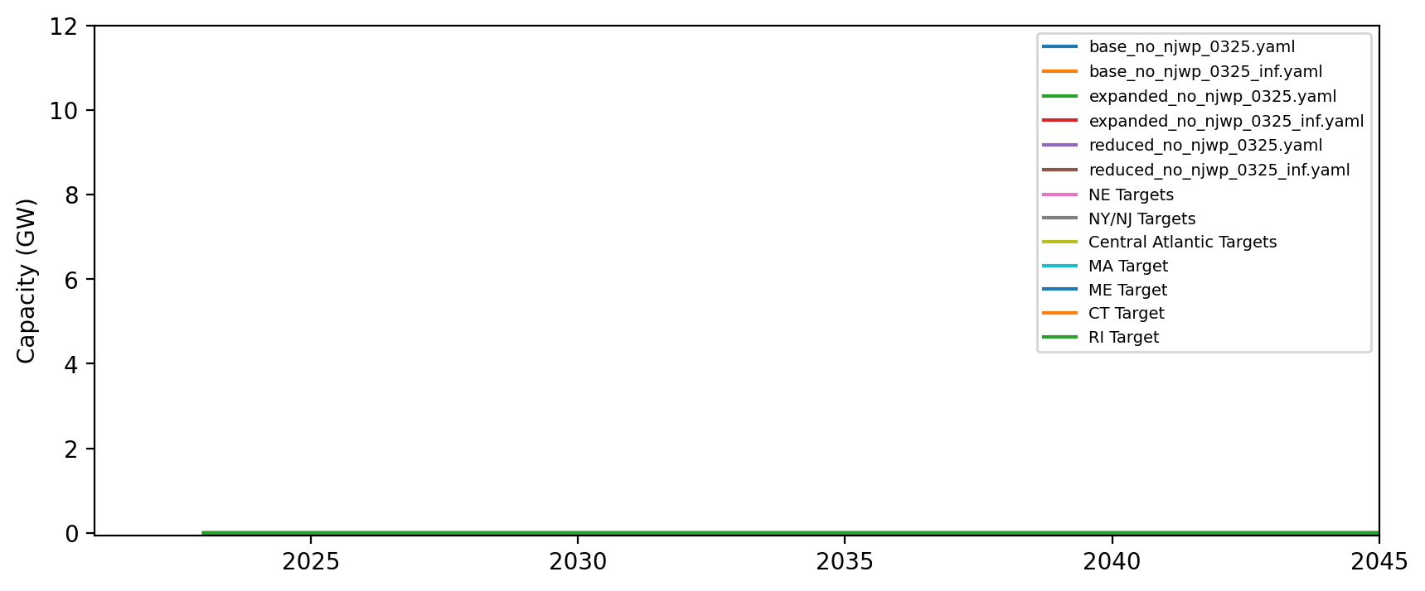
Cumulative Installed Capacity - NH

Slide 32
Cumulative Installed Capacity - RI/CT

Slide 33
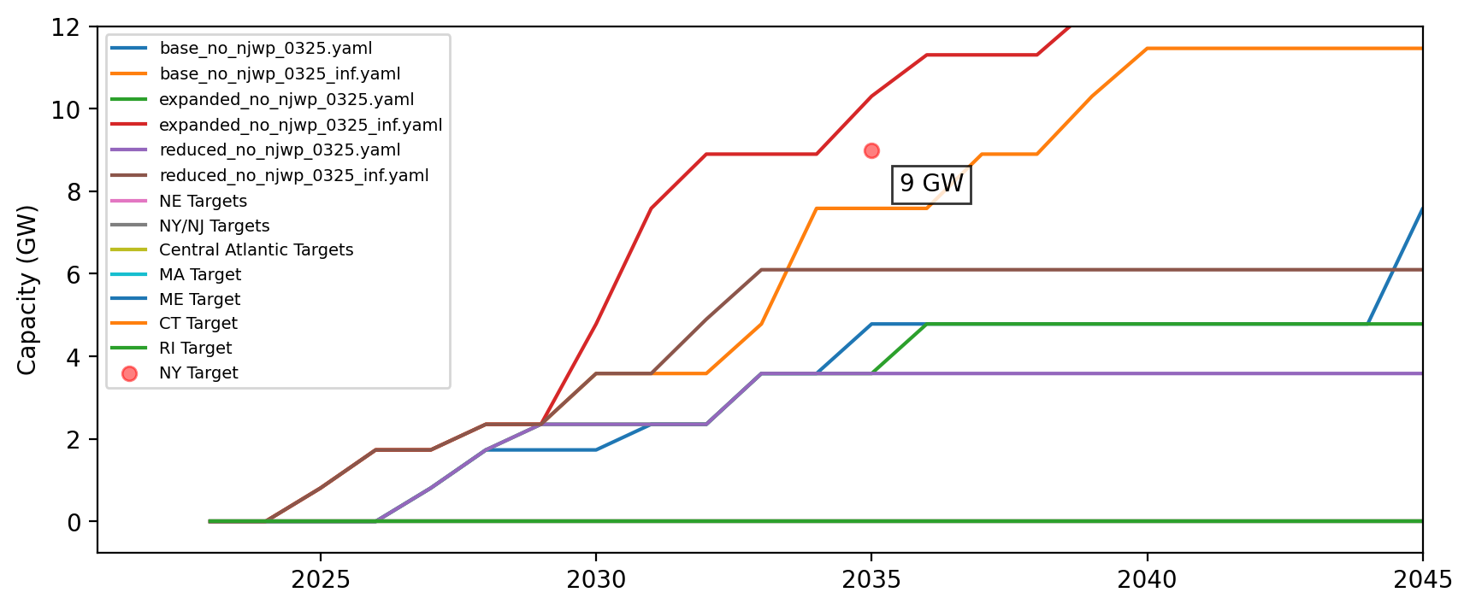
Cumulative Installed Capacity - NY

Slide 34
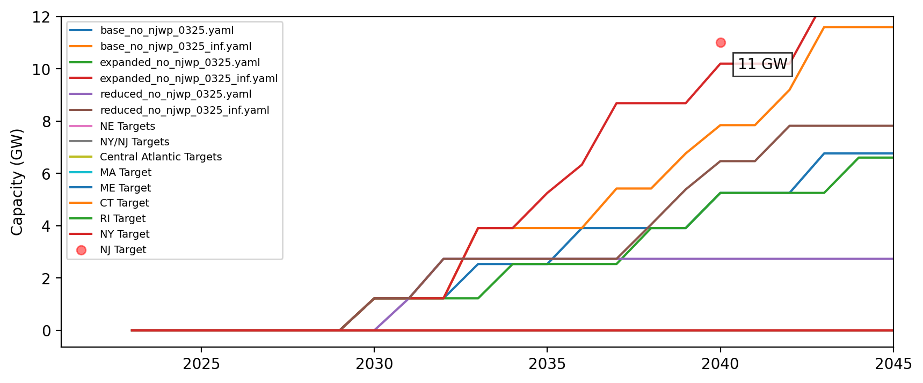
Cumulative Installed Capacity - NJ

Slide 35
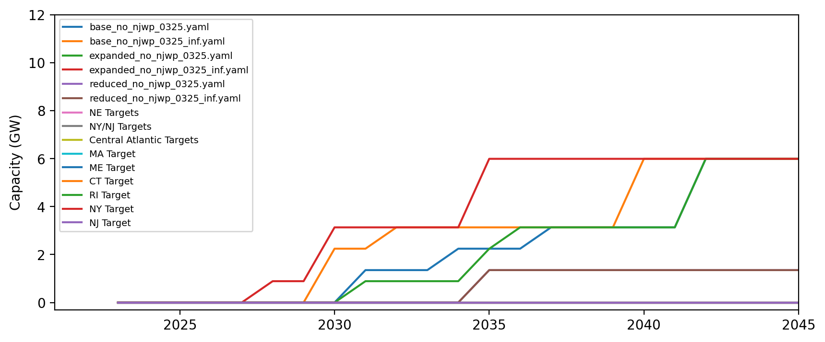
Cumulative Installed Capacity - NC

Slide 36
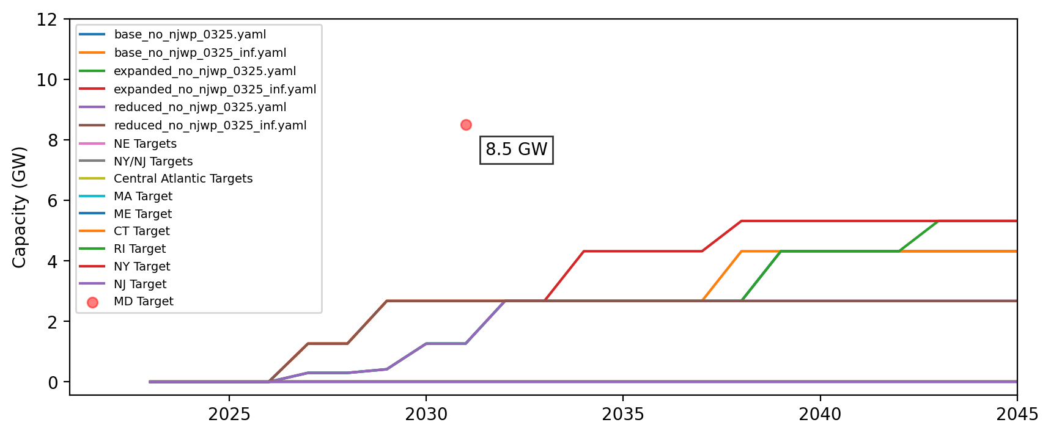
Cumulative Installed Capacity - MD

Slide 37
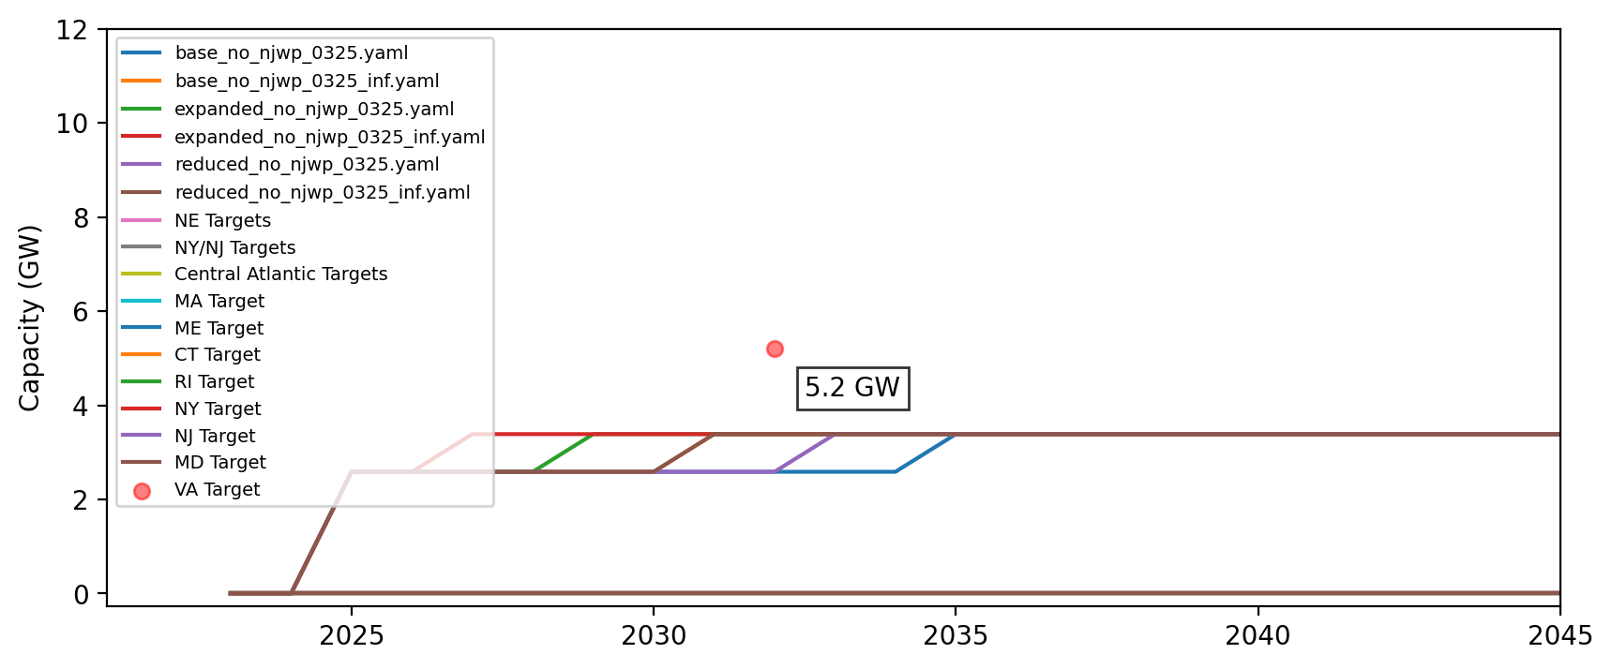
Cumulative Installed Capacity - VA

Slide 38
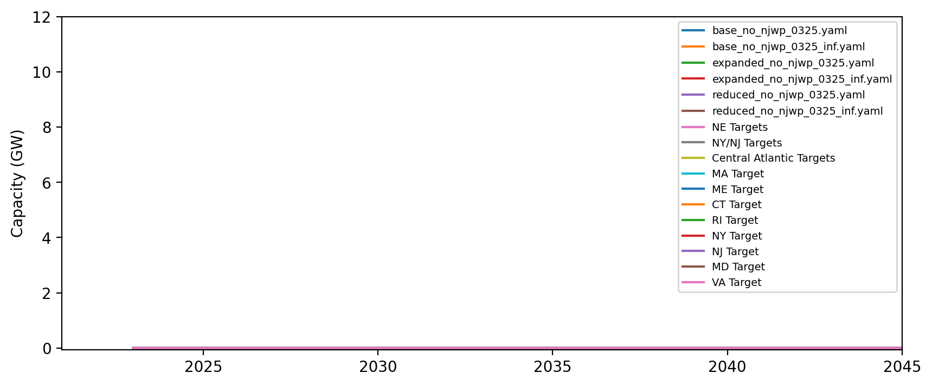
Cumulative Installed Capacity - DE

Slide 39
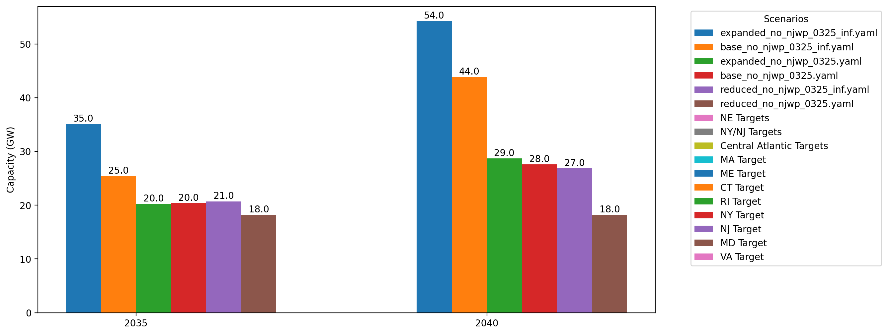
Cumulative Capacity by 2035 and 2040

Slide 40
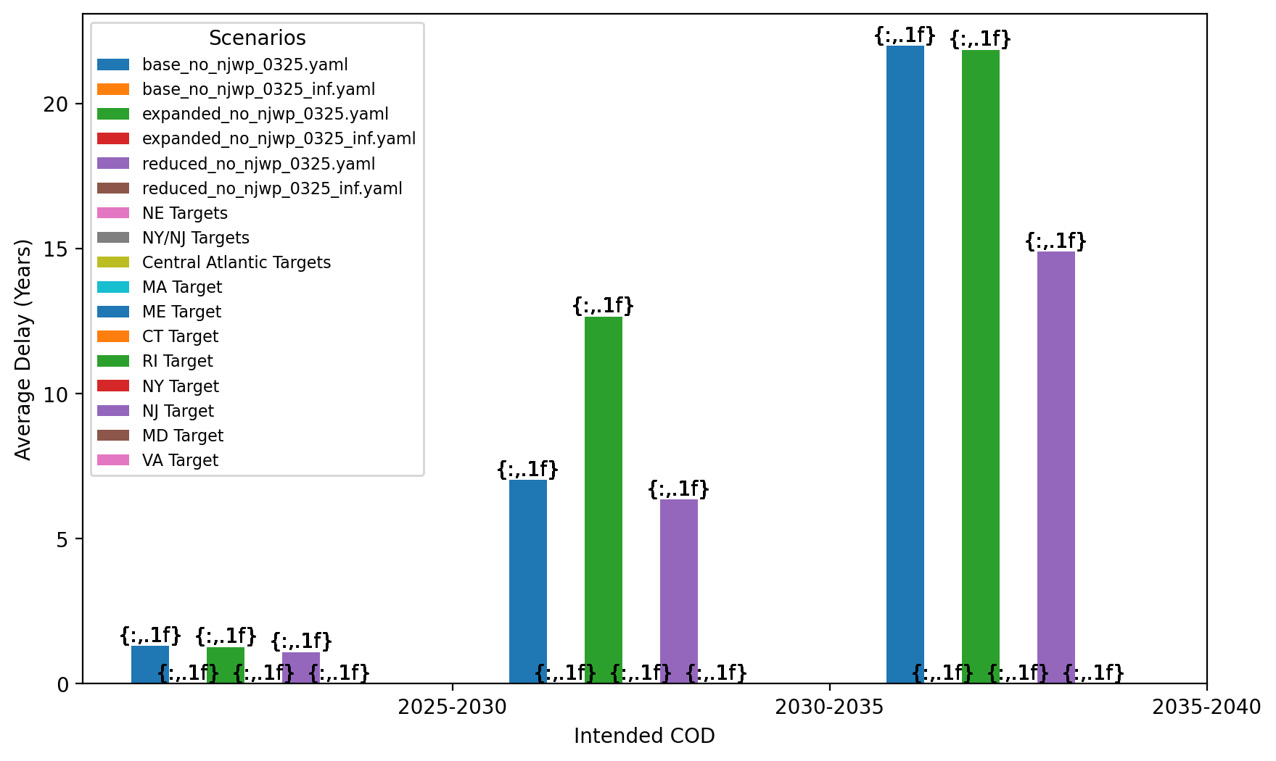
Average Delay Per Project by COD - All Regions

Slide 41
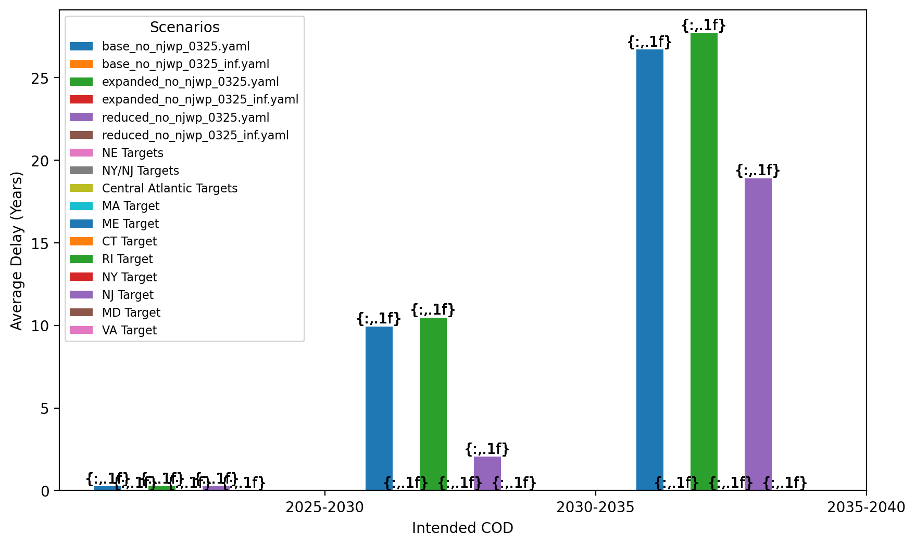
Average Delay Per Project by COD - NE

Slide 42
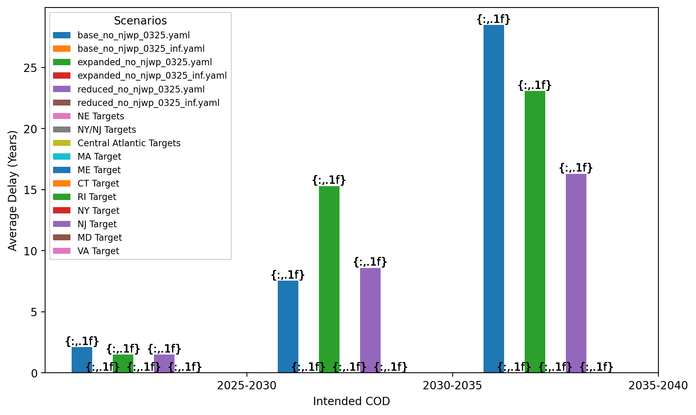
Average Delay Per Project by COD - NY/NJ

Slide 43
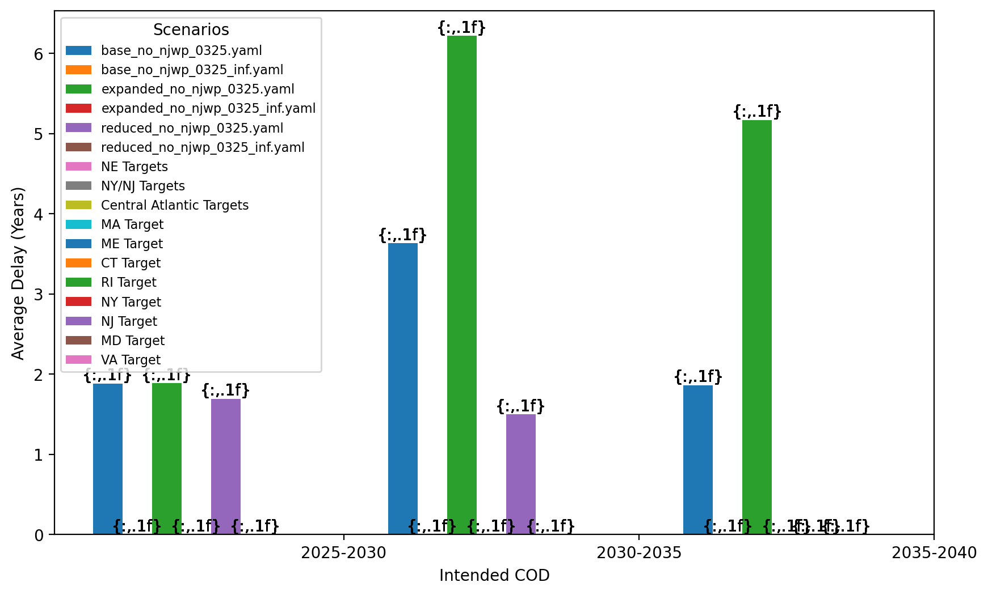
Average Delay Per Project by COD - Mid-Atlantic

Slide 44
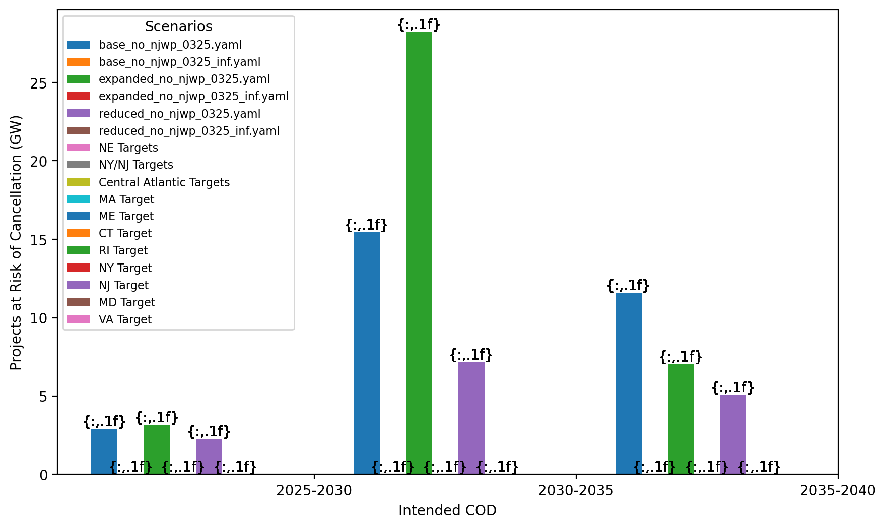
Total Capacity at Risk by COD - All Regions

Slide 45
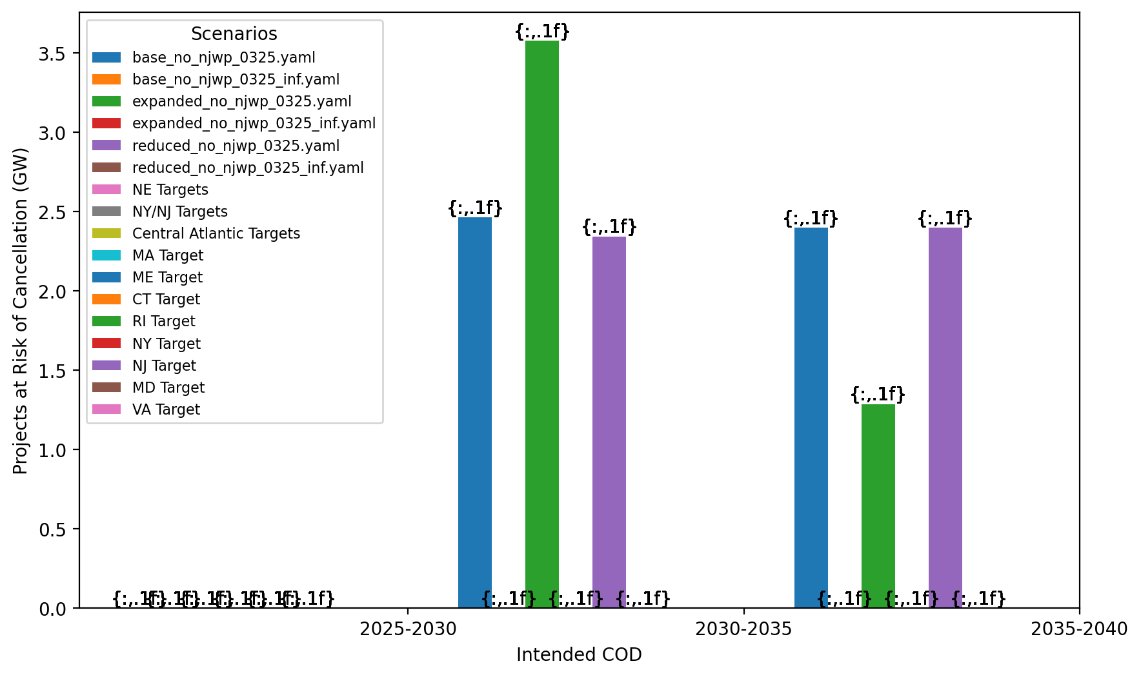
Total Capacity at Risk by COD - NE

Slide 46
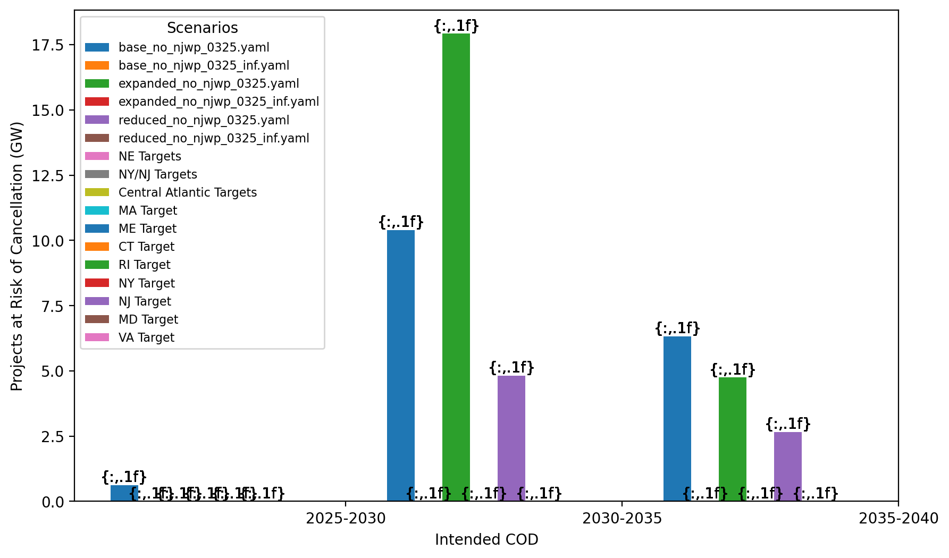
Total Capacity at Risk by COD - NY/NJ

Slide 47
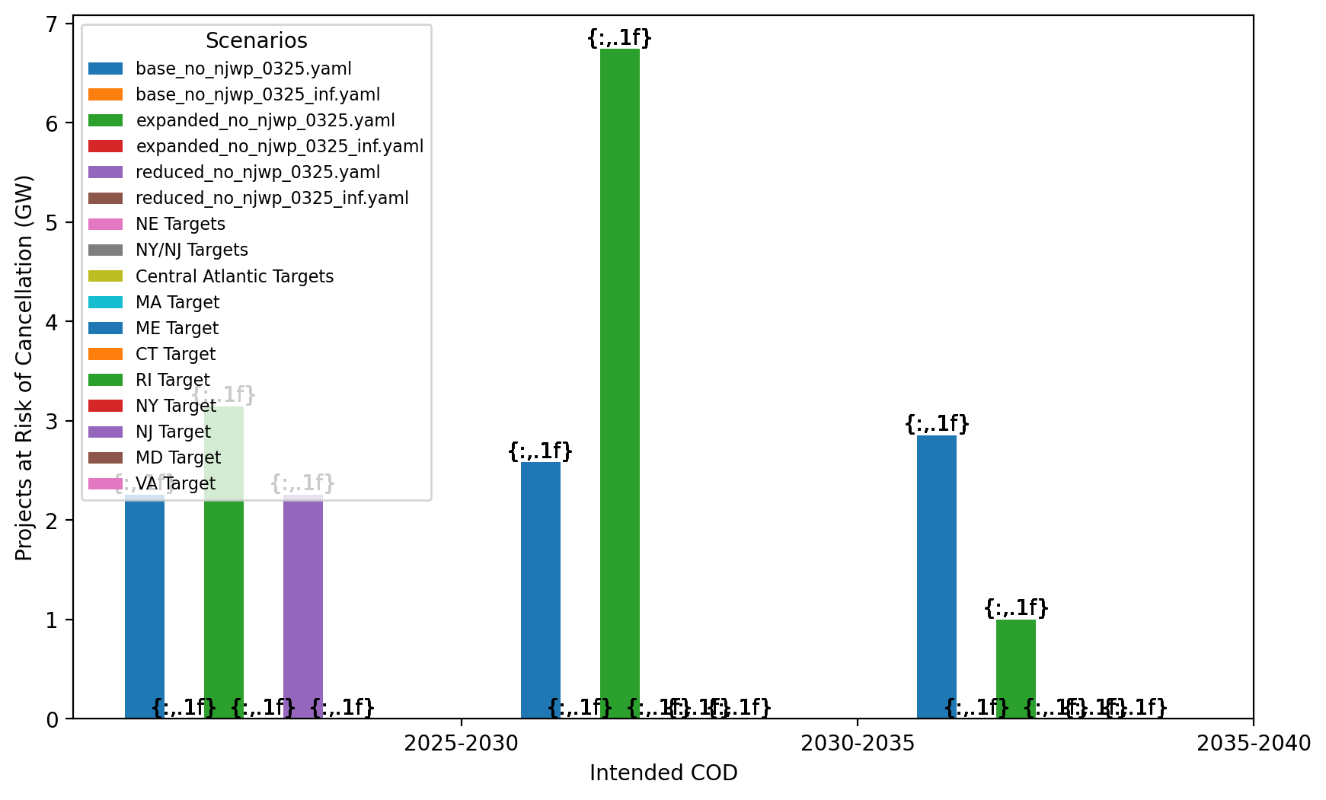
Total Capacity at Risk by COD - Mid-Atlantic

Slide 48
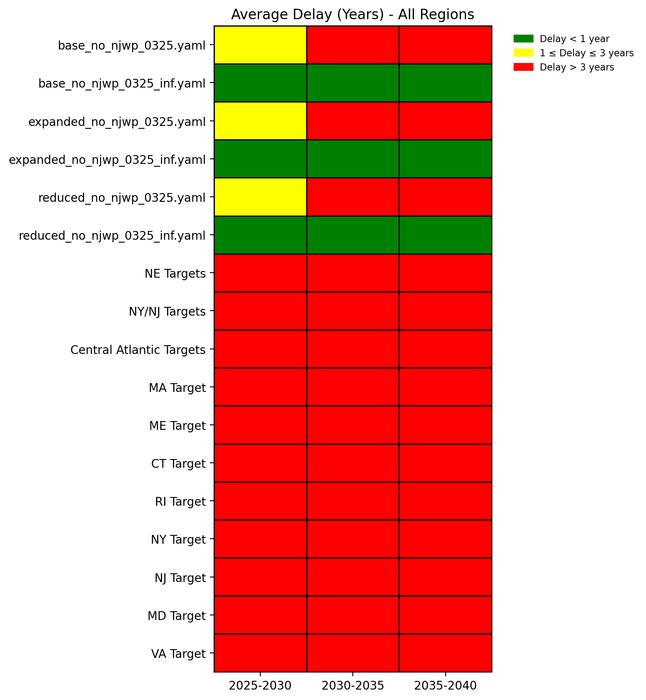
Average Delay Heat Map - All Regions

Slide 49
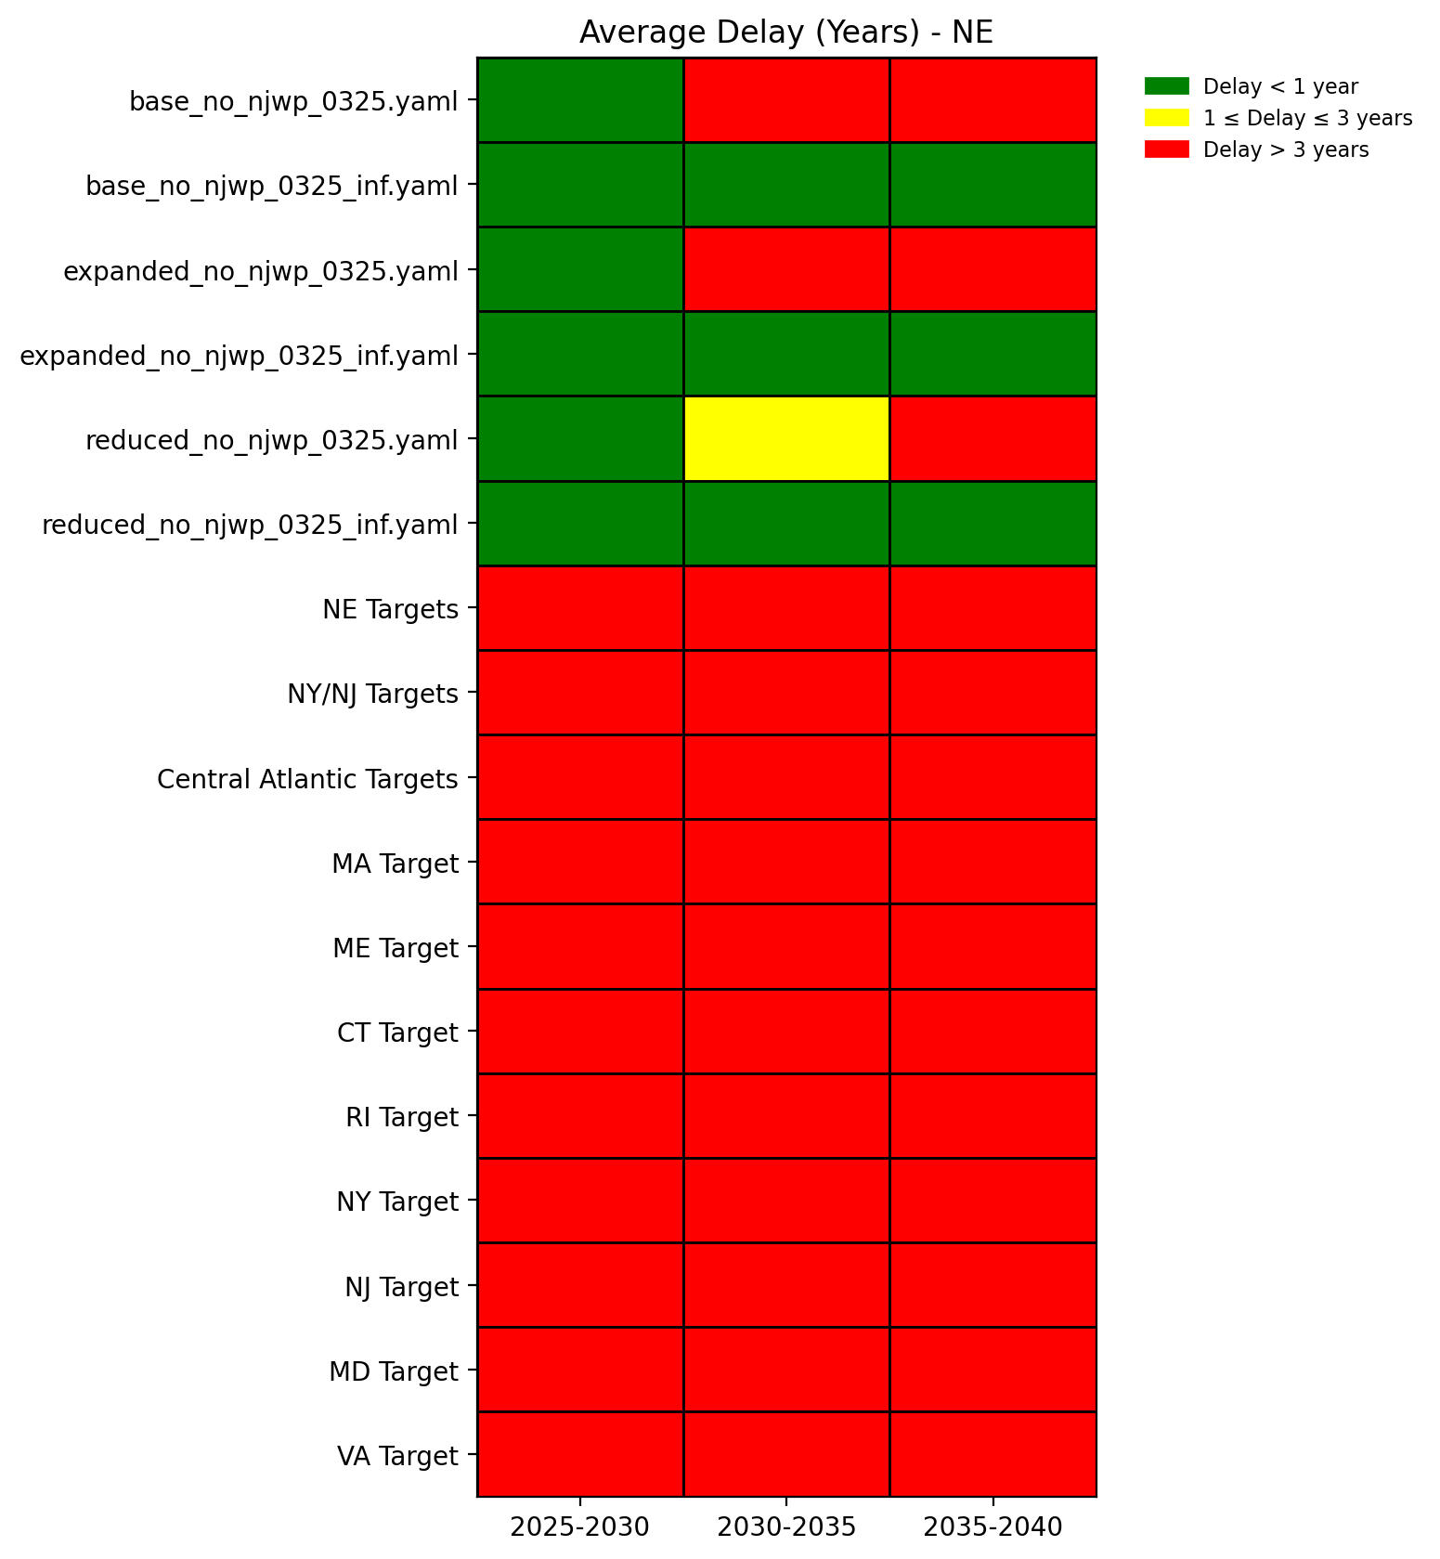
Average Delay Heat Map - NE

Slide 50

Average Delay Heat Map - NY/NJ

Slide 51
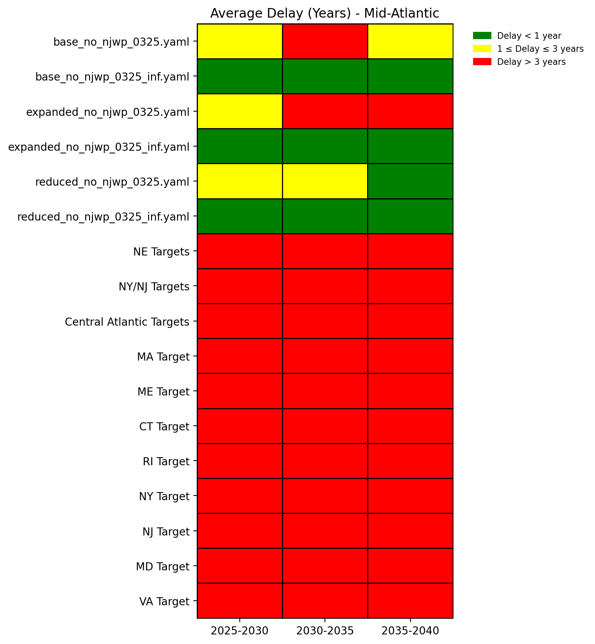
Average Delay Heat Map - Mid-Atlantic

