Slide 1
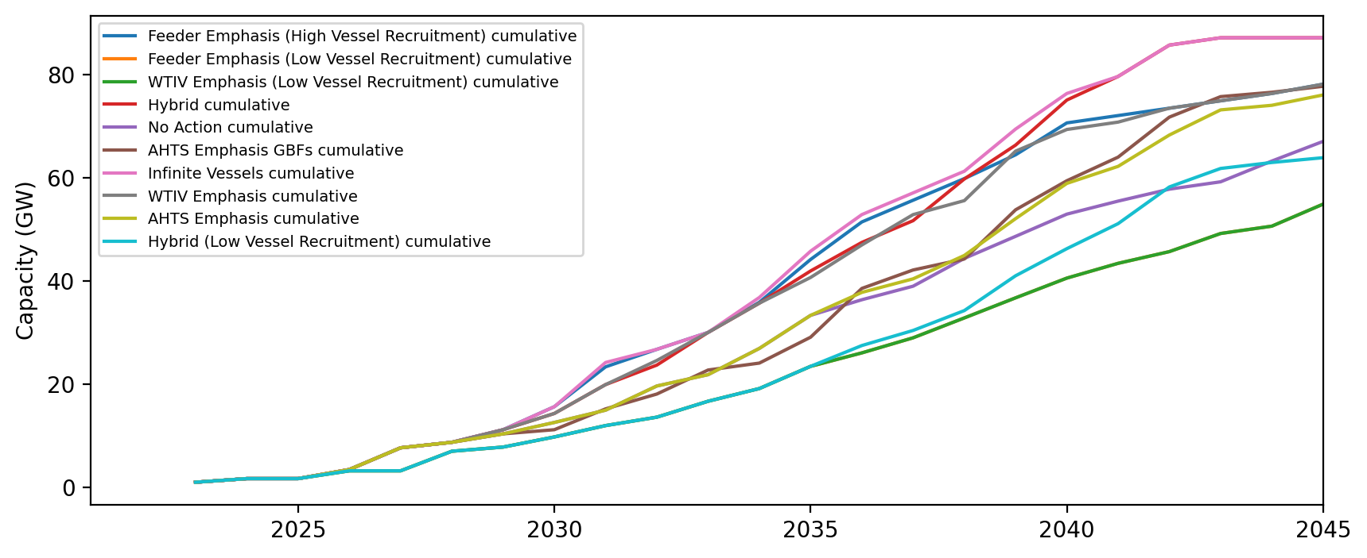
Installed Capacity - All Regions

Slide 2
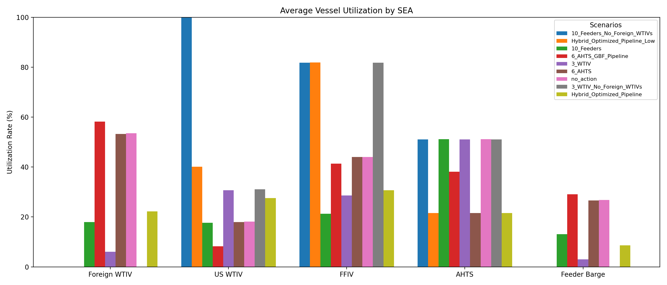
Average Vessel Utilization Across Scenarios
*Avg utilization for each vessel is currently calculated for the entire pipeline (first project start to last project end). In cases where only floating projects still need to be installed at end of pipeline, WTIV/feeder utilization is 0 in those years.

Slide 3
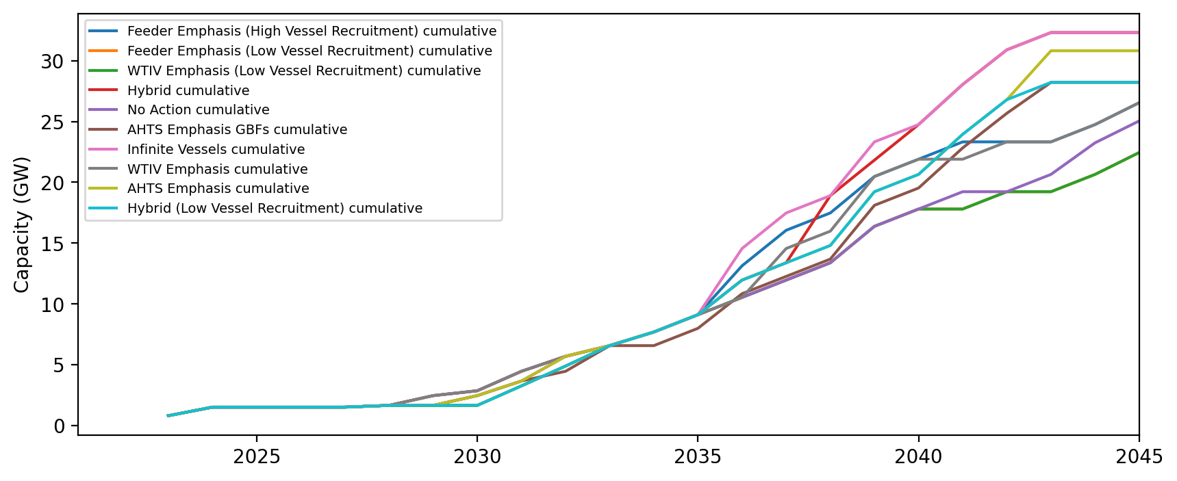
Installed Capacity - NE

Slide 4
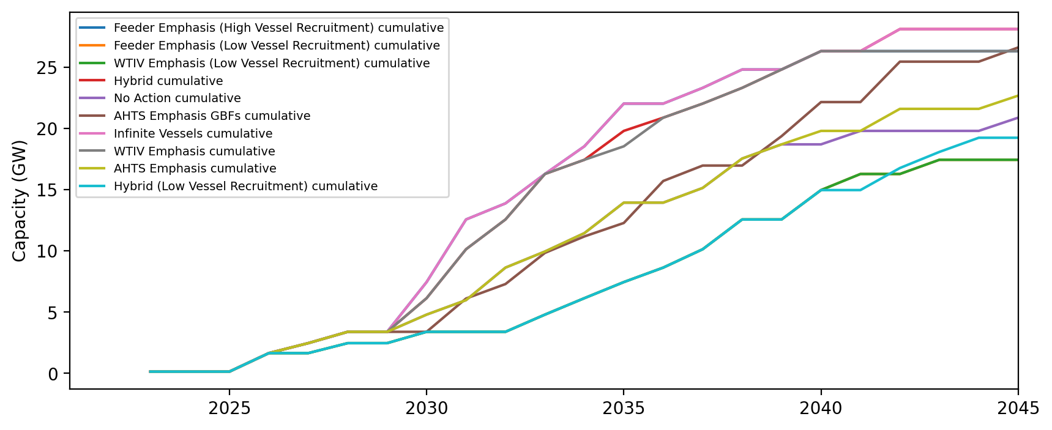
Installed Capacity - NYNJ

Slide 5
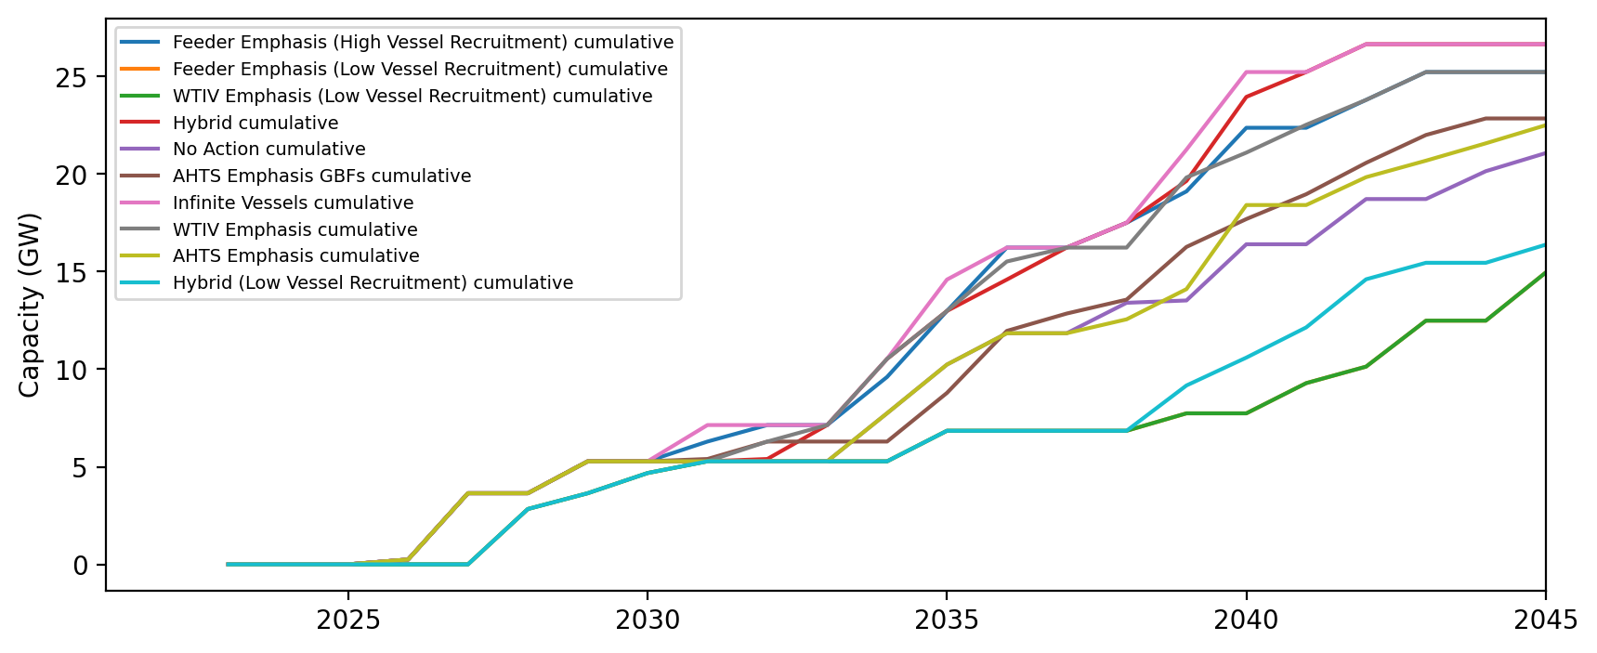
Installed Capacity - Mid-Atlantic

Slide 6
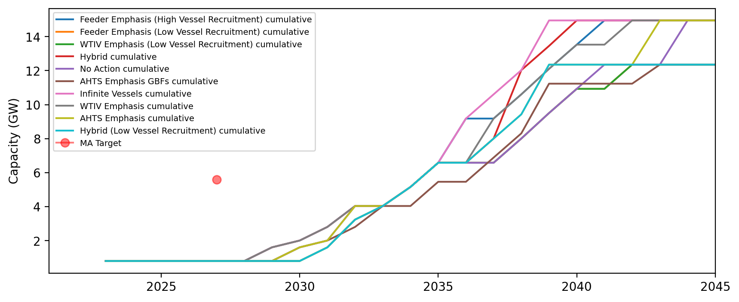
Installed Capacity - MA

Slide 7
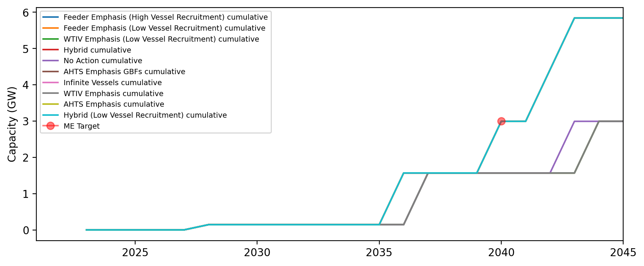
Installed Capacity - ME

Slide 8
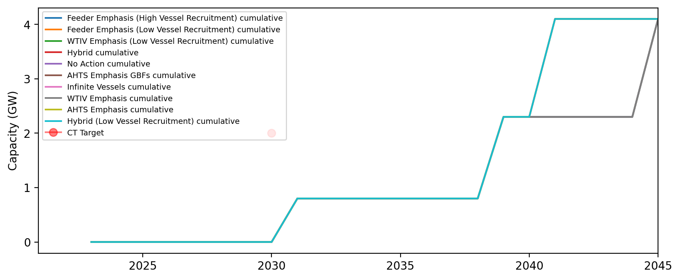
Installed Capacity - CT

Slide 9
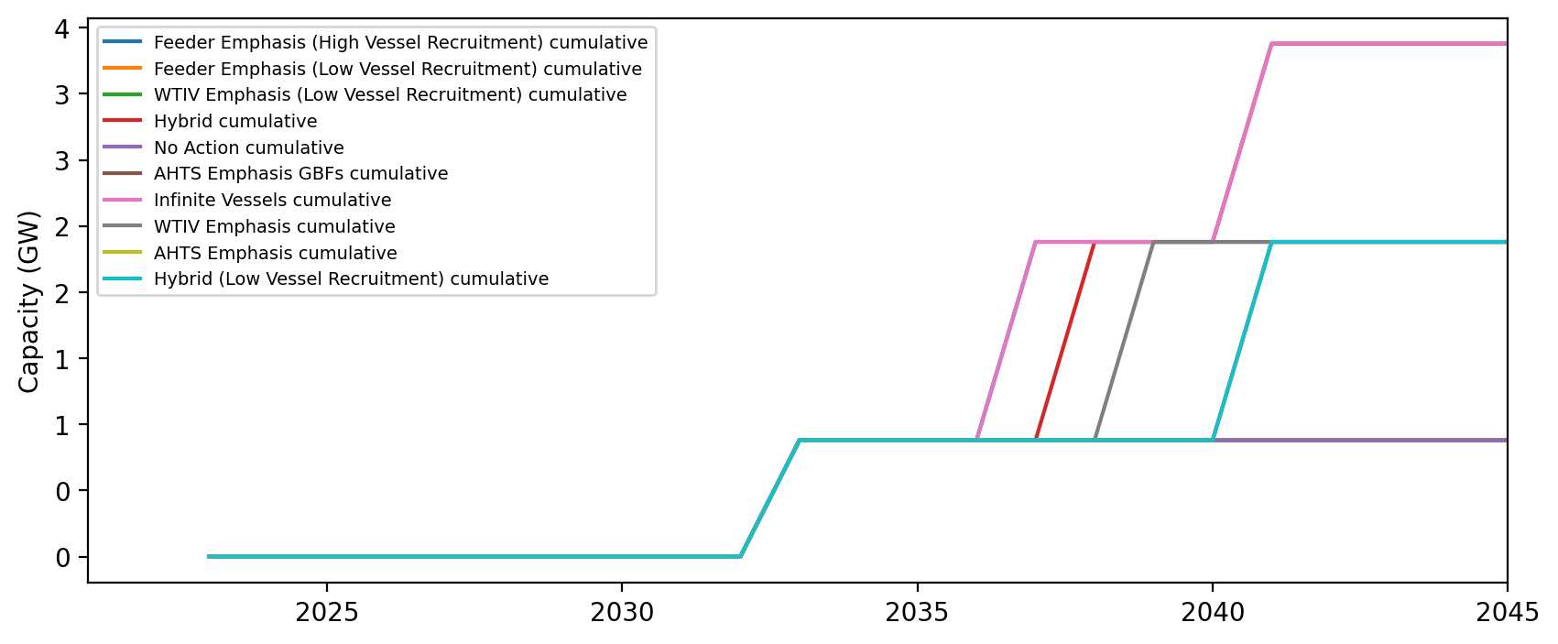
Installed Capacity - RI

Slide 10
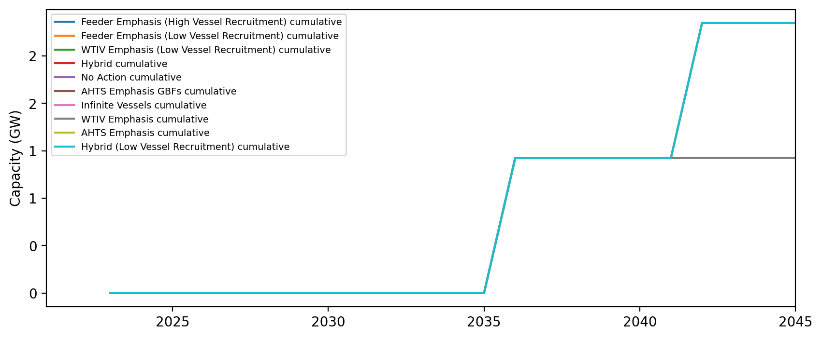
Installed Capacity - NH

Slide 11
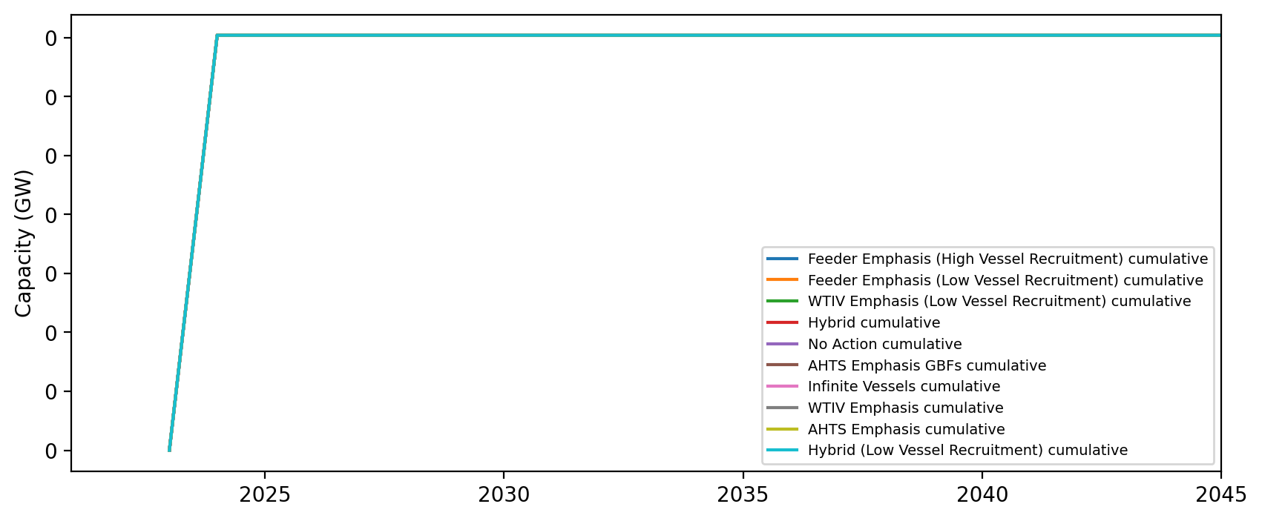
Installed Capacity - RI/CT

Slide 12
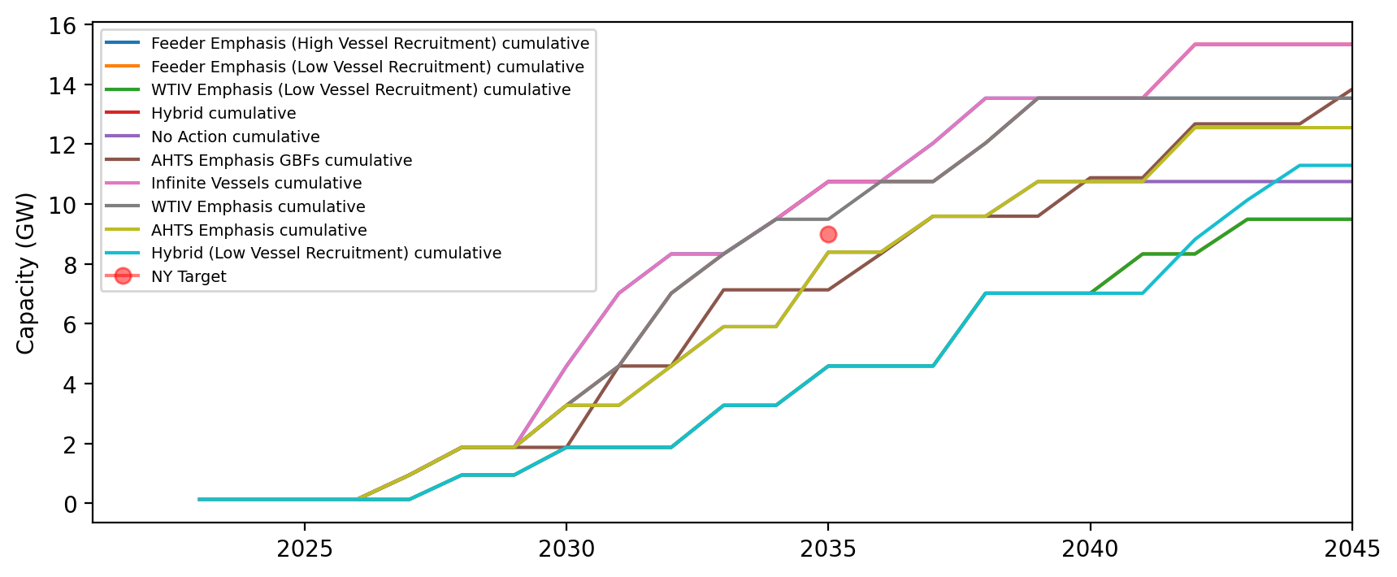
Installed Capacity - NY

Slide 13
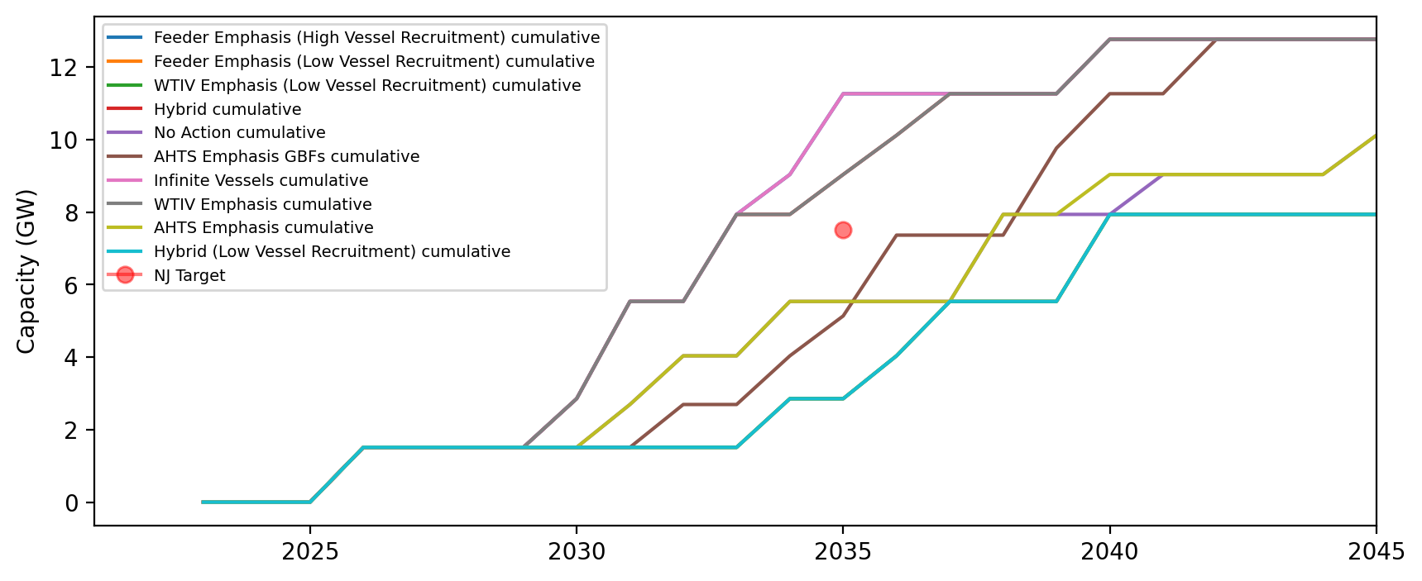
Installed Capacity - NJ

Slide 14
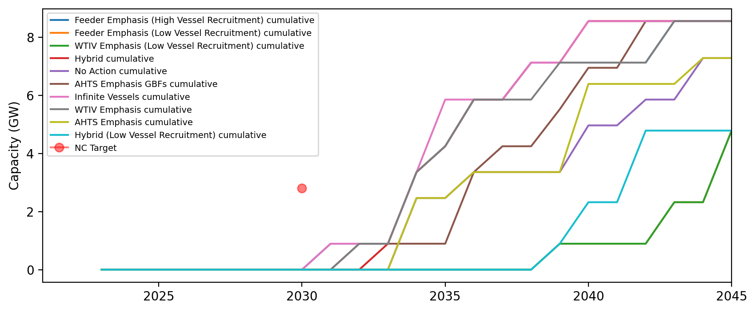
Installed Capacity - NC

Slide 15
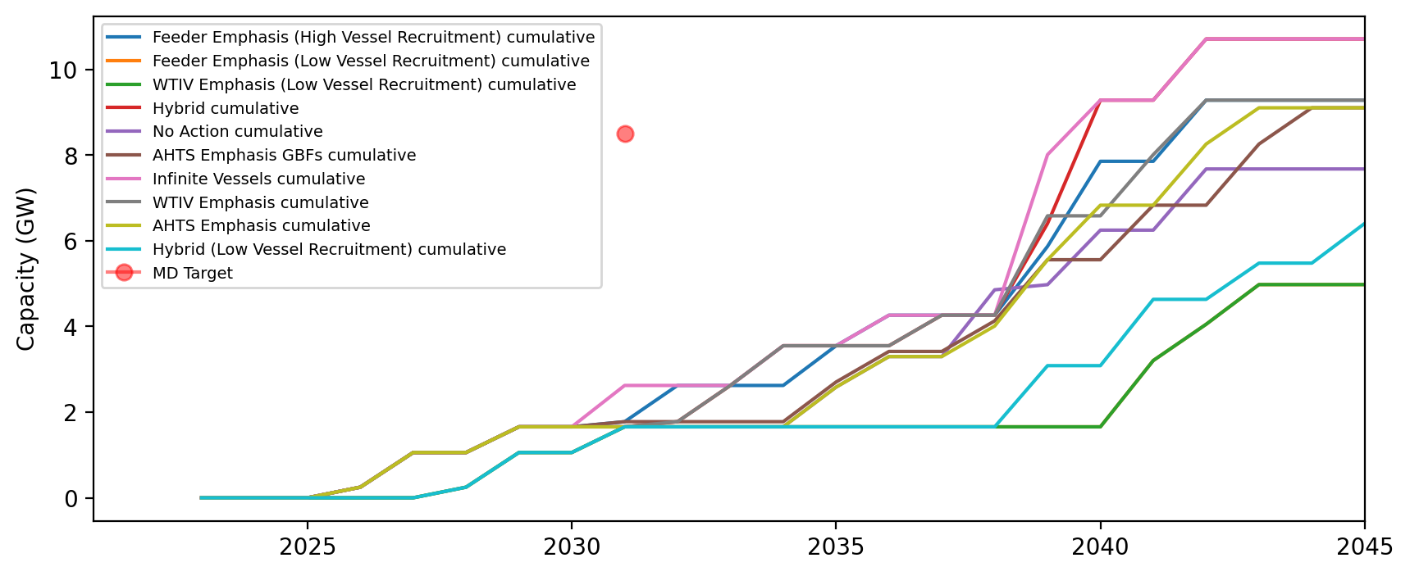
Installed Capacity - MD

Slide 16
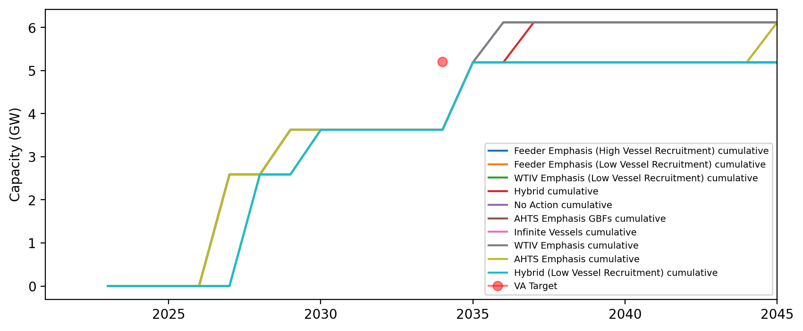
Installed Capacity - VA

Slide 17
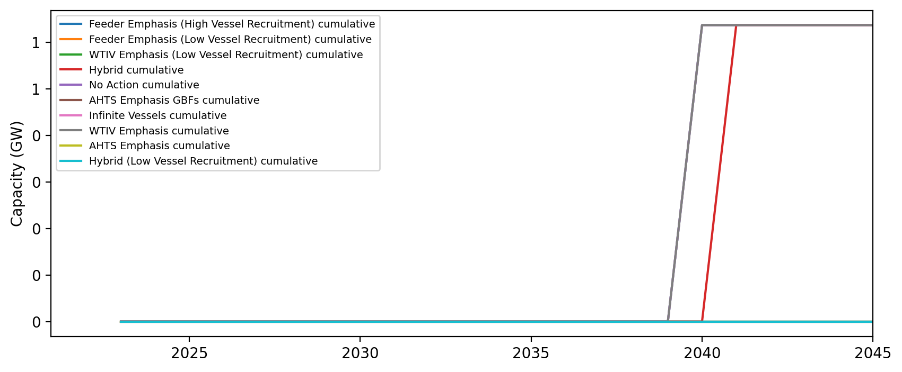
Installed Capacity - DE

Slide 18
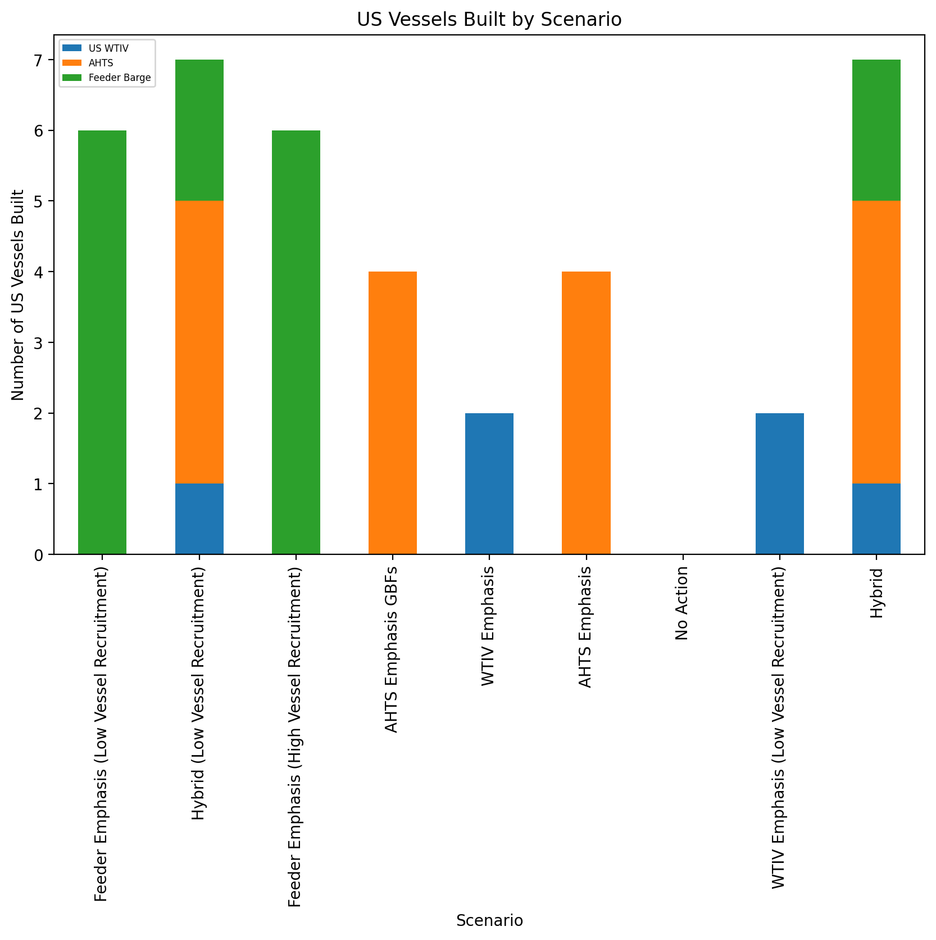
US Vessels Built

Slide 19
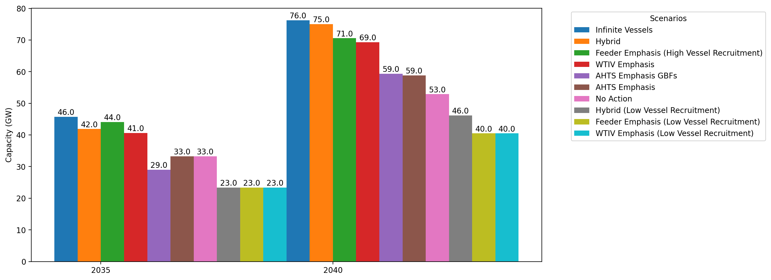
Cumulative Capacity by 2035 and 2040

Slide 20
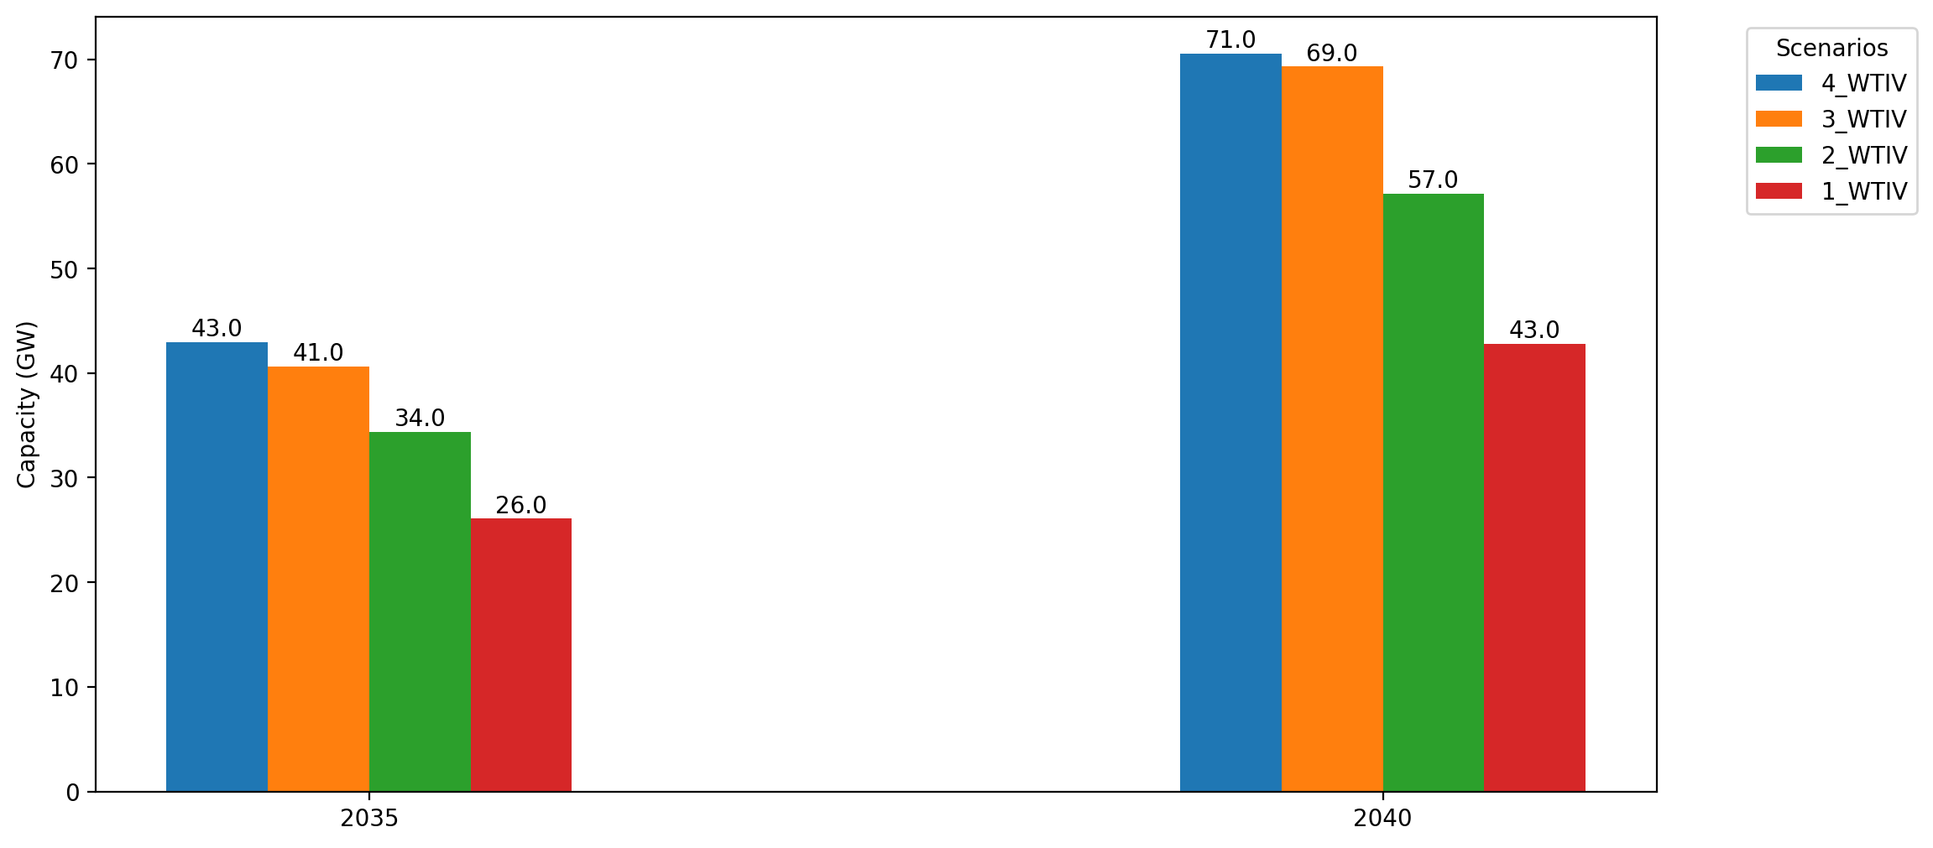
Cumulative Capacity by 2035 and 2040: Sensitivity to WTIVs

Slide 21
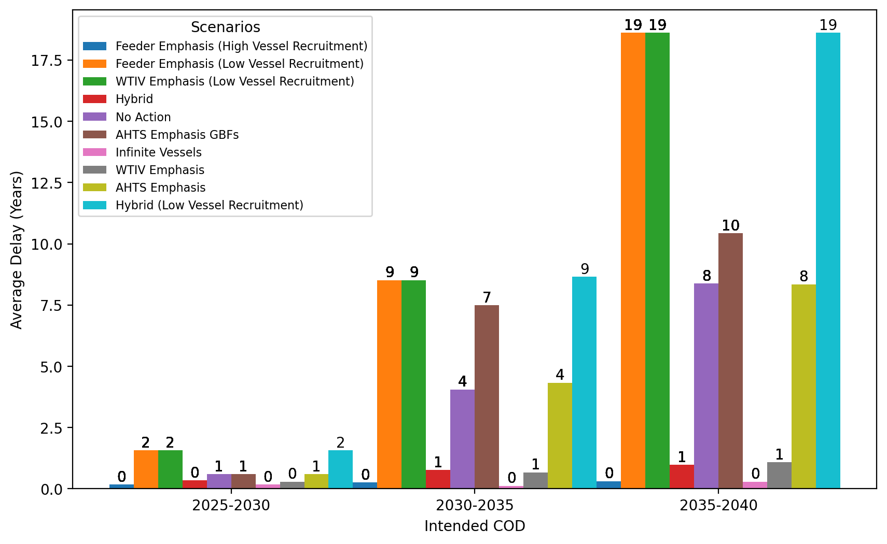
Average Delay Per Project by COD - All Regions

Slide 22
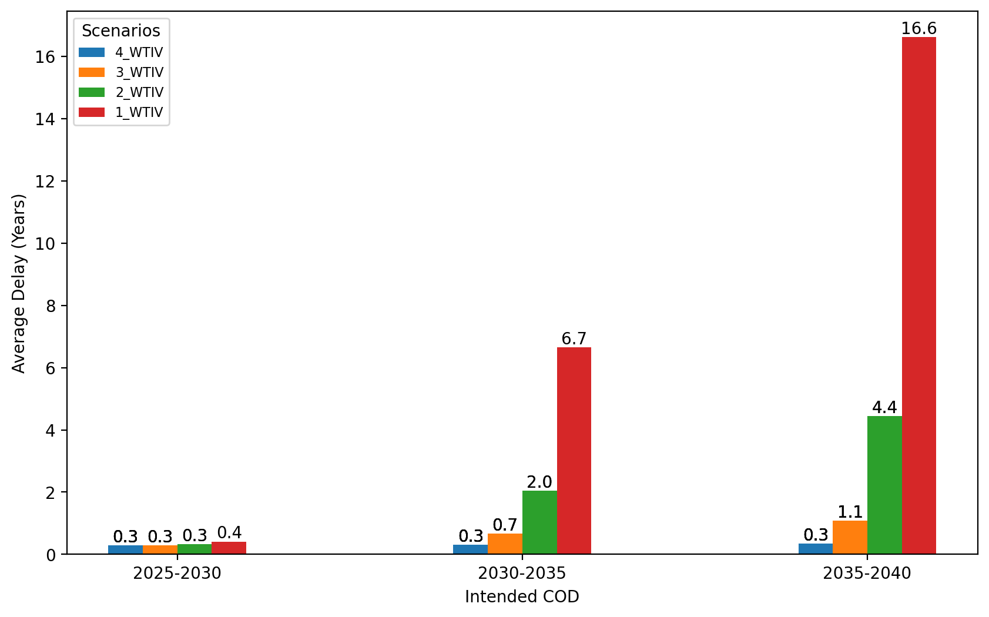
Average Delay Per Project by COD - All Regions (Sensitivity to WTIVs)

Slide 23
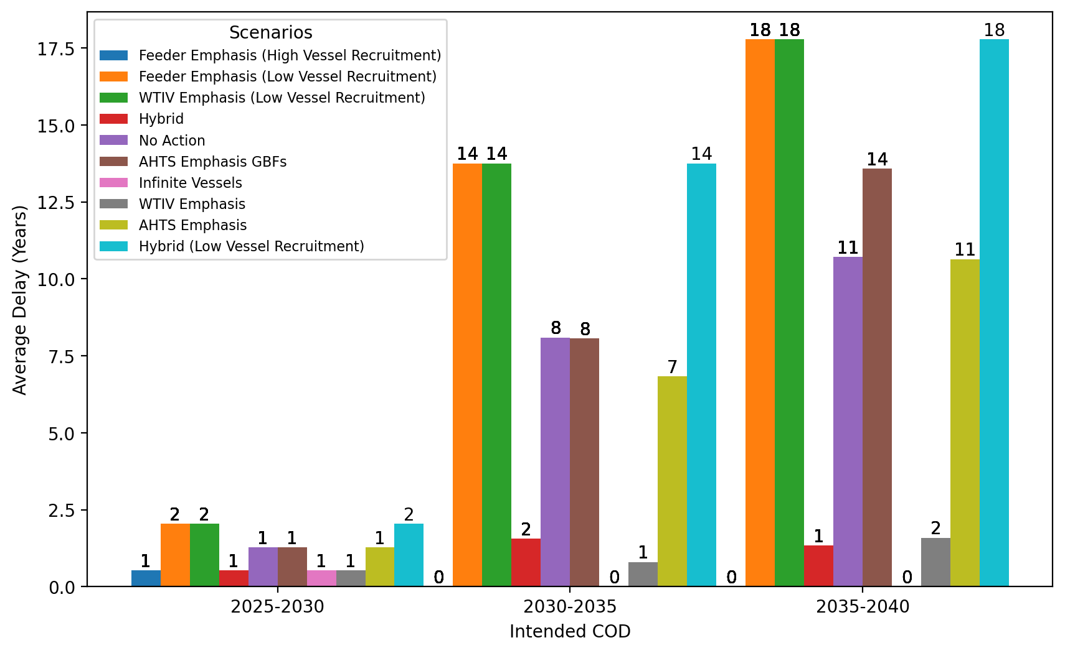
Average Delay Per Project by COD - NE

Slide 24
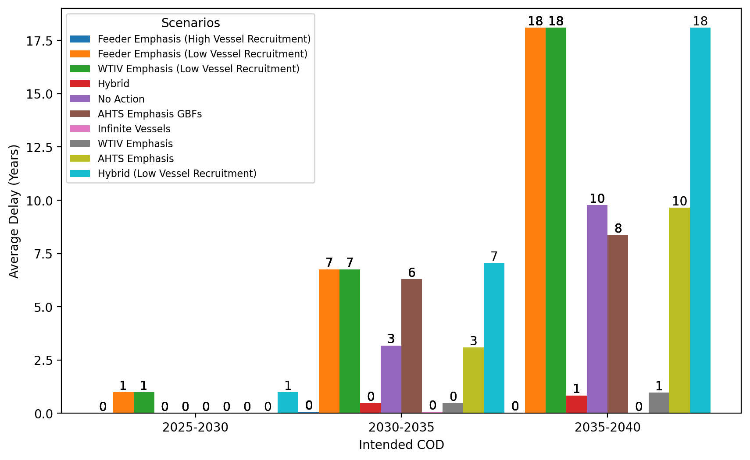
Average Delay Per Project by COD - NYNJ

Slide 25
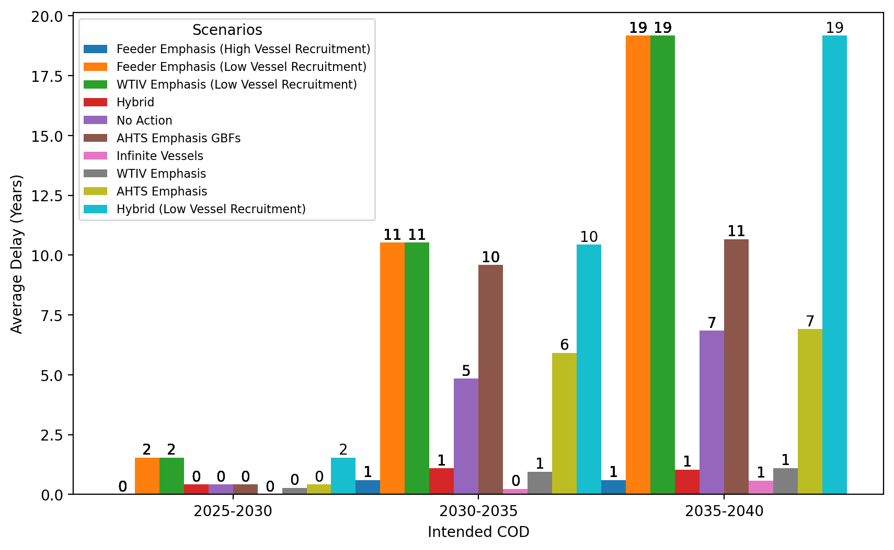
Average Delay Per Project by COD - Mid-Atlantic

Slide 26
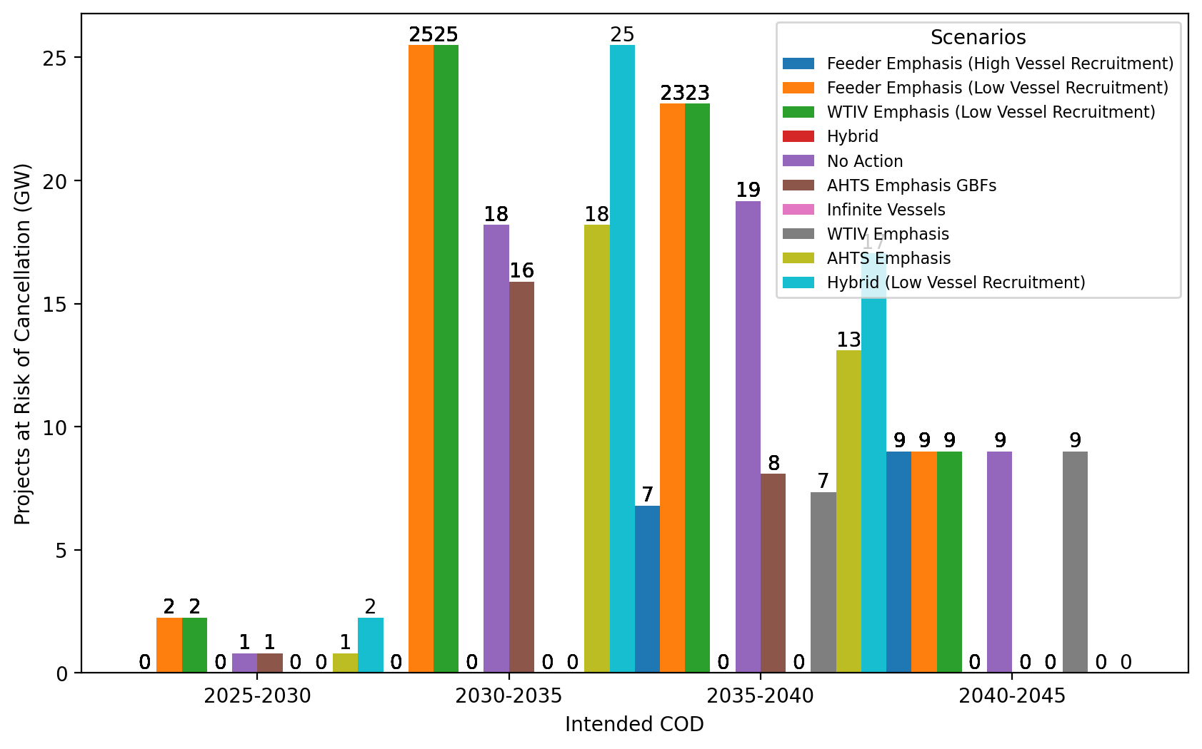
Total Capacity at Risk by COD - All Regions

Slide 27
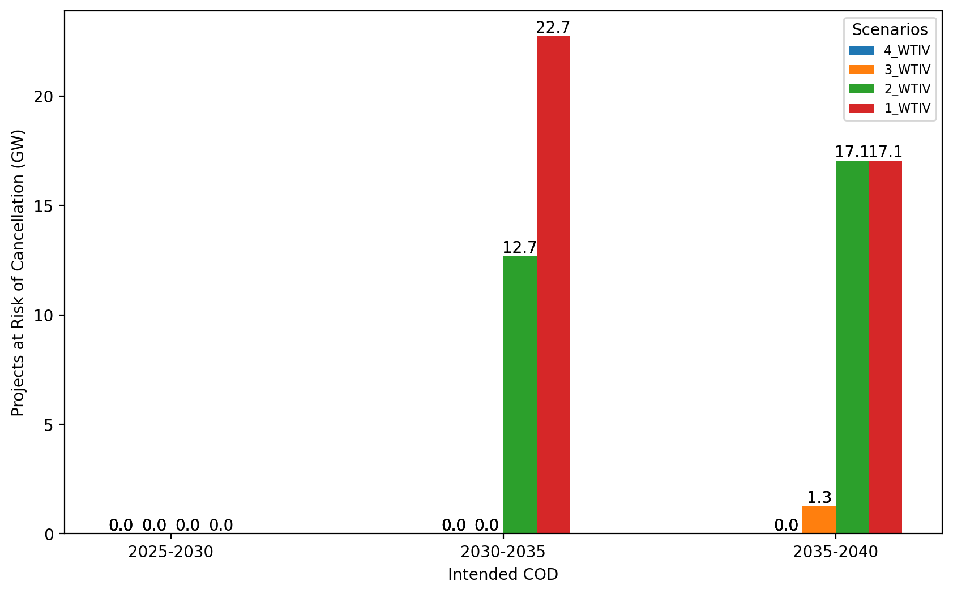
Total Capacity at Risk by COD - All Regions (Sensitivity to WTIVs: Fixed-Bottom Only)

Slide 28
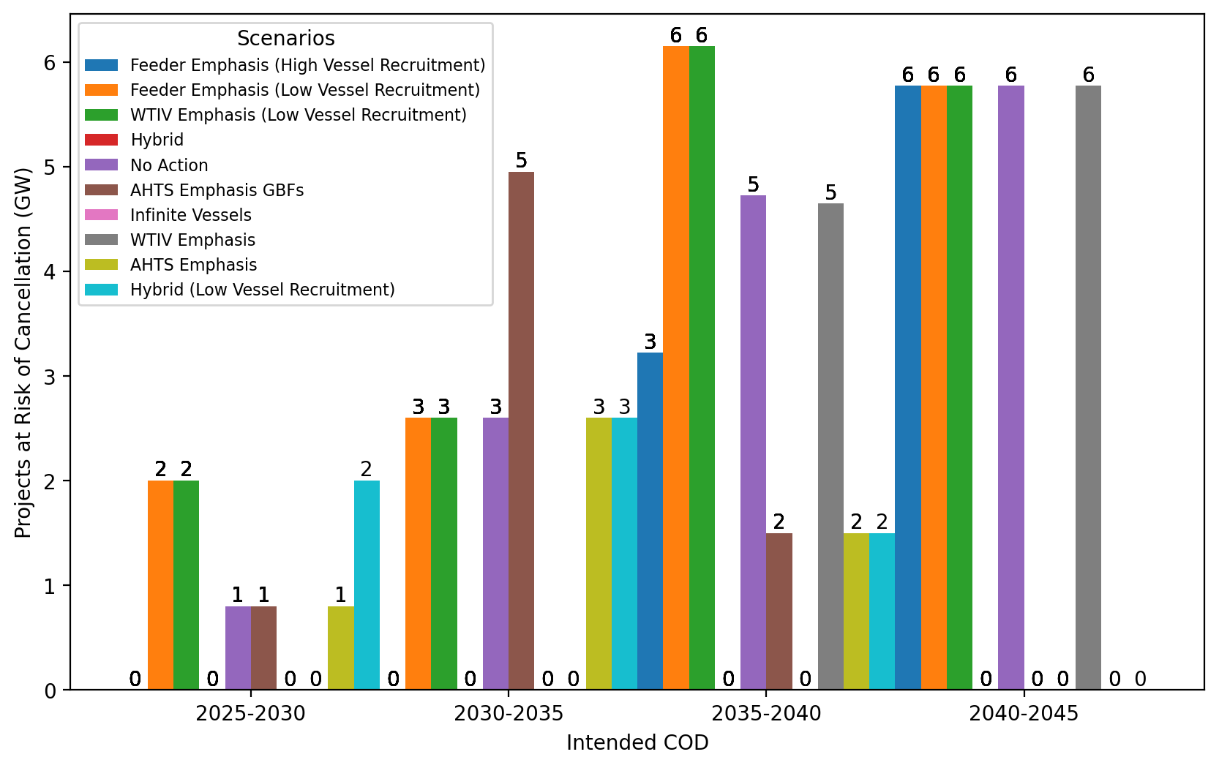
Total Capacity at Risk by COD - NE

Slide 29
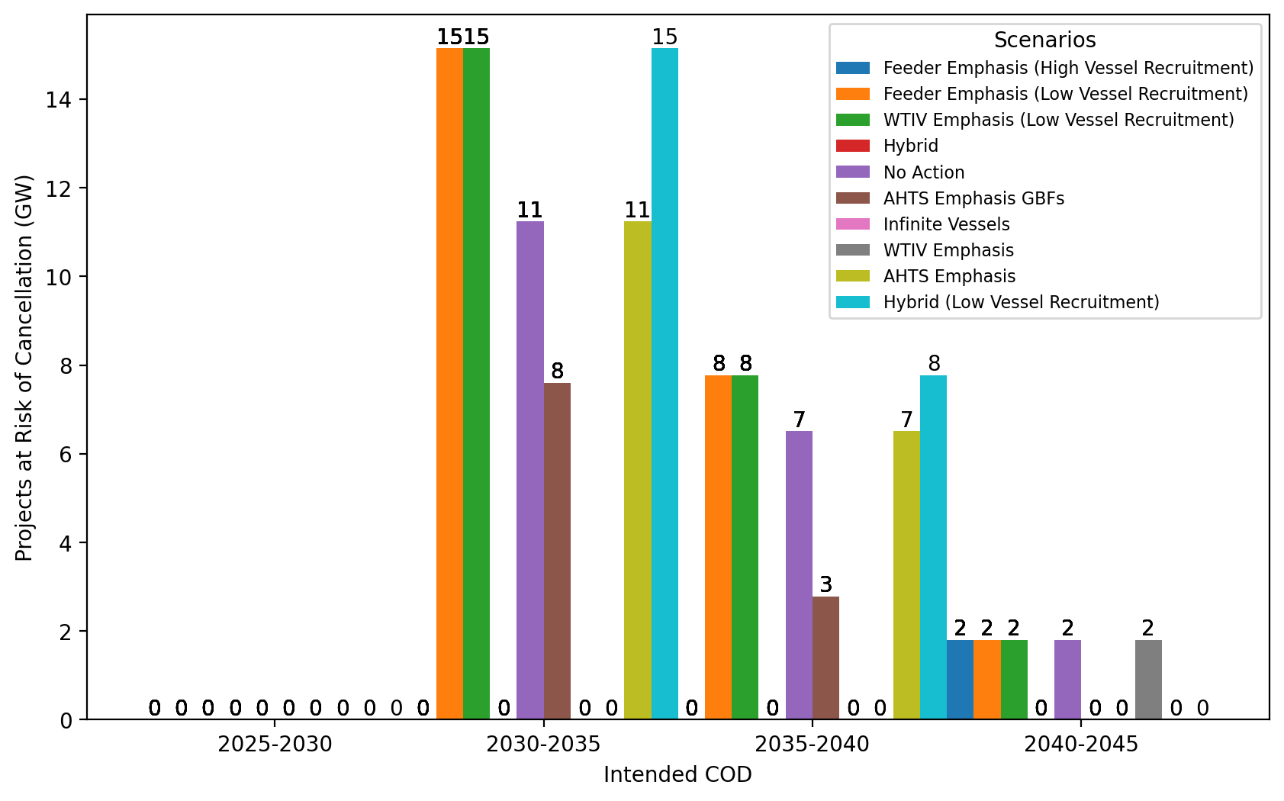
Total Capacity at Risk by COD - NYNJ

Slide 30
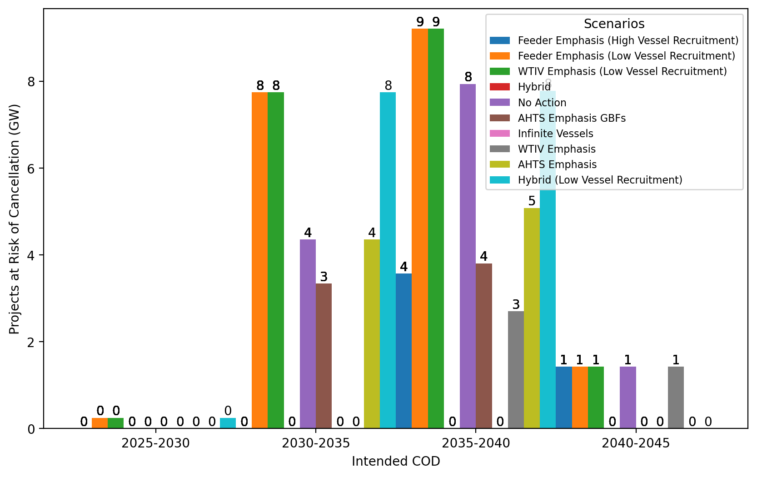
Total Capacity at Risk by COD - Mid-Atlantic

