Slide 1
1_WTIV
1 US WTIV starting with CVOW. Foreign WTIV removed from pool in 2030

Slide 2
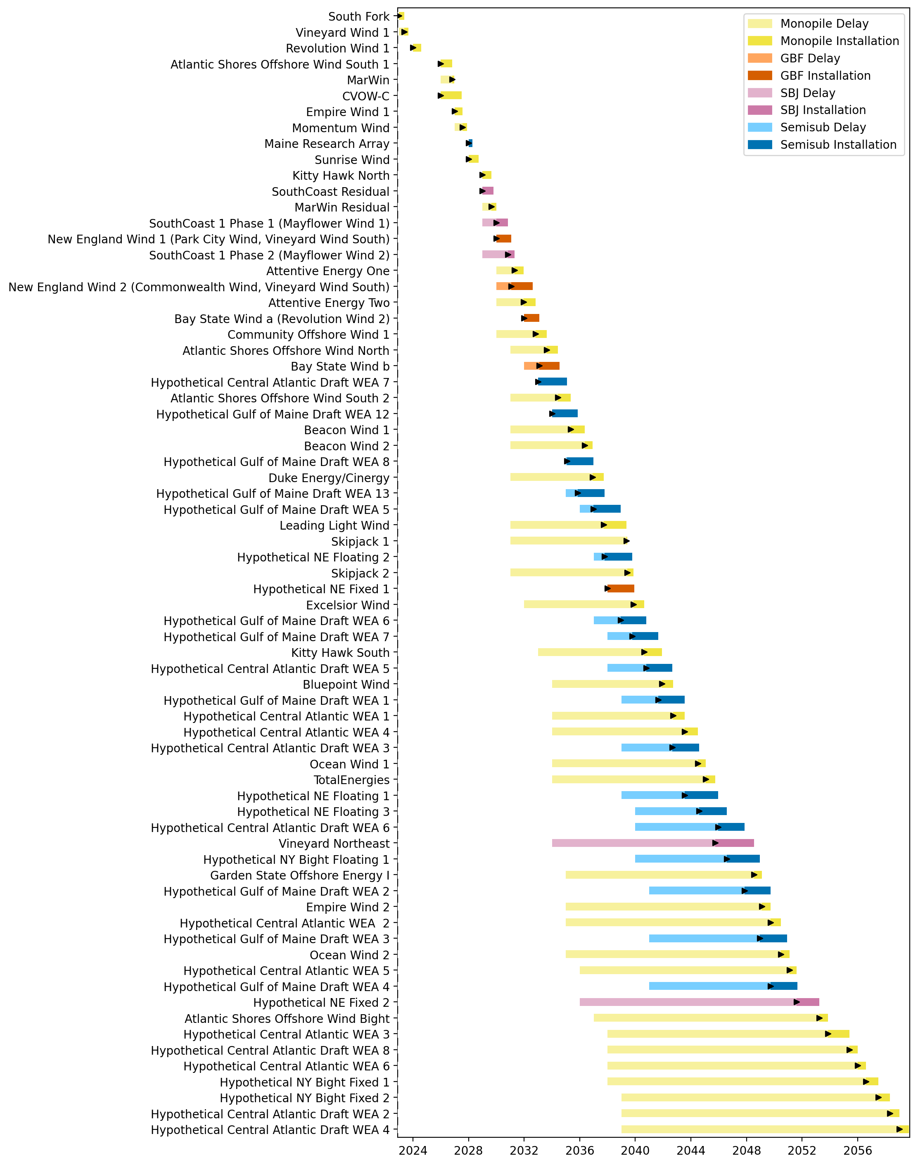
Full Gantt

Slide 3
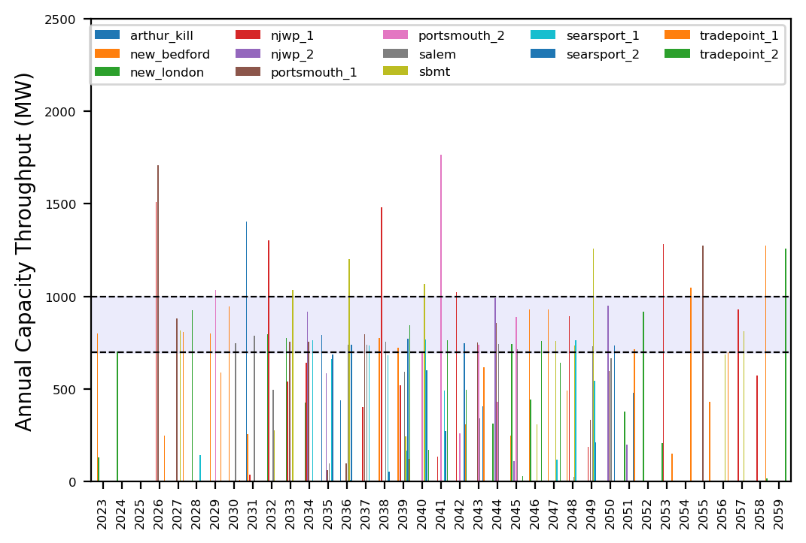
Port Throughput

Slide 4
2_WTIV
1 US WTIV starting with CVOW, then 1 in 2030. Foreign WTIV removed from pool in 2030

Slide 5
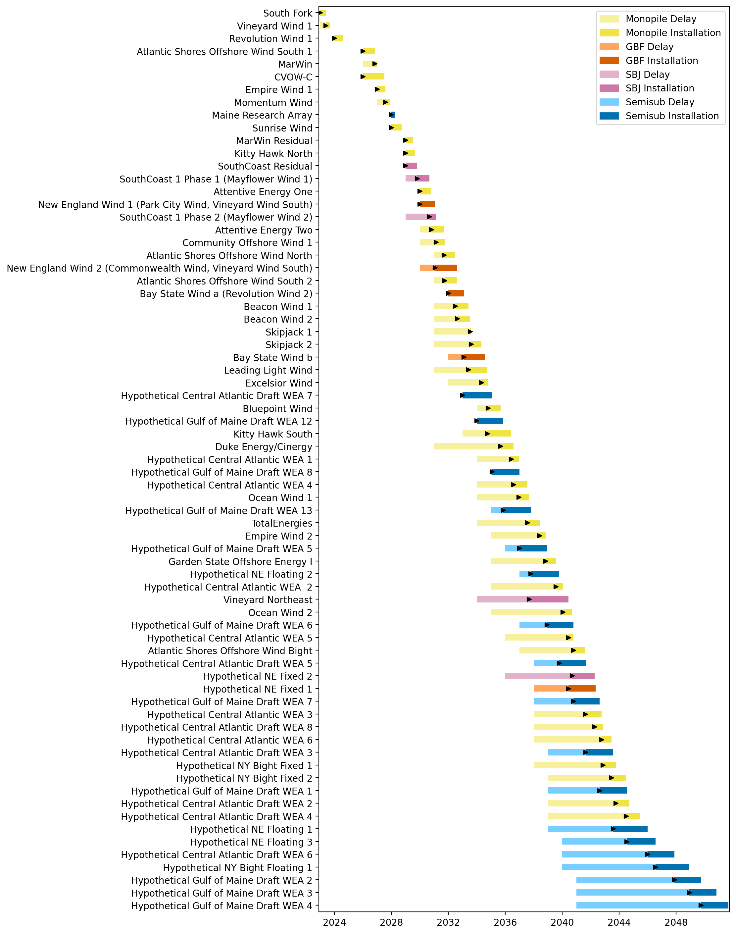
Full Gantt

Slide 6
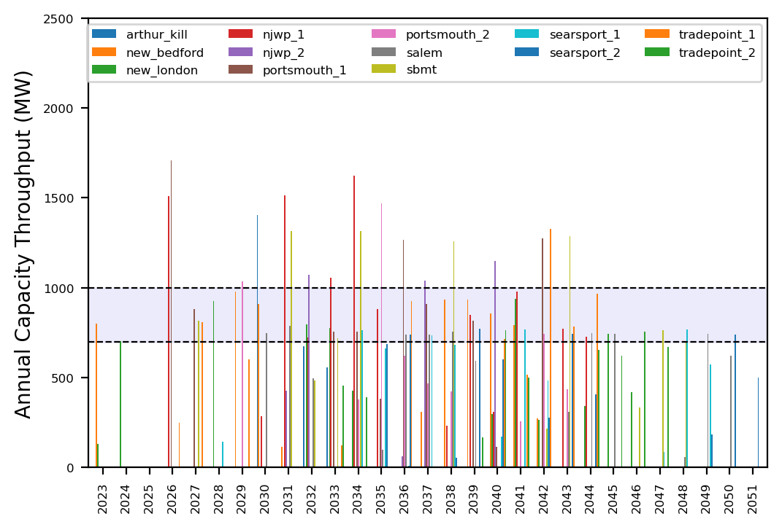
Port Throughput

Slide 7
3_WTIV
1 US WTIV starting with CVOW, then 1 in 2030, 2033. Foreign WTIV removed from pool in 2030

Slide 8
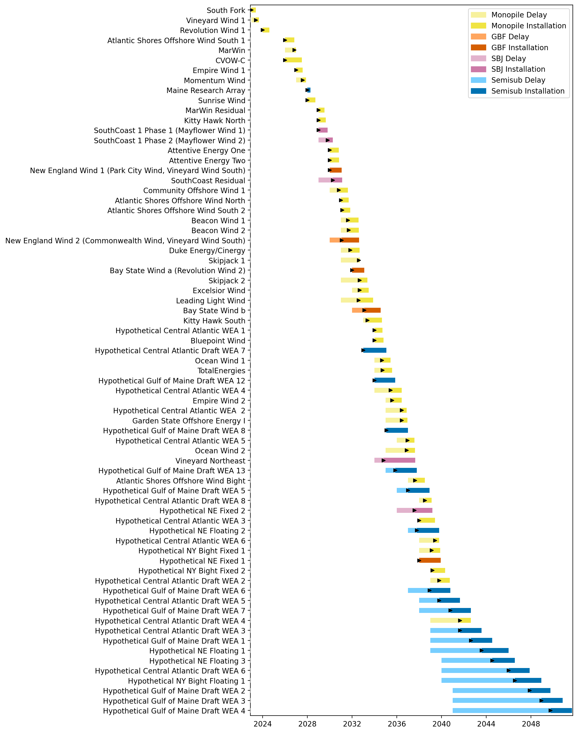
Full Gantt

Slide 9
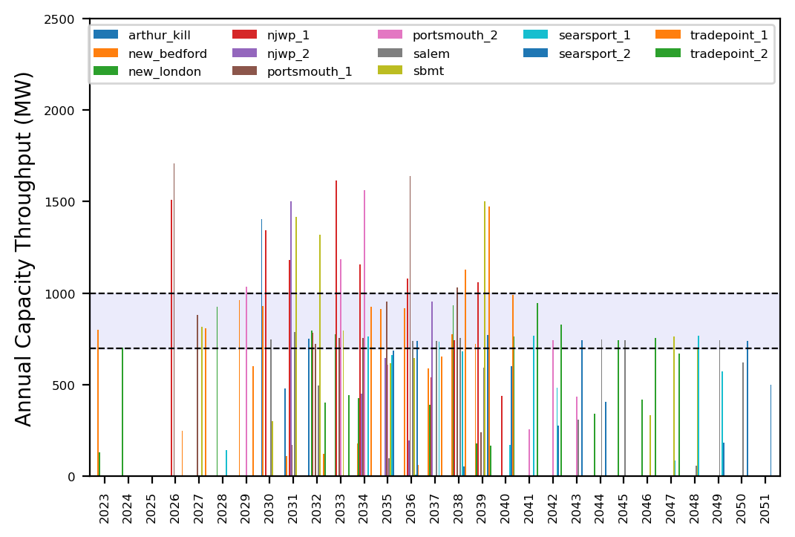
Port Throughput

Slide 10
4_WTIV
1 US WTIV starting with CVOW, then 1 in 2030, 2033, 2036. Foreign WTIV removed from pool in 2030

Slide 11
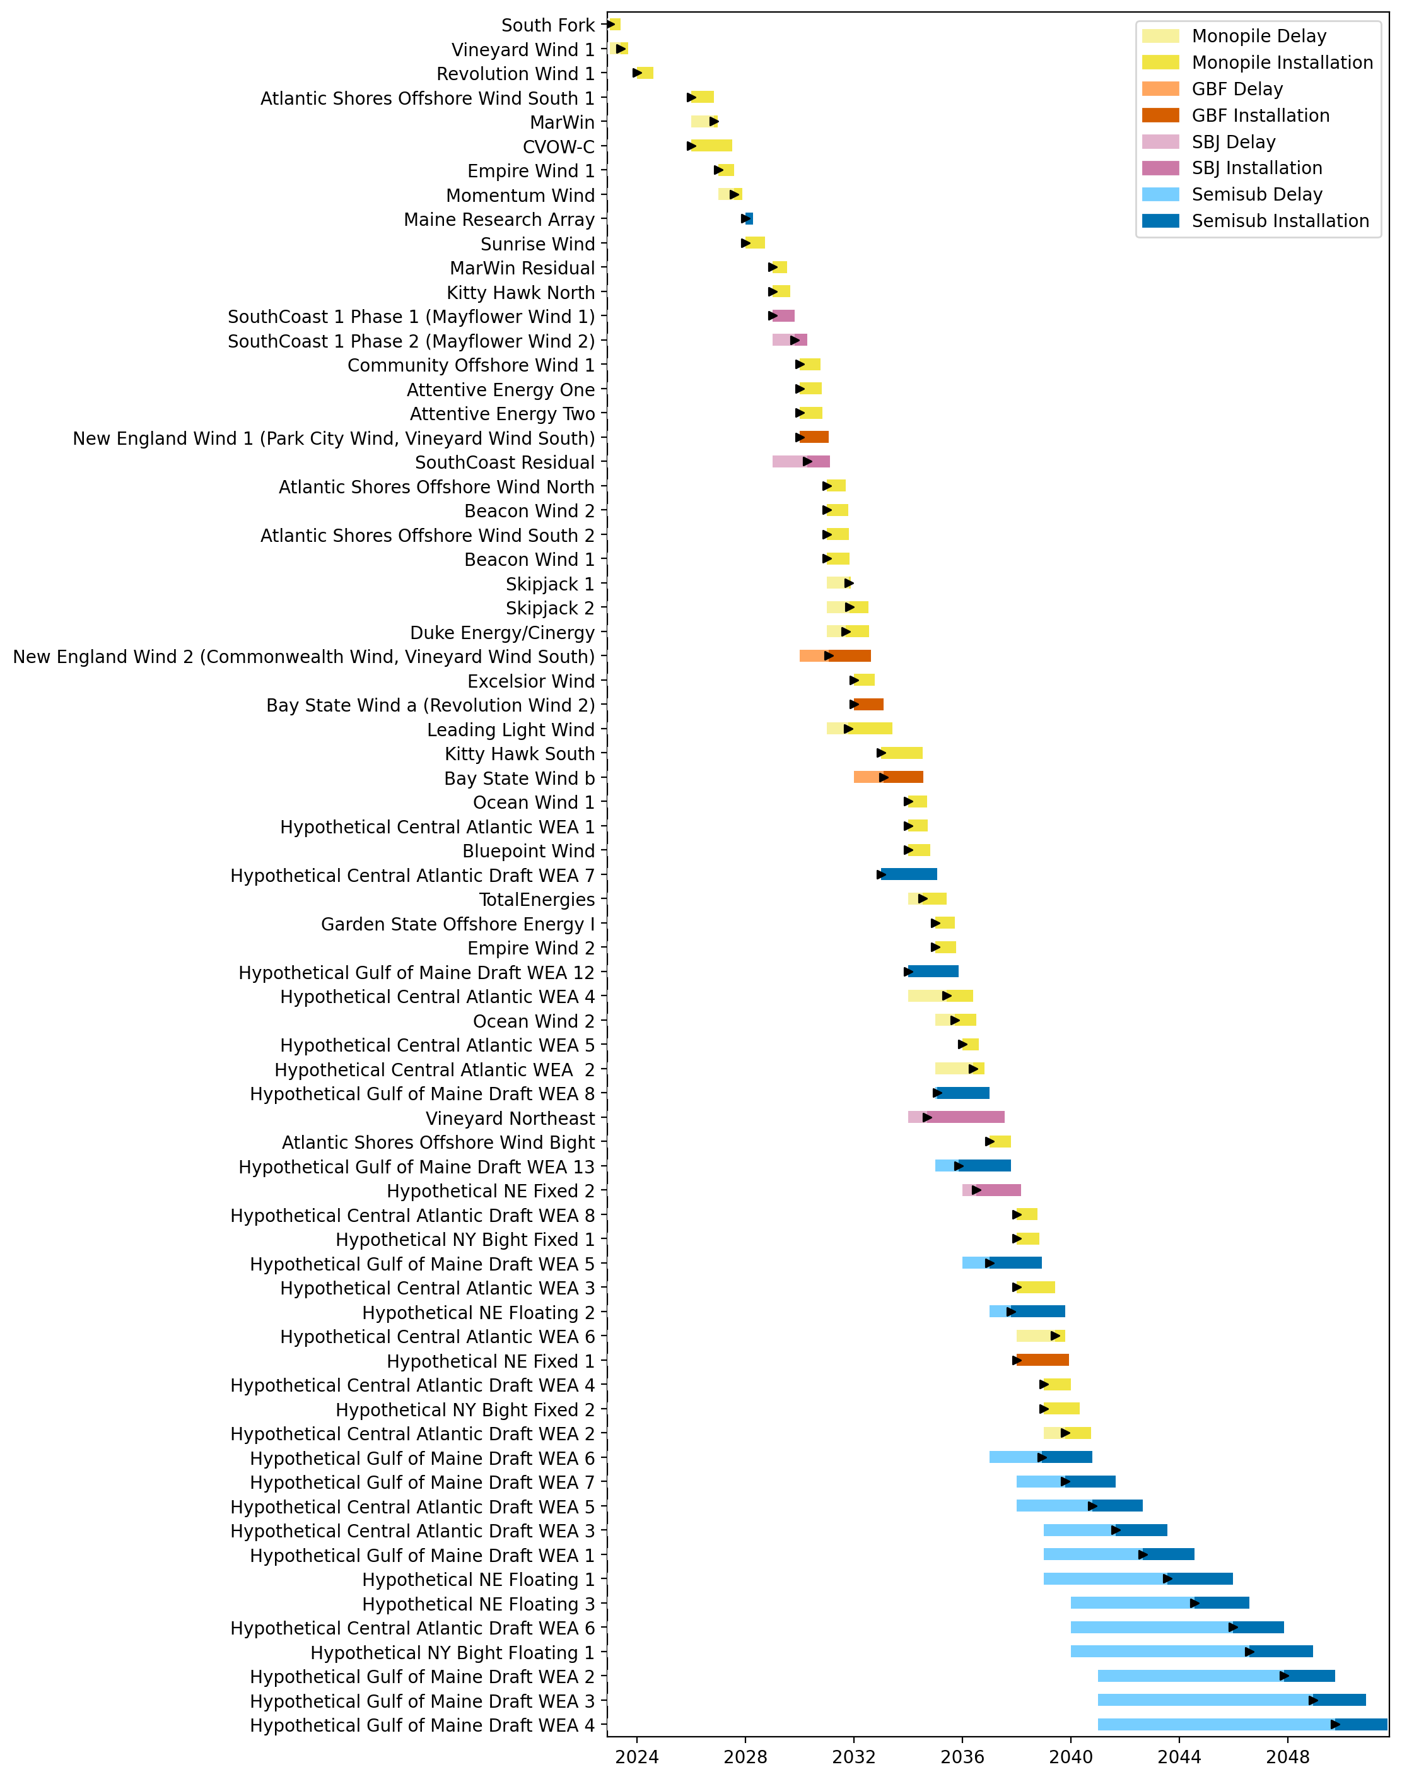
Full Gantt

Slide 12
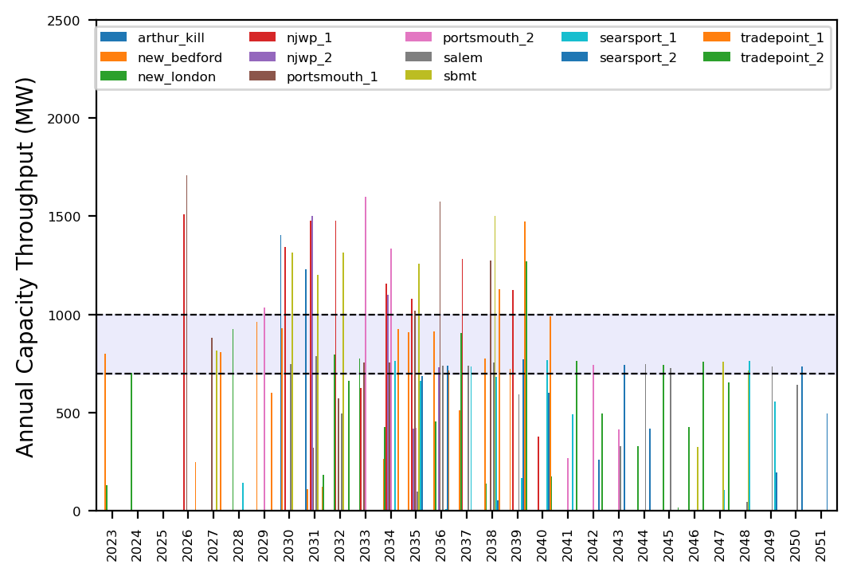
Port Throughput

Slide 13
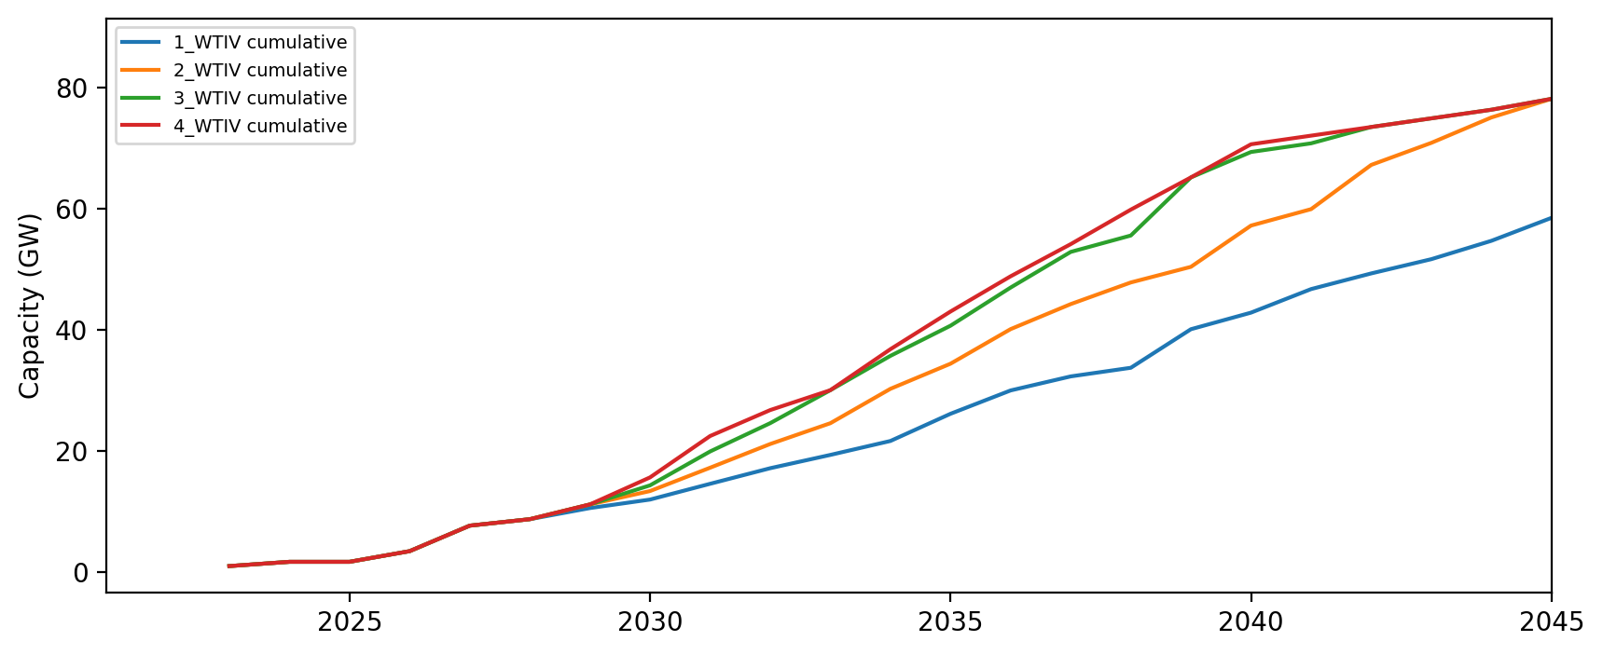
Installed Capacity

