Slide 1
best_path_forward_gbf
Pipeline: Best Path Foward
Vessel Pathway: Common
Port Pathway: Common

Slide 2
best_path_forward
Pipeline: Best Path Foward
Vessel Pathway: Common
Port Pathway: Common

Slide 3
full_monopile
Pipeline: Full Monopile Pipeline
Vessel Pathway: Common
Port Pathway: Common

Slide 4
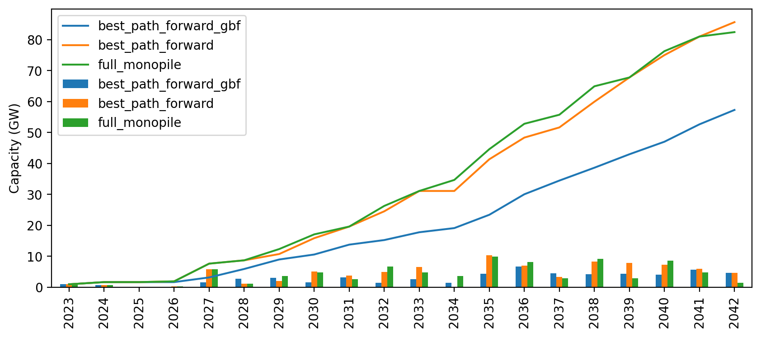
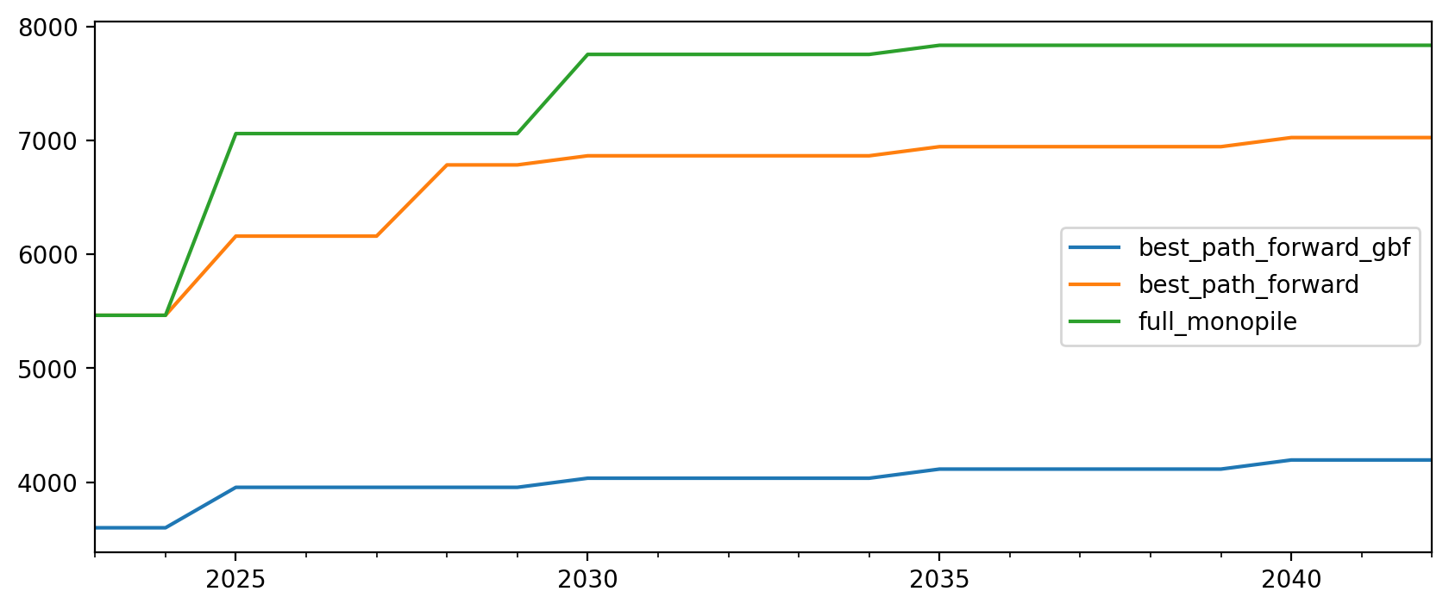
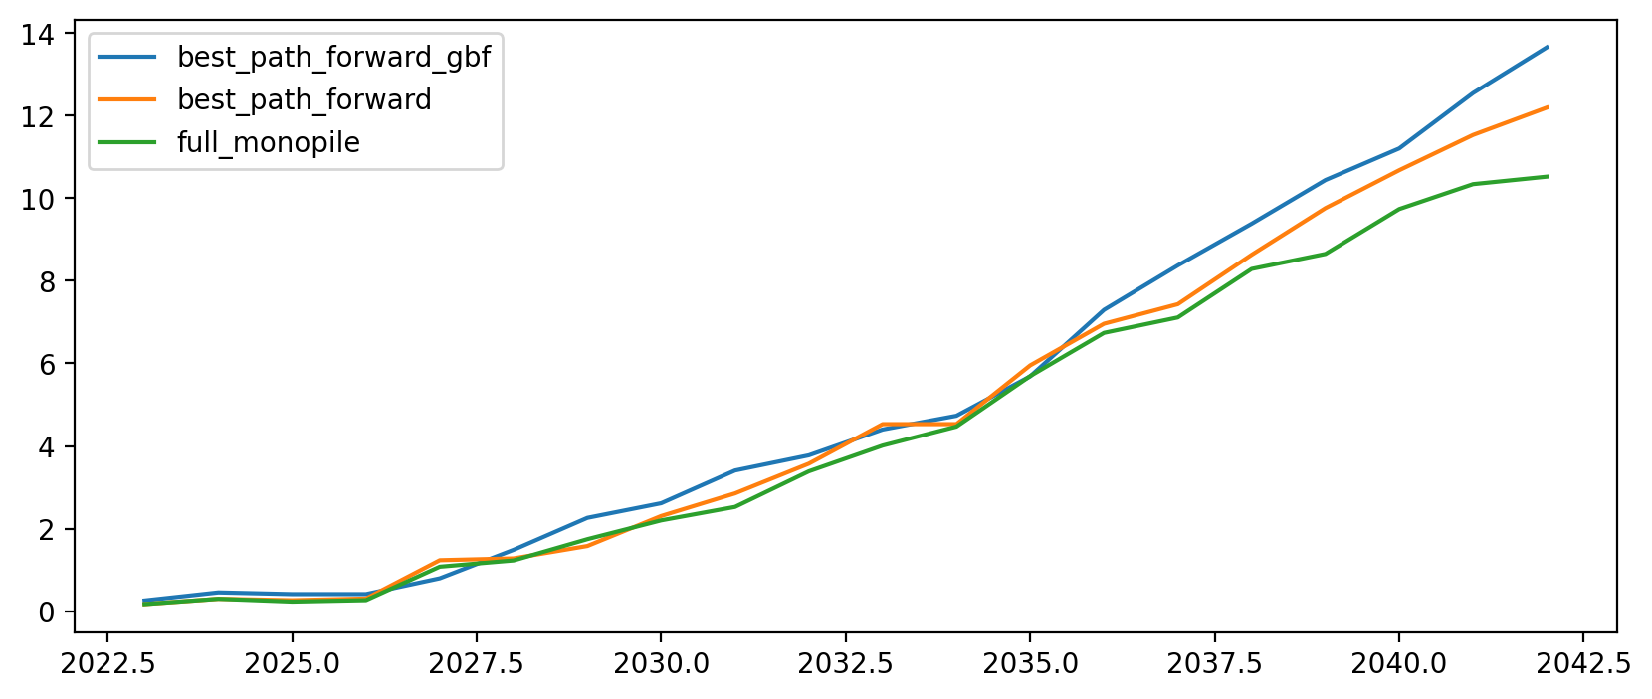
Cumulative Installed Capacity

Slide 5
Vessel Investment Plot

Slide 6
Capacity per $ Invested (MW/$)

