Slide 1
Compare Foundations - NE
May 20, 2024

Slide 2
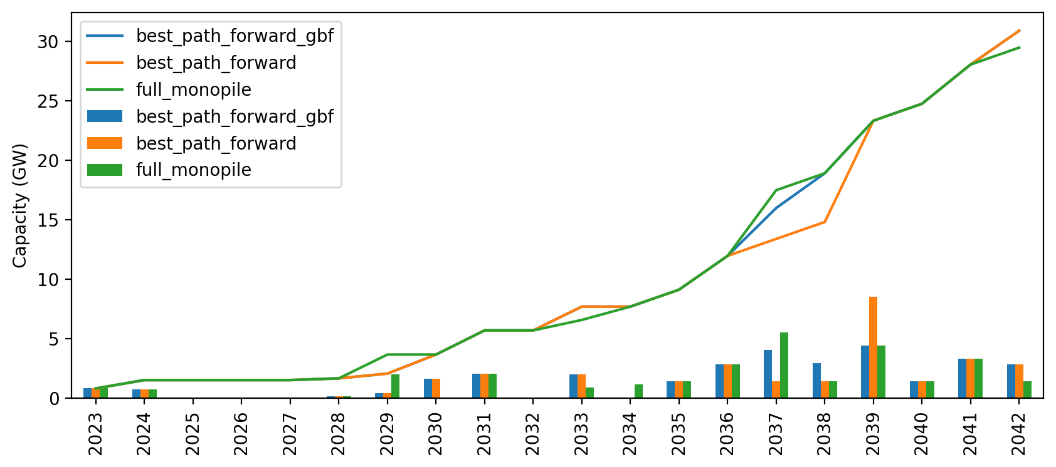
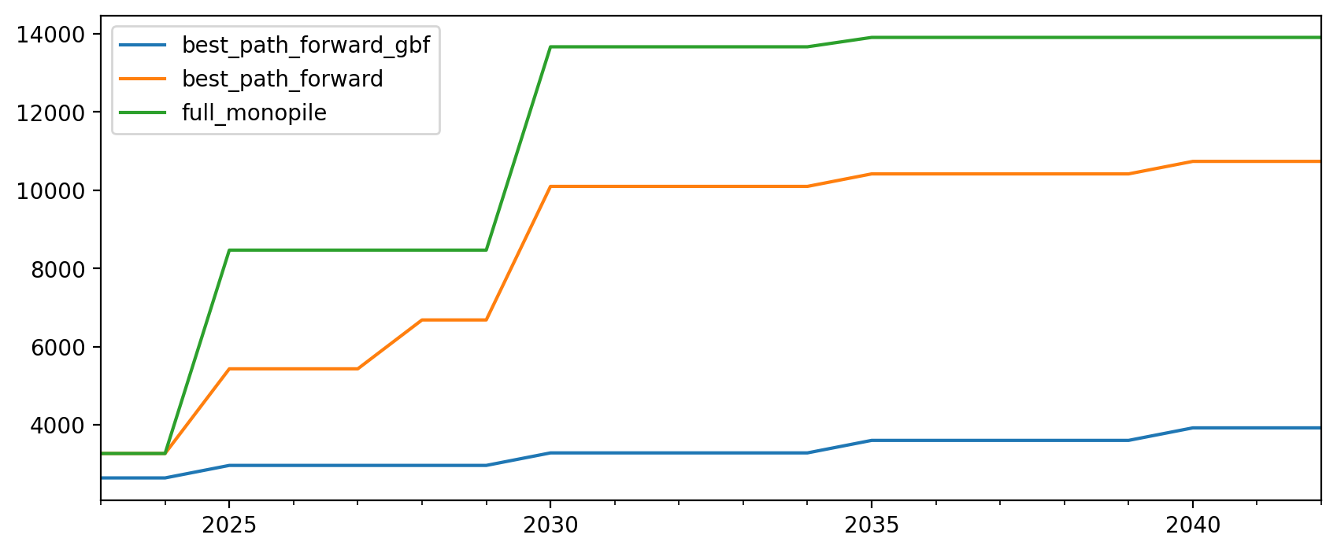
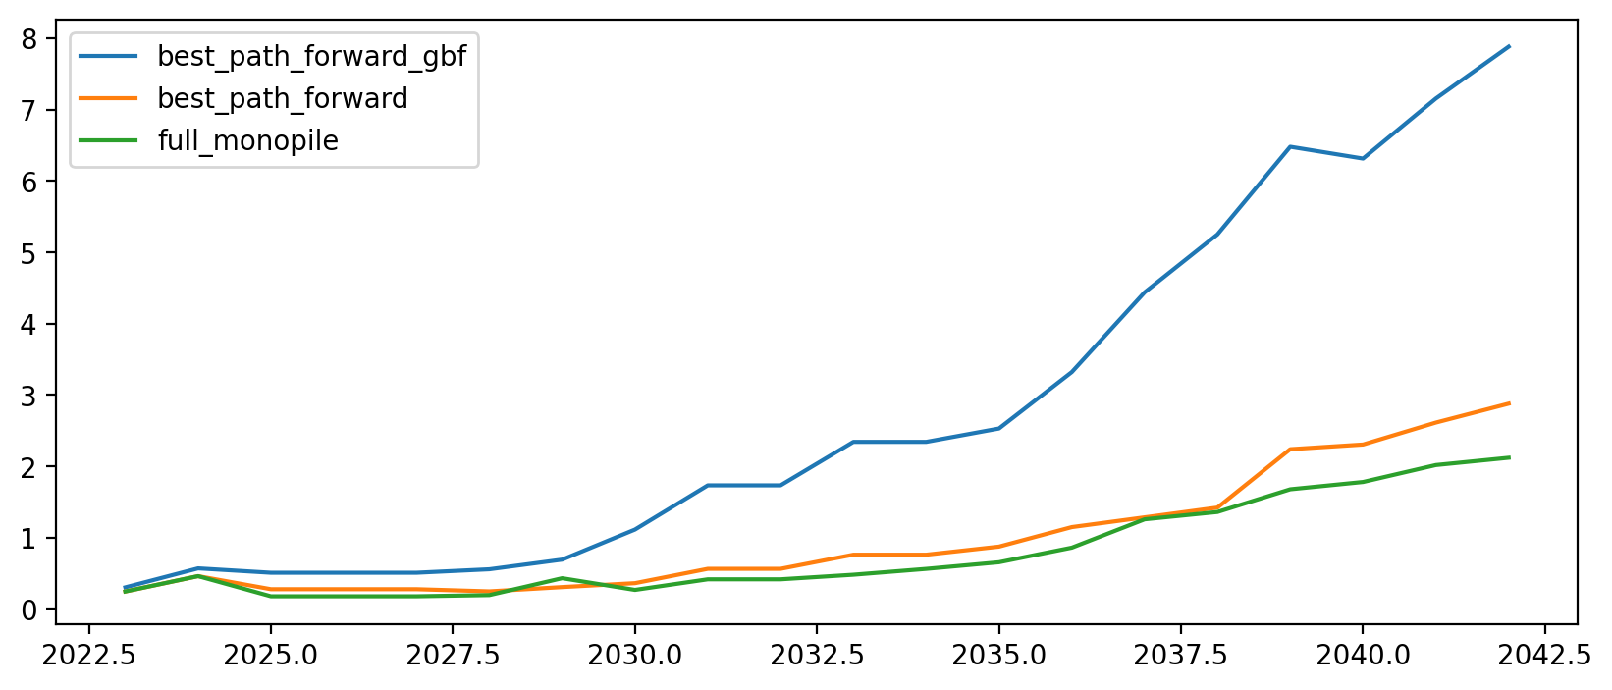
Summary
All scenarios are provided vessels to achieve minimal delays
Vessels tracked for investment include:
AHTS - $80M
WTIV - $615M
HLV - $625M
Best path forward = ½ SBJ, ½ GBF (fixed post 2030)
Full monopile = all monopile (fixed)
Best path forward GBF = all GBF (fixed post 2030)
If all GBF, independent of WTIV/HLV fleet (not competing with rest of Atlantic) -> Can achieve minimal delays with much lower vessel investment
Vessel Investment ($M)
Capacity per Investment (MW/$)

Slide 3
Gantt Charts

Slide 4
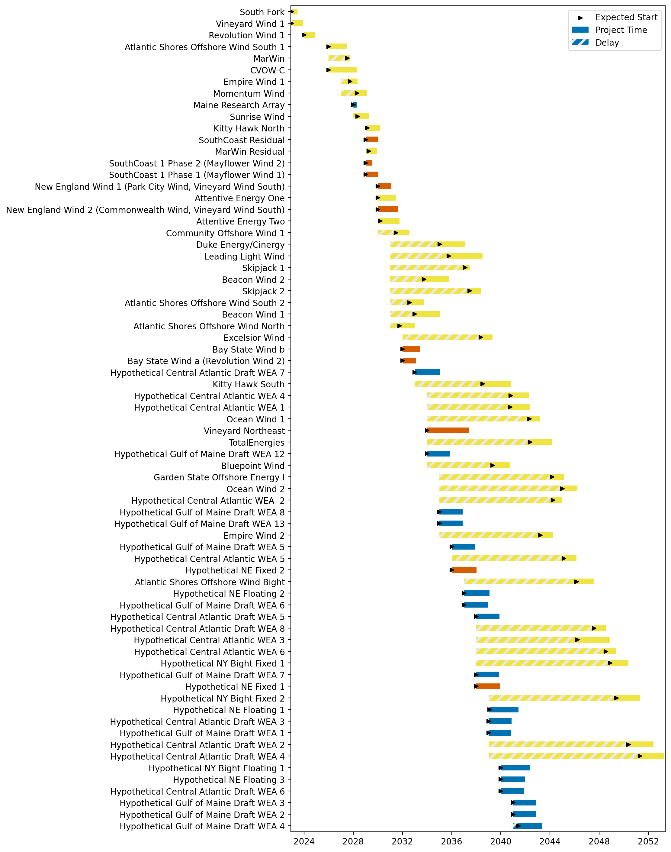
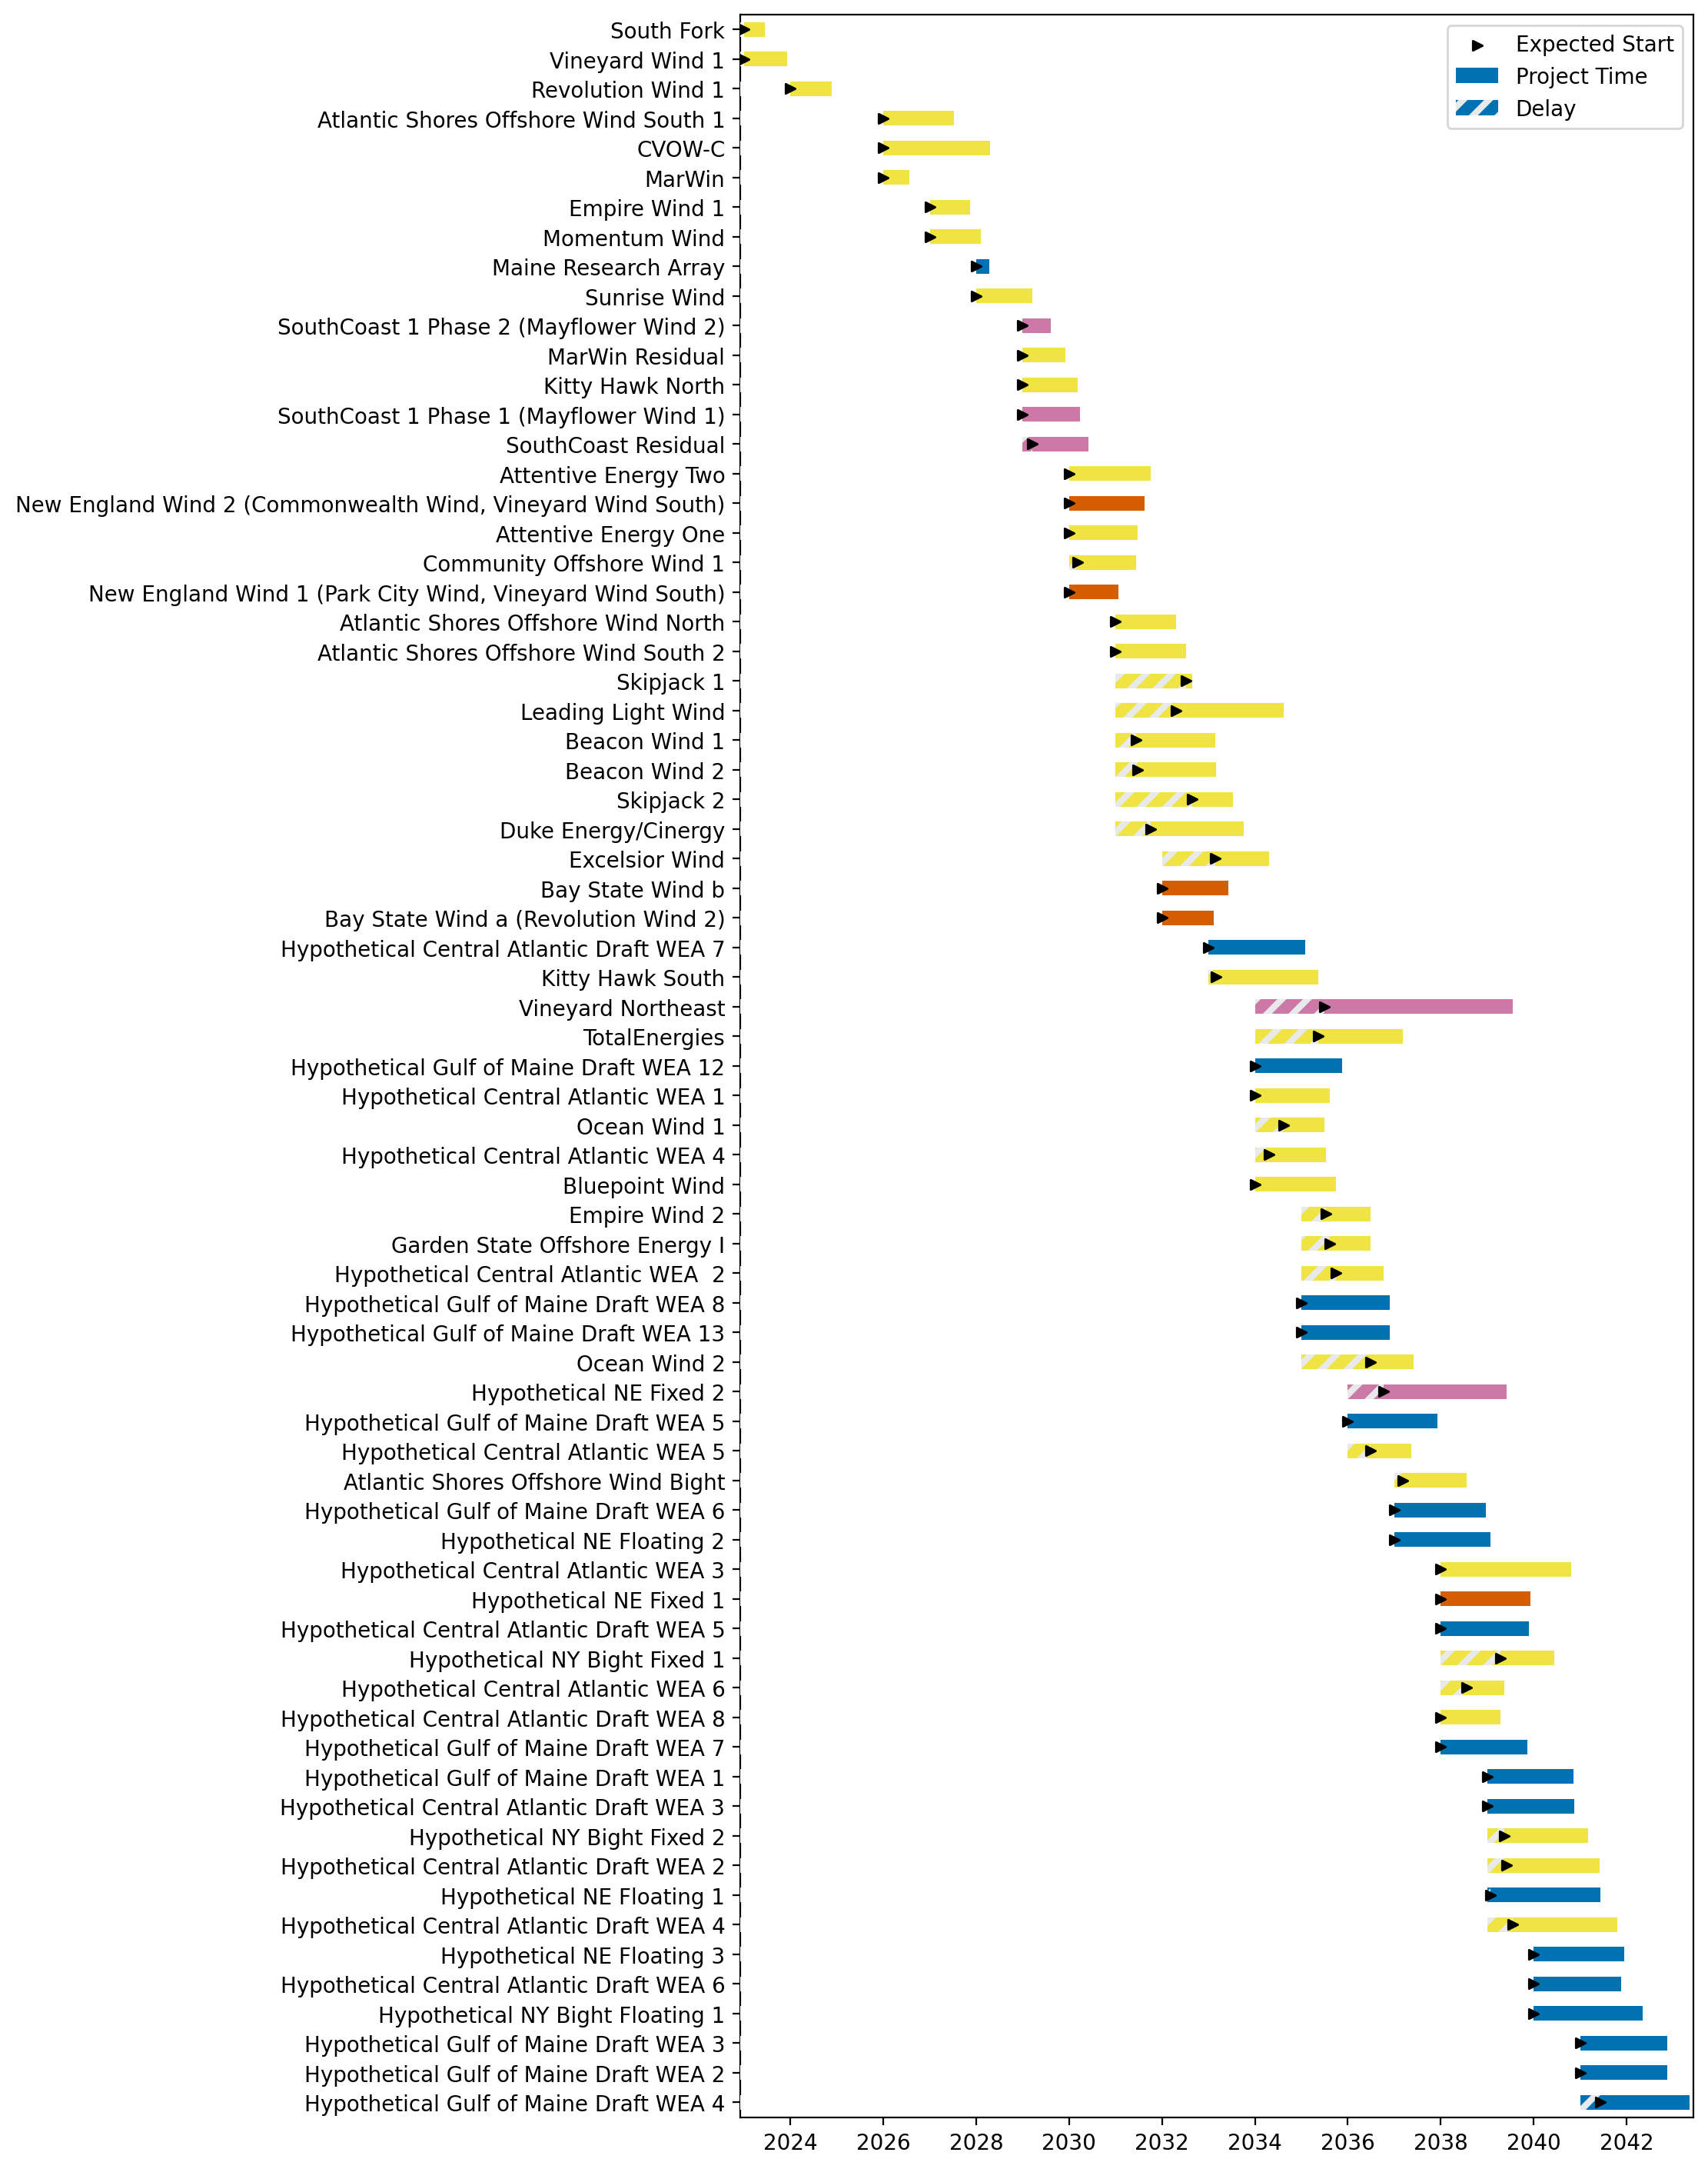
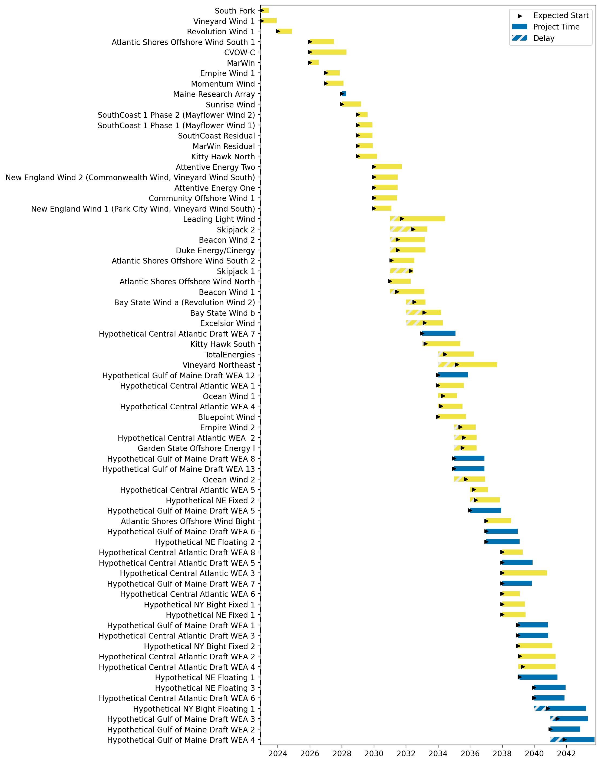
Full Gantt
GBF (post 2030)
Best Path Forward
Full Monopile
___ monopile
___ SBJ
___ GBF
___ semisub

Slide 5
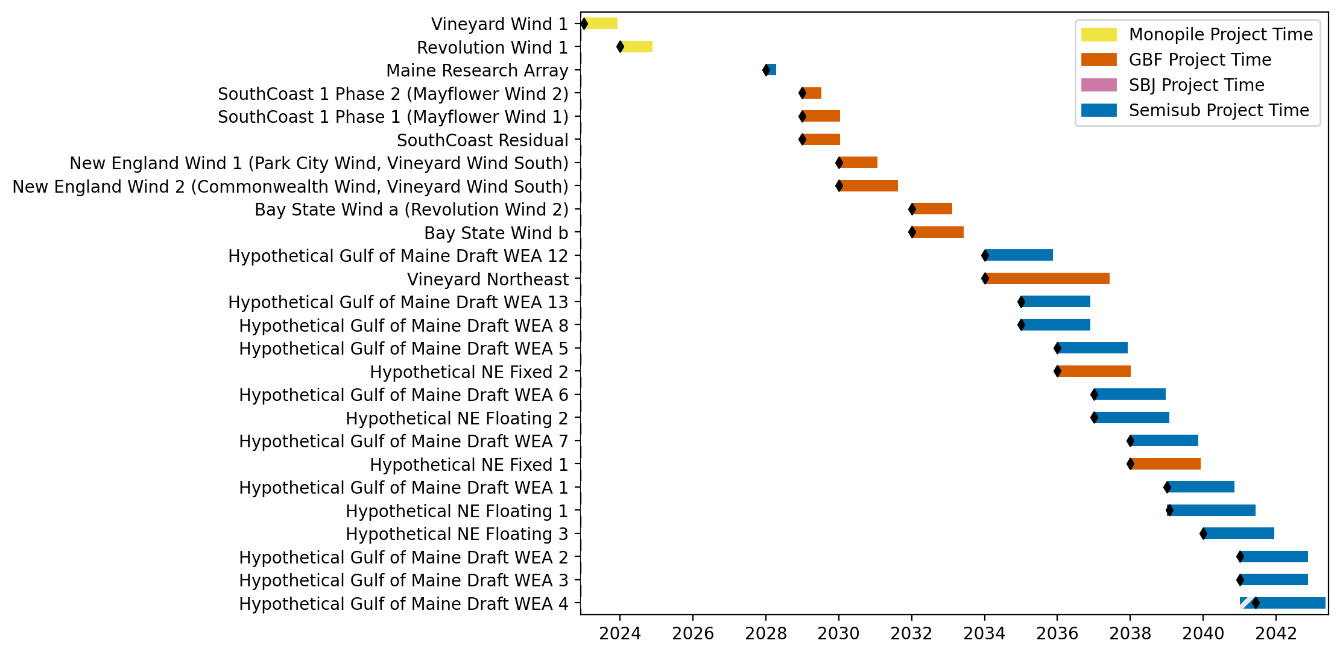
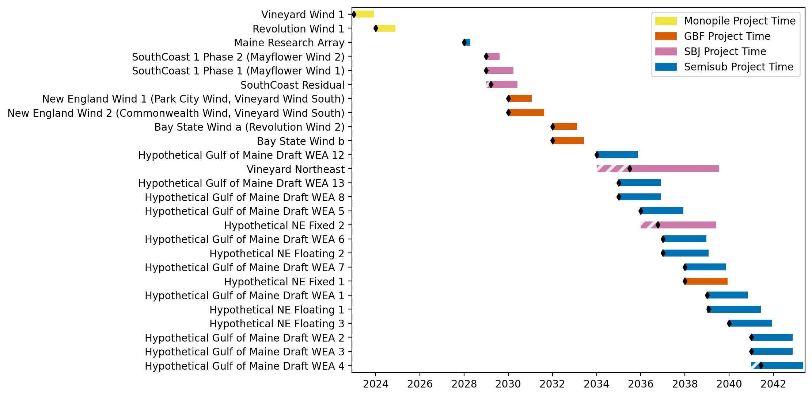
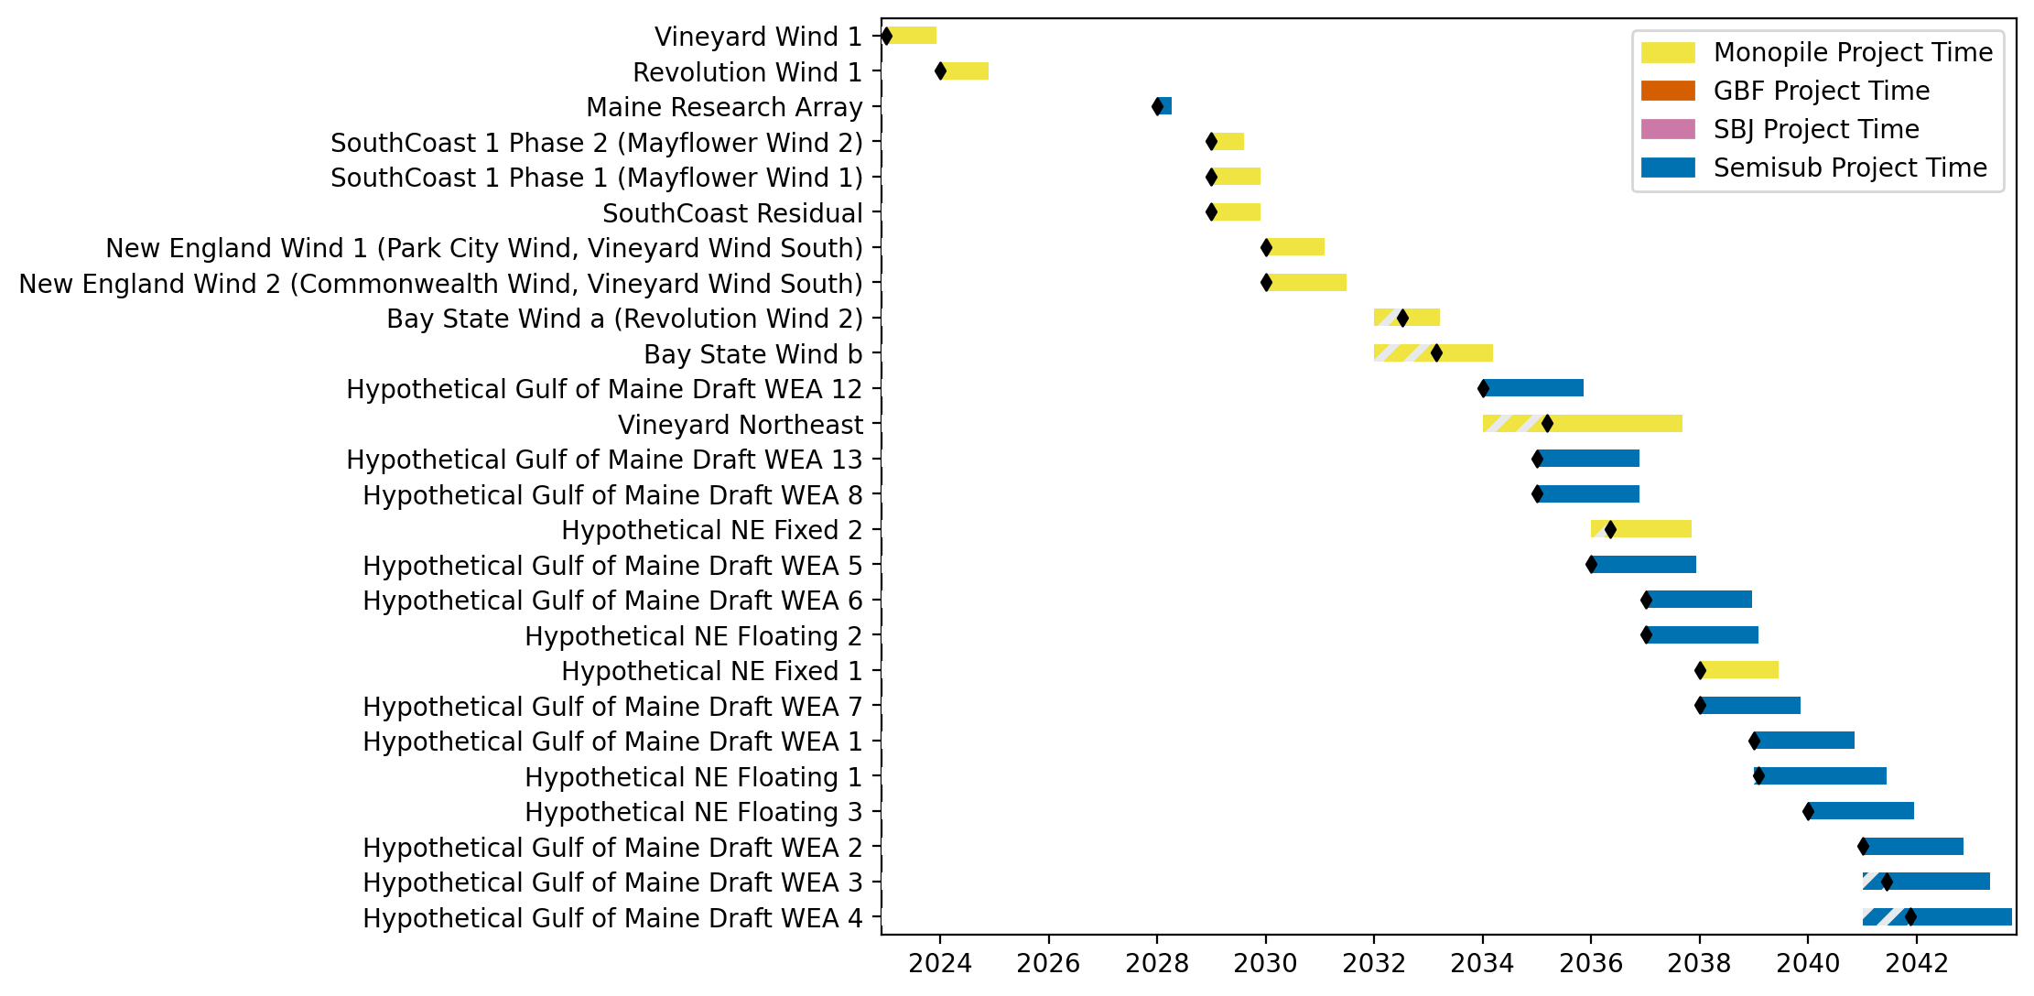
New England Gantt
GBF (post 2030)
Best Path Forward
Full Monopile

