Slide 1
natl_gaps_4us
1 US WTIV starting with CVOW, then 1 in 2030, 2033, 2036

Slide 2
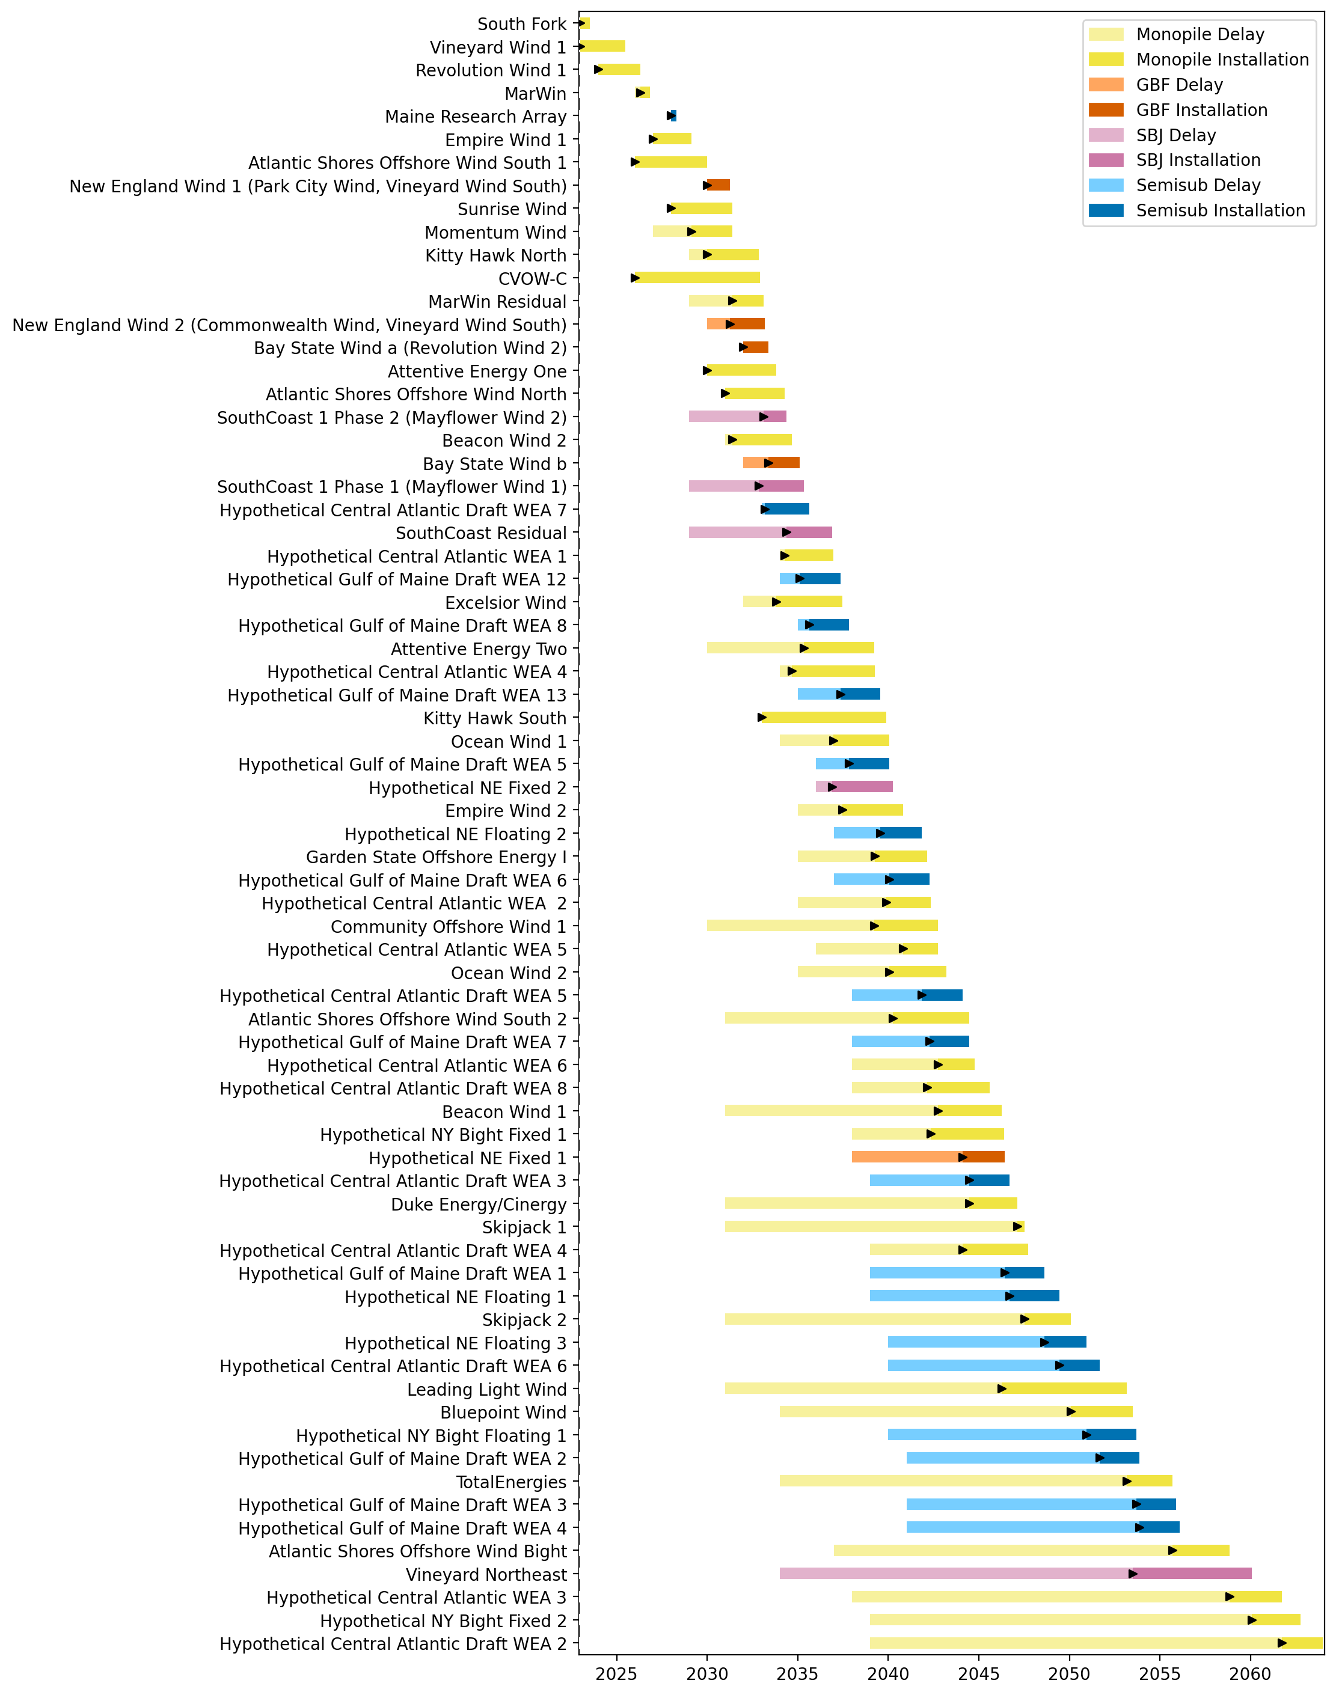
Full Gantt

Slide 3
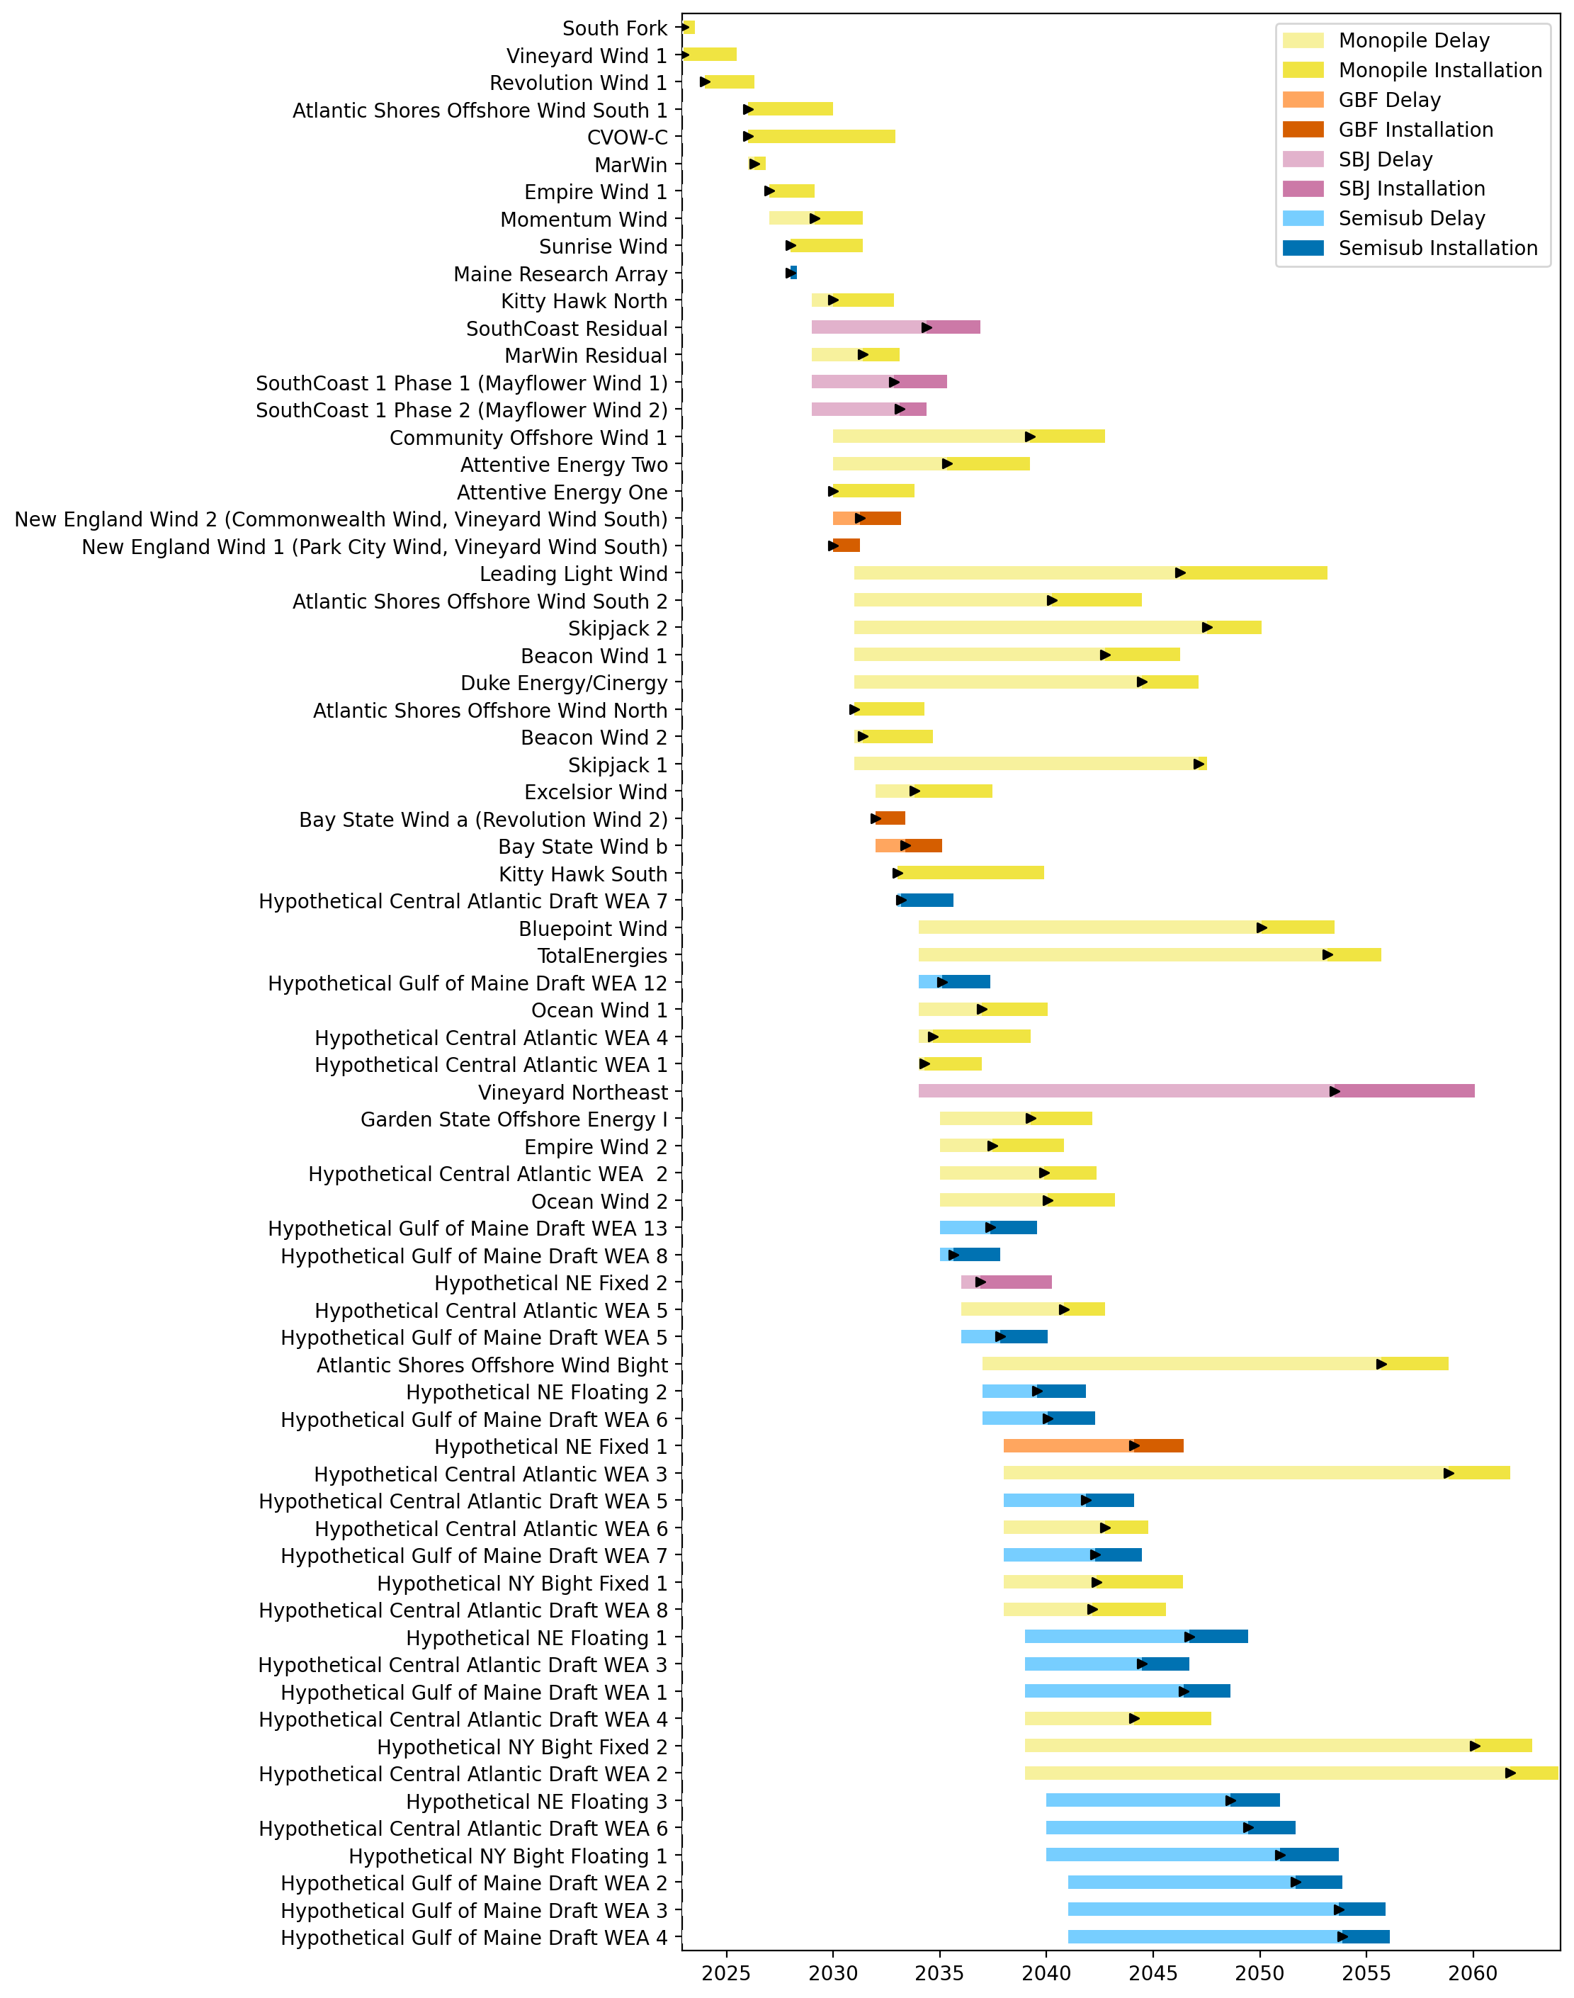
Sorted Full Gantt

Slide 4
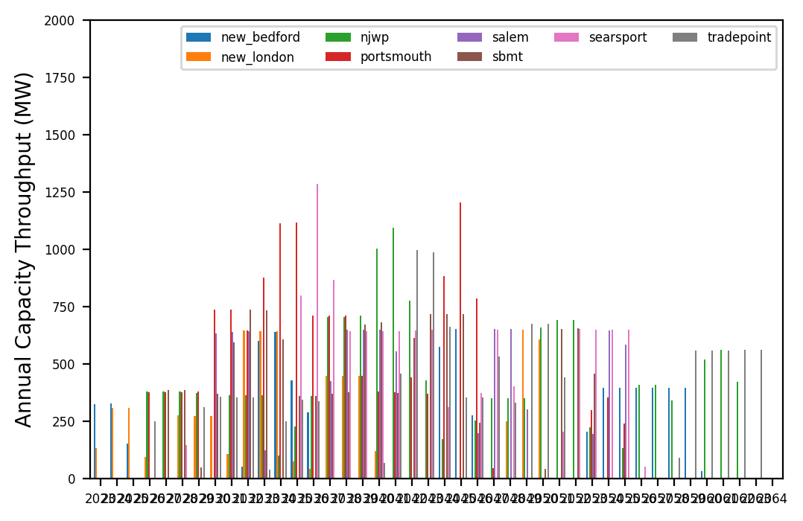
Port Throughput

Slide 5
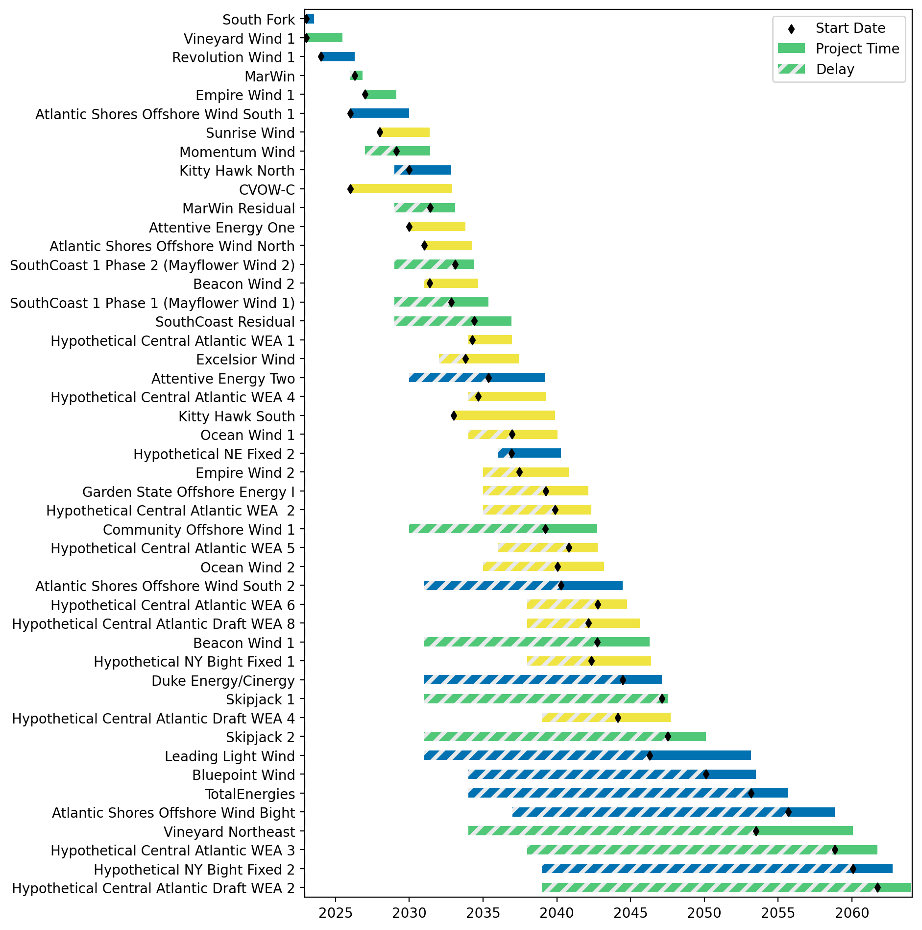
Fixed Gantt

Slide 6
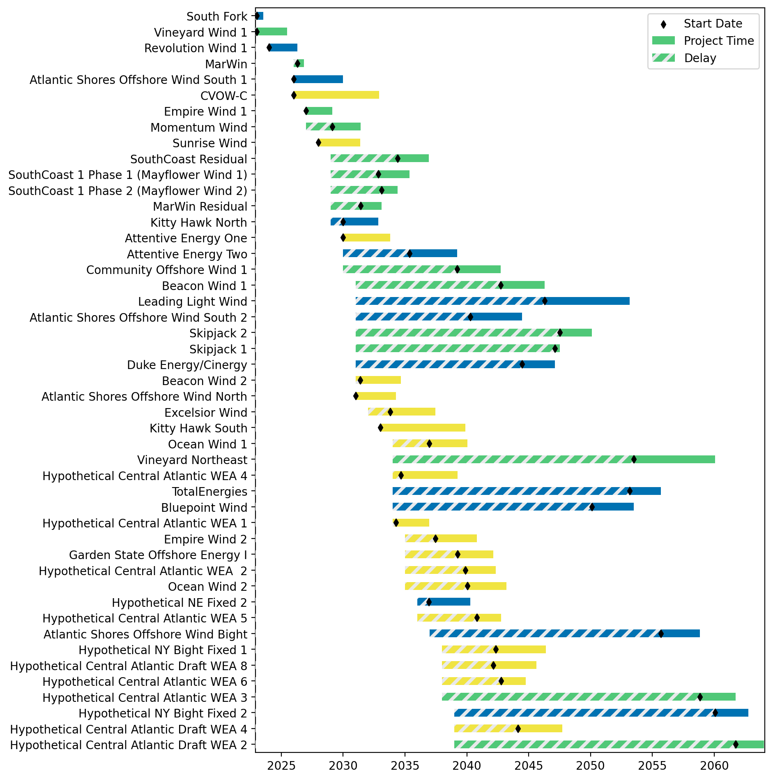
Sorted Fixed Gantt

Slide 7
natl_gaps_5foreign
1 more foreign WTIV 2025

Slide 8
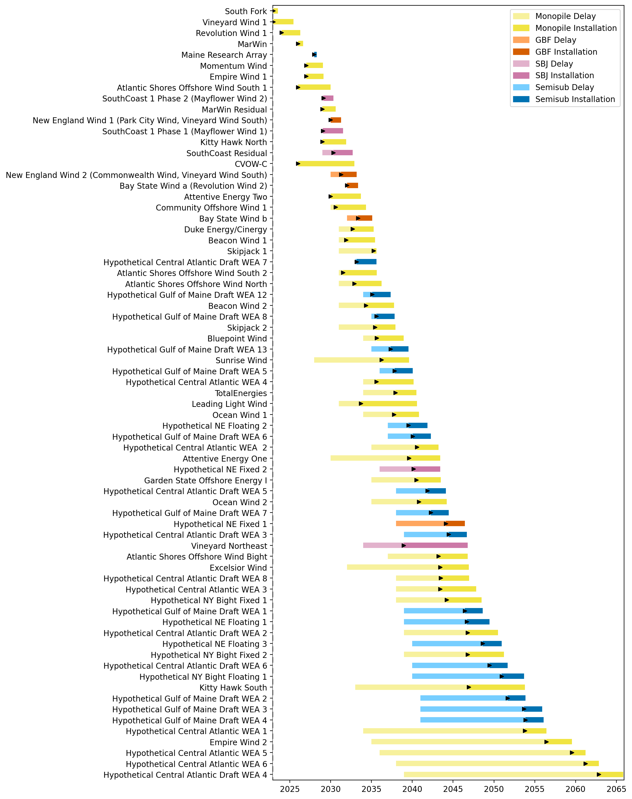
Full Gantt

Slide 9
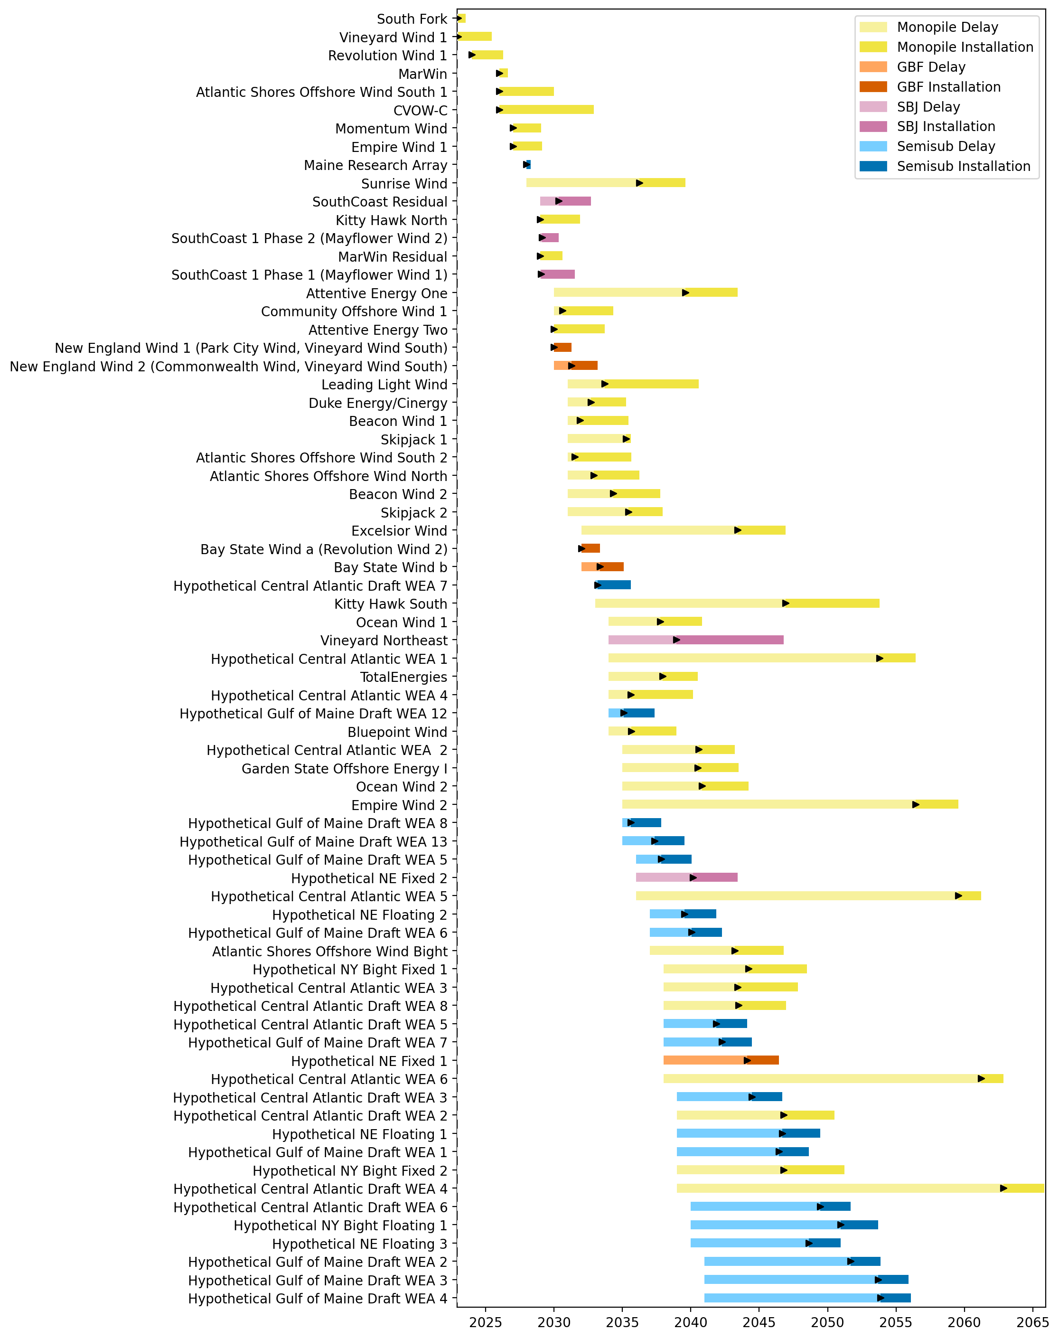
Sorted Full Gantt

Slide 10
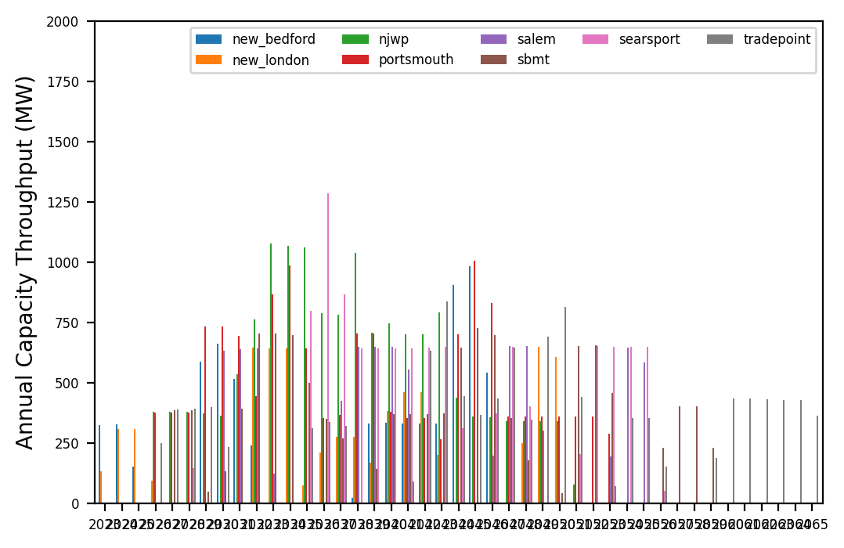
Port Throughput

Slide 11
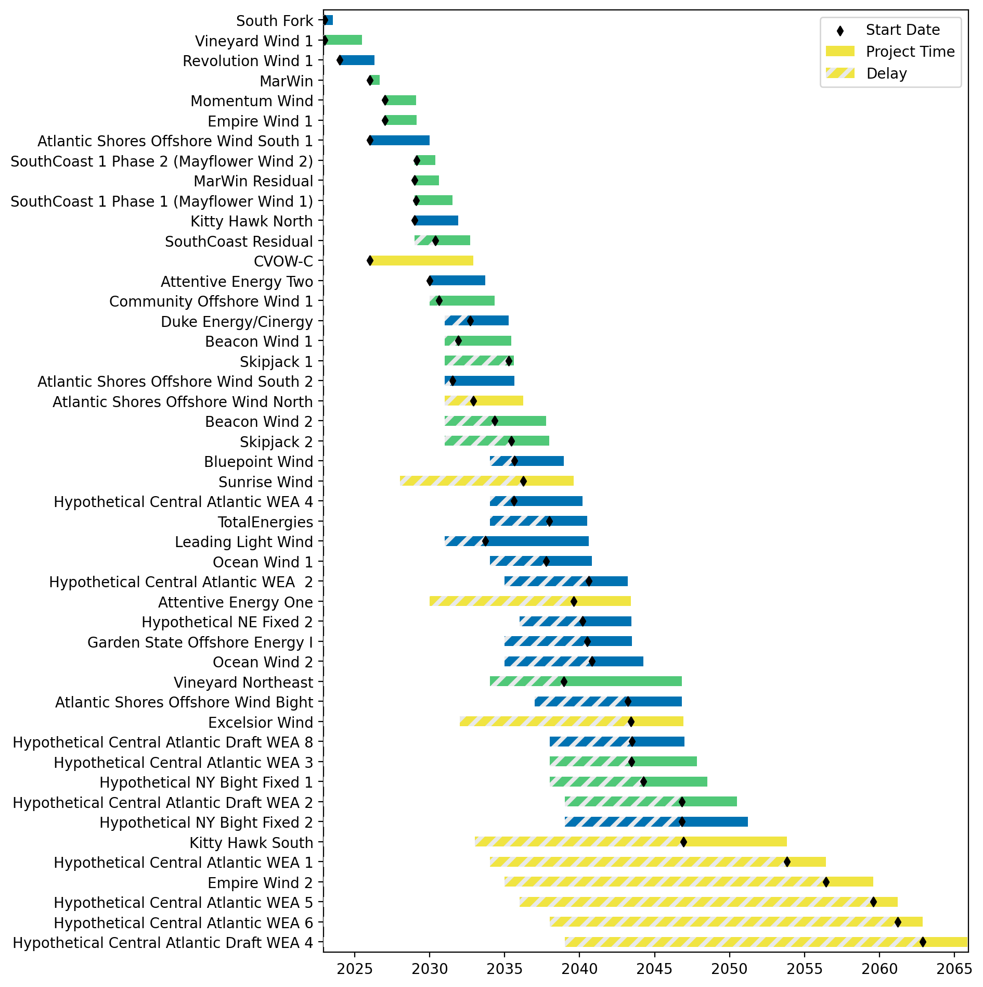
Fixed Gantt

Slide 12
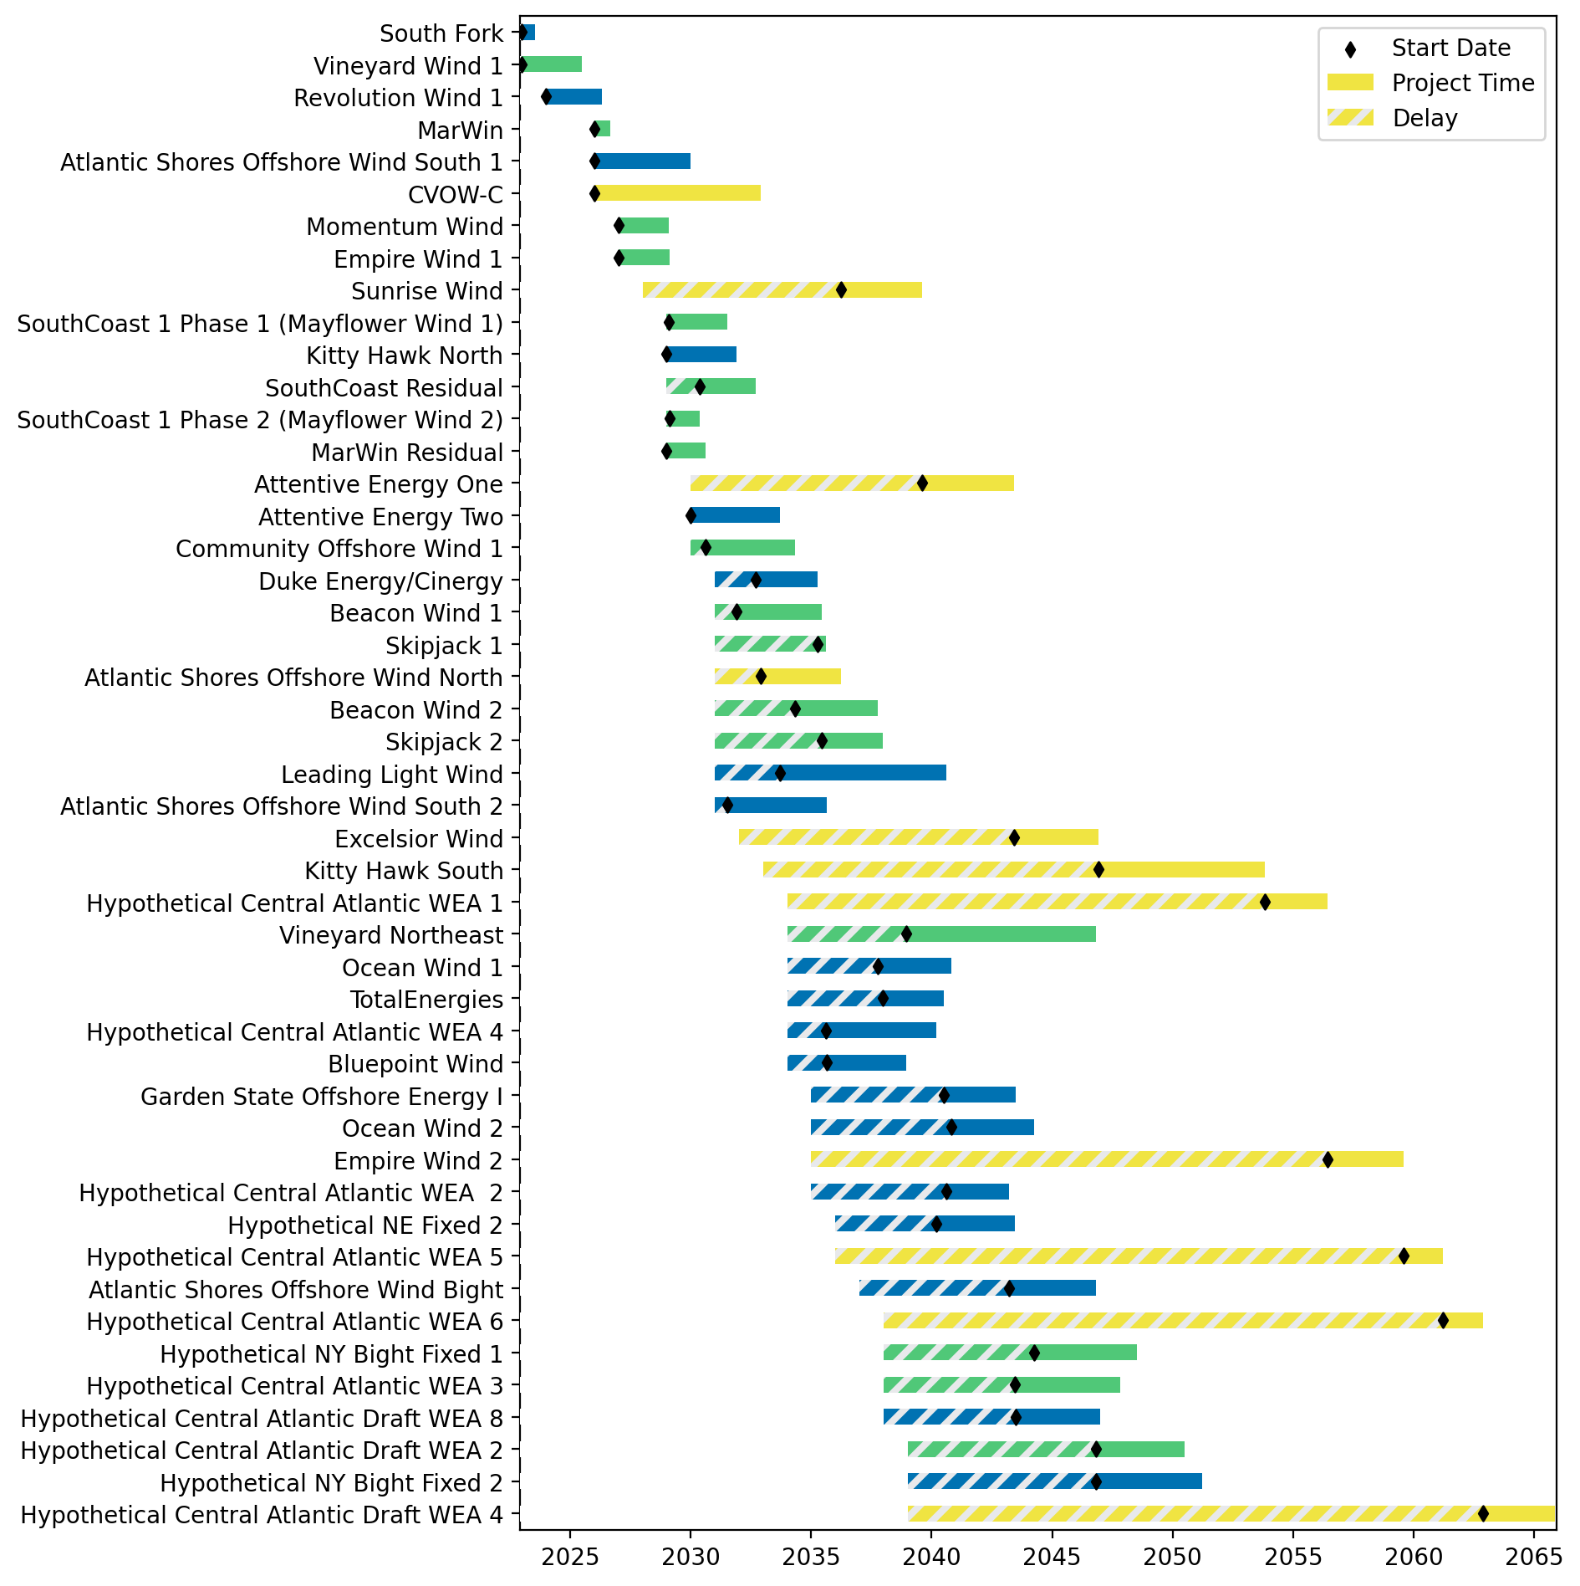
Sorted Fixed Gantt

Slide 13
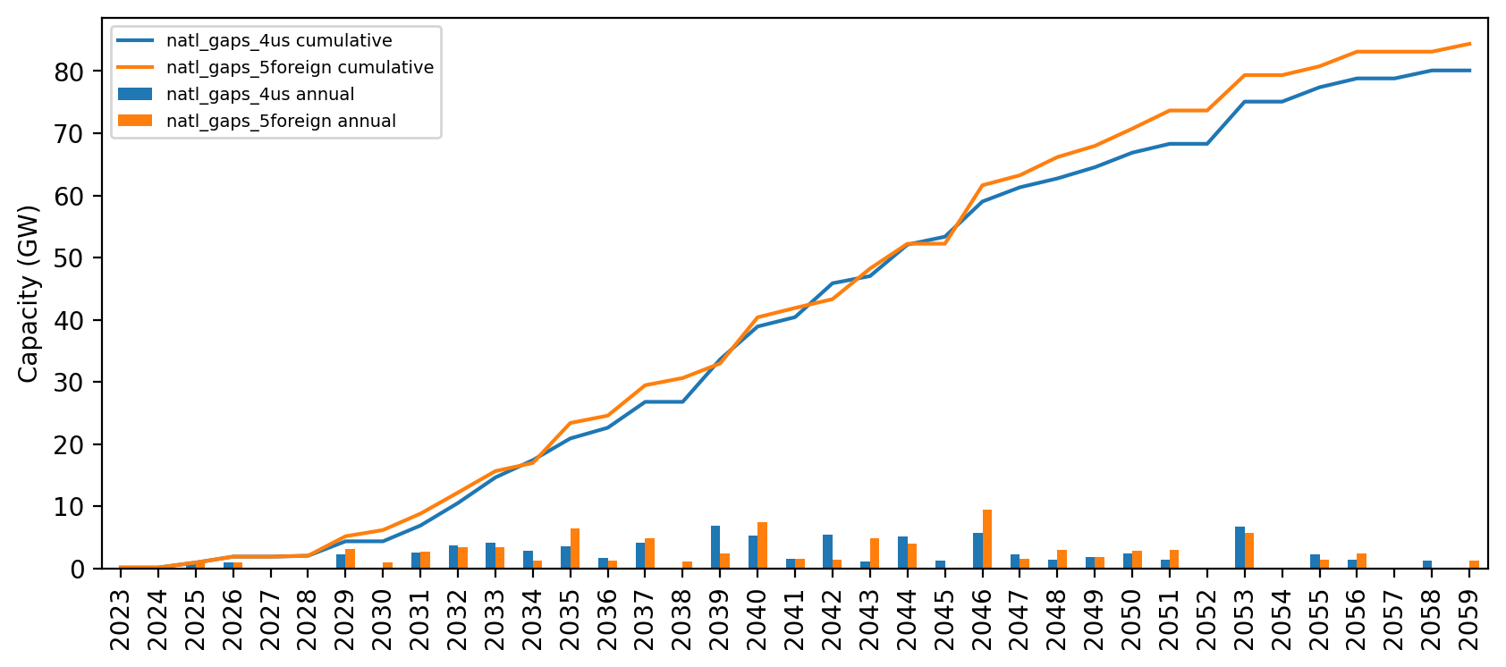
Installed Capacity

Slide 14
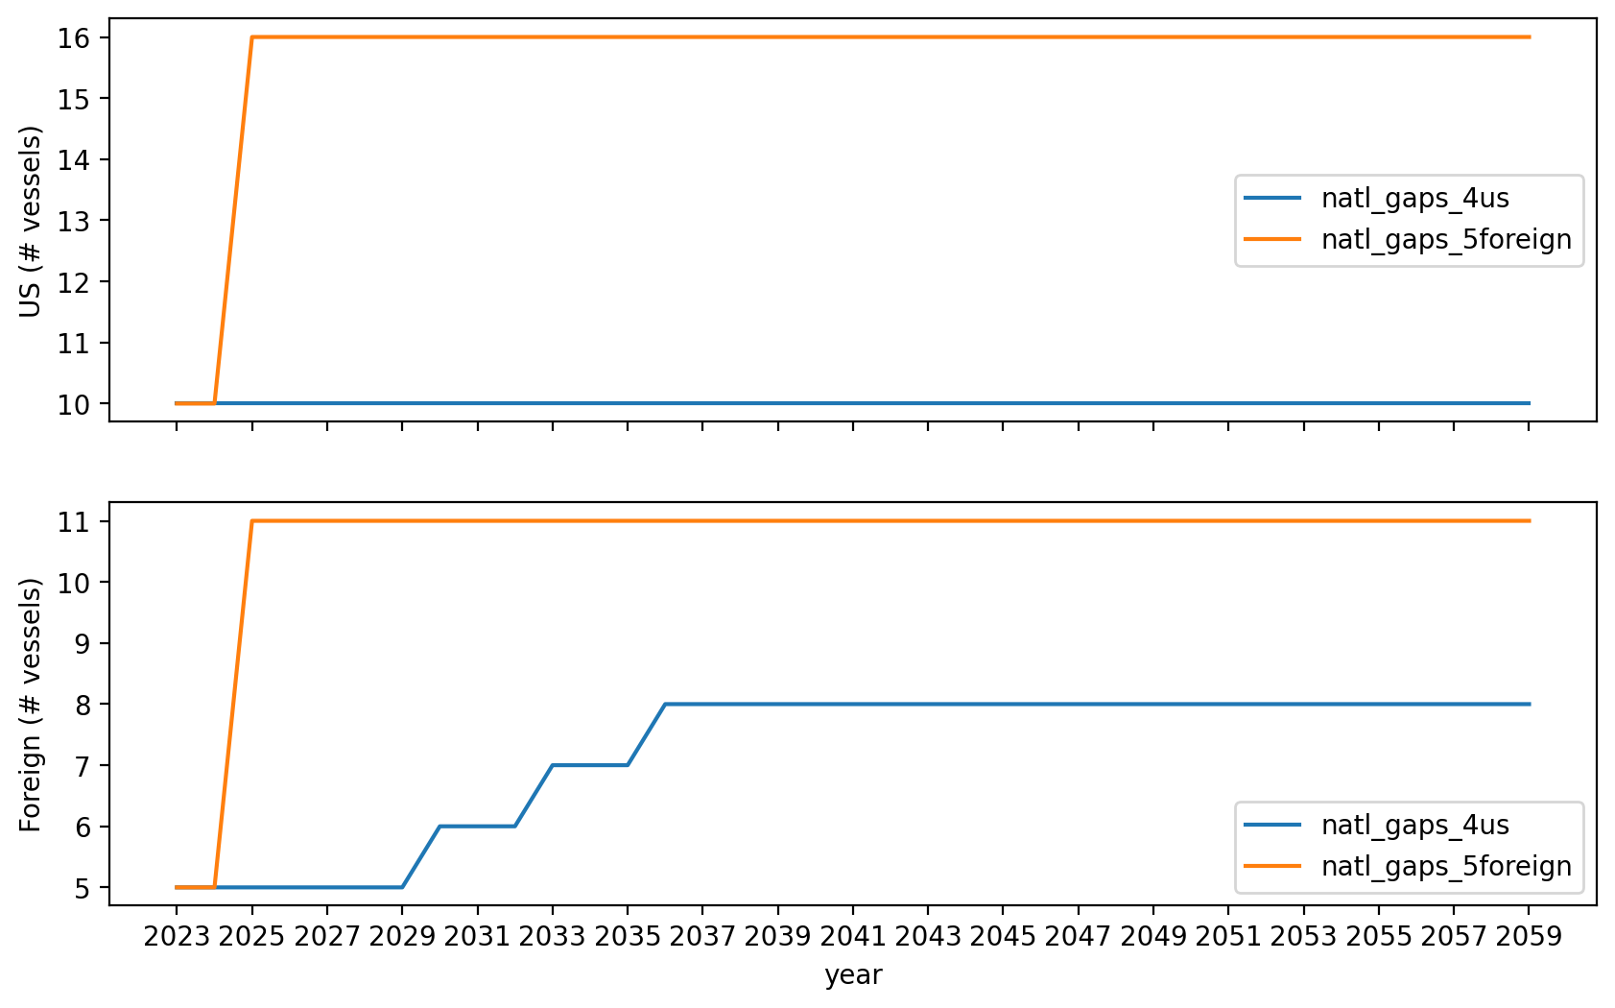
Vessel Investment

Slide 15
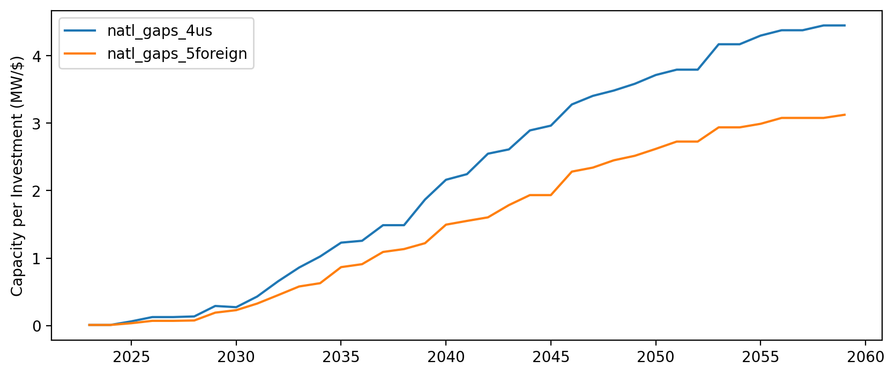
Capacity per Investment (MW/$)

