Slide 1
Vessel Study: Prelim Results (6/27)
Core Scenario + US WTIV sweep

Slide 2
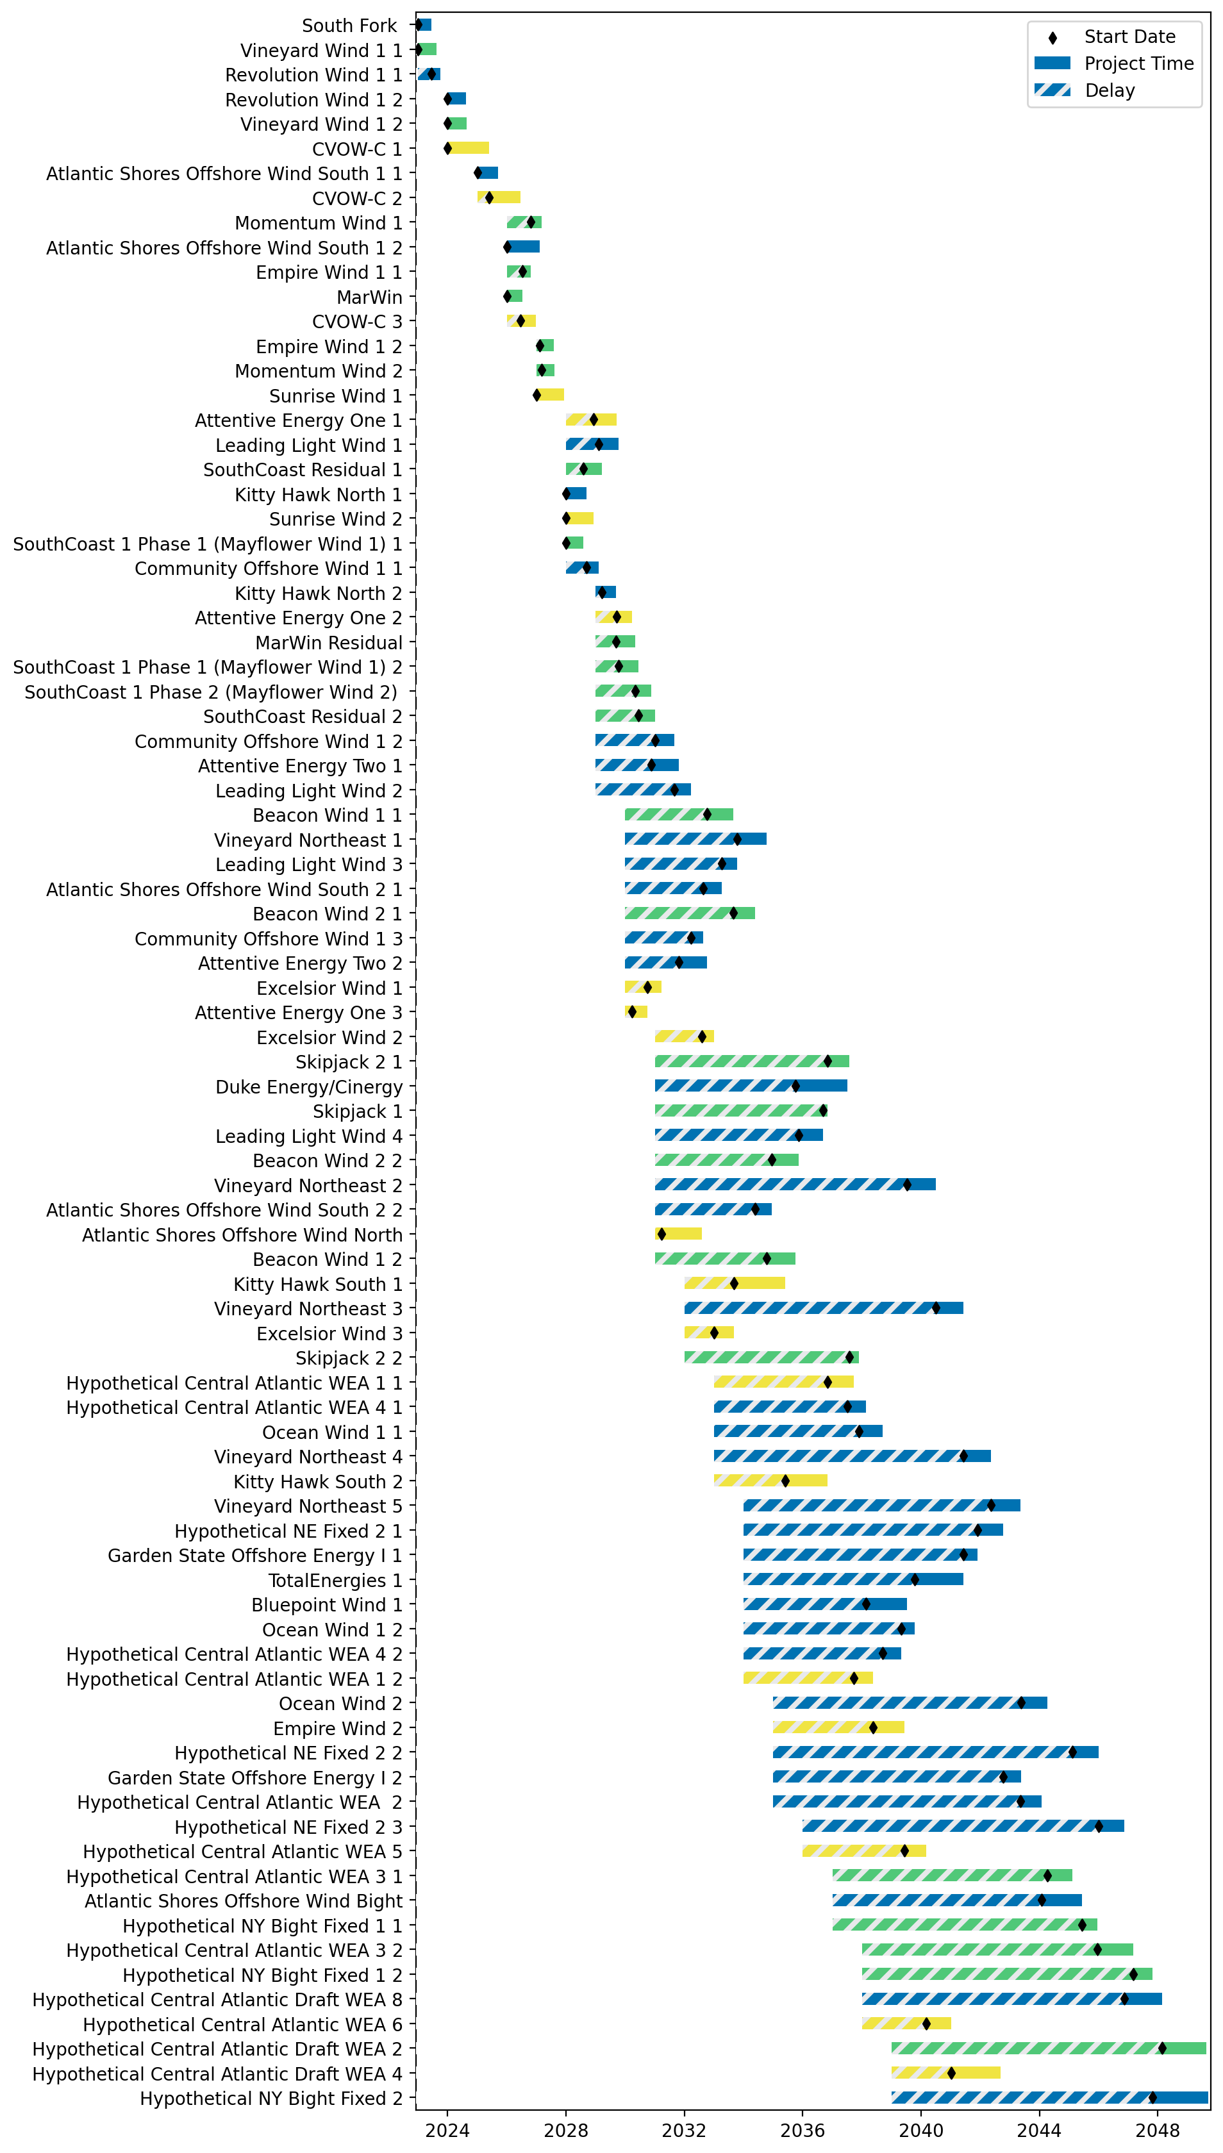
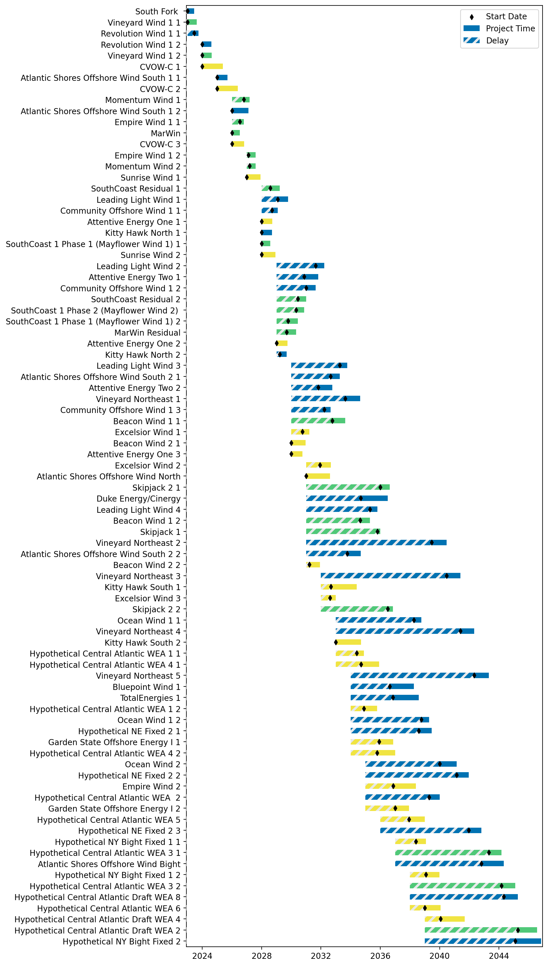
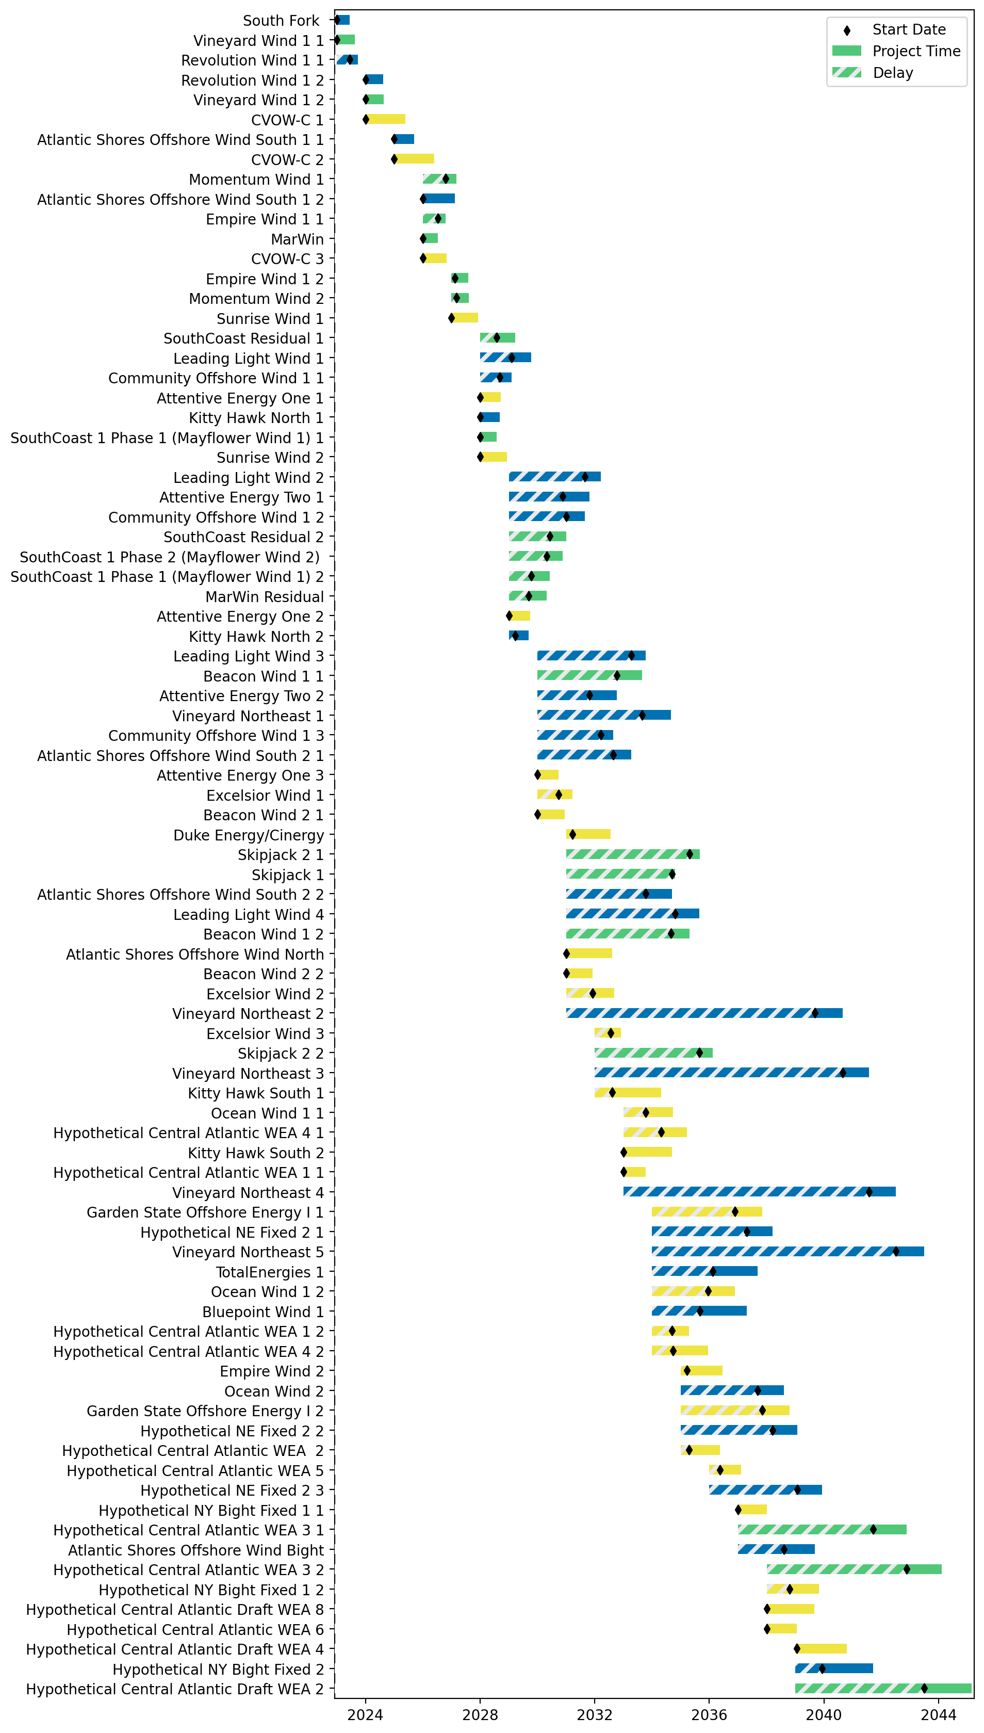
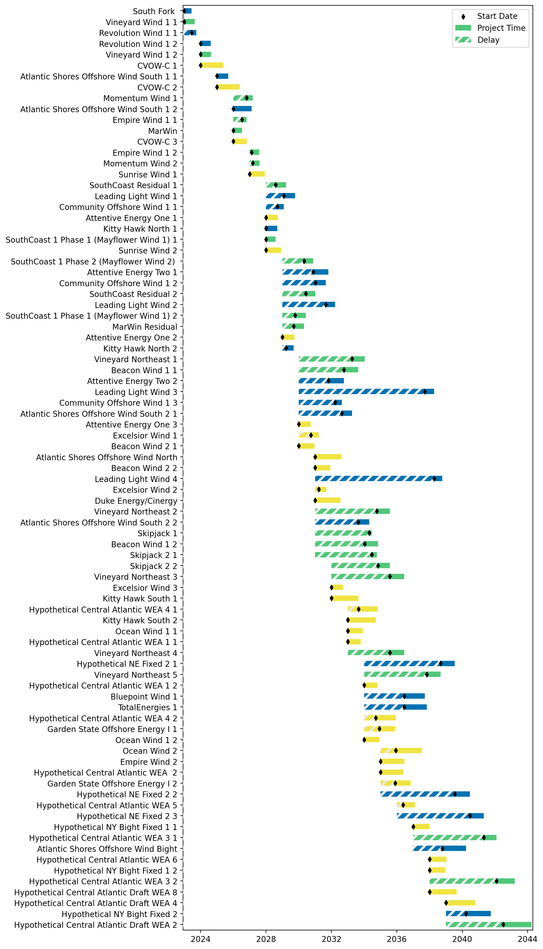
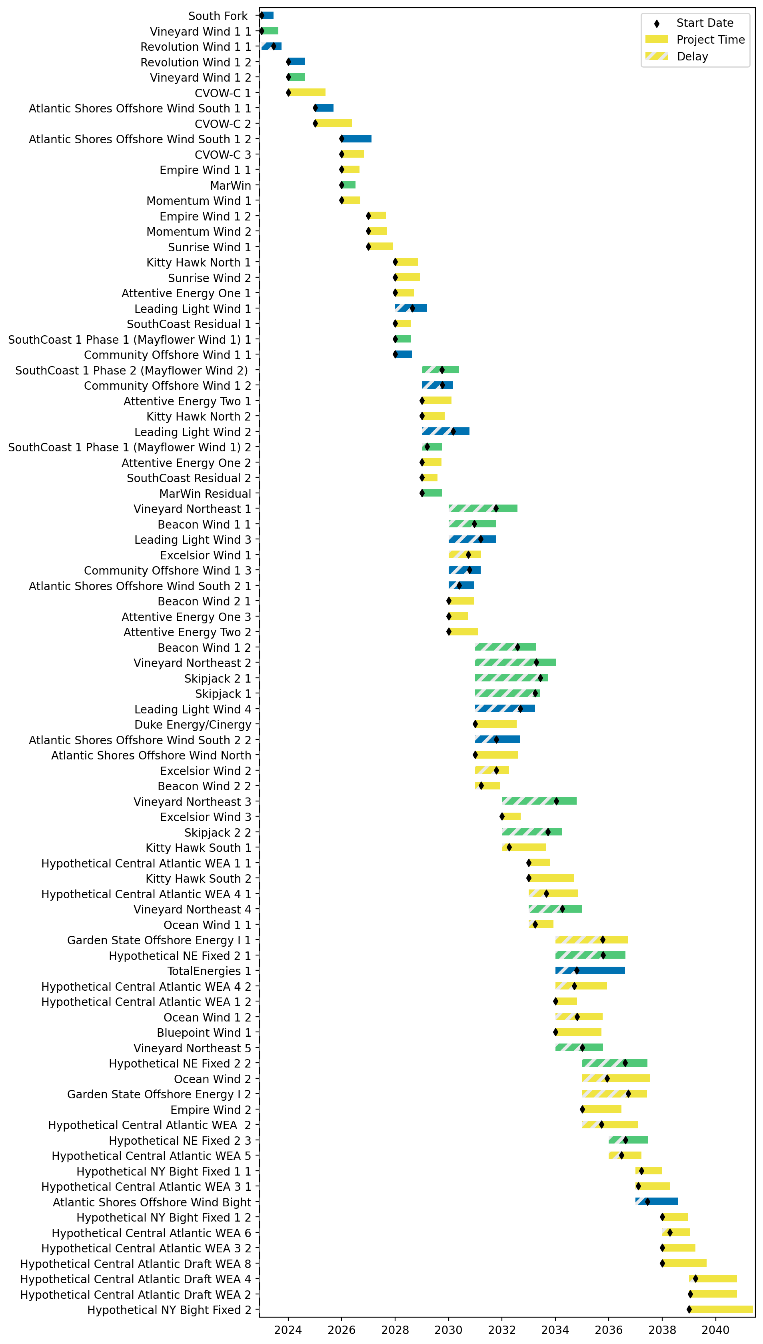
Sorted Fixed Gantt
1 US WTIV
2 US WTIV
3 US WTIV
4 US WTIV
4 US WTIV, shuttle

Slide 3
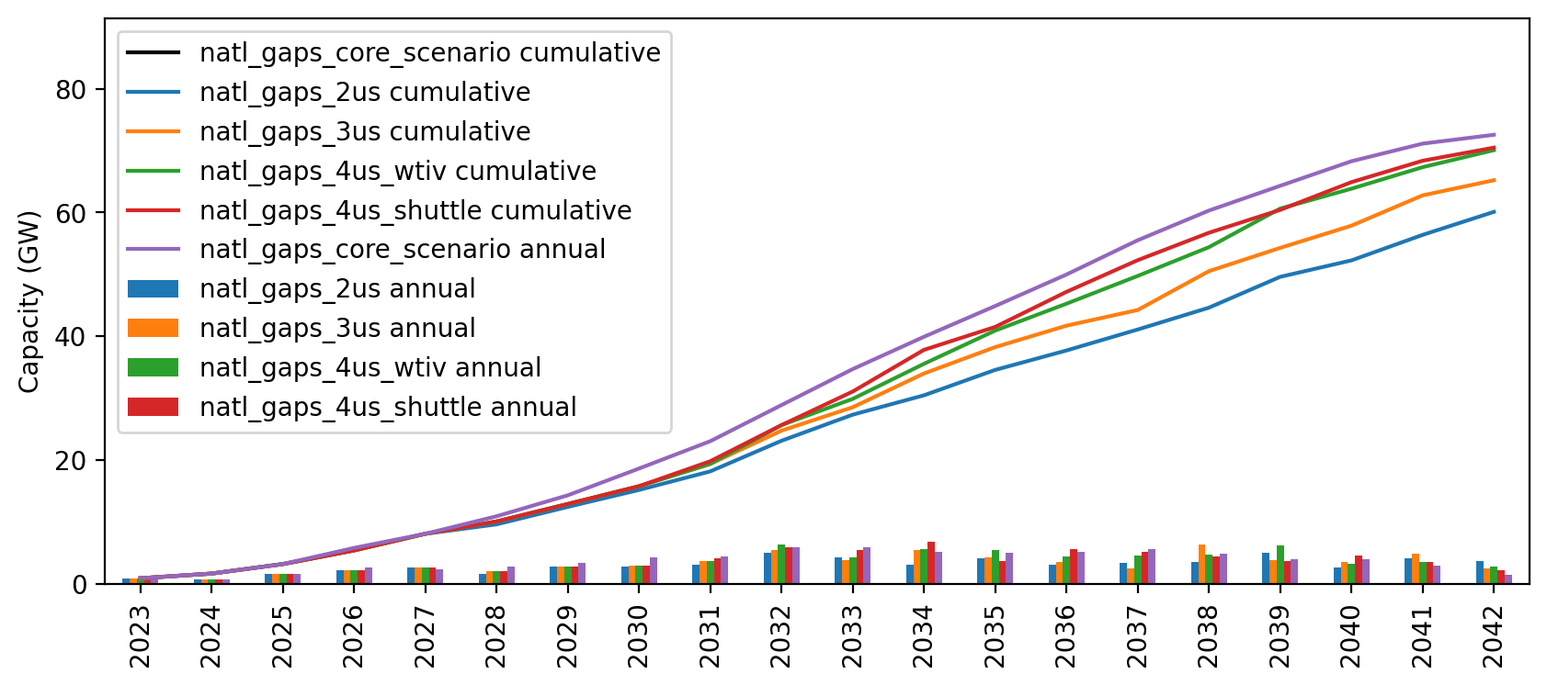
Installed Capacity

