Slide 1
base_baseline
Pipeline: Baseline
Vessel Pathway: Base
Port Pathway: Base

Slide 2
2029_baseline
Pipeline: Baseline
Vessel Pathway: 2029
Port Pathway: Base

Slide 3
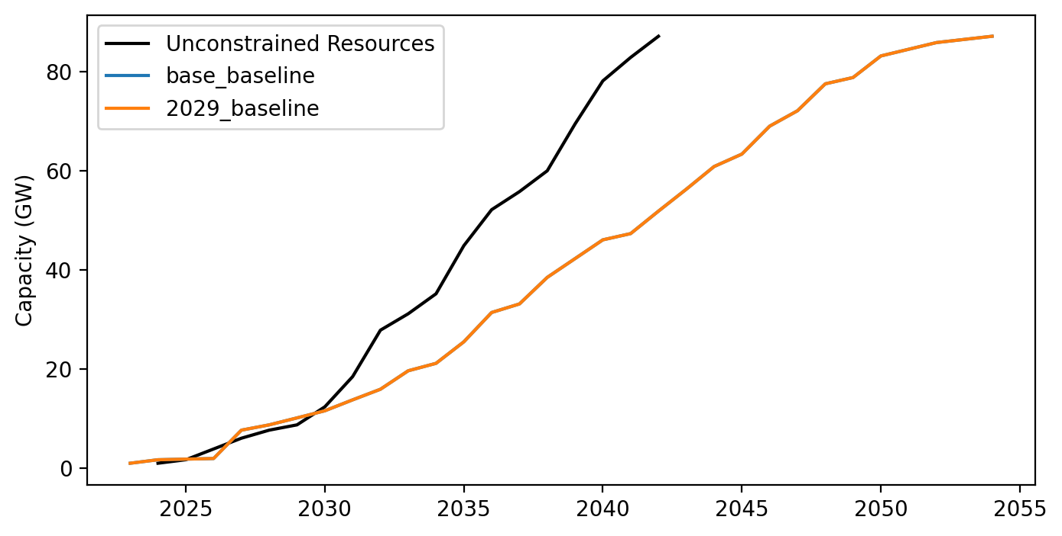
Cummulative Installed Capacity

