Slide 1
base_ne_baseline
Pipeline: Baseline - NE
Vessel Pathway: Base
Port Pathway: Base

Slide 2
base_ne_mono_baseline
Pipeline: Baseline - NE, Monopiles
Vessel Pathway: Base
Port Pathway: Base

Slide 3
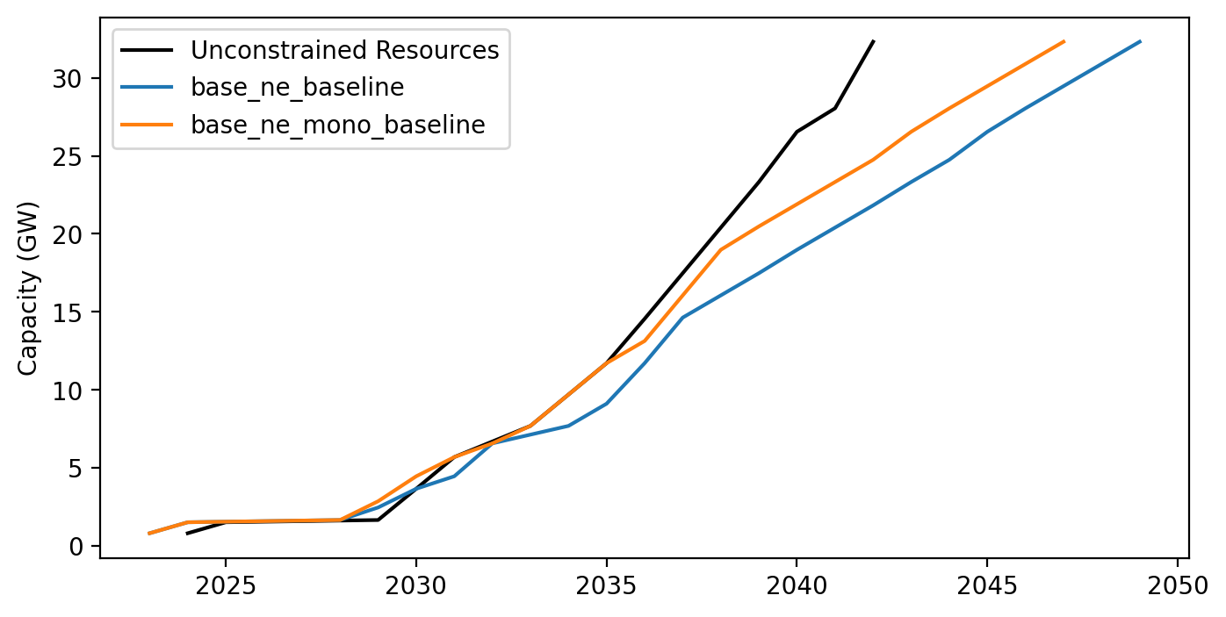
Cummulative Installed Capacity

