Slide 1
natl_gaps_unconstrained_vessels
Unconstrained Vessels

Slide 2
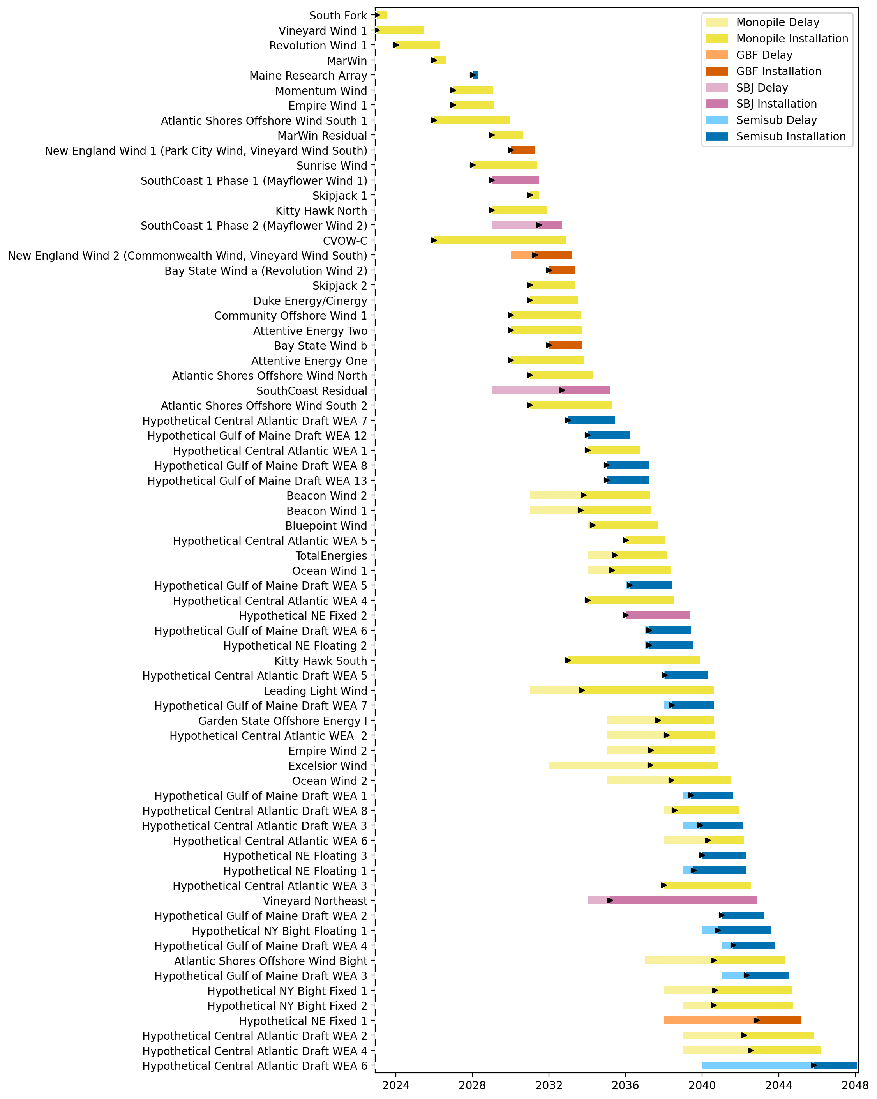
Full Gantt

Slide 3
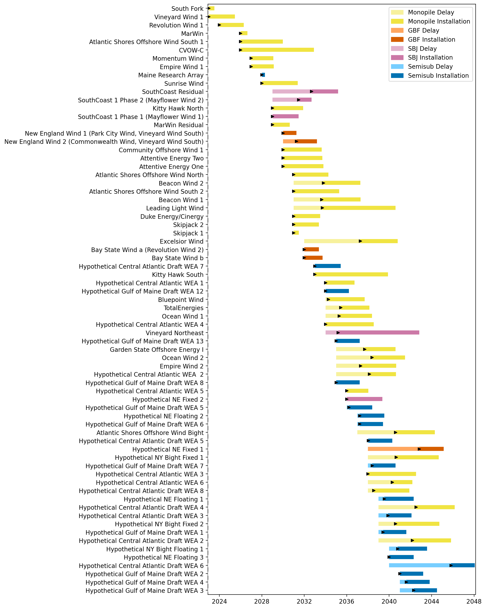
Sorted Full Gantt

Slide 4
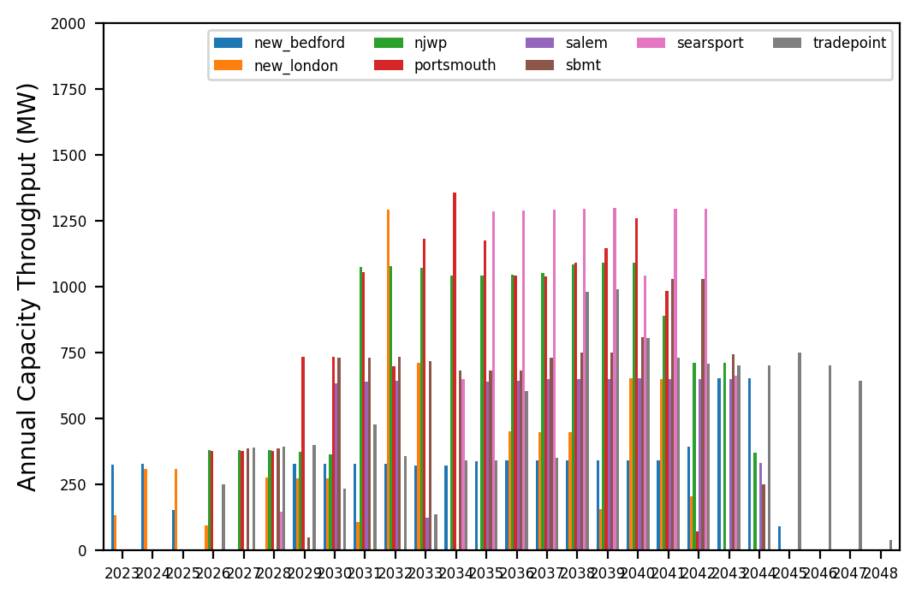
Port Throughput

Slide 5
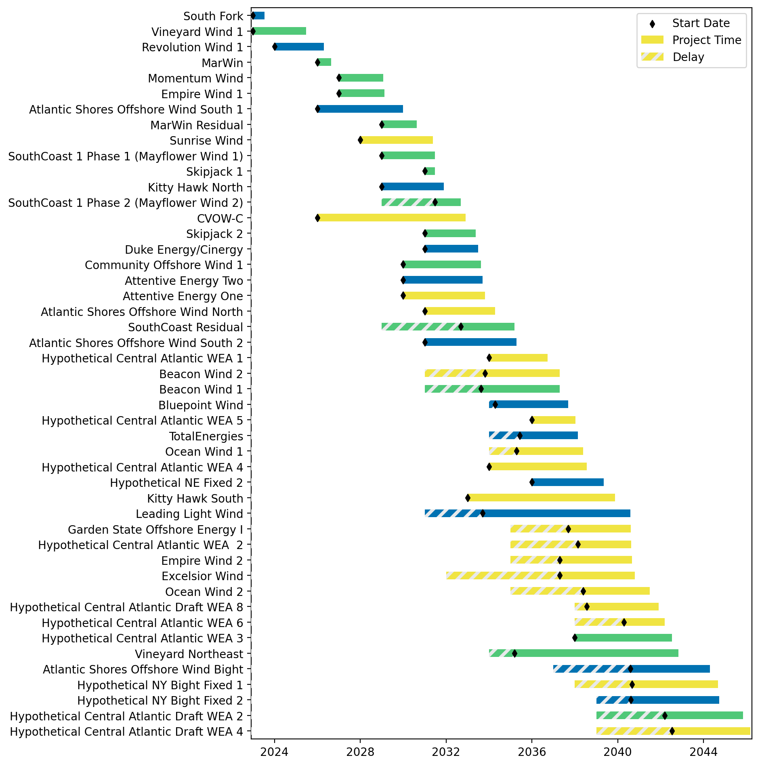
Fixed Gantt

Slide 6
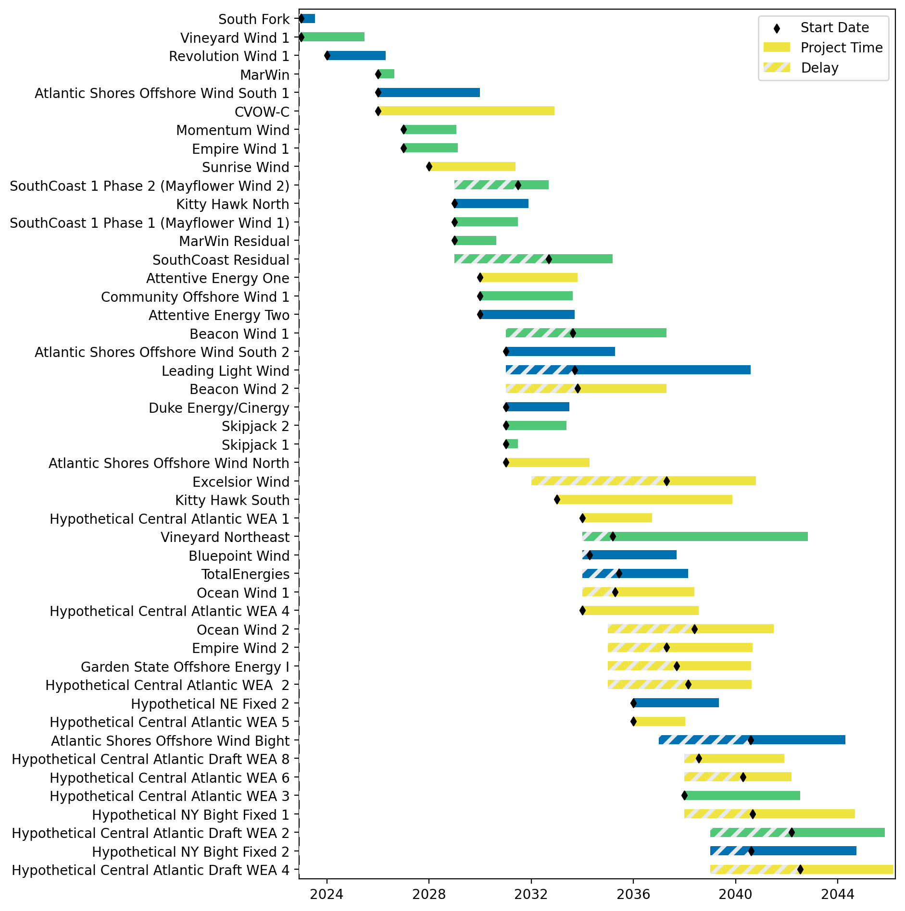
Sorted Fixed Gantt

Slide 7
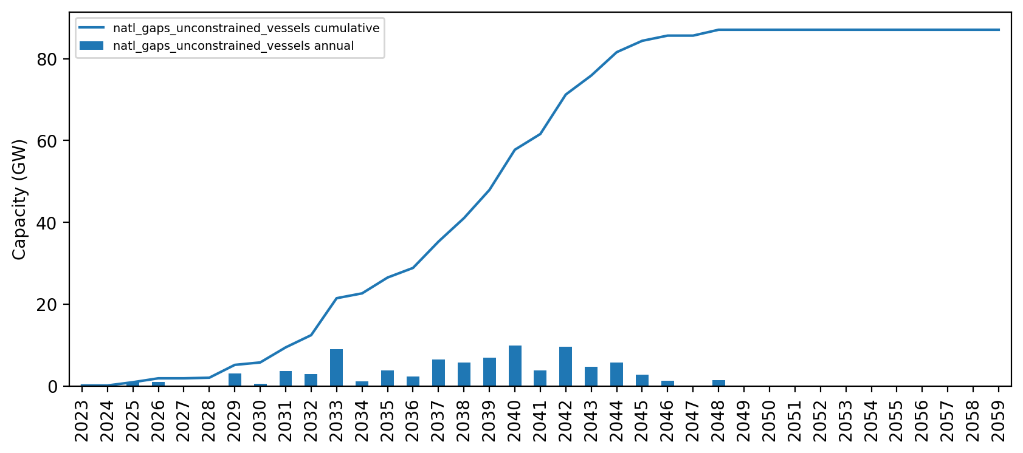
Installed Capacity

Slide 8
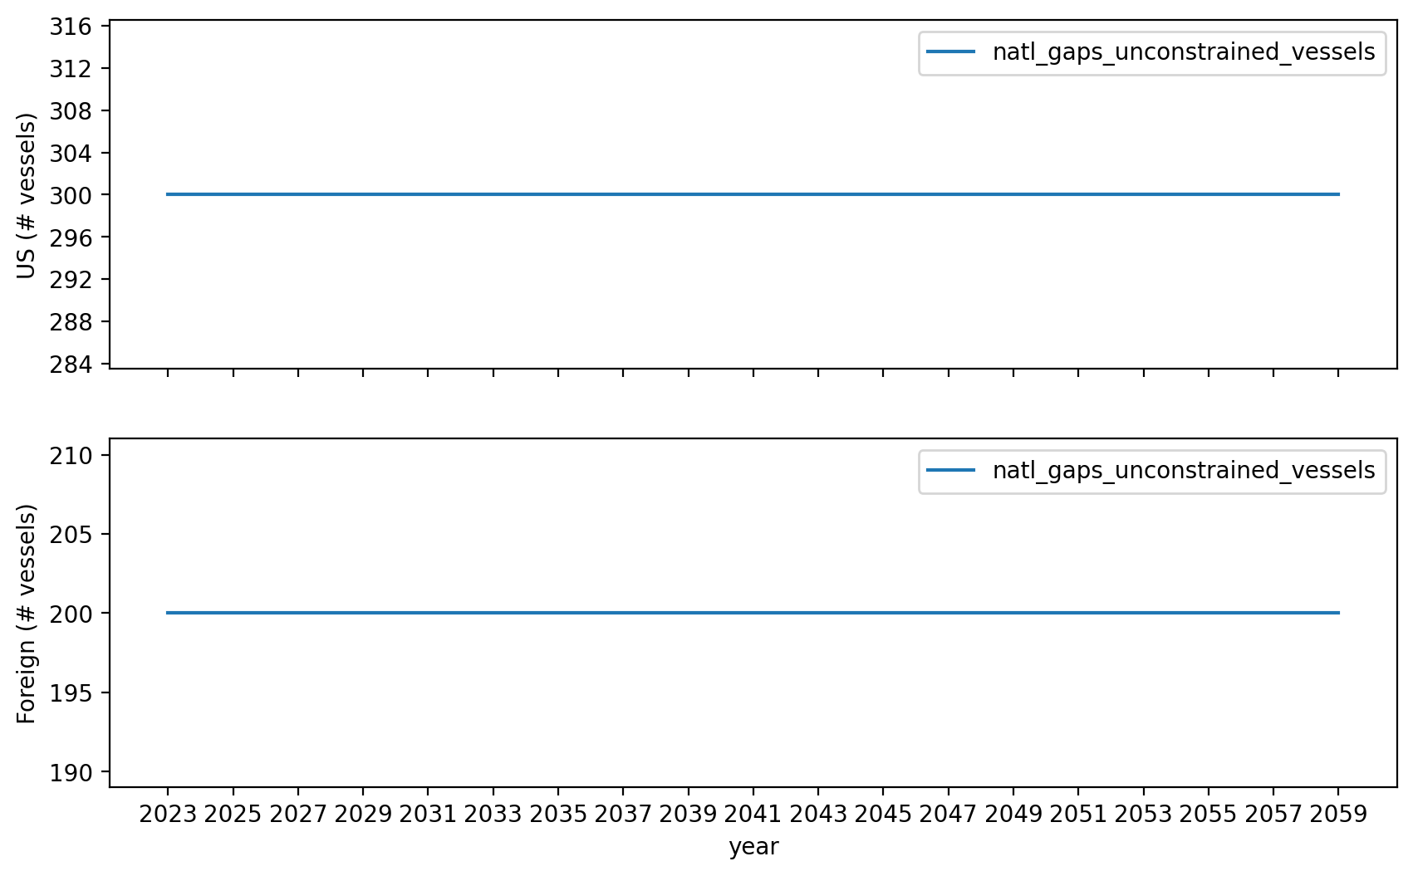
Vessel Investment

Slide 9
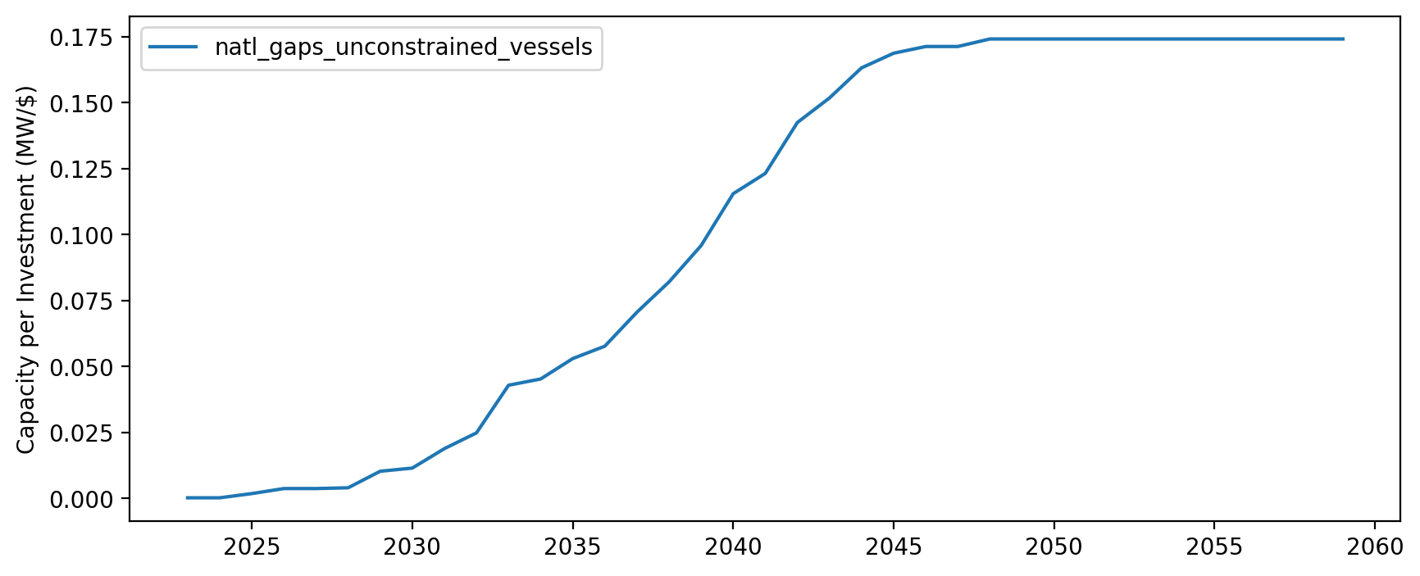
Capacity per Investment (MW/$)

