Slide 1
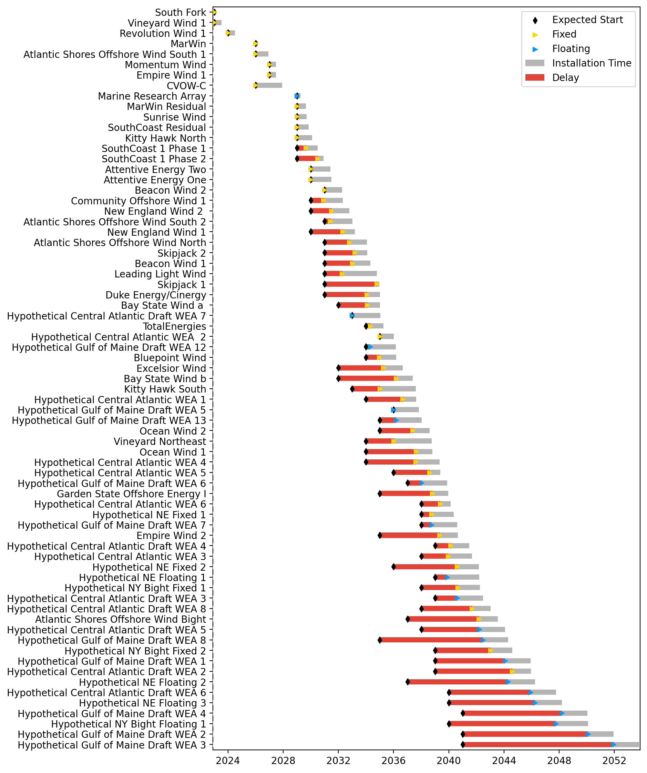
Full Gantt

Slide 2
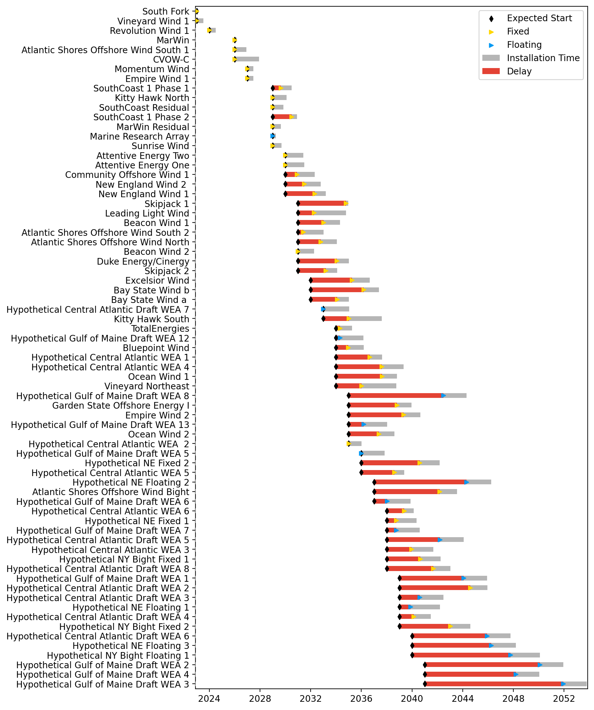
Sorted Full Gantt

Slide 3
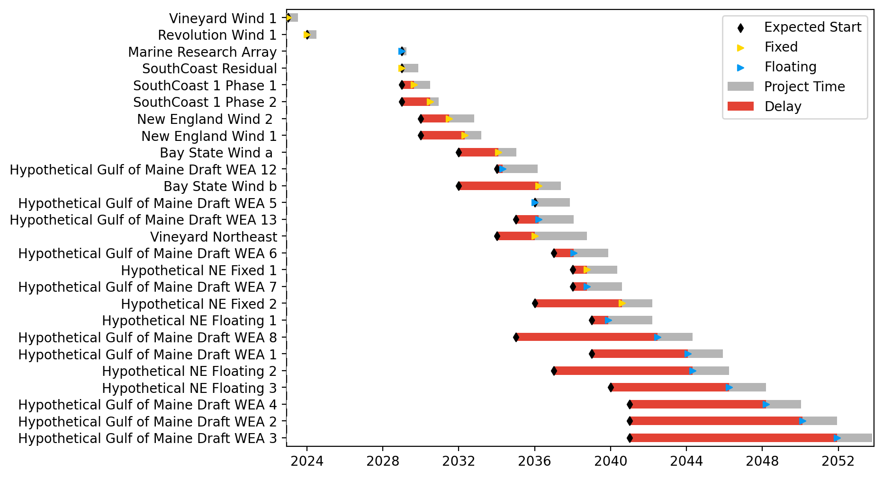
New England Gantt

Slide 4
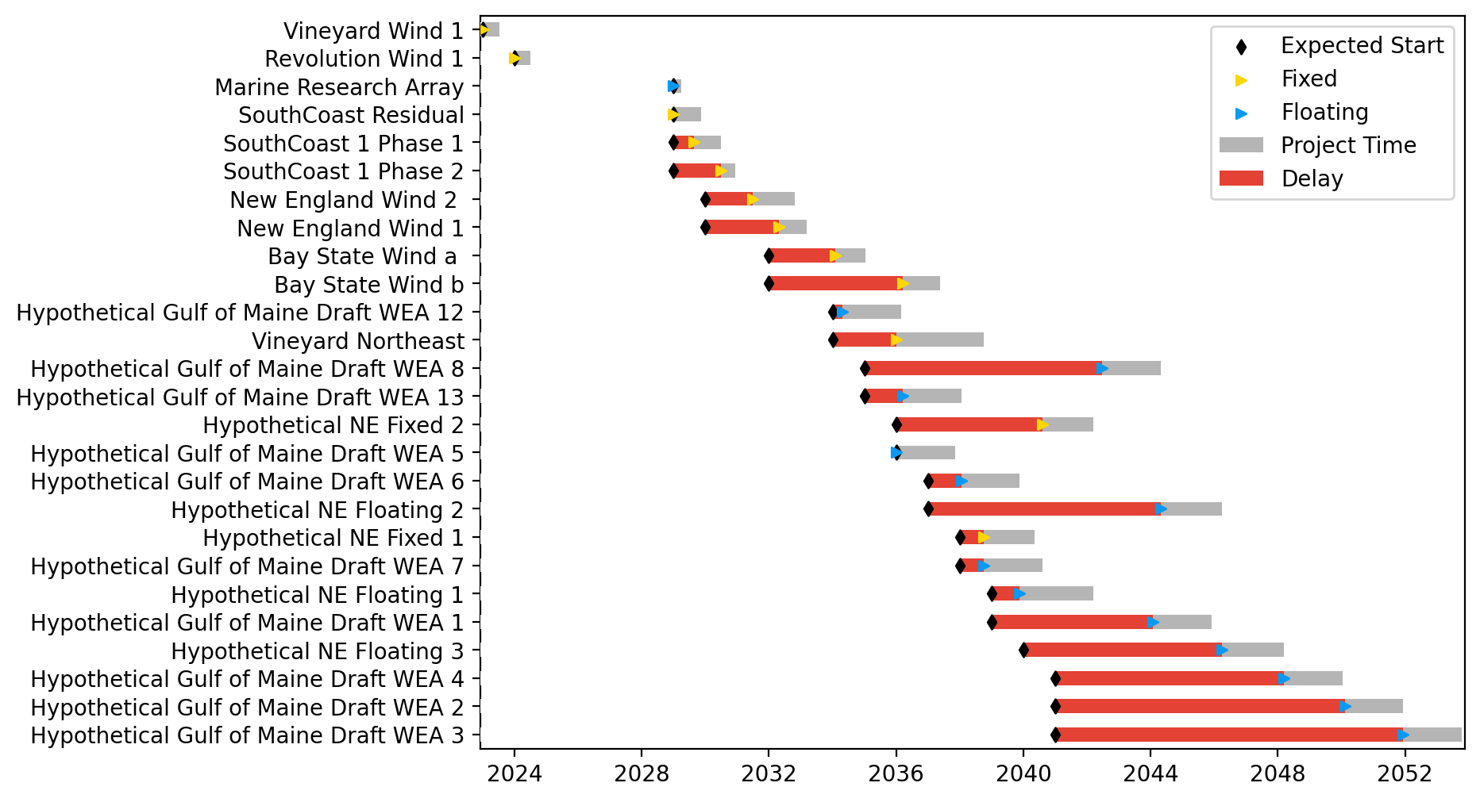
Sorted New England Gantt

Slide 5
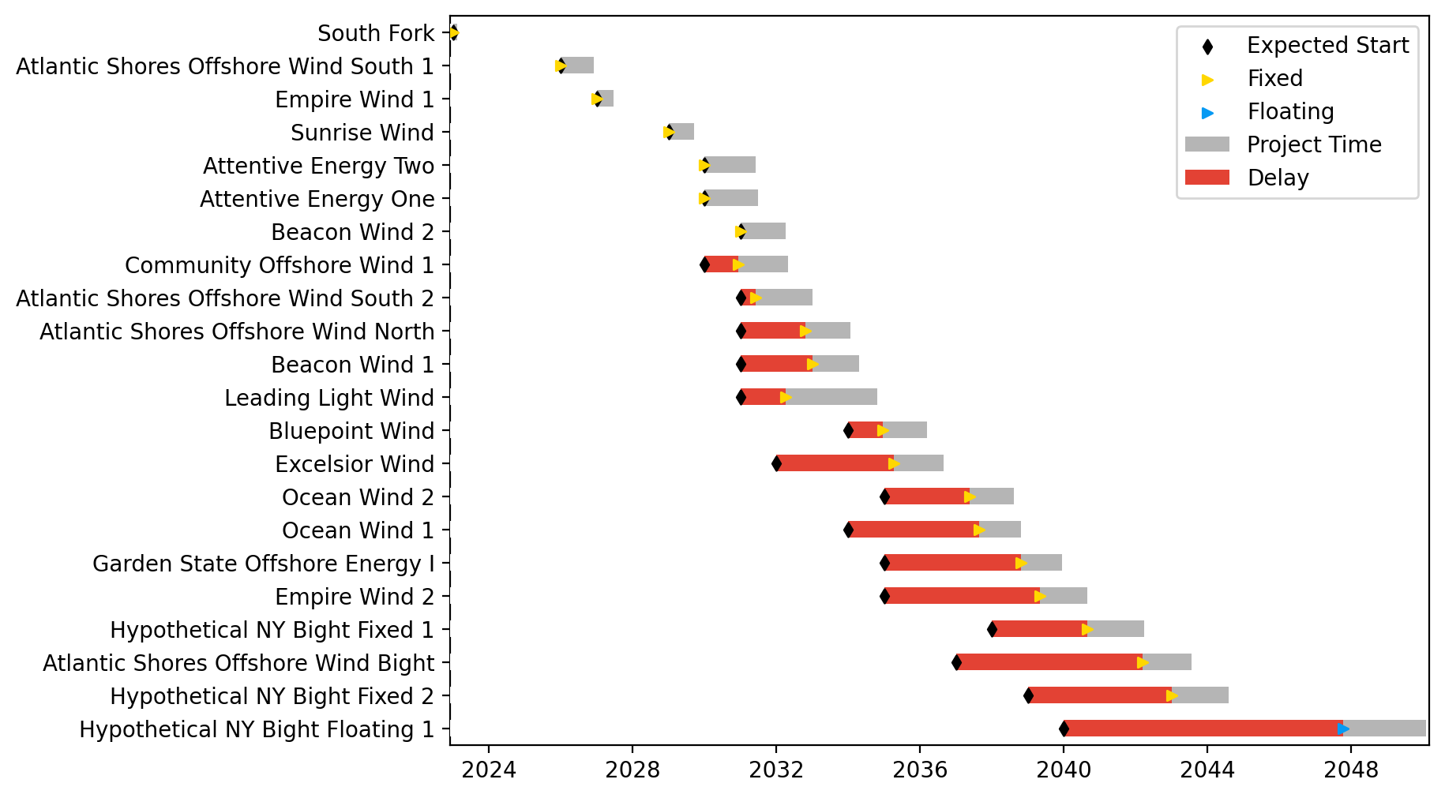
New York/New Jersey Gantt

Slide 6
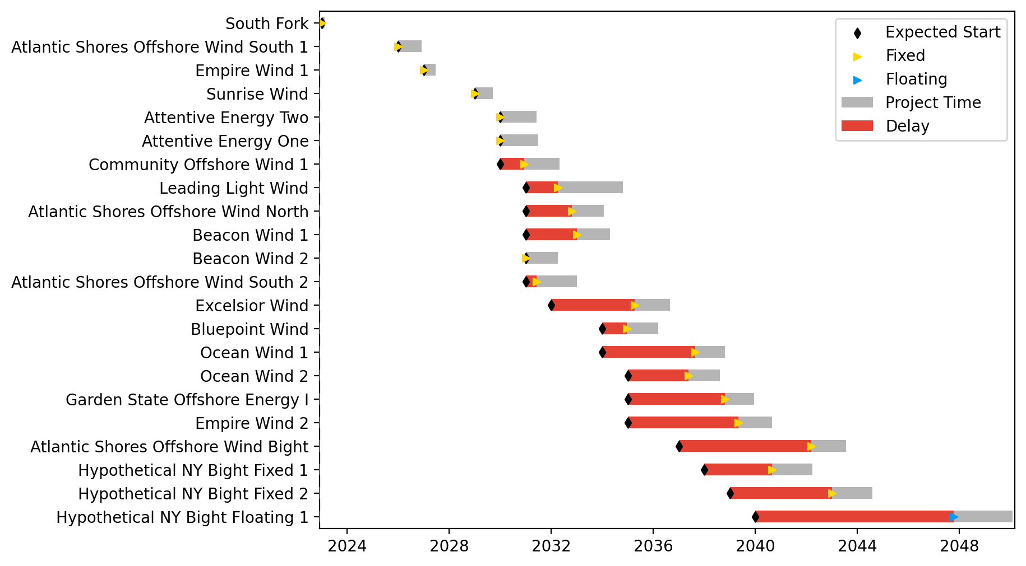
Sorted New York/New Jersey Gantt

Slide 7
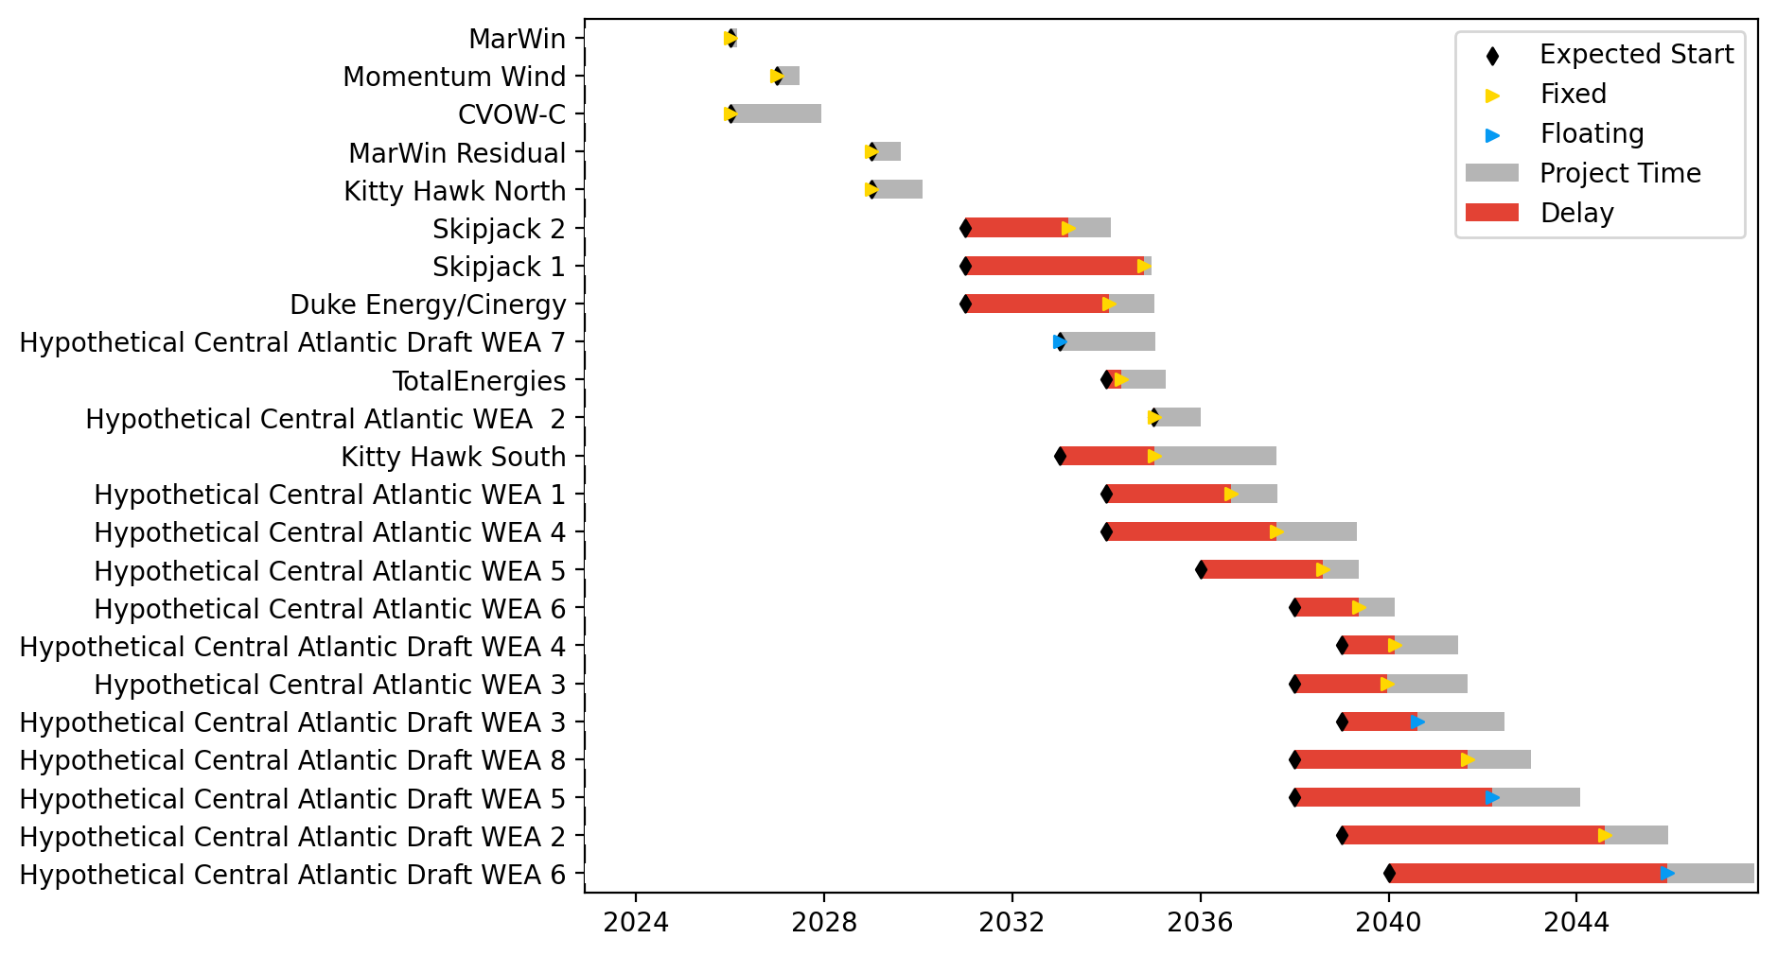
Midatlantic Gantt

Slide 8
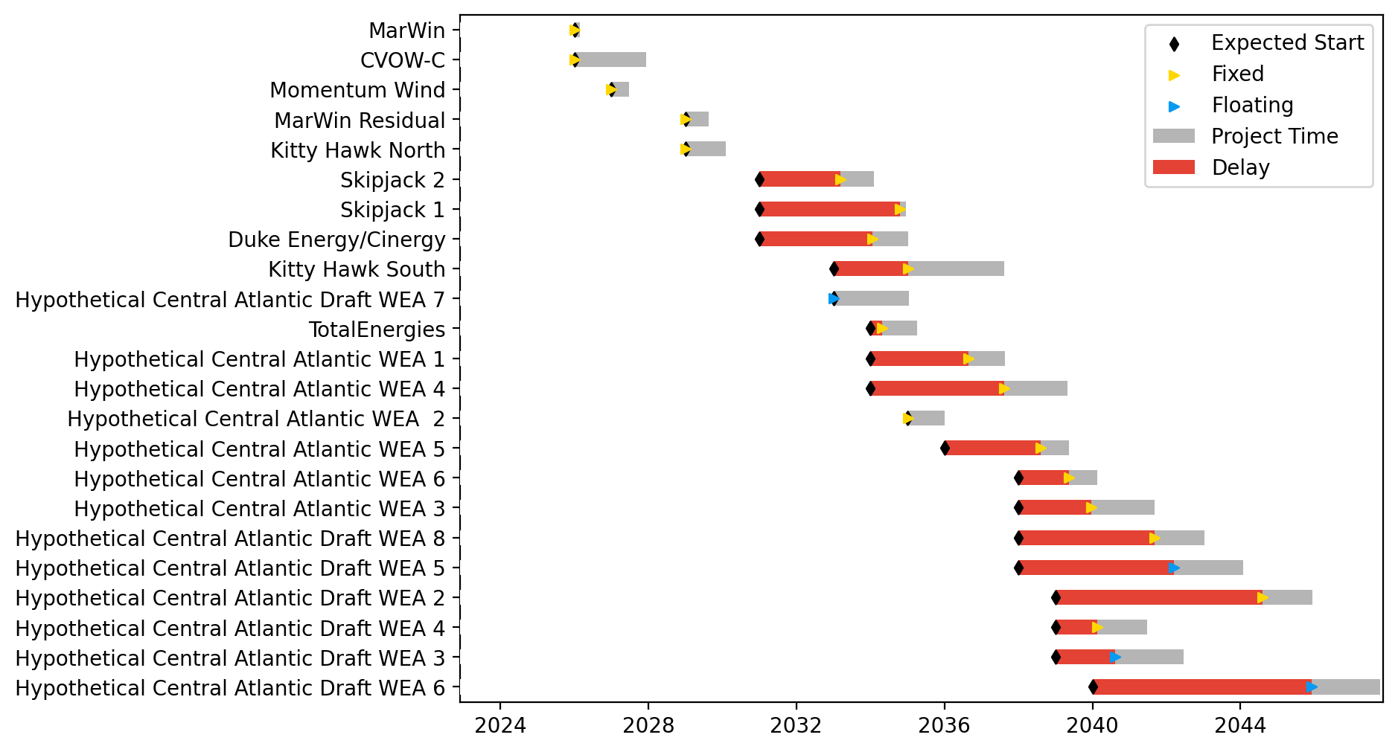
Sorted Midatlantic Gantt

