Slide 1
base_baseline_dev
Pipeline: Baseline - NE
Vessel Pathway: Base
Port Pathway: Base

Slide 2
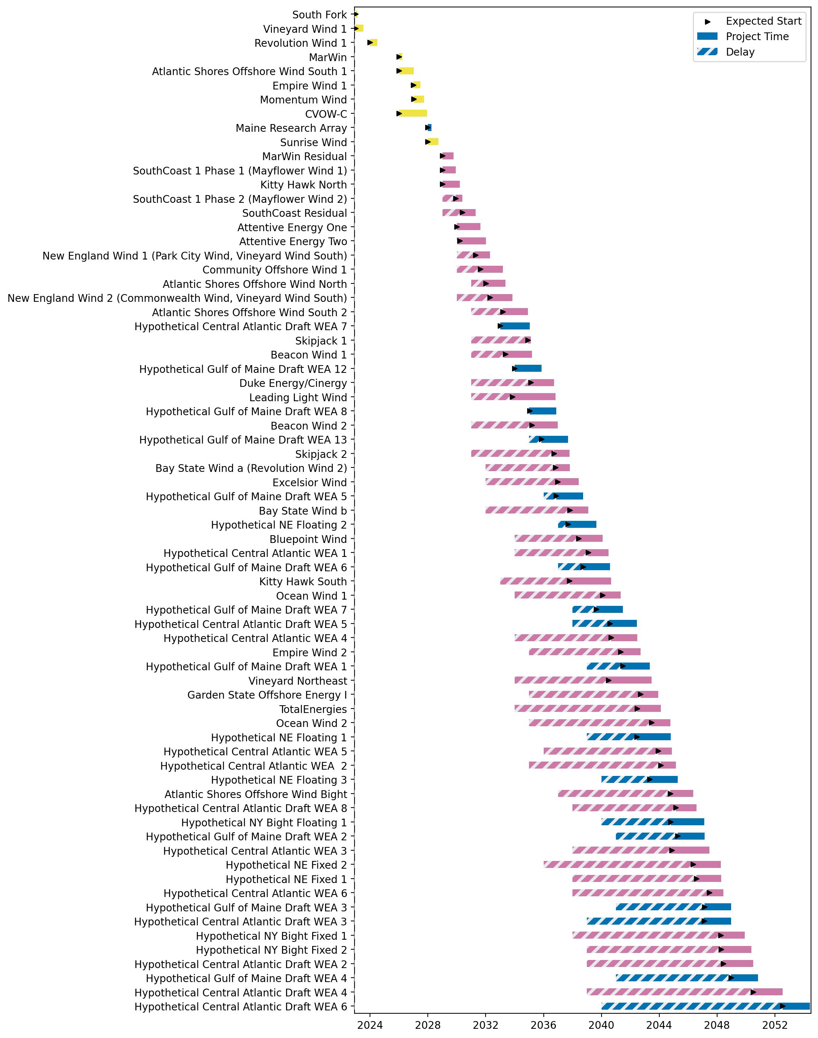
Full Gantt

Slide 3
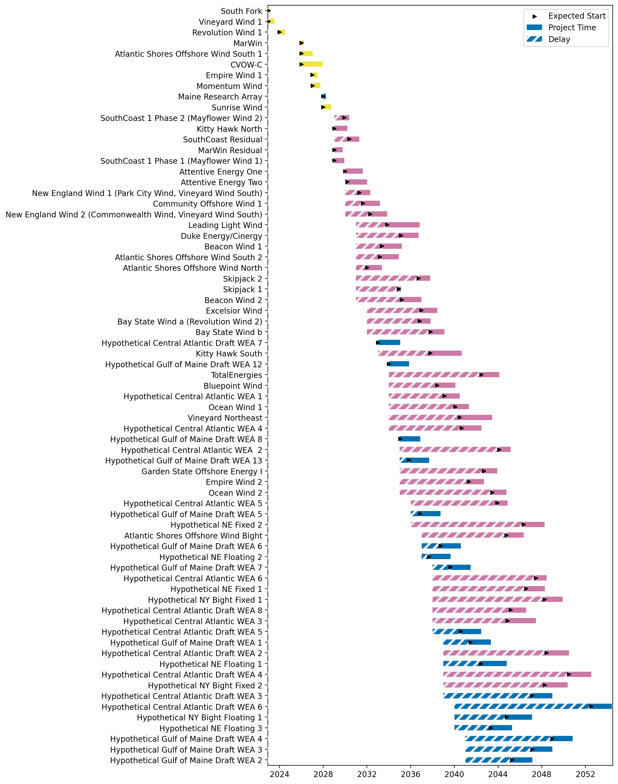
Sorted Full Gantt

Slide 4
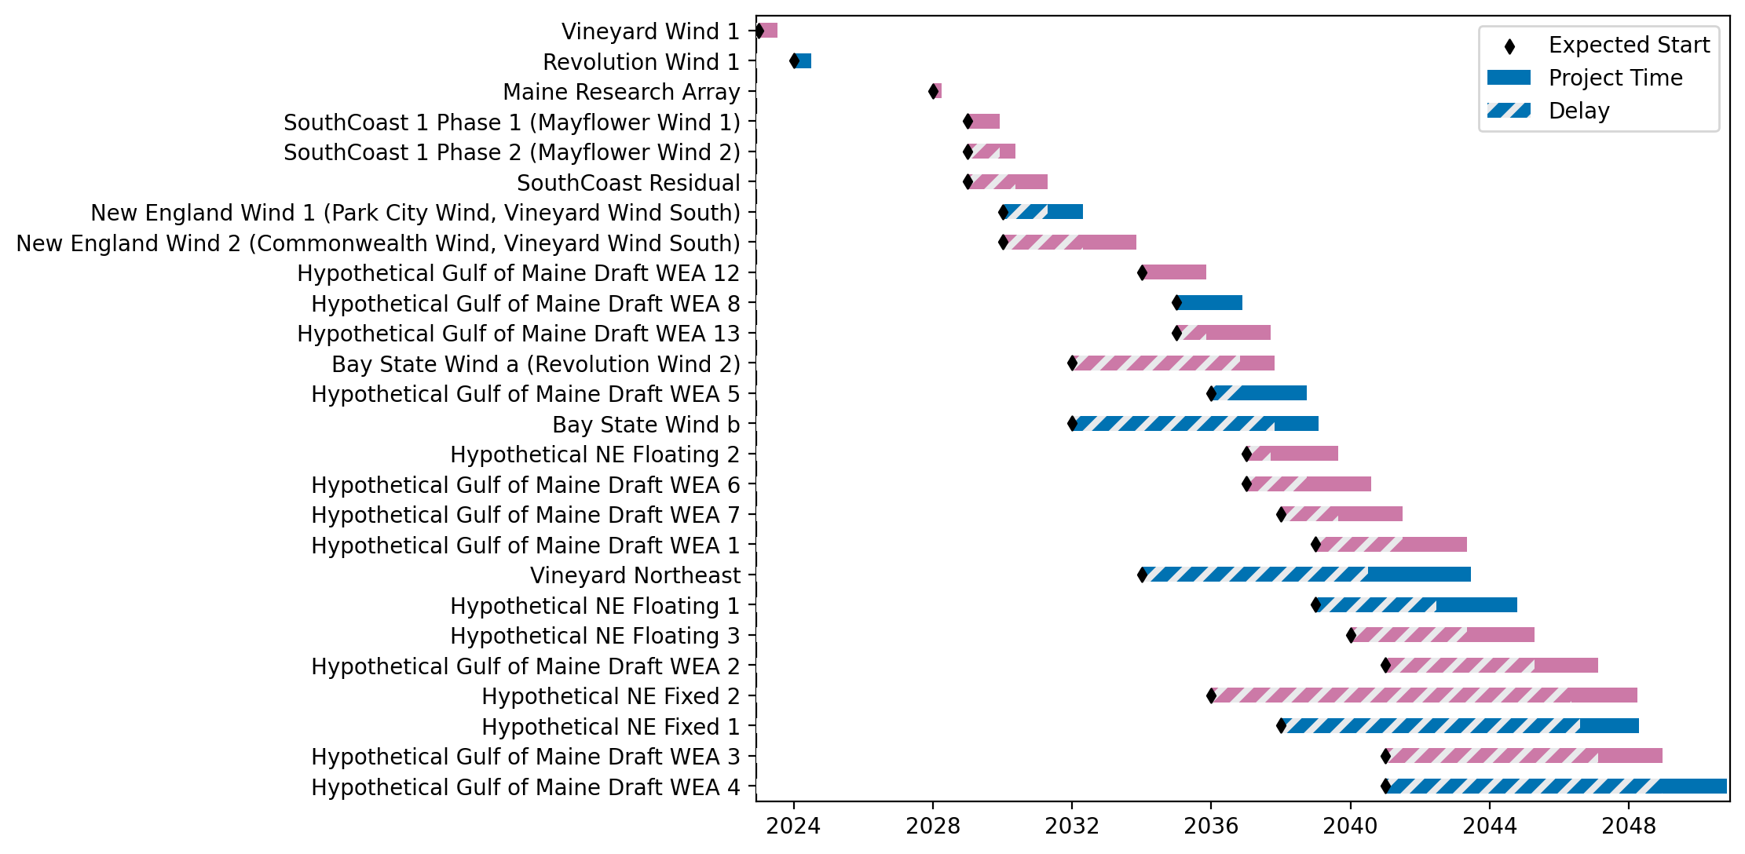
New England Gantt

Slide 5
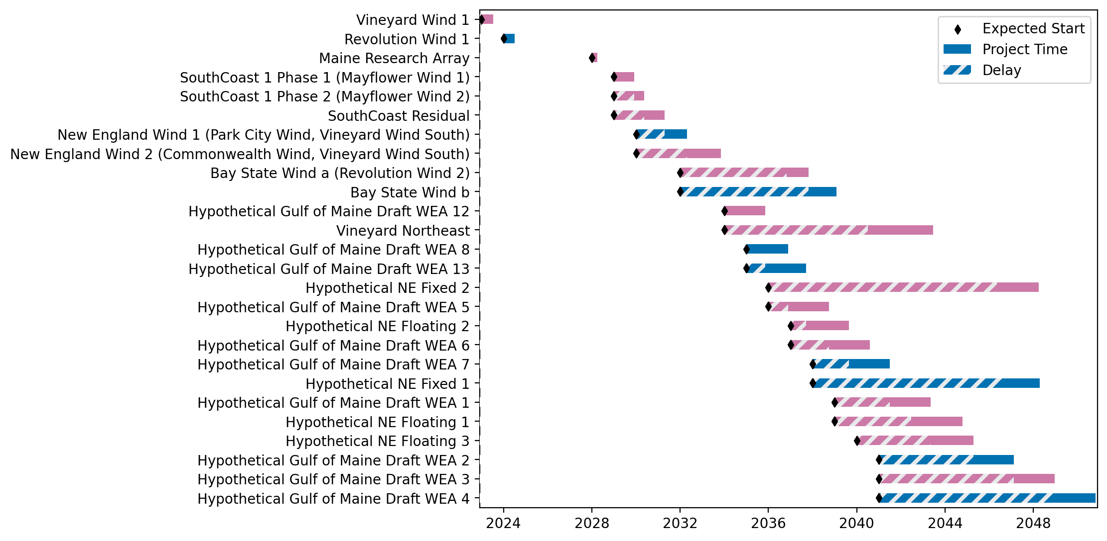
Sorted New England Gantt

Slide 6
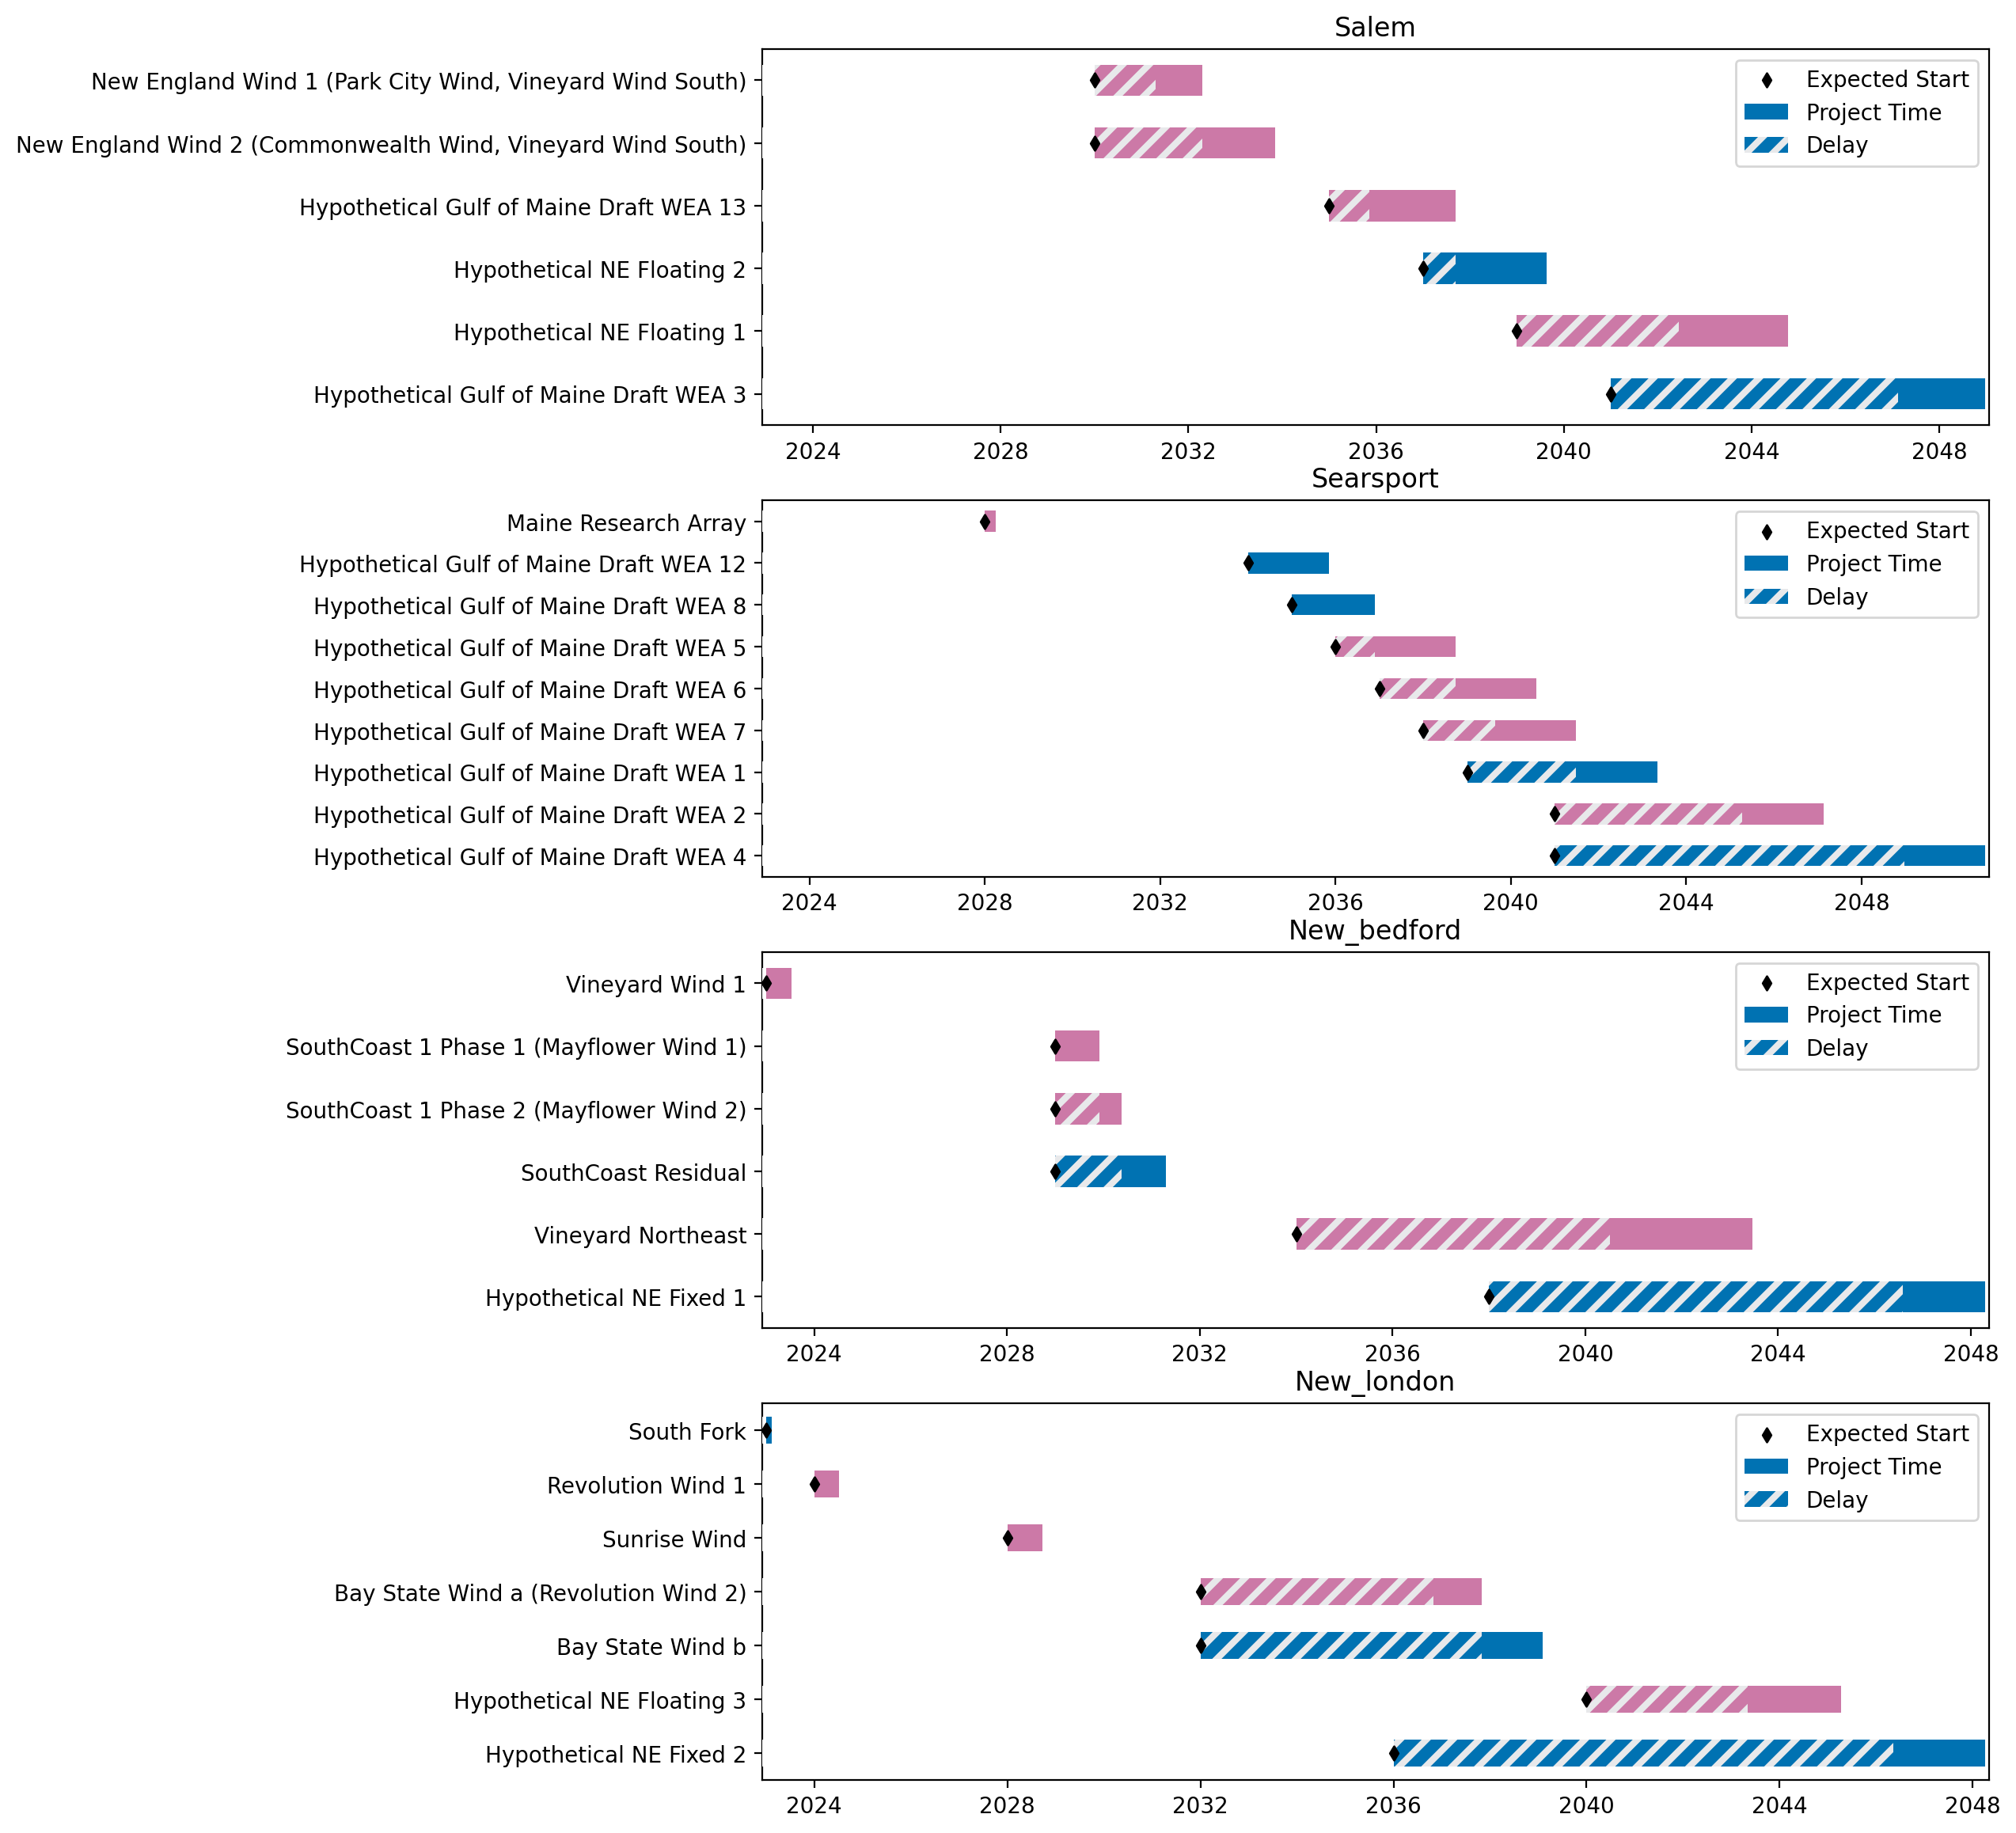
Port Gantts

Slide 7
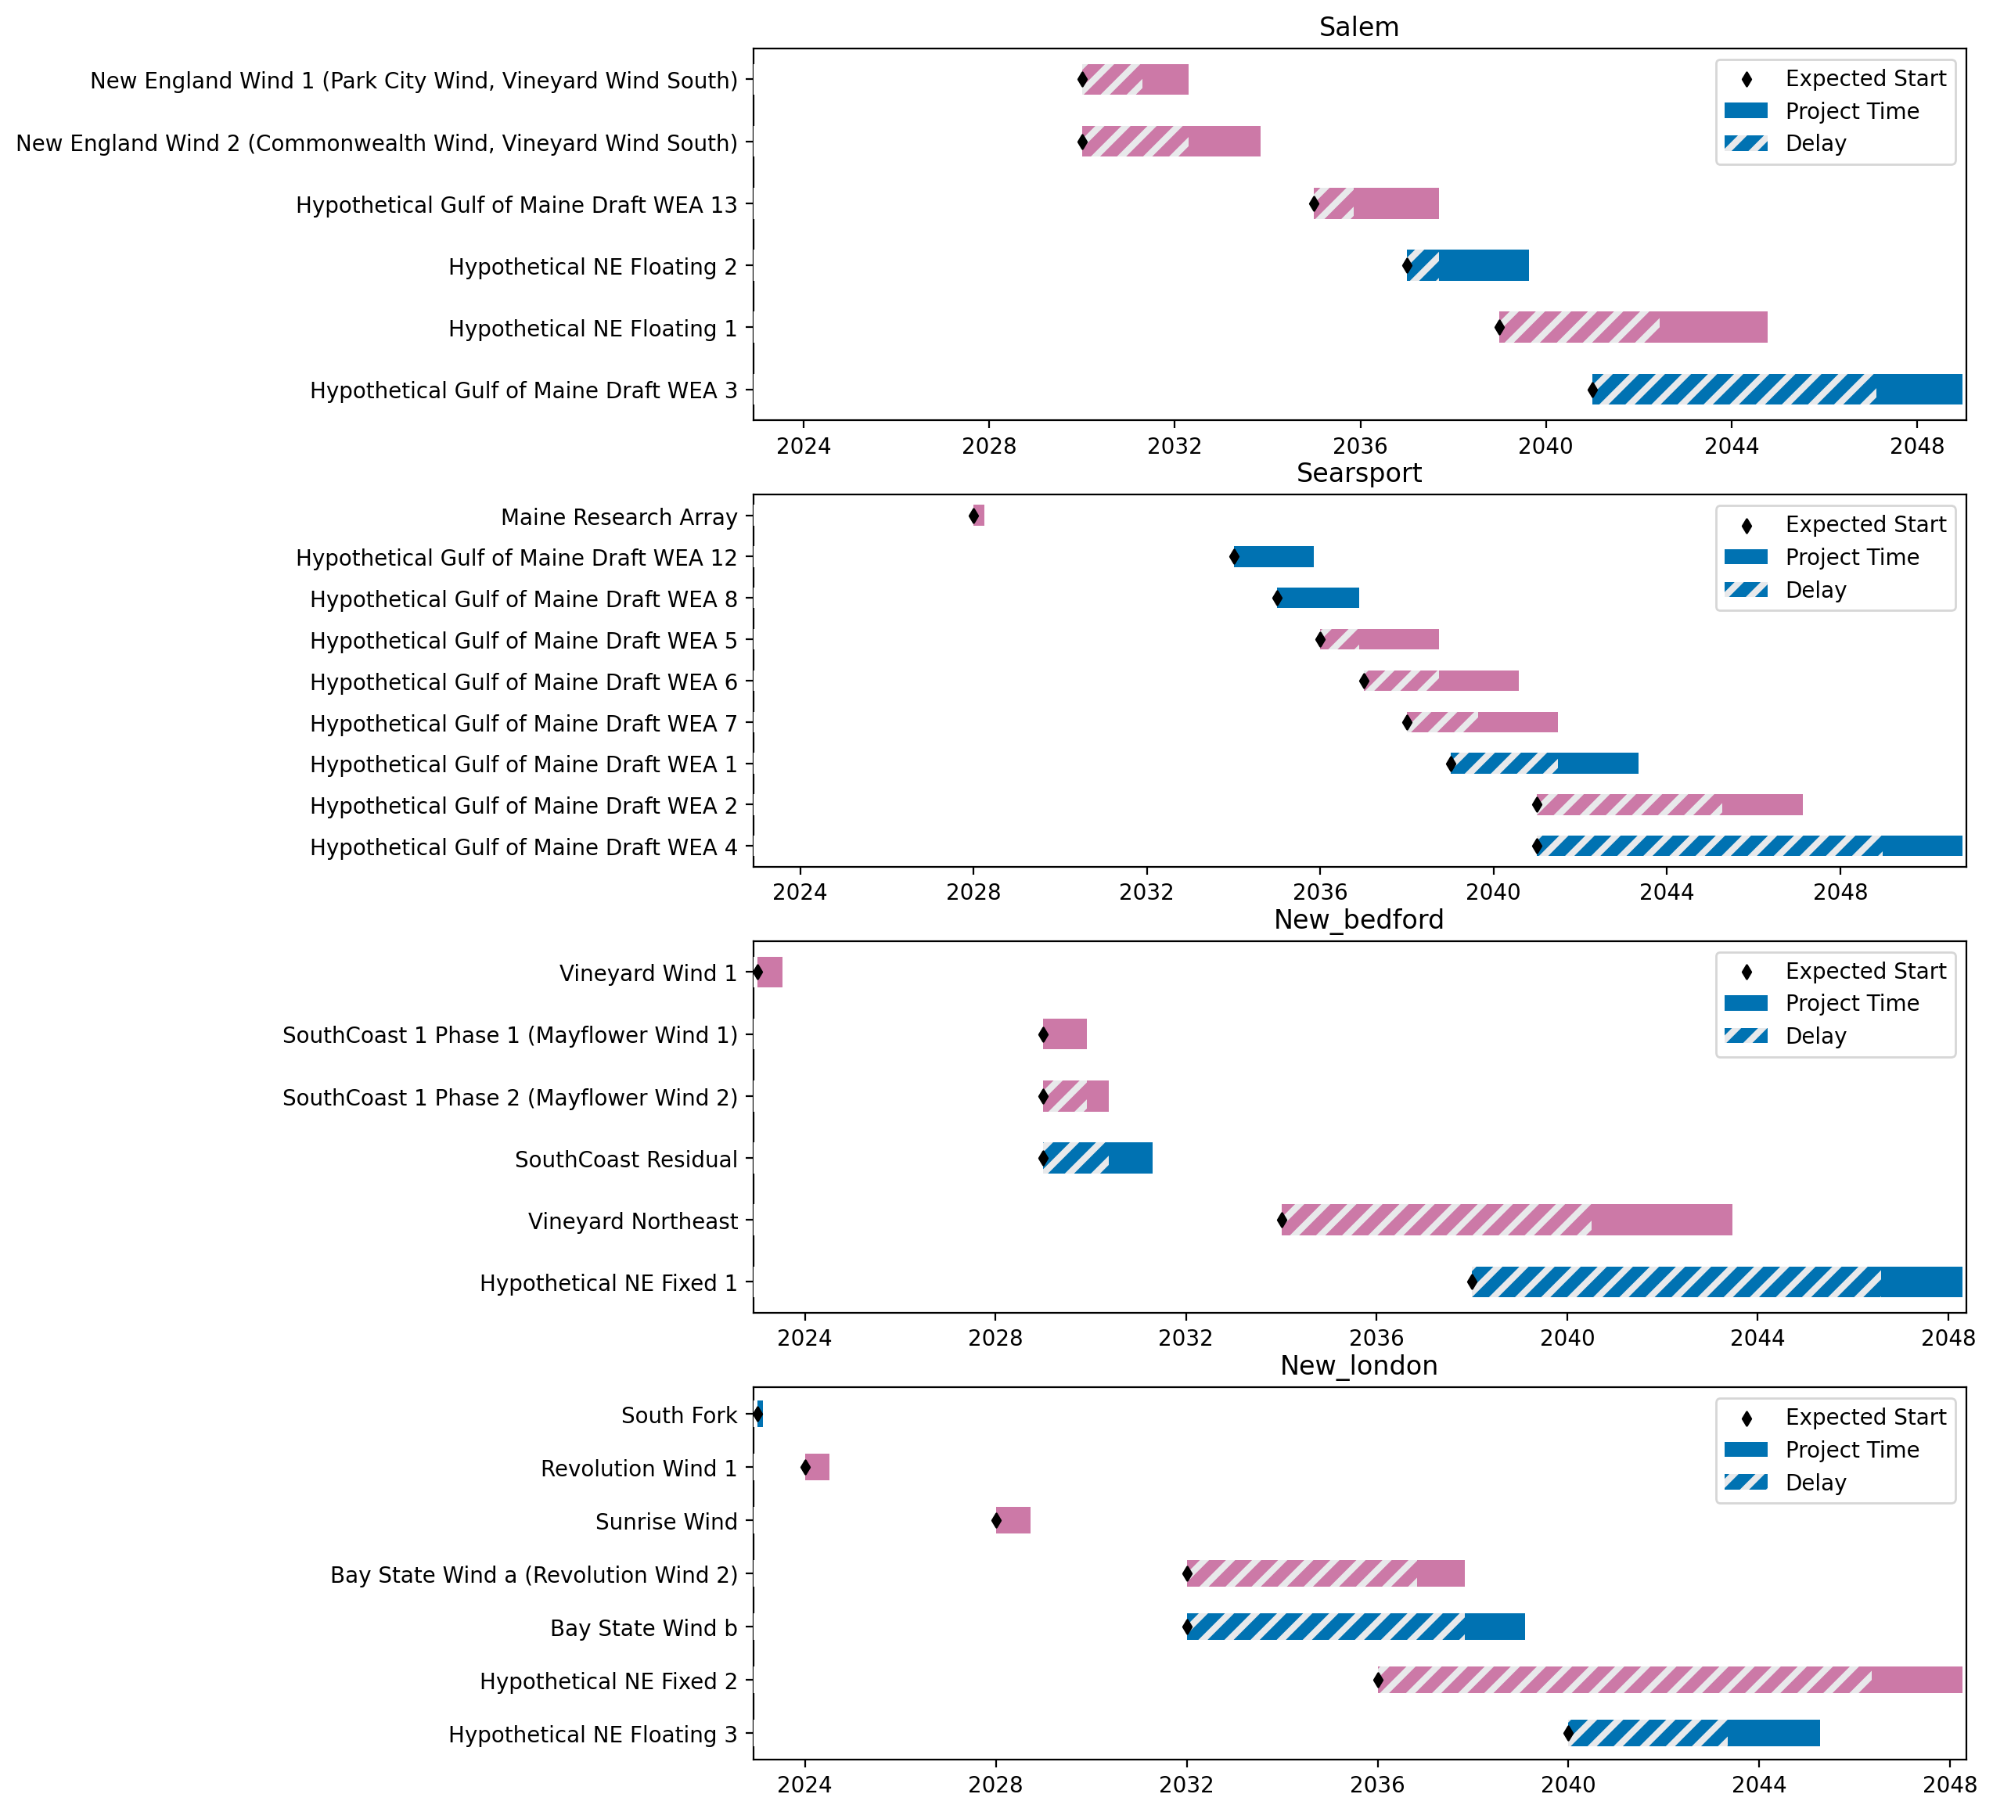
Sorted Port Gantts

Slide 8
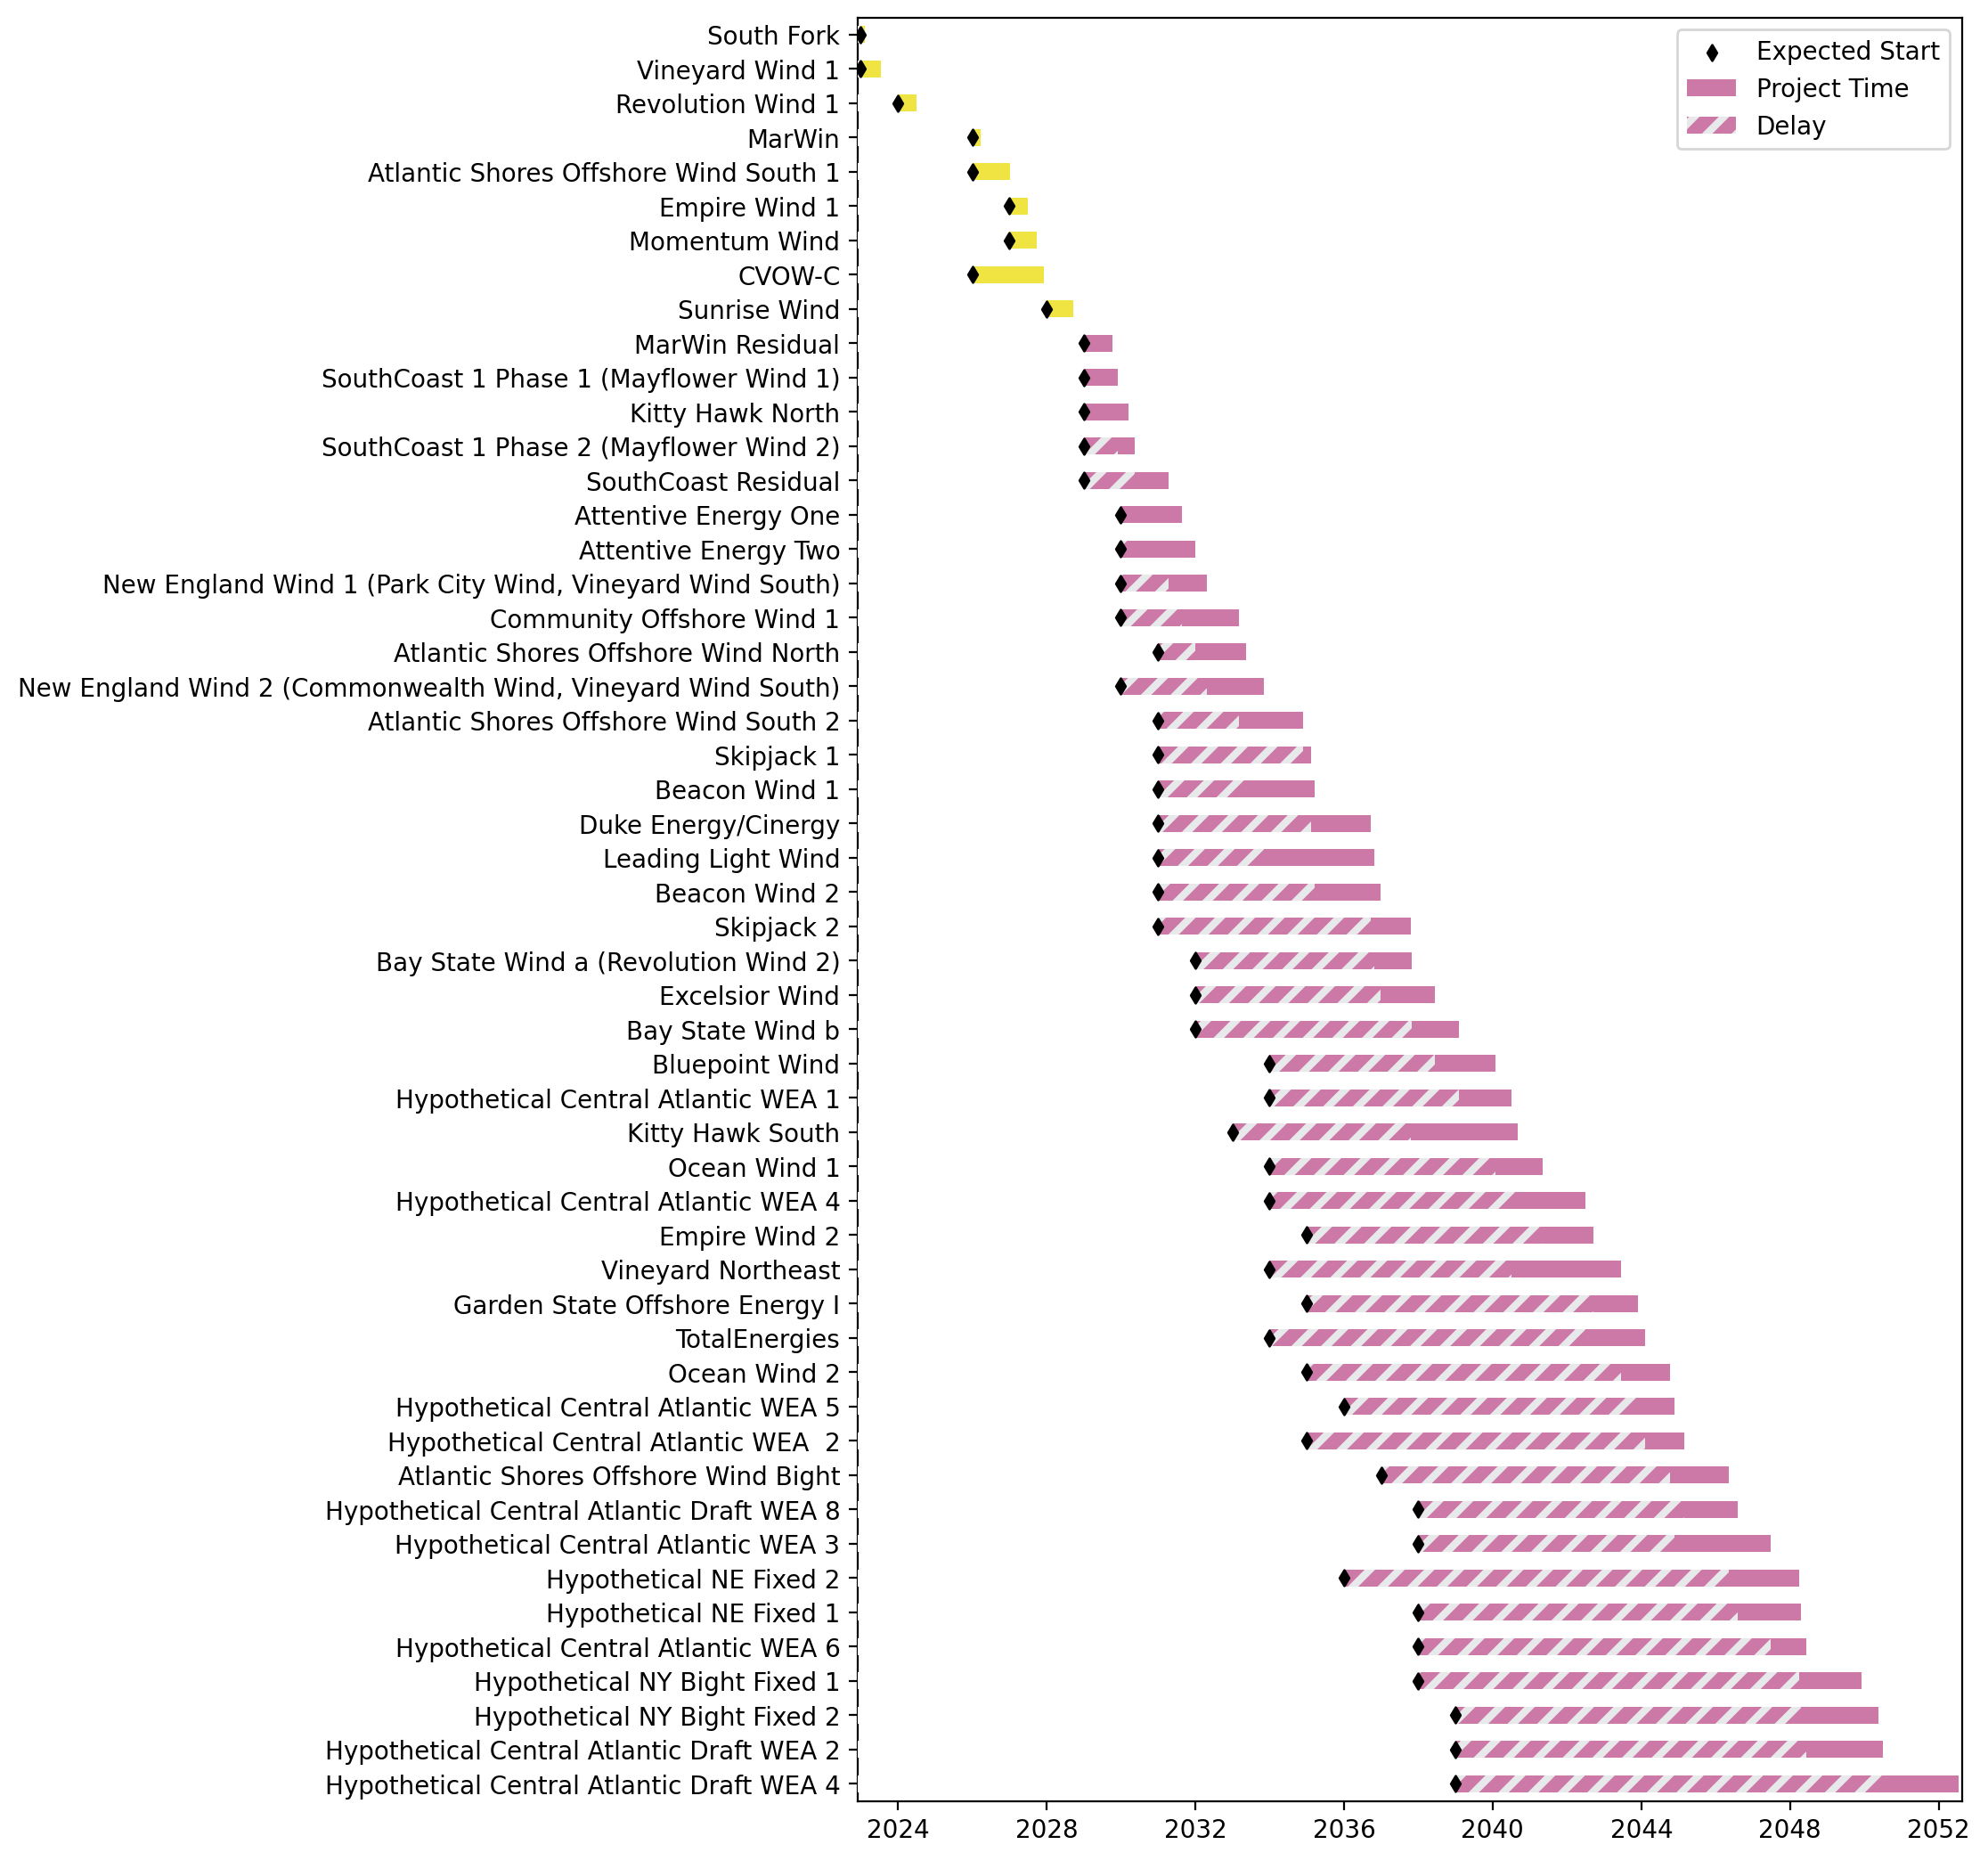
Fixed Gantt

Slide 9
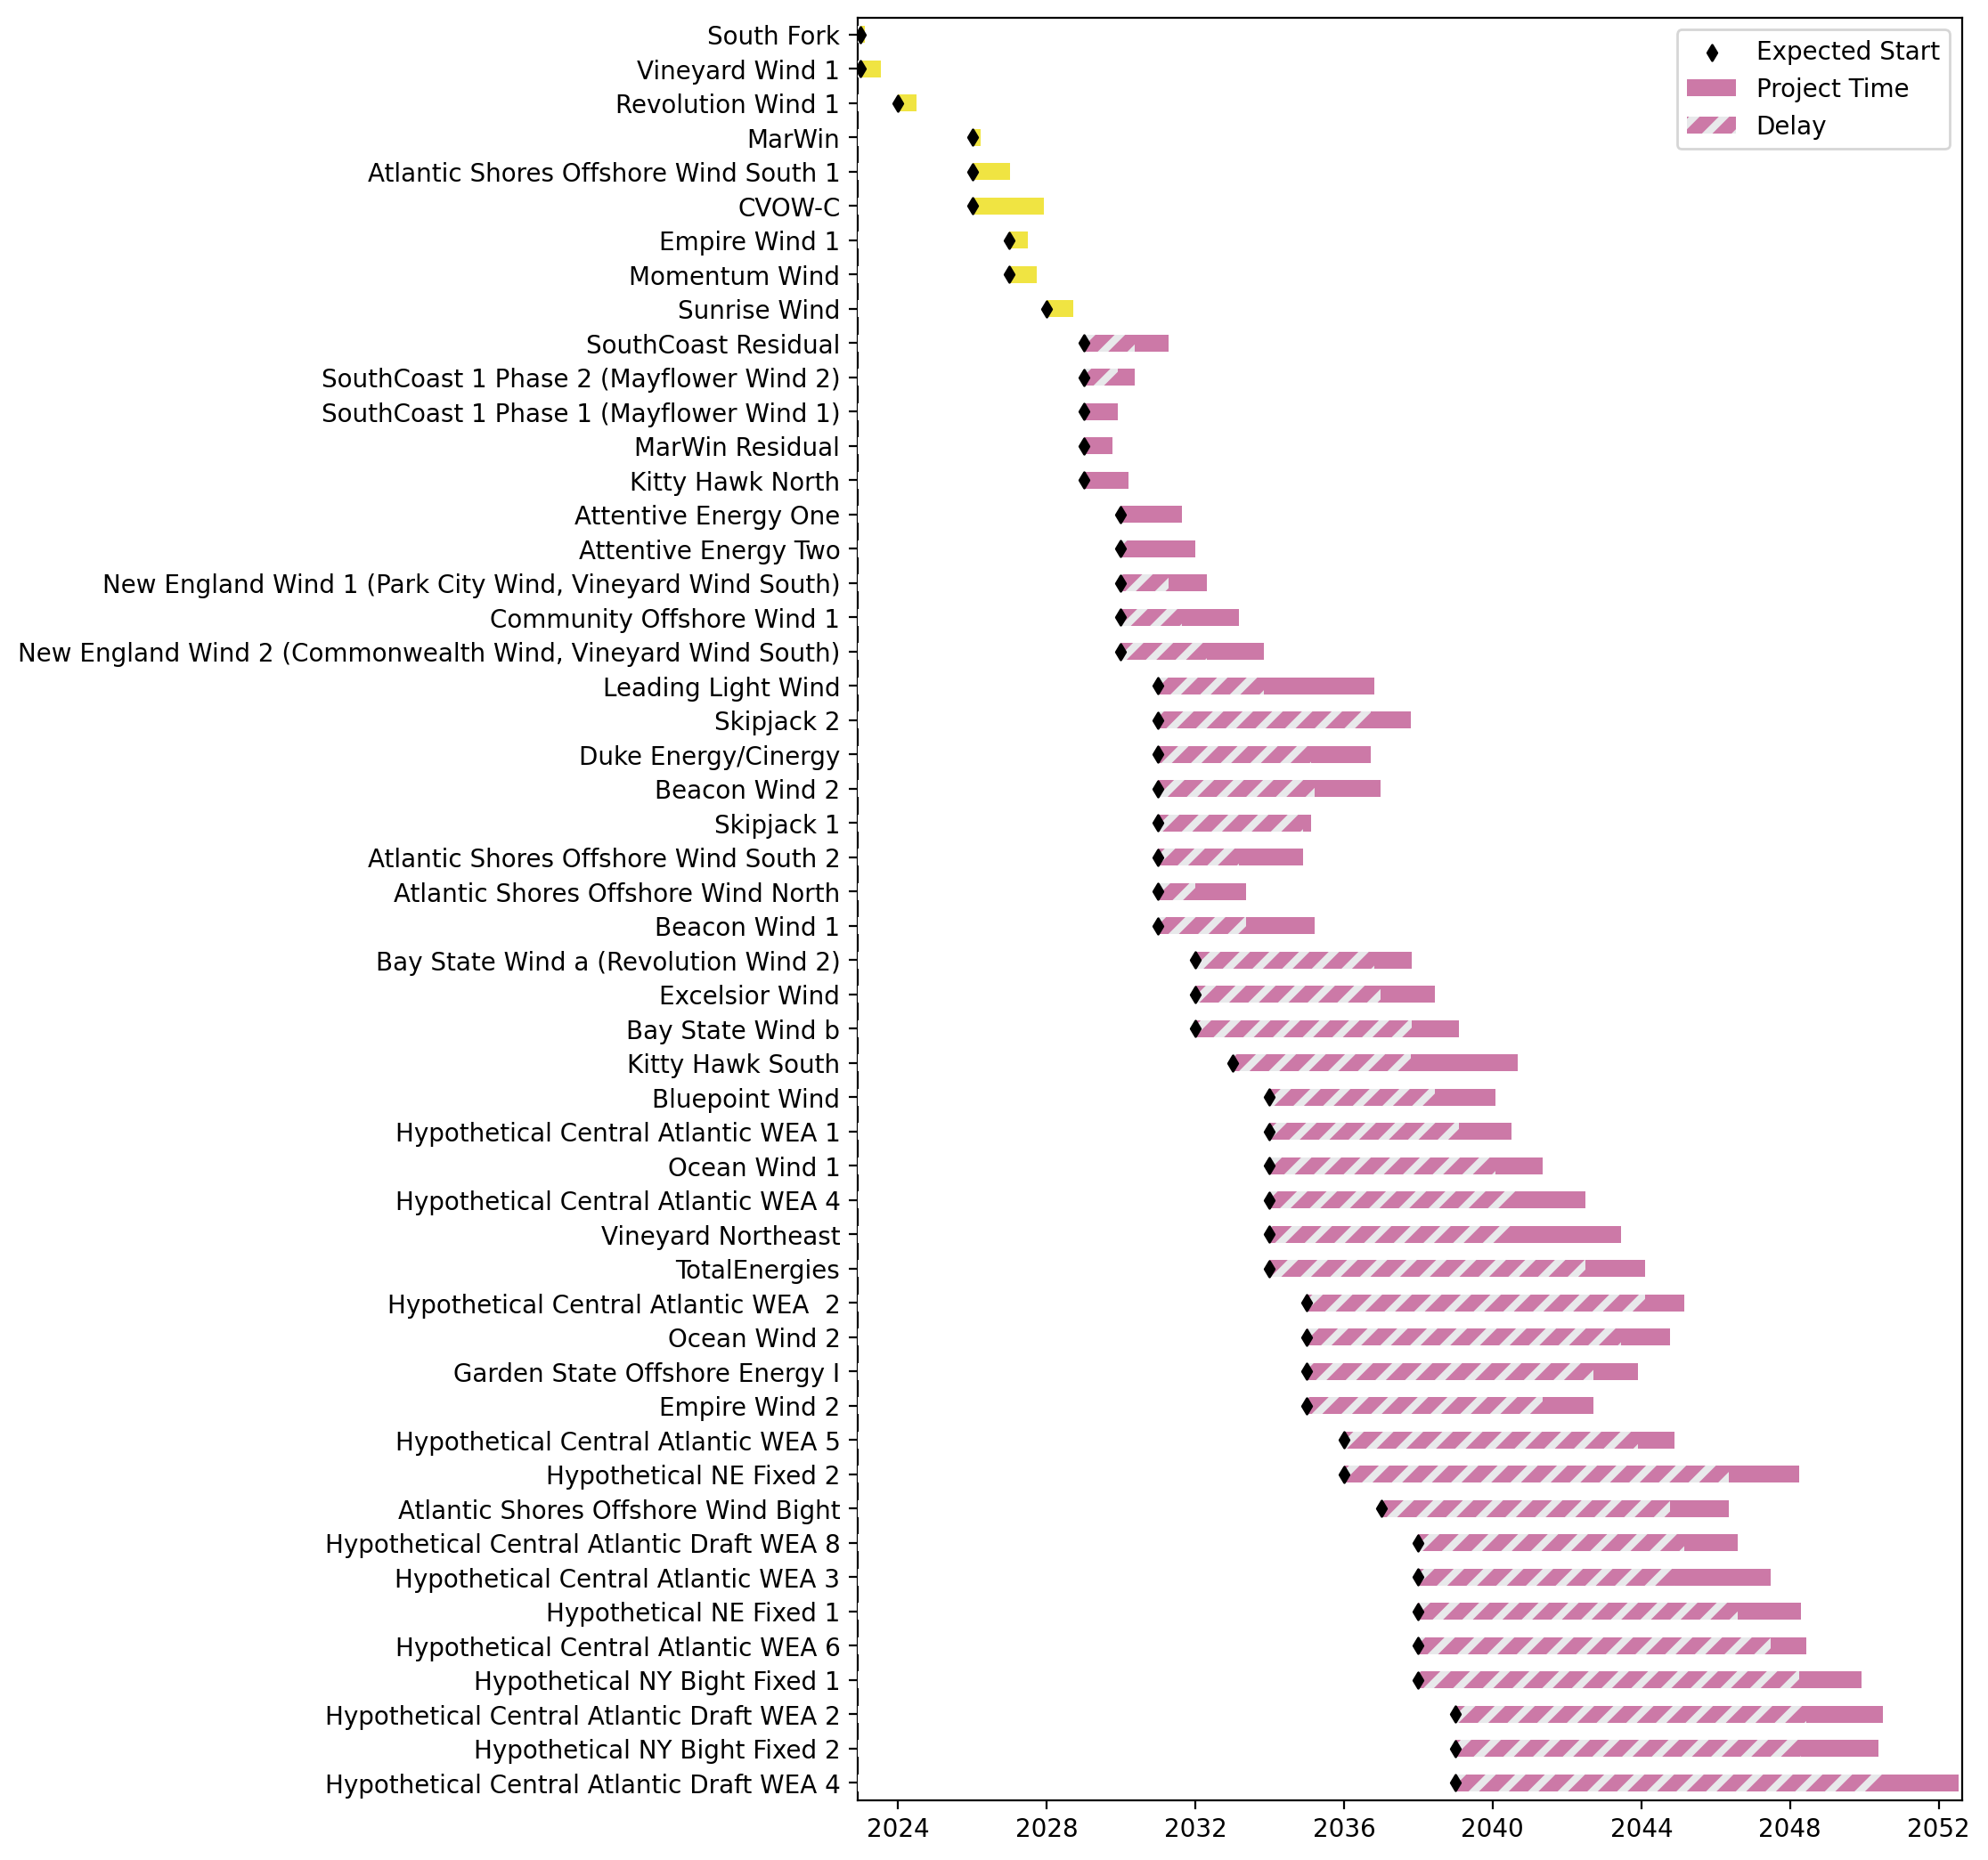
Sorted Fixed Gantt

Slide 10
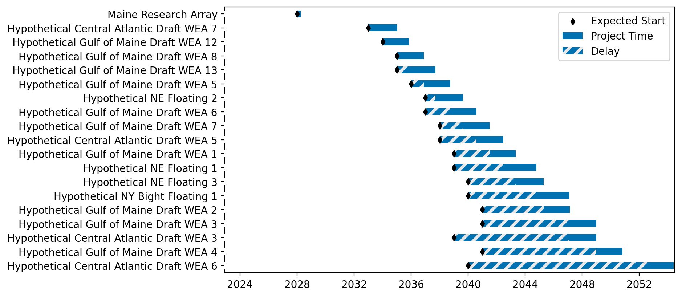
Floating Gantt

Slide 11
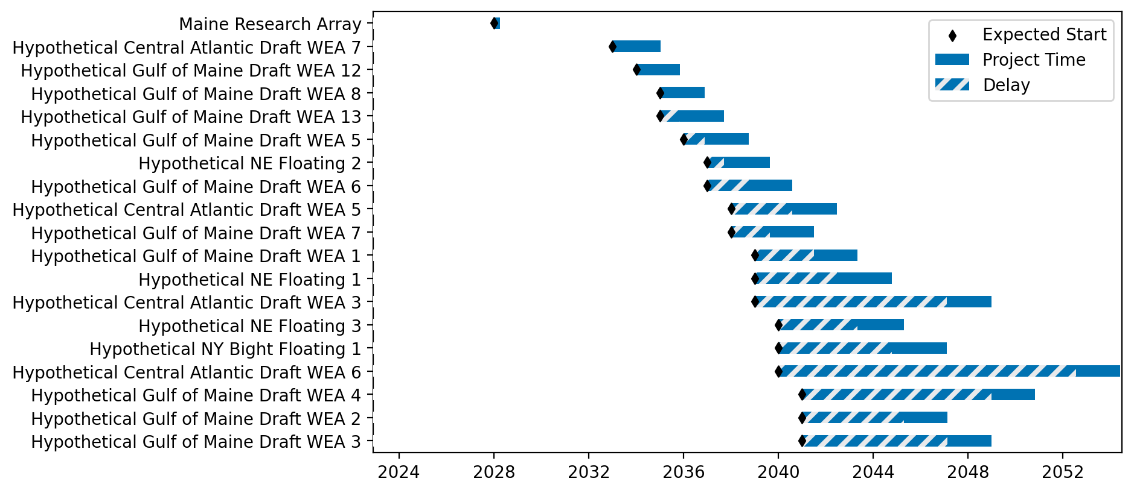
Sorted Floating Gantt

Slide 12
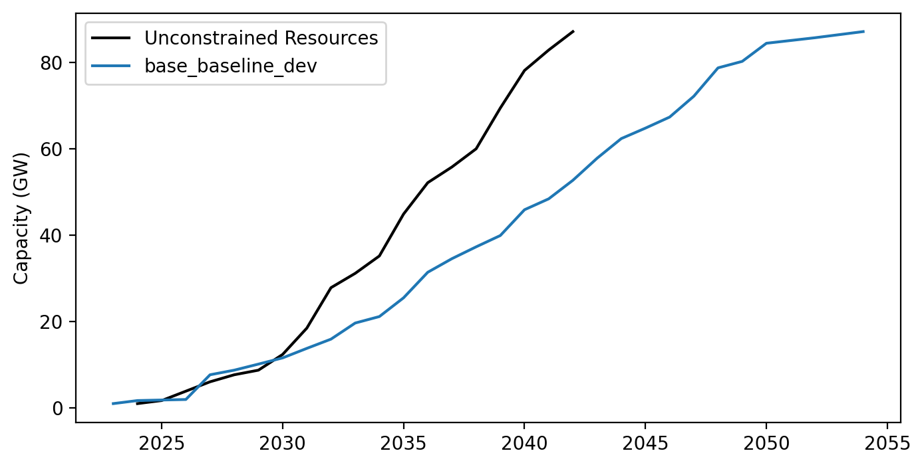
Cummulative Installed Capacity

