Slide 1
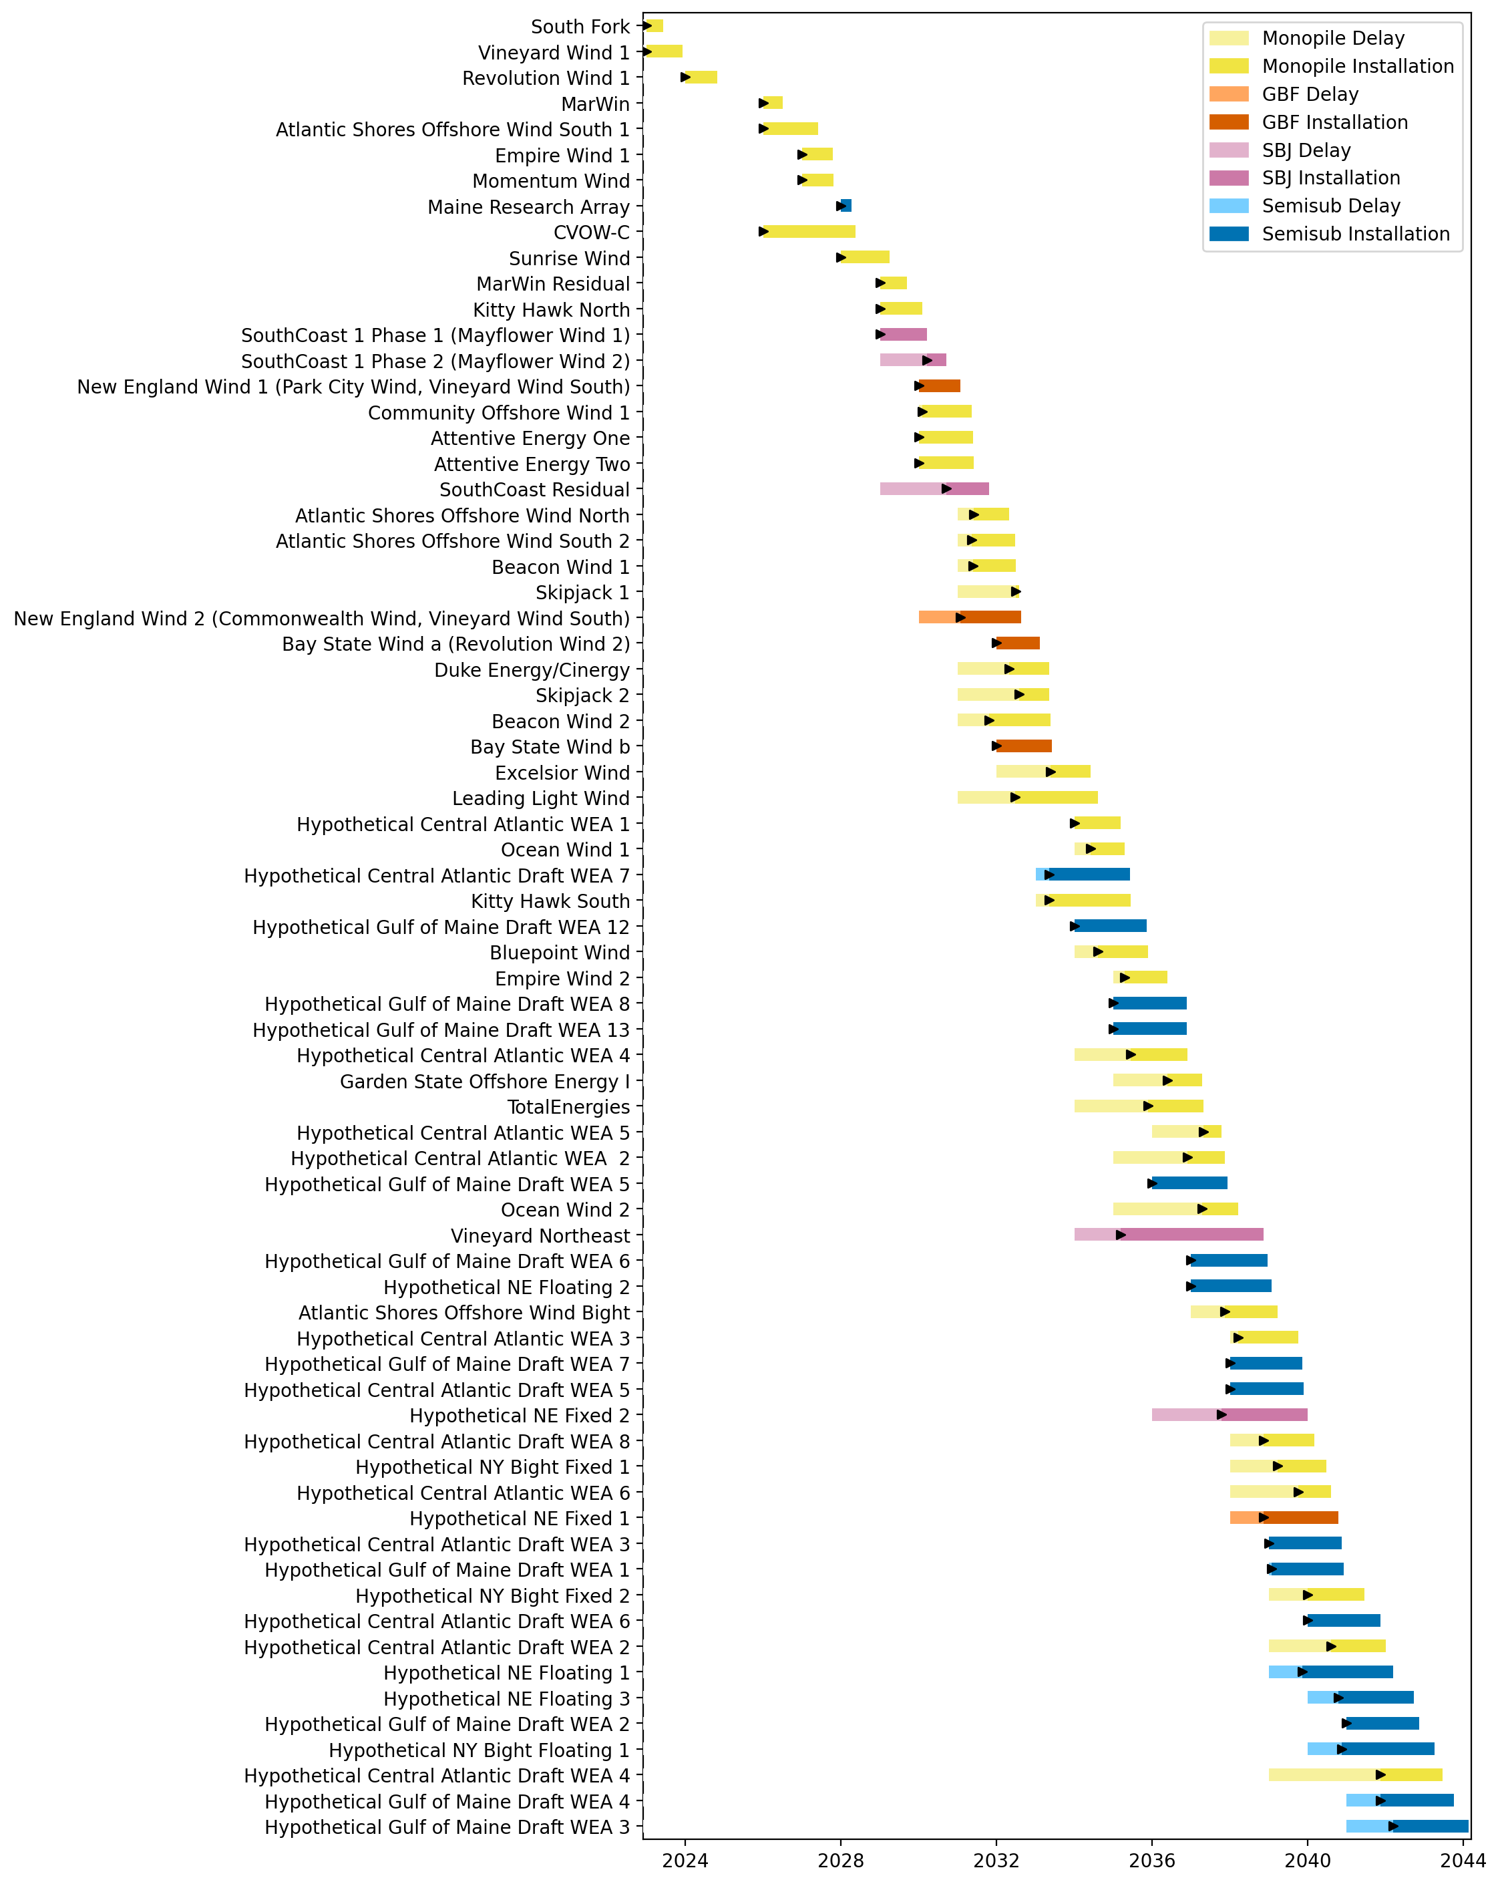
Full Gantt

Slide 2
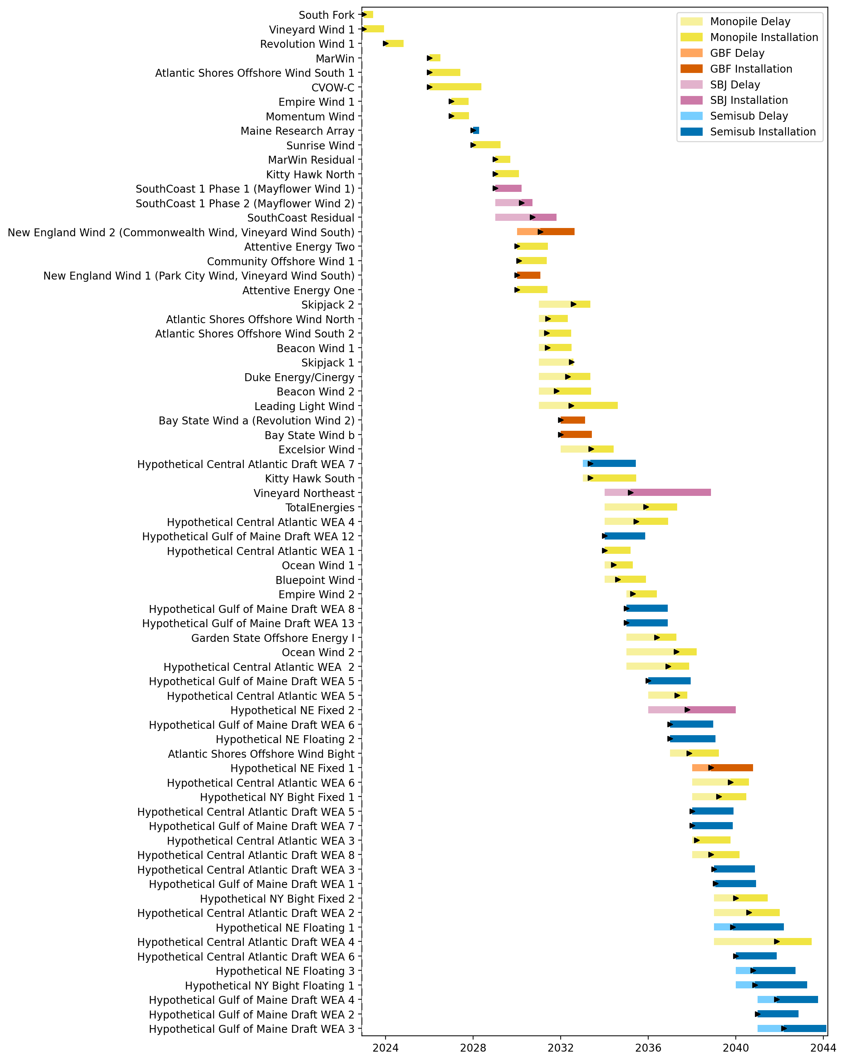
Sorted Full Gantt

Slide 3
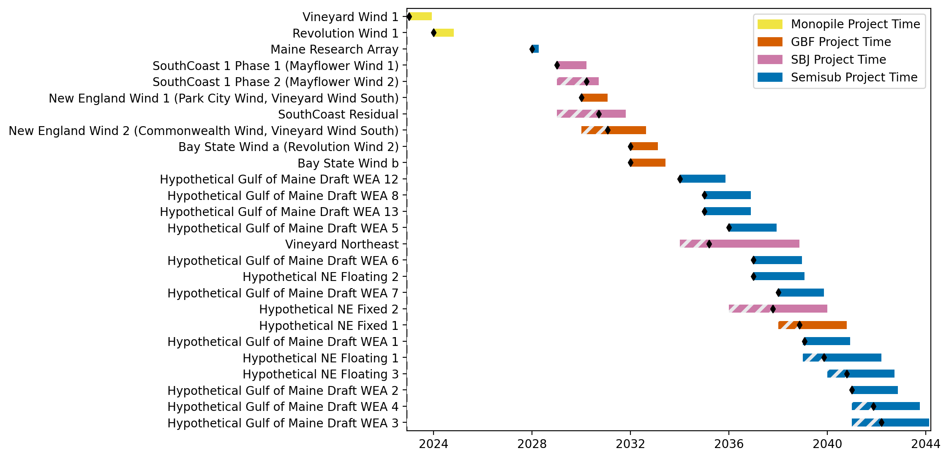
New England Gantt

Slide 4
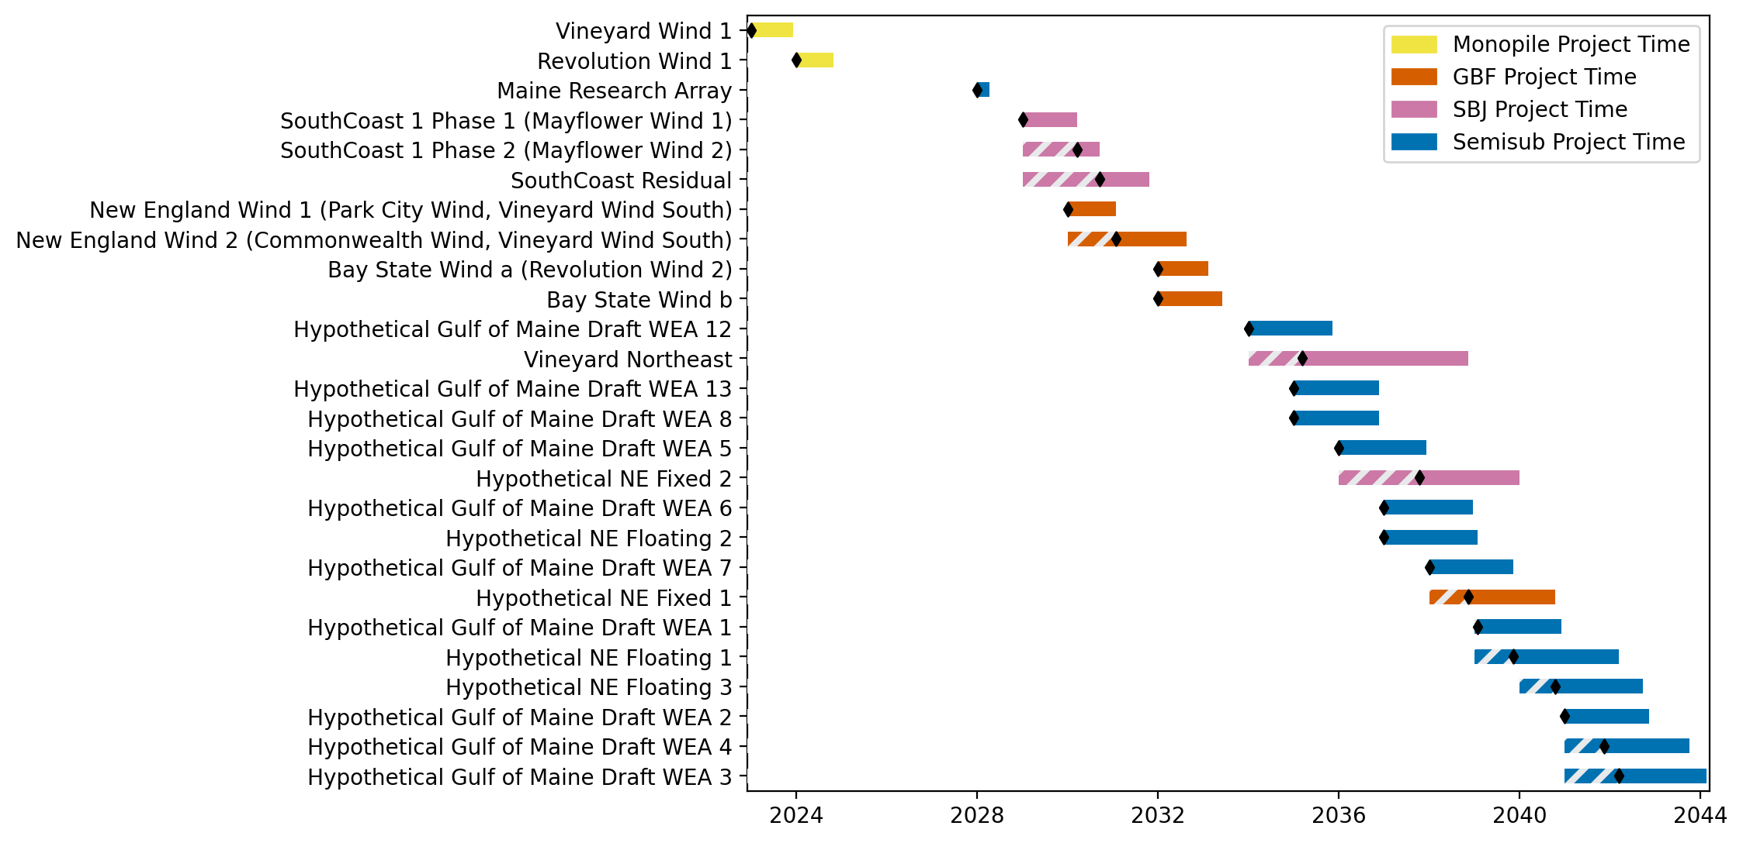
Sorted New England Gantt

Slide 5
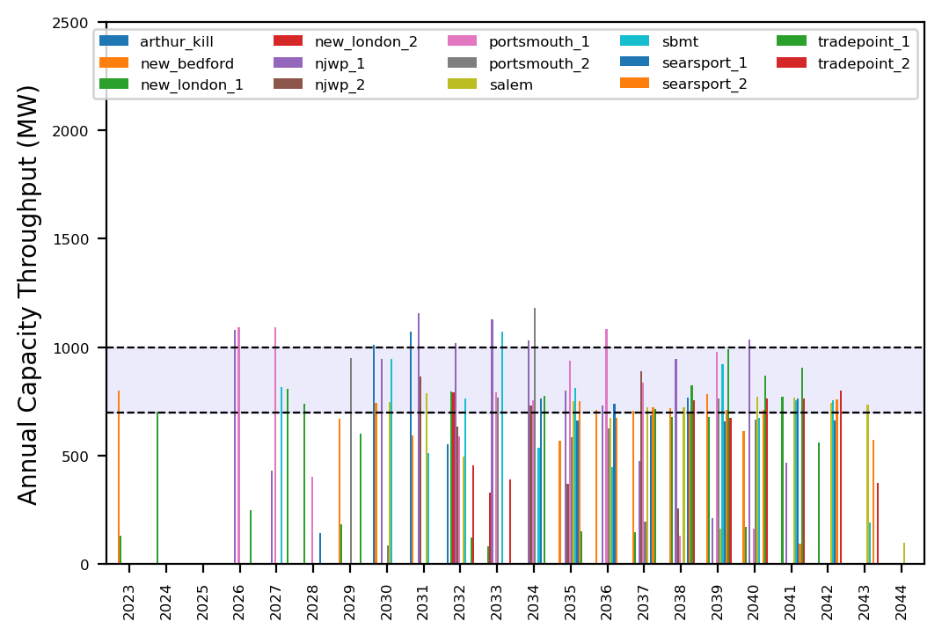
Port Throughput

Slide 6
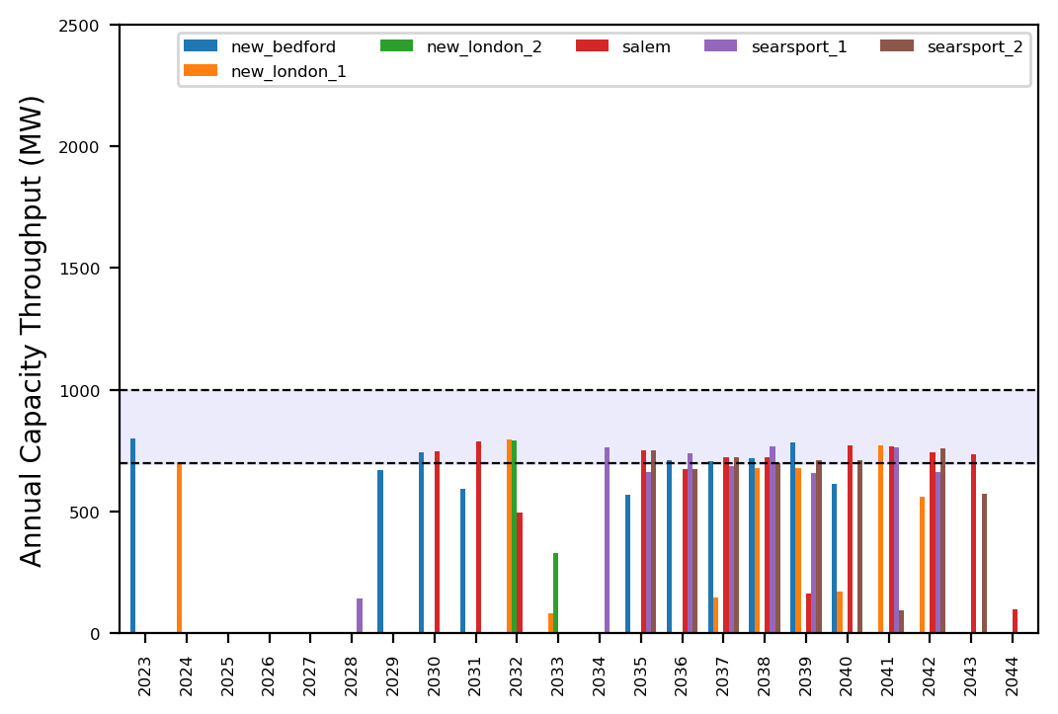
Port Throughput

Slide 7
Full Gantt

Slide 8
Sorted Full Gantt

Slide 9
New England Gantt

Slide 10
Sorted New England Gantt

Slide 11
Port Throughput

Slide 12
Port Throughput

Slide 13
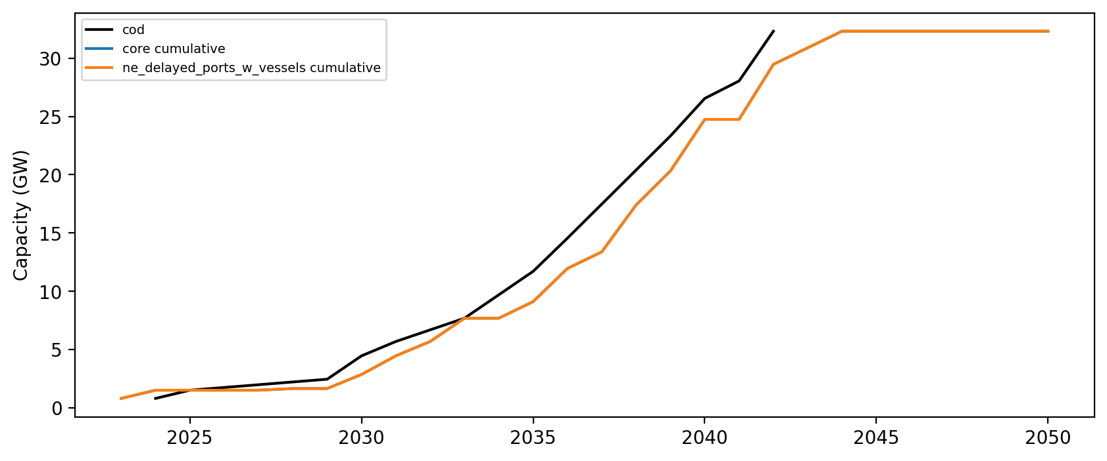
Installed Capacity

