Slide 1
ne_delayed_ports_w_vessels
Delayed Port Scenario

Slide 2
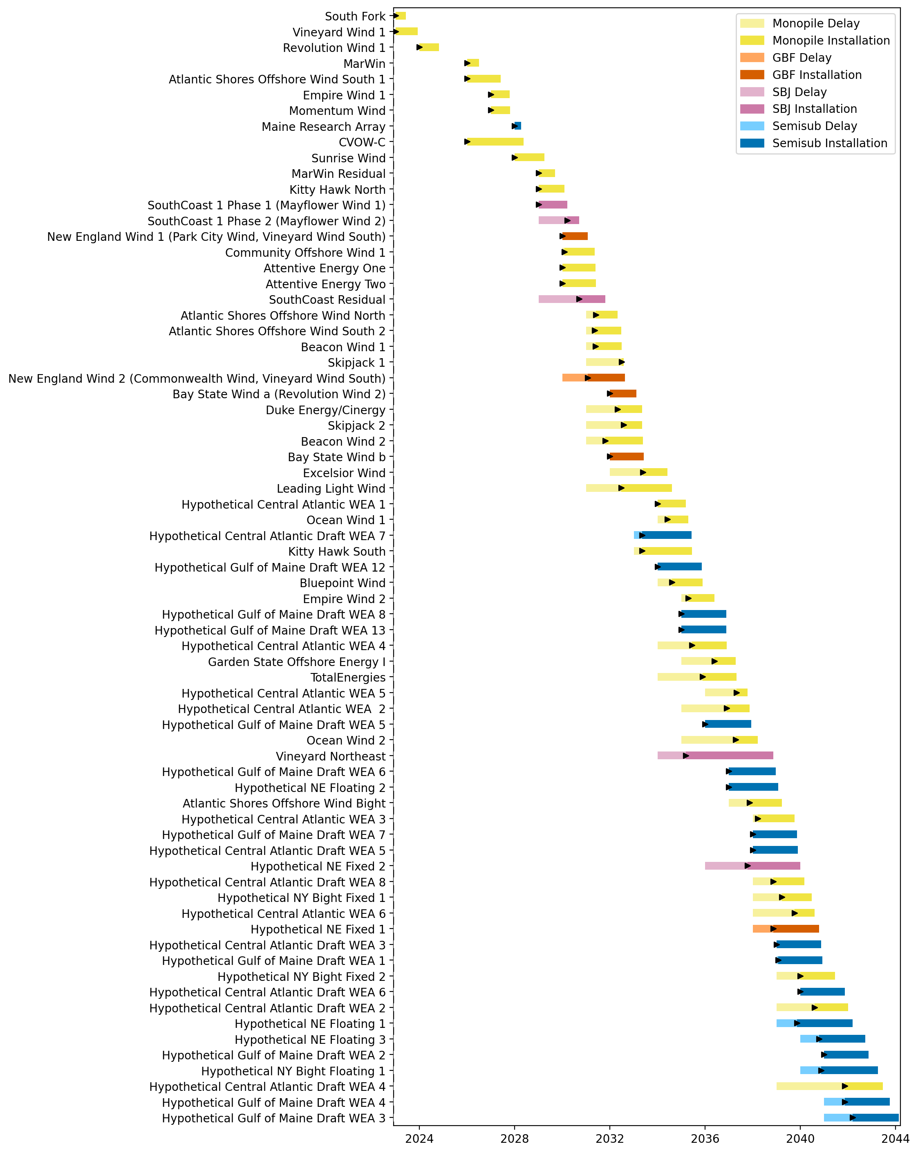
Full Gantt

Slide 3
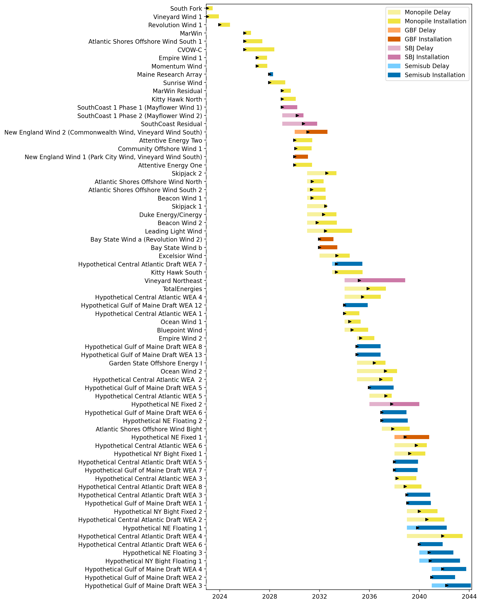
Sorted Full Gantt

Slide 4
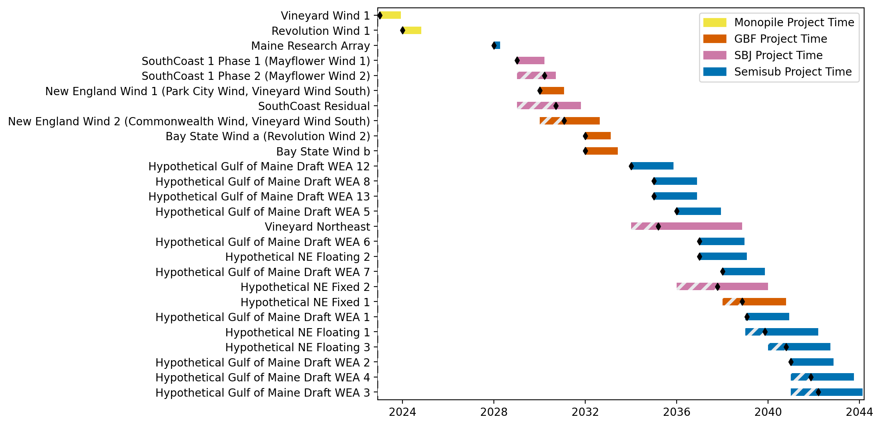
New England Gantt

Slide 5
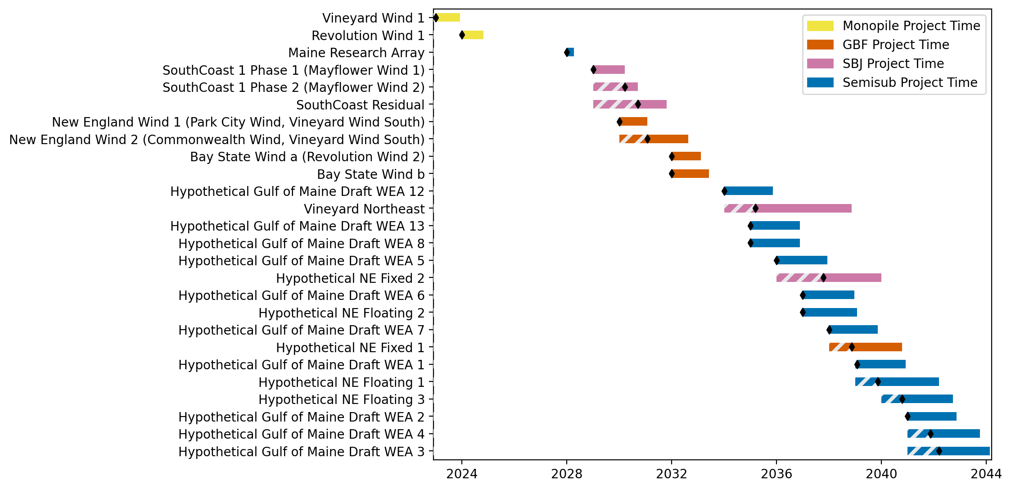
Sorted New England Gantt

Slide 6
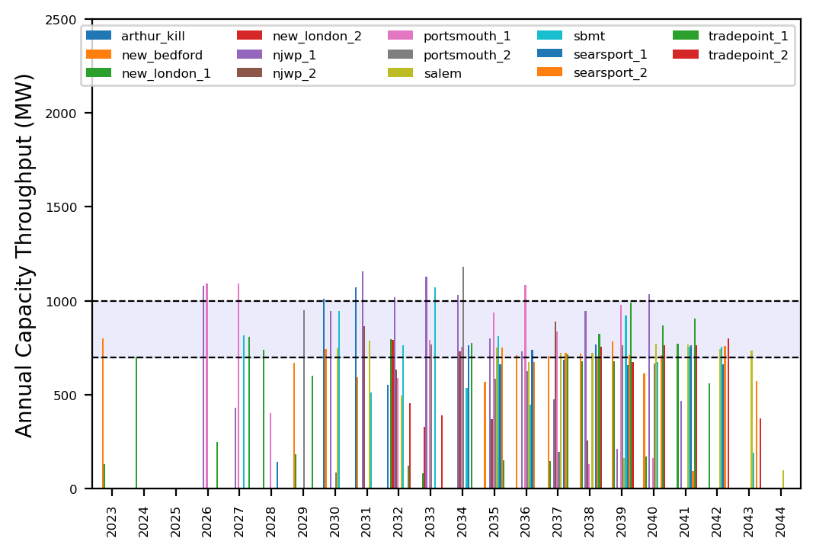
Port Throughput

Slide 7
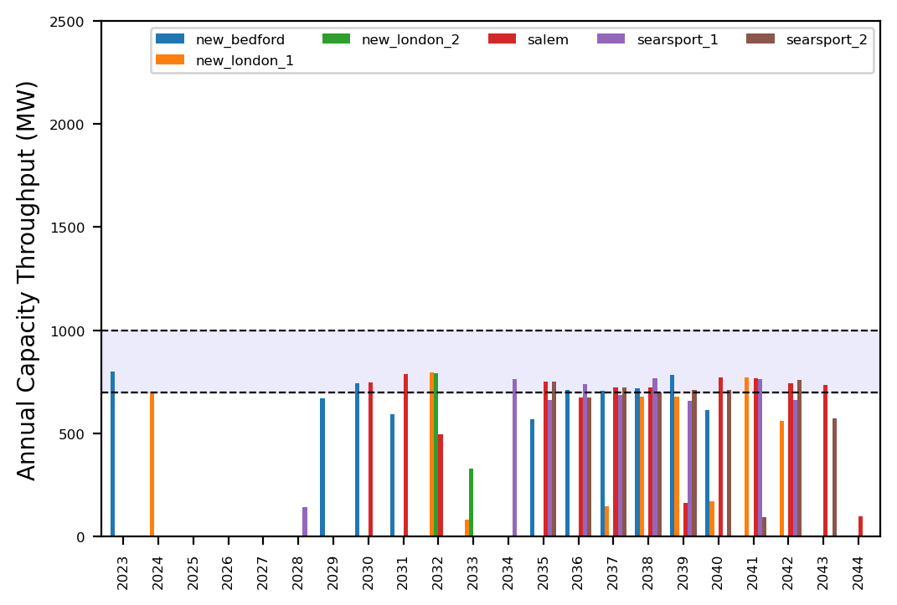
Port Throughput

Slide 8
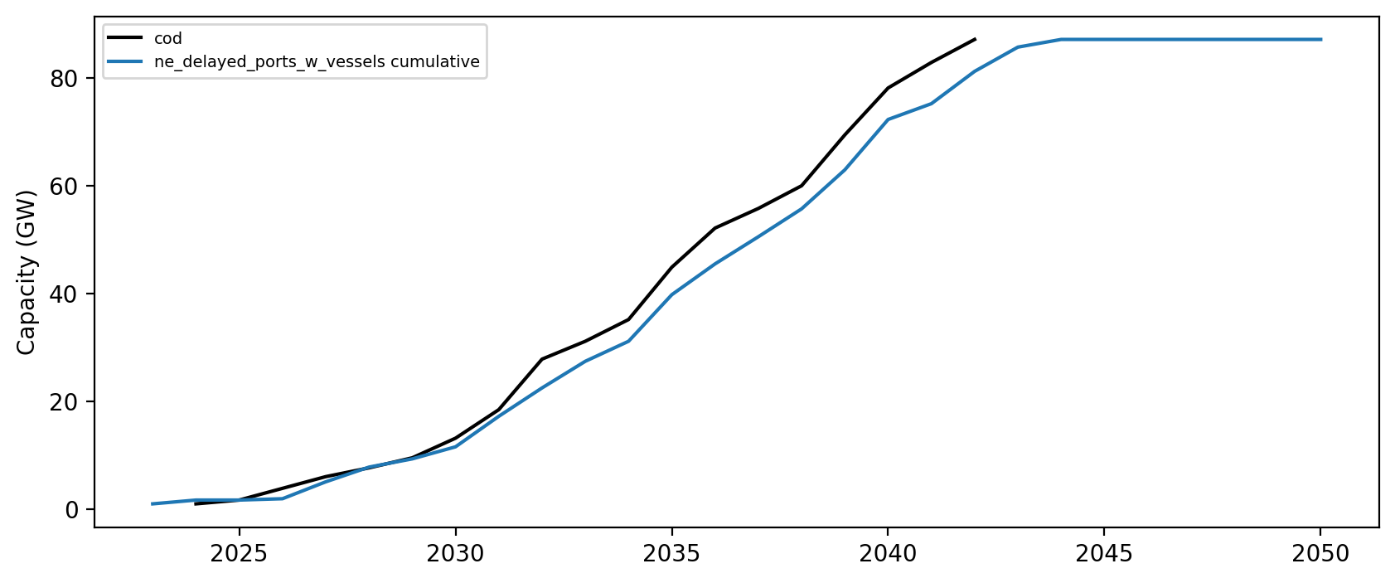
Installed Capacity

