Slide 1
ne_low_3wtiv_3ahts
Low Deployment Scenario

Slide 2
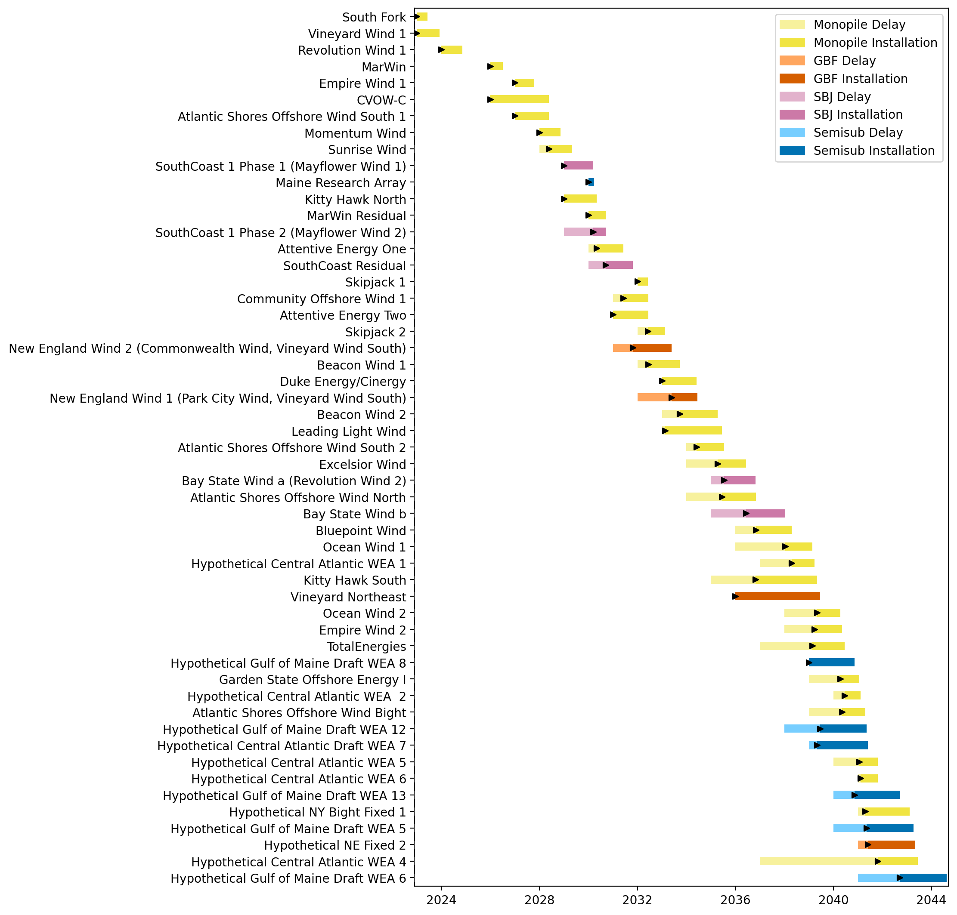
Full Gantt

Slide 3
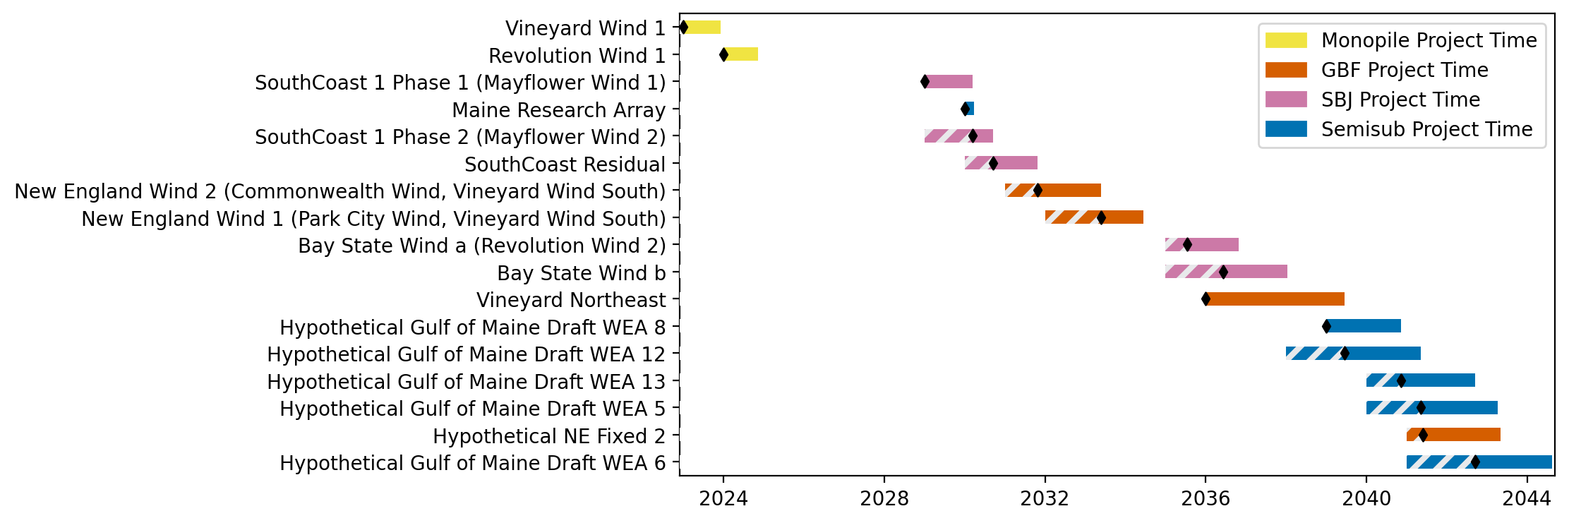
New England Gantt

Slide 4
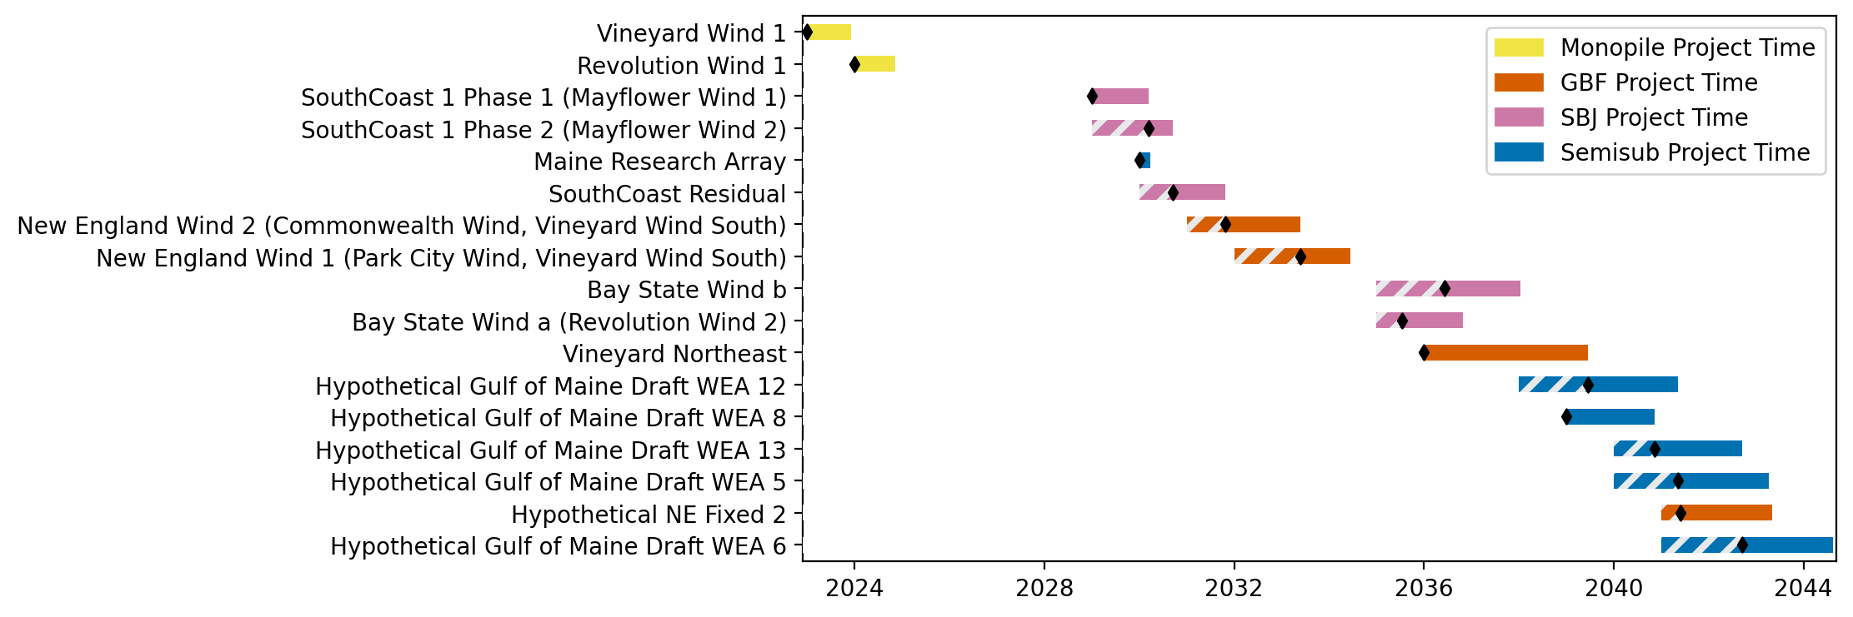
Sorted New England Gantt

Slide 5
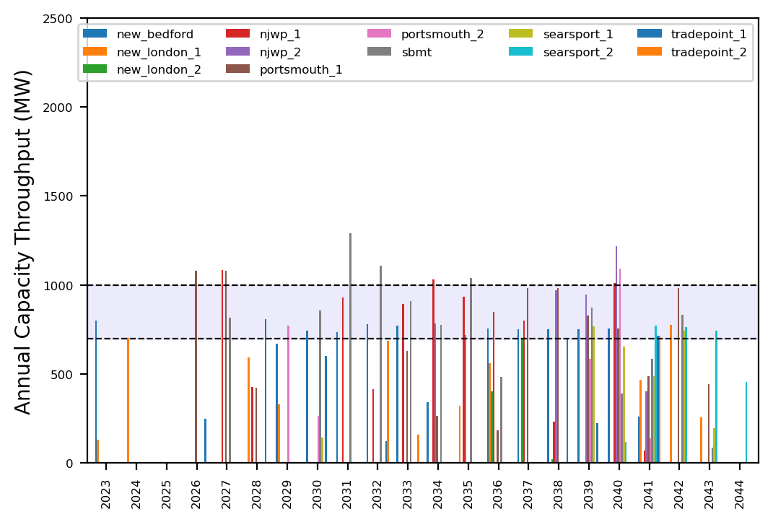
Port Throughput

Slide 6
ne_mono_5wtiv_add_2ahts
All Monopile Pipeline
Add 3 WTIV

Slide 7
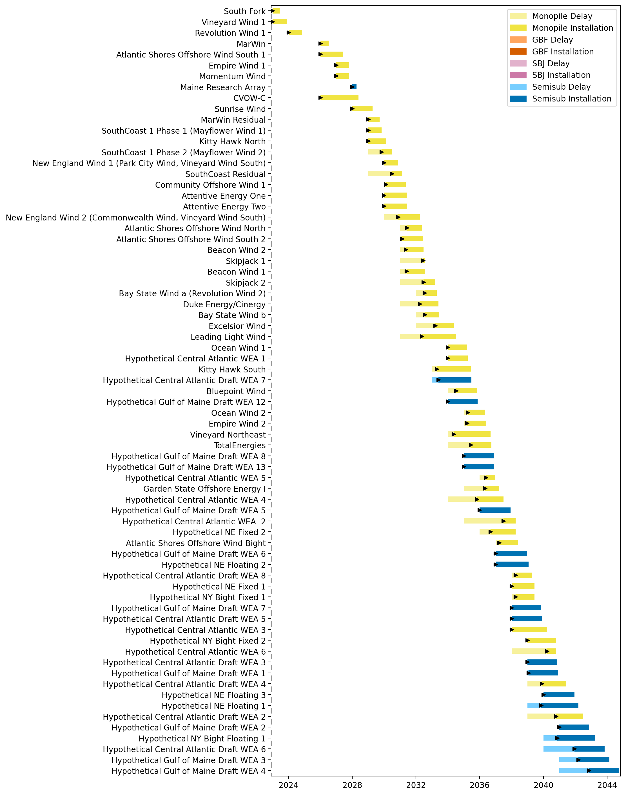
Full Gantt

Slide 8
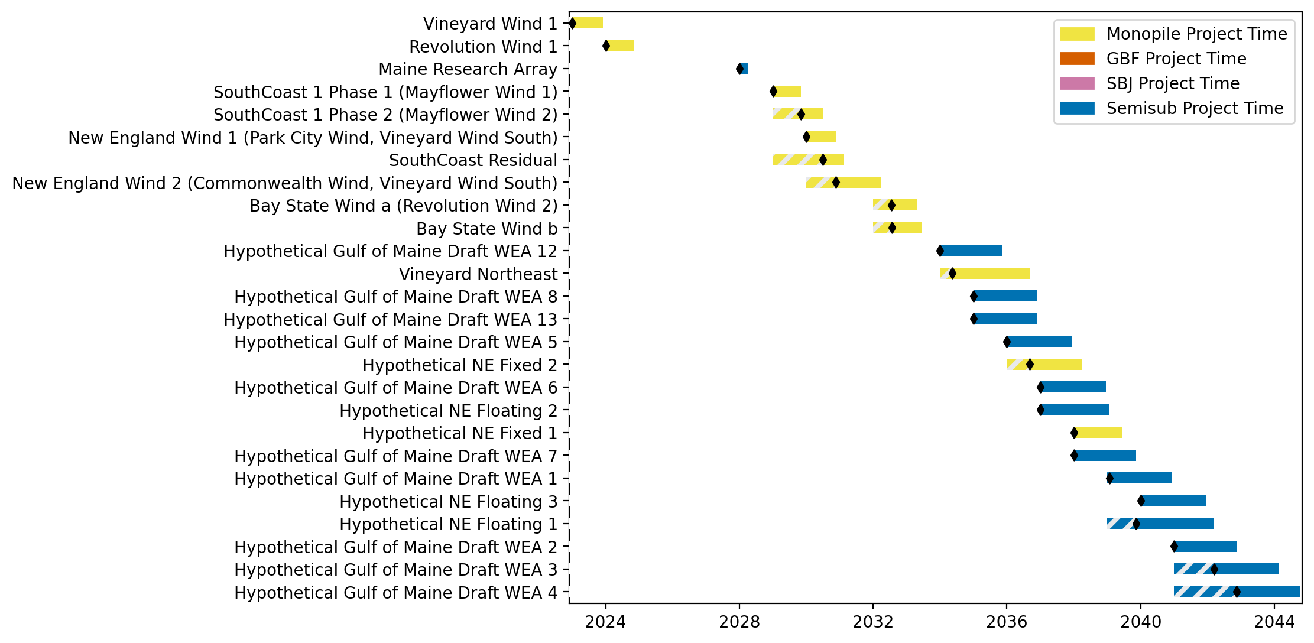
New England Gantt

Slide 9
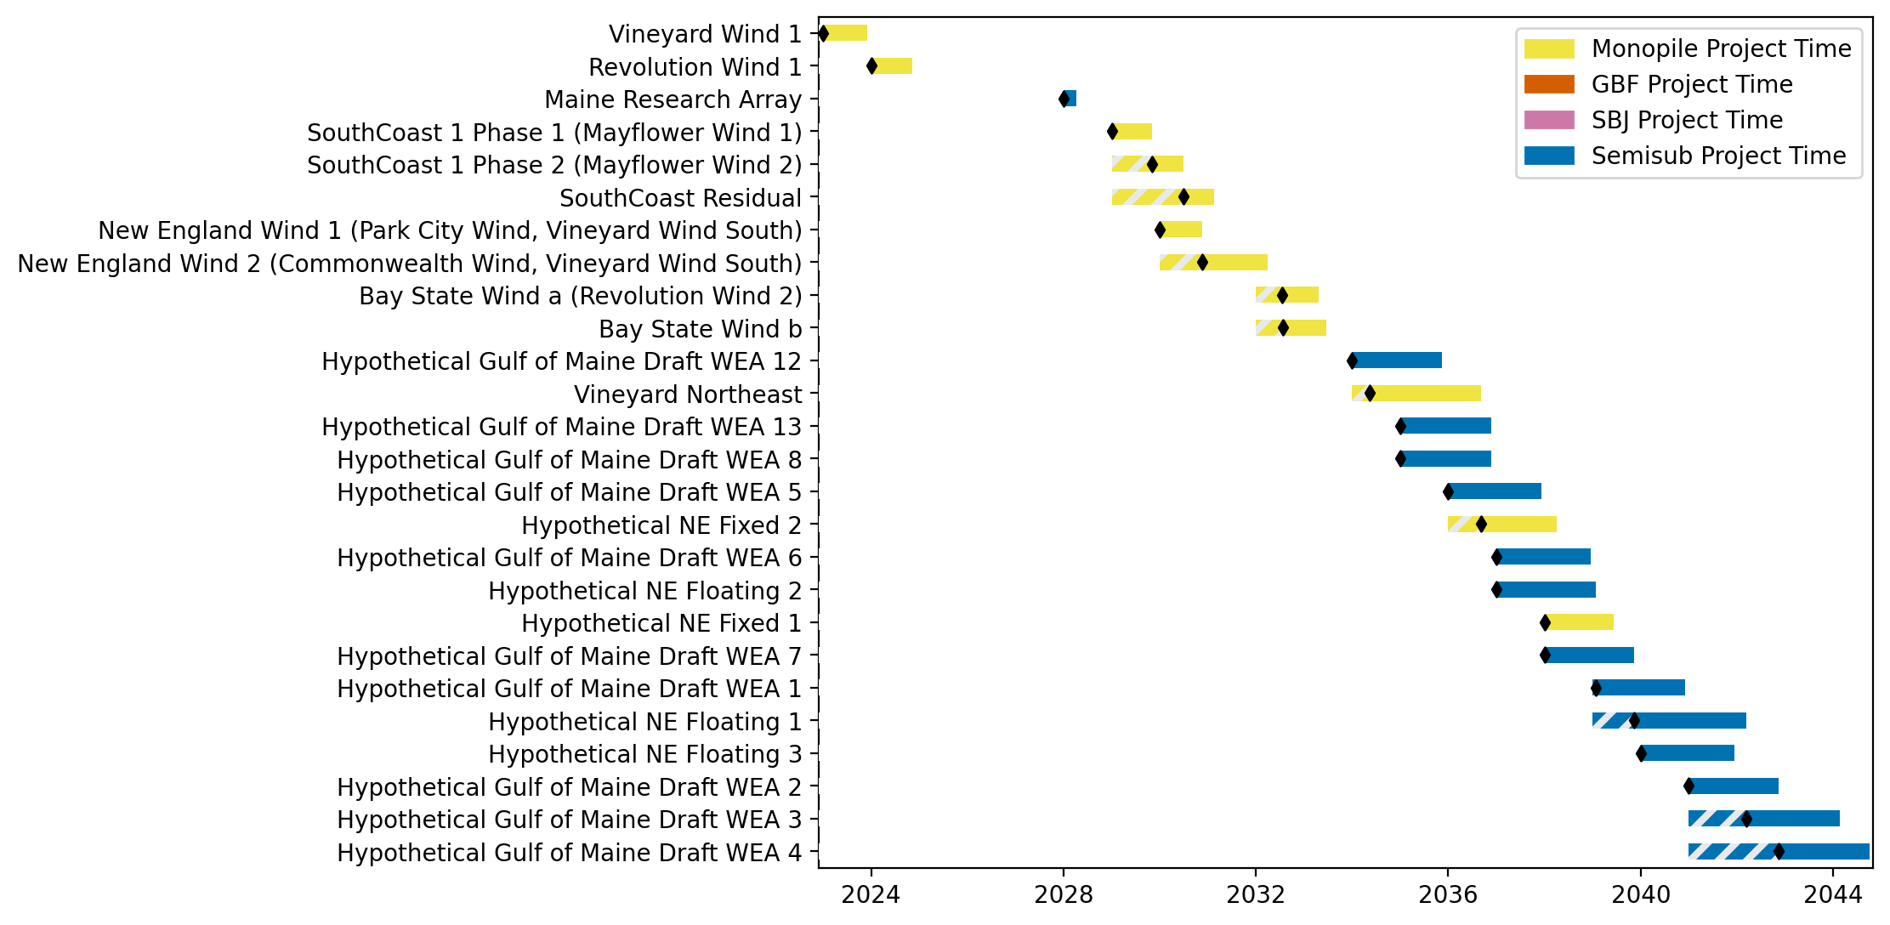
Sorted New England Gantt

Slide 10
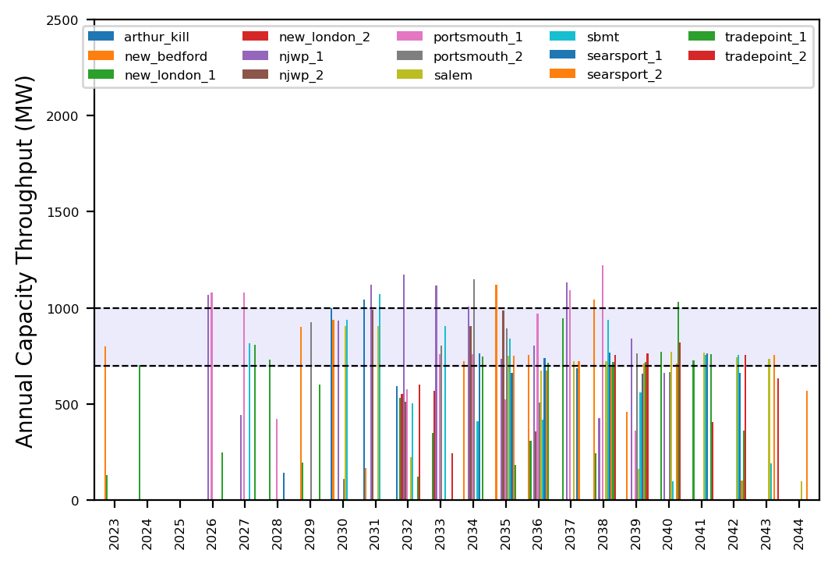
Port Throughput

Slide 11
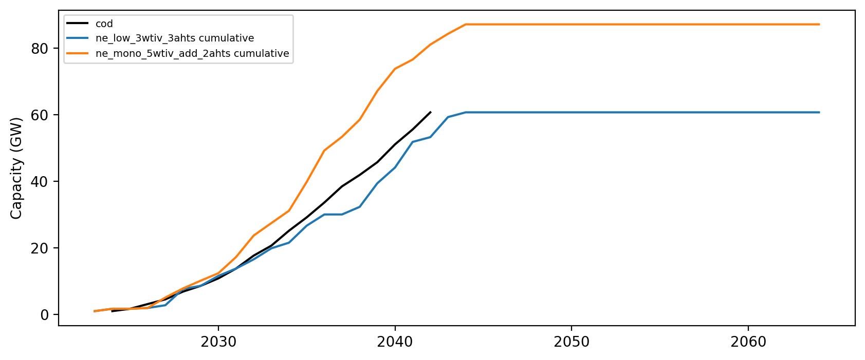
Installed Capacity

