Slide 1
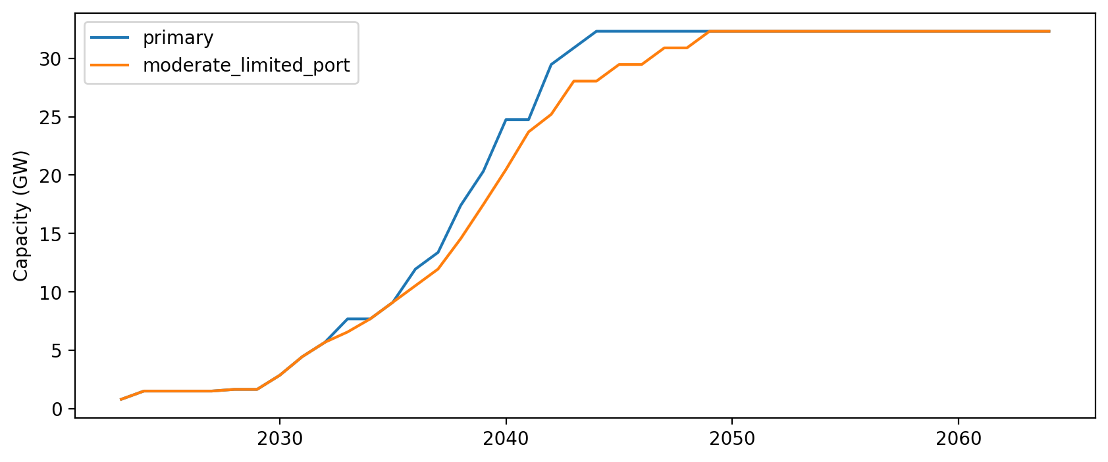
Installed Capacity

Slide 2
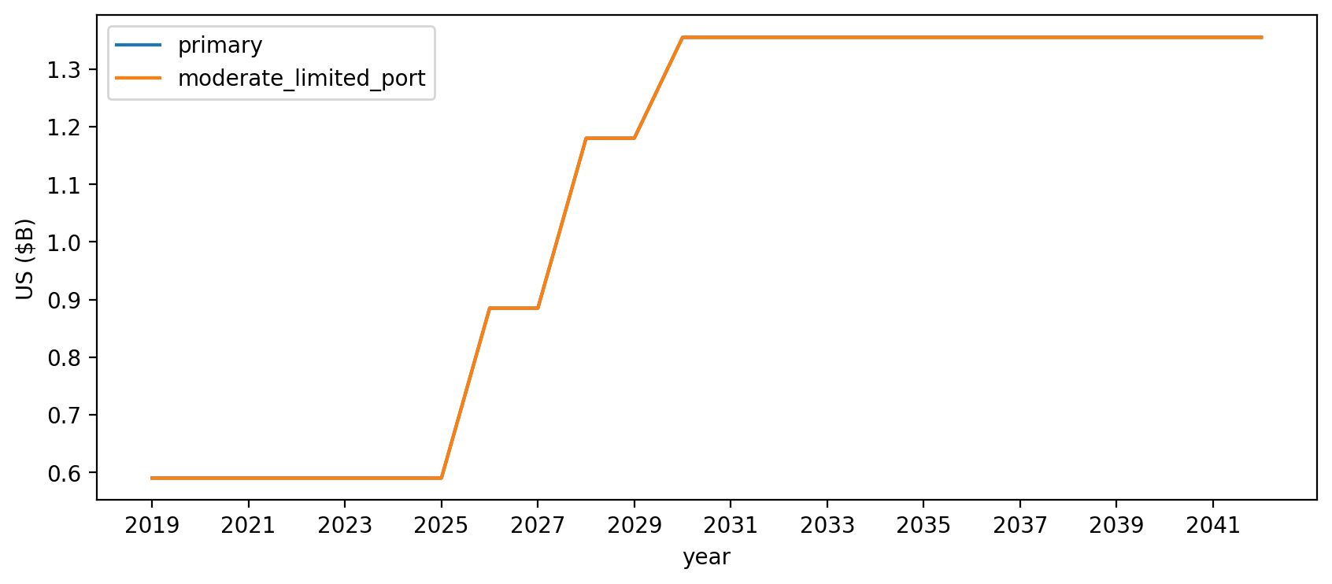
Vessel investment

Slide 3
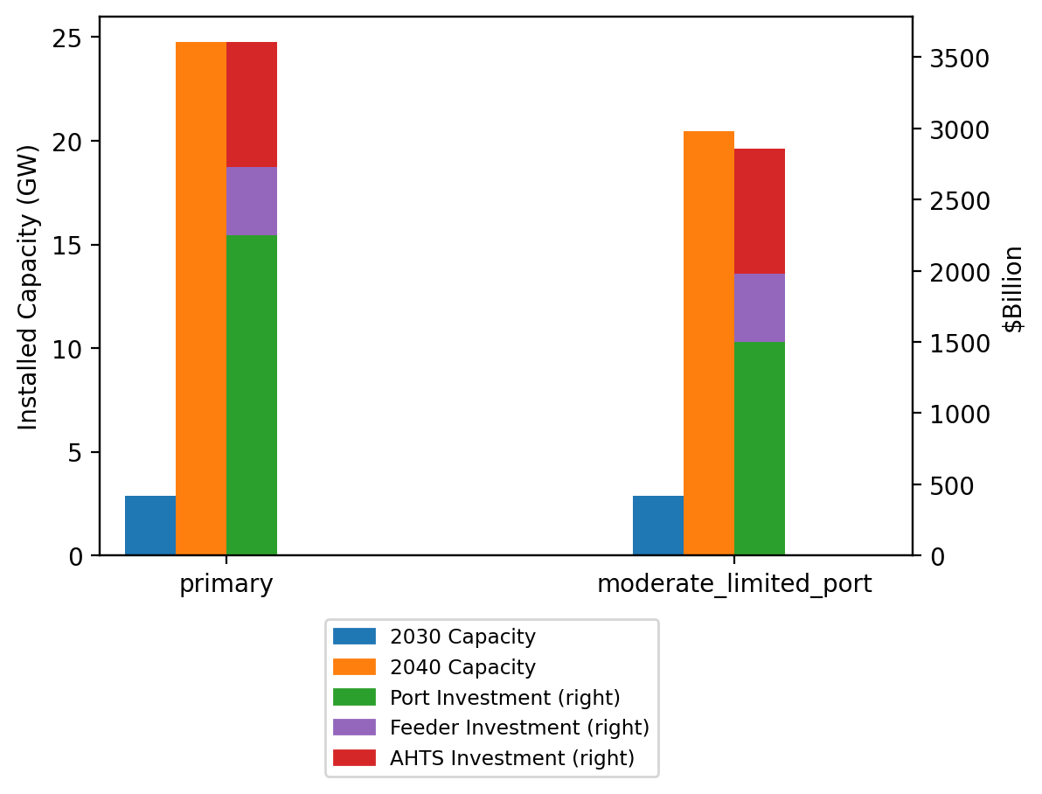
Summary Installed Cap/Investment

