Slide 1
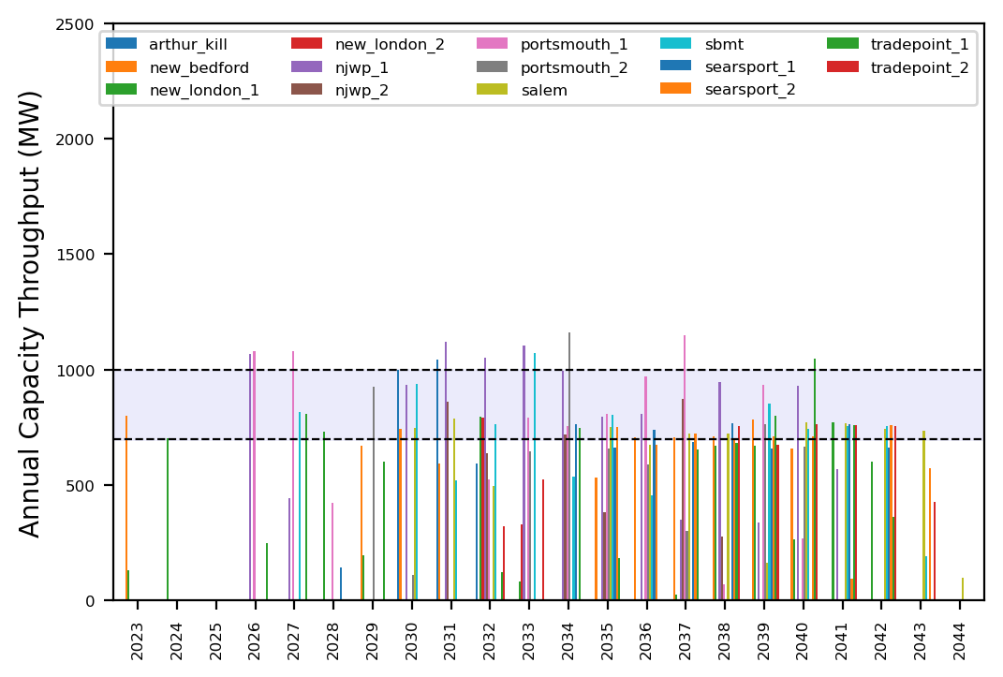
Port Throughput

Slide 2
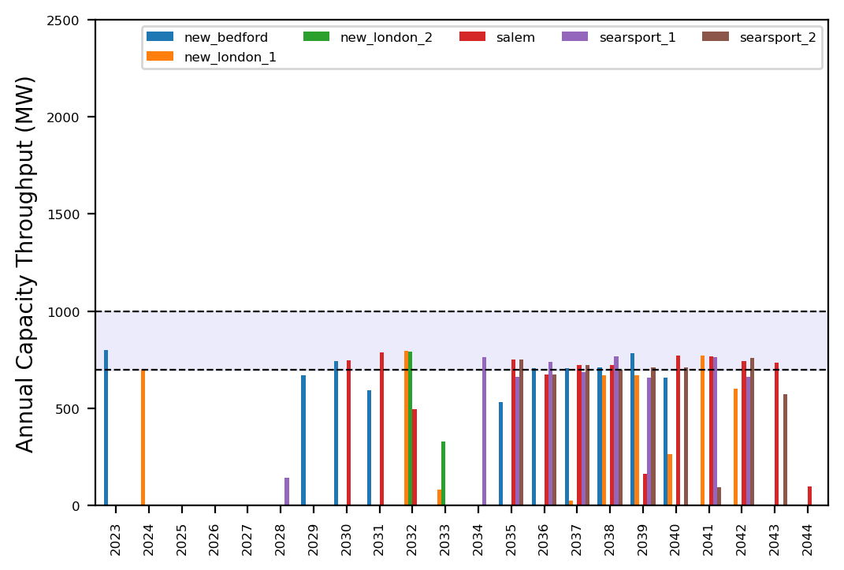
Port Throughput

Slide 3
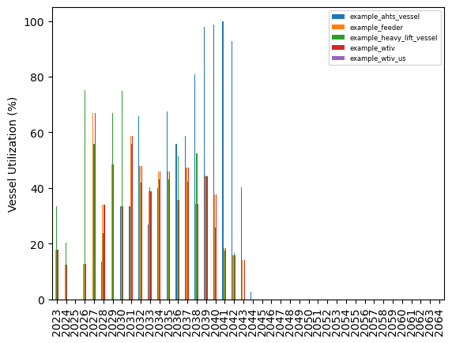
Vessel Utilization

Slide 4
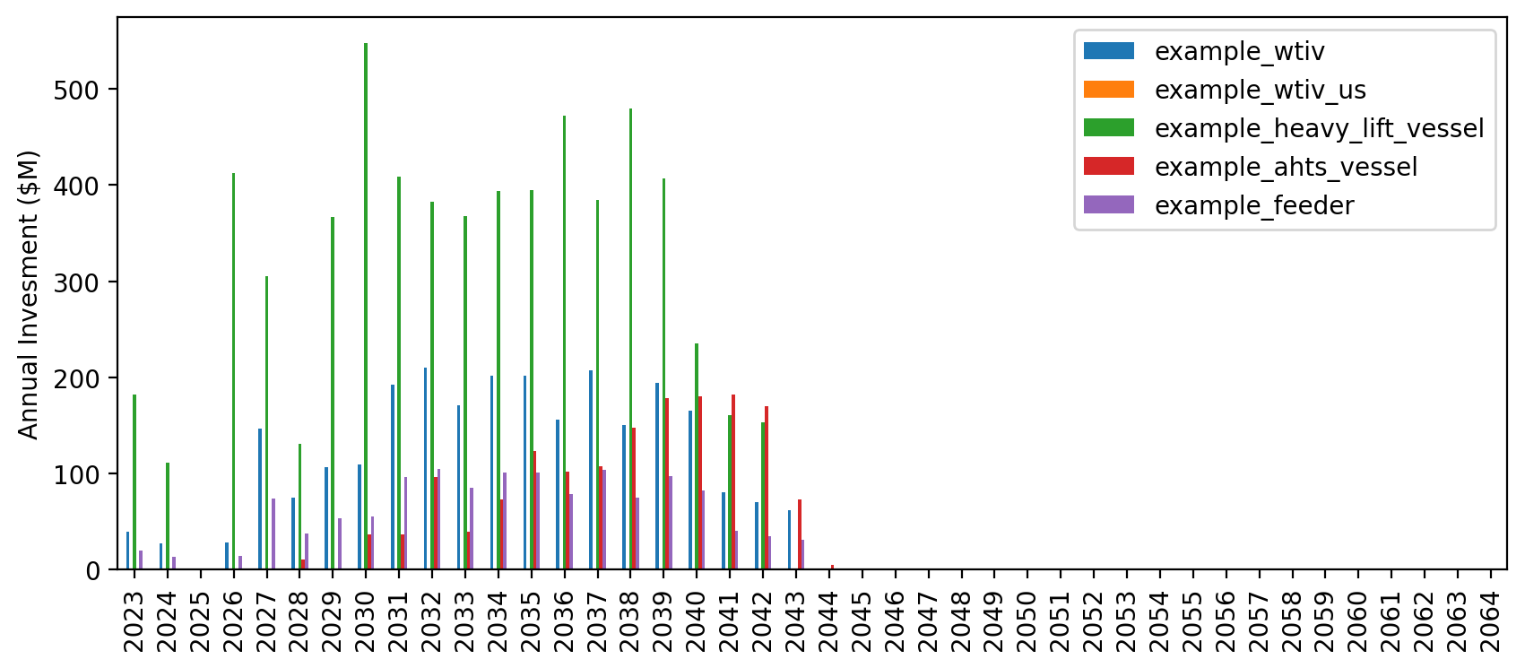
Vessel Revenue

Slide 5
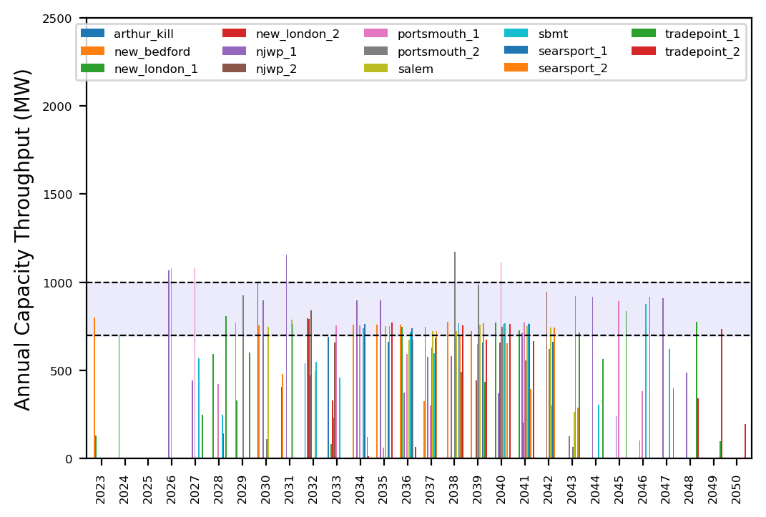
Port Throughput

Slide 6
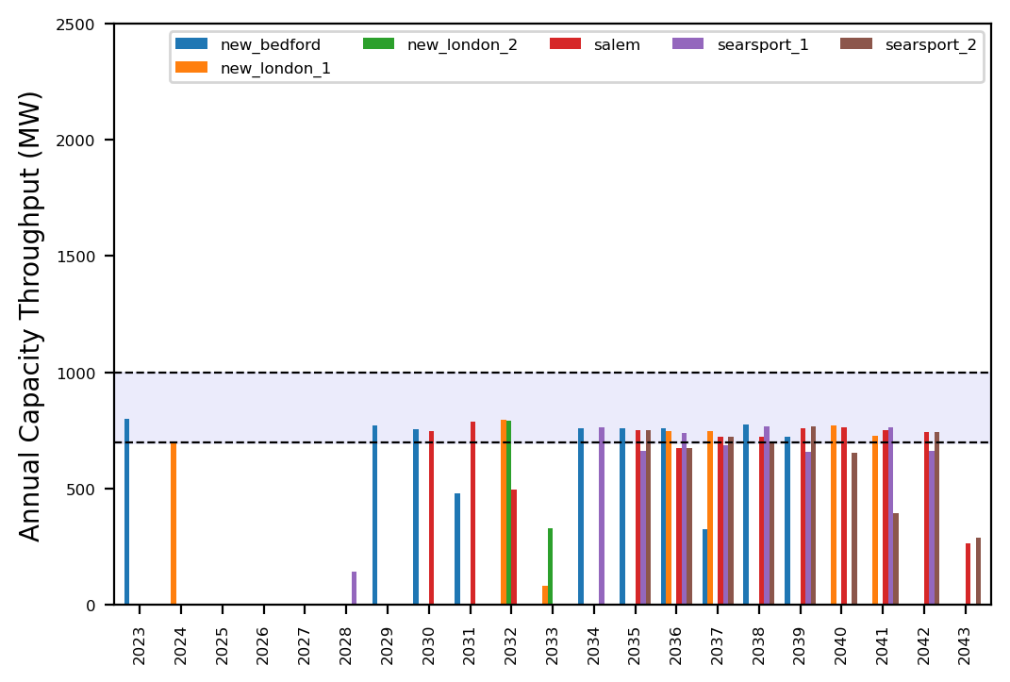
Port Throughput

Slide 7
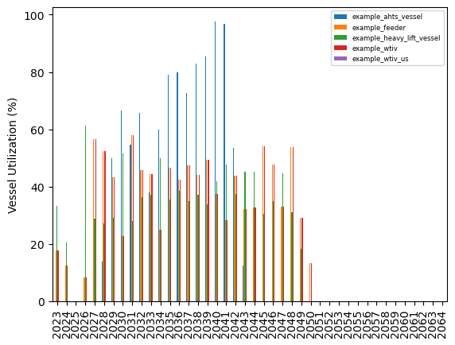
Vessel Utilization

Slide 8
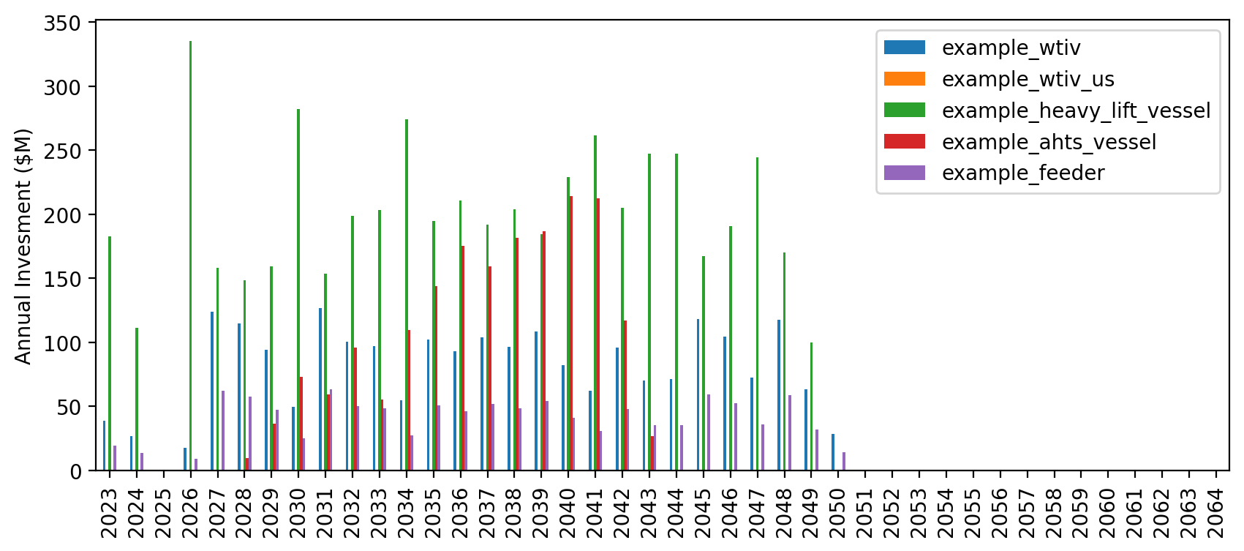
Vessel Revenue

Slide 9
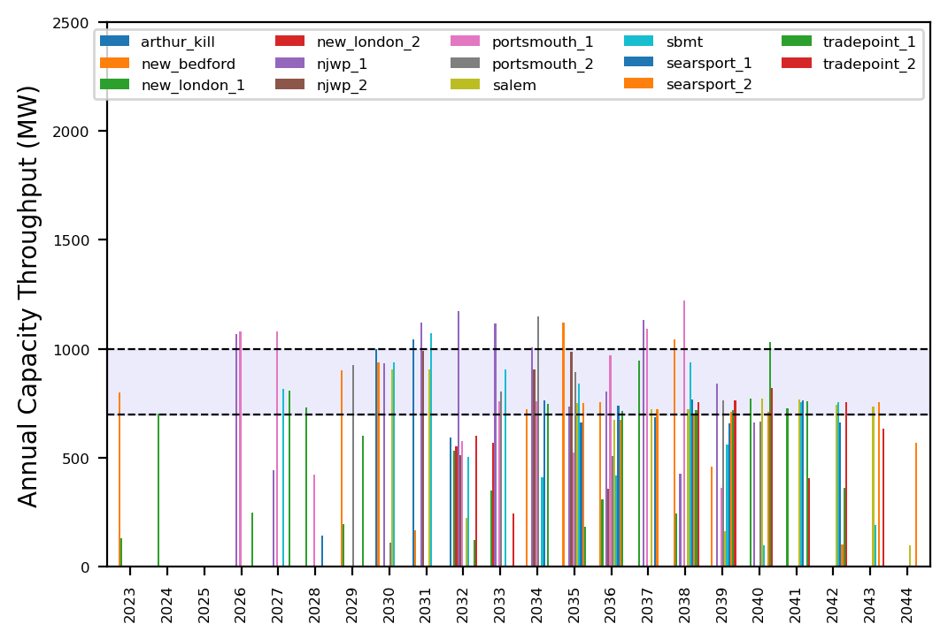
Port Throughput

Slide 10
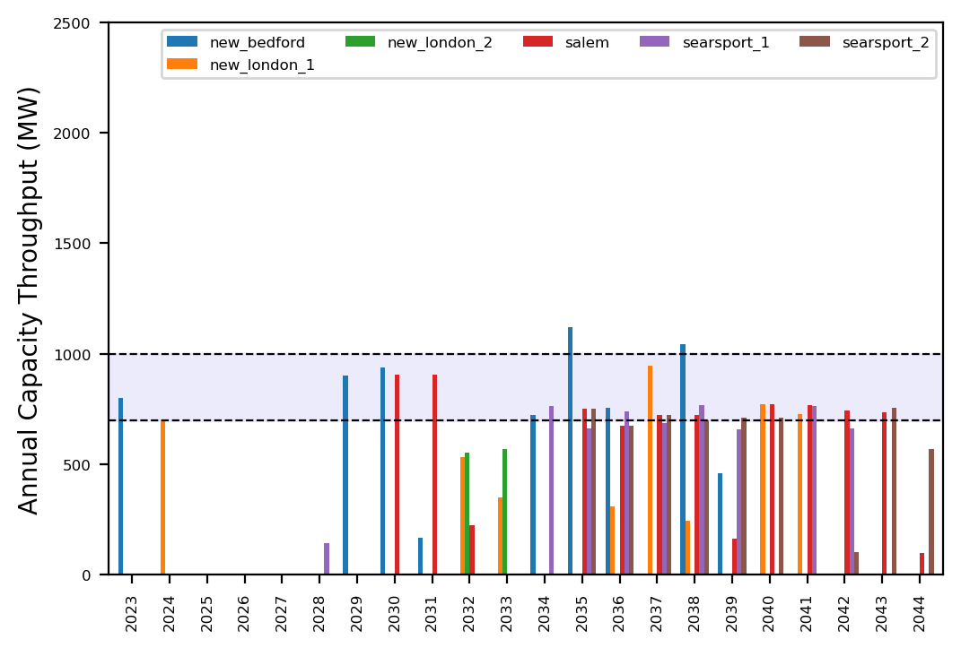
Port Throughput

Slide 11
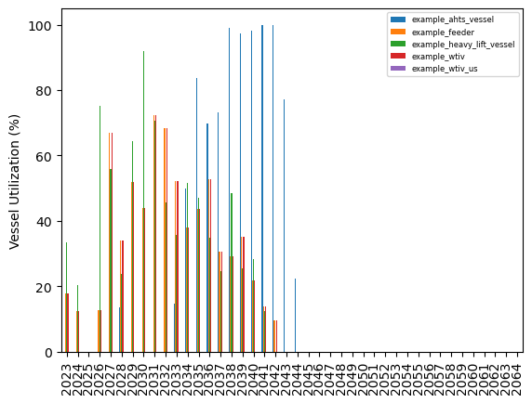
Vessel Utilization

Slide 12
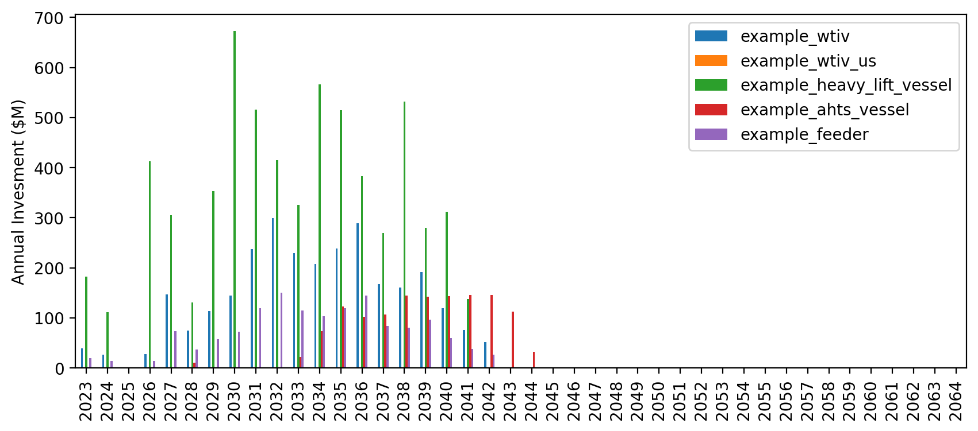
Vessel Revenue

Slide 13
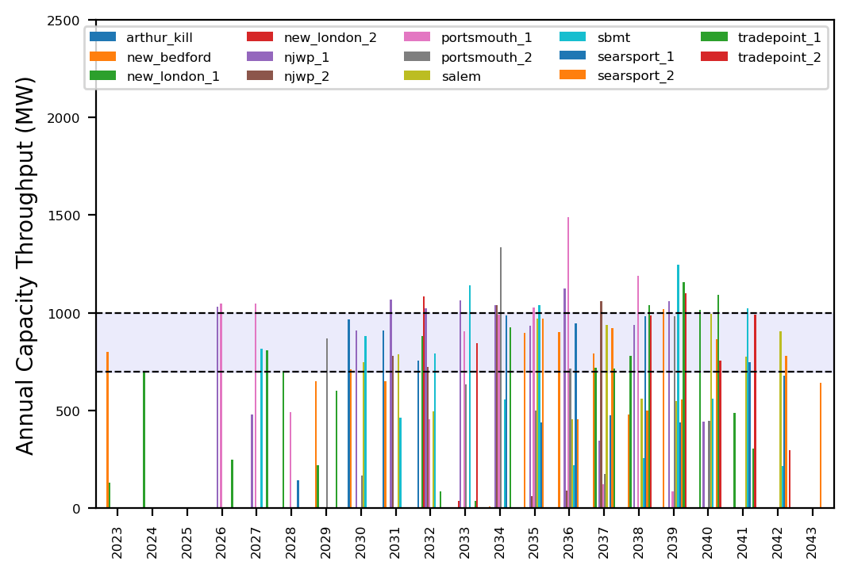
Port Throughput

Slide 14
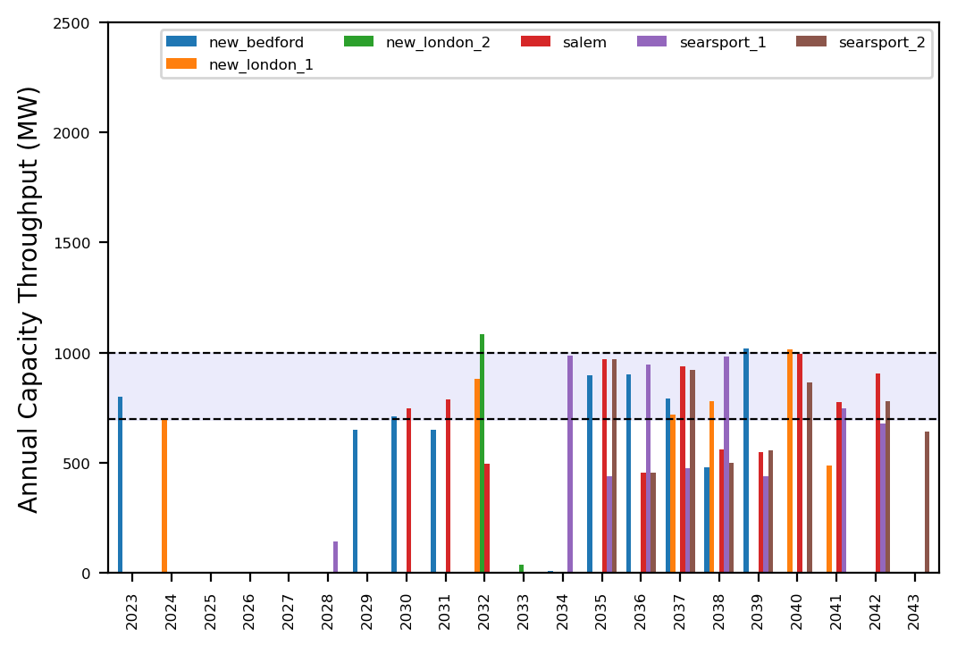
Port Throughput

Slide 15
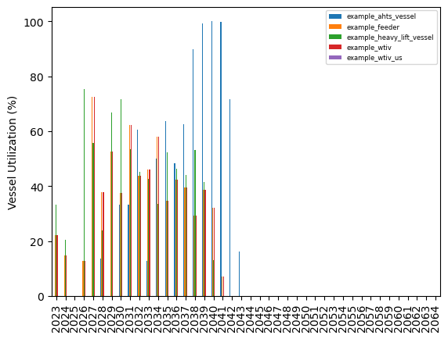
Vessel Utilization

Slide 16
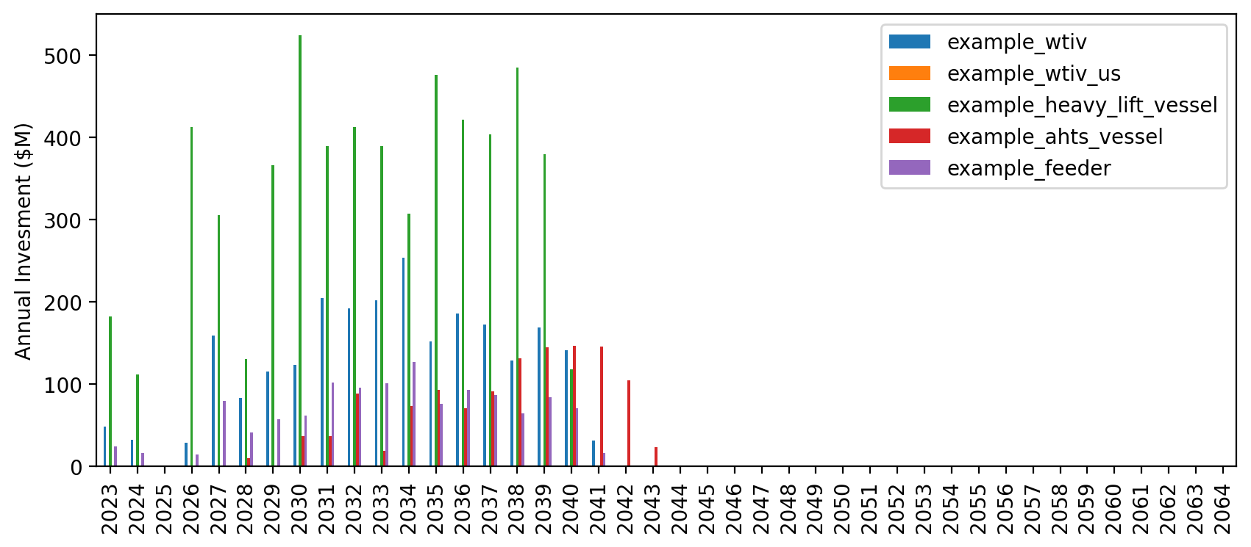
Vessel Revenue

Slide 17
Port Throughput

Slide 18
Port Throughput

Slide 19
Vessel Utilization

Slide 20
Vessel Revenue

Slide 21
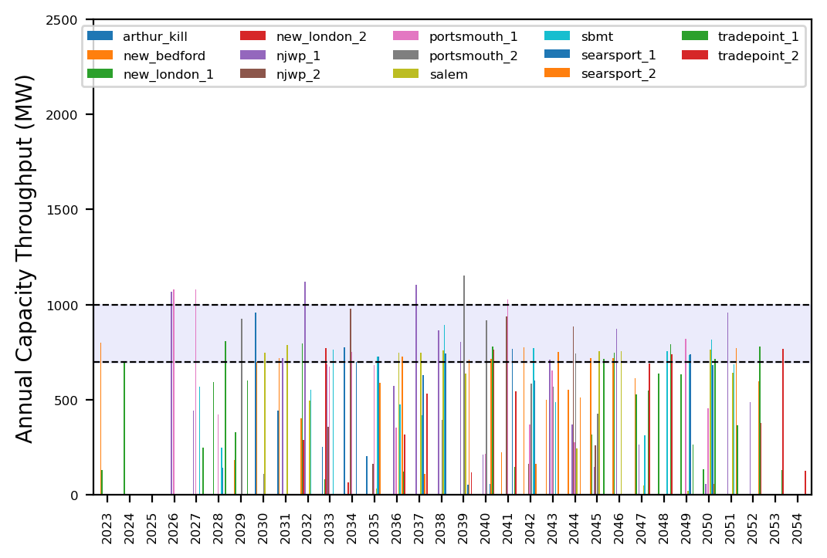
Port Throughput

Slide 22
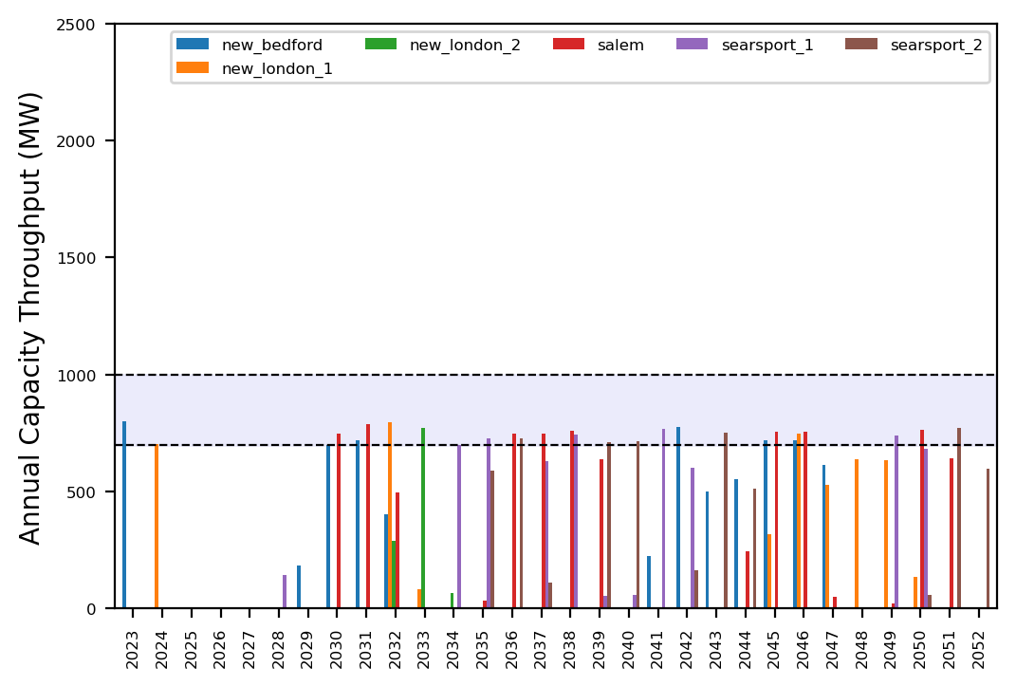
Port Throughput

Slide 23
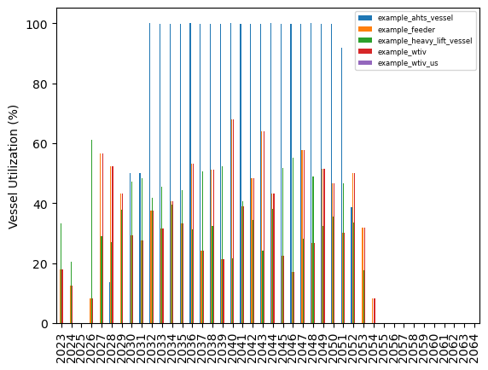
Vessel Utilization

Slide 24
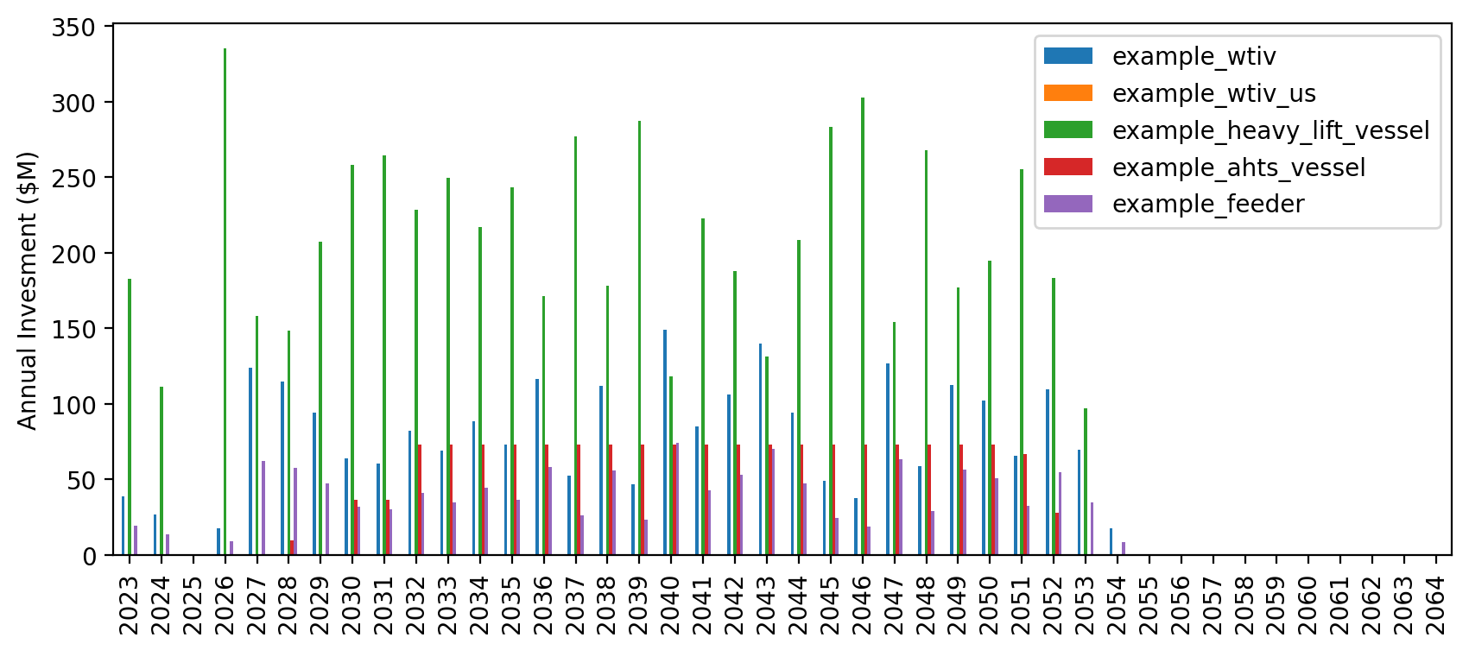
Vessel Revenue

Slide 25
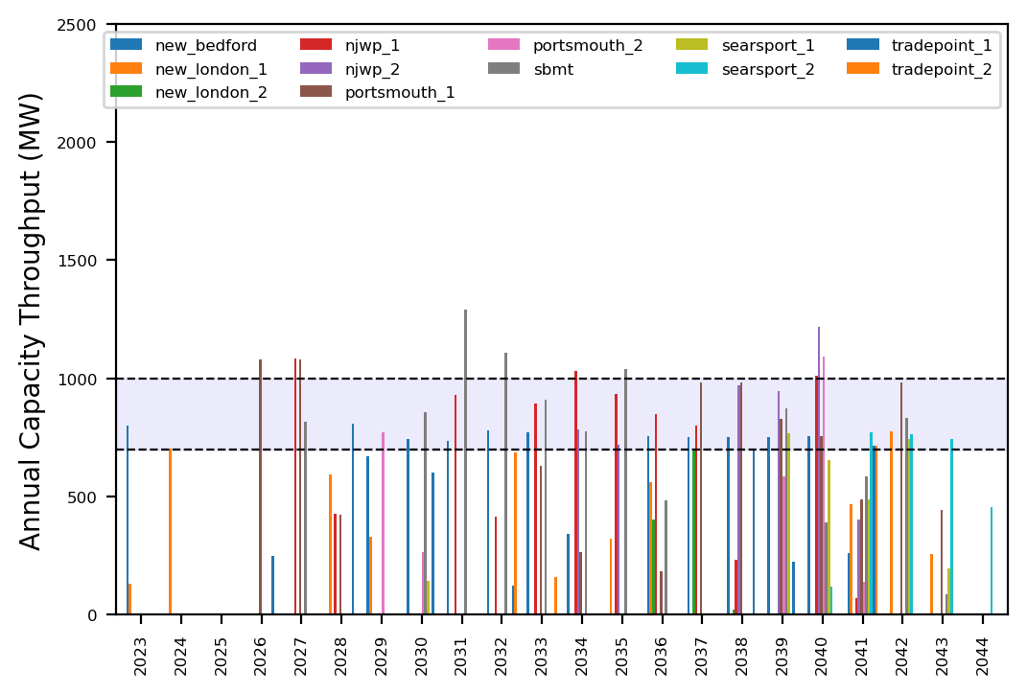
Port Throughput

Slide 26
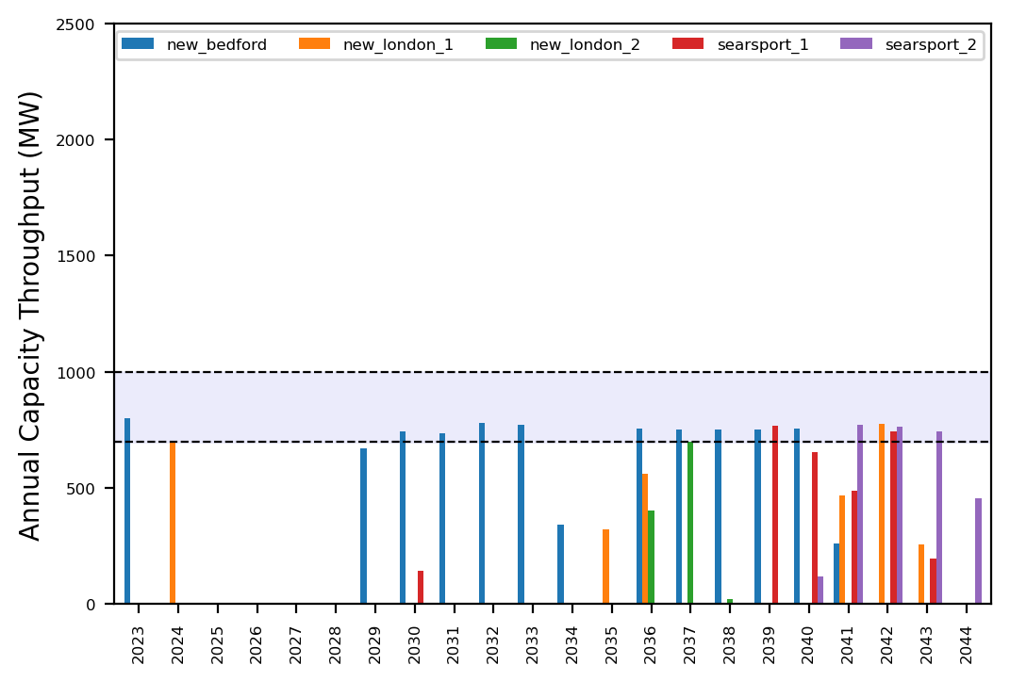
Port Throughput

Slide 27
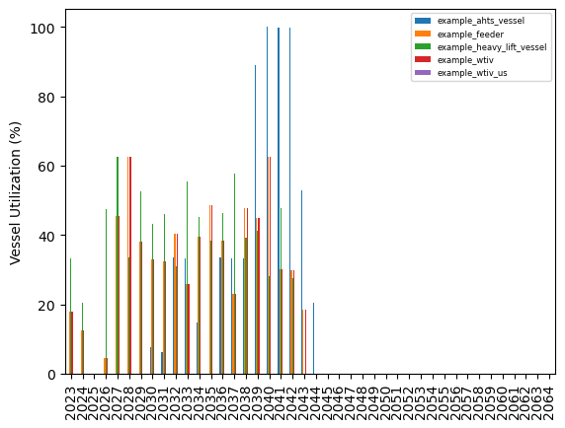
Vessel Utilization

Slide 28
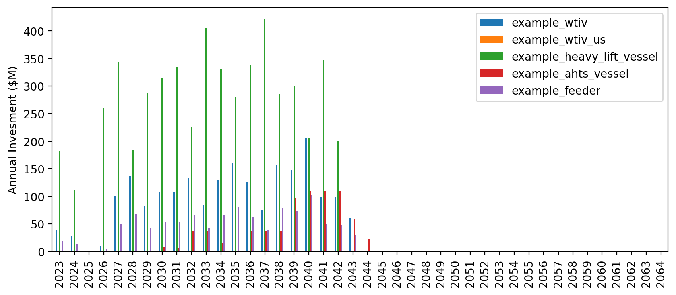
Vessel Revenue

Slide 29
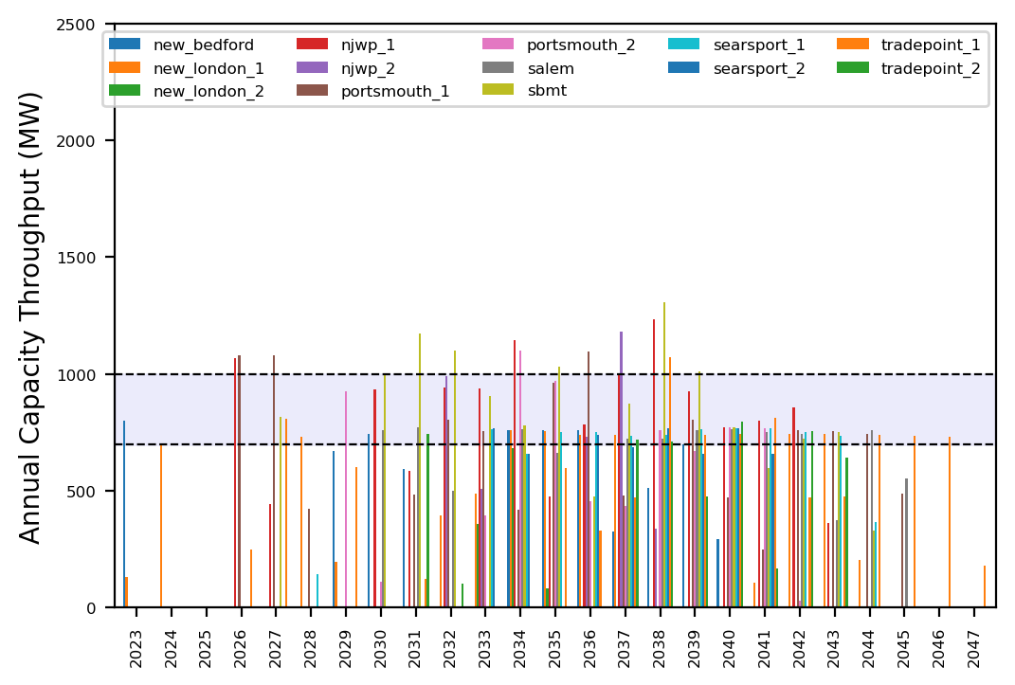
Port Throughput

Slide 30
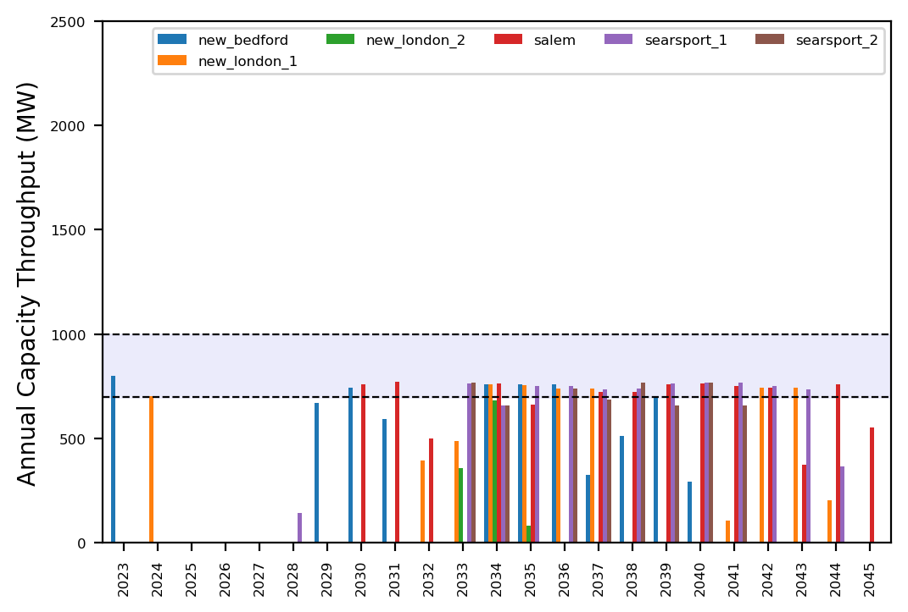
Port Throughput

Slide 31
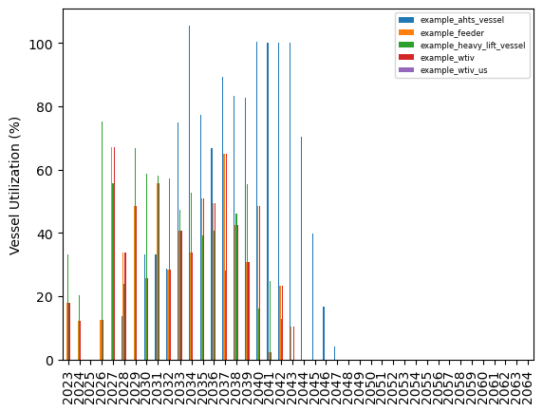
Vessel Utilization

Slide 32
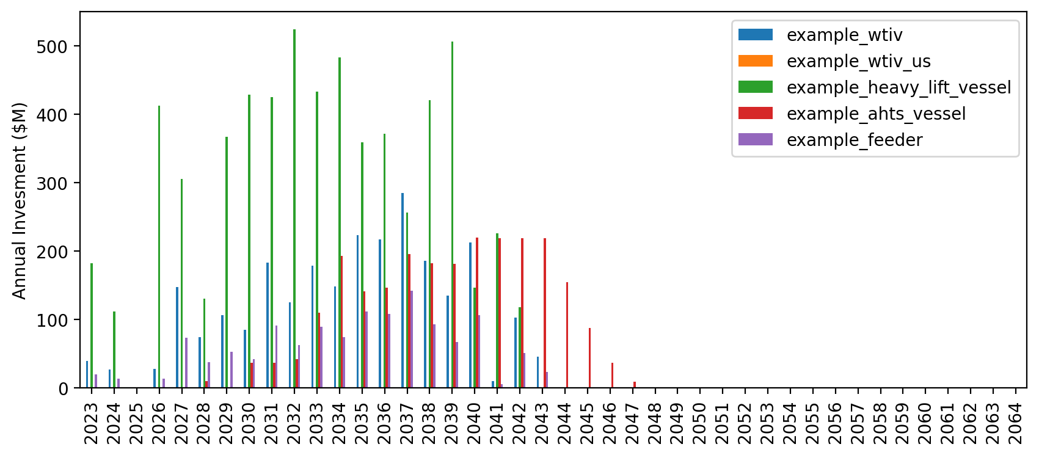
Vessel Revenue

Slide 33
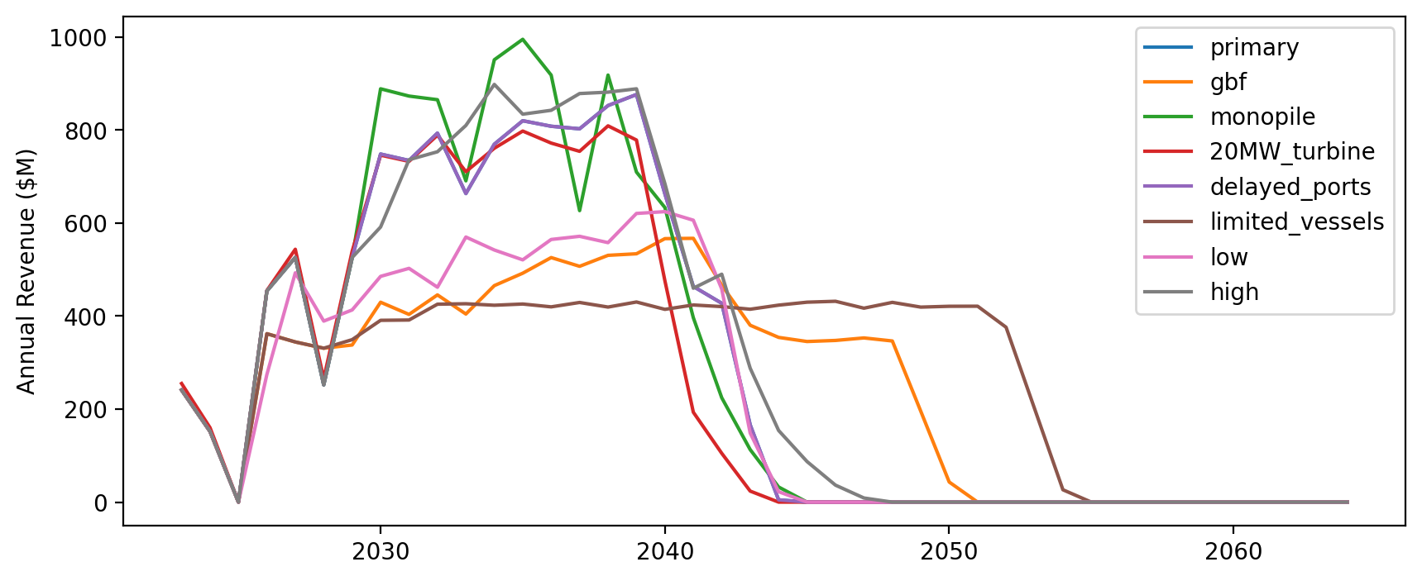
Vessel Revenue by Scenario

Slide 34
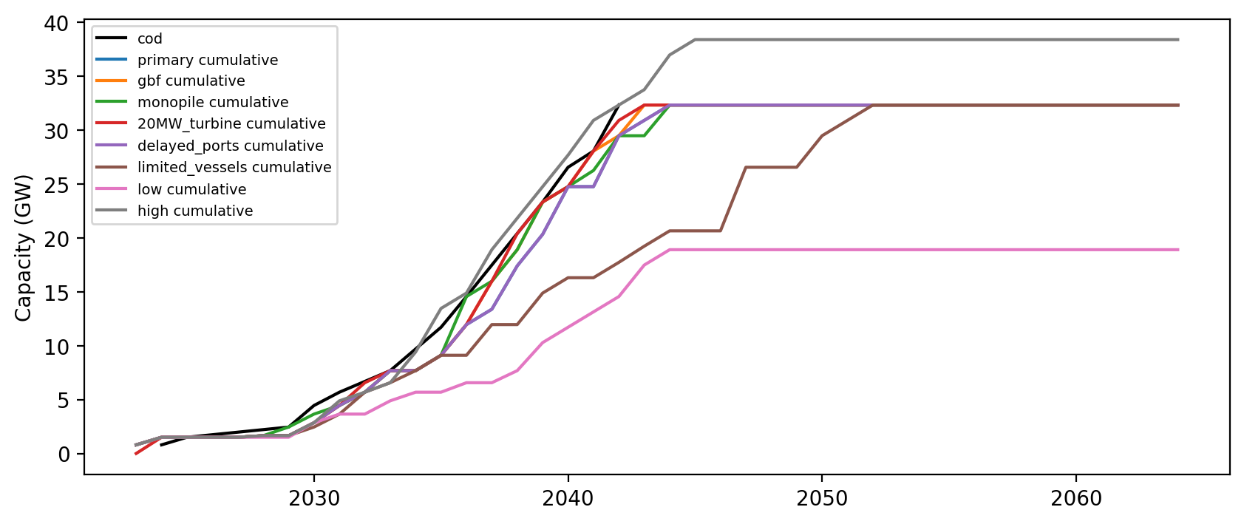
Installed Capacity

Slide 35
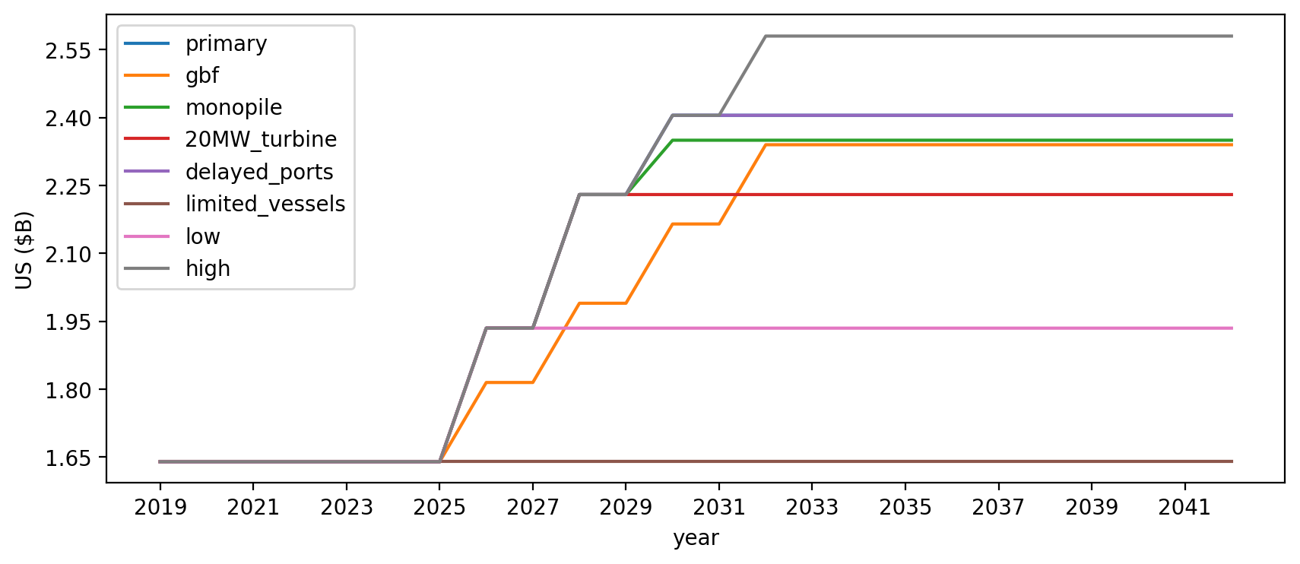
Vessel investment

Slide 36
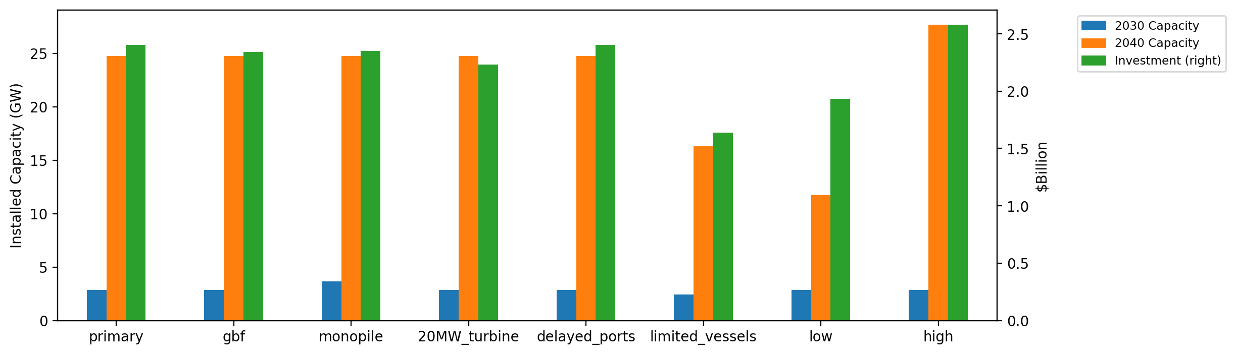
Summary Installed Cap/Investment

