Slide 1
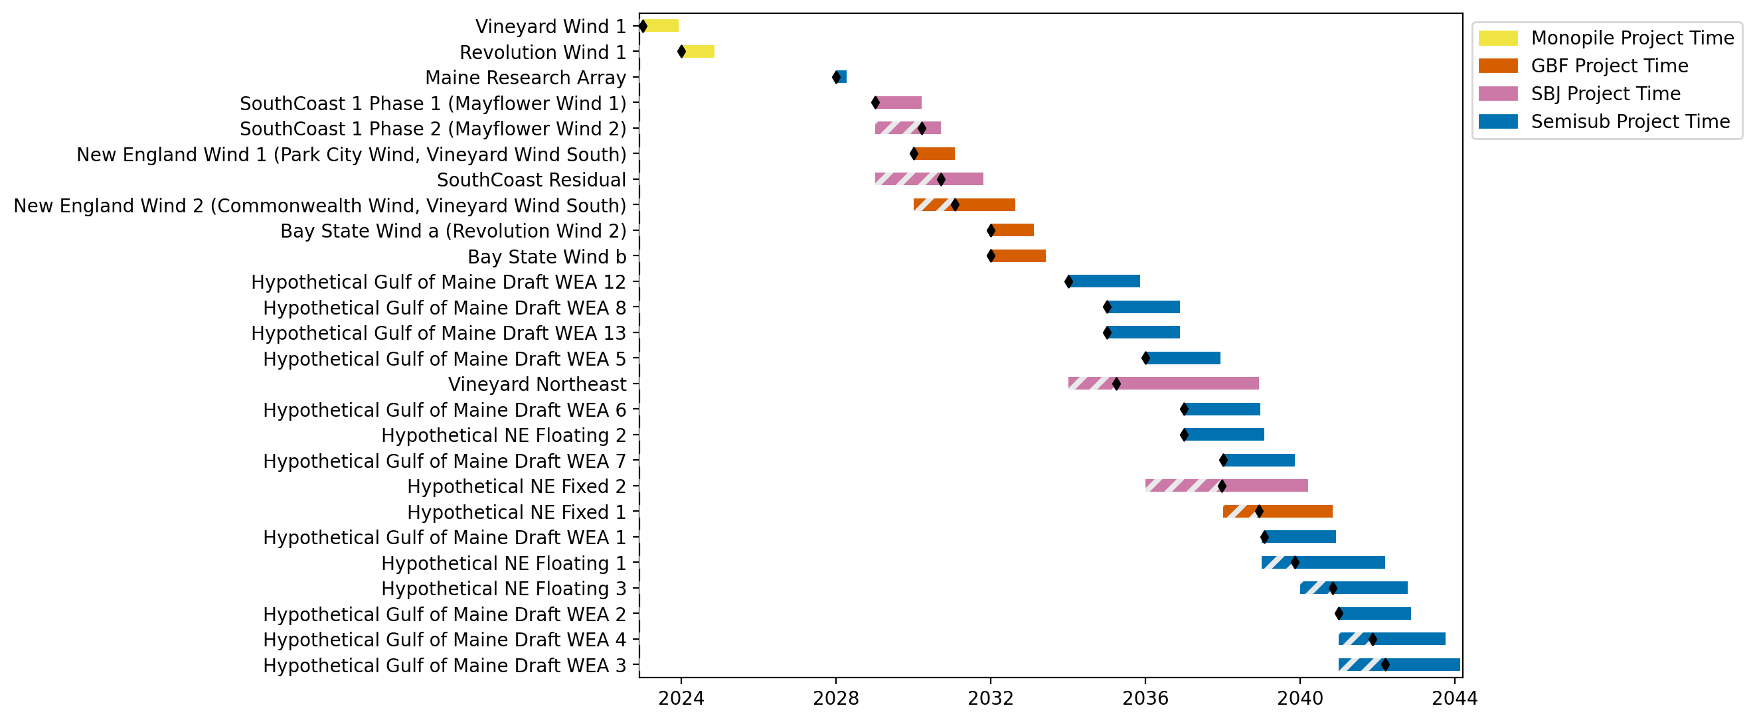
New England Gantt

Slide 2
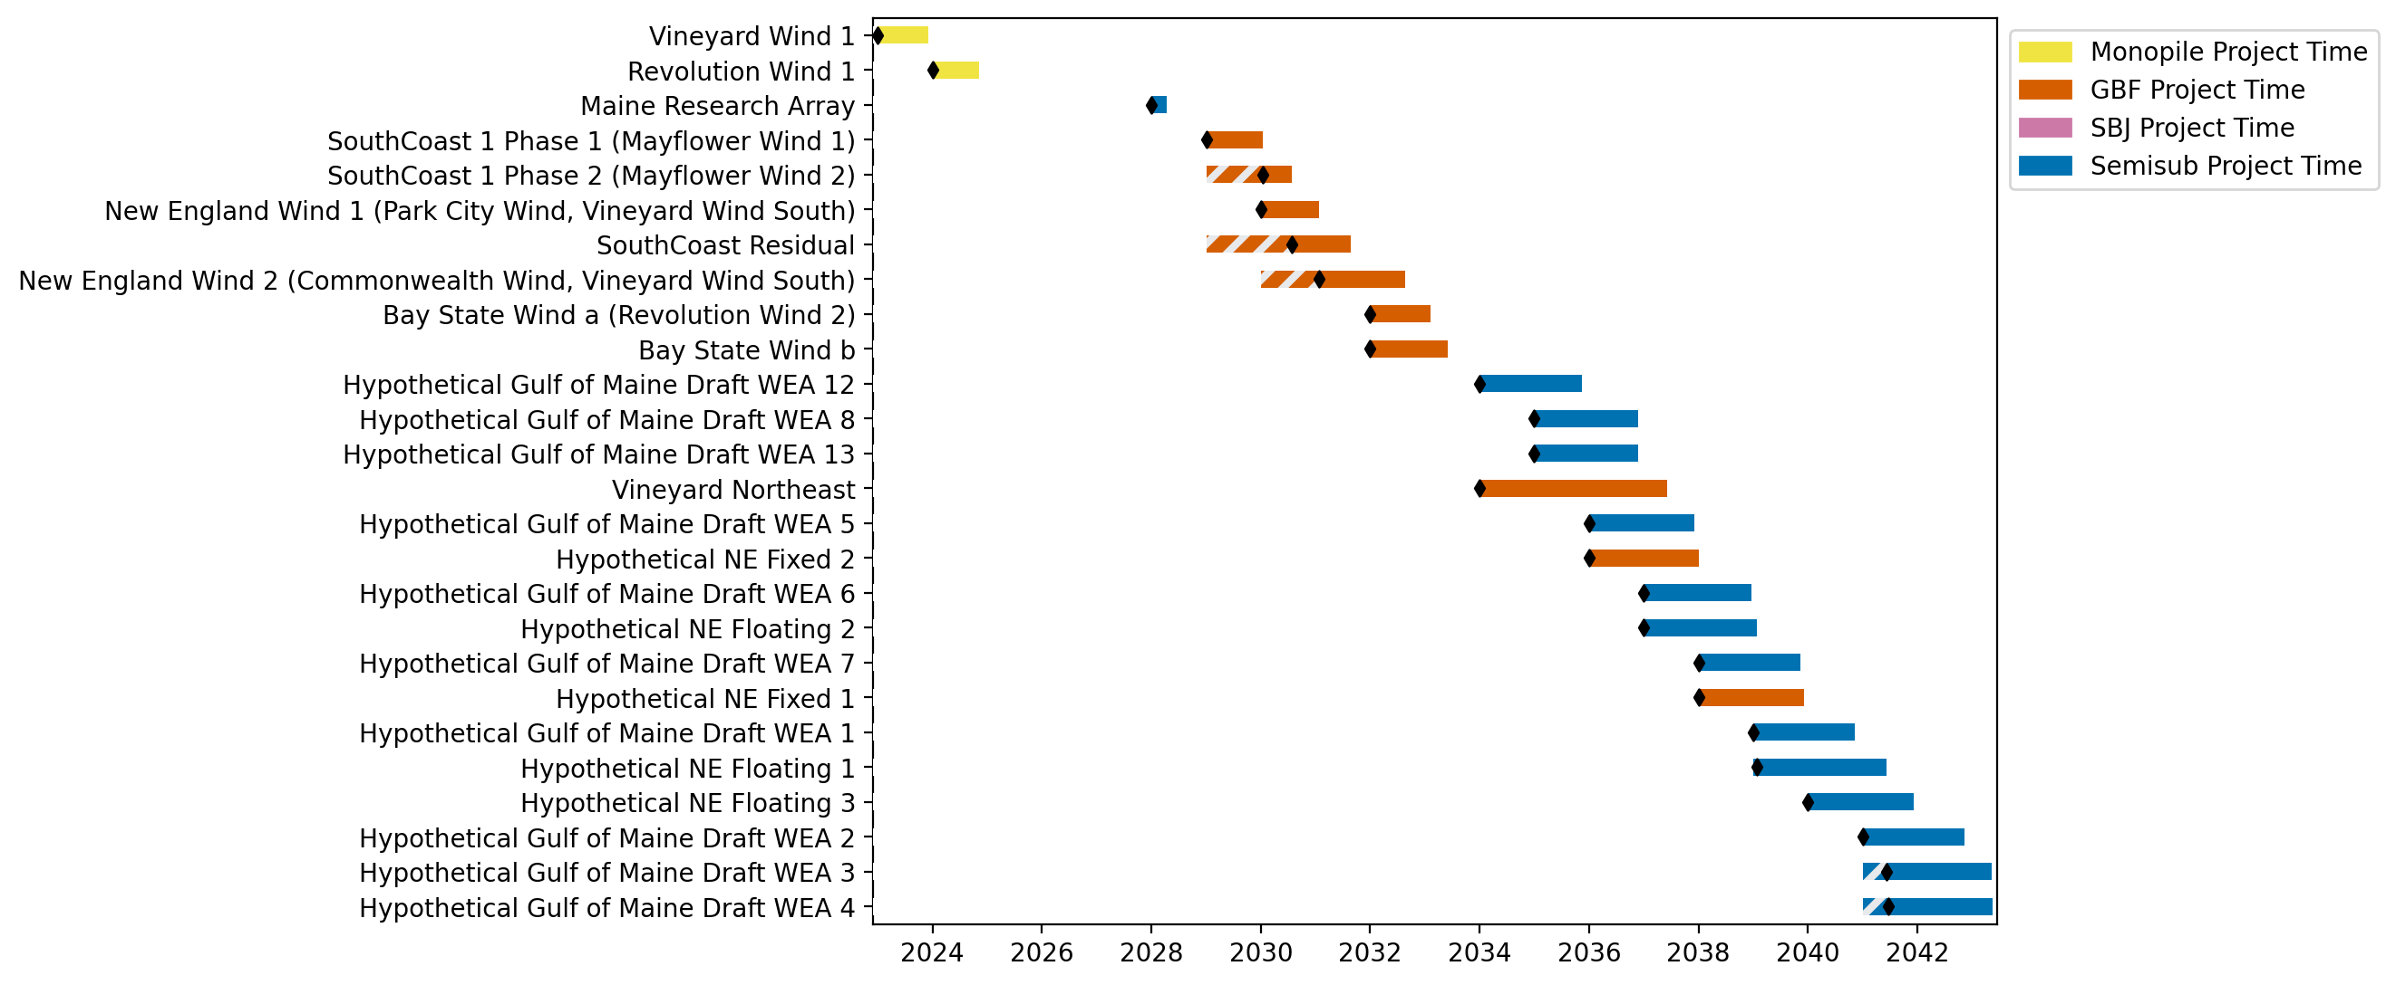
New England Gantt

Slide 3
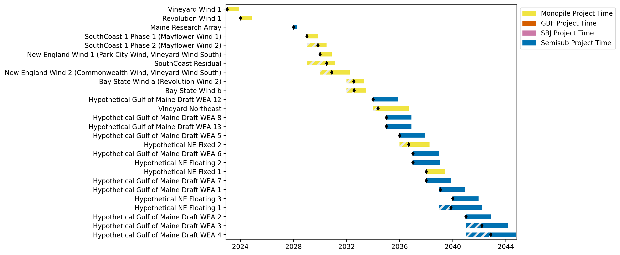
New England Gantt

Slide 4
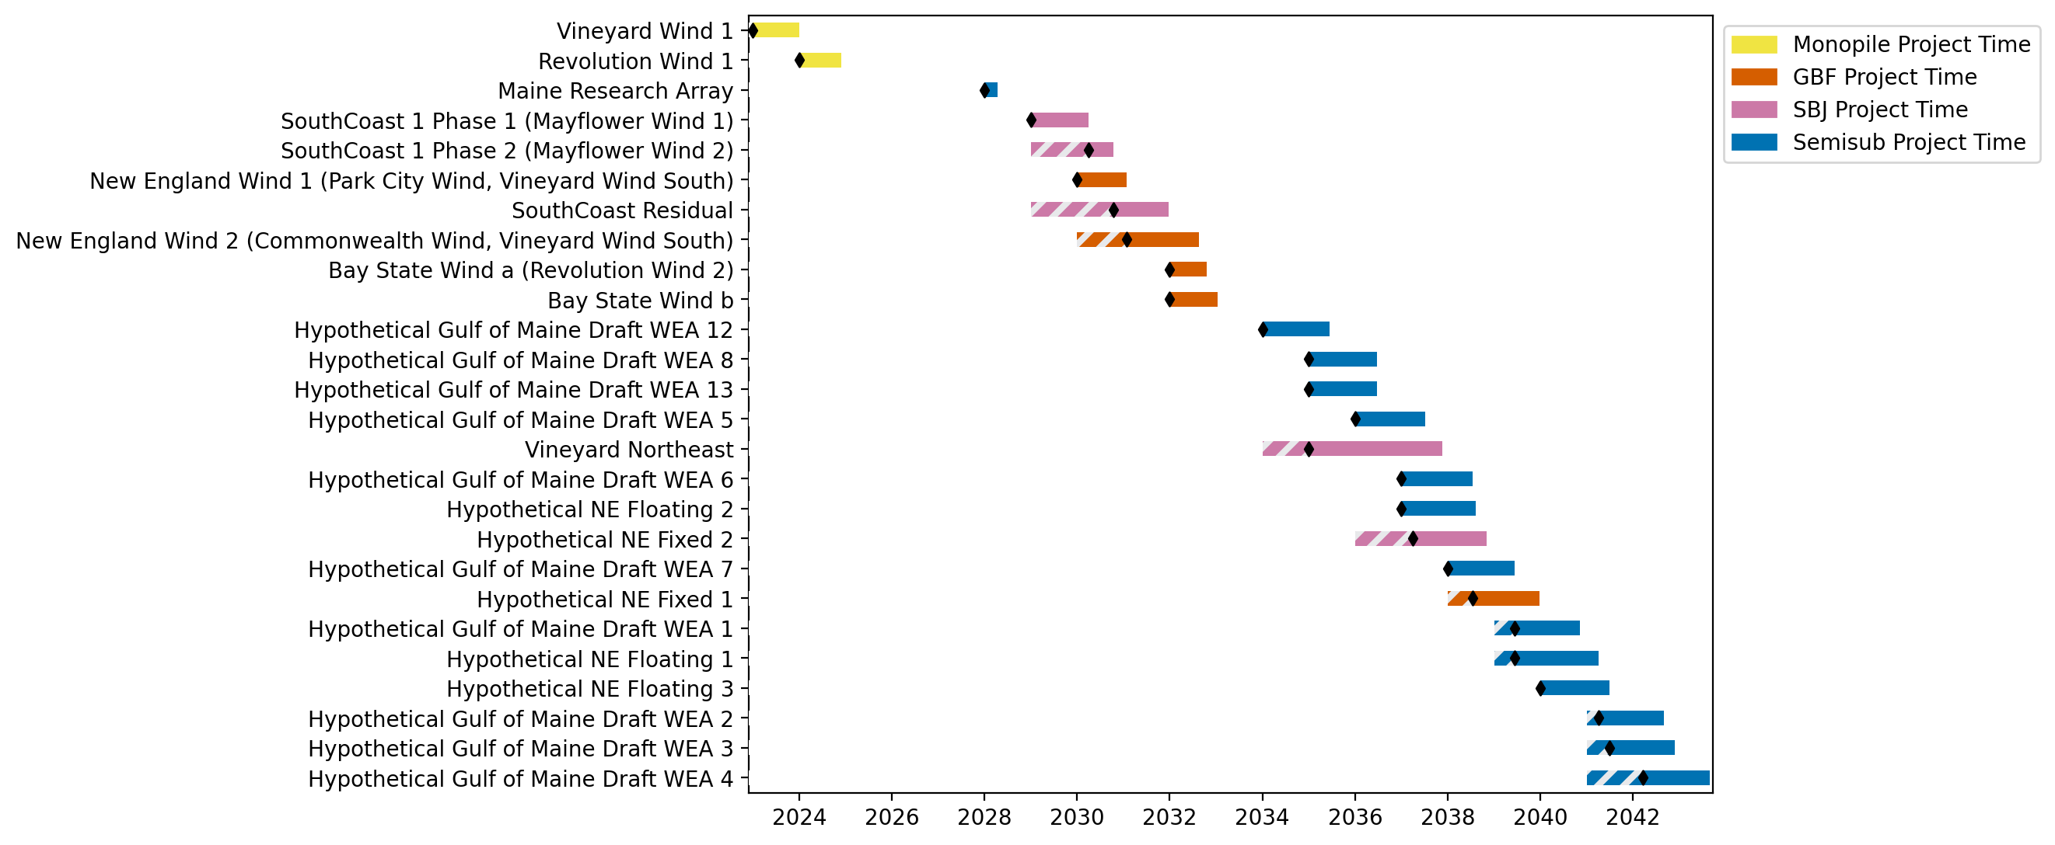
New England Gantt

Slide 5
New England Gantt

Slide 6
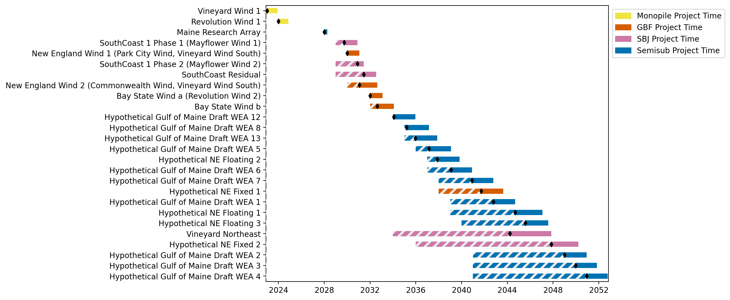
New England Gantt

Slide 7
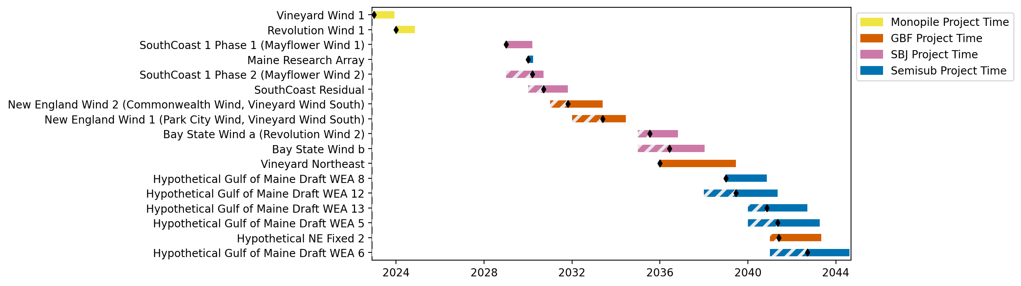
New England Gantt

Slide 8
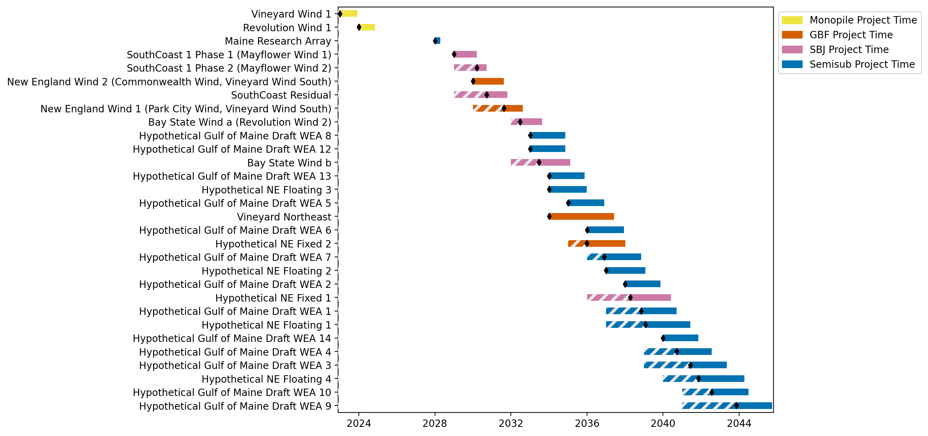
New England Gantt

Slide 9
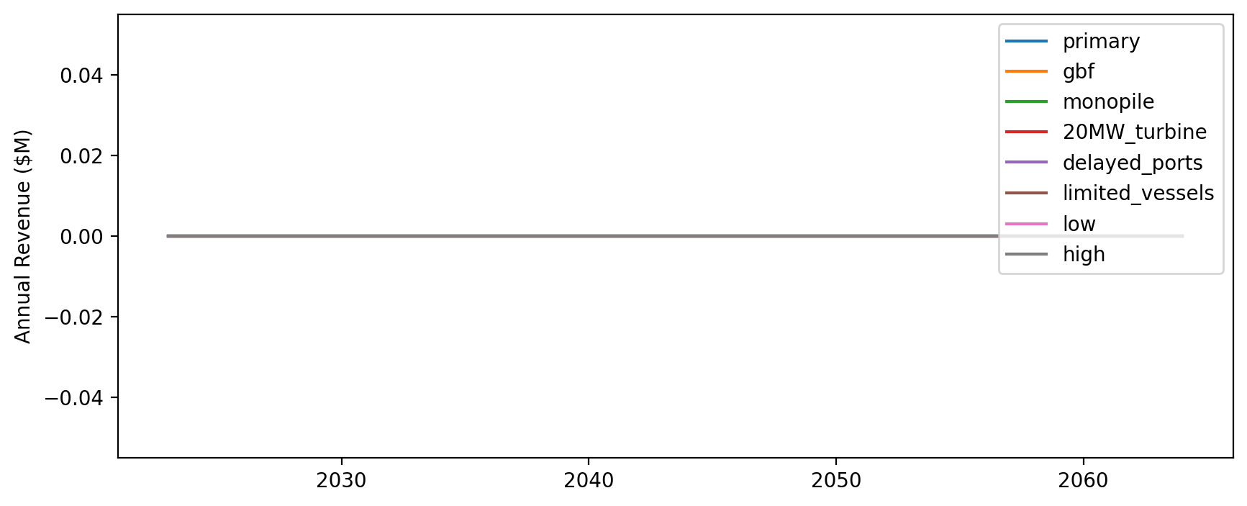
Vessel Revenue by Scenario

Slide 10
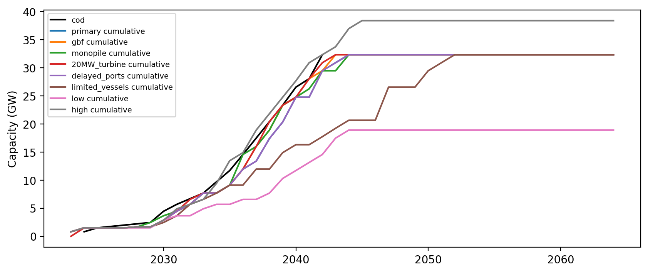
Installed Capacity

Slide 11
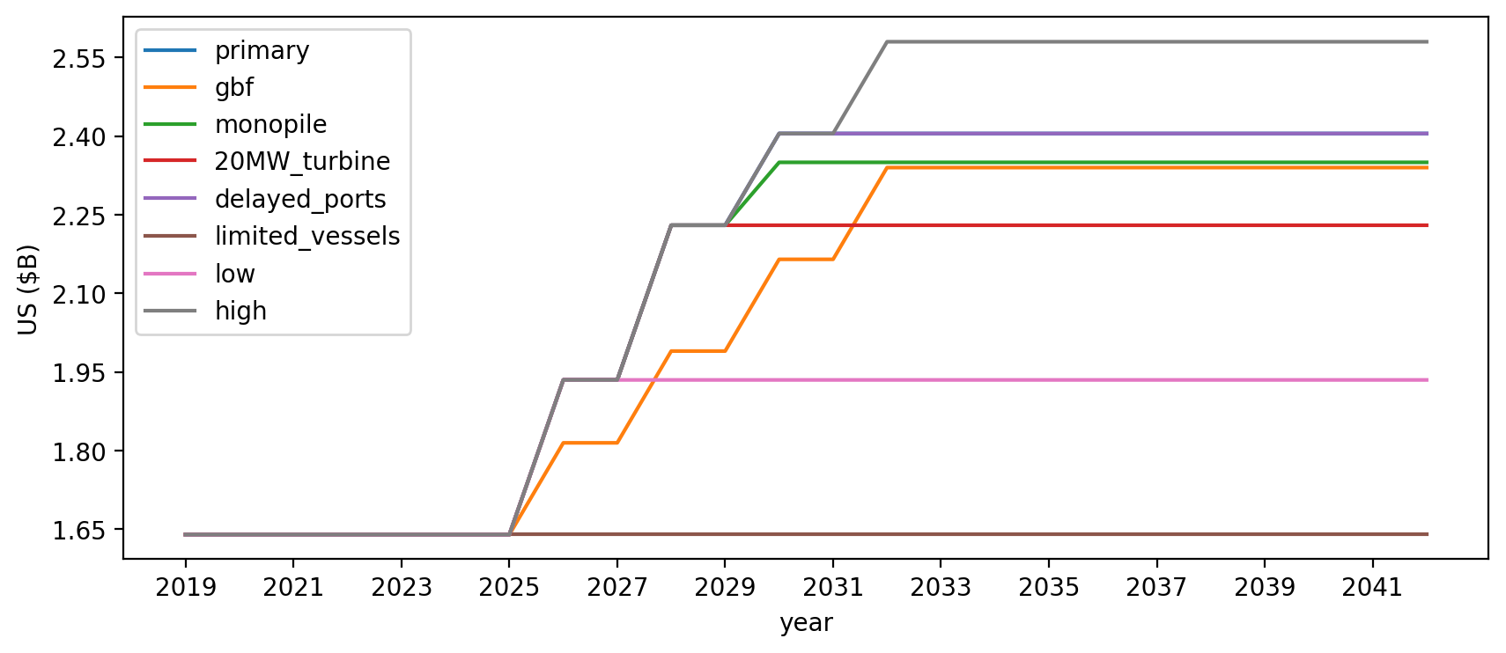
Vessel investment

Slide 12
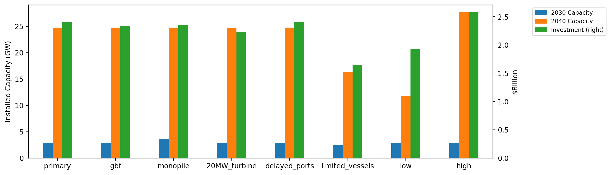
Summary Installed Cap/Investment

