Slide 1
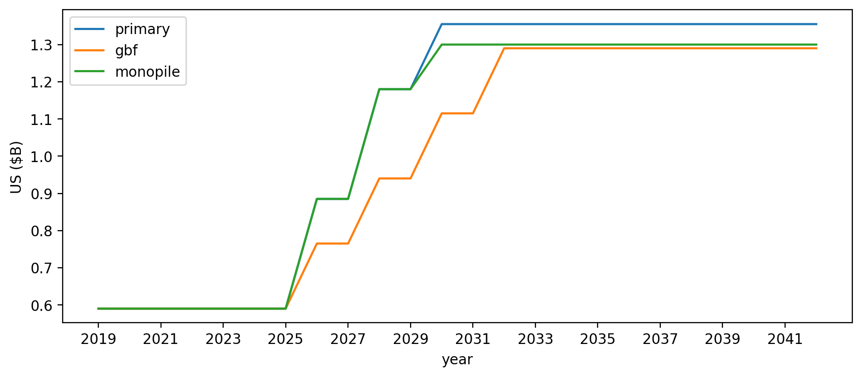
Vessel investment

Slide 2
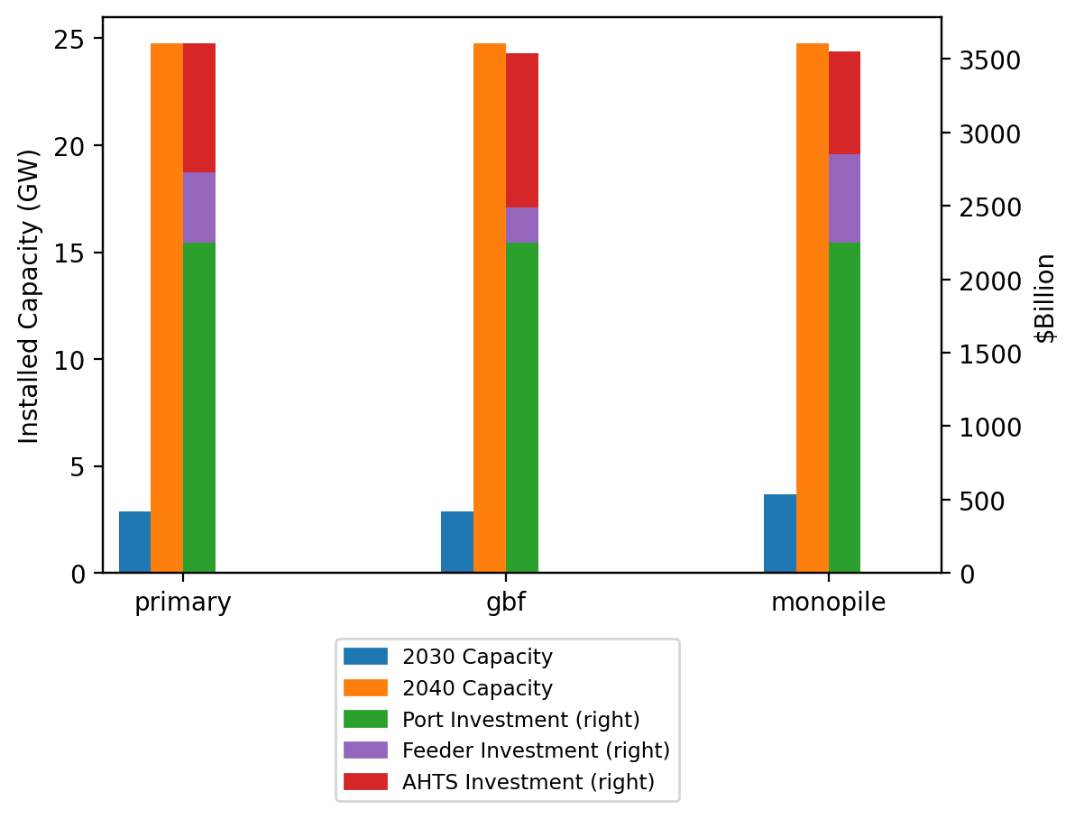
Summary Installed Cap/Investment

