Slide 1
turb
Turbine Upsizing Scenario
Add 2 WTIV

Slide 2
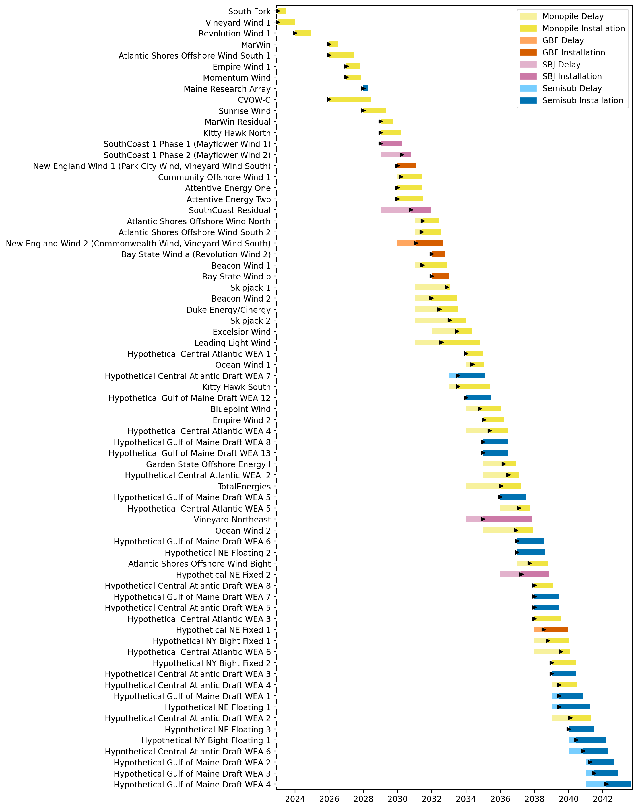
Full Gantt

Slide 3
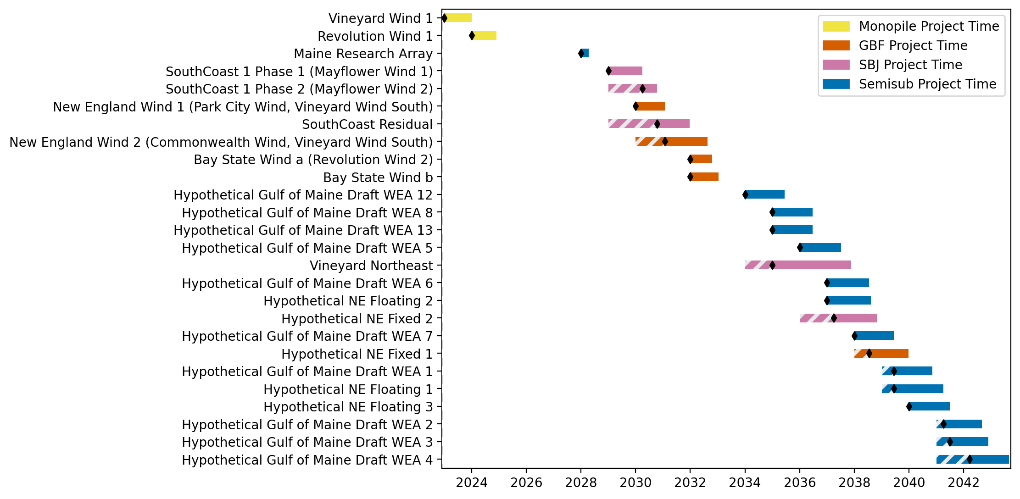
New England Gantt

Slide 4
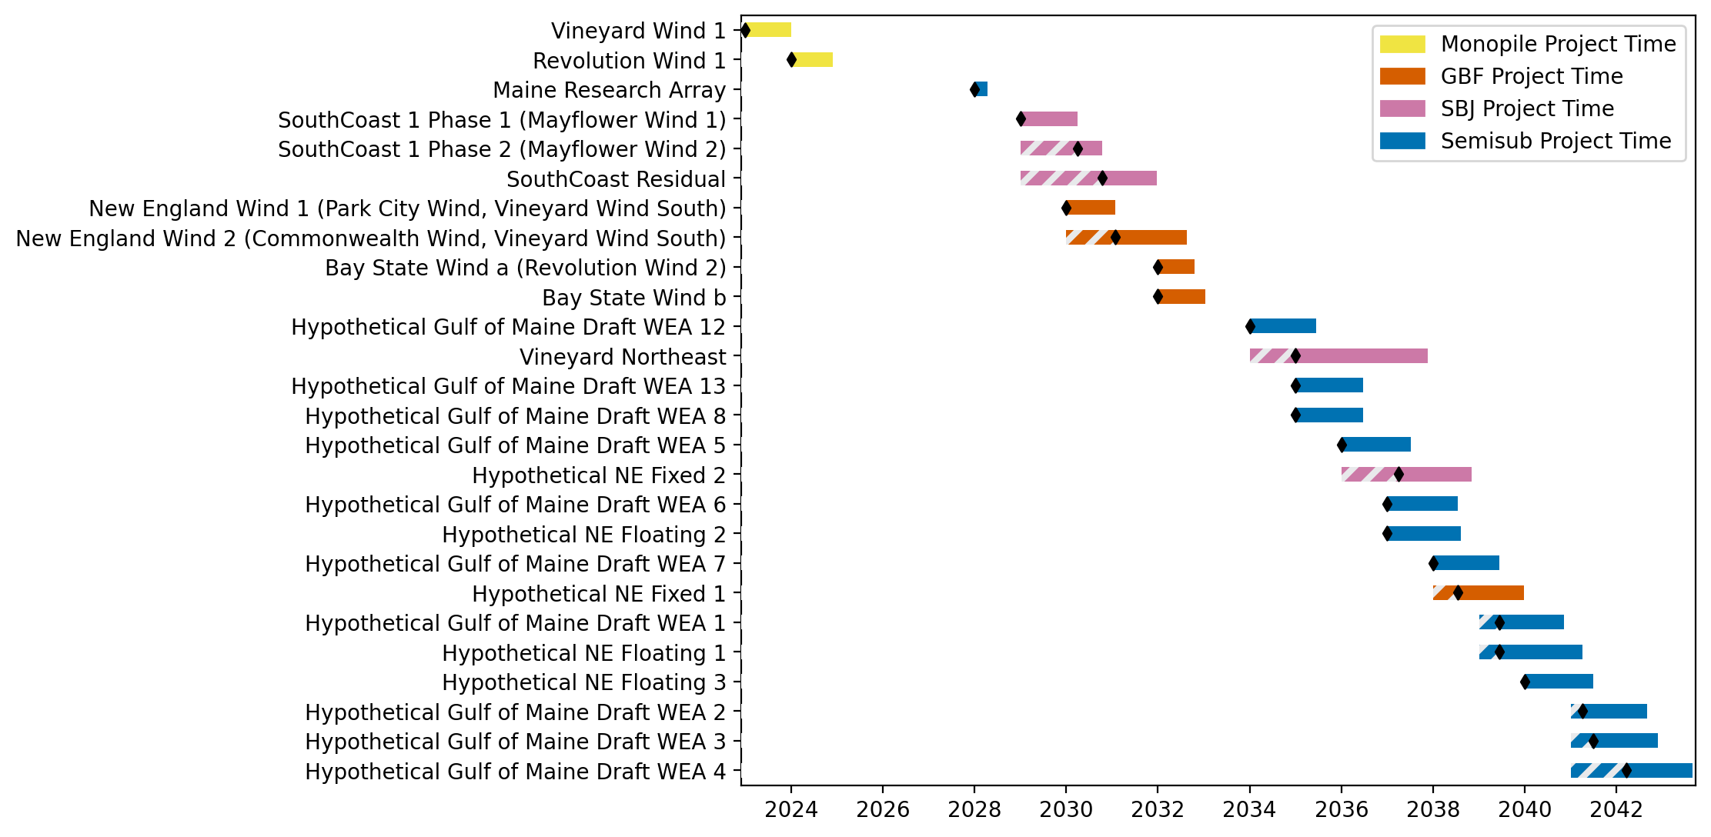
Sorted New England Gantt

Slide 5
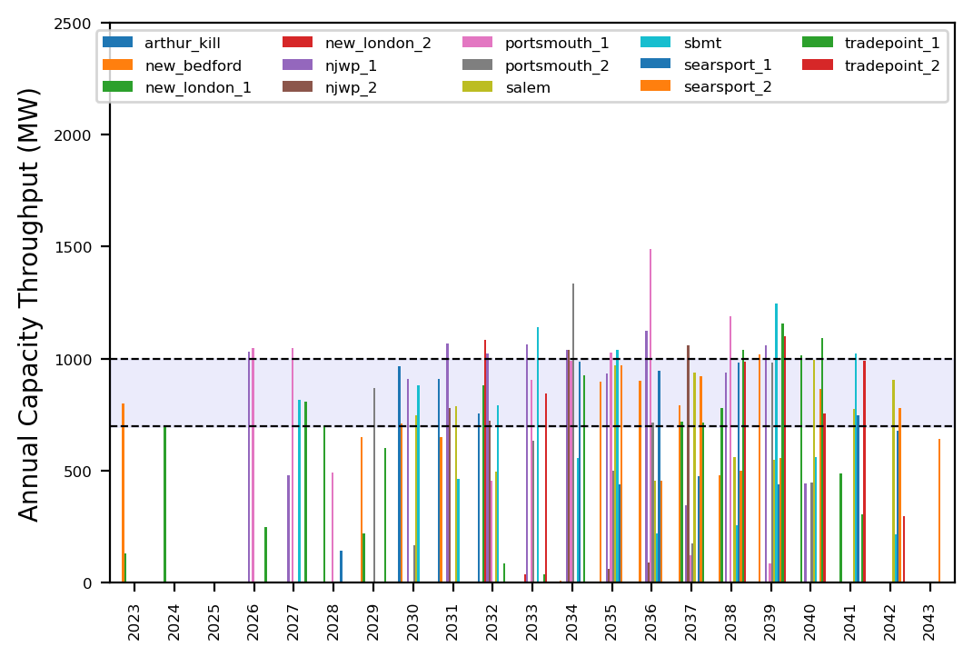
Port Throughput

Slide 6
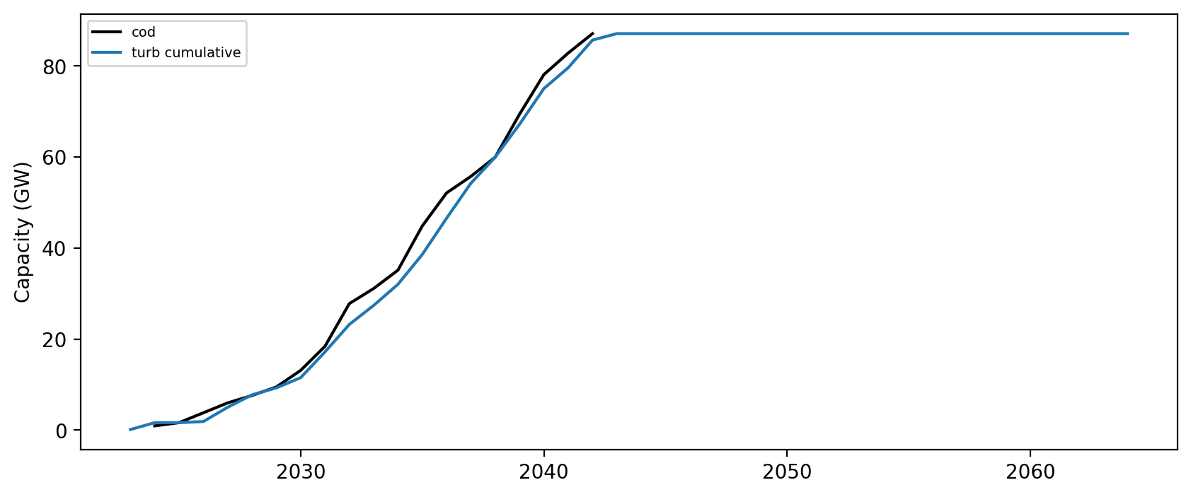
Installed Capacity

