Slide 1
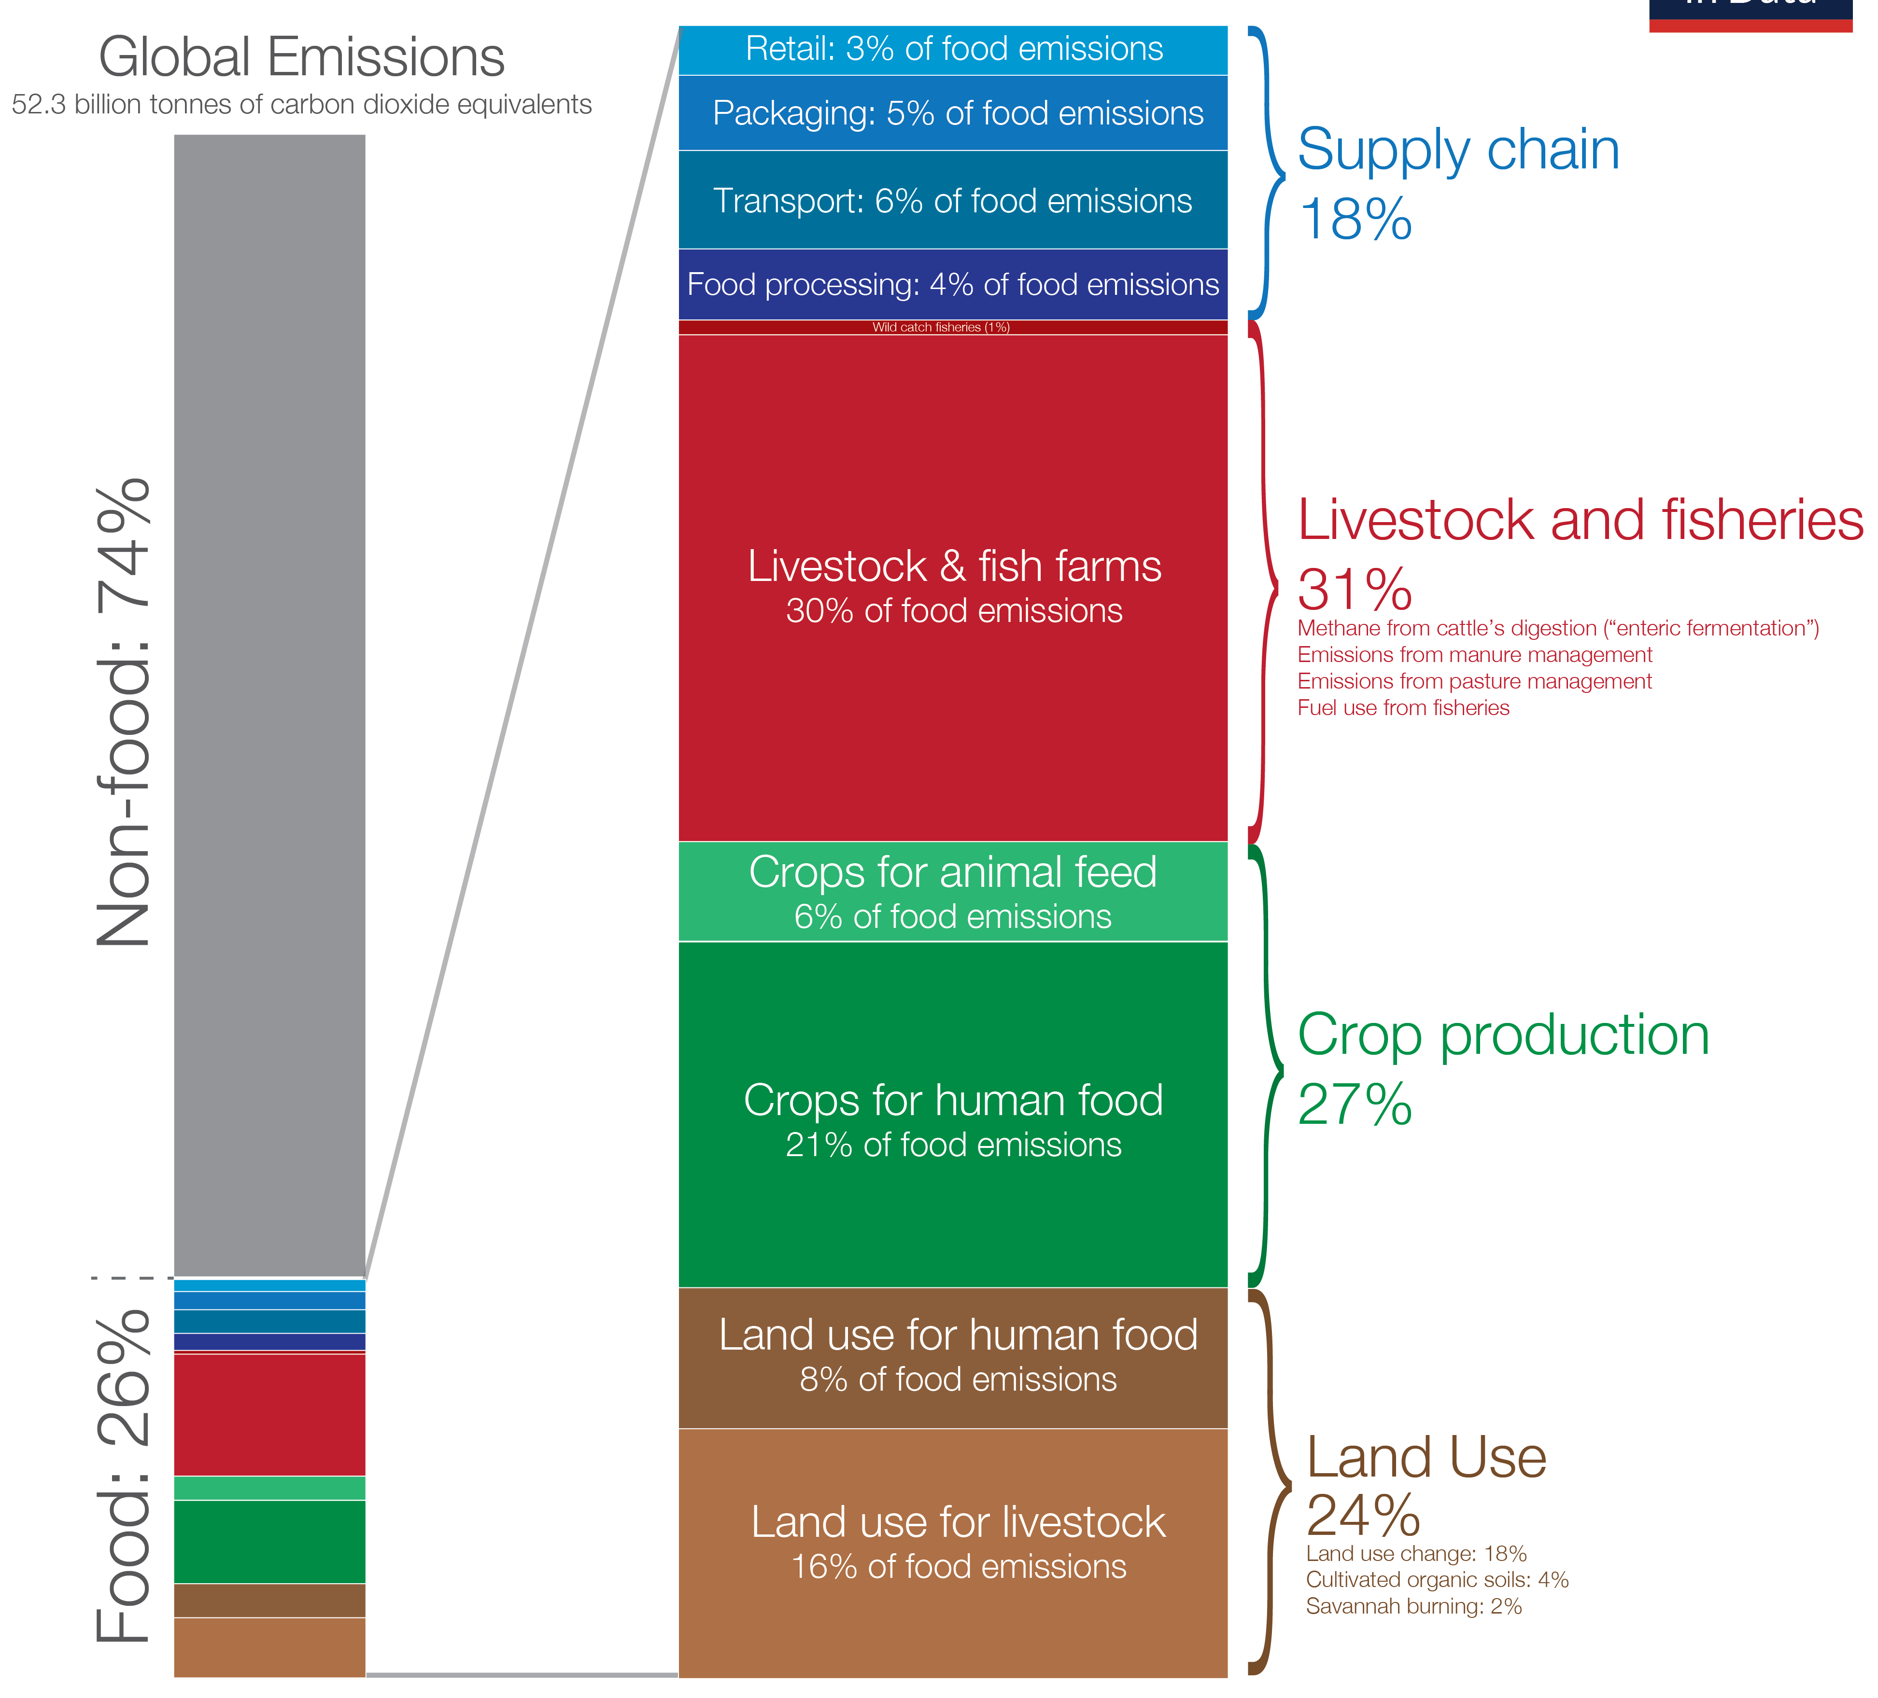
Global greenhouse gas emissions from food production

Slide 2
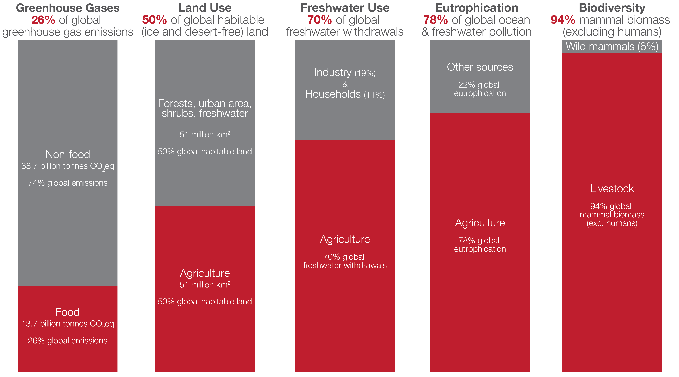
The environmental impact of food and agriculture

Slide 3
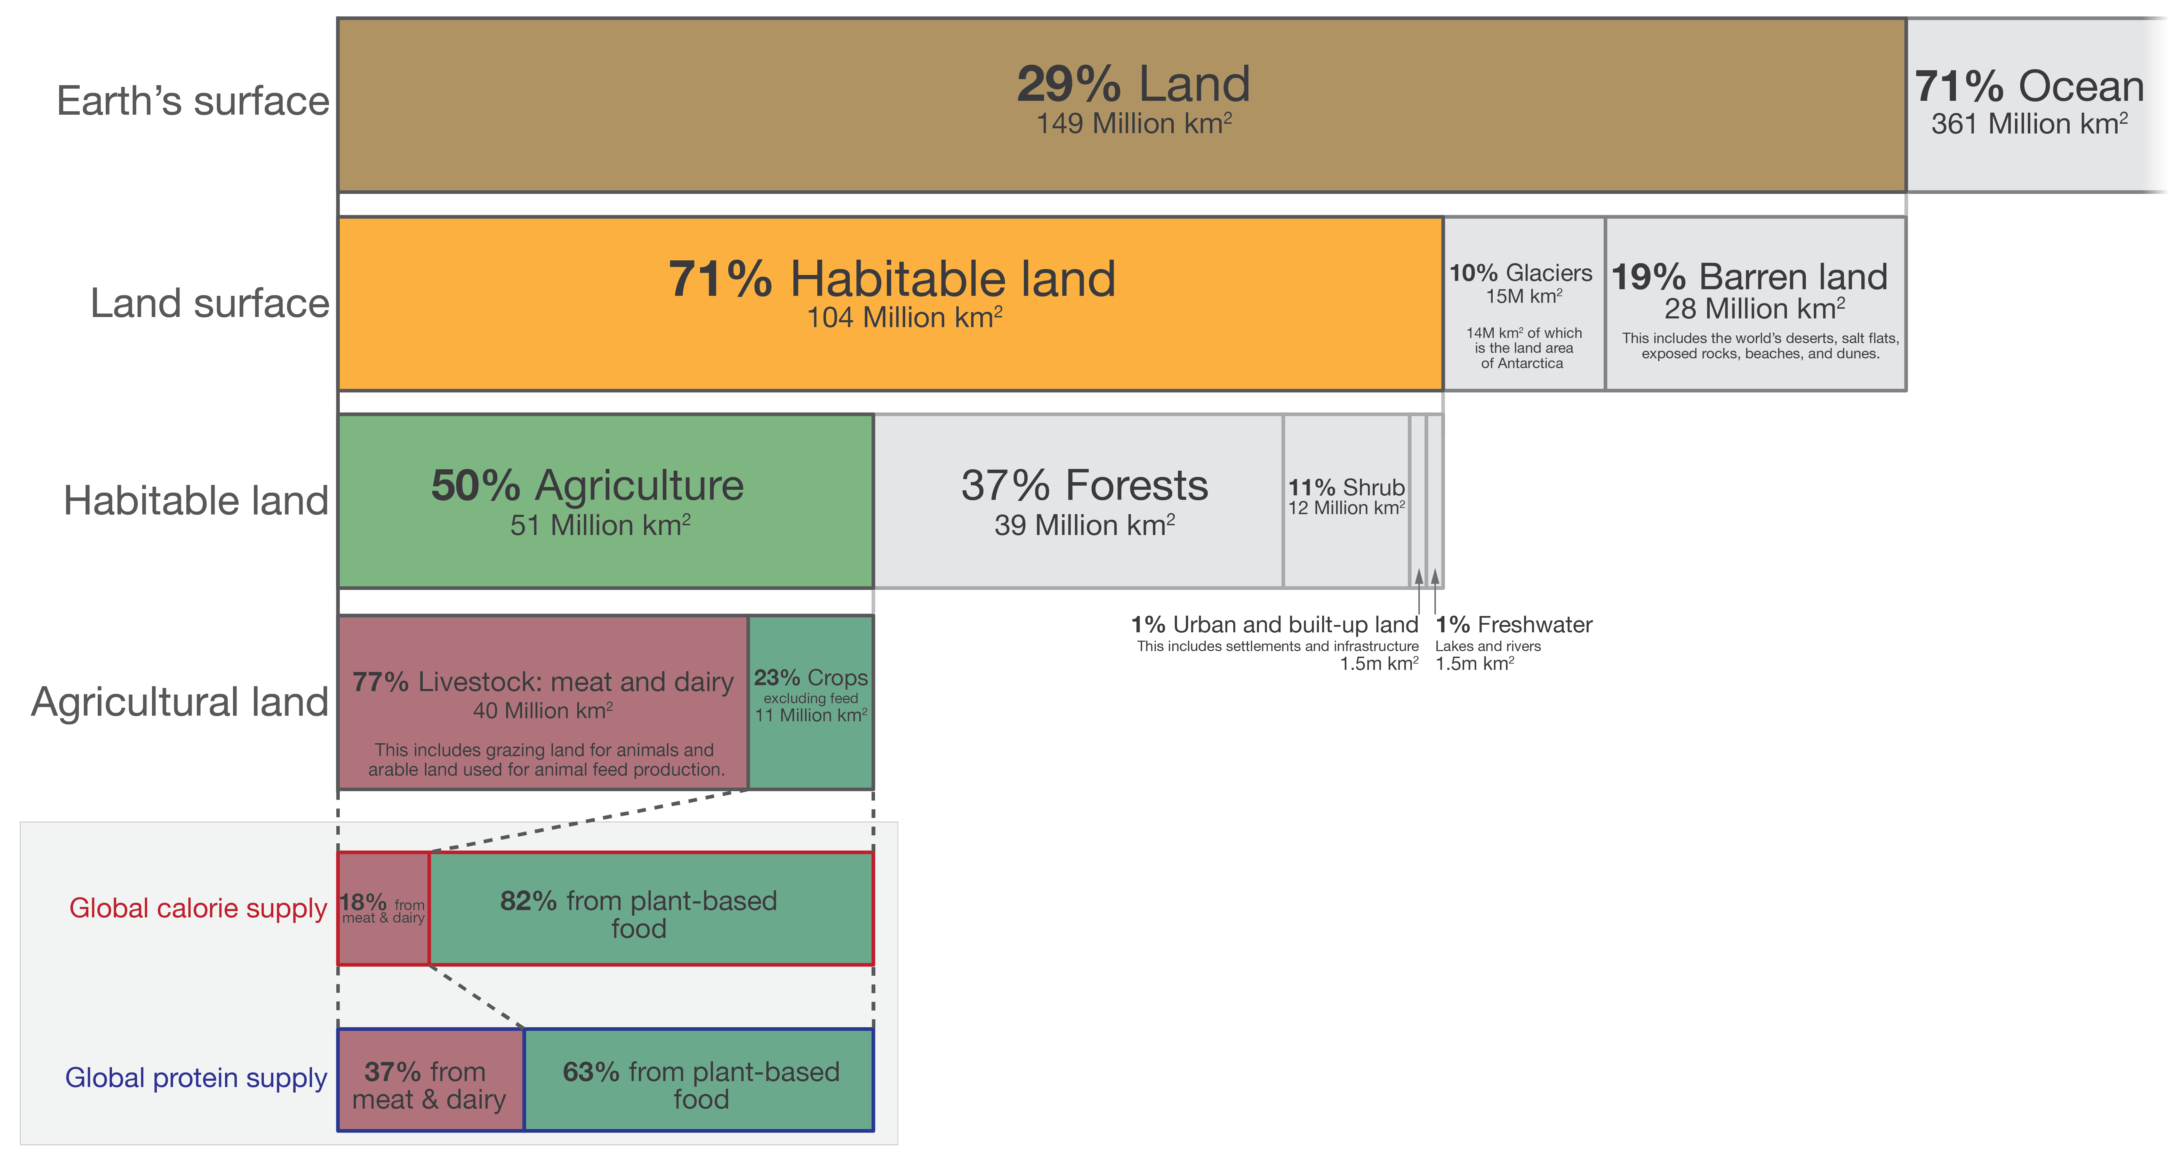
Global land use for food production

