Slide 1

The MMOTTG Site
„Massive Multiplayer Online Team Table-Top Game“

Slide 2


Content
Introduction
Project Review
Lessons Learned
The Result
www.multiplay.website
1
Notes:
Thats what we want to talk about today
Macht selina

Slide 3
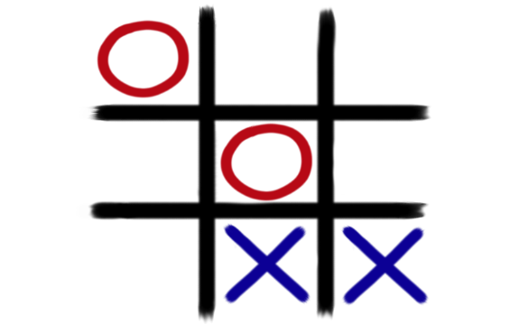
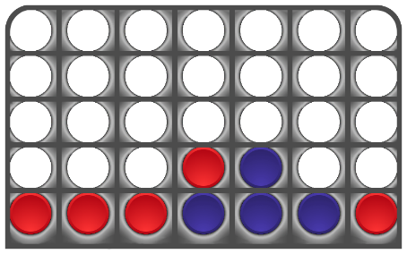
Introduction
Thiago Gumhold
Project Manager
Alexander Dietrich
Deputy PM
Selina Brinnich
Project member
Phillip Schermann
Project member
Website
Team based gaming experience
4 in a row
tic-tac-toe
Chat
www.multiplay.website
2
Notes:
Most of you know us already, but just to refresh the memory: Talk about us and our „jobs“ Talk about our Project and explain it as simple as possible
Mach selina

Slide 4
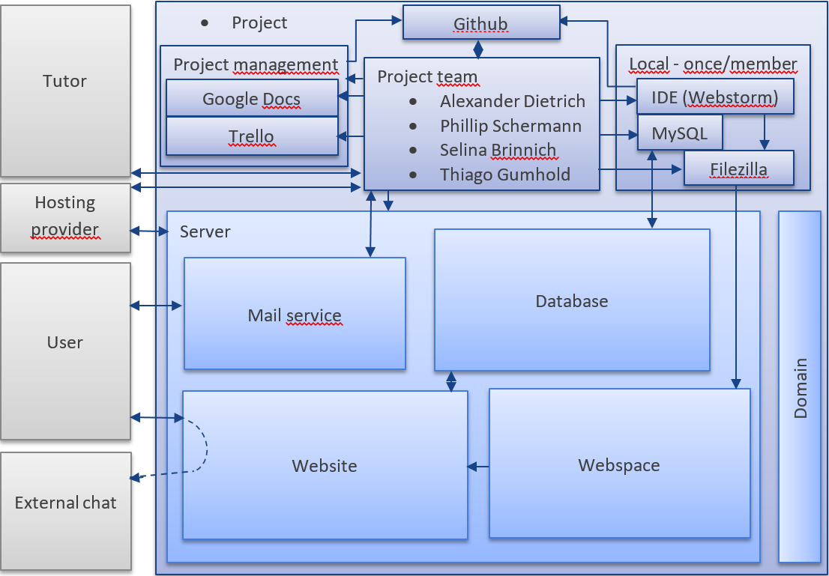
Project Review
SIMPLYFY !!!! And animate
www.multiplay.website
3
Notes:
Talk eventually about motivation for roject in the first place
Talk about our workflow, talk about our PM construct that should have made our lives easier (GitHub, arbeitszeitaufzeichnung, testing, and so on)
GitHub paired with PhpStorm was our primary development tool
Then talk about the general feeling of how we think it turned out
And how it really turned out: Statistics on everything…
Mach ich

Slide 5
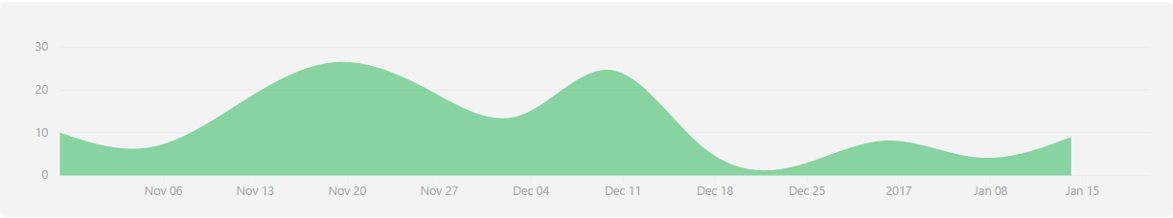
Project Review
Hier kommt das ganze PM zeugs schnell in Graphiken hin
Arbeitszeitaufteilung
Schätzung der PMs und vergleich mit tatsächlichem Wert
www.multiplay.website
3
Notes:
Talk eventually about motivation for roject in the first place
Talk about our workflow, talk about our PM construct that should have made our lives easier (GitHub, arbeitszeitaufzeichnung, testing, and so on)
GitHub paired with PhpStorm was our primary development tool
Then talk about the general feeling of how we think it turned out
And how it really turned out: Statistics on everything…
Mach ich

Slide 6




Lessons Learned
HTML
Cascading Style Sheets (CSS)
PHP
JavaScript
www.multiplay.website
4
Notes:
Macht der Alex

Slide 7
The result
…to our website
www.multiplay.website
5
Notes:
Macht phillp

