Slide 1

The MMOTTG Site
„Massive Multiplayer Online Team Table-Top Game“

Slide 2


Content
Introduction
Project Review
Lessons Learned
The Result
www.multiplay.website
1
Notes:
Thats what we want to talk about today
Macht selina

Slide 3
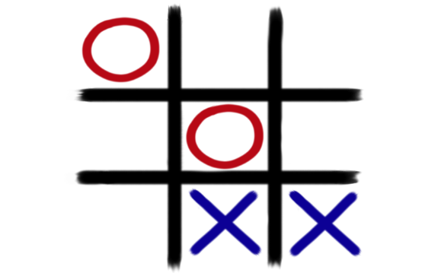
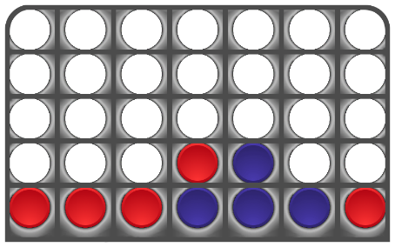
Introduction
Thiago Gumhold
Project Manager
Alexander Dietrich
Deputy PM
Selina Brinnich
Project member
Phillip Schermann
Project member
Website
Team based gaming experience
4 in a row
tic-tac-toe
Chat
www.multiplay.website
2
Notes:
Most of you know us already, but just to refresh the memory: Talk about us and our „jobs“ Talk about our Project and explain it as simple as possible
Mach selina

Slide 4
Project Review
Team
Tutor
User
Project management
GitHub - synchronization
Server
Database
Website
Domain
Development
www.multiplay.website
3
Notes:
Our project was built apon 3 main pillars.
The team that manages the project and develops the website.
GitHubs File synchronisation service, which allows for much easier planning of work packages since overlapping code-changes are managed and merged by it.
And our project environment with the server that was partly managed by us, a database, website, and domain.
A typical implementation of a feature would include the development, and synchronisation via github. Then an upload to the server and afterwards testing the feature as users by the project team
But how did the project turn out in the end, management wise?

Slide 5
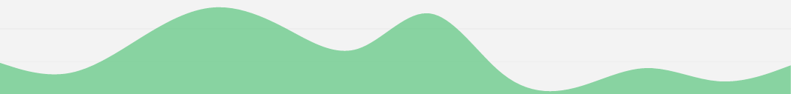
Project Review
Start
End
X-MAS
Planning
Front-end
Back-end
Testing
www.multiplay.website
3
Notes:
We started with the Project planning Phase back in late October and we were able to reach our goals like showing a first overview of our site at the first presentation and finishing the most work before christmas.
After christmas we mainly tested our site, and implemented the last features.
During all this time we managed to work 181 hours which where quite evenly distributed among our teammembers
181 man-hours is a lot less than estimated. We had to drop a teamchat feature since we wouldnt have met our timeline trying to write our own Chat-service.
As shown in the diagram we also didn‘t anticipate the amount of work for the back end features of our site well. That was due to our lack in experience with some used technologies. But in the end it all turned out easier as expected.

Slide 6




Lessons Learned
HTML
Cascading Style Sheets (CSS)
PHP
JavaScript
www.multiplay.website
4
Notes:
Macht der Alex

Slide 7
The result
…to our website
www.multiplay.website
5
Notes:
Macht phillp

