Slide 1
Fundamental Patterns
Repository Pattern
Unit of Work (UoW)
Service

Slide 2
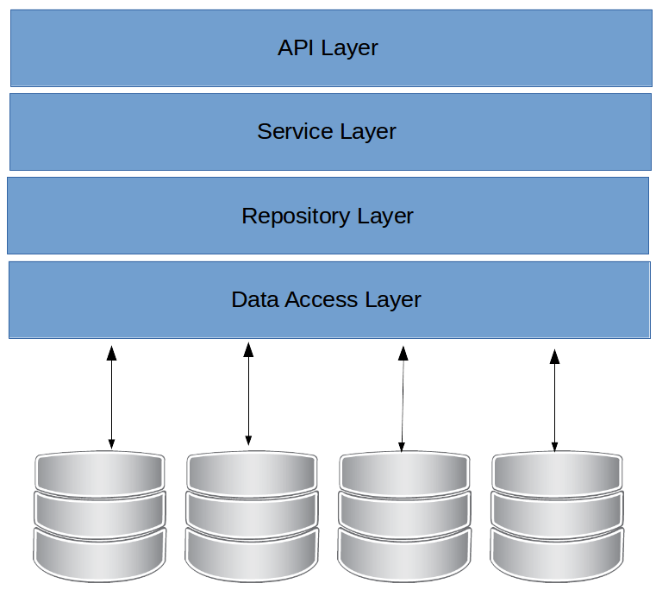

Slide 3
Repository Pattern
Martin Fowler

Slide 4
What is Repository Pattern?
“The repository Pattern mediates between the domain and data mapping layers using a collection-like interface for accessing domain objects. It is like a object collection in memory”

Slide 5
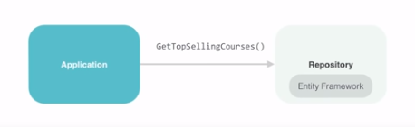
Repository Pattern Goals
Minimizes the query logic in your application avoiding queries spread by the code;
Minimize duplicate query logic
Decouples Business access code from data access. Then it could separate your application from persistence frameworks like EF Core
Facilitates unit testing in your application

Slide 6
Methods used in the Repository Pattern
The repository pattern handles objects in memory, like this:
Remove (entity)
Get (id)
IEnumerable GetAll (entity)
Find (predicate)
The repository pattern is NOT related to database persistence! So it is not part of the Repository Patter:
Add (entity)
Save (entity)
Update (entity)

Slide 7
Return IEnumerable instead of IQueryable
In the repository standard, IQueryable should NOT be returned, but IEnumerable! Example:
IEnumerable queries on the client side, while IQueryable on the bank side. This prevents queries from spreading to other layers, so it does not allow you to extend or perform redundancies, giving the repository exclusivity to perform this function.

Slide 8
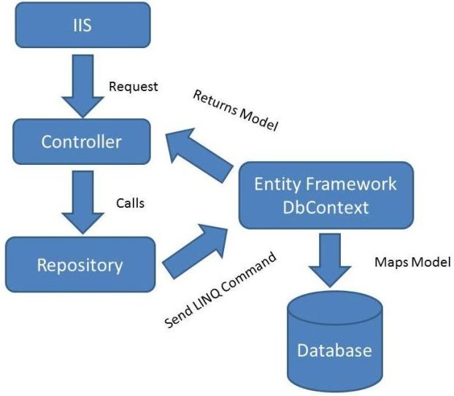

Slide 9
Clean code for Repository Pattern
Use generics
Don't use one repository per domain
Focus your repository to manage a specific entity collection
Share the context
Don’t return view models from ur repository
Avoid Save/Update method in repositories (idk)
Don’t return IQueryable

Slide 10
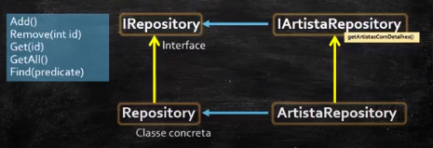
Implementation of the Repository Pattern
Generic implementation - Specific implementation

Slide 11
Unit Of Work Pattern

Slide 12
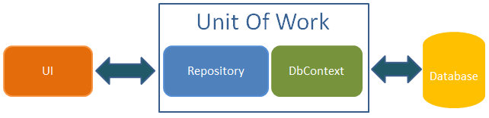
How about the entities persistence?
The Repository pattern deals with objects in memory. While the management of the states of the objects and the realization of their persistence is performed using the Unit Of Work Pattern.
"It keeps a list of objects affected by a transaction and coordinates the writing of changes and addresses possible competition issues".

Slide 13
UoW examples
TTransaction from NHibernate
DataContext from LINQ to SQL
ObjectContent from Entity Framework

Slide 14
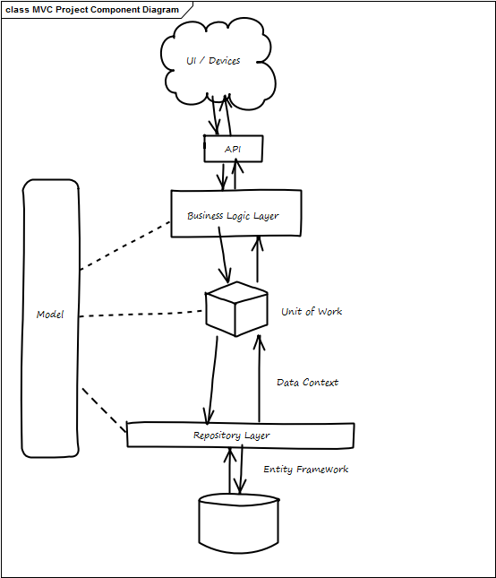

Slide 15
Example
Situation 1: When working with multiple repositories, but with dependent transactions, for example, if it is necessary to include the customer and then the order if the first is successful, then these are actions that have to be in the same transaction, for that it is necessary to generate a dependency by passing the same context in the repository builder.

Slide 16
Unit of Work Pattern Goals
- Keeps track of manipulated objects in order to synchronize data -> data store;
- Provides a single transaction for multiples queries
- The UoW commits the transaction
- Single commit call on database (single transaction)
- All object tracking information is centralized

Slide 17
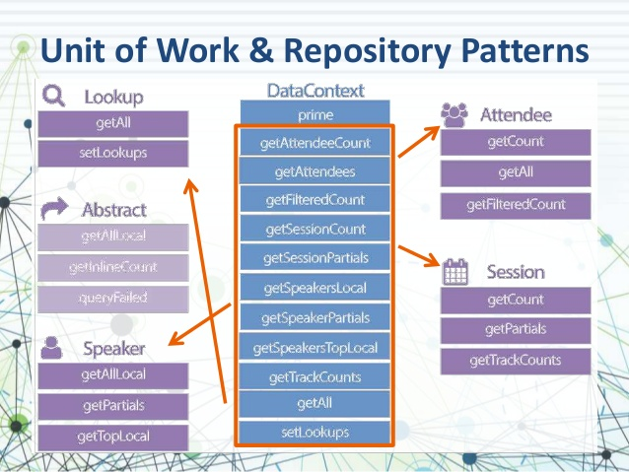

Slide 18
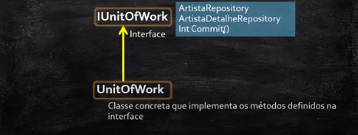
Implementation of the Unit Of Work Pattern
Generic implementation - Specific implementation

Slide 19
Entity Framework

Slide 20
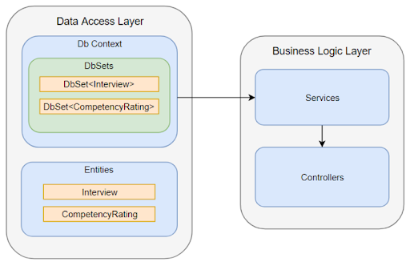
Entity Framework
Usually frameworks, like the entity framework in dotnet, already implement both the Unit Of Work Pattern and the Repository Pattern.
DbSet - Represents a collection of objects in memory (add, remove, etc.)
DbContext - Acts as a UnitOfWork, it has DbSets and SaveChanges ()

Slide 21
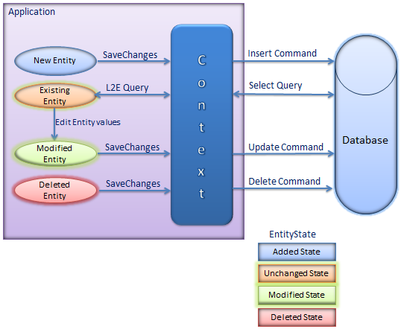

Slide 22
Since EF core already provide to us the Repository Pattern and UoW, why should we make our own?
The problem with DbSet is that it returns IQueryable which makes it easier to duplicate queries by your code.
So, we understand using the standard to decouple the framework.

Slide 23
“Architecture must be independent of frameworks” - Clean Architecture
Entity Framework does not bring all the benefits of this architecture. We have to use them as tools to help include your system in limited restrictions.

Slide 24
Service Pattern

Slide 25
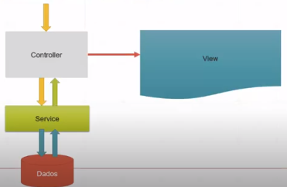
Service Layer Pattern
Introduces the separation of the service code from the application presentation layer. In this way the controller is gonna be simpler and easier to test, and if you need to make adjustments to the presentation or service, it is easier.

Slide 26
Service Layer Goals
- Centralizing duplicated business logic
- Allows you to organize the code by separating responsibilities
- Code that needs to be re-used by multiple clients
- Third party libraries that we have limited licenses for
- Third parties that need an integration point into our system
- Allows you to reuse the code avoiding errors and thus increase productivity
- Allows you to test the application more easily

Slide 27
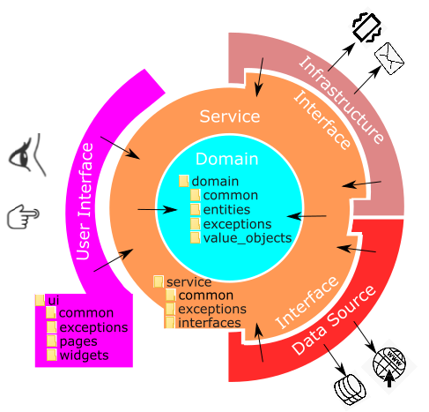

Slide 28
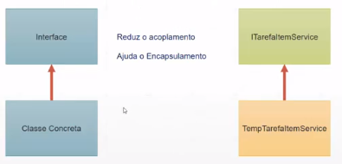
Implementation of the Service Layer pattern
Interface-oriented programming:

Slide 29
Clean code for Service Layer
The operation relates to a domain concept that is not a natural part of an ENTITY or VALUE OBJECT
The interface is defined in terms of other elements of the domain model
The operation is stateless (any client can use any instance of a particular SERVICE without regard to the instance’s individual history)

Slide 30
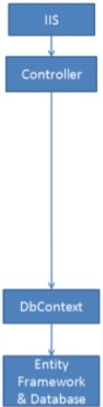
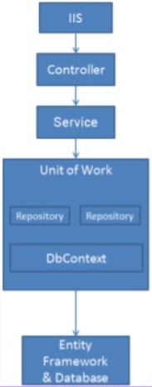
Overview: Before and After

Slide 31
In summary
Business objects should interface with a business oriented storage service
Data objects should interface with a data oriented service
The repository should be the bridging mediator
BUT the real use case for the repository pattern is in dealing with multiple persistence services

Slide 32

Be aware: Use the patterns only when you need to!

Slide 33
TEST TIME!
We have a real project with Entity Framework, our test is to switch EF core to PetaPoco and then Dapper.

