Slide 1
Prohibitory sign

Slide 2
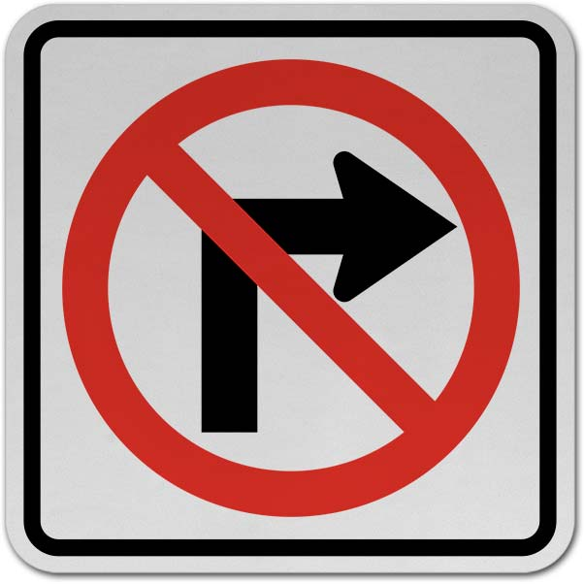
No right turn

Slide 3
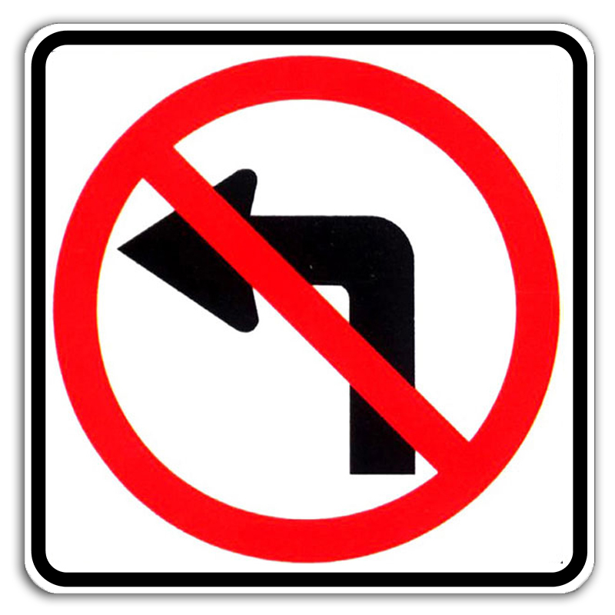
No left turn

Slide 4

No u- turn

Slide 5

No entry

Slide 6

No stopping

Slide 7
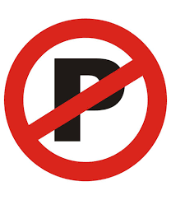
No parking

Slide 8
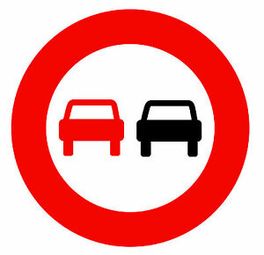
No overtaking

Slide 9

No overtaking by goods vehicle

Slide 10

No entry for all vehicles

Slide 11

No entry for goods vehicles

Slide 12
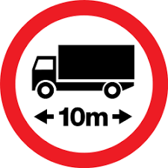
No entry for goods vehicle longer than 10m

Slide 13

No entry for agricultural vehicles

Slide 14

No entry for trailers

Slide 15

No entry for buses

Slide 16
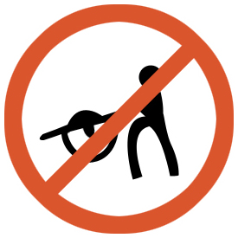
No entry for handcart

Slide 17
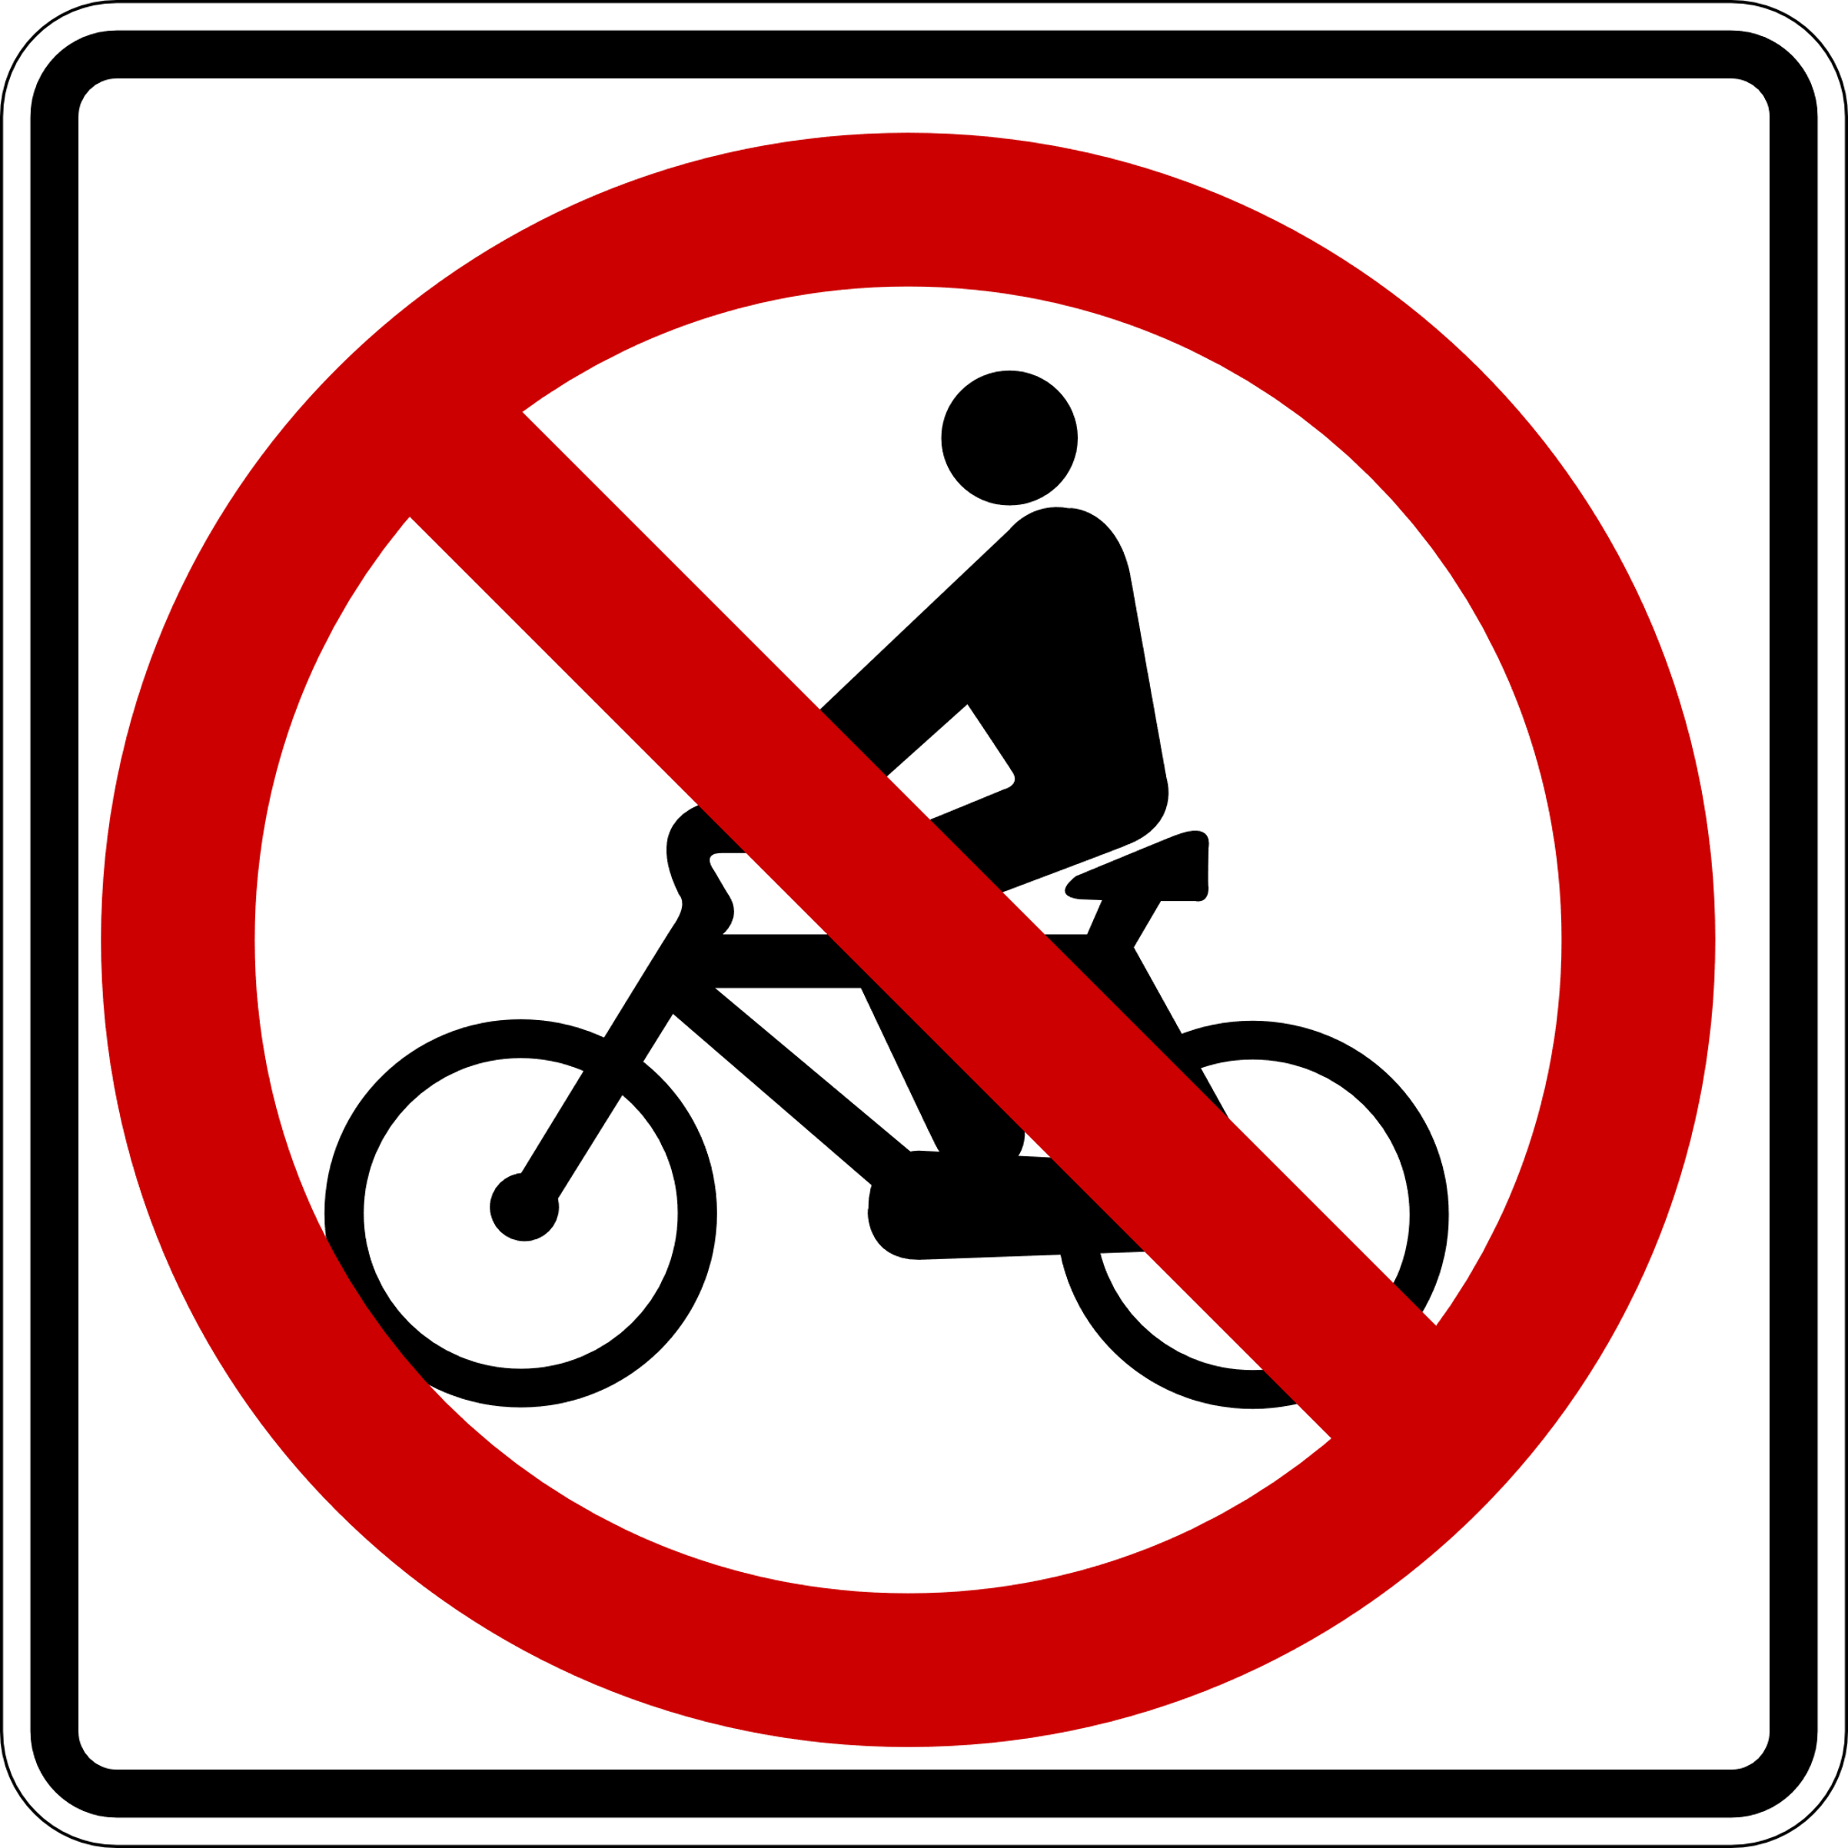
No entry for cyclist

Slide 18

No entry for motorcycles

Slide 19
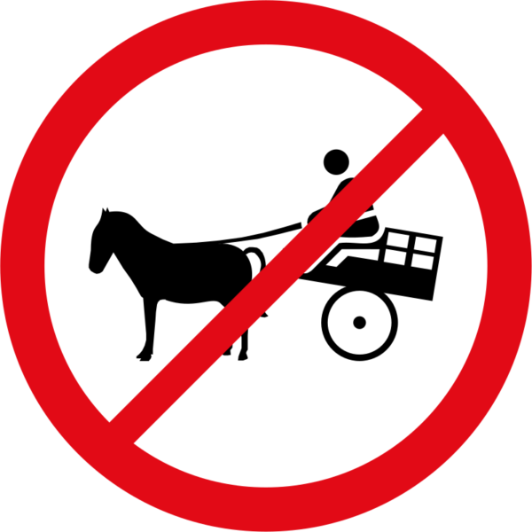
No entry for animal drawn vehicles

Slide 20
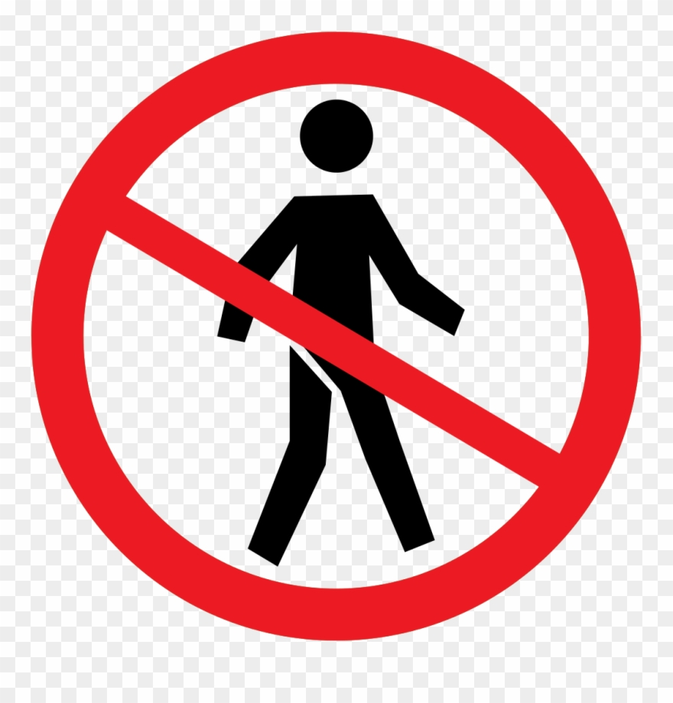
No entry for pedestrians

Slide 21
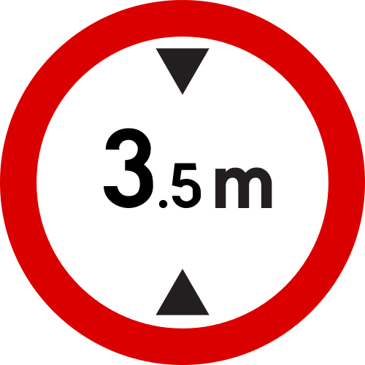
No entry for vehicles higher than 3.5m

Slide 22
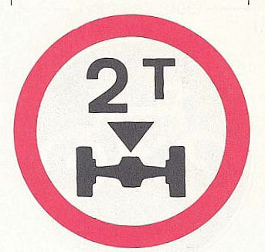
No entry for vehicles of more than 2 ton

Slide 23
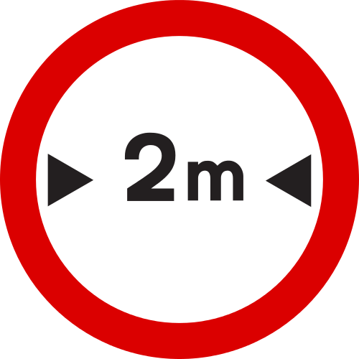
No entry for vehicles wider than 2m

Slide 24
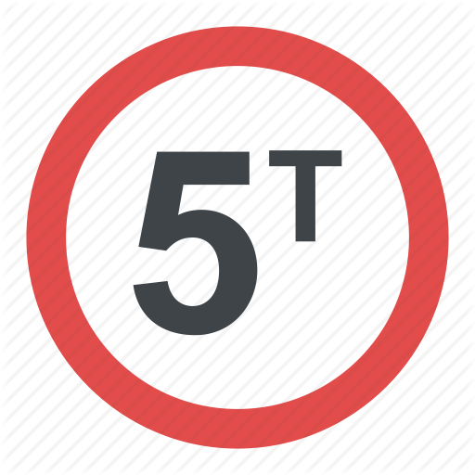
No entry for vehicles of more than 5 ton

Slide 25

No sounding horn

Slide 26

Stop police

