Slide 1
Regulatory sign

Slide 2

Stop

Slide 3

Give way

Slide 4

Priority road

Slide 5

End of priority road

Slide 6

Keep right

Slide 7
Keep left

Slide 8

Turn right at the junction

Slide 9
Turn left at the junction

Slide 10

Go straight or turn right

Slide 11
Go straight or turn right

Slide 12

Turn left

Slide 13
Turn right

Slide 14
Go straight only

Slide 15

One way

Slide 16

Pass either side

Slide 17

Compulsory roundabout

Slide 18

Motorway

Slide 19
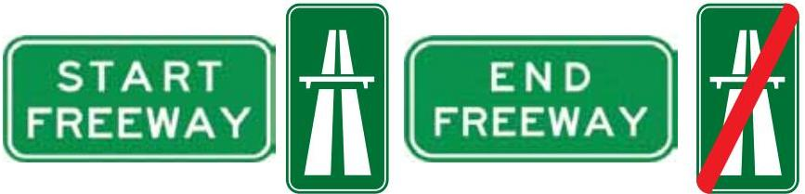
End of motorway

Slide 20

Priority to Vehicles Coming from the Opposite Side

Slide 21
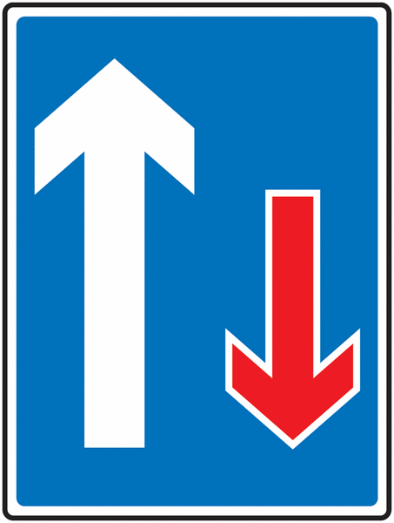
Priority over oncoming vehicles

Slide 22

End of prohibition

Slide 23

Road Ramp

Slide 24
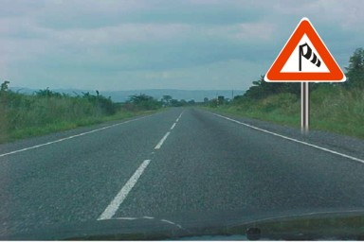
Side wind

Slide 25
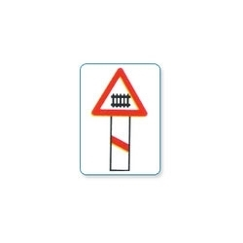
Level crossing 30m ahead

Slide 26
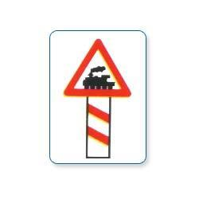
Level crossing 60m ahead

Slide 27

Level crossing 90m ahead

