Slide 1
Waiting and parking

Slide 2
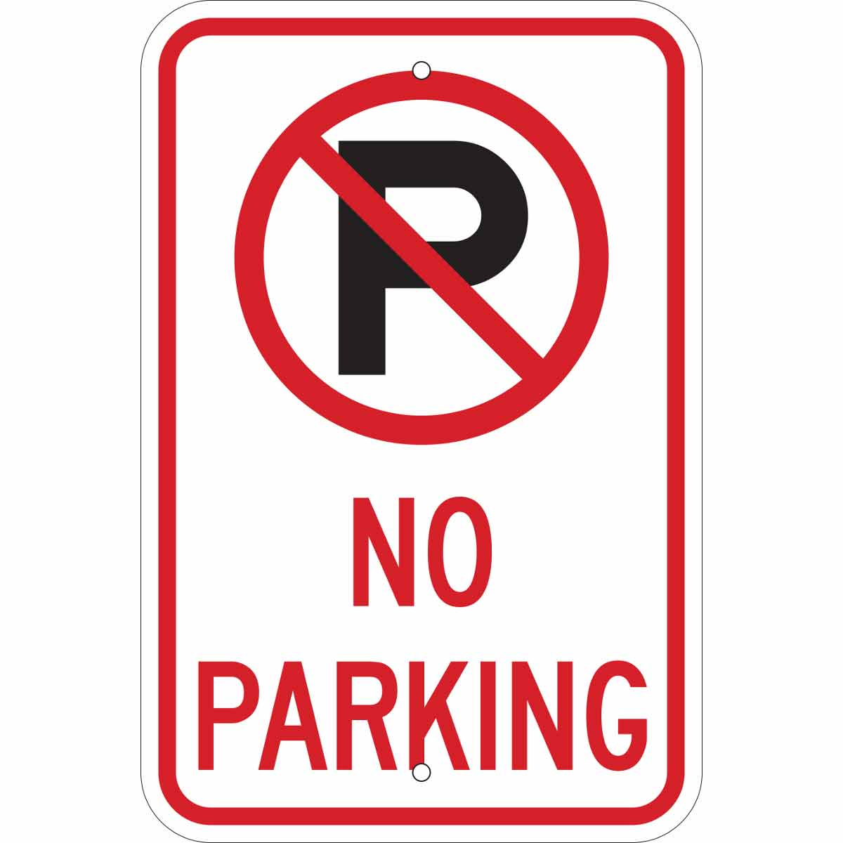
Do NOT park where..
There is a prohibitory road sign
It would be difficult for others to see clearly
It would be a danger to others
It would hold up traffic or make the road narrow
Emergency vehicles stop

