Slide 1
Warning signs

Slide 2

Right bend

Slide 3
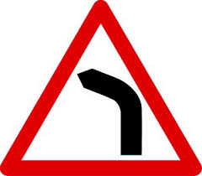
Left bend

Slide 4

Sharp reverse curve to left

Slide 5

Sharp reverse curve to right

Slide 6

Carriageway narrow from left

Slide 7

Carriageway narrow from right

Slide 8

Carriageway narrow both ends

Slide 9

Roundabout coming up

Slide 10

Dual carriageway ahead

Slide 11

Dual carriageway ends

Slide 12

Steep hill downwards

Slide 13

Steep hill downwards

Slide 14
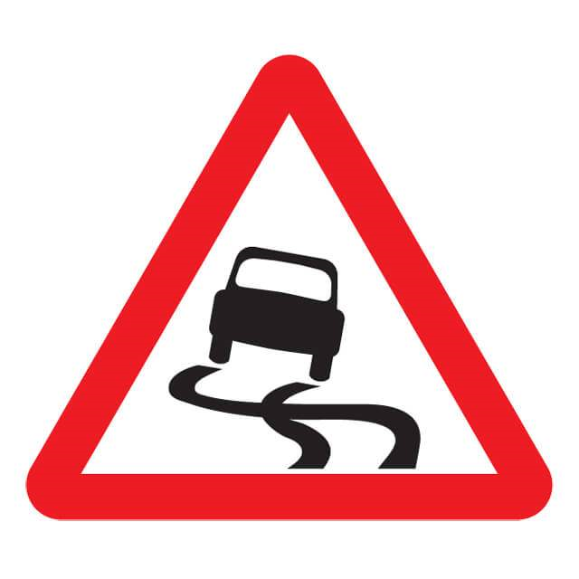
Slippery road

Slide 15

Loose gravel

Slide 16

Quayside or river bank

Slide 17

Uneven road

Slide 18

Falling rocks

Slide 19

Traffic signal

Slide 20
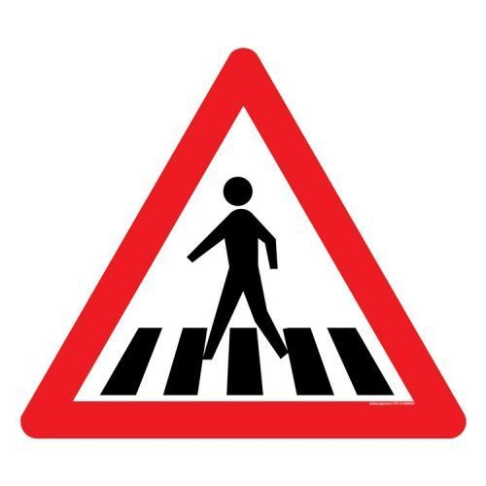
Pedestrian crossing ahead

Slide 21
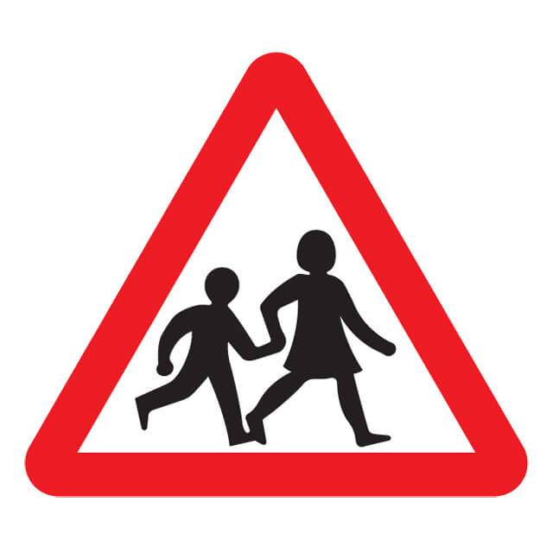
Children

Slide 22

Road works

Slide 23

Cyclist

Slide 24
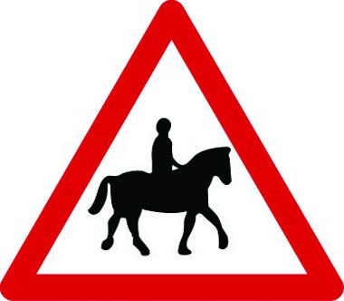
Horse crossing

Slide 25
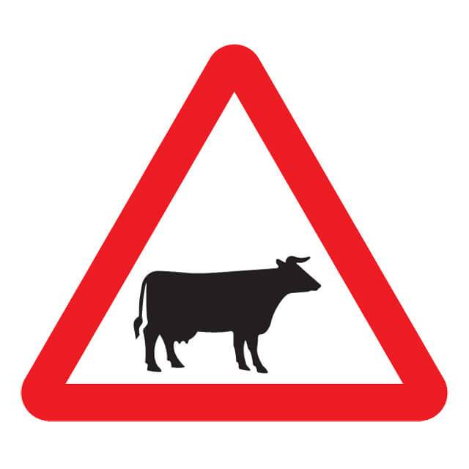
Cattle

Slide 26
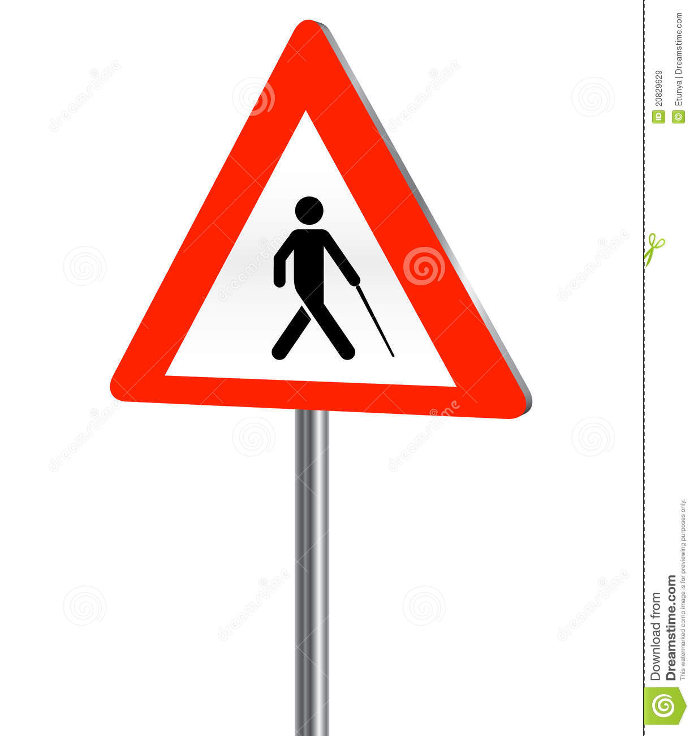
Blind people

Slide 27

Wheel chair users

Slide 28

Cross wind

Slide 29

Low flying aircraft

