Slide 1
Understanding Swing Processes Through Bat and Pitch Tracking
Stephen Sutton-Brown

Slide 2
Overview
Why do batters swing at breaking pitches in the dirt? Why do they whiff on pitches down the middle?
Batters can hit a ball anywhere off a tee
Misses are a disconnect between observation and expectation
Pitch data is the observation, swing data reveals the expectation
Predicting swing shapes and swing decisions reveals how batters track pitches and with what amount of “measurement error”
This study finds that pitch tracking is a dynamic process in which early, uncertain information influences swing shape while later information influences whether or not the batter takes

Slide 3
Agenda
Bat tracking background
Inferring expected pitch location from bat tracking data
Pitch detection background
How early pitch trajectory influences swing characteristics
How later pitch trajectory influences swing vs take decisions
Implications for batter evaluation and pitching development
Areas of future study

Slide 4
Bat Tracking Background
Swing Path Tilt
“measures the angular orientation of the ‘plane’ of the swing … approximates a slice of a flat disc in shape”
“A higher angle is a "steeper" swing (further from horizontal) and a lower angle is a "flatter" swing (closer to horizontal).”
Intercept Point
“point at which their bat is nearest to the baseball on a swing (whether or not they make contact)”

Slide 5
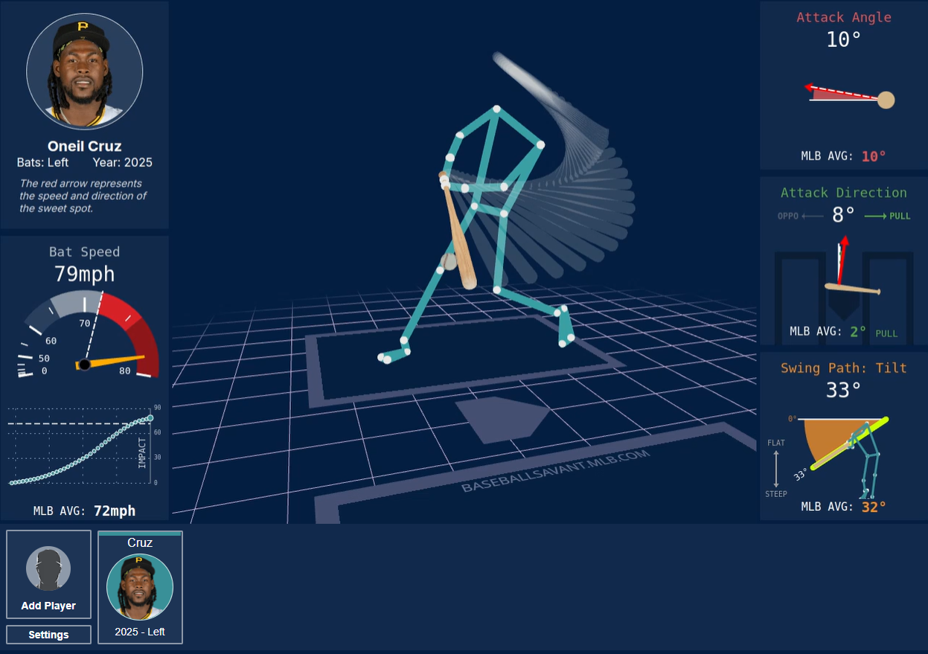
Source: Statcast

Slide 6
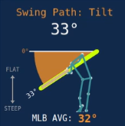
Source: Statcast

Slide 7
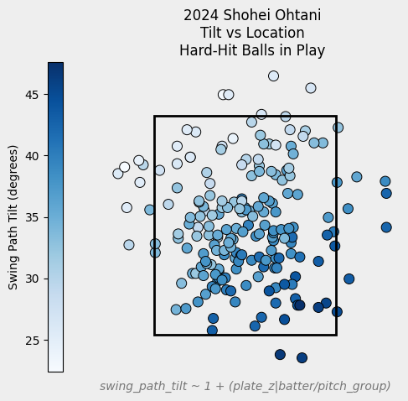
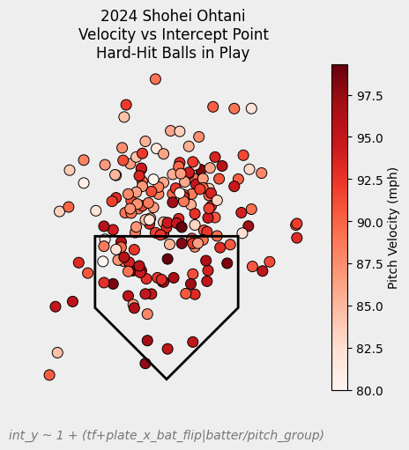
Estimating Expected Pitch Location from Bat Tracking

Slide 8
Estimating Expected Pitch Location from Bat Tracking
Tilt increases as pitch height decreases

Slide 9
Estimating Expected Pitch Location from Bat Tracking
Intercept point moves closer to batter as velocity increases and location moves away

Slide 10
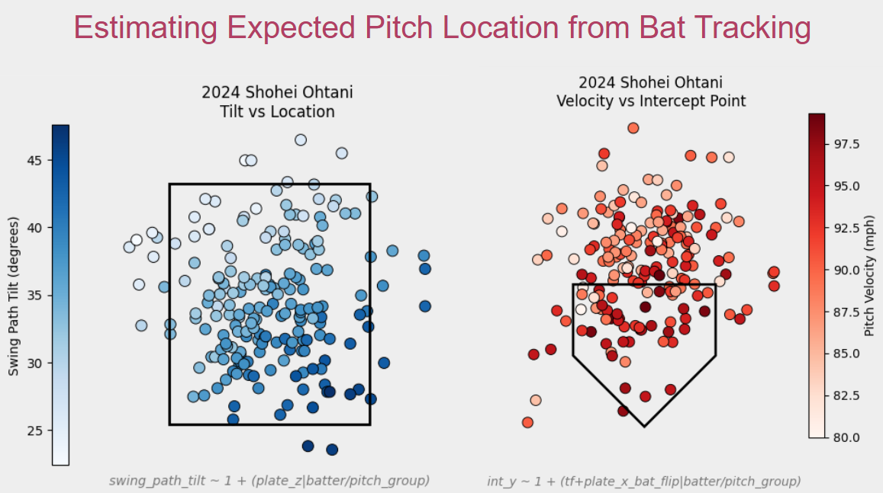
Train tilt and intercept models on hard-hit balls to determine “ideal” shape given velo, location, and type
More Tilt Than Expected: Batter was Under
Deeper Intercept Than Expected: Batter was Behind

Slide 11
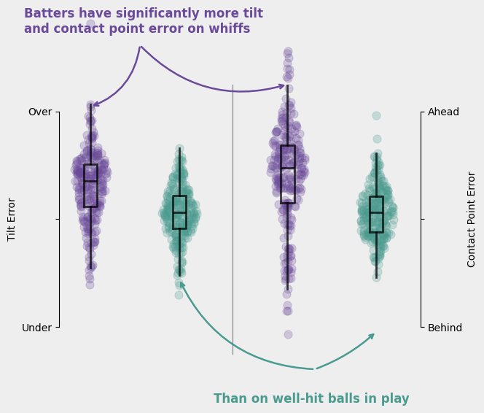
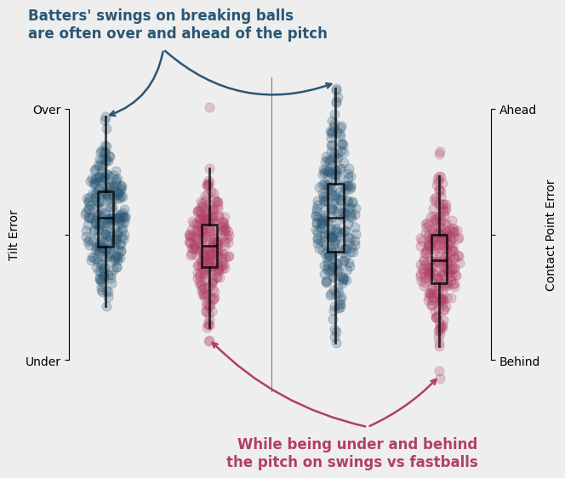
Expected Swing Shape: Model Validation

Slide 12
Expected Swing Shape: Model Validation

Slide 13
Expected Swing Shape: Model Validation

Slide 14
Checkpoint
We know if a batter is over or under
We know if a batter is ahead or behind
How do we predict it?
Need a model of where and how fast the batter expected the pitch to be

Slide 15
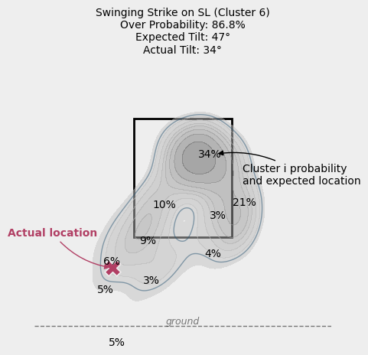
Predicting Pitch Types to Predict Over / Under and Ahead / Behind on Swings
Cluster pitches using velo, movement, and movement angle relative to arm angle
Predict pitch cluster probability given pitch tracking inputs (see next slide)
Estimate each cluster’s expected movement relative to actual pitch to get expected location
Sum probability location is higher or lower than observed → Under / Over Probability
Repeat for velocity to get Ahead / Behind Probability

Slide 16
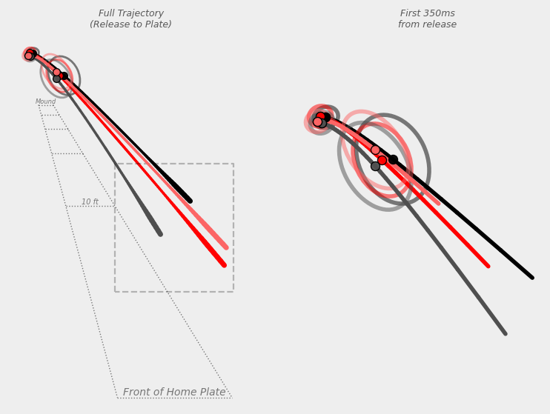
Expected Pitch Type Inputs
Batters predict pitch location using the following:
Pitcher handedness
Arm angle
Release angle
From release to 50ms after release
Pitch velocity
Measured in how much the size of the ball increases in the batter’s field of vision
Trajectory arc
How much trajectory in batter POV deviates from straight line from release to decision point
Distance traveled to decision point
Direct measure from release point to x/y location at decision point in batter’s POV

Slide 17
Expected Pitch Type Model Refinement
Using raw inputs results in a model that is overfit to pitch cluster detection while underfit to predicting whether the batter was under or ahead of the pitch
To address this, I estimated a batter’s measurement uncertainty for each feature by discretizing it into quantile-based bins
Optuna was used to jointly optimize:
Number of bins for each input
How long after release to set as the decision point
Optimization was run to maximize the average Brier Loss for:
Predicting whether the batter was under the pitch
Predicting whether the batter was ahead of the pitch

Slide 18
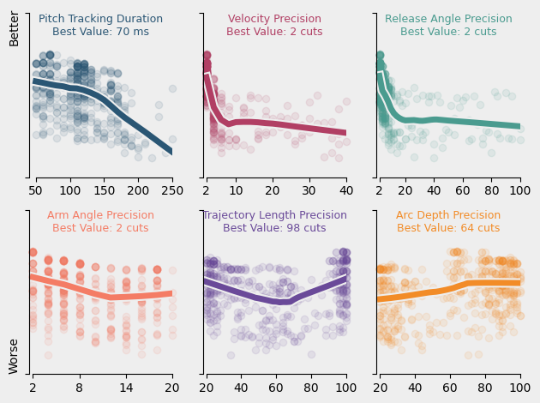
Expected Pitch Type Study Results
Model performance increased with more uncertainty (fewer cuts) for arm angle, velocity, and release angle, but less uncertainty for trajectory arc and distance traveled from release to decision point
Performance increased with an earlier decision point
Strong negative correlation (0.92 r) between the model’s ability to predict under/ahead probability vs it’s ability to predict pitch cluster

Slide 19
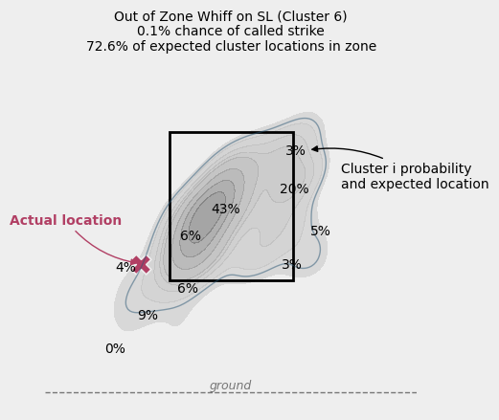
Predicting Pitch Types to Predict Swing or Take
Batters swing when they think the pitch is a strike
Predict swings by predicting probability each cluster would be in-zone
Repeat previous study but optimize on correlation between In-Zone Probability and swing / take decision

Slide 20
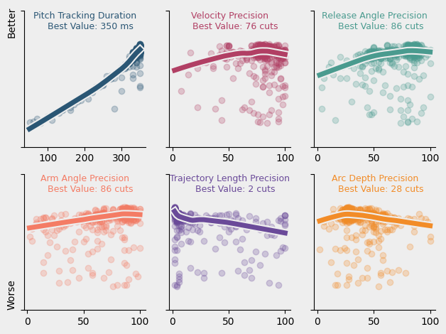
Swing or Take Study Results
Model performed best with higher precision for arm angle, velocity, and release angle, while achieving better correlation with less precision for total distance and arc depth
Much better performance with a much later decision point

Slide 21
Discussion
Results support a multi-stage process for a batter’s swing
Early Stage (0-100ms): Swing Initiation
Determines tilt and intercept point
Strong prior updated by 2D trajectory information with high uncertainty
Late Stage (100-300+ms): Adjustments & Swing/Take Decision
Starts absorbing 3D trajectory info in higher precision
Batter evaluation: How good are their priors? How well can they determine early trajectory? How quickly can they adjust?
Pitching development: Different tunneling for different pitches
CH in the zone: high swing probability, tunnel FB Thru Stage One to disrupt tilt/timing
SL out of zone: low swing probability, tunnel into Stage Two to prevent take
Pitching analysis: Tunneling and arsenal interaction must consider visual uncertainty

Slide 22
Areas of Improvement / Future Work
Improved bat tracking models
Input full trajectory rather than discrete inputs
Estimate uncertainty as correlated gaussian noise
Update “prior” pitch type expectation with pitcher tendencies and results vs batter(s) within game / series / season
Weight Under Probabilities by magnitude of relative vertical movement
Use full expected location distribution for In-Zone Probability
Leverage previous swing(s) information

Slide 23
THANK YOU!
Happy to discuss the results at any point
Reach out to me live or on Twitter or Bluesky (@srbrown70)
I’ll provide the code…. Eventually
It’s complete but horribly ugly with very little in the way of documentation or comments
If you’re interested in any of it in the meantime just reach out and I’ll be happy to send you any snippets

Slide 24
BACKUP

Slide 25
Related Work Performed During Process
A previous version of this report highlighting a study where I estimated how much knowing the pitcher’s repertoire influenced pitch cluster probabilities
This was put on hold after it found the optimization performed best when not knowing the pitcher’s usage patterns
More careful thought will need to be put into how to structure this
One idea from feedback: test tilt and intercept error for batters against new pitches that the pitcher is debuting within that game
Another version of the study added random noise to the inputs to estimate measurement uncertainty for the batter
This failed to accurately capture the measurement error of a batter’s eyes, likely due to the added jitter being applied independently to each of the inputs rather than correlating across the inputs
Attempting this again should be coupled with what was mentioned previously about modeling the trajectory as a whole rather than as a set of inputs
Early versions of this used release extension and did not use release angle
This was updated after finding that extension showed very little impact on the models while testing with release angles showed some small but notable impact
The swing / take study was originally ran by simply predicting swing or take using those inputs and optimizing on p(swing) ROC AUC, and the results were practically identical but didn’t 1) tie together with the use of predicted pitch clusters from the swing shape study nor 2) lend themselves well to pretty plots

Slide 26
Tunneling Background
Overview: Three main pieces that influenced this are linked below. The key takeaways are: batters estimate what pitch type is coming based on how its release and trajectory looks and how those compare to other pitches they’ve seen, but those estimates come with large amounts of visual uncertainty due to the eyes’ limitations in perceiving dynamic objects. There’s some general ideas of what visual pathways are being used and how precise they are, but translating that conceptual framework into a model of pitch type estimation is key. Need to consider what inputs to include and how precisely to measure them (the topic of this study)
BPro: Looked at differences in trajectories from batter’s point of view
Pro: rotated the trajectories! This is huge; you cannot just think about how they look in global coordinates
Pro: looked both at the tunnel point itself and the trajectory leading up to it
Con: no estimates of visual uncertainty
Con: only considered pitch pairs
Rob Gray: Considered what would make two pitches “Perceptually equivalent”
Pro(super duper good in fact): centered on visual uncertainty
Con: did not consider multiple dimensions
Con: estimates of visual uncertainty derived from lab measurements, which don’t always track real world
Neutral: may be difficult to translate into a probabilistic pitch detection framework
Arsenal Metrics: A framework for how well a batter can detect which offering from an arsenal is on its way
Pro: Rotated the trajectories and considered visual uncertainty
Con: Estimate of visual uncertainty are just that, a very rough estimate
Con: Considers only the arsenal against itself and no weight given to what pitch type a trajectory appears to be given no info about that particular pitcher

Slide 27
Additional, Related Research
Rob Gray:
The Use of Contextual Information In Sports
Integrating visual trajectory and probabilistic information in baseball batting
Myszka et. al.:
(Re)contextualizing movement behavior in sport as a problem-solving activity
Julie M. Harris & Vit F. Drag:
Using visual direction in three-dimensional motion perception

Slide 28
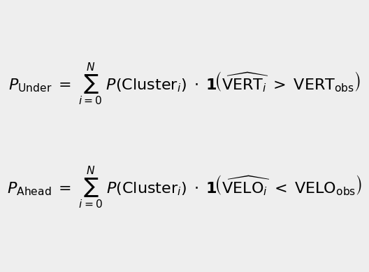
Detailed Formulas for Under and Ahead Probability
P_{Under} is probability a batter would swing under a pitch
P(Cluster_{i}) is probability of the pitch being of cluster i given the inputs
VERT_{i} is the expected vertical movement of a pitch given the arm angle
VERT_{obs} is the actual vertical movement of the pitch

Slide 29
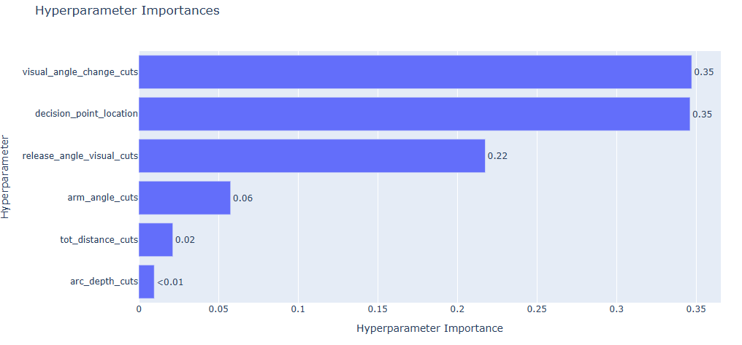
Swing Shape Results: Additional Details
Decision Point Time and Visual Angle Change had by far the greatest impacts on model performance in predicting under / ahead probability

Slide 30
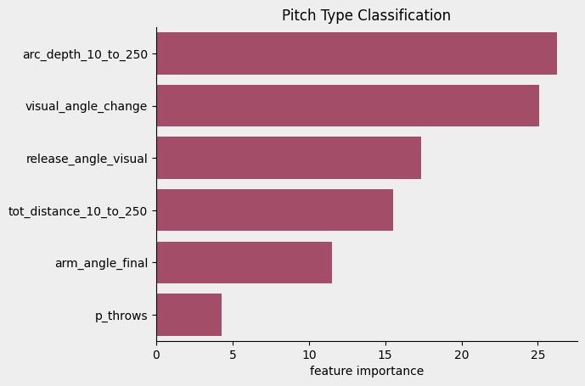
Additional Details
Catboost variable importances for predicting pitch type with goal of maximizing ability to accurately predict type

Slide 31
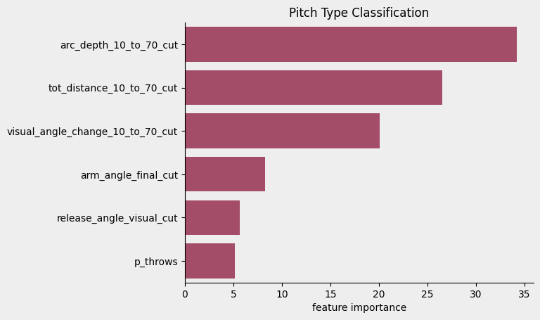
Additional Details
Catboost variable importances for predicting pitch type with goal of maximizing ability to accurately whether batter would be under / ahead

Slide 32
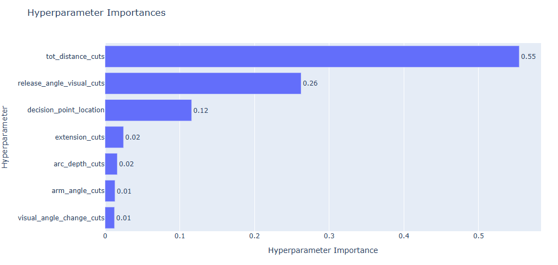
Swing or Take Results: Additional Details
Total Distance Cuts had the largest impact on optimization results followed by Release Angle Cuts and Decision Point Location

Slide 33
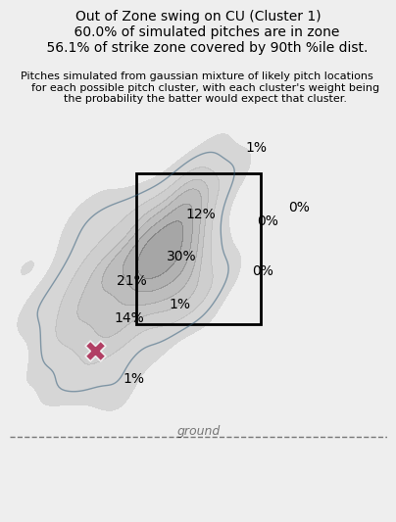
Areas of Improvement / Future Work: Detailed
Improved bat tracking models
Splines rather than linear
Batter height as informed prior
Explore additional inputs and/or interactions
Input full trajectory rather than discrete inputs
Leverage deep learning
Estimate uncertainty as correlated gaussian noise
Apply gaussian random noise to each point along the trajectory with the noise at one point correlating to the noise at another
Would allow you to learn each batter’s “noise level”
Update “prior” pitch type expectation with pitcher tendencies and results vs batter(s) within game / series / season
Could test this by looking at initial use of a new pitch by a pitcher
Weight Under Probabilities by magnitude of relative vertical movement
Use full expected location distribution for In-Zone Probability
Rather than using mean point estimate of cluster location use full distribution and calculate amount of distribution area is in zone and amount of zone area covered by distribution
Fits with Kaggle competition submission that predicted swings using both probability of called strike and p(called_strike) if it were an average fastball
Leverage previous swing(s) information
Can we quantify and systematize “reading swings” similarly to elite catchers?

Slide 34
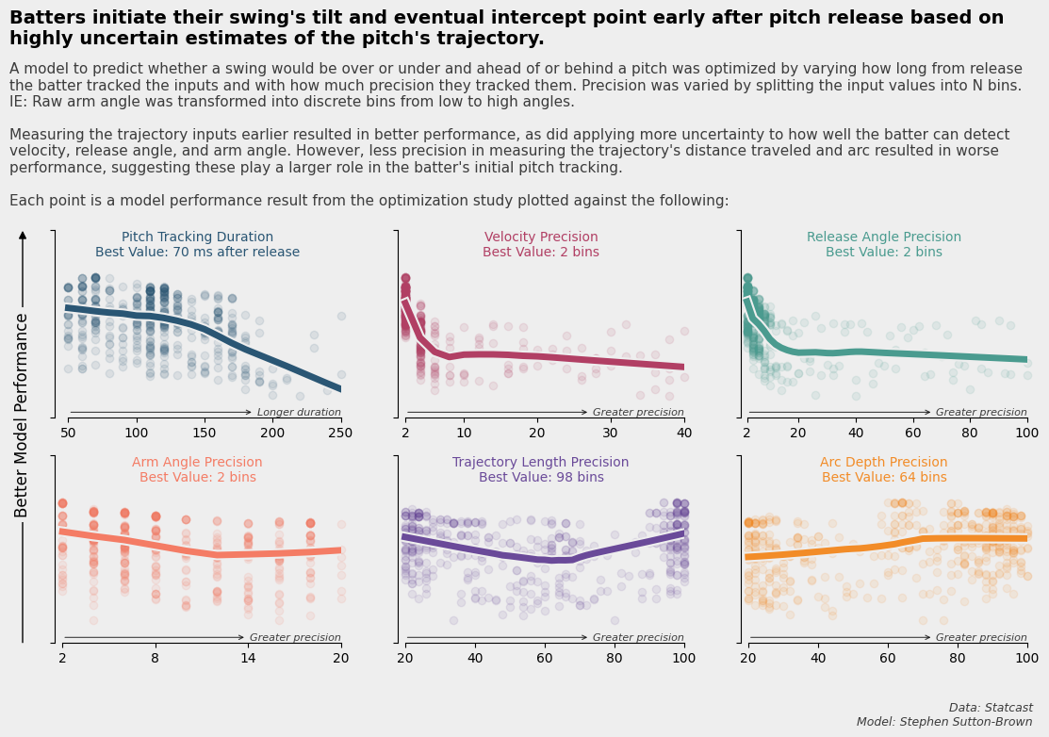

Slide 35
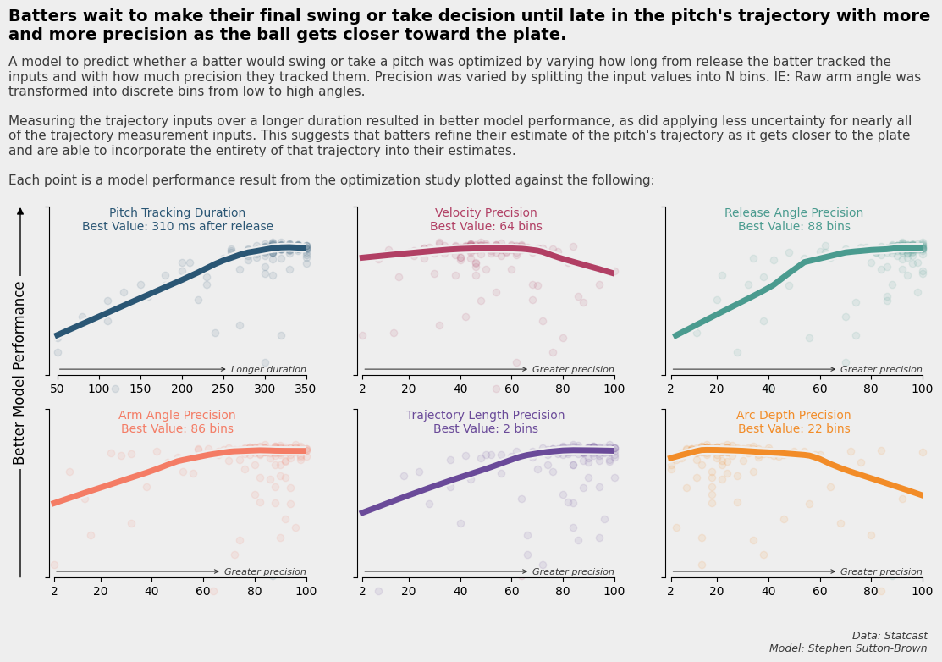

Slide 36
