Slide 1
MFC · EXASCALE MULTIPHYSICS CFD
Reacting Flows & Combustion, on GPUs
Finite-rate H₂/O₂ chemistry, gas & condensed-phase detonations, and solid-fuel combustion — computed with the Multi-component Flow Code on NVIDIA A100s, from one source that runs on four CI-gated compilers.

Slide 2
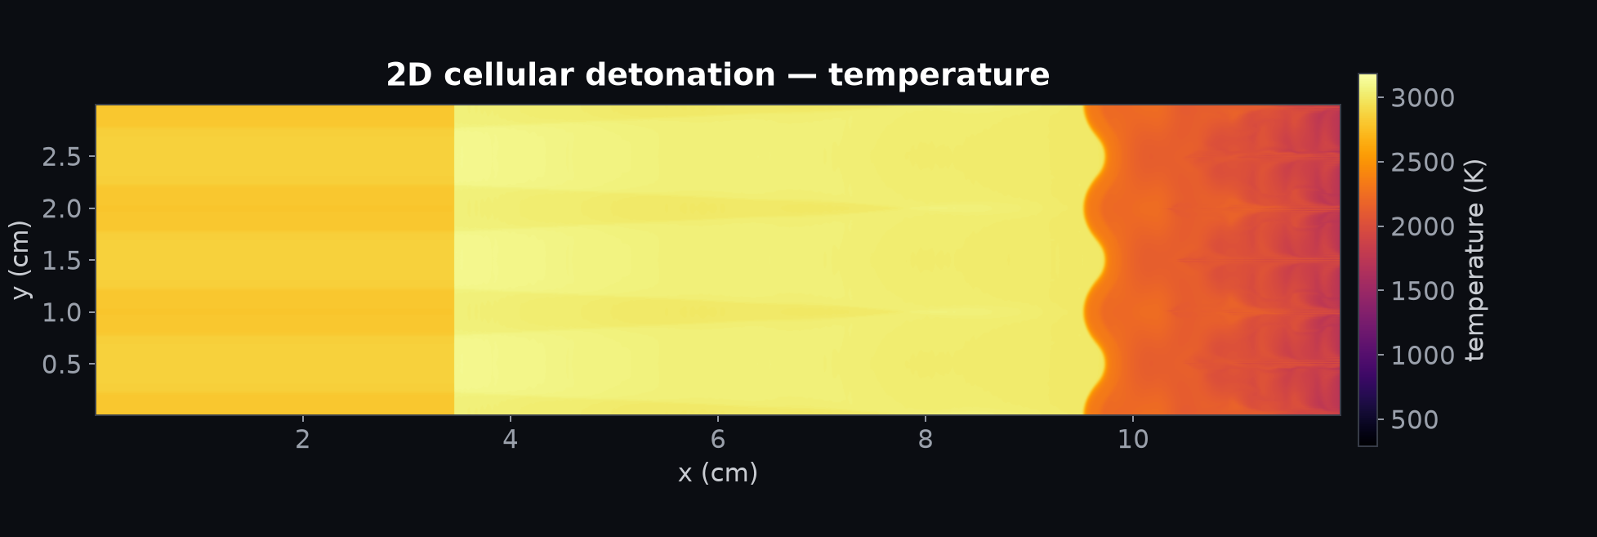
01
2D cellular detonation in Ar-diluted H₂/O₂
A piston-driven shock ignites 2H₂+O₂+7Ar and locks into a self-sustained Chapman–Jouguet detonation (~1600 m/s). Heavy argon dilution regularizes the transverse-wave pattern, so the classic cellular soot-foil structure is resolved directly on the mesh.

Slide 3
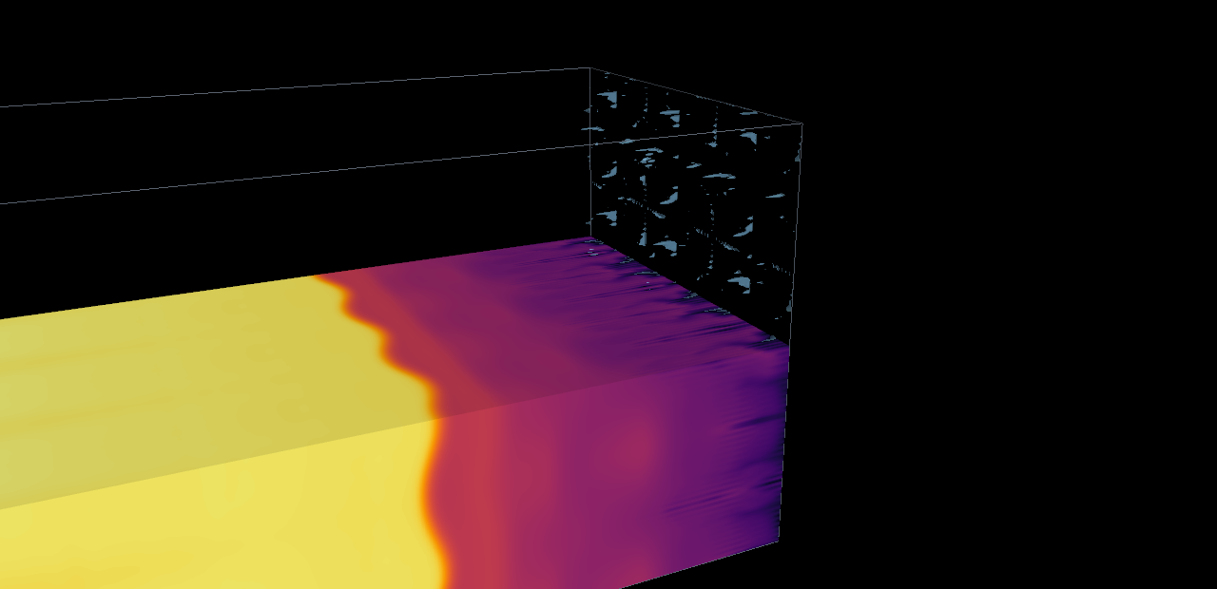
02
3D cellular detonation on four GPUs
The same case run in 3D on the four A100s (millions of cells). The domain is cut in half to expose the internal temperature field: hot burned products trail the corrugated detonation front as it sweeps into the dark unreacted mixture ahead, the reacting front picked out in blue. Recording the peak pressure at every point traces the soot foil — the diamond fish-scale imprint of the transverse waves, the classic fingerprint of a cellular detonation.

Slide 4
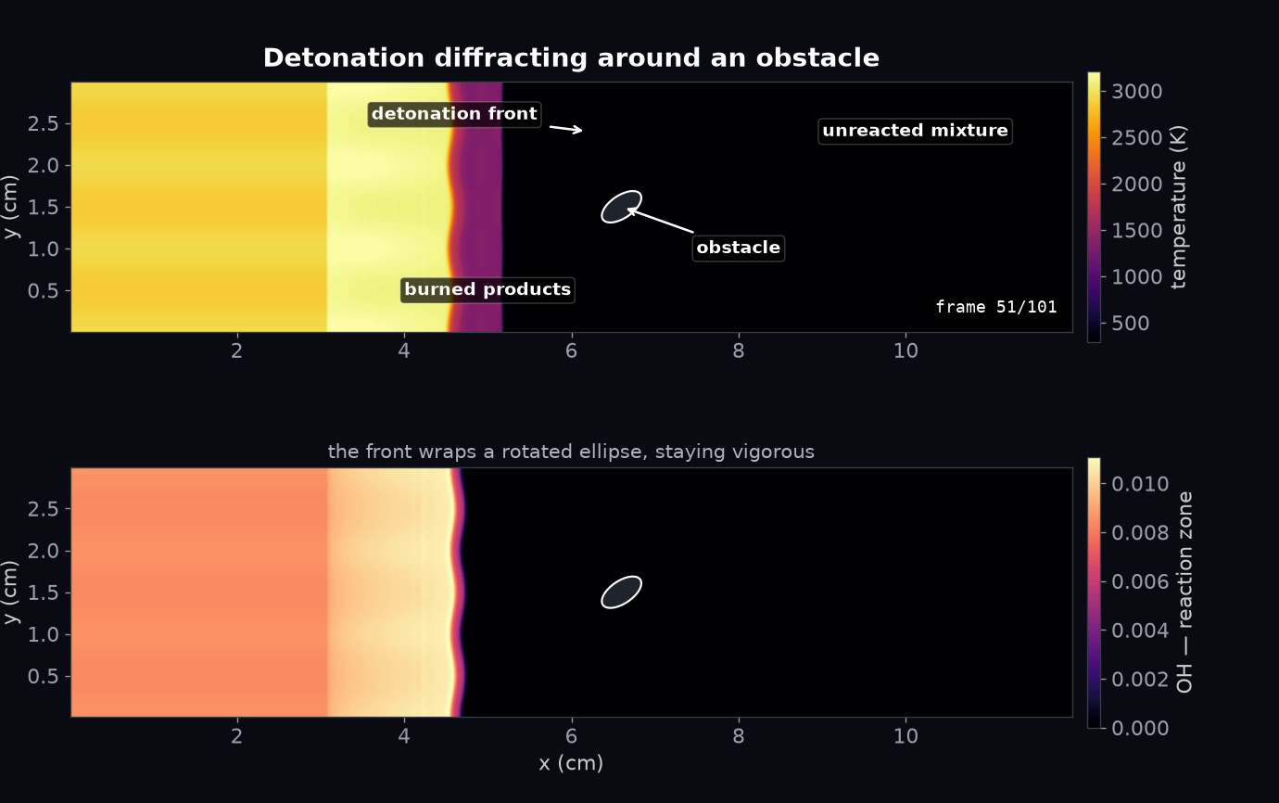
03
Detonation diffracting around an obstacle
The detonation runs into a rotated-ellipse immersed boundary and wraps around it, staying vigorous (~3400 K). This surfaced a solver finding: CFL-adaptive time-stepping drives the timestep to NaN and silently hangs at the super-heated impact, while a fixed timestep sails through the diffraction.

Slide 5
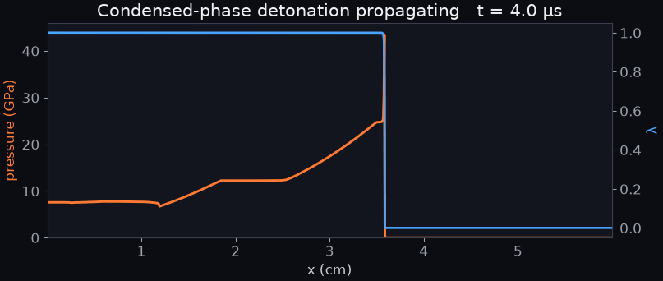
04
Condensed-phase detonation — a solid explosive
● NEW CAPABILITY
A programmed pressure burn converts reactant to product on the multi-fluid model (no ideal-gas chemistry): the two fluids share an EOS and differ only in reference energy, releasing heat through the mixture equation of state. A self-sustained ~7 km/s detonation forms — von Neumann spike, ZND reaction zone, Taylor rarefaction — bypassing the Cantera single-fluid lock.

Slide 6
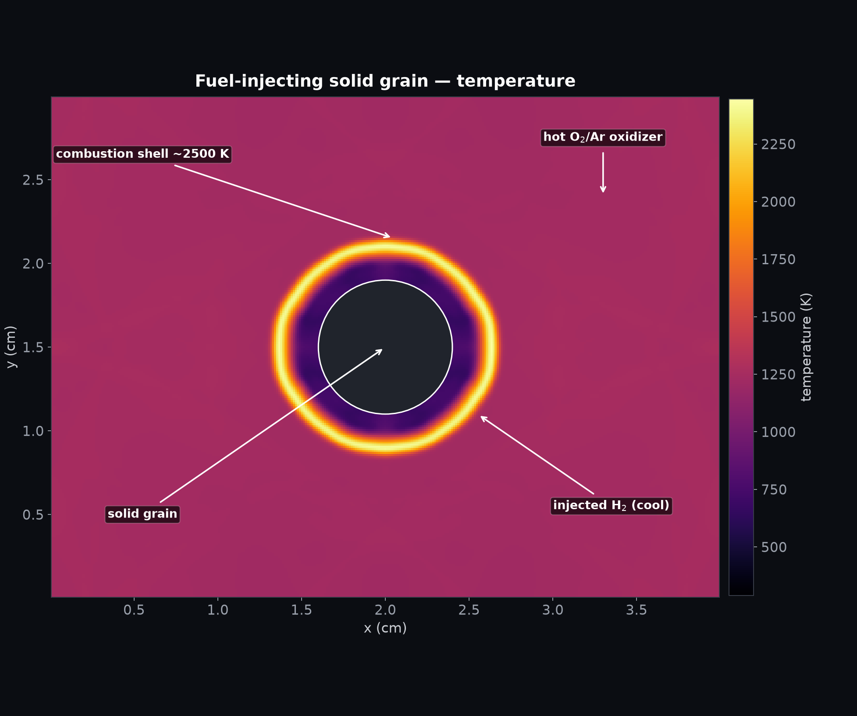
05
Burning solid-fuel grain
● NEW CAPABILITY
A solid cylinder injects H₂ off its surface into a hot O₂/Ar chamber; the fuel auto-ignites and anchors a surface diffusion flame (~2700 K). Enabled by two new immersed-boundary knobs — wall-normal blowing and injected-species — that let a solid surface transpire and inject fuel.

Slide 7
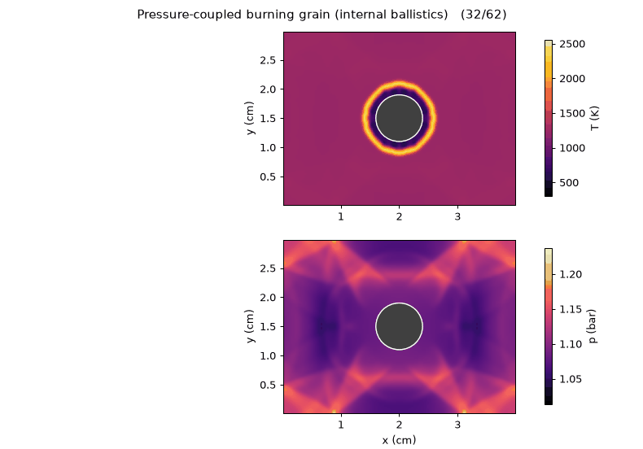
06
Internal ballistics — pressure-coupled burn
● NEW CAPABILITY
A Vieille's-law burn rate (v ∝ pⁿ) turns the closed chamber into a feedback loop: combustion raises the pressure, which raises the burn rate, which raises the pressure — the defining signature of solid-rocket internal ballistics, reproduced from first-principles CFD.

Slide 8
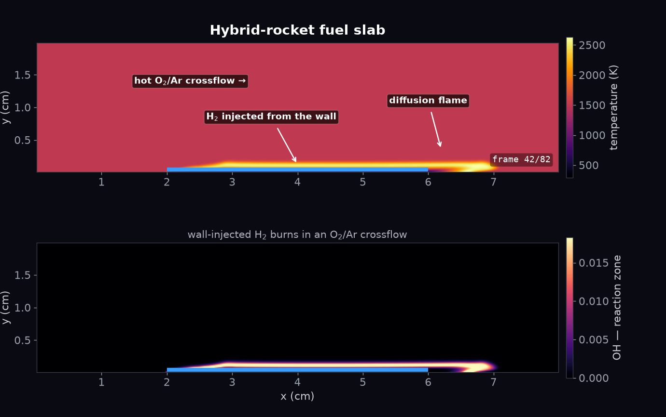
07
Hybrid-rocket fuel slab
A wall strip injects H₂ into a hot O₂/Ar crossflow, forming a boundary-layer diffusion flame (~2660 K) that lifts off the wall and burns downstream — the essential hybrid-rocket picture of fuel blowing off a surface into an oxidizer stream, at high resolution.

Slide 9
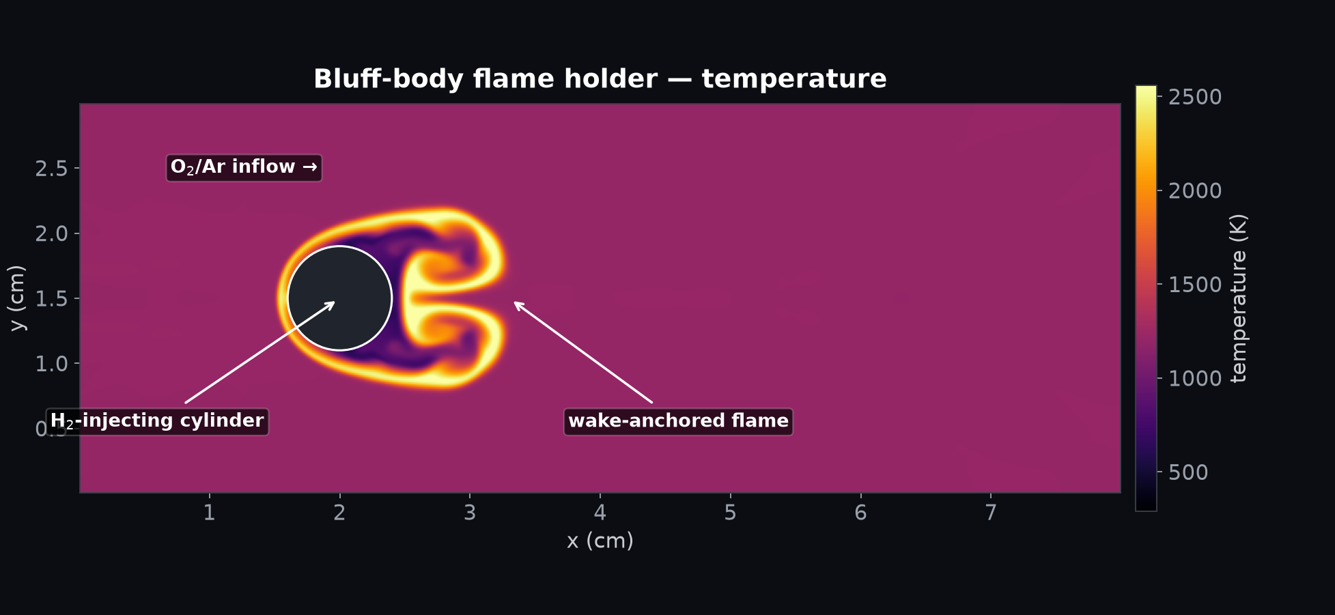
08
Bluff-body flame holder
A fuel-injecting cylinder anchors a flame in its recirculating wake (~2630 K). The freestream carries no fuel, so combustion can only stabilize where the injected H₂ meets the oxidizer behind the body — the classic afterburner/ramjet flame-holder configuration.

Slide 10
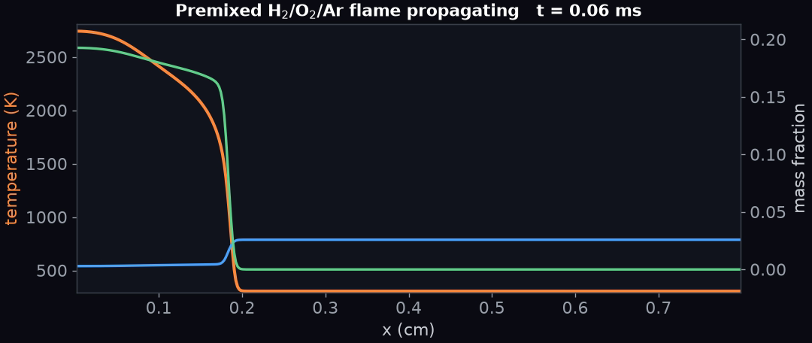
09
1D premixed propellant flame
A premixed H₂/O₂/Ar deflagration propagating at ~18.6 m/s with full multicomponent transport and finite-rate chemistry — the slow, diffusion-controlled counterpart to the shock-driven detonations.

Slide 11
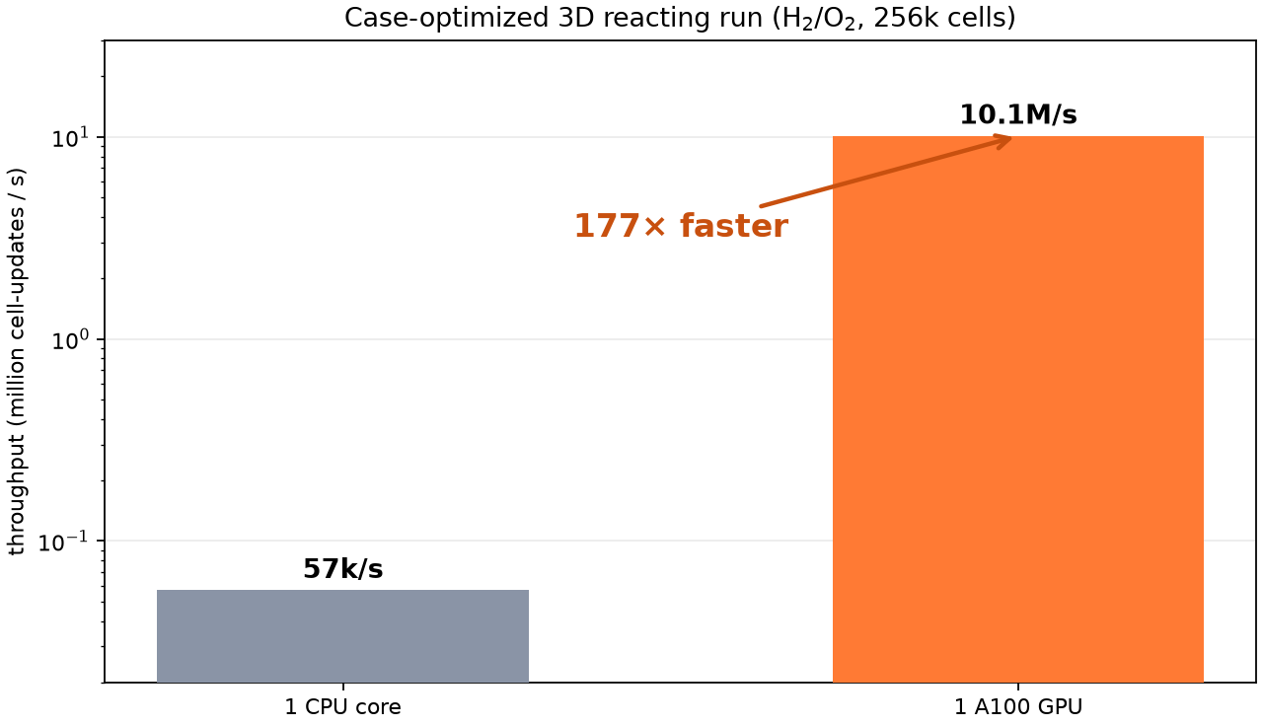
PERF
GPU performance
177× speedup
On a case-optimized 3D reacting run (H₂/O₂, 256k cells), a single A100 sustains 10.1 million cell-updates per second versus 57 thousand on one CPU core.
The same Fortran source runs on four CI-gated compilers (gfortran, nvfortran, Cray, Intel) and across CPU, OpenACC, and OpenMP-offload GPU back-ends.

