Slide 1

The Role of Machine Learning in Predicting Diabetes
Image source
Saleh Babaei
BTM 710
2024-12-01

Slide 2
Goal of the Project
Main Point:
To evaluate the effectiveness of machine learning models in predicting diabetes and to identify significant factors influencing diabetes risk.
Supporting Points:
Assess the performance of three models: Logistic Regression, Decision Tree, and XGBoost.
Analyze key health indicators (e.g., glucose, BMI, age) contributing to diabetes prediction.
Notes:
Before diving into the details, let me share the main goal of my project. I wanted to see how machine learning models can be used to predict diabetes and identify the most important factors that contribute to the risk.
To achieve this, I focused on evaluating three models: Logistic Regression, Decision Tree, and XGBoost. Each of these models has its strengths, and I wanted to find out which one works best for this specific problem.
Another key part of this project was analyzing the features in the dataset—like glucose levels, BMI, and age—to understand their role in diabetes prediction. This insight could help healthcare professionals target the right areas for early intervention.

Slide 3
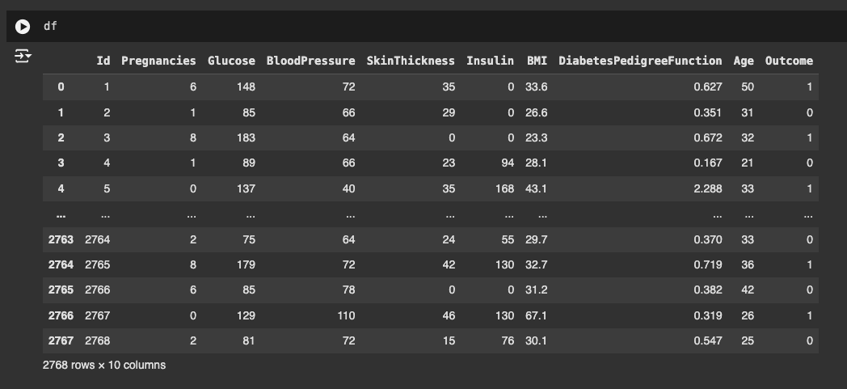
Data Overview
Source:
“Kaggle – Healthcare-Diabetes Dataset.”
Dataset Size and Structure:
~3,000 records with 10 features, including demographics and clinical markers.
Notes:
Let me walk you through the dataset I used for this project. It comes from Kaggle, a platform known for hosting datasets across various fields, including healthcare. This particular dataset focuses on diabetes prediction and contains about 3,000 patient records.
The data is quite comprehensive. It includes health indicators like glucose levels, blood pressure, and BMI, which are crucial for assessing diabetes risk. There are also demographic details, such as age and the number of pregnancies, which add valuable context to the predictions.
The target variable in this dataset is simple: it tells us whether a person is diabetic, marked as 1, or not diabetic, marked as 0. This straightforward structure makes it ideal for building and testing machine learning models.
This dataset forms the backbone of my analysis, and everything I’ll show you in the following slides is built on the insights drawn from these features.

Slide 4
Actions and Processes
Data Preprocessing:
Handled missing values using median imputation.
Scaled features for uniformity using standardization.
Split data into training (80%) and testing (20%) sets.
Model Implementation:
Logistic Regression: Simple baseline for comparison.
Decision Tree: Captures feature interactions and non-linear patterns.
XGBoost: Advanced boosting algorithm with high predictive accuracy.
Evaluation:
Metrics: Accuracy, Precision, Recall, F1-Score, and ROC-AUC.
Notes:
Once I had the data, the first step was preprocessing. Missing values were handled using median imputation to ensure no information was lost. Then, I standardized the numerical features to ensure they were all on the same scale, which is crucial for some models like Logistic Regression. Finally, I split the data into training and testing sets, with 80% used for training the models and 20% for testing.
I implemented three machine learning models. Logistic Regression served as a simple baseline—it’s great for quick comparisons. The Decision Tree model allowed me to explore feature interactions and non-linear patterns in the data. Finally, I used XGBoost, an advanced algorithm that’s well-known for its high accuracy and robustness in handling complex datasets.
To evaluate the performance of these models, I focused on key metrics like Accuracy, Precision, Recall, F1-Score, and ROC-AUC. These metrics helped me compare the models and determine which one was most effective in predicting diabetes.
With the data processed and models implemented, it was time to test their performance and analyze the results. Let’s take a look at what I found.

Slide 5
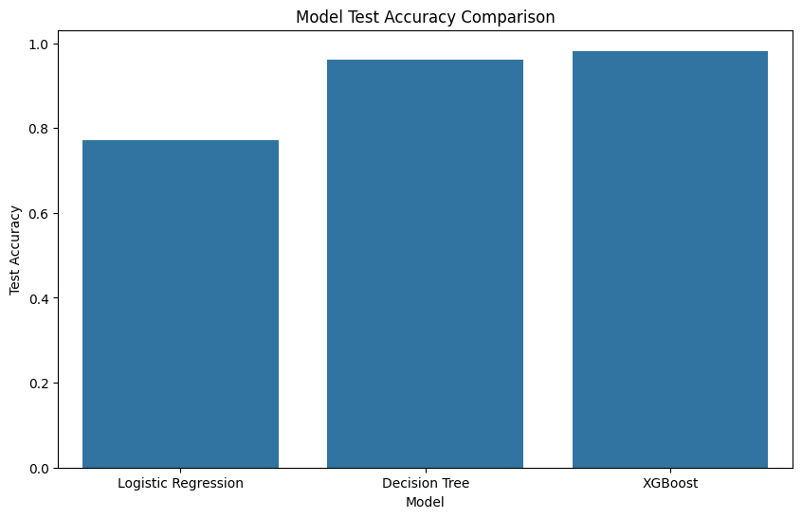
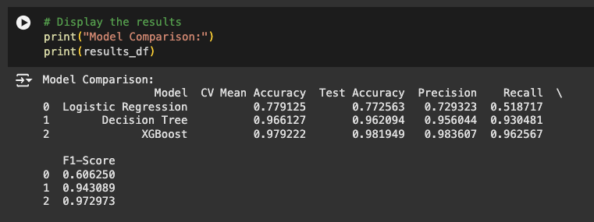
Results
Model Comparison:
Logistic Regression:
CV Mean Accuracy: 77.91%, Test Accuracy: 77.26%.
Precision: 72.93%, Recall: 51.87%, F1-Score: 60.63%.
Decision Tree:
CV Mean Accuracy: 96.61%, Test Accuracy: 96.21%.
Precision: 95.60%, Recall: 93.05%, F1-Score: 94.31%.
XGBoost:
CV Mean Accuracy: 97.92%, Test Accuracy: 98.19%.
Precision: 98.36%, Recall: 96.26%, F1-Score: 97.30%.
Notes:
Here are the results of my analysis, comparing the performance of three models:
Logistic Regression had the lowest performance, with a test accuracy of 77.26%. While it’s simple and quick, it struggled with capturing the complexity of the data.
The Decision Tree model performed much better, achieving over 96% accuracy. It was effective but slightly less consistent, as reflected in its precision and recall scores.
Finally, XGBoost stood out as the best-performing model, with a test accuracy of 98.19%. It had the highest precision, recall, and F1-Score, making it the most reliable for predicting diabetes.”

Slide 6
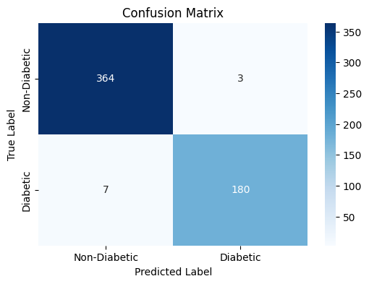
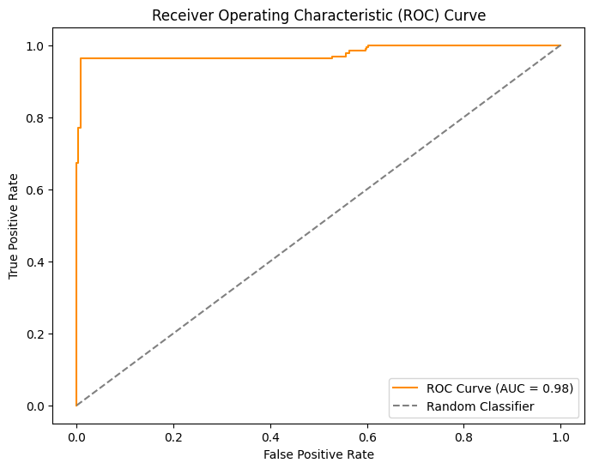
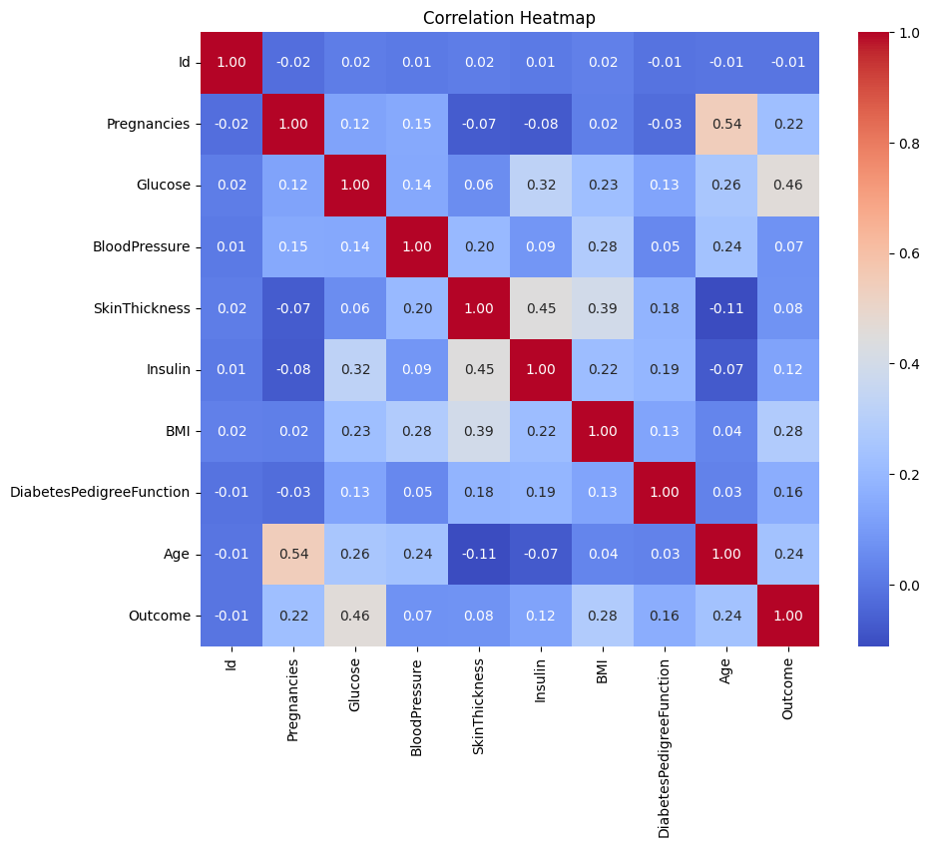
Results Cont.
Confusion Matrix:
True Positives: 180
True Negatives: 364
False Positives: 3
False Negatives: 7
Correlation Heatmap:
Strongest correlations with Outcome:
Glucose (0.46)
BMI (0.28)
Age (0.24)
ROC Curve:AUC: 0.98
Notes:
Let’s take a closer look at how XGBoost performed in detail. This model consistently outperformed others, so I wanted to highlight its metrics and key insights.
Here’s the confusion matrix for XGBoost. The model correctly classified 180 diabetic cases and 364 non-diabetic cases, with only 10 misclassifications in total. This demonstrates its reliability.
The ROC curve further supports its performance, with an AUC of 0.98. This means XGBoost is highly effective at distinguishing between diabetic and non-diabetic cases.
The heatmap shows the correlation of features with the target variable, Outcome. Glucose has the strongest correlation at 0.46, followed by BMI and Age. These findings align with clinical knowledge, highlighting the importance of these factors in diabetes prediction.
While XGBoost’s performance is impressive, it’s essential to address some of the gaps and limitations of this project. Let’s discuss those next.

Slide 7

Gaps
Dataset Limitations:
Limited demographic diversity in the dataset.
Lack of representation for regional and lifestyle factors.
Feature Availability:
Some features, like insulin levels and skin thickness, may not be routinely available in real-world healthcare settings.
Potential Overfitting:
XGBoost may show slight overfitting, particularly due to the smaller dataset size.
Notes:
No project is without its limitations, and understanding these gaps is crucial for improvement. Let me walk you through some key challenges I faced.
The dataset, while robust, is not fully representative of diverse populations. Factors like ethnicity, lifestyle, and regional health disparities are missing, which could impact the generalizability of the model.
Certain features, like insulin levels and skin thickness, are not always available in routine healthcare settings. This could limit the model’s usability in practical applications.
XGBoost, though high-performing, showed slight overfitting due to the limited size of the dataset. This could reduce its reliability when applied to completely new data.

Slide 8
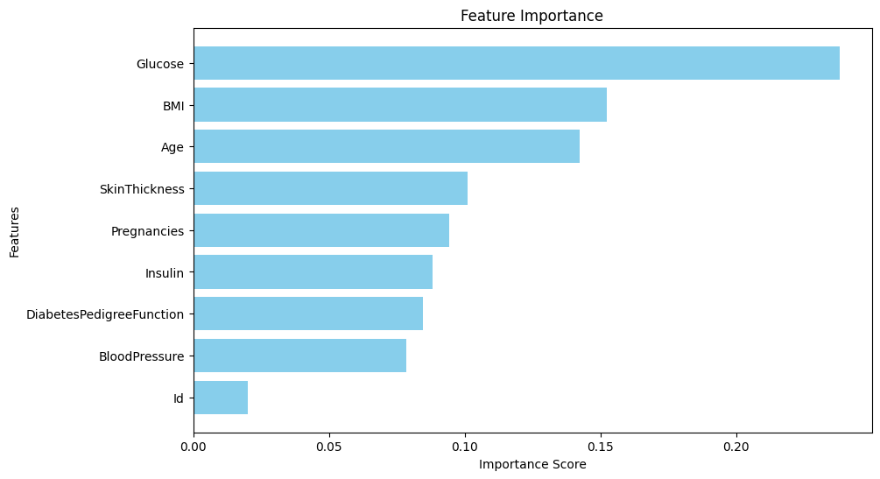
How to Mitigate Diabetes
Key Insights:
Glucose Levels
BMI
Age as a Risk Factor
Notes:
This graph breaks down the importance of different features in predicting diabetes. It shows that glucose levels are by far the most critical, followed by BMI and age.
Controlling glucose levels is the most impactful step. For those at risk, adopting low-carb diets like ketogenic or carnivore can significantly lower glucose levels. These diets reduce carbohydrate intake, forcing the body to use fat for energy, which naturally stabilizes blood sugar and insulin levels.
BMI, or Body Mass Index, is a critical modifiable factor. Maintaining a healthy weight through regular physical activity and balanced eating habits is crucial.
Age is a non-modifiable factor, but it doesn’t mean risks can’t be managed.
To conclude, the takeaway here is clear: managing glucose levels, maintaining a healthy weight, and adopting proactive health habits are powerful ways to reduce diabetes risk.

Slide 9
Other Papers
Shi et al. (2024):
Developed a machine learning model to predict severe hypoglycemia.
Focused on older adults with diabetes and demonstrated the potential of predictive analytics in reducing hospitalizations.
Shin et al. (2022):
Improved diabetes prediction models for clinical effectiveness.
Highlighted the role of feature engineering in enhancing model performance.
Jahan Kakoly et al. (2023):
Explored risk factor analysis using feature selection techniques.
Identified key features influencing diabetes and emphasized the importance of data preprocessing.
Notes:
As part of my research, I reviewed related studies that align with the focus of my project. These papers provided valuable context and reinforced the importance of machine learning in diabetes prediction.
Shi et al. developed a model specifically for predicting severe hypoglycemia in older adults. This study demonstrated how machine learning can proactively identify at-risk individuals, reducing hospitalizations and improving care outcomes.
And the same person worked on another study in 2022 on refining diabetes prediction models to make them more effective in clinical settings. They showed that advanced feature engineering techniques could significantly enhance model performance.
Jahan Kakoly et al. took a different approach by focusing on risk factor analysis. Their study emphasized the importance of identifying and selecting the most critical features, which aligns closely with the feature importance analysis in my project.
These papers supported the findings in my study and highlighted key areas like feature selection, advanced algorithms, and clinical applications. They validated the approach I took and underscored the potential of machine learning in healthcare.
Thank you! And I’m happy to answer any questions.

