Slide 1
Predicting Safest Grocery Store in Vancouver City, Canada

Slide 2
Predicting Safest Grocery Store in Vancouver City, Canada
Table of contents
Introduction: Business Problem
Data
Methodology
Analysis
Results and Discussion
Conclusion
Introduction: Business Problem
The aim of this project is to find a safe and secure location for opening of commercial establishments in Vancouver, Canada. Specifically, this report will be targeted to stakeholders interested in opening any business place like Grocery Store in Vancouver City, Canada.
The first task would be to choose the safest borough by analysing crime data for opening a grocery store and short listing a neighbourhood, where grocery stores are not amongst the most common venues, and yet as close to the city as possible.
We will make use of our data science tools to analyse data and focus on the safest borough and explore its neighbourhoods and the 10 most common venues in each neighbourhood so that the best neighbourhood where grocery store is not amongst the most common venue can be selected.

Slide 3
Data
Based on definition of our problem, factors that will influence our decision are:
finding the safest borough based on crime statistics
finding the most common venues
choosing the right neighbourhood within the borough
We will be using the geographical coordinates of Vancouver to plot neighbourhoods in a borough that is safe and in the city's vicinity, and finally cluster our neighbourhoods and present our findings.
Following data sources will be needed to extract/generate the required information:
Part 1: Using a real world data set from Kaggle containing the Vancouver Crimes from 2003 to 2019: A dataset consisting of the crime statistics of each Neighbourhood in Vancouver along with type of crime, recorded year, month and hour.
Part 2: Gathering additional information of the list of officially categorized boroughs in Vancouver from Wikipedia.: Borough information will be used to map the existing data where each neighbourhood can be assigned with the right borough.
Part 3: Creating a new consolidated dataset of the Neighbourhoods, along with their boroughs, crime data and the respective Neighbourhood's co-ordinates.: This data will be fetched using OpenCage Geocoder to find the safest borough and explore the neighbourhood by plotting it on maps using Folium and perform exploratory data analysis.
Part 4: Creating a new consolidated dataset of the Neighbourhoods, boroughs, and the most common venues and the respective Neighbourhood along with co-ordinates.: This data will be fetched using Four Square API to explore the neighbourhood venues and to apply machine learning algorithm to cluster the neighbourhoods and present the findings by plotting it on maps using Folium.

Slide 4
###Part 1: Using a real world data set from Kaggle containing the Vancouver Crimes from 2003 to 2019
Vancouver Crime Report
Properties of the Crime Report
TYPE - Crime type
YEAR - Recorded year
MONTH - Recorded month
DAY - Recorded day
HOUR - Recorded hour
MINUTE - Recorded minute
HUNDRED_BLOCK - Recorded block
NEIGHBOURHOOD - Recorded neighbourhood
X - GPS longitude
Y - GPS latitude
Data set URL: https://www.kaggle.com/agilesifaka/vancouver-crime-report/version/2
###Part 2: Gathering additional information about the Neighbourhood from Wikipedia
######As part of data set Borough which the neighbourhood was part of was not categorized, so we will create a dictionary of Neighbourhood and based on data in the following Wikipedia page.

Slide 5
##Methodology
Categorized the methodologysection into two parts:
Exploratory Data Analysis: Visualise the crime repots in different Vancouver boroughs to idenity the safest borough and normalise the neighborhoods of that borough. We will Use the resulting data and find 10 most common venues in each neighborhood.
Modelling: To help stakeholders choose the right neighborhood within a borough we will be clustering similar neighborhoods using K - means clustering which is a form of unsupervised machine learning algorithm that clusters data based on predefined cluster size. We will use K-Means clustering to address this problem so as to group data based on existing venues which will help in the decision making process.
####Exploratory Data Analysis
####Pivoting the table to better understand the data by crimes per borough

Slide 6
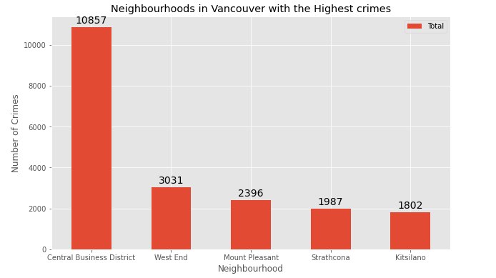
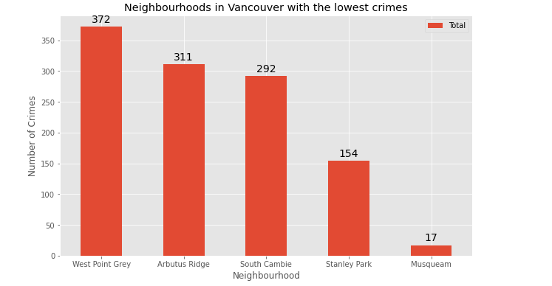

Slide 7
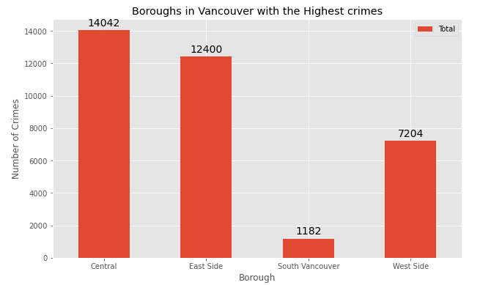
Based on exploratory data analysis it is clear that South Vancouver has the lowest crimes
Since South Vancouver has very little number of neighbourhoods and opening a commercial establishment would not be viable, we can choose the next borough with lowest crime which is West Side.
####Different types of crimes recorded in the West Side Borough
####West side was chosen because crime type Break and enter Commercial is also low amongst other crimes types which makes West Side ideal destination for opening of commercial establishments

Slide 8
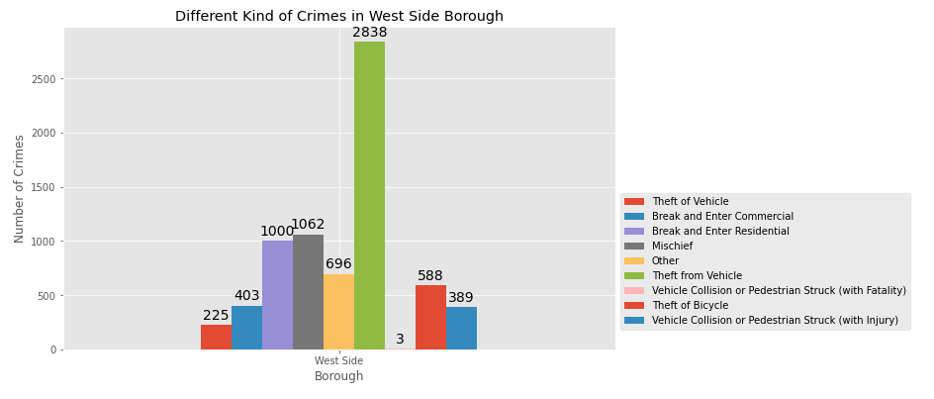

Slide 9
###Part 3: Creating a new consolidated dataset of the Neighborhoods, along with their boroughs, crime data and the respective Neighbourhood's co-ordinates.:
####This data will be fetched using OpenCage Geocoder to find the safest borough and explore the neighbourhood by plotting it on maps using Folium and perform exploratory data analysis.
#####Restricting the rows in the data frame to only those with West side as Borough

Slide 10
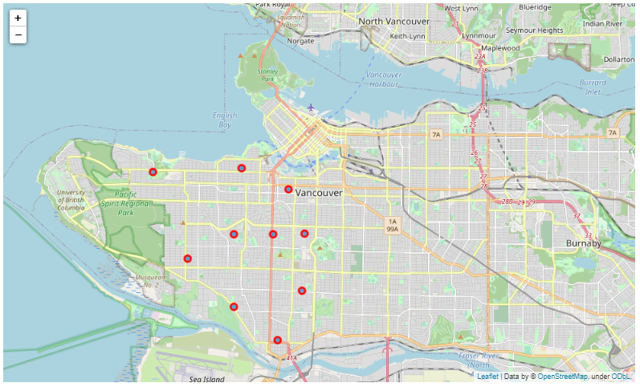
####Using Folium to plot Vancouver City's West Side Borough and it's Neighbourhoods

Slide 11
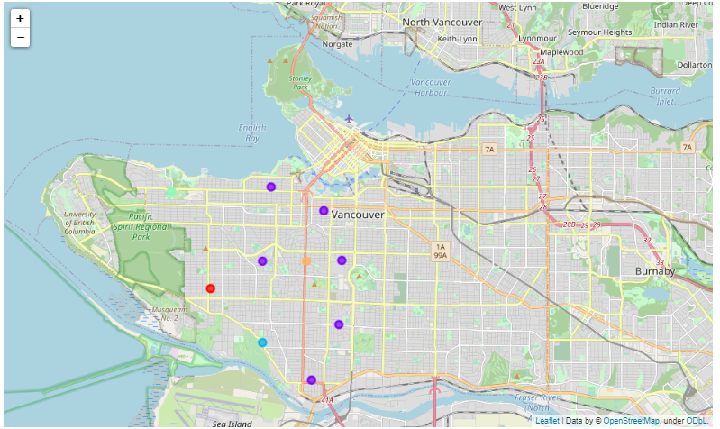
Cluster Neighbourhoods

Slide 12
Results and Discussion
The objective of the business problem was to help stakeholders identify one of the safest borough in Vancouver, and an appropriate neighbourhood within the borough to set up a commercial establishment especially a Grocery store. This has been achieved by first making use of Vancouver crime data to identify a safe borough with considerable number of neighbourhood for any business to be viable. After selecting the borough it was imperative to choose the right neighbourhood where grocery shops were not among venues in a close proximity to each other. We achieved this by grouping the neighbourhoods into clusters to assist the stakeholders by providing them with relevant data about venues and safety of a given neighbourhood.
Conclusion
We have explored the crime data to understand different types of crimes in all neighbourhoods of Vancouver and later categorized them into different boroughs, this helped us group the neighbourhoods into boroughs and choose the safest borough first. Once we confirmed the borough the number of neighbourhoods for consideration also comes down, we further shortlist the neighbourhoods based on the common venues, to choose a neighbourhood which best suits the business problem.

