Slide 1
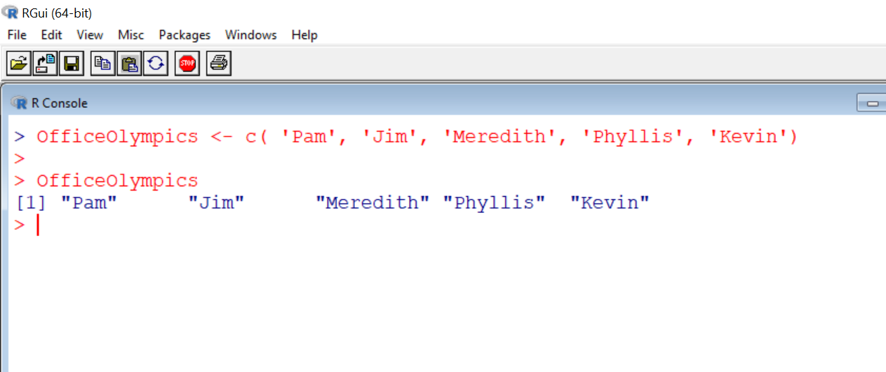
Groups of Objects: Vectors
It is often more convenient to save groups of object together. For instance, say we want to group the names of all the students in a class.
Note the syntax for a vector: c( Item1, Item2, … )

Slide 2
c(Item 1, Item 2, … ) stands for concatenate:
Concatenate: link things together in a chain or series.
Despite the terminology, the most important thing to note is that we have a means to create a new data structure: a vector.
A vector let’s us group related items together in one place.

Slide 3
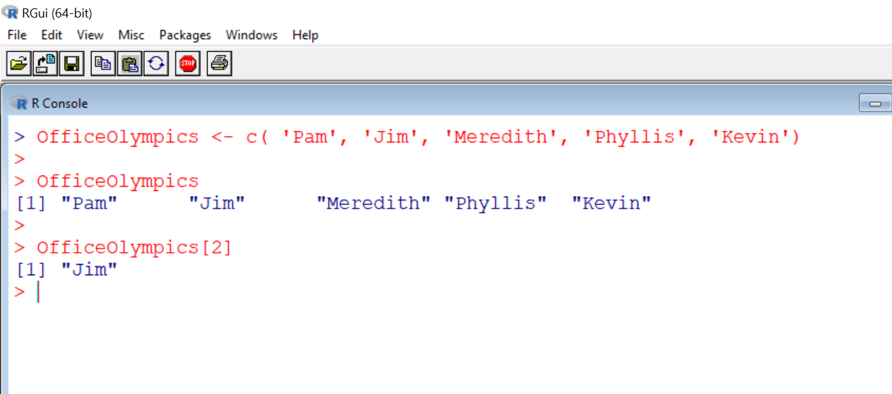
Items in a vector have a fixed position. We can isolate individual items by using indexing.
Jim is the second item in the vector.
We use VectorName[index #] to isolate the desired item.

Slide 4
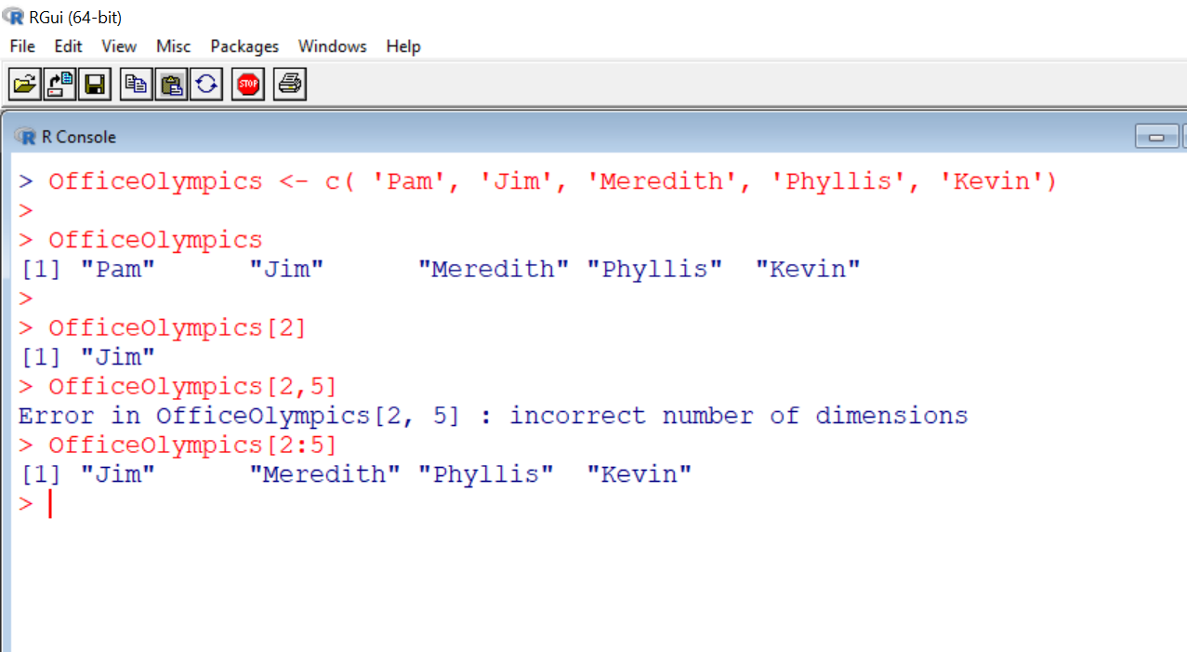
There are limits to the way indexing can be used.
Can’t call individual items in the vector.
Can call a range of individual items in the vector. (Use “:” .)

Slide 5
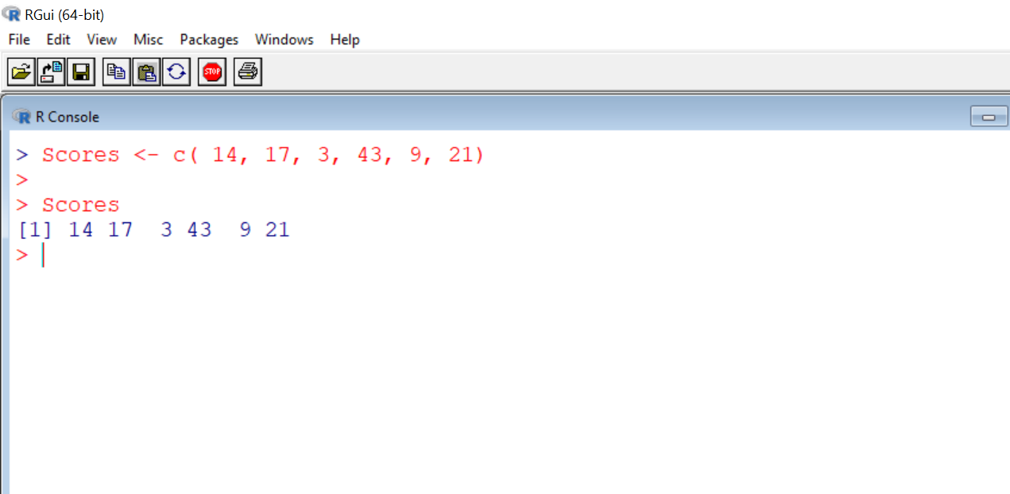
We can also create vectors of numeric values.
Why do you think you don’t want to use quotes?
We have more options for how use these vectors. We can now do math on these.

Slide 6
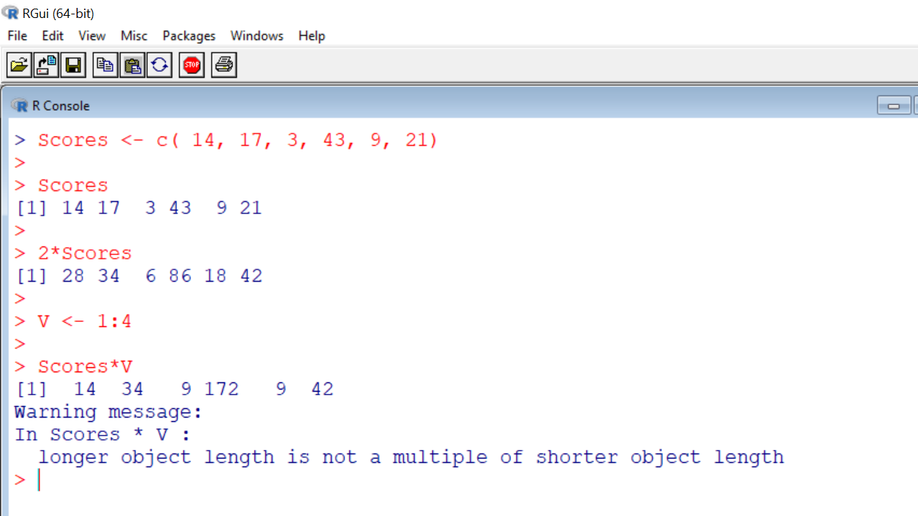
Scalar x Vector
Defining of new vector (note syntax)
Vector x Vector
Do we understand
the output?

Slide 7

We can also index numeric vectors.
What will be the answer here? Scores <- [ 14, 17, 3, 43, 9, 21]

Slide 8

To see where this came from:
( Scores[3:6] = 3, 43, 9, 21 ) x ( V = 1, 2, 3, 4 ) = 3, 86, 27, 84

Slide 9
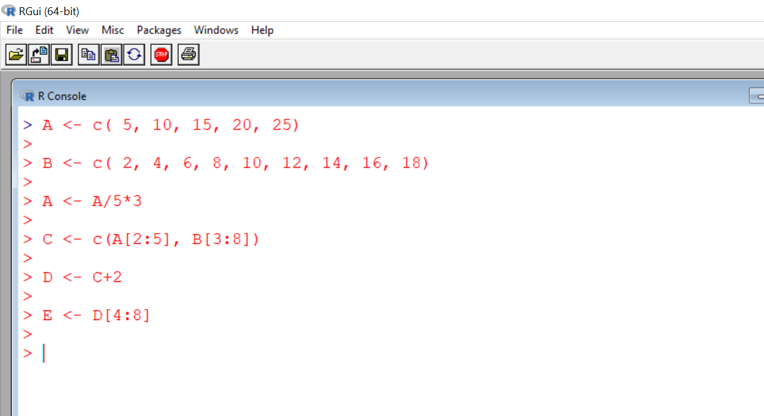
Practice with Vector Math and Indexing
What is E?

Slide 10
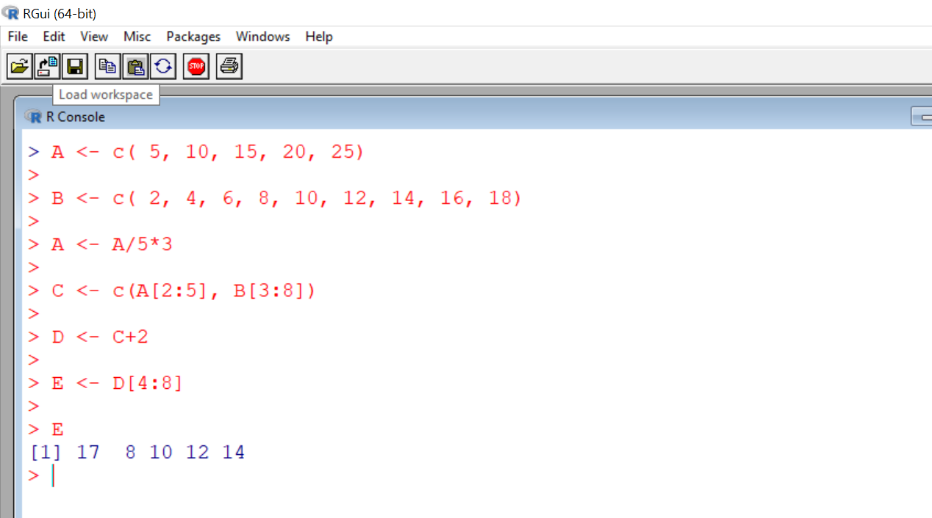
You can check intermediate steps by typing code into R.

Slide 11
Sequence of writing a program
Pseudo-code: Like an outline. Written on a sheet of paper or in a word processing program. It is not part of the program.
2. 1st section of Code/Comments
3. Debug
4. 2nd Section of Code/Comments
5. Debug
6. Repeat

Slide 12
Guidelines for Commenting
Provide basic information in header: who wrote program & program objective
There is no need to comment every line. Instead, comment major tasks or any unusual code whose meaning can’t be gleaned from its structure. You might have around a 5:1 ratio of lines of code to comments.
Minimize the need for comments by making code self-explanatory:
• Avoid multiple nested functions
• Use meaningful variable and function names (even if long)
• Keep code broken into chunks that only do one thing

Slide 13
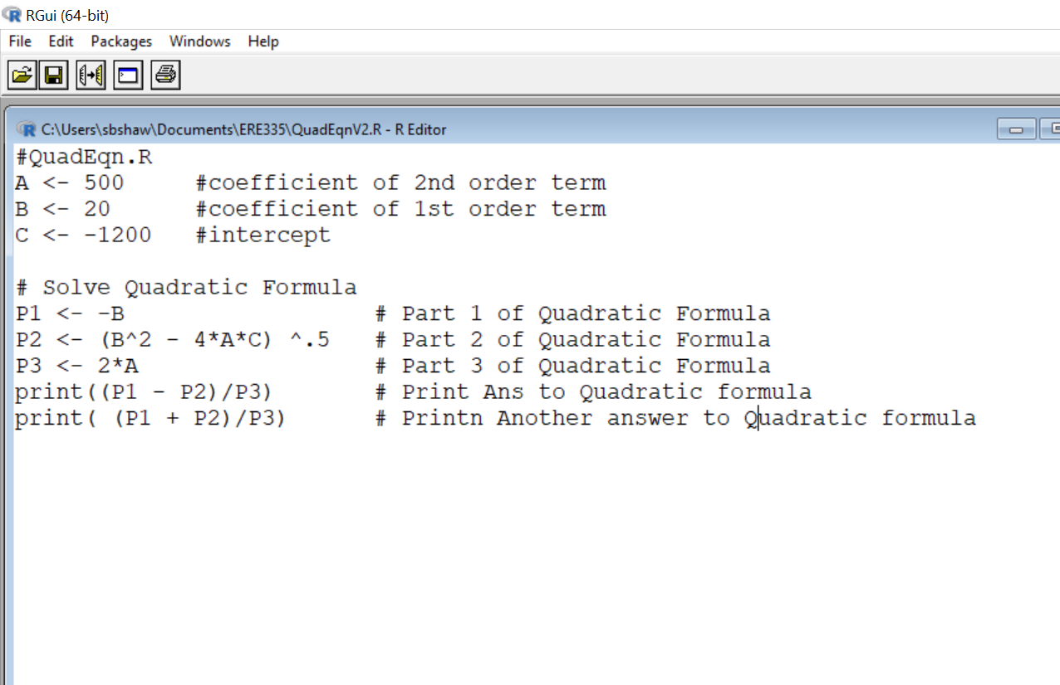

Slide 14
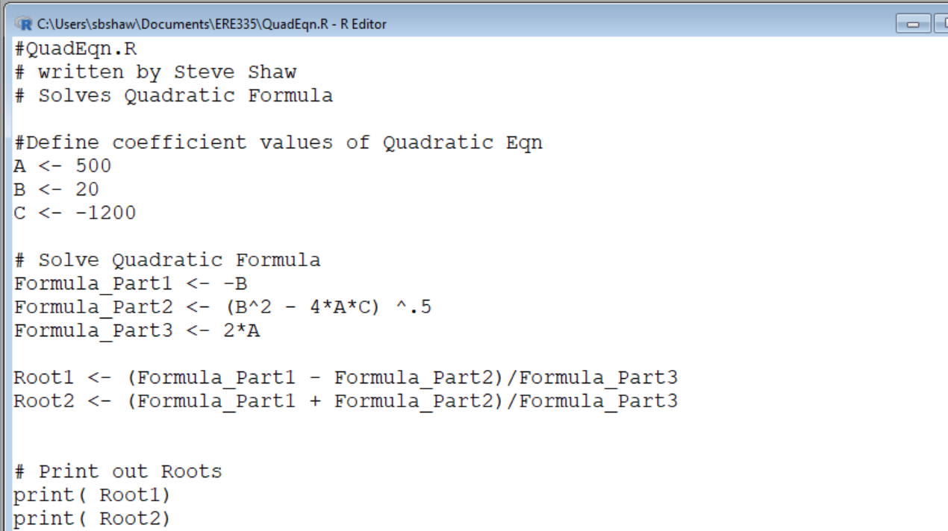

Slide 15
Debugging
Two Categories of Errors:
Errors indicated by R (usually due to syntax)
Errors not indicated by R (usually due to structure & logic)
Which is more difficult to deal with?
How do we deal with each?

Slide 16
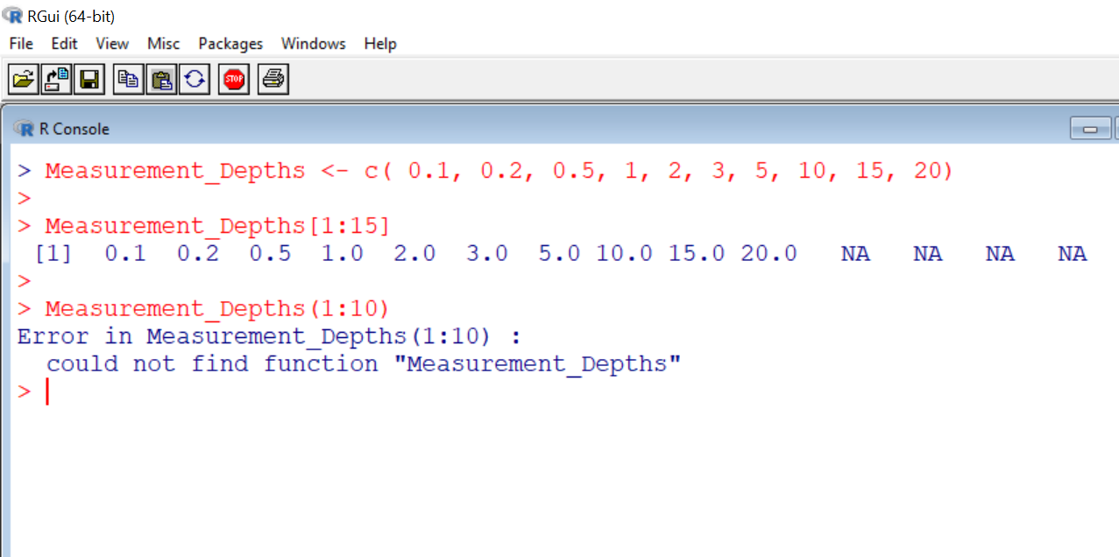
Examples of Errors
Here, R partially accommodates error.
Here, we receive error. But does it tell us exactly what we did wrong?

Slide 17

What did we do wrong? Identify the error.

Slide 18
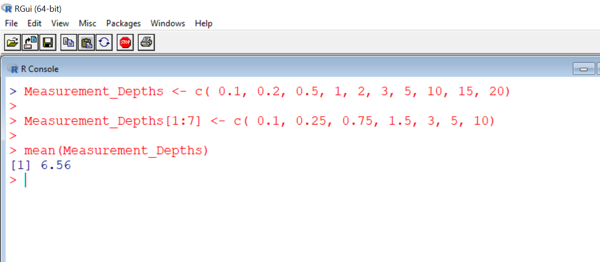
Examples of Errors
Scenario: You want to calculate the mean measurement depth of lake water samples you have taken. You initially type in a set of measurement depths and then update them with a new set of measurement depths.
There is no error. But, did it do what we intended?

Slide 19
The prior example is somewhat trivial – it’s based on a pretty blatant mistake in the coding.
However, the main lesson is that it can be easy to introduce errors into the code that are not syntax errors and that are not reported.
Thus, a critical part of debugging is to test your code using inputs that lead to known outcomes. One should test all possible paths through the code.
In the following flow chart, how has the code been constructed to avoid any undefined outcomes?
http://bigbangtheory.wikia.com/wiki/The_Friendship_Algorithm

Slide 20
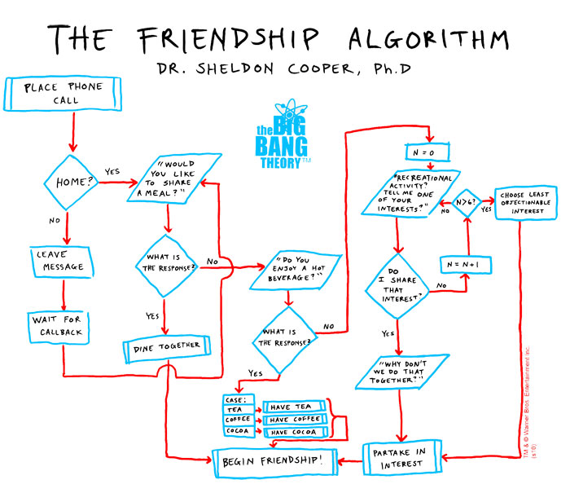
Exception Handling

Slide 21
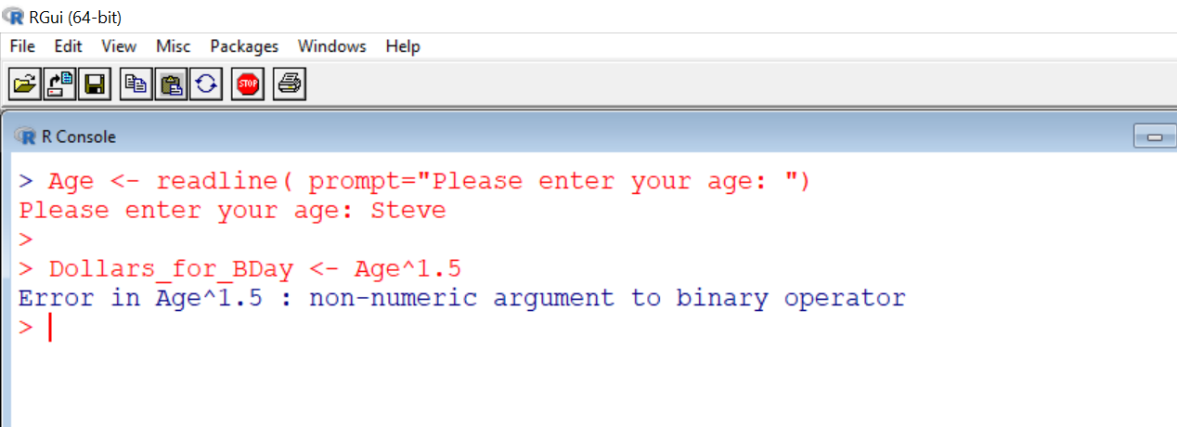
A related element of Debugging is Exception Handling.
An “Exception” is an unusual or unexpected input or occurrence in the computer code. Well-constructed code will include exception handling.
What exception was not handled well?

Slide 22
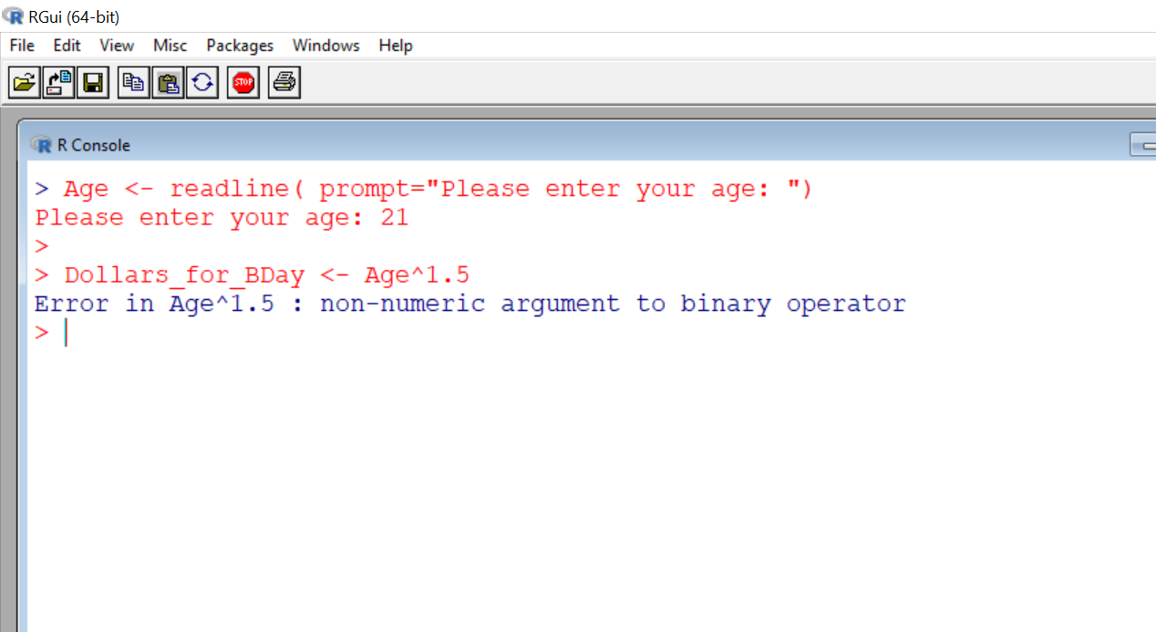
But, now we do this seemingly right, but we still get an error. Why?

Slide 23
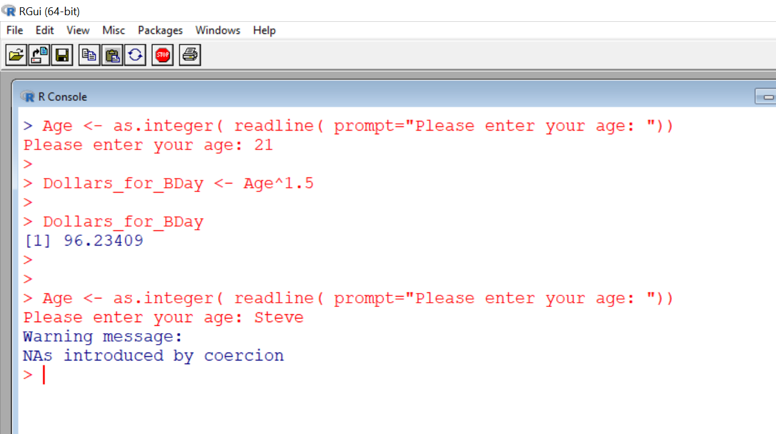
Readline reads in a character data type. Need to convert to an integer.
If one tries to enter a non-integer, R has built-in exception handling. It converts Age to an NA (not a number).

Slide 24
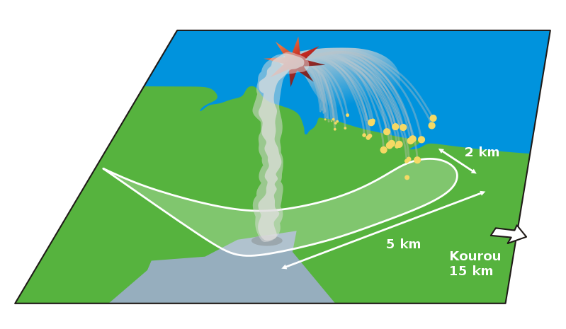
Ariane 5 Rocket Failure: June 4, 1996
Conversion of a 64-bit floating point to a 16-bit integer value led to an overflow (value was outside range that could be supported by given number of bits). Software exception handling was designed to shut-down all computations if there were any arithmetic errors. This led to the inadvertent shut-down of the navigational computers.
European Space Agency Launch Site: Guiana Space Center
$300M satellite lost in launch
Fragment fallout of failed launch.

Slide 25
Assignment 3 (Due Wed., Sept. 19)
Objectives:
1. Write a short script that converts a known 8-bit sequence (a byte) into a base-10 value. Show your code works for the byte: 1 1 1 0 0 1 1 1
Have the script print out the byte as well as the base-10 value.
2. Write a short script that converts a known 16-bit sequence into a hexadecimal value. Show your code for the sequence: 1 1 1 0 0 1 1 1 0 1 0 1 0 0 1 1 .
You’ll need to use a built-in function to help make your binary to hexadecimal conversion. To convert from a base-10 digit to hexadecimal, you can use as.hexmode. For instance, as.hexmode(15) results in “f”. Note, you will also need to use some indexing of vector values.

