Slide 1
Class Nuts & Bolts
• Grade out of 1000 points: Tests are 400 points, Assignments are 500 points, Final Project is 100 points.
• Friday class time is a recitation intended to provide help from TA’s and an opportunity for group work
• Will need to demonstrate functioning program to TA’s; would usually do this on Friday
• No book; lots of helpful content on-line
• 2 weeks after Thanksgiving will mainly be spent developing and presenting final project

Slide 2
Class Learning Goals
• Fluency with the basics of programming (variables, arrays, if/then, functions, loops, input/output)
• Basic familiarity with numerical methods ( 2 weeks taught by Dr. Morin in November)
• Ability to independently conceive and develop a computer program (Final Project)
• Become a self-learning programmer (using trial-and-error and on-line resources)

Slide 3
Programming requires thinking differently than you may be used to…
Computational Thinking (aka sequenced problem solving)
Process of trial-and-error in which you can test whether your thinking is correct

Slide 4
Computational Thinking
Example 1
Take 3 minutes: Add up all numbers from 1 to 200.
What is your approach? Is there a computational short-cut?
https://code.org/curriculum/course3/1/Teacher

Slide 5
Standard approach:
1 + 2 +3 +4 + 5 +… + 199 + 200
Alternate Approach 1:
Note that 1+2+3+4+5+6+7+8+9 = 45
Then, break into parts: 45 + (10*10 +45) + (10*20 +45) + (10*30 +45) + … + (10 *190 +45) =
Alternate Approach 2:
1 + 200 = 201
2 + 199 = 201
3 + 198 = 201
…

Slide 6
Elements of Computational Thinking
Abstraction (Identifying universalities across problems)
Pattern Matching (finding similarities)
Algorithm (Creating specific sequence of steps that lead to a solution)
Decomposition (Breaking down into smaller parts)

Slide 7
Standard approach:
1 + 2 +3 +4 + 5 +… + 199 + 200
Algorithm
Alternate Approach 1:
Note that 1+2+3+4+5+6+7+8+9 = 45
Algorithm
Decomposition
Pattern Matching
Then, break into parts: 45 + (10*10 +45) + (10*20 +45) + (10*30 +45) + … + (10 *190 +45) +200 =
Regroup: 45*20 + 10*(10 +20 +30+40+…+190) + 200 = 900 + 19,000 + 200 = 20,100
Alternate Approach 2:
1 + 200 = 201
2 + 199 = 201
3 + 198 = 201
Algorithm
Decomposition
Pattern Matching
Regroup: 100 * 201 = 20,100

Slide 8
Abstraction (Identifying universalities across problems)
Example 2:
Sum all numbers from 1 to 2000.

Slide 9
Example 3 Create instructions for brushing your teeth.

Slide 10
Example 3 Create instructions for brushing your teeth.
Algorithm
(set of instructions)
Wet brush.
Apply paste.
Brush front, top teeth. Apply up-and-down motion, including along gum line. Brush for 30 secs.
Repeat but for back, top teeth.
Repeat but for front, bottom teeth.
Repeat but for back, bottom teeth.
7. Rinse mouth.
8. Rinse brush.
Decomposition
(break into indiv. steps)
Pattern Matching
(What other types of problems could this be adapted to? What are most important features?)
Abstraction

Slide 11
Example 4
You can work in groups of 2. On the 3 by 3 grid, develop a line pattern. Create a set of instructions that will allow another group to recreate your line pattern.
Example Pattern:
You will have two sheets. Don’t show your drawn design to the team following the instructions.

Slide 12
Some Comments on the Exercise
• Instructions are a first example of writing pseudo-code. Pseudo-code outlines the logic and sequence of the program but does so in a way independent of any specific programming language. You’ll begin every project writing pseudo-code and quiz questions will in part be based on interpreting pseudo-code.
• The other team trying to follow your instructions is kind of like a computer trying to interpret your code. You have tangible evidence whether the code worked or not. Much of programming involves messing something up the first time around and then revising and eventually getting correct.

Slide 13
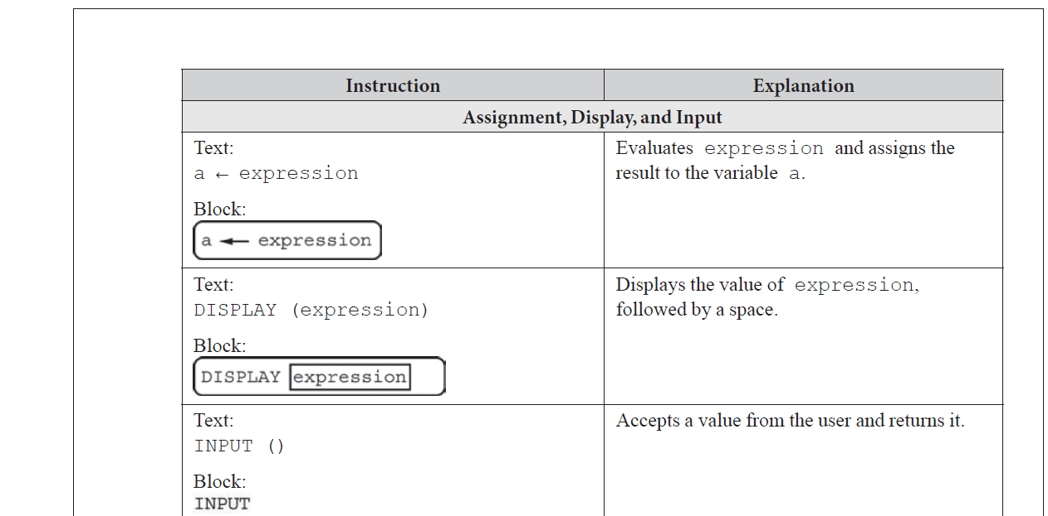
Generic code expressions from AP Computer Science

Slide 14
Examples 5 & 6
We will have several standard problem set-ups we will revisit over the course of the semester (and on exams) to apply different concepts to.
One of these problems is assigning commands to a rover.

Slide 15
Rover Problems:
You can send the rover two commands:
Forward – moves forward one space
RotateR – rotates right without moving forward
start
finish
Example 5: What sequence of the commands would you use to move the rover from the start to the finish?

Slide 16
Ans: Forward, Forward, Rotate, Forward, Rotate, Rotate, Rotate, Forward, Forward, Forward
F
F
R
start
F
R
R
F
F
F
R
finish

Slide 17
Example 6: What sequence of the commands would you use to move the rover from the start to the finish? Say now we add a third command: sample. With sample, the rover stops and drills into the ground to take a soil sample.
Take a sample in each grid with a flag.
start
finish

Slide 18
Ans: Forward, Rotate, Forward, Forward, Sample, Rotate, Rotate, Forward, Rotate, Forward, Forward, Sample, Forward
F
R
start
F
F
F
R
F
finish
F
F
R
R

Slide 19
Do we use many of our computational thinking concepts in Examples 5 & 6?

Slide 20
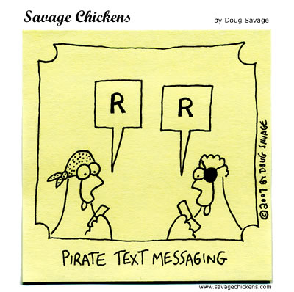

Slide 21
Why R?
• Somewhat eclectic computing language that includes elements of other languages (C, Matlab, Unix)
• Has same fundamental elements of any programming language (we will emphasize universalities in programming, not features unique to a given language)
• Open Source: free with extensive support available on internet

Slide 22
R Background
• grew out of a language called S that was developed at Bell Labs* in 1970’s
• R is known as being a language for doing data science; sometimes referred to as a statistical computing language

Slide 23
*Brief History of Bell Labs
• It was at its peak during AT&T’s monopoly of the telephone industry from the 1940’s to the early 1980’s
• Had a role in nearly all computing and telecommunication technologies of the 20th century (e.g. transistors, integrated circuits, cellular phone, satellite communication)
• Bell Labs developed S language (predecessor to R) as well as C ( predecessor to C++) as well as Unix (language used on servers and mainframes)

Slide 24
Getting Started in R
Two Options for Using R:
Use R on lab computers.
Install R on your own computer. https://www.r-project.org/ (or Google “Install R”)

Slide 25
Two Ways to Interact with R:
Basic R Interface
R Studio
All commands and syntax is exactly the same. R Studio simply provides some shortcuts for running code and debugging as well as more easily allows you to keep track of variables and output.

Slide 26
5 Simple Items to Try:
Typing commands at the command line
Getting help at the command line
Using the “print” command
Creating and calling a script (i.e. running a program)
Identifying your working directory

Slide 27
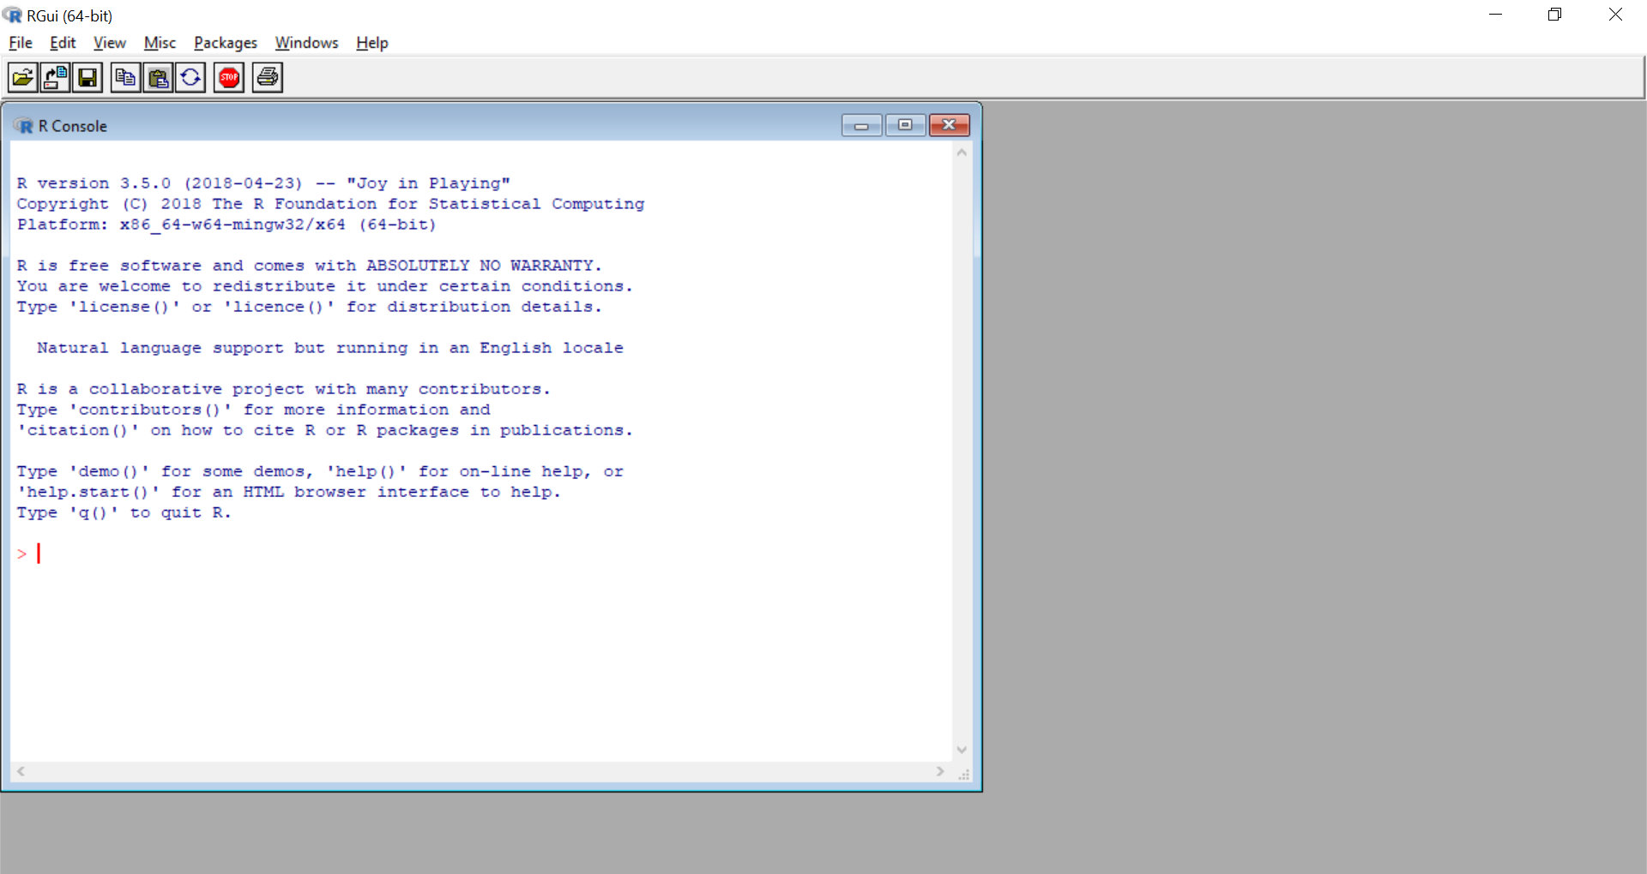
Getting Started in R
Command Line

Slide 28
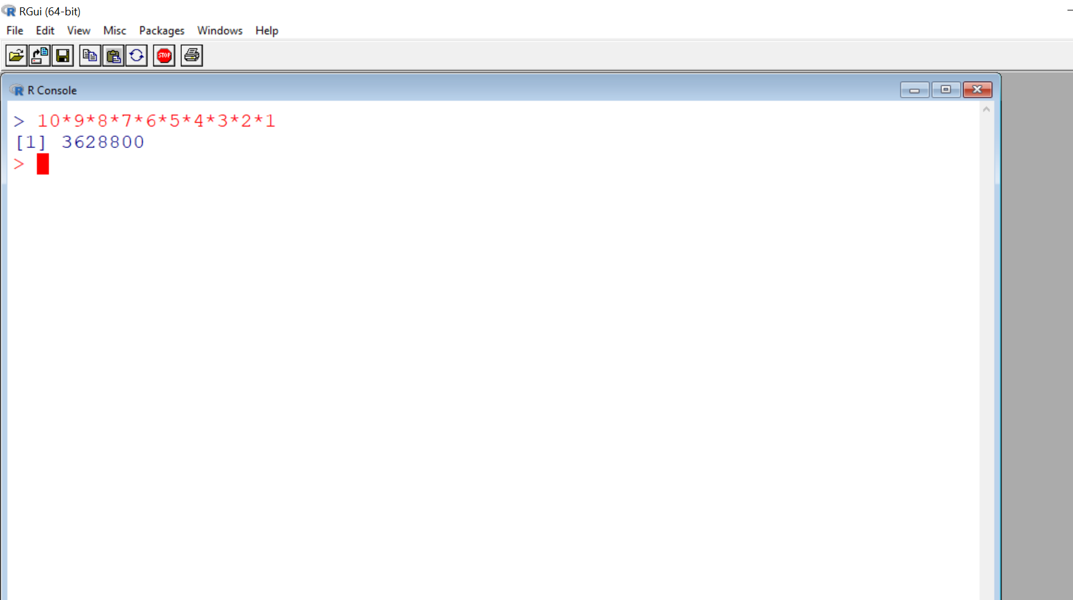
Can use command line as a calculator.

Slide 29
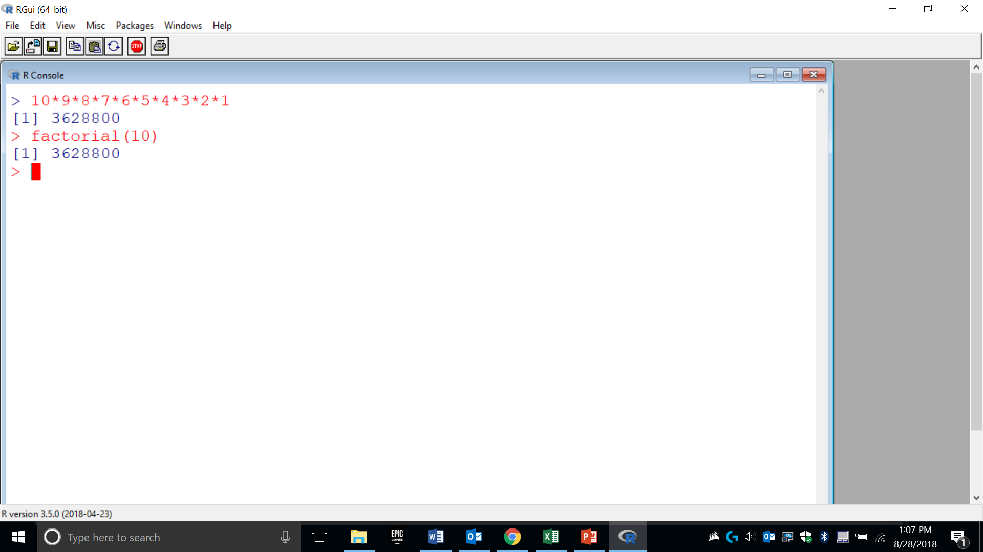
R has whole assortment of built-in functions. For instance, see use of factorial.

Slide 30
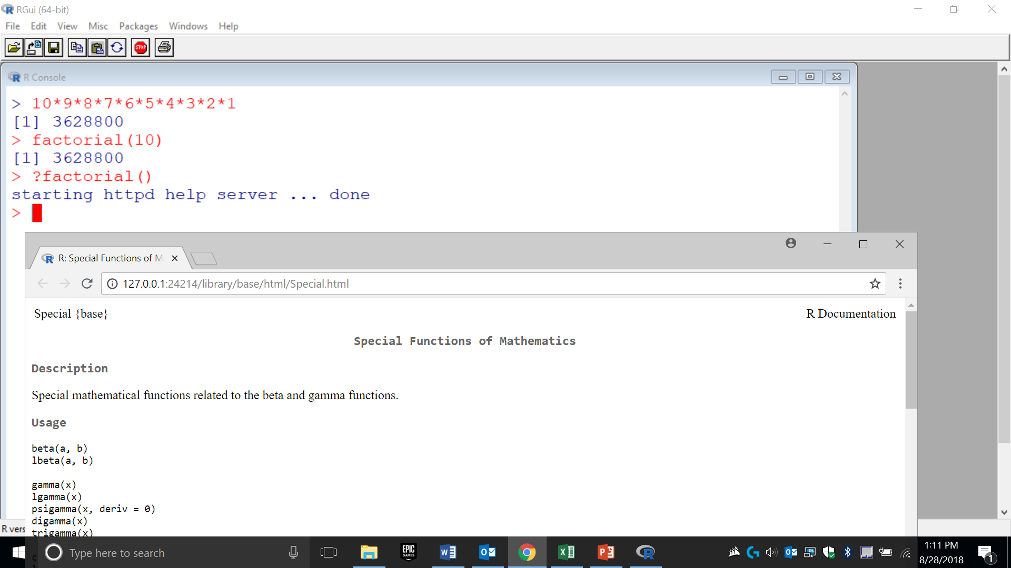
Typing “?” before function name open web link with reference info.

Slide 31
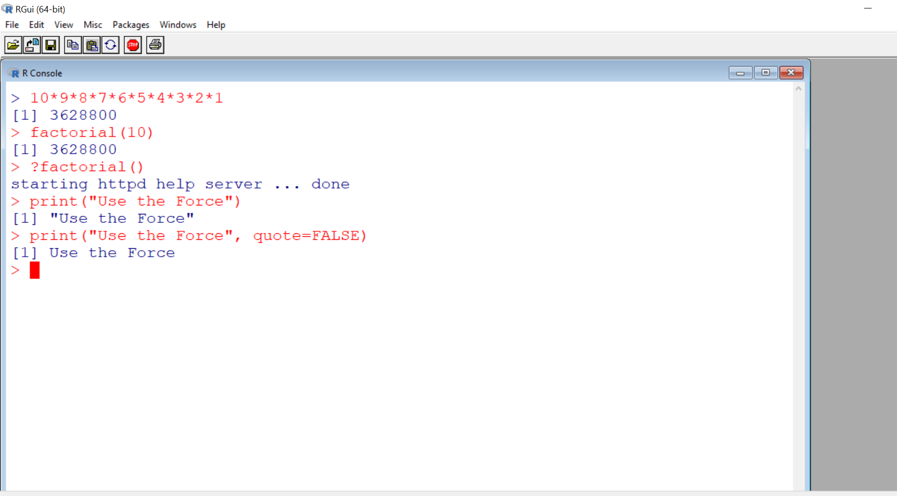
Using the “print” function; outputs text to user window.

Slide 32
While useful for small snippets of code, why wouldn’t we want to type a whole program at the command line?

Slide 33
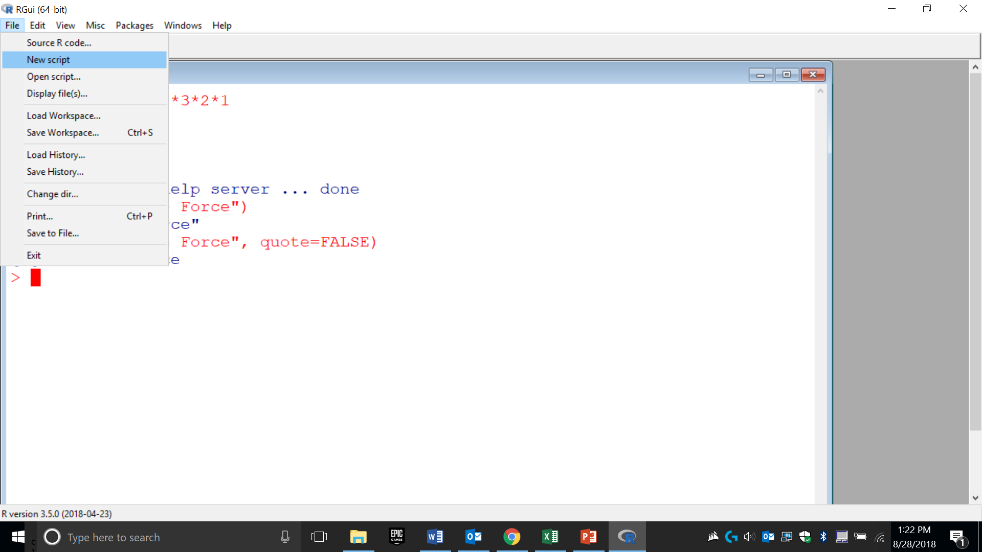
Create a “script” or program.

Slide 34
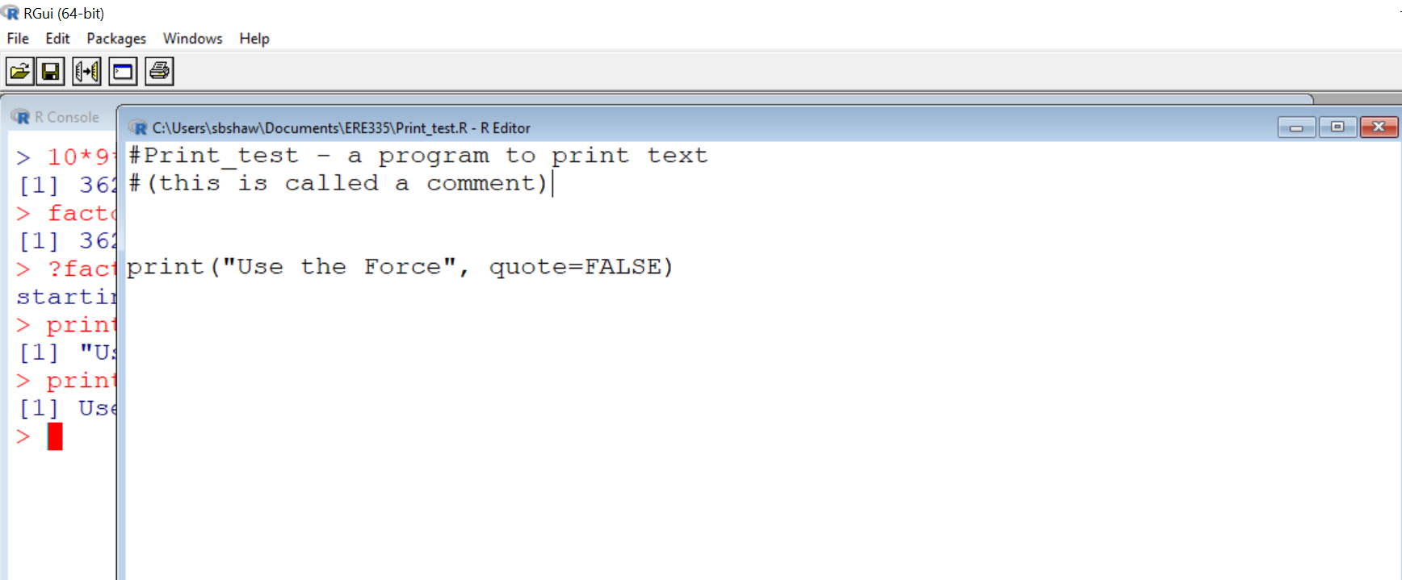
I named the script. This indicates the “file path” with the name.
A comment explains how the code is working.

Slide 35
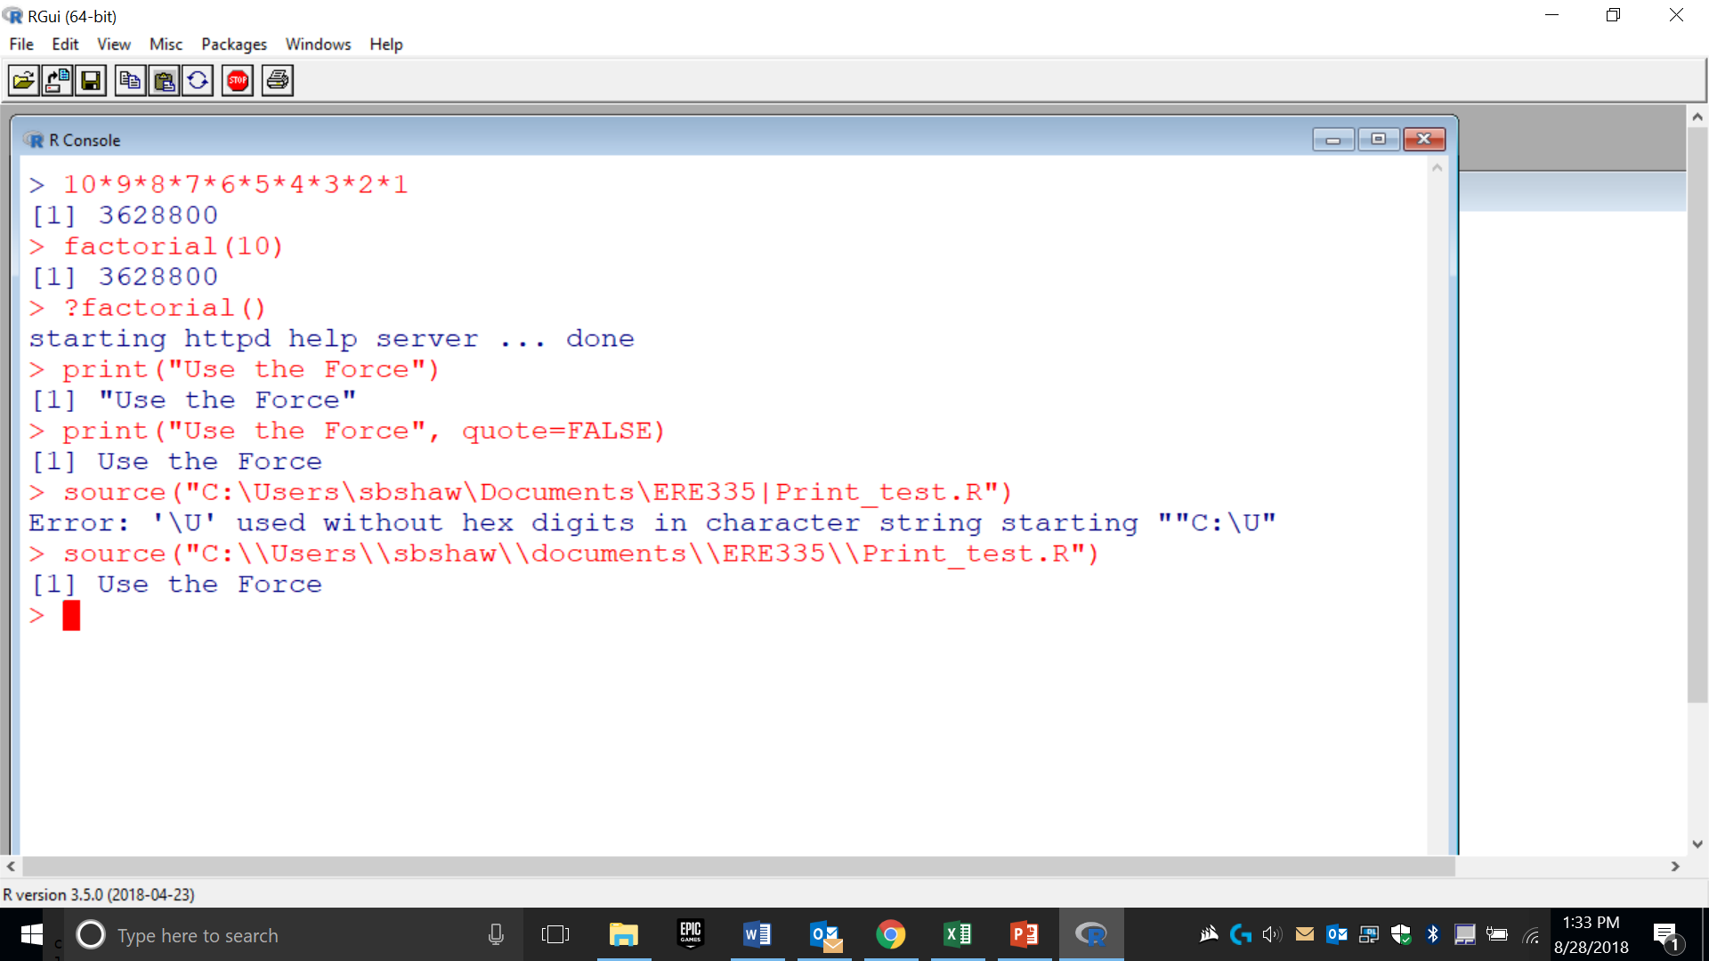
Calling the script from the command line using “source”.

Slide 36
Review :
What is the benefit of using the command line?
How do you get help for a function at the command line?
Why didn’t this use of “print” work properly?:
print( Ewoks rarely bathe, quote=TRUE )
4. How do you create a script?
5. What is the working directory?

Slide 37
Assignment 1 (see full text on Blackboard)
Objectives:
1. Test out print at the command line.
2. Write an R script that creates a picture using letters and symbols on the keyboard. In the comments of the R script, indicate where you completed this assignment: on your own personal computer or on a lab computer.
To receive credit for the assignment, you need to: 1) hand in a copy of your R script and 2) a copy of the output of your script (use a screenshot). You must hand this in by noon on Friday, Aug 30 (so we can make sure everyone has access to a working version of R).

