Slide 1
Self-learning in R:
Quick R by Datacamp: https://www.statmethods.net/r-tutorial/index.html
Swirls: downloaded as package into R
R for Data Science by Grolemund and Wickham: http://r4ds.had.co.nz/
Complementary to what we are doing in class but not identical. These have a stronger data science focus.

Slide 2
Variables
Using variables:
• Minimizes errors
• Makes the code more generalizable
• Allows automation of data processing
• Makes the code easier to update and revise
Assigning and using variables is a central aspect of computer programming

Slide 3
Example 1:
A = 1
B = 2
C = 3
D = A + C
C = 2*A*B^2
C + D = ?

Slide 4
Example 1:
A = 1
B = 2
C = 3
D = A + C = 1 + 3 = 4
C = 2*A*B^2 = 2*1*2^2 = 2*4 = 8
C + D = 8 + 4 = 12

Slide 5
Example 2: Write pseudo-code to calculate the number of heads, shoulders, knees, and toes for a party that may have between 2 and 200 people?

Slide 6
Example 3: Write pseudo-code to calculate the number of heads, shoulders, knees, and toes for a party that may have between 2 and 200 people?
Ans. Say there are 100 people
People = 100
Heads = People
Knees = People *2
Shoulders = Knees
Toes = People *10

Slide 7
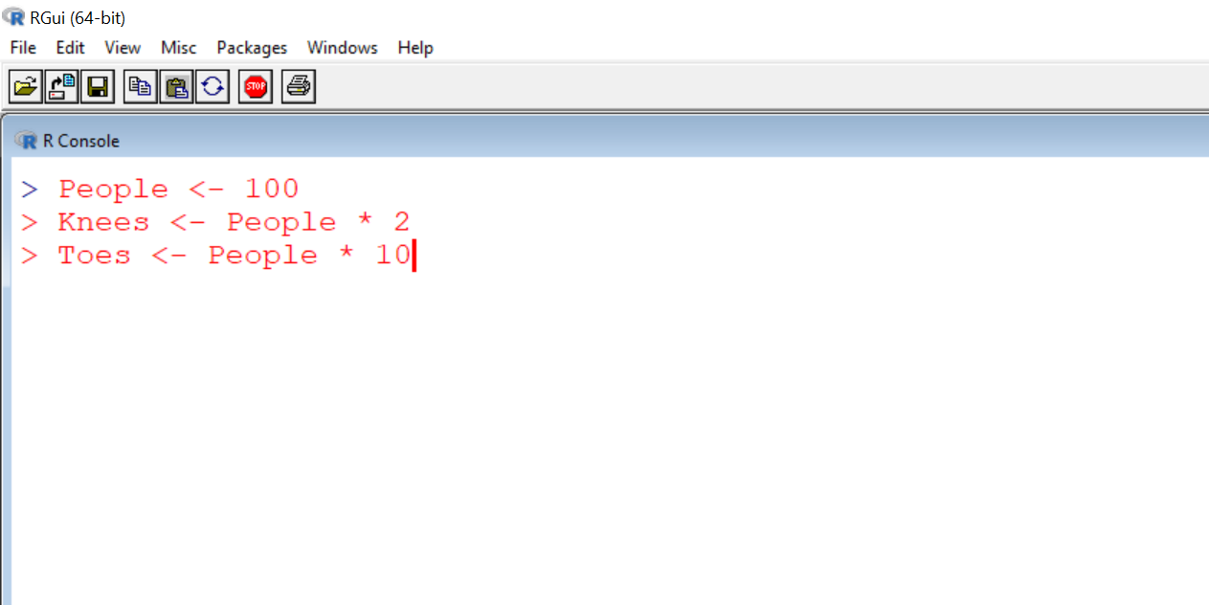
Assigning Variables (i.e. Objects) in R
In R, variable assignment is made using “arrow” notation.
But, where is value of the variable?

Slide 8
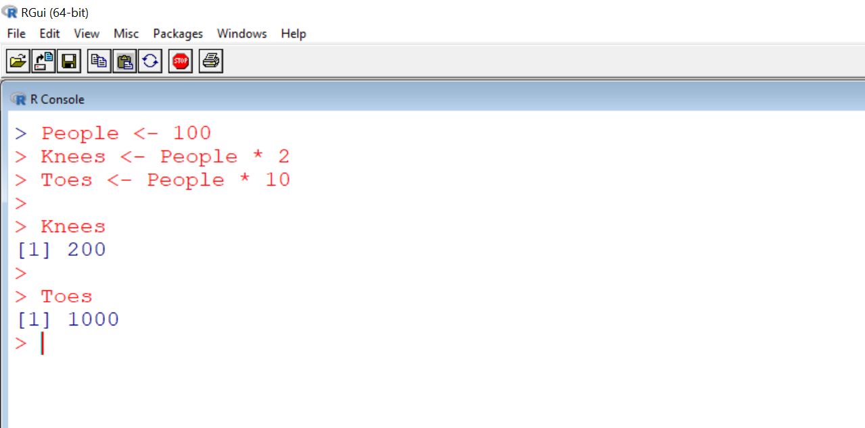
Assigning Variables in R
Variable value is being stored within R. It can be seem by typing the name of the variable.
In R, variable assignment is made using “arrow” notation.

Slide 9
Example 3: Find the roots of the following equations
2x² + 50x +0.3 = 0
-4x² + 0.2x + 99 = 0
500x² + 20x - 1200 = 0

Slide 10
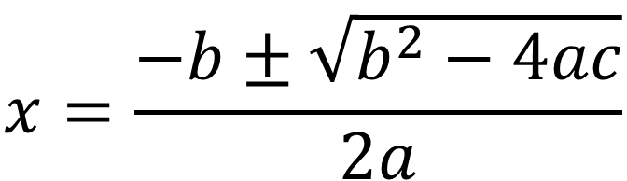
Example 3: Find the roots of the following equations
$$x=\frac{−b±\sqrt{b^{2}−4ac}}{2a}$$
Would take some time to do this by hand with a calculator.
Can we write a script?

Slide 11
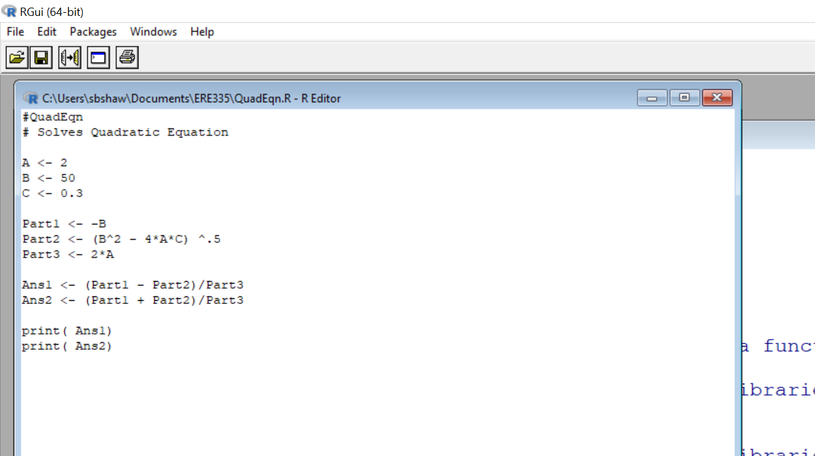
Assigning variables to quadratic formula
Solving parts of quadratic formula
Finding first and second root
Printing Roots
Note use of eight different variables to make writing and understanding of this solution easier.

Slide 12
Variables Don’t Have to be Numbers.
There are multiple data types. (In R and in other computer languages.)
Standard data types you will see are:
1. Numeric
2. Character
3. Logic

Slide 13
1. Numeric: 10 or -5 or 999.87
(subcategories: integer & double)
2. Logic (or Boolean): TRUE or FALSE
3. Character (or string): “A” or “meat” or “123”

Slide 14
What is a “double” numeric value?
Double refers to the degree of precision (the number of significant digits in a number). More broadly referred to as “double precision floating point”.
A double is a 64-bit value. 53 bits are used to determine the number of significant digits (around 16 digits). We’ll talk more about ‘bits’ next week.
R automatically converts between integer and double as needed, so it is unlikely you will ever have to explicitly define.

Slide 15
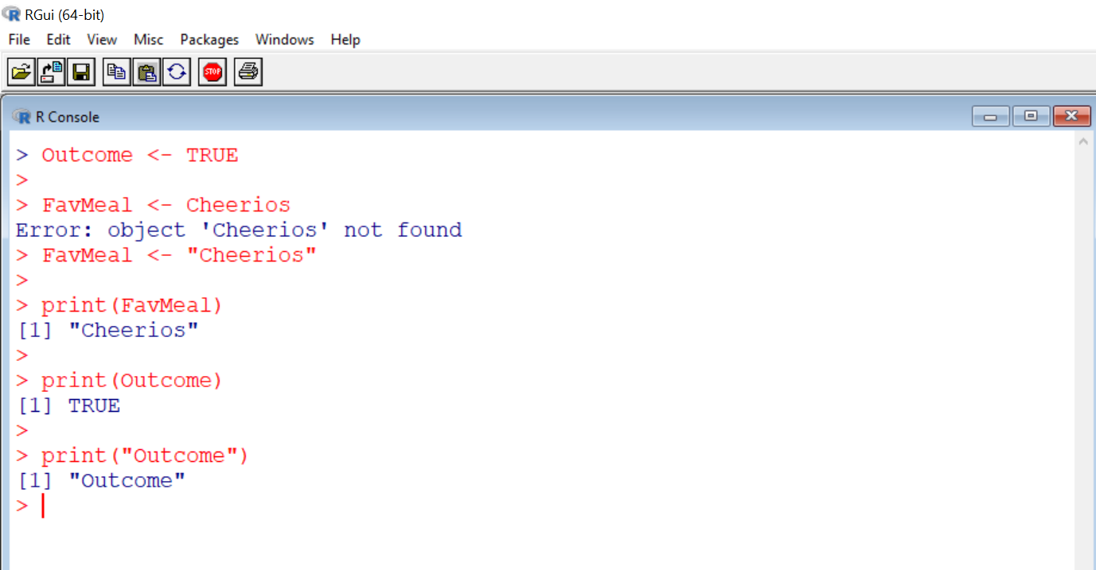
Define LOGIC variable
Define CHARACTER variable
Print CHARACTER variable
Print LOGIC variable
Print the word “Outcome” (not the variable)

Slide 16
2nd Assignment
Objectives:
1. First, start by testing out paste and readline at the command line.
2. Before starting to code, develop pseudocode that lays out the sequence and logic of the code. Remember, the intent of this exercise is to practice using variables, and the pseudo-code should indicate how variables come into play in this program.
3. Write an R script that requests from the user specified words of a given part of speech and that then outputs the completed text with the words filled in.
To receive credit for the assignment, you need to: 1) hand in a typed version of your pseudo-code, 2) hand in a copy of your R script, and 3) show a TA a working version of your code. When you hand in your pseudocode and script, be sure to indicate anyone you may have worked with on your code.

Slide 17
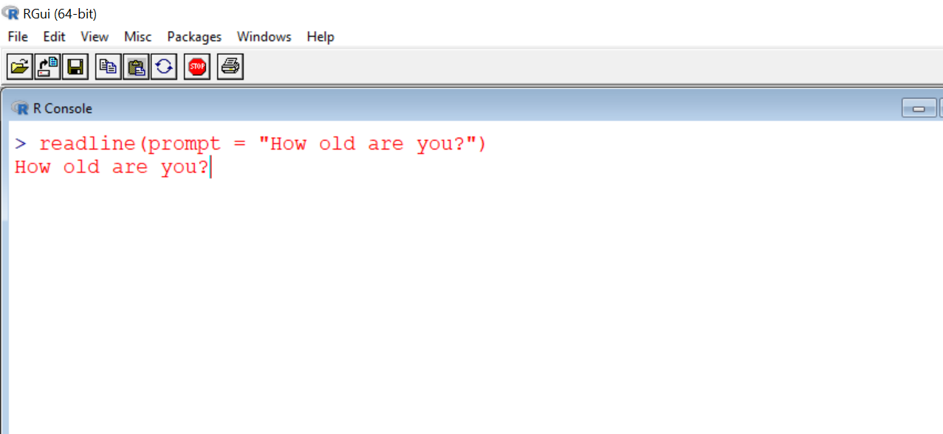
readline(prompt = “ “ ) : function to allow user to input data into script
Note syntax
Output to user

Slide 18
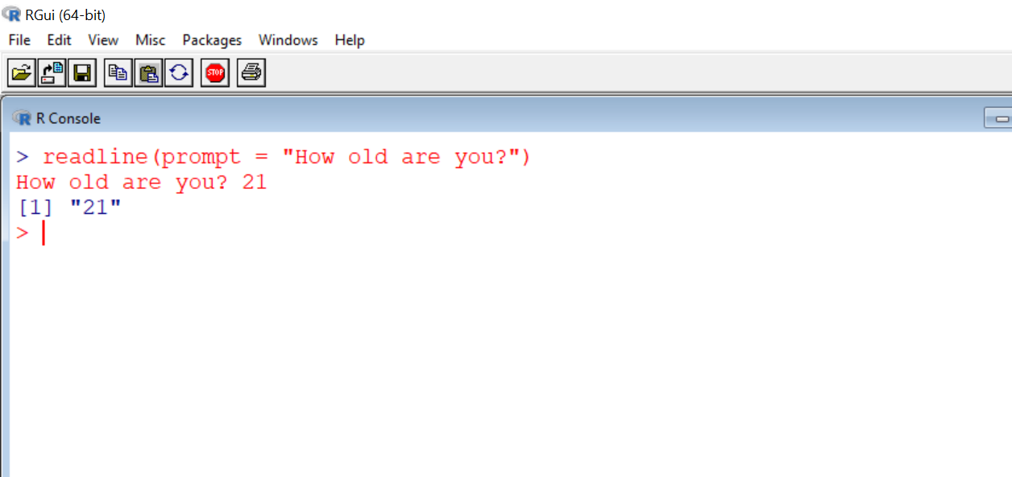
readline(prompt = “ “ ) : function to allow user to input data into script
Input by user
But where does this user entered value go?

Slide 19
The value is not stored anywhere. It just disappears.
Is there something we can do to store the value input by the user?

Slide 20
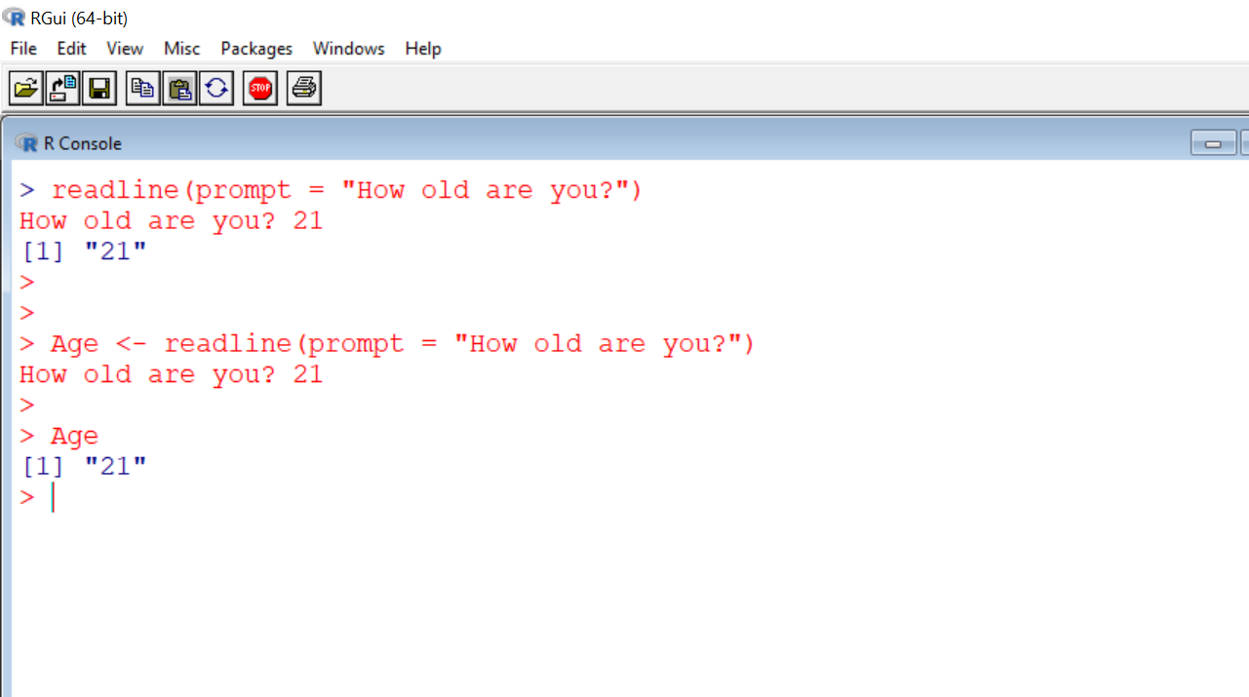
Assigns user input to a variable.
The variable age now has the value of 21.

Slide 21
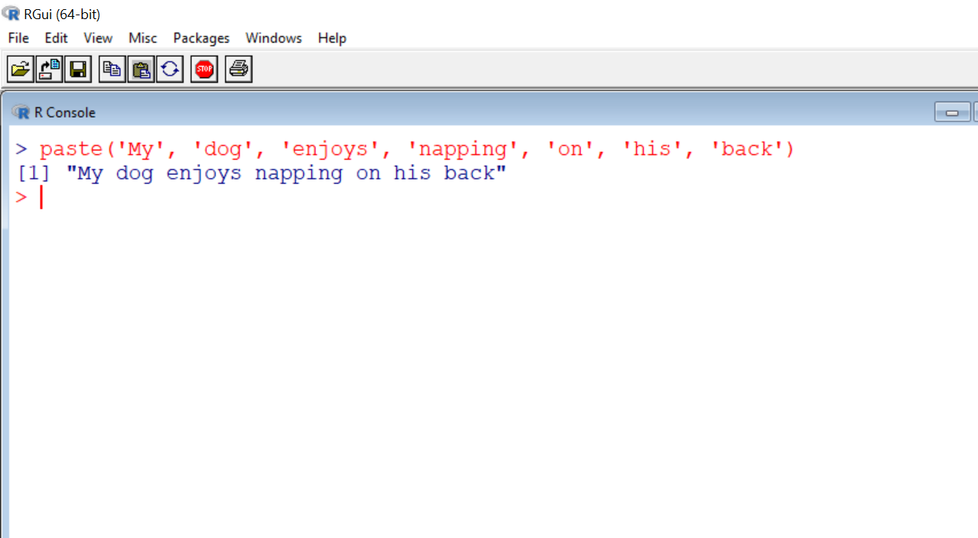
paste() : function to combine text, including multiple variables

Slide 22
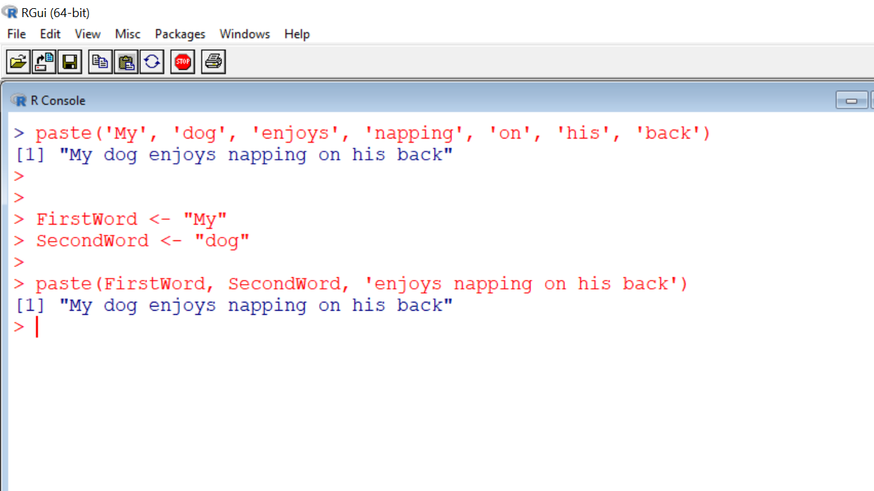

Slide 23
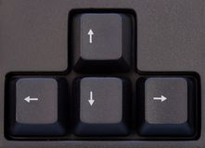
Some R shortcuts:
Use “up” & “ down” arrow keys to toggle between prior commands typed at command line.
Use “~/path/filename” to abbreviate full path.
Say, source(“C://Users//sbshaw//Documents//ERE335//TestFig.R”)
if the working directory is : C://Users//sbshaw//Documents
then, source(~//ERE335//TestFig.R”) is equivalent. Use getwd() to find directory.

Slide 24
Guideline for Pseudo-code
Presents structure and flow of the program in natural language.
It includes a line for every major command given within the code.
3. Does not use the exact syntax of the language you are coding in.
Main idea: it should be easily understood by someone trying to make sense of your program.

Slide 25
Pseudo-Code: Quadratic Formula Solver
Assign numeric value to A
Assign numeric value to B
Assign numeric value to C
Calculate Part I of Quad Formula: -B
Calculate Part II of Quad Formula: sqrt(B² – 4AC)
Calculate Part III of Quad Formula: 2A
Calculate 1st Root using Part I, Part II, and Part III
Calculate 2nd Root using Part I, Part II, and Part III
Print Root 1
Print Root 2
We’ll look at more graphical approach in a few weeks as we learn about more programming structures.

Slide 26
Assignment Reminders
Put name on top of paper. (You can also repeat in script comments if you want).
Clearly indicate who you worked with. Also indicate this at the top of the paper.
You can cut-and-paste code into Word doc. You don’t need to show screen shot of code.
Hardcopy of pseudo-code and code due Wednesdays. Can show TA working code at next lab.

Slide 27
MadLib Text
SUNY ESF has some of the [superlative] [plural noun 1] in the country. The [plural noun 1] are known for their [ adjective 1] [noun 2]. The [adjective 1] [ noun 2] was refined by thousands of [unit of time] of tireless [noun 3]. However, if the [plural noun 1] had done less [noun 3], they SUNY ESF may have a better [noun 4] club.

